Slide 1
Persistent Homology Filtration
Result:
Each Tree Represented as Persist. Diag.
“Coordinate Free Rep’n” (Edelsbrunner)
I.e. Persistence Diag.s are Data Objects

Slide 2
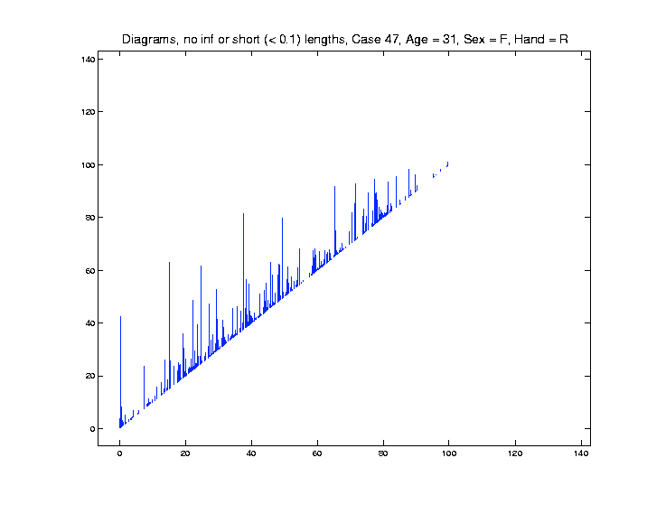
Raw Data Persistence Diagrams

Slide 3
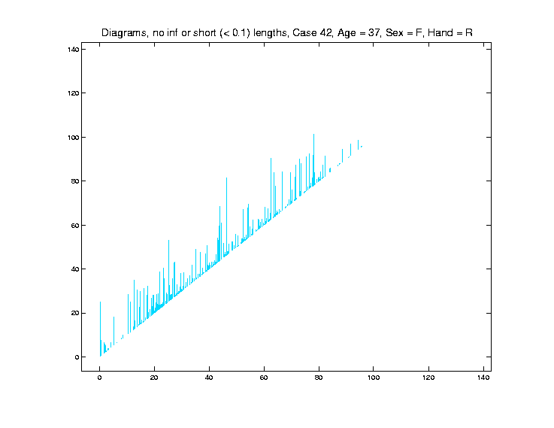
Raw Data Persistence Diagrams

Slide 4
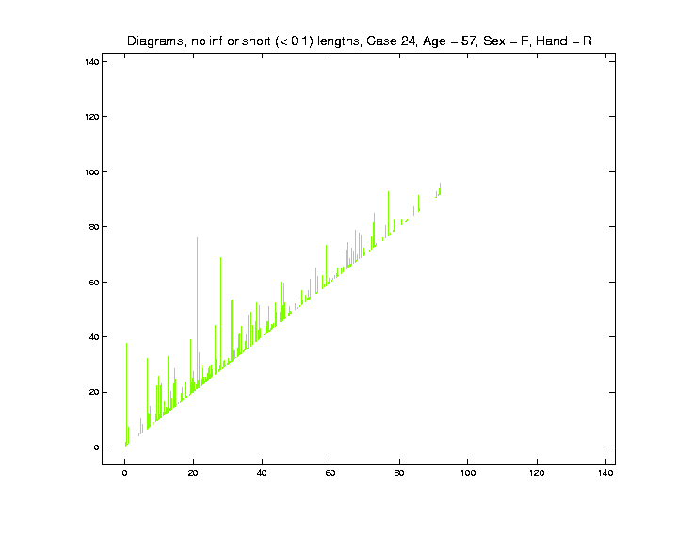
Raw Data Persistence Diagrams

Slide 5
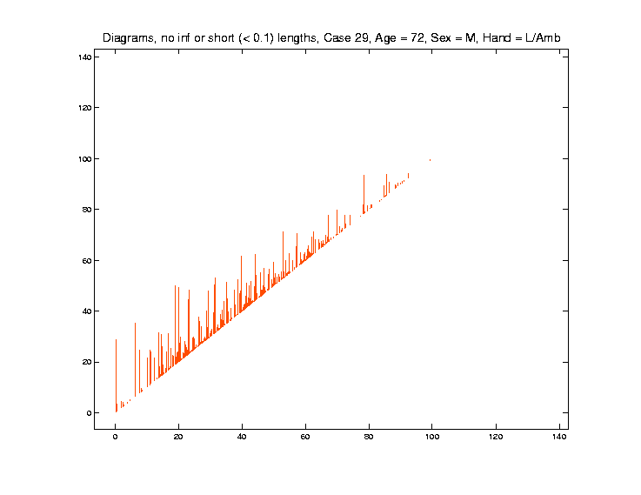
Raw Data Persistence Diagrams

Slide 6
Levels of Homology Application
Data Objects:

Slide 7
Levels of Homology Application
Carlsson, Edelsbrunner, et al
Population Level
Data Objects:

Slide 8
Levels of Homology Application
Data Objects:
Bendich et al
Data Object Level

Slide 9
Persistence Diag. Data Objects?
Data Object Choices:
Full Diagrams (Wasserstein Metric)
Complete & Compelling
But Unwieldy
Harder to Go Deep

Slide 10
Persistence Diag. Data Objects?
Data Object Choices:
Full Diagrams (Wasserstein Metric)
Euclidean Summaries
Many Methods Available
Deep Results Come Quick
Still Exploit “Coordinate Free” Aspects!

Slide 11
Persistence Diag. Data Objects?
Data Object Choices:
Full Diagrams (Wasserstein Metric)
Euclidean Summaries
Other Options?
Smooth Functions: Fasy et al (2014)
Landscapes: Bubenik (2015)

Slide 12
Euclidean Summaries
Many Aspects to Consider:
Start Times
Bar Lengths
Bar Numbers
Ordering of Summaries
Others???

Slide 13
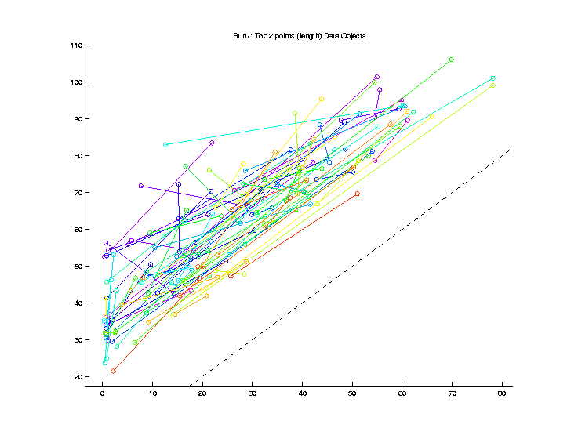
Euclidean Summaries
Repr’n:
Top 2
Points
(Length)

Slide 14
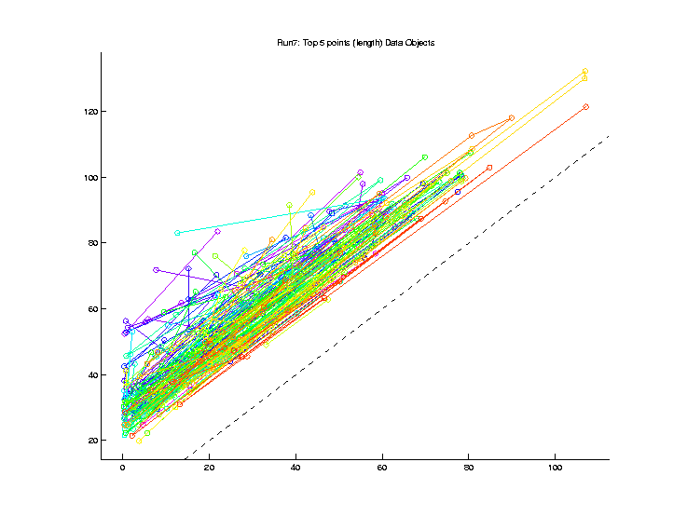
Euclidean Summaries
Repr’n:
Top 5
Points
(Length
& Length
Order)

Slide 15
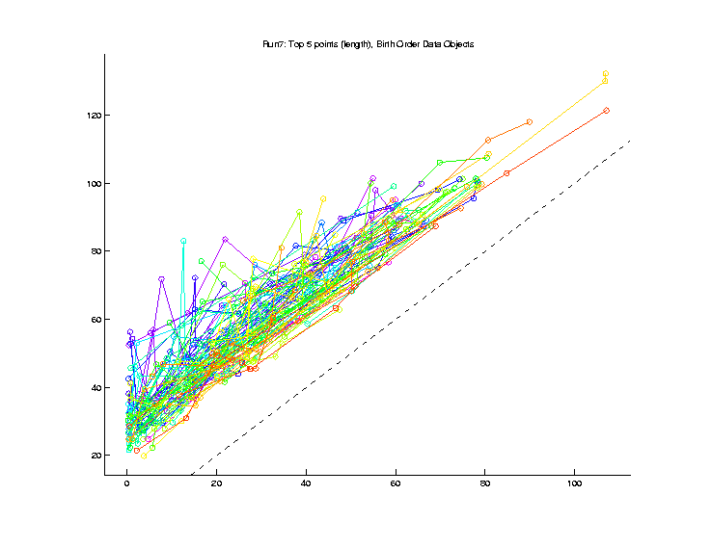
Euclidean Summaries
Repr’n:
Top 5
Points
(Length
& Birth
Order)

Slide 16
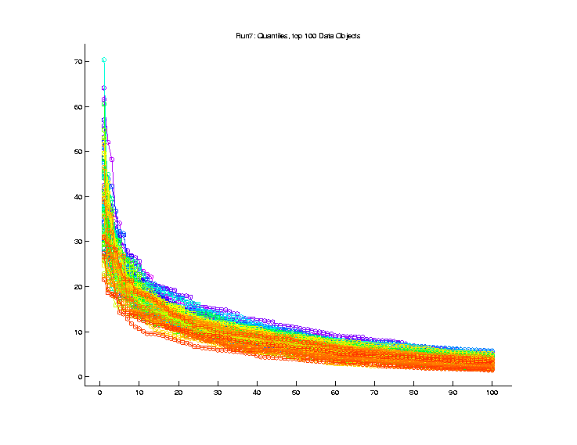
Euclidean Summaries
Repr’n:
Lengths
Only,
Length
Order

Slide 17
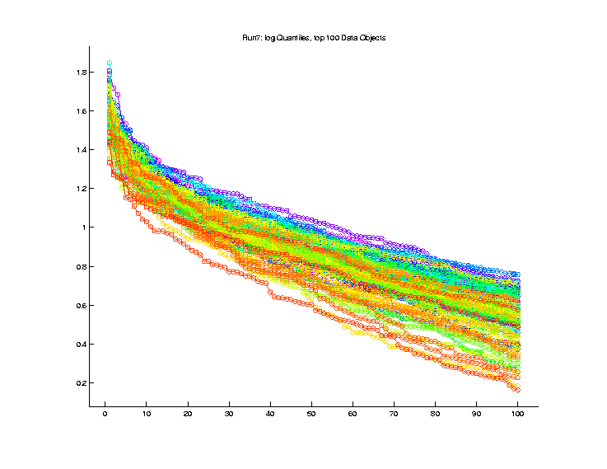
Euclidean Summaries
Repr’n:
Lengths
Only,
Length
Order,
Log₁₀
Scale

Slide 18
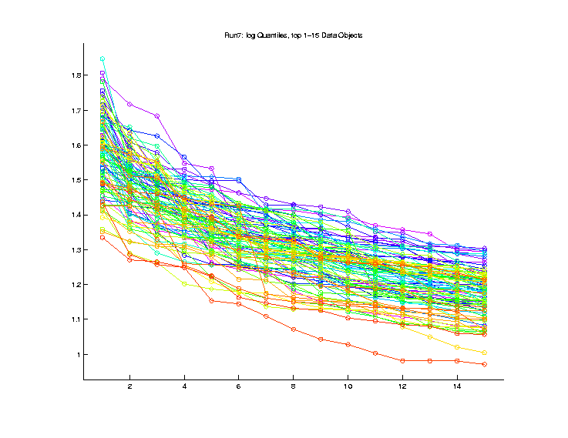
Euclidean Summaries
Repr’n:
Lengths
Only,
Log₁₀ Scale,
Smaller
Set

Slide 19
Euclidean Summaries
Measures of Success:
Would love to do:
Find Brain Cancer (Tortuosity)
Predict Stroke Tendency

Slide 20
Euclidean Summaries
Measures of Success:
Would love to do:
Find Brain Cancer (Tortuosity)
Predict Stroke Tendency
No Data On These

Slide 21
Euclidean Summaries
Measures of Success:
Correlation with Age
Distinguish Gender
(Have Transexuals)

Slide 22
Euclidean Summaries
Measures of Success:
Correlation with Age
Distinguish Gender
Also have Handedness (but too many Rights)

Slide 23
Age & Gender
Previous Approaches:
Combinatorics: Found Nothing
Aydin et al (2009)

Slide 24
Age & Gender
Previous Approaches:
Combinatorics: Found Nothing
Dyck Path:
Shen et al (2014)

Slide 25
Age & Gender
Previous Approaches:
Combinatorics: Found Nothing
Dyck Path:
Rather Faint Effects
Required Complicated Tree Pruning

Slide 26
Euclidean Summaries
Measures of Success:
Correlation with Age
Distinguish Gender

Slide 27
Correlation with Age
Best P. H. Representation:
Top 100 lengths
In Length Order
Log Scale

Slide 28
Correlation with Age
Raw
Data
Curves

Slide 29
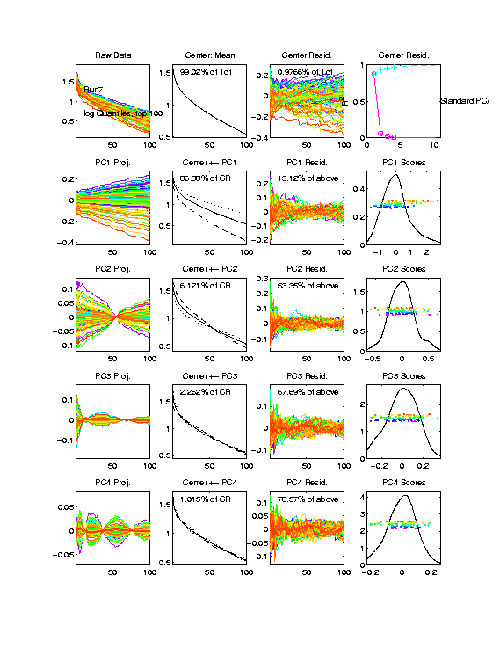
Correlation with Age
PCA
Loadings
Analysis
(Study Parts
Separately)

Slide 30
Correlation with Age
Raw
Data
Mean
Resid’s

Slide 31
Correlation with Age
PC1
(age!)
PC2

Slide 32
Correlation with Age
PC3
PC4

Slide 33
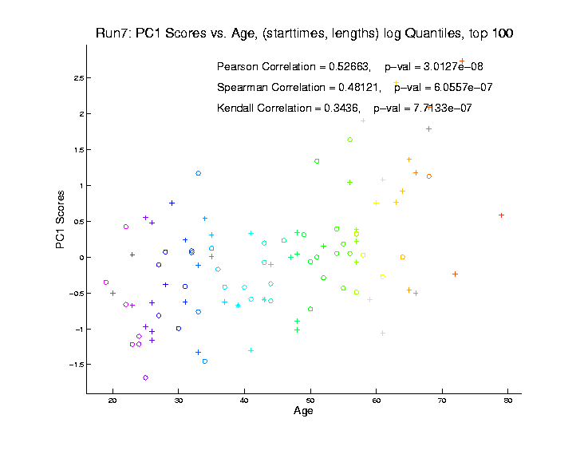
Correlation with Age
Focus
On
PC1
Vs. Age

Slide 34
Correlation with Age
PC1
Vs. Age
Strongly
Signif’t
Correl’n
With Age

Slide 35
Correlation with Age
Zoom
In On
Bar
Intervals
Start at l = 20
End at l = 60
Restrict to Windows

Slide 36
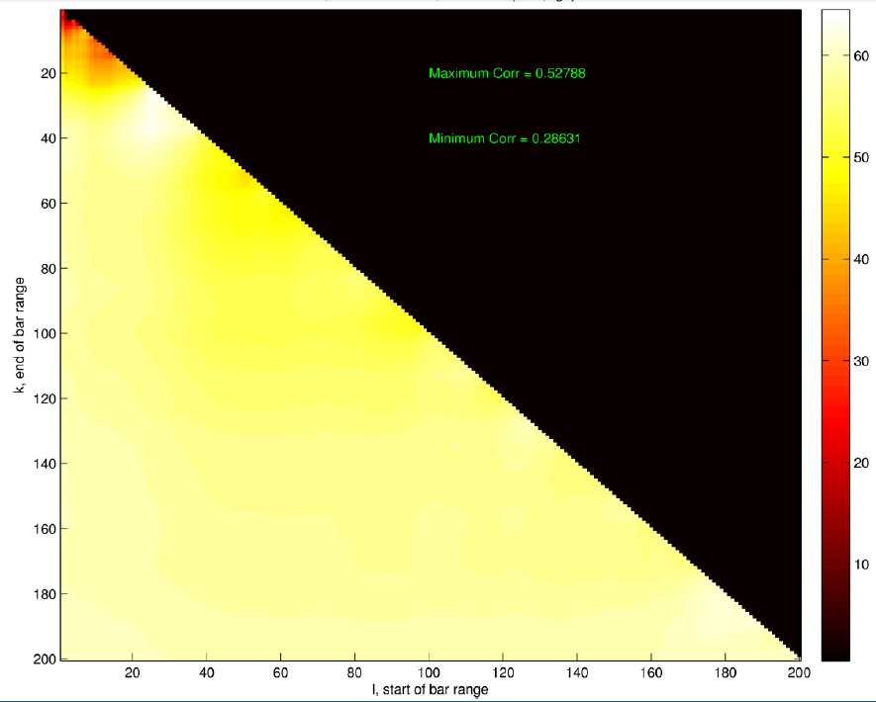
Correlation with Age
Zoom
In On
Bar
Intervals
E.g. Window
Color by Age Correlation

Slide 37
Correlation with Age
Less Correlation
From Longest
Bars
(Since Common
To All, So
Least Variation)

Slide 38
Correlation with Age
Most Correlation
From Medium
Bars
(Important
Variation)

Slide 39
Correlation with Age
Higher Order
Bars Mostly
Add Noise
(w.r.t. Age)

Slide 40
Euclidean Summaries
Measures of Success:
Correlation with Age
Distinguish Gender

Slide 41
Distinguish Gender
Best P. H. Representation:
Top 10 (length) points
(Birth, Length)
In Birth Order
(length order much worse)

Slide 42
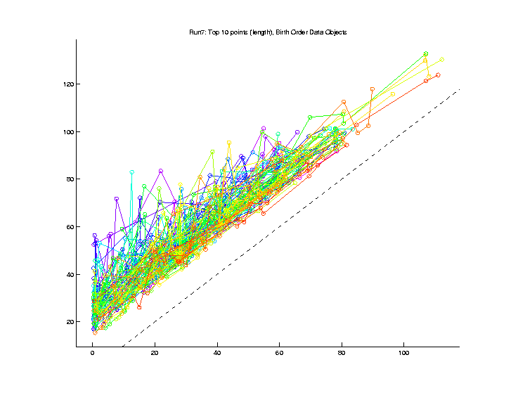
Distinguish Gender
Raw
Data
Overlaid
Age
Colors

Slide 43
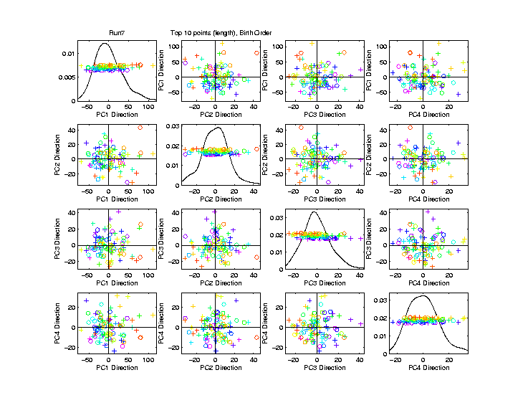
Distinguish Gender
PCA
Scatterplot
Gender
Symbols

Slide 44
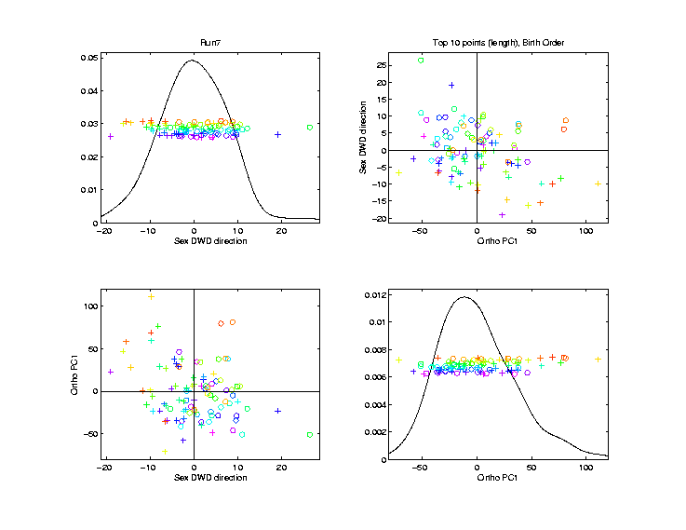
Distinguish Gender
Gender
DWD
Projection
& Ortho
PCA
Reasonable
Separation?

Slide 45
Distinguish Gender
Gender Effect Looks Strong
But is it Real?
DWD Can Find Spurious Separation

Slide 46
Distinguish Gender
Gender Effect Looks Strong
But is it Real?
DWD Can Find Spurious Separation
Approach Di-Pro-Perm Test:
Find Separating Direction (DWD)
Project & Summarize
Permute (to Assess Significance)

Slide 47
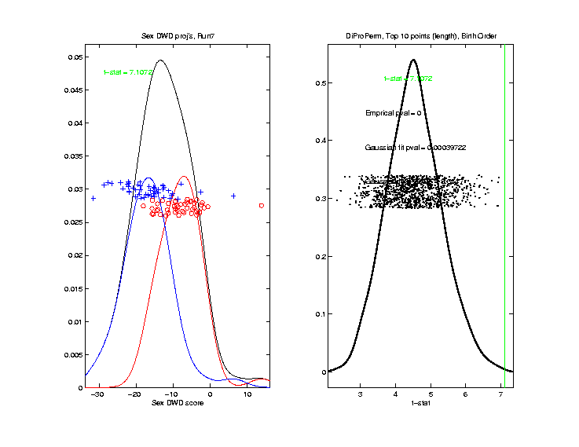
Distinguish Gender
Projected
Statistic

Slide 48
Distinguish Gender
Projected
Statistic
Null Dist’n
(permuted)

Slide 49
Distinguish Gender
Projected
Statistic
Null Dist’n
Strongly
Significant

Slide 50
Persistent Homology Summary
“Coordinate Free” Representation
Any Benefit?
More Conclusive than Other Rep’ns
Best Yet Correlation With Age
Significant Gender Correlation
Main Lesson:
Connectivity & Branch Length Not Enough
“Location” & “Twists” Also Important

Slide 51
State of Topological Data Analysis
“Smoke and Mirrors”?
Has Been Over-Advertised
Won’t Solve All Problems
Remember that tune?
Artificial Intelligence
Neural Networks
Machine Learning

Slide 52
State of Topological Data Analysis
“Smoke and Mirrors”?
No:
There are Situations it Works Very Well
Need to Understand When
Suggested Motivation:
Serious Data Analysis

Slide 53
Bump Hunting via TDA
Sommerfeld et al (2017)
Collaborators:
Max Sommerfeld Peter Kim
Giseon Heo Stephen Rush

Slide 54
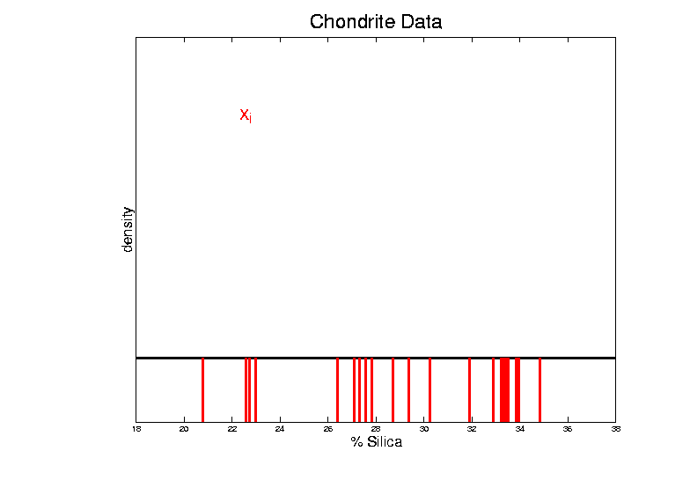
Bump Hunting via TDA
Bump Hunting Background:
Approach: Kernel Density Estimation

Slide 55
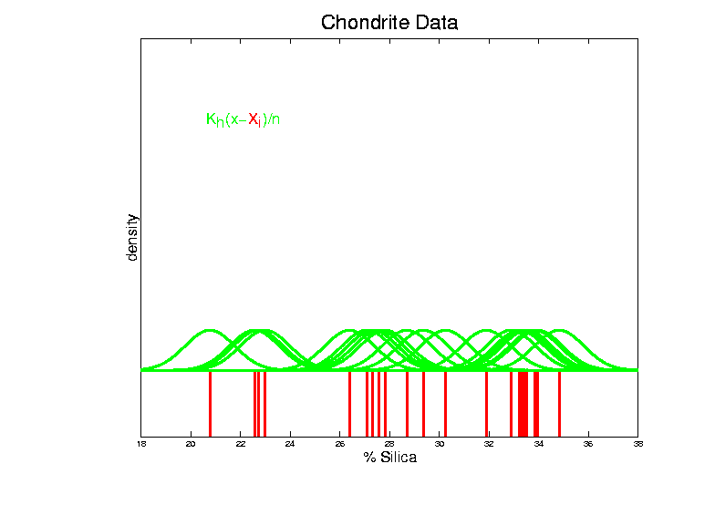
Bump Hunting via TDA
Bump Hunting Background:
Approach: Kernel Density Estimation

Slide 56
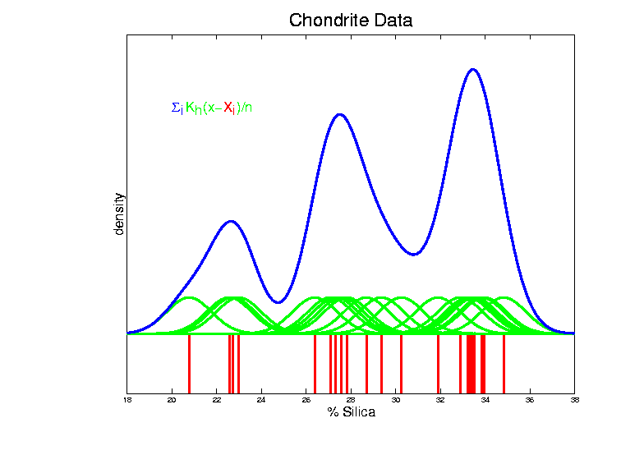
Bump Hunting via TDA
Bump Hunting Background:
Approach: Kernel Density Estimation

Slide 57
Bump Hunting via TDA
Bump Hunting Background:
Approach: Kernel Density Estimation
$${\hat{f}}_{h}\left(x\right)=n^{−1}\sum_{i=1}^{n}{K_{h}\left(x−X_{i}\right)}$$
Scale Factor: $h$ (bandwidth)
Choice of $K$: Gaussian (Variation Diminishing)

Slide 58
Bump Hunting via TDA
Bump Hunting Background:
Fun Data Set: Hidalgo Stamp Data ($n=485$)
How Many Bumps
Are “Really There”?

Slide 59
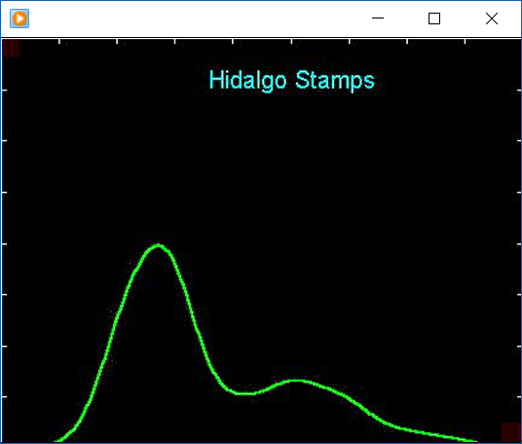
Bump Hunting via TDA
Bump Hunting Background:
Fun Data Set: Hidalgo Stamp Data ($n=485$)
How Many Bumps
Are “Really There”?
2?

Slide 60
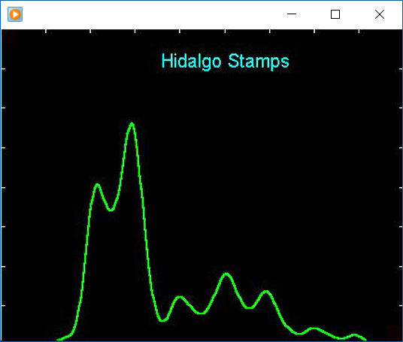
Bump Hunting via TDA
Bump Hunting Background:
Fun Data Set: Hidalgo Stamp Data ($n=485$)
How Many Bumps
Are “Really There”?
2?
5?

Slide 61
Bump Hunting via TDA
Bump Hunting Background:
Fun Data Set: Hidalgo Stamp Data ($n=485$)
How Many Bumps
Are “Really There”?
2?
5?
7?

Slide 62
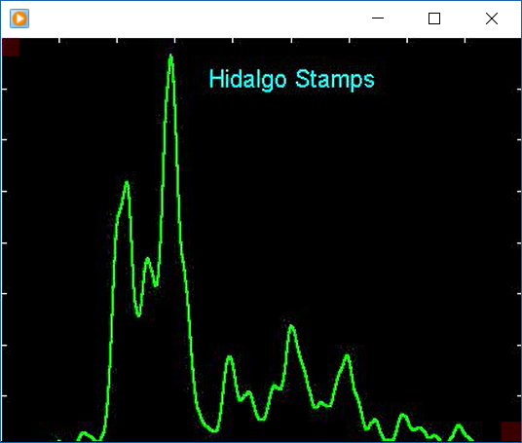
Bump Hunting via TDA
Bump Hunting Background:
Fun Data Set: Hidalgo Stamp Data ($n=485$)
How Many Bumps
Are “Really There”?
2?
5?
7?
10?

Slide 63
Bump Hunting via TDA
Exploratory Approach: SiZer
Chaudhuri & Marron (1999)
Suggests 3-5
Are “Real”

Slide 64
Bump Hunting via TDA
Exploratory Approach: SiZer
Chaudhuri & Marron (1999)
Important Concept:
Investigate Bumps in $K_{h}∗f\left(x\right)$
Not More Traditional: $f\left(x\right)$

Slide 65
Bump Hunting via TDA
Connection to TDA:
Bandwidth (Scale) ~ Persistence Filtration

Slide 66
Bump Hunting via TDA
Actual Approach: Double Filtration
Bandwidth (Scale) $h$
Sub-Level Sets, Indexed by $ε>0$, of ${\hat{f}}_{h}$
$$L_{ε}=\left\{x∈R^{n}: {\hat{f}}_{h}\left(x\right)≤ε\right\}$$
Note: Clear Natural Ordering

Slide 67
Bump Hunting via TDA
Key to Statistical Inference:
Fasy, et al. (2014),
‘Confidence sets for persistence diagrams’

Slide 68
Bump Hunting via TDA
Stamps Data:
Each dot is a peak at scale (bandwidth $h$)

Slide 69
Bump Hunting via TDA
Stamps Data:
Each dot is a peak at scale (bandwidth $h$)
Colored Red for “Really There”

Slide 70
Bump Hunting via TDA
Significant Sub-Level Death Time

Slide 71
Bump Hunting via TDA
Significance Threshold

Slide 72
Bump Hunting via TDA
Large Scale: Only 2 Significant

Slide 73
Bump Hunting via TDA
Fine Scale: Have 4 Significant!

Slide 74
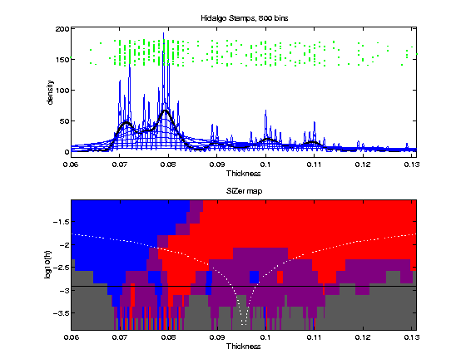
Bump Hunting via TDA
Note on Fine Scale: Many Bumps Are There!

Slide 75
Carry Away Concept
OODA is more than a “framework”
It Provides a Focal Point
Highlights Pivotal Choices:
What should be the Data Objects?
How should they be Represented?

