Slide 1
Probability Distributions as Data Objects
Interesting Question:
What is “Best” Representation?
(Which Function ~ Distributions?)
Density Function? (Very Interpretable)
Cumulative Distribution Function
Quantile Function (Recall Inverse of CDF)

Slide 2
Random Matrix Theory
Main Idea:
Pure Noise Distribution of PCA Eigenvalues
Usefulness:
Interpretation of Scree Plots
For Eigenvalues $λ_{j}$ of Sample Covariance $\hat{Σ}$
Plot $λ_{j}$ vs. $j$

Slide 3
Random Matrix Theory
Clean Notation Version of Covariance Matrix:
$$\tilde{Σ}=\frac{1}{n}XX^{t}$$
Simplified by:
No Mean Centering (using $N(0,1)$)
Roughly OK, By Usual Mean Centering
Also Standardize by $\frac{1}{n}$ not $\frac{1}{n−1}$
Easy & Sensible for No Mean Centering
Size = $d×d$

Slide 4
Random Matrix Theory
Eigenvalues are $\tilde{λ_{j}}$, diagonal entries of $Λ$ in
$$\tilde{Σ}=UΛU^{t}$$
(Eigen-analysis)
Distribution of $\tilde{λ_{j}}$?

Slide 5
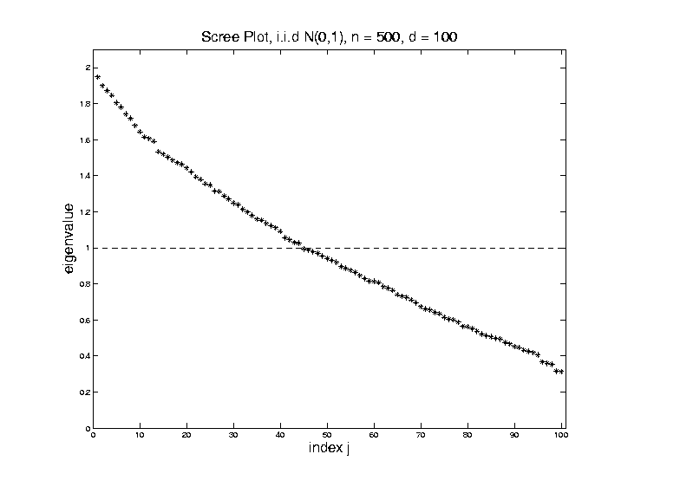
Random Matrix Theory
Fix $y=\frac{d}{n}$, and let $d$, $n$ grow.
Essentially
Same
Shape

Slide 6
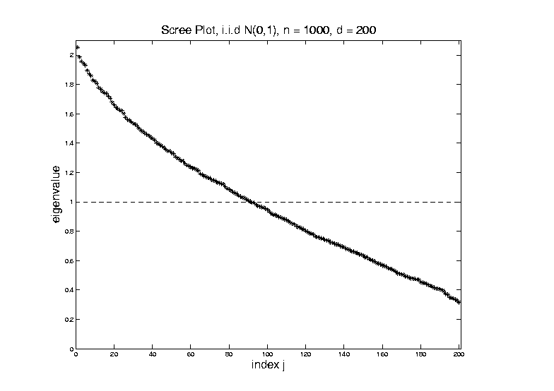
Random Matrix Theory
Fix $y=\frac{d}{n}$, and let $d$, $n$ grow.
Essentially
Same
Shape

Slide 7
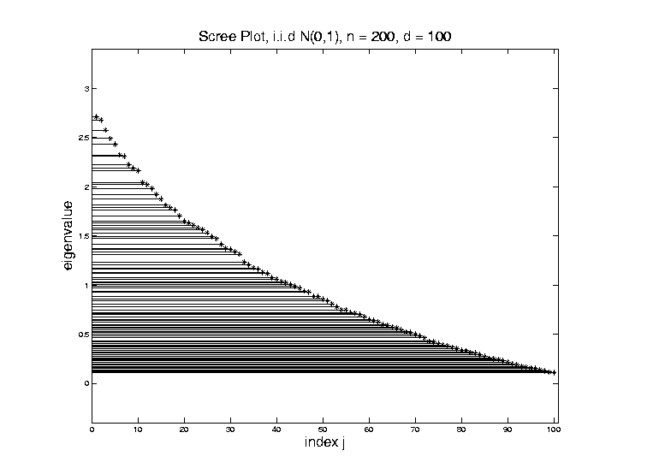
Random Matrix Theory
Shape is Captured by
Empirical Spectral Density
“Density”
Of These
Eigenvalues

Slide 8
Random Matrix Theory
Limiting Spectral Density
(in limit as $n, d→∞$, with $y=\frac{d}{n}$)
Limit Exists
No Closed Form
But Can Implicitly Define
(Using Integral Equations)
And Numerically Approximate

Slide 9
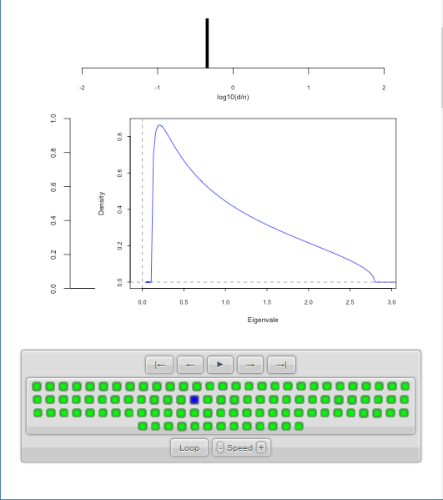
Random Matrix Theory
LSD:
Above
Case
$n=200,$
$d=100,$
$y=0.5$
$\log_{10}{y}=−0.301$

Slide 10
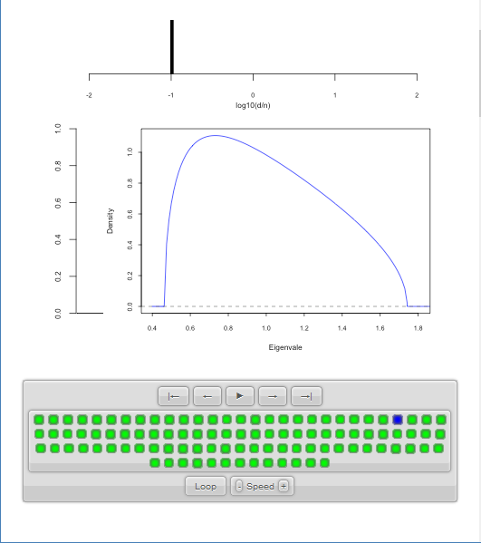
Random Matrix Theory
LSD:
Now Try Smaller
(More Negative)
Values of $y=\frac{d}{n}$

Slide 11
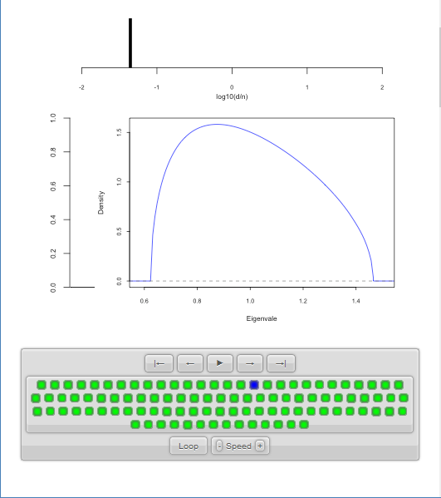
Random Matrix Theory
LSD:
Now Try Smaller
(More Negative)
Values of $y=\frac{d}{n}$
Note: Support
Points $→1$

Slide 12
Random Matrix Theory
LSD:
Now Try Smaller
(More Negative)
Values of $y=\frac{d}{n}$
Note: Increasing
Symmetry

Slide 13
Random Matrix Theory
Limiting Case:
$$\lim_{d→∞}{\lim_{n→∞}{}}$$
Called Medium Dimension High Sample Size
Resulting Density is “Semi-Circle”
$$f\left(x\right)=\frac{2}{πR^{2}}\sqrt{R^{2}−x^{2}}1_{\left[−R,R\right]}(x)$$
Called “Wigner Semi-Circle Distribution”

Slide 14
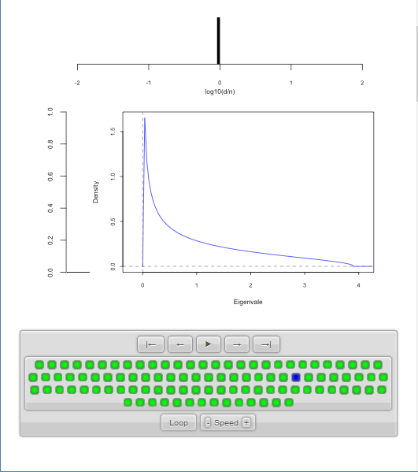
Random Matrix Theory
LSD:
Start With
$y=\frac{d}{n}=1$
Case

Slide 15
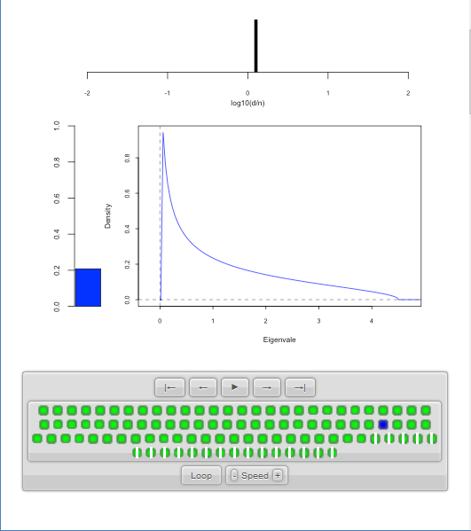
Random Matrix Theory
LSD:
Now Try Larger
Values of $y=\frac{d}{n}$
Proportion of
0 Eigenvalues

Slide 16
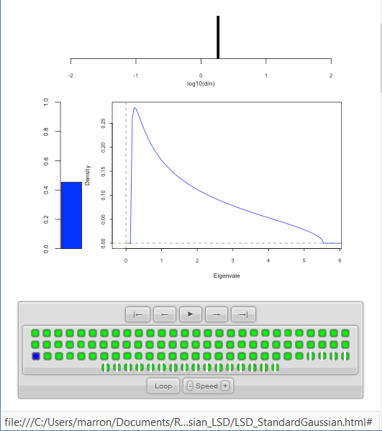
Random Matrix Theory
LSD:
Now Try Larger
Values of $y=\frac{d}{n}$
Spectral Density of
Non-0 Eigenvalues

Slide 17
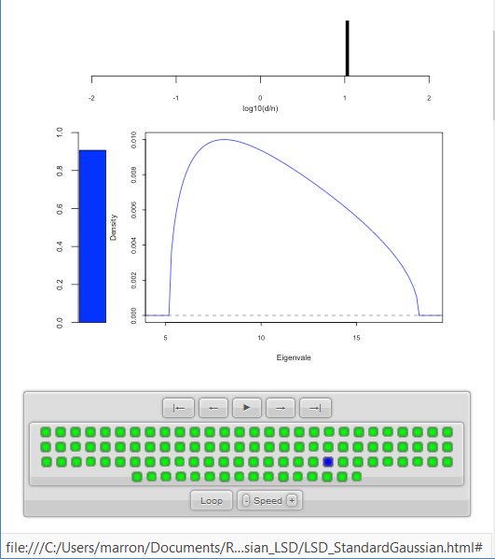
Random Matrix Theory
LSD:
Now Try Larger
Values of $y=\frac{d}{n}$

Slide 18
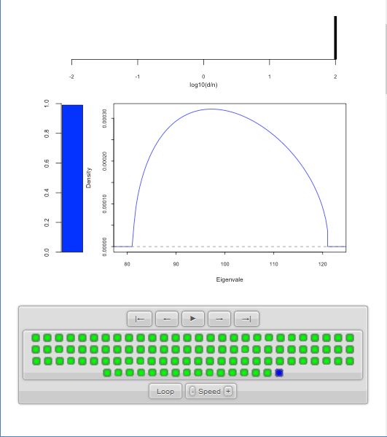
Random Matrix Theory
LSD:
Now Try Larger
Values of $y=\frac{d}{n}$
Again Heads
Towards Semi-Circle
But Small
Proportion

Slide 19
Random Matrix Theory
LSD: Dual Covariance Variation
Idea: Replace $\tilde{Σ}=\frac{1}{n}XX^{t}$ by $\frac{1}{d}X^{t}X$
Recall:
Rows as Data Objects
Inner Product of $X$
Different Normalization ($d$ not $n$)
N(0,1) Avoids Messy Centering Issues

Slide 20
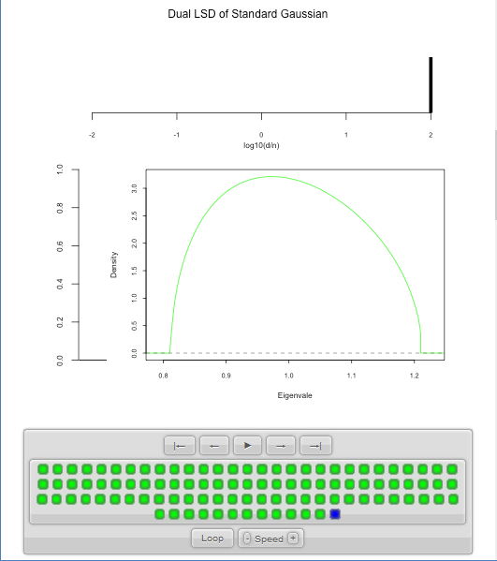
Random Matrix Theory
LSD: Dual Covariance Variation
$y=\frac{d}{n}=100$ Is
Close to Semi-Circle

Slide 21
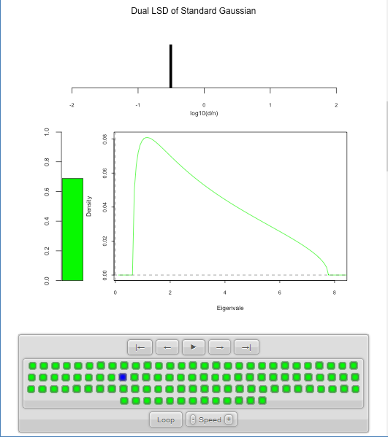
Random Matrix Theory
LSD: Dual Covariance Variation

Slide 22
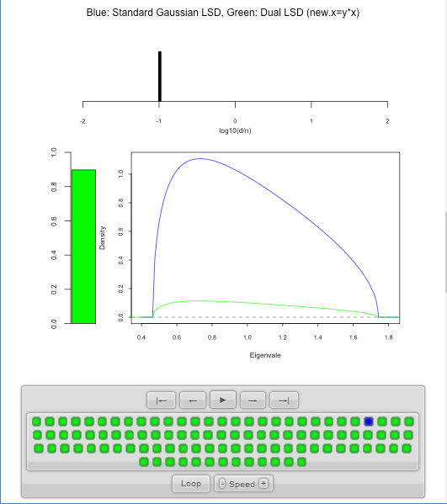
Random Matrix Theory
LSD: Primal & Dual
Overlaid For
Direct
Comparison
Notes:
Area = 1
Area = 1 - Bar

Slide 23
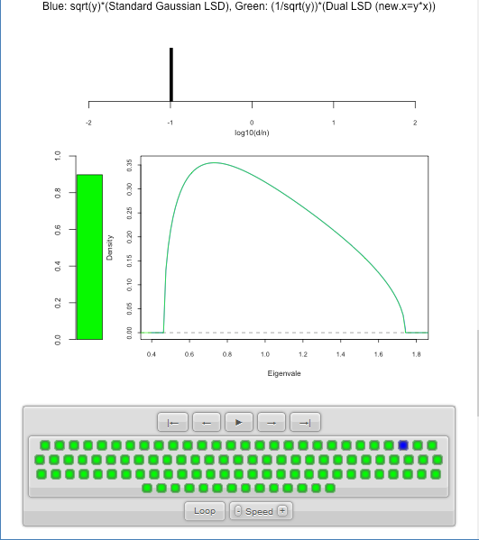
Random Matrix Theory
LSD: Rescaled
Primal & Dual
$\sqrt{y}×LSD$
(underneath)
$\frac{1}{\sqrt{y}}×Dual LSD$

Slide 24
Random Matrix Theory
Conclusion:
Family of Marcenko – Pastur Distributions
Has Several Interesting Symmetries

Slide 25
Random Matrix Theory
Important Parallel Theory:
Distribution of Largest Eigenvalue
(Assuming Matrix of i.i.d. N(0,1)s)
Tracey Widom (1994)
Good Discussion of Statistical Implications
Johnstone (2008)

Slide 26
Non - Euclidean Data Spaces
Recall Data Objects Lying on a Manifold
Called “Mildly
Non-Euclidean”

Slide 27
Non - Euclidean Data Spaces
What is “Strongly Non-Euclidean” Case?
Tree Structured Data Objects
Special Challenge:
No Tangent Plane
Must Re-Invent
Data Analysis

Slide 28
Strongly Non-Euclidean Spaces
Trees as Data Objects
From Graph Theory:
Data Objects: Trees
Graph is a Set of Nodes and Edges
Tree has a Root and Direction
Thanks to Burcu Aydin
Notes:
FIGp8correct.eps

Slide 29
Strongly Non-Euclidean Spaces
General Graph:
Thanks to Sean Skwerer

Slide 30
Strongly Non-Euclidean Spaces
Special Case Called “Tree”
Directed
Acyclic
Graphical note:
Sometimes “grow up” $↑$
Others “grow down” $↓$
5
3
4
1
2
Terminology:
Root
0

Slide 31
Strongly Non-Euclidean Spaces
Special Case Called “Tree”
Directed
Acyclic
5
3
4
Terminology:
Children
Of
Parent
1
2
0

Slide 32
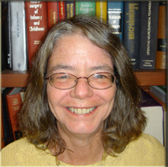
Strongly Non-Euclidean Spaces
Motivating Example:
From Dr. Elizabeth Bullitt
Dept. of Neurosurgery, UNC
Blood Vessel Trees in Brains
Segmented from MRAs
Study population of trees
Forest of Trees

Slide 33
Blood vessel tree data
Marron’s brain:
MRI (T1) view
(Magnetic Resonance Image)
Single Slice
From 3-d Image

Slide 34
Blood vessel tree data
Marron’s brain:
MRA view
“A” for “Angiography”
Finds Arteries
(show up as white)
Track through 3d

Slide 35
Blood vessel tree data
Marron’s brain:
MRA view
“A” for “Angiography”
Finds Arteries
(show up as white)
Track through 3d

Slide 36
Blood vessel tree data
Marron’s brain:
MRA view
“A” for “Angiography”
Finds Arteries
(show up as white)
Track through 3d

Slide 37
Blood vessel tree data
Marron’s brain:
MRA view
“A” for “Angiography”
Finds Arteries
(show up as white)
Track through 3d

Slide 38
Blood vessel tree data
Marron’s brain:
MRA view
“A” for “Angiography”
Finds Arteries
(show up as white)
Track through 3d

Slide 39
Blood vessel tree data
Marron’s brain:
MRA view
“A” for “Angiography”
Finds Arteries
(show up as white)
Track through 3d

Slide 40
Blood vessel tree data
Marron’s brain:
From MRA
Segment tree
of vessel segments
Using tube tracking
Bullitt and Aylward (2002)

Slide 41
Blood vessel tree data
Marron’s brain:
From MRA
Reconstruct trees
in 3d
Rotate to view

Slide 42
Blood vessel tree data
Marron’s brain:
From MRA
Reconstruct trees
in 3d
Rotate to view

Slide 43
Blood vessel tree data
Marron’s brain:
From MRA
Reconstruct trees
in 3d
Rotate to view

Slide 44
Blood vessel tree data
Marron’s brain:
From MRA
Reconstruct trees
in 3d
Rotate to view

Slide 45
Blood vessel tree data
Marron’s brain:
From MRA
Reconstruct trees
in 3d
Rotate to view

Slide 46
Blood vessel tree data
Marron’s brain:
From MRA
Reconstruct trees
in 3d
Rotate to view

Slide 47
Blood vessel tree data
,
, ... ,
Now look over many people (data objects)
Structure of population (understand variation?)
PCA in strongly non-Euclidean Space???

Slide 48
Blood vessel tree data
,
, ... ,
Examples of Potential Specific Goals
(not accessible by traditional methods)
Predict Stroke Tendency (Collateral Circulation)
Screen for Loci of Pathology
Explore how age affects connectivity

Slide 49
Blood vessel tree data
Big Picture: 4 Approaches
Purely Combinatorial
Euclidean Orthant (Phylogenetics)
Dyck Path
Persistent Homologies - Topological DA

Slide 50
Blood vessel tree data
Big Picture: 4 Approaches
Purely Combinatorial
Euclidean Orthant (Phylogenetics)
Dyck Path
Persistent Homologies

Slide 51
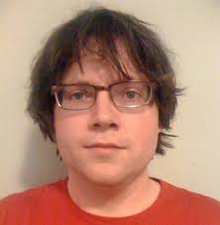
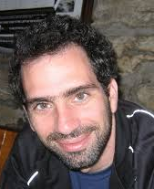
Persistent Homology Approach
People:
Paul Bendich
Ezra Miller
Sean Skwerer
Paper: Bendich
et al (2016)

Slide 52
Persistent Homology Approach
Persistent Homology Idea:
Alternate Data Representation
Focusing on Structure not Location
Summarized via Filtration
(Think: Multi-Scale Summary)

Slide 53
Persistent Homology Approach
Persistent Homology “Flavors”:
H0 - Count Connected Components
H1 - Count Loops
H2 - Count Cavities (3-d “holes”)
(Counting Done Across Scales of Filtration)

Slide 54
Persistent Homology Approach
Brain Tree Persistent Homology “Flavors”:
All H0 (just conn’s, no loops, cavities, etc.)
Tried Various Filtrations
Expanding Balls
Rising Sub-Level Sets

Slide 55
Persistent Homology Filtration
Example:
Expanding
Balls

Slide 56
Persistent Homology Filtration
Example:
Expanding
Balls

Slide 57
Persistent Homology Filtration
Example:
Expanding
Balls

Slide 58
Persistent Homology Filtration
Example:
Expanding
Balls

Slide 59
Persistent Homology Filtration
Example:
Expanding
Balls

Slide 60
Persistent Homology Filtration
Example:
Expanding
Balls

Slide 61
Persistent Homology Filtration
Example:
Expanding
Balls

Slide 62
Persistent Homology Filtration
Example:
Expanding
Balls

Slide 63
Persistent Homology Filtration
Example:
Expanding
Balls

Slide 64
Persistent Homology Filtration
Example:
Expanding
Balls

Slide 65
Persistent Homology Filtration
Example:
Expanding
Balls

Slide 66
Persistent Homology Filtration
Example:
Expanding
Balls

Slide 67
Persistent Homology Filtration
Example:
Expanding
Balls

Slide 68
Persistent Homology Filtration
Example:
Expanding
Balls

Slide 69
Persistent Homology Filtration
Example:
Expanding
Balls

Slide 70
Persistent Homology Filtration
Example:
Expanding
Balls

Slide 71
Persistent Homology Filtration
Example:
Expanding
Balls

Slide 72
Persistent Homology Filtration
Example:
Expanding
Balls

Slide 73
Persistent Homology Filtration
Example:
Expanding
Balls

Slide 74
Persistent Homology Filtration
Example:
Expanding
Balls

Slide 75
Persistent Homology Filtration
Rising
Sub-Level Brain
Sets Artery
For 1 Trees
Tree
Thanks to:
Paul Bendich
Sean Skwerer

Slide 76
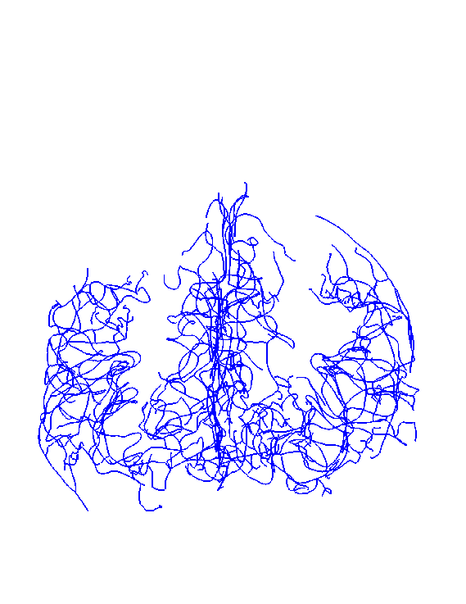
Persistent Homology Generation
Rising
Sub-Level
Sets
For 1
Tree

Slide 77
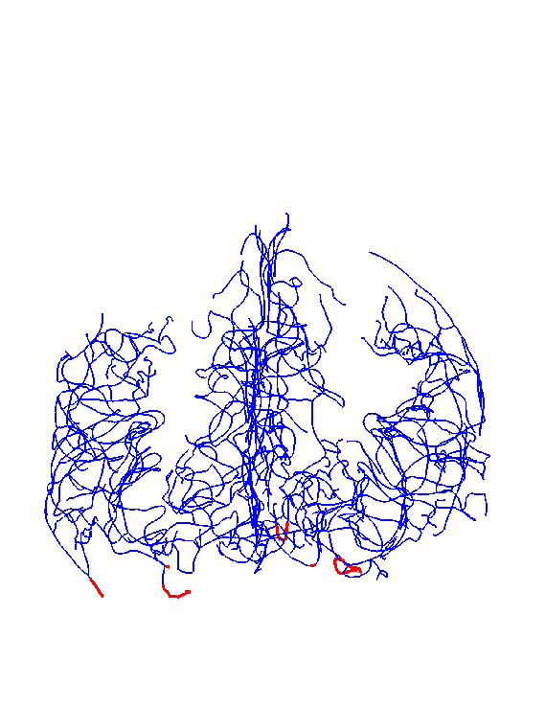
Persistent Homology Generation
Rising
Sub-Level
Sets
For 1
Tree

Slide 78
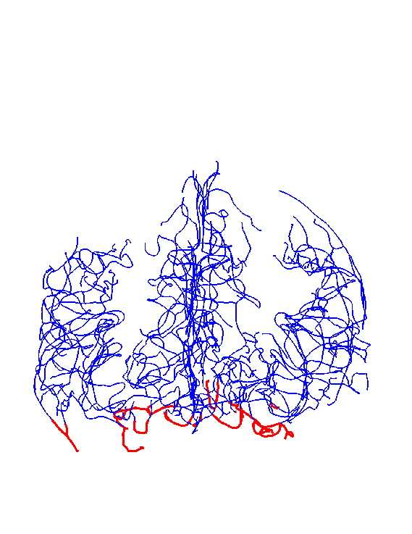
Persistent Homology Generation
Rising
Sub-Level
Sets
For 1
Tree

Slide 79
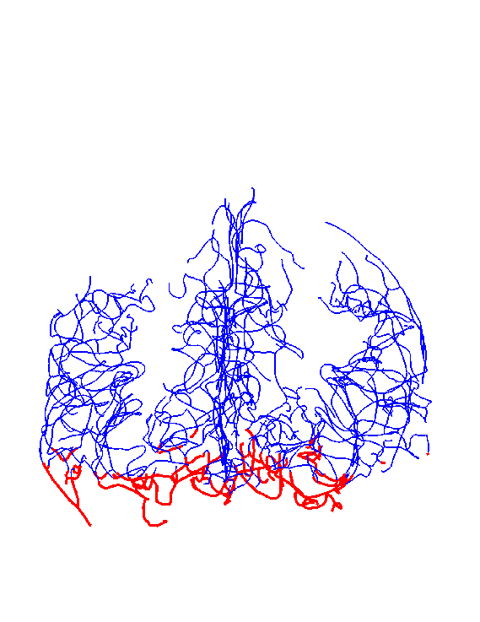
Persistent Homology Generation
Rising
Sub-Level
Sets
For 1
Tree

Slide 80
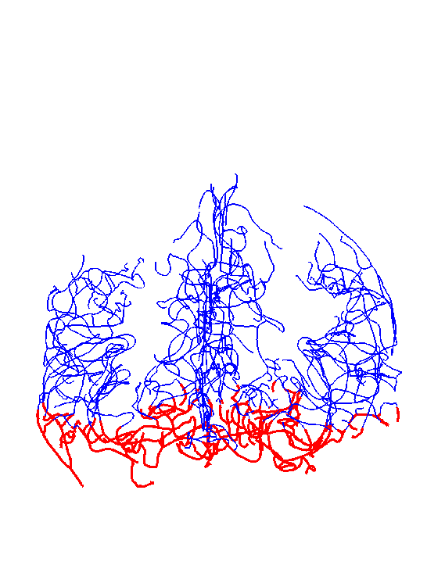
Persistent Homology Generation
Rising
Sub-Level
Sets
For 1
Tree

Slide 81
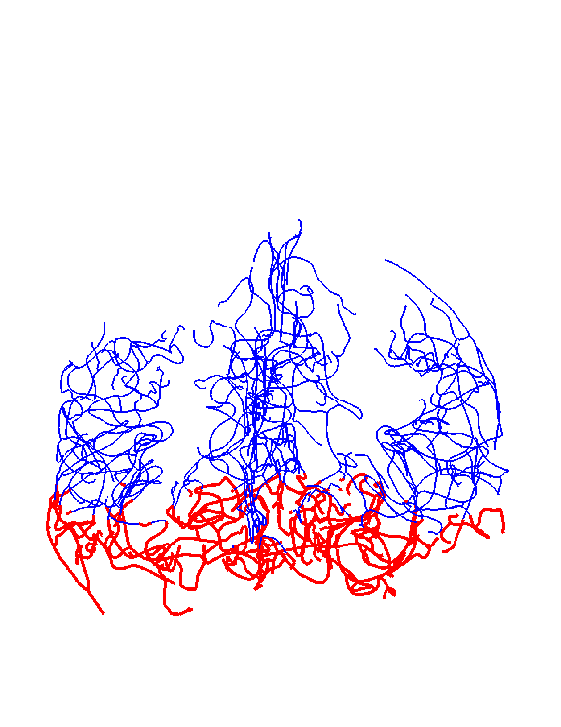
Persistent Homology Generation
Rising
Sub-Level
Sets
For 1
Tree

Slide 82
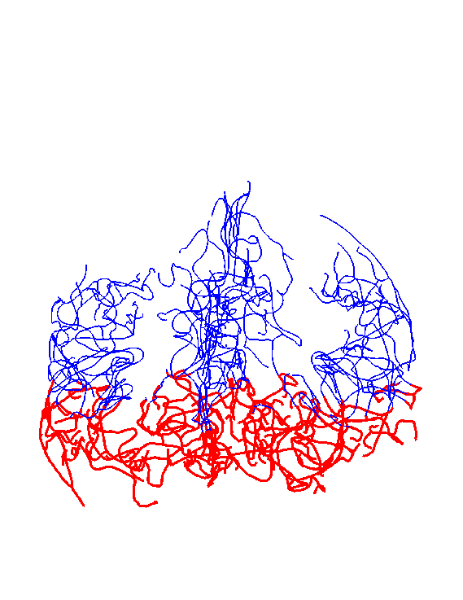
Persistent Homology Generation
Rising
Sub-Level
Sets
For 1
Tree

Slide 83
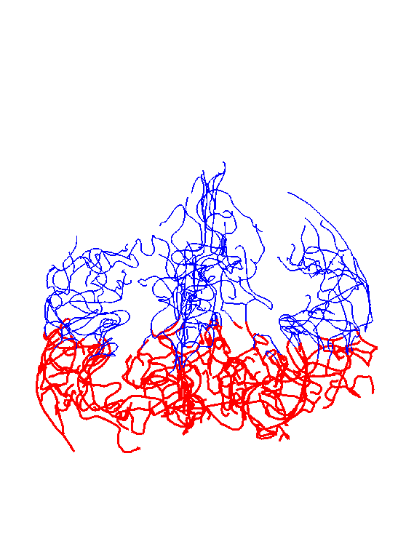
Persistent Homology Generation
Rising
Sub-Level
Sets
For 1
Tree

Slide 84
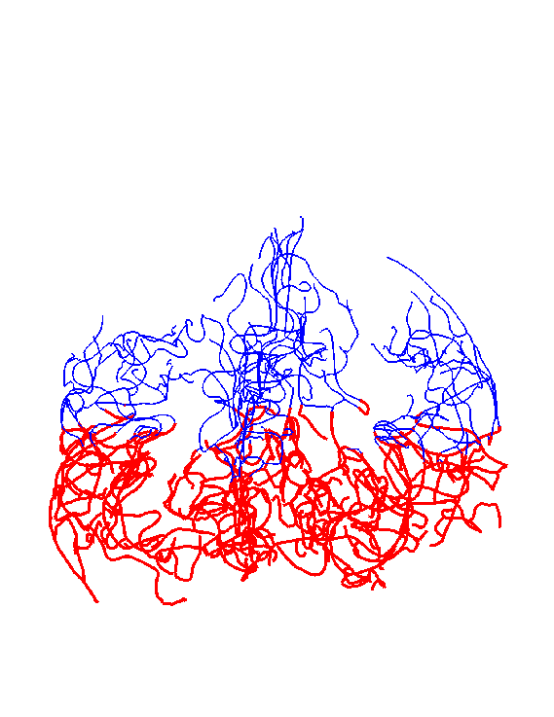
Persistent Homology Generation
Rising
Sub-Level
Sets
For 1
Tree

Slide 85
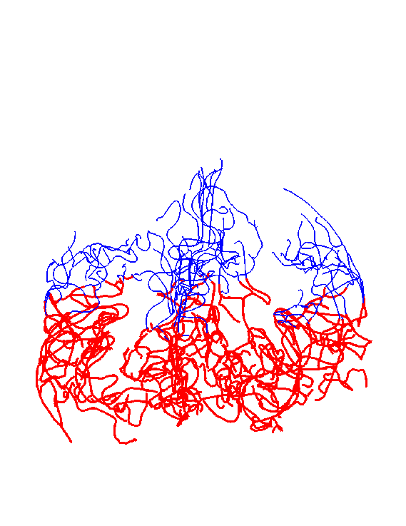
Persistent Homology Generation
Rising
Sub-Level
Sets
For 1
Tree

Slide 86
Persistent Homology Generation
Rising
Sub-Level
Sets
For 1
Tree

Slide 87
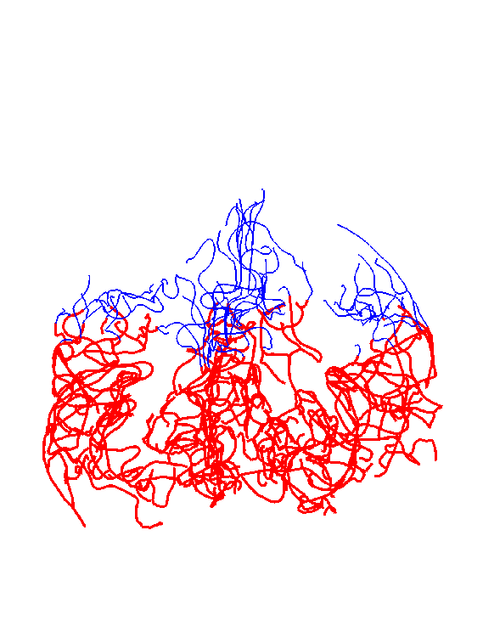
Persistent Homology Generation
Rising
Sub-Level
Sets
For 1
Tree

Slide 88
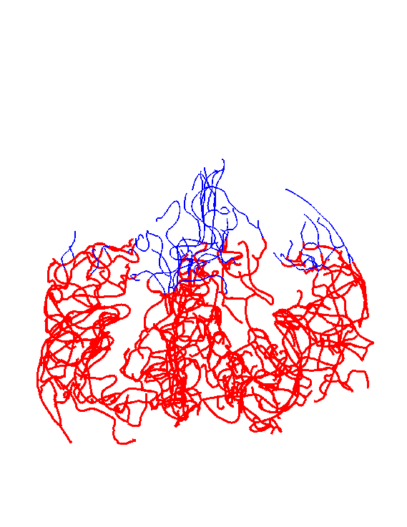
Persistent Homology Generation
Rising
Sub-Level
Sets
For 1
Tree

Slide 89
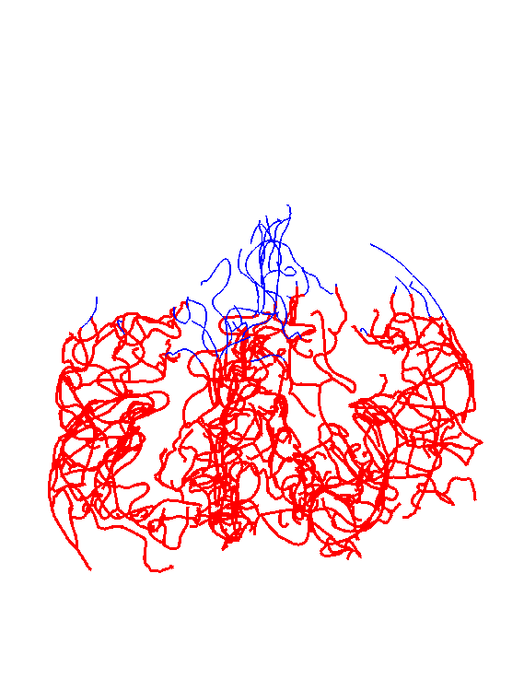
Persistent Homology Generation
Rising
Sub-Level
Sets
For 1
Tree

Slide 90
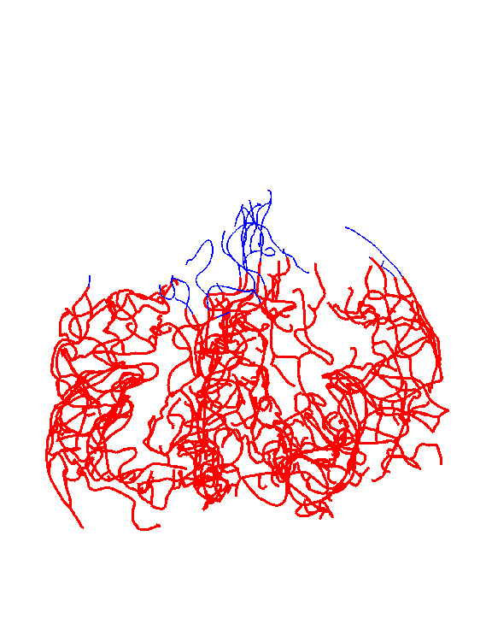
Persistent Homology Generation
Rising
Sub-Level
Sets
For 1
Tree

Slide 91
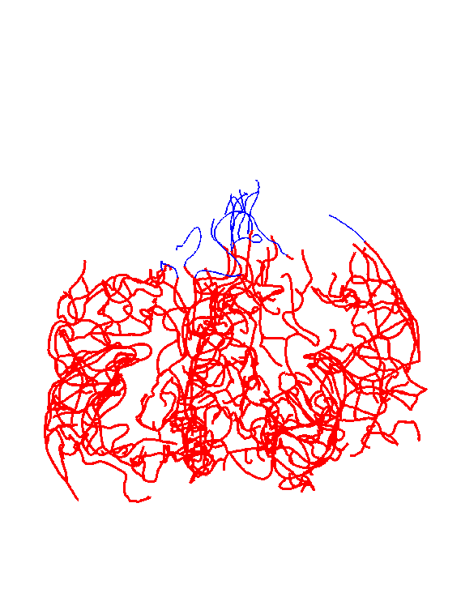
Persistent Homology Generation
Rising
Sub-Level
Sets
For 1
Tree

Slide 92
Persistent Homology Generation
Rising
Sub-Level
Sets
For 1
Tree

Slide 93
Persistent Homology Generation
Rising
Sub-Level
Sets
For 1
Tree

Slide 94
Persistent Homology Generation
Rising
Sub-Level
Sets
For 1
Tree

Slide 95
Persistent Homology Generation
Rising
Sub-Level
Sets
For 1
Tree

