Slide 1
Generative Adversarial Networks
Yaoyu Chen

Slide 2
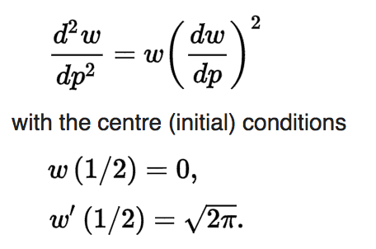
Q:
Transform U(0,1) to N(0,1) ?
Approach 1: Box-Muller Transform
Approach 2: Quantile Function

Slide 3
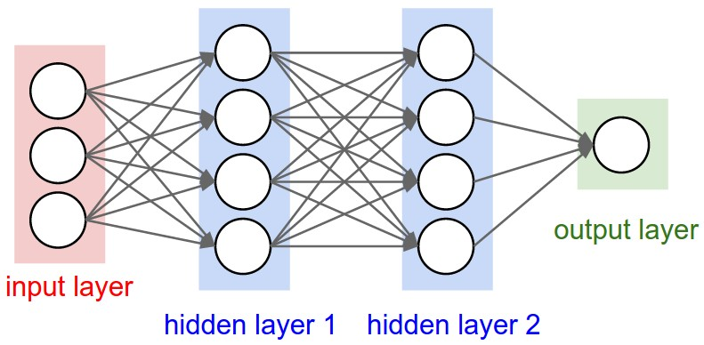
Q:
What if know nothing about statistics?
N
D
simulate
1/0
U
G
F

Slide 4
Q:
What if know nothing about statistics?
N
Train Discriminator:
D
0
1/0
U
G
F

Slide 5
Q:
What if know nothing about statistics?
N
Train Discriminator:
D
1
1/0
U
G
F

Slide 6
Q:
What if know nothing about statistics?
N
Train Generator:
D
1
1/0
U
G
F

Slide 7
Q:
What if know nothing about statistics?
Experiment
N
N(4,${1.25}^{2}$)
D
1/0
U
G
F
U(0,1)

Slide 9
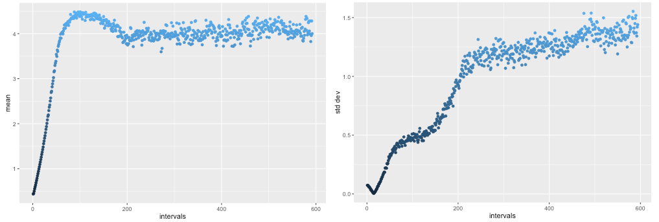
Fake Data
Mean
Std Dev
Credited to Dev Nag

Slide 11
Thank you

