Slide 1
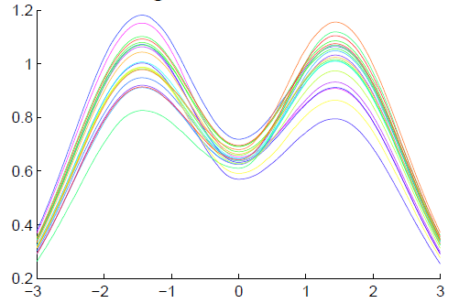
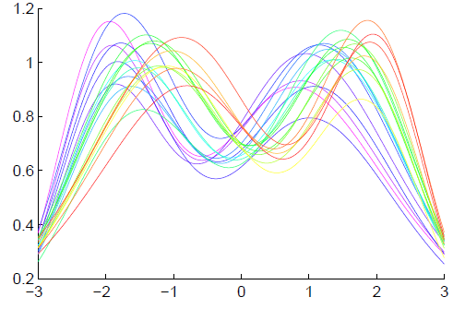
Functional Data Analysis
Insightful
Decomposition
Vertical Variation
Horiz’l
Var’n

Slide 2
More Data Objects
Final Curve Warps:
Warp Each Data Curve, $f_{1}, ⋯,f_{n}$
To Template Mean, $μ_{n}$
Denote Warp Functions $γ_{1}, ⋯,γ_{n}$
Gives (Roughly Speaking):
Vertical Components $f_{1}∘γ_{1}, ⋯,f_{n}∘γ_{n}$
(Aligned Curves)
Horizontal Components $γ_{1}, ⋯,γ_{n}$
Data Objects I

Slide 3
More Data Objects
Data Objects II
Final Curve Warps:
Warp Each Data Curve, $f_{1}, ⋯,f_{n}$
To Template Mean, $μ_{n}$
Denote Warp Functions $γ_{1}, ⋯,γ_{n}$
Gives (Roughly Speaking):
Vertical Components $f_{1}∘γ_{1}, ⋯,f_{n}∘γ_{n}$
(Aligned Curves)
Horizontal Components $γ_{1}, ⋯,γ_{n}$
~ Kendall’s Shapes

Slide 4
More Data Objects
Final Curve Warps:
Warp Each Data Curve, $f_{1}, ⋯,f_{n}$
To Template Mean, $μ_{n}$
Denote Warp Functions $γ_{1}, ⋯,γ_{n}$
Gives (Roughly Speaking):
Vertical Components $f_{1}∘γ_{1}, ⋯,f_{n}∘γ_{n}$
(Aligned Curves)
Horizontal Components $γ_{1}, ⋯,γ_{n}$
Data Objects III
~ Chang’s Transfo’s

Slide 5
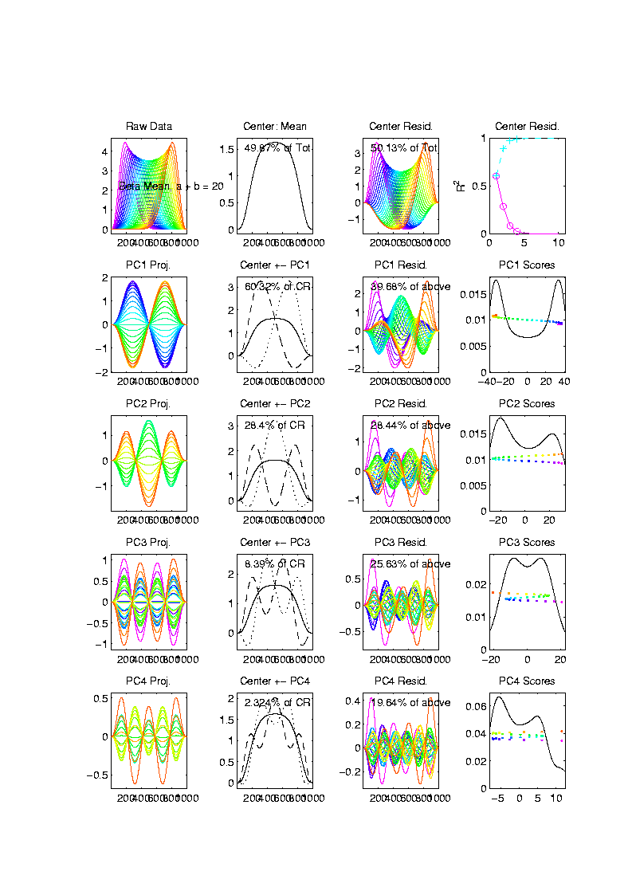
Toy Example
Conventional
PCA
Projections
Power
Spread
Across
Spectrum

Slide 6
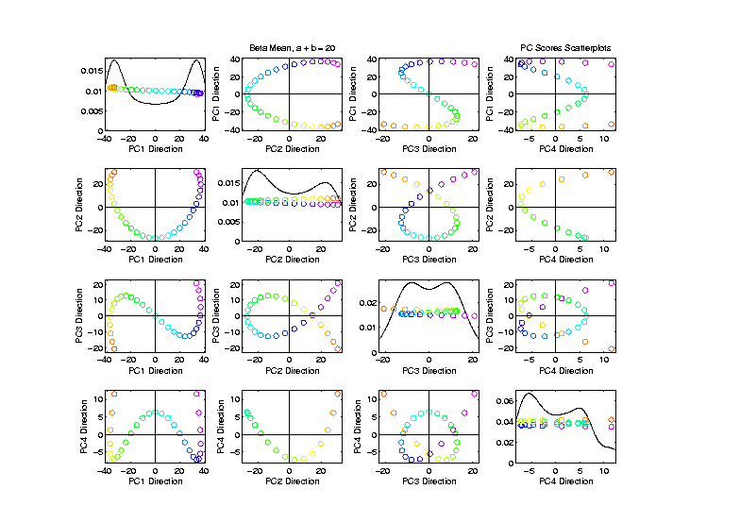
Toy Example
Conventional
PCA
Scores
Views of
1-d Curve
Bending
Through
4 Dim’ns’

Slide 7
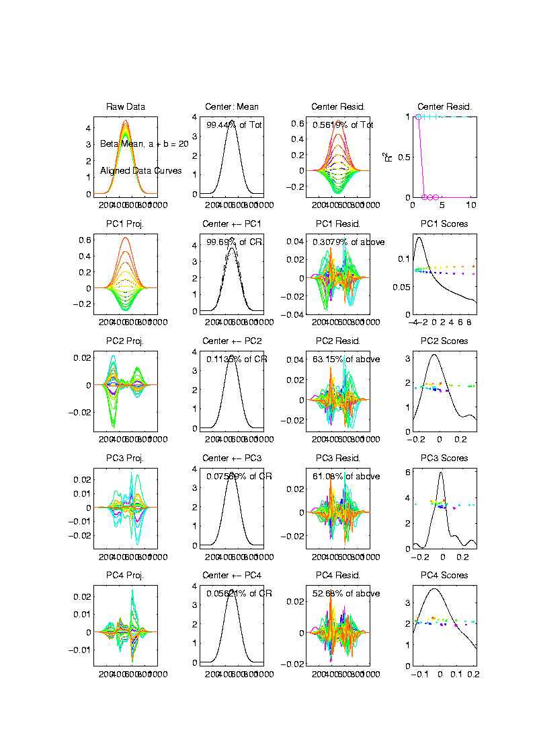
Toy Example
Aligned
Curve
PCA
Projections
All Var’n
In 1st
Component

Slide 8
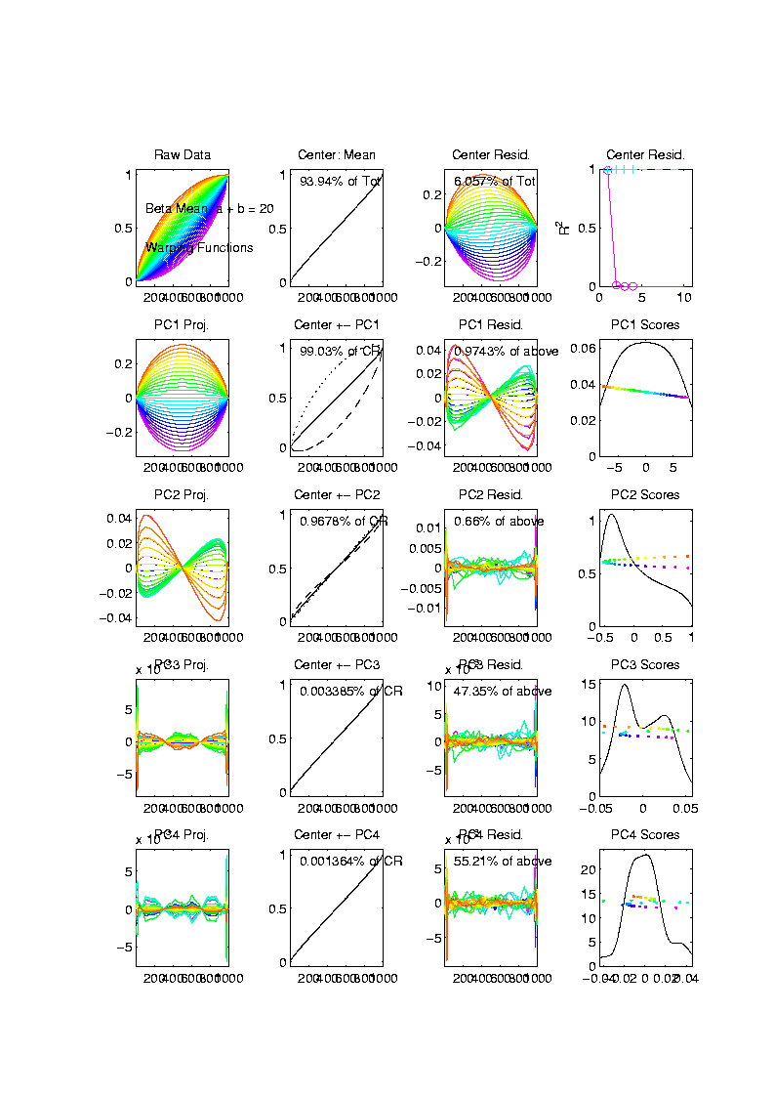
Toy Example
Warps,
PC
Projections
Mostly
1st PC,
But 2nd
Helps Some

Slide 9
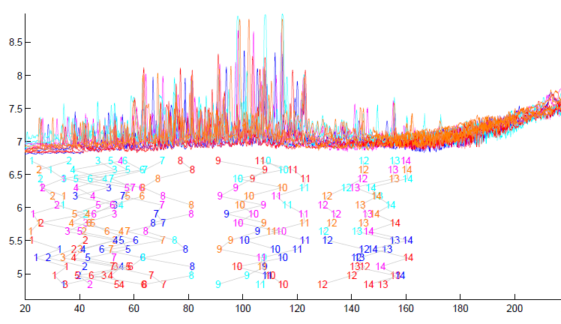
TIC testbed
Special Feature: Answer Key of Known Peaks
Goal:
Find
Warps
To Align
These

Slide 10
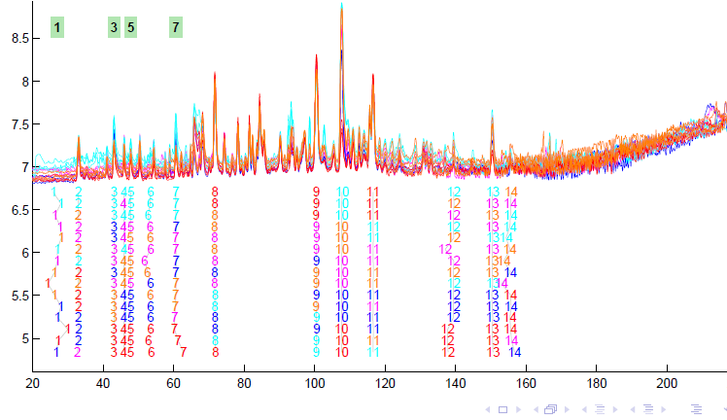
TIC testbed
Fisher – Rao Alignment

Slide 11
PNS on SRVF Sphere
Toy Example
View As Points
Tangent Plane PC 1
PNS 1
Boundary of
Nonnegative
Orthant

Slide 12
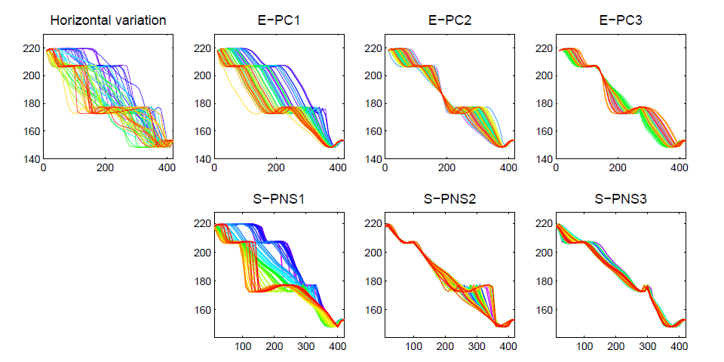
PNS on SRVF Sphere
Real Data Analysis: Blood Glucose Curves

Slide 13
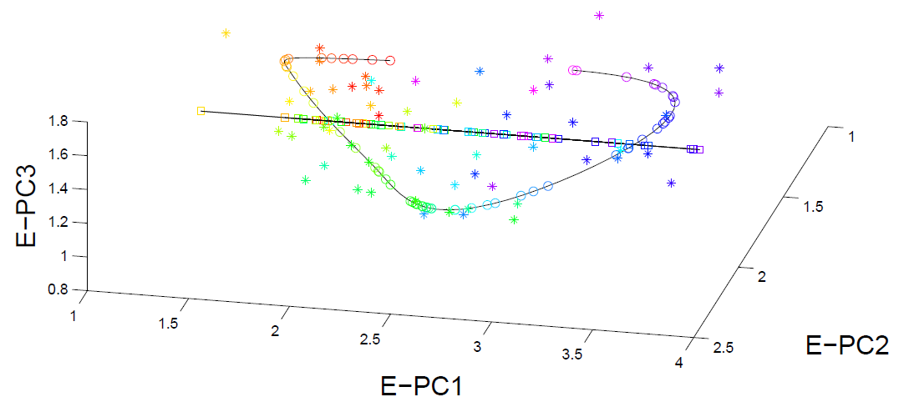
PNS on SRVF Sphere
Real Data Analysis: Blood Glucose Curves

Slide 14
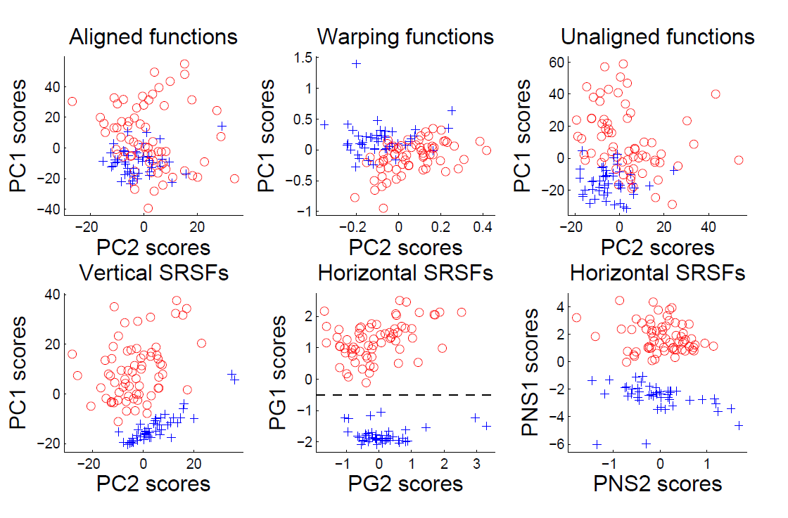
Juggling Data
Clustering In Phase Variation Space:

Slide 15
Probability Distributions as Data Objects
Interesting Question:
What is “Best” Representation?
(Which Function ~ Distributions?)
Density Function? (Very Interpretable)
Cumulative Distribution Function
Quantile Function (Recall Inverse of CDF)

Slide 16
Probability Distributions as Data Objects
Recall Representations of Distributions

Slide 17
Probability Distributions as Data Objects
PCA of
Random
Densities
Power
Spread
Across
Spectrum

Slide 18
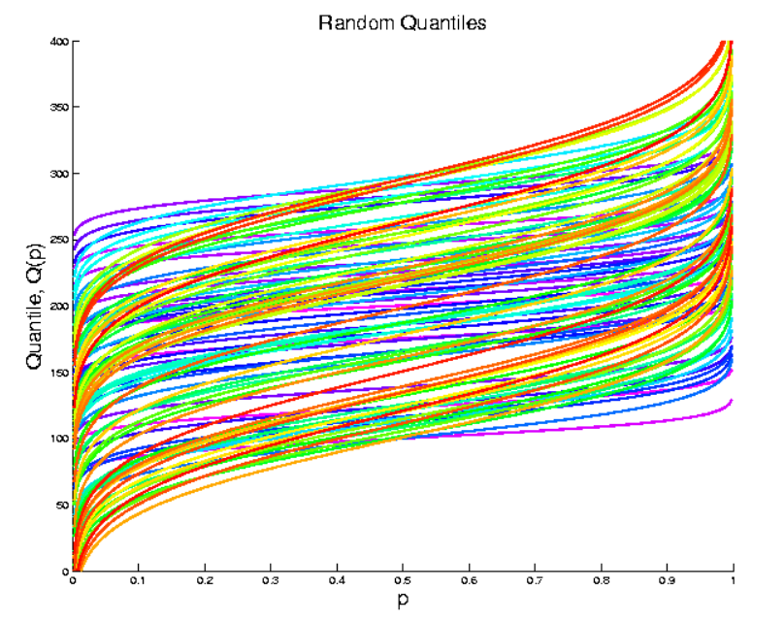
Probability Distributions as Data Objects
Now Try Quantile Representation (Same E.g.)

Slide 19
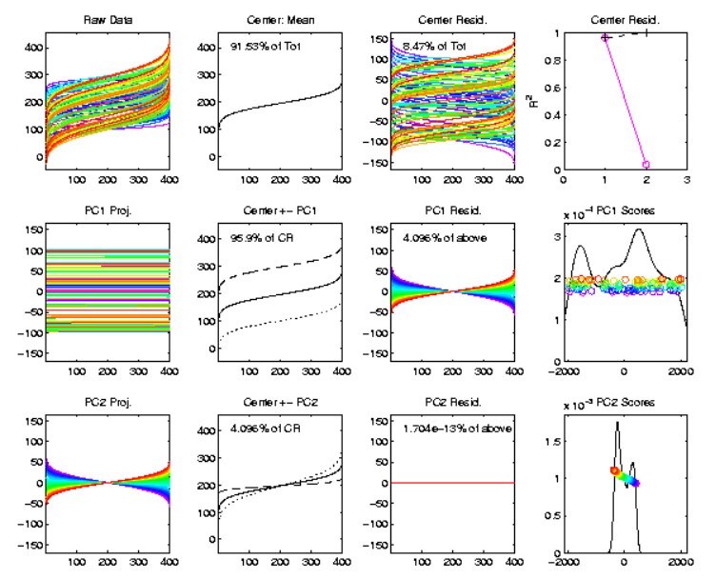
Probability Distributions as Data Objects
PCA of
Quantile
Rep’ns
Only 2
Modes!
Shift
Tilt

Slide 20
Probability Distributions as Data Objects
Conclusion:
Quantile Representation Best for Typical 2 “First” Modes of Variation
(Essentially Linear Modes)
Density & C. D. F. Generally Much Worse
(Natural Modes are Non-Linear)

Slide 21
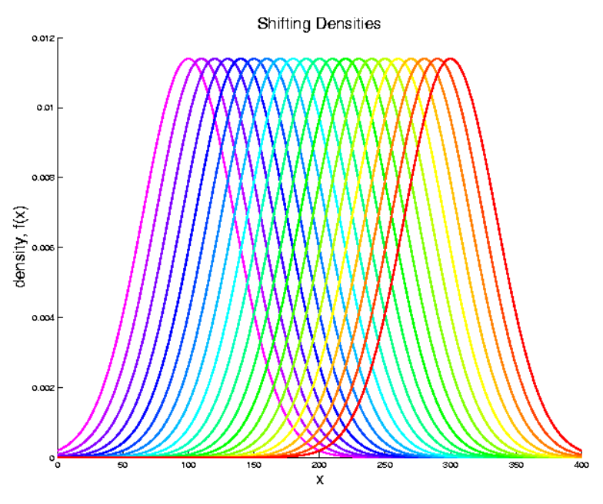
Probability Distributions as Data Objects
Point 1: Mean Changes, Nicely Represented
By Quantiles

Slide 22
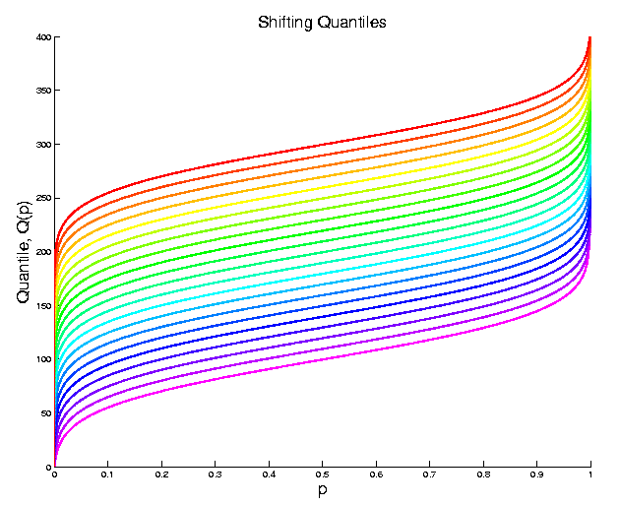
Probability Distributions as Data Objects
Point 1: Mean Changes, Nicely Represented
By Quantiles

Slide 23
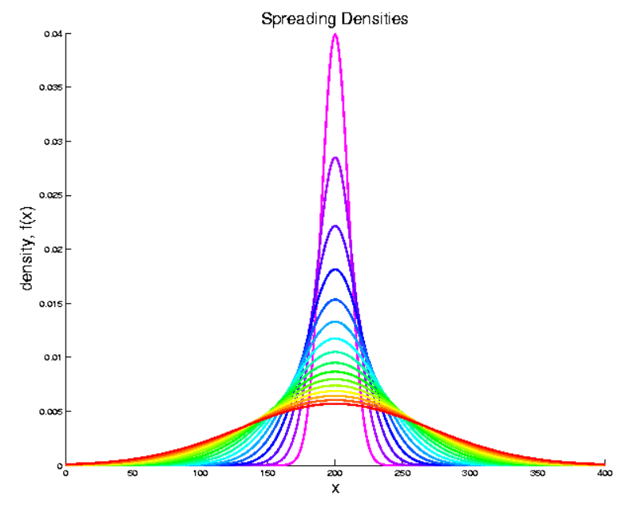
Probability Distributions as Data Objects
Point 2: Spread Changes, Nicely Represented
By Quantiles

Slide 24
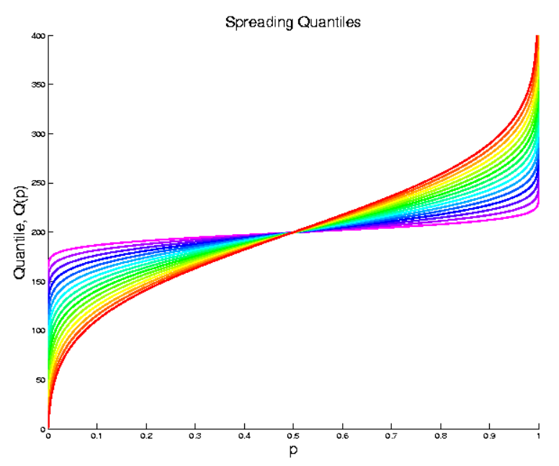
Probability Distributions as Data Objects
Point 2: Spread Changes, Nicely Represented
By Quantiles

Slide 25
Random Matrix Theory
Main Idea:
Pure Noise Distribution of PCA Eigenvalues
Usefulness:
Interpretation of Scree Plots
For Eigenvalues $λ_{j}$ of Sample Covariance $\hat{Σ}$
Plot $λ_{j}$ vs. $j$

Slide 26
PCA Redist’n of Energy (Cont.)
Note, have already considered some of these Useful Plots:
Power Spectrum (as %s)
Cumulative Power Spectrum (%)
Common Terminology:
Power Spectrum is Called
“Scree Plot”
Kruskal (1964) Cattell (1966)
(all but name “scree”) (1st Appearance of name???)
Notes:
26

Slide 27
PCA Redist’n of Energy (Cont.)
Note, have already considered some of these Useful Plots:
Power Spectrum (as %s)
Cumulative Power Spectrum (%)
Large Values Reflect
Important Structure
Notes:
27

Slide 28
PCA Redist’n of Energy (Cont.)
Note, have already considered some of these Useful Plots:
Power Spectrum (as %s)
Cumulative Power Spectrum (%)
Zoom In & Characterize Noise
Notes:
28

Slide 29
Random Matrix Theory
Pure Noise Data Matrix:
$X=$
Defined as: Entries i.i.d. $N(0,1)$
$$d$$
Thinking of
Columns As
Data Objects
$$n$$

Slide 30
Random Matrix Theory
Clean Notation Version of Covariance Matrix:
$$\tilde{Σ}=\frac{1}{n}XX^{t}$$
Simplified by:
No Mean Centering (using $N(0,1)$)
Roughly OK, By Usual Mean Centering
Also Standardize by $\frac{1}{n}$ not $\frac{1}{n−1}$
Easy & Sensible for No Mean Centering
Size = $d×d$

Slide 31
Random Matrix Theory
Eigenvalues are $\tilde{λ_{j}}$, diagonal entries of $Λ$ in
$$\tilde{Σ}=UΛU^{t}$$
(Eigen-analysis)
Distribution of $\tilde{λ_{j}}$?

Slide 32
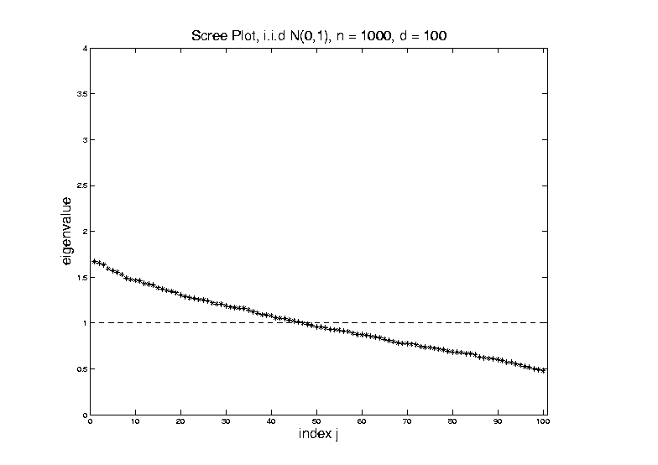
Random Matrix Theory
For $d=100$, $n=1000$, Eigenvalues $≈1$
But There Is (Chance) Variation

Slide 33
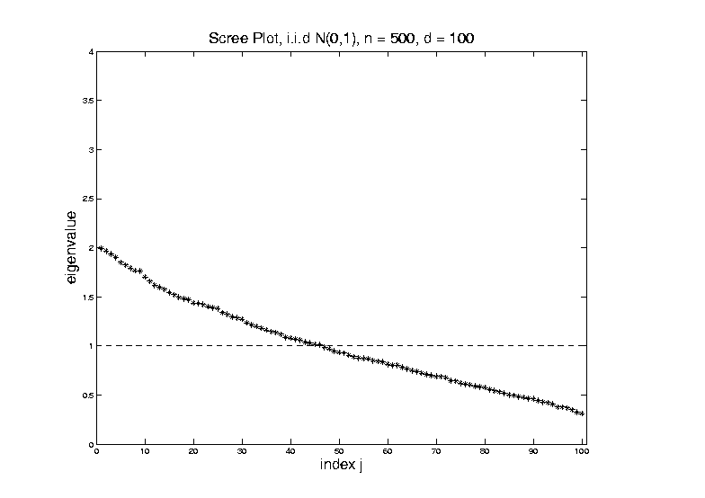
Random Matrix Theory
Smaller $n=500$ Boosts Variation
(More Uncertainty)

Slide 34
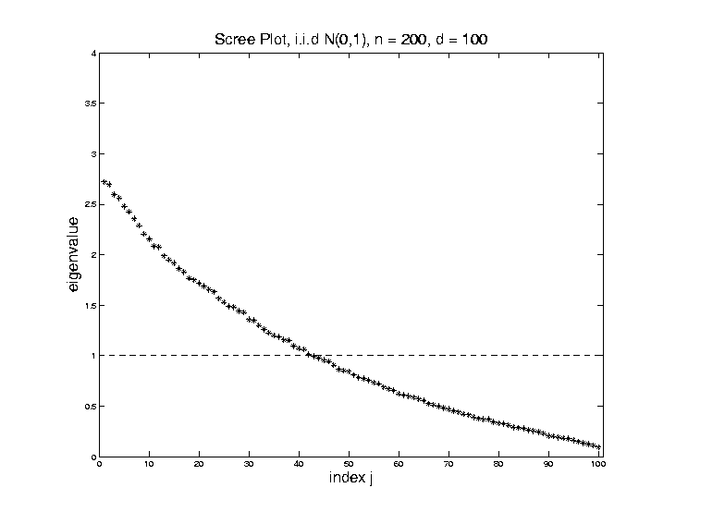
Random Matrix Theory
Smaller $n=200$ Boosts Variation
(More Uncertainty)

Slide 35
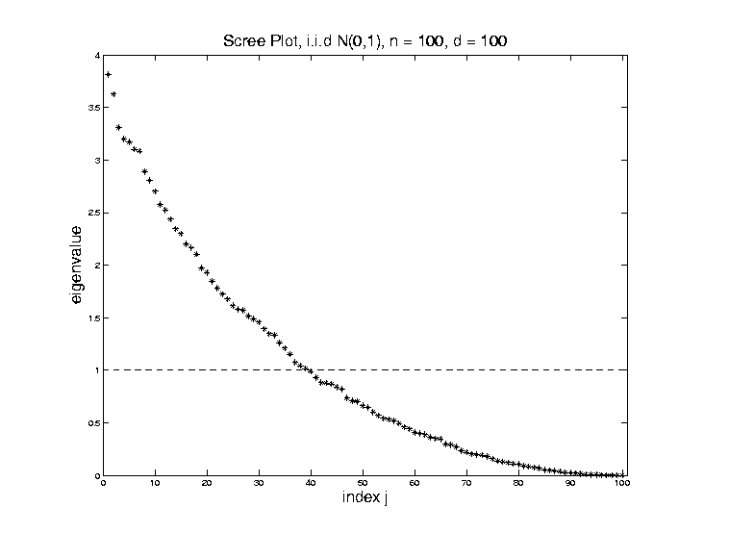
Random Matrix Theory
Smaller $n=100$ Boosts Variation
But Can’t Go Negative
Although
Can Get
Large

Slide 36
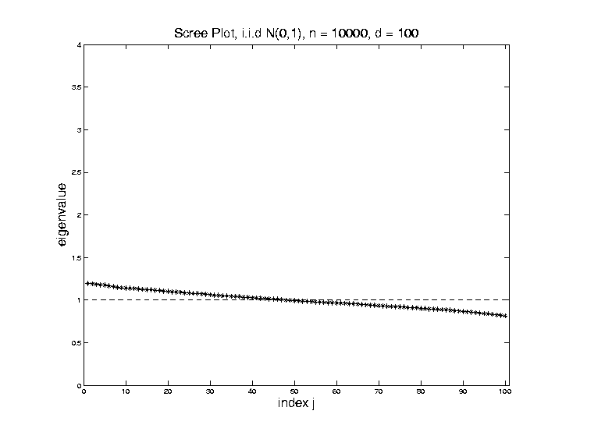
Random Matrix Theory
Larger $n=10,000$ Reduces Variation

Slide 37
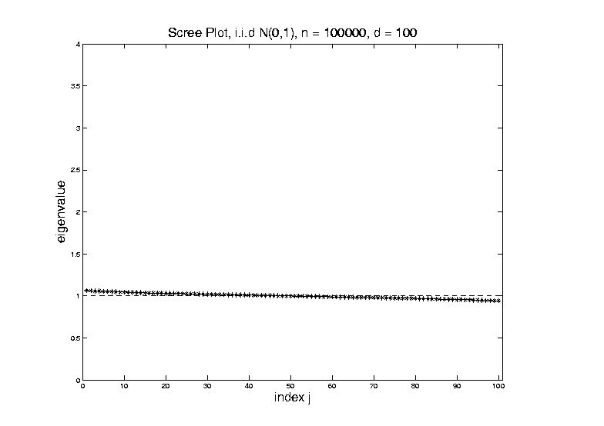
Random Matrix Theory
Larger $n=100,000$ Reduces Variation

Slide 38
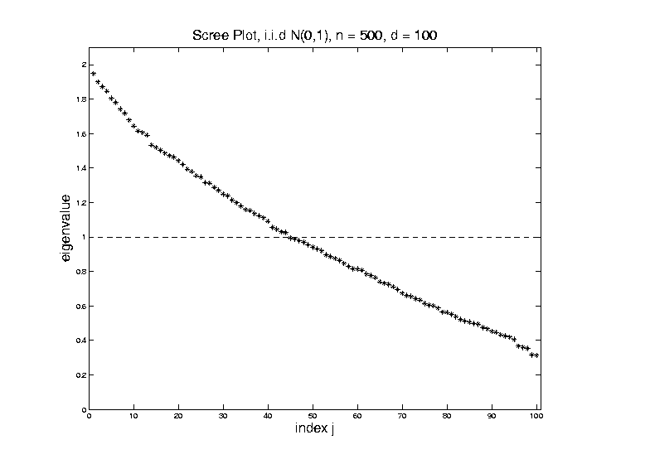
Random Matrix Theory
Fix $y=\frac{d}{n}$, and let $d$, $n$ grow.
Essentially
Same
Shape

Slide 39
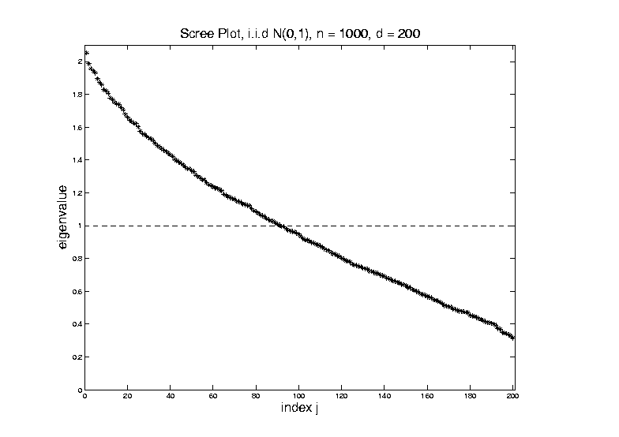
Random Matrix Theory
Fix $y=\frac{d}{n}$, and let $d$, $n$ grow.
Essentially
Same
Shape

Slide 40
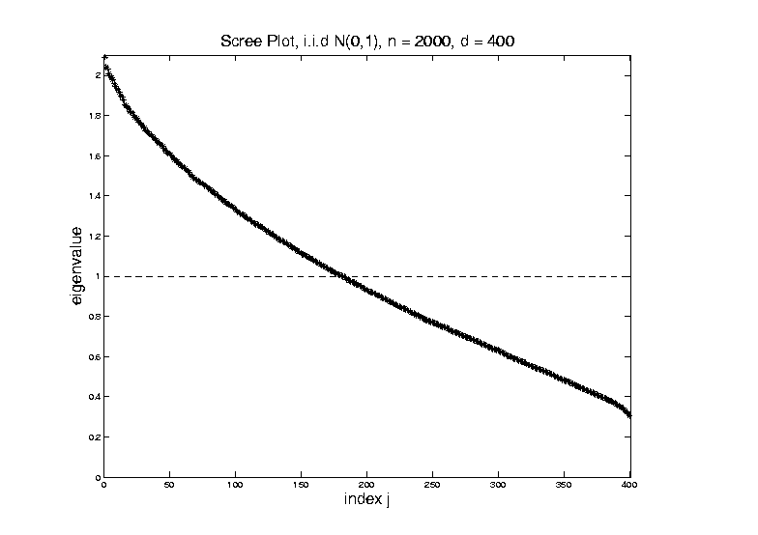
Random Matrix Theory
Fix $y=\frac{d}{n}$, and let $d$, $n$ grow.
But Less
Sampling
Noise

Slide 41
Random Matrix Theory
Fix $y=\frac{d}{n}$, and let $d$, $n$ grow.
But Less
Sampling
Noise

Slide 42
Random Matrix Theory
Fix $y=\frac{d}{n}$, and let $d$, $n$ grow.
What Is
That Shape?

Slide 43
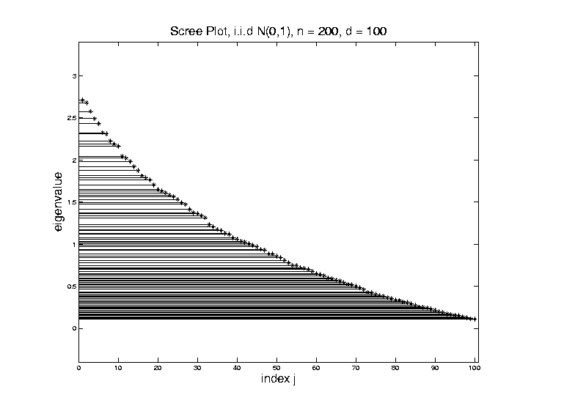
Random Matrix Theory
Shape is Captured by
Empirical Spectral Density
“Density”
Of These
Eigenvalues

Slide 44
Random Matrix Theory
Limiting Spectral Density
(in limit as $n, d→∞$, with $y=\frac{d}{n}$)
References:
Marčenko Pastur (1967)
Yao et al (2015)
Dobriban (2015)

Slide 45
Random Matrix Theory
Limiting Spectral Density
(in limit as $n, d→∞$, with $y=\frac{d}{n}$)
Limit Exists
No Closed Form
But Can Implicitly Define
(Using Integral Equations)
And Numerically Approximate

Slide 46
Random Matrix Theory
Limiting Spectral Density, for given $y=\frac{d}{n}$
Convenient Visualization Interface
By Hyo Young Choi

Slide 47
Random Matrix Theory
LSD:
Above
Case
$n=200,$
$d=100$

Slide 48
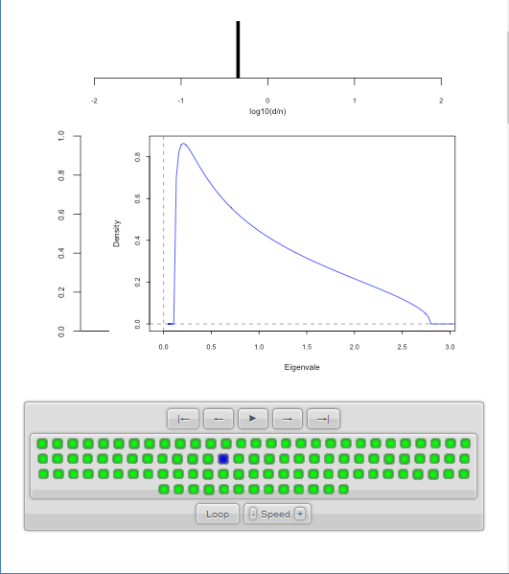
Random Matrix Theory
LSD:
Above
Case
$n=200,$
$d=100,$
$y=0.5$
$\log_{10}{y}=−0.301$

Slide 49
Random Matrix Theory
LSD
Note: These
Have Finite
Support
$⊂(0,∞)$

Slide 50
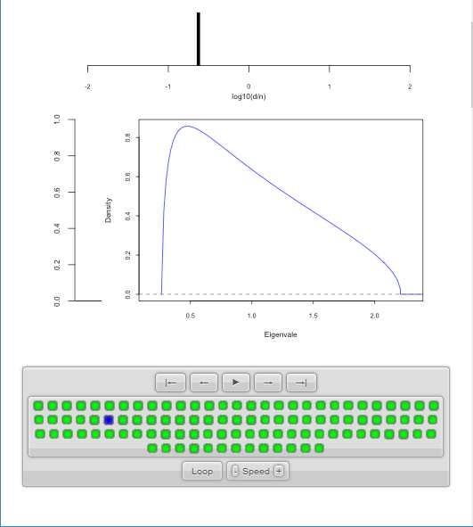
Random Matrix Theory
LSD:
Now Try Smaller
(More Negative)
Values of $y=\frac{d}{n}$

Slide 51
Random Matrix Theory
LSD:
Now Try Smaller
(More Negative)
Values of $y=\frac{d}{n}$

Slide 52
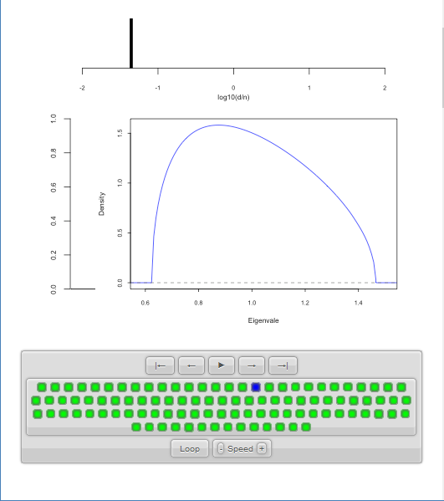
Random Matrix Theory
LSD:
Now Try Smaller
(More Negative)
Values of $y=\frac{d}{n}$
Note: Support
Points $→1$

Slide 53
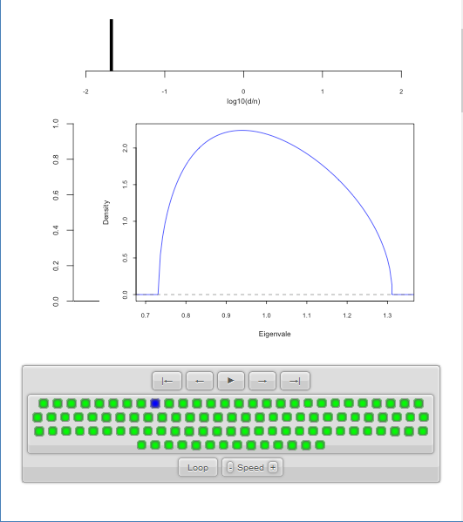
Random Matrix Theory
LSD:
Now Try Smaller
(More Negative)
Values of $y=\frac{d}{n}$

Slide 54
Random Matrix Theory
LSD:
Now Try Smaller
(More Negative)
Values of $y=\frac{d}{n}$
Note: Increasing
Symmetry

Slide 55
Random Matrix Theory
Larger $n=100,000$ Reduces Variation
Recall
Previous
Large $n$
Case,
LSD is
Zooming
In On This

Slide 56
Random Matrix Theory
Limiting Case:
$$\lim_{d→∞}{\lim_{n→∞}{}}$$
Called Medium Dimension High Sample Size
Resulting Density is “Semi-Circle”
$$f\left(x\right)=\frac{2}{πR^{2}}\sqrt{R^{2}−x^{2}}1_{\left[−R,R\right]}(x)$$
Called “Wigner Semi-Circle Distribution”

Slide 57
Random Matrix Theory
Summary:
Have Studied Data Matrix Shapes
Observed:
Convergence to 1
Increasing Symmetry
What About Other Direction (Larger $d$)?

Slide 58
Random Matrix Theory
Consider Growing $d$
Challenge:
Only $n$ Columns in $X$ (so rank $=n$)
Yet $\tilde{Σ}$ is $d×d$
So Have $d−n$ Eigenvalues $=0$

Slide 59
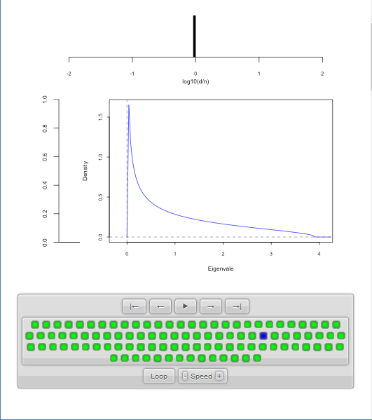
Random Matrix Theory
LSD:
Start With
$y=\frac{d}{n}=1$
Case

Slide 60
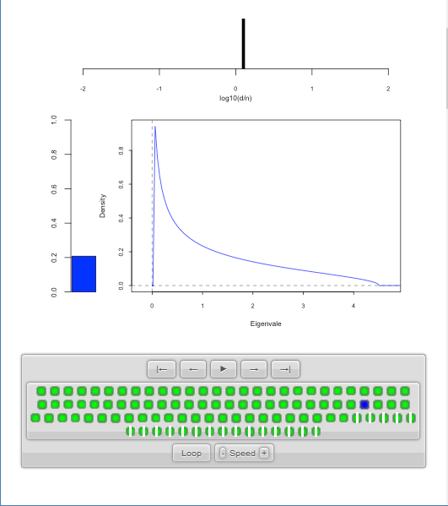
Random Matrix Theory
LSD:
Now Try Larger
Values of $y=\frac{d}{n}$
Proportion of
0 Eigenvalues

Slide 61
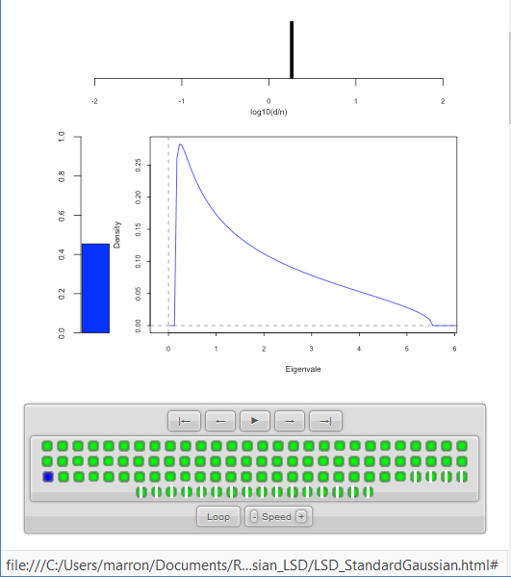
Random Matrix Theory
LSD:
Now Try Larger
Values of $y=\frac{d}{n}$
Spectral Density of
Non-0 Eigenvalues

Slide 62
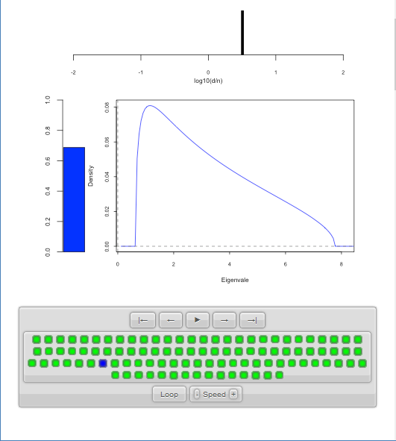
Random Matrix Theory
LSD:
Now Try Larger
Values of $y=\frac{d}{n}$

Slide 63
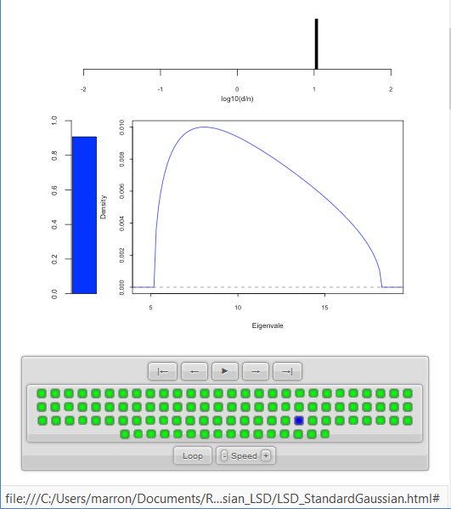
Random Matrix Theory
LSD:
Now Try Larger
Values of $y=\frac{d}{n}$

Slide 64
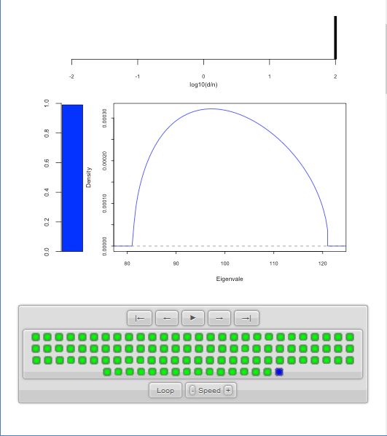
Random Matrix Theory
LSD:
Now Try Larger
Values of $y=\frac{d}{n}$
Again Heads
Towards Semi-Circle
But Small
Proportion

Slide 65
Random Matrix Theory
LSD:
Now Try Larger
Values of $y=\frac{d}{n}$
Note:
Shapes Seem Similar to Above

Slide 66
Random Matrix Theory
LSD: Dual Covariance Variation
Idea: Replace $\tilde{Σ}=\frac{1}{n}XX^{t}$ by $\frac{1}{d}X^{t}X$
Recall:
Rows as Data Objects
Inner Product of $X$
Different Normalization ($d$ not $n$)
N(0,1) Avoids Messy Centering Issues

Slide 67
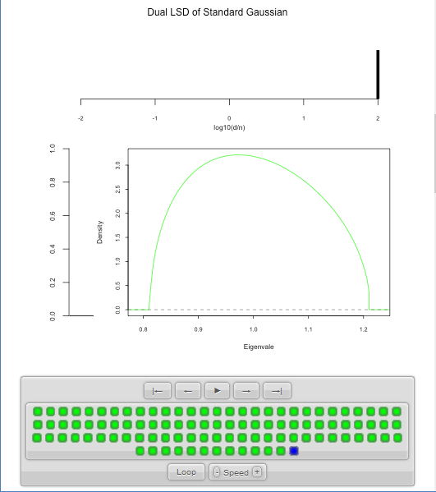
Random Matrix Theory
LSD: Dual Covariance Variation
$y=\frac{d}{n}=100$ Is
Close to Semi-Circle

Slide 68
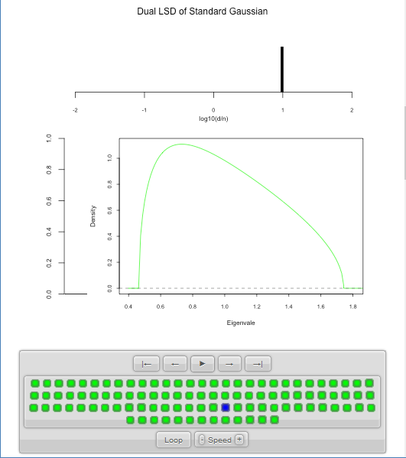
Random Matrix Theory
LSD: Dual Covariance Variation

Slide 69
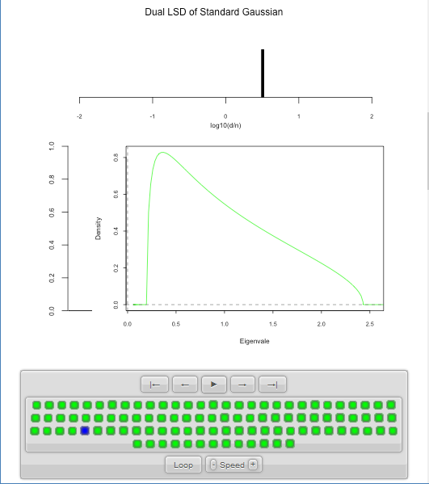
Random Matrix Theory
LSD: Dual Covariance Variation
Seem to Follow
Similar Pattern

Slide 70
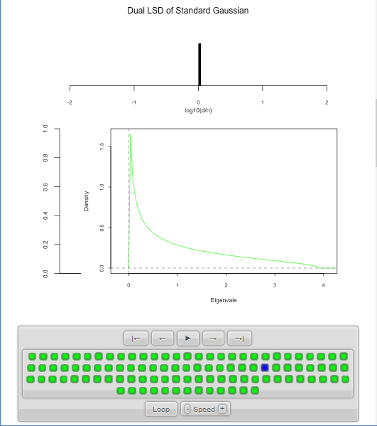
Random Matrix Theory
LSD: Dual Covariance Variation

Slide 71
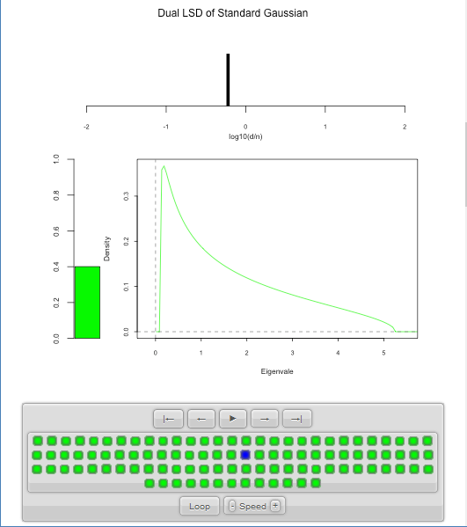
Random Matrix Theory
LSD: Dual Covariance Variation
For $d<n$ Now
Get 0 Eignevalues

Slide 72
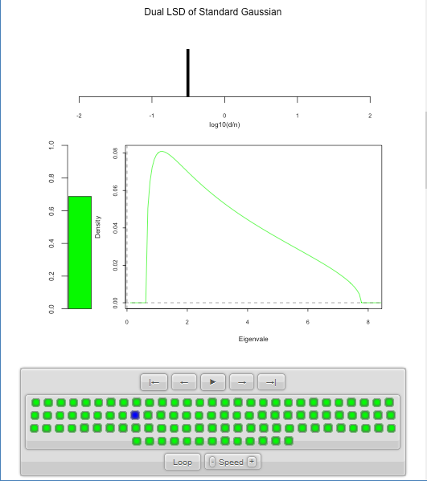
Random Matrix Theory
LSD: Dual Covariance Variation

Slide 73
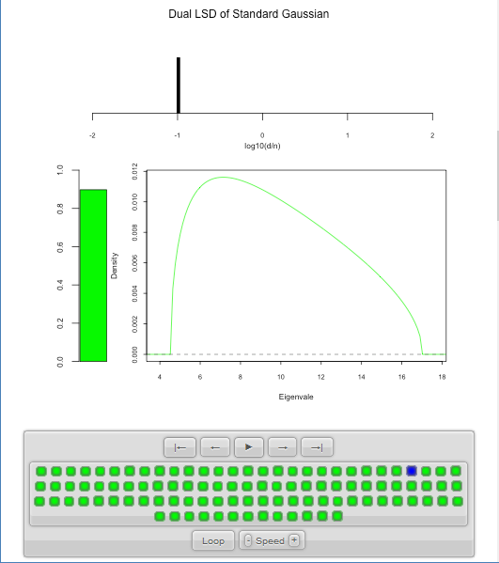
Random Matrix Theory
LSD: Dual Covariance Variation

Slide 74
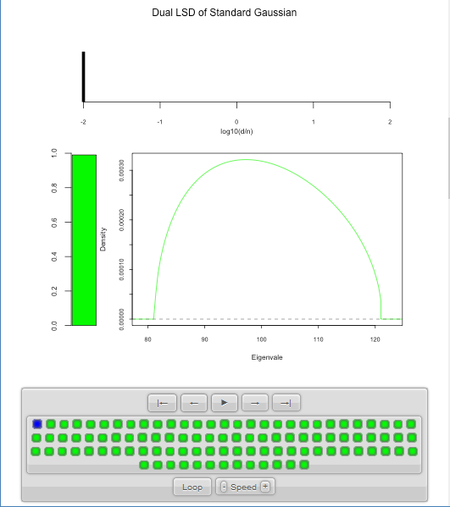
Random Matrix Theory
LSD: Dual Covariance Variation
Again Heads To
Semi-Circle

Slide 75
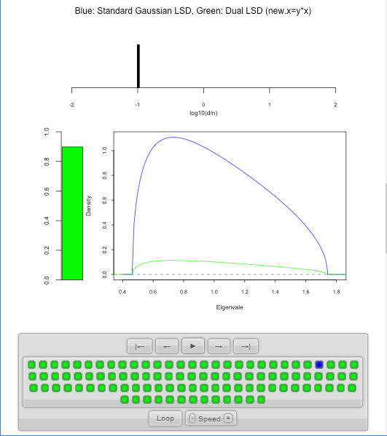
Random Matrix Theory
LSD: Primal & Dual
Overlaid For
Direct
Comparison
Notes:
Area = 1
Area = 1 - Bar

Slide 76
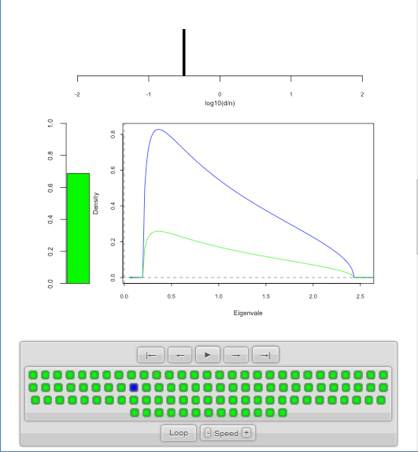
Random Matrix Theory
LSD: Primal & Dual

Slide 77
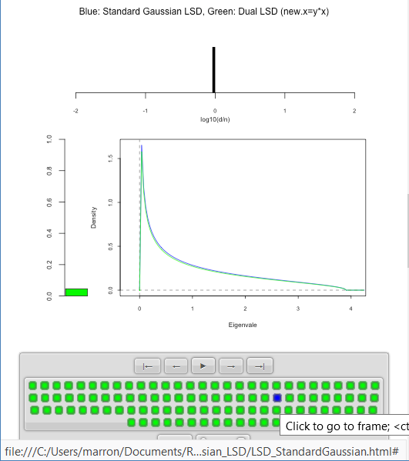
Random Matrix Theory
LSD: Primal & Dual
Very Close
For $d≈n$

Slide 78
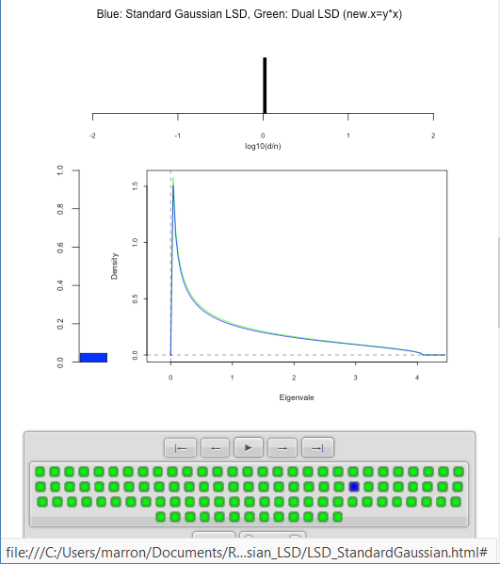
Random Matrix Theory
LSD: Primal & Dual
Very Close
For $d≈n$

Slide 79
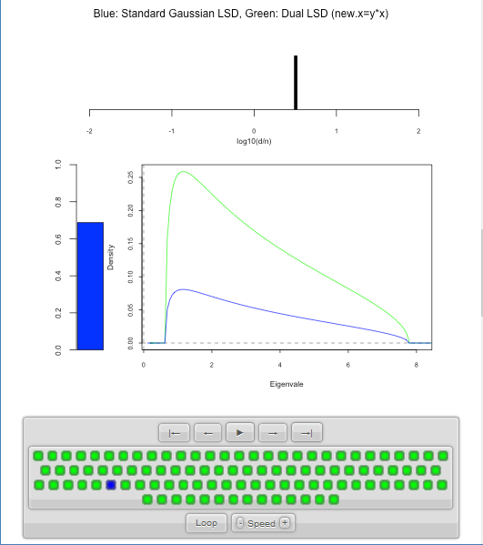
Random Matrix Theory
LSD: Primal & Dual

Slide 80
Random Matrix Theory
LSD: Primal & Dual

Slide 81
Random Matrix Theory
LSD: Primal & Dual

Slide 82
Random Matrix Theory
LSD: Rescaled
Primal & Dual
$\sqrt{y}×LSD$
(underneath)
$\frac{1}{\sqrt{y}}×Dual LSD$

Slide 83
Random Matrix Theory
LSD: Rescaled
Primal & Dual

Slide 84
Random Matrix Theory
LSD: Rescaled
Primal & Dual

Slide 85
Random Matrix Theory
LSD: Rescaled
Primal & Dual

Slide 86
Random Matrix Theory
LSD: Rescaled
Primal & Dual

Slide 87
Random Matrix Theory
LSD: Rescaled
Primal & Dual

Slide 88
Random Matrix Theory
Conclusion:
Family of Marcenko – Pastur Distributions
Has Several Interesting Symmetries

Slide 89
Random Matrix Theory
Important Parallel Theory:
Distribution of Largest Eigenvalue
(Assuming Matrix of i.i.d. N(0,1)s)
Tracey Widom (1994)
Good Discussion of Statistical Implications
Johnstone (2008)

Slide 90
Participant Presentations
Zhengling Qi
Classification in personalized medicine
Zhiyuan Liu
CPNS Visualization in Pablo
Fuhui Fang
DiProPerm Analysis of OsteoArthritis Data

