Slide 1
OODA Big Picture
New Topic:
Curve Registration
Main Reference:
Srivastava et al (2011)

Slide 2
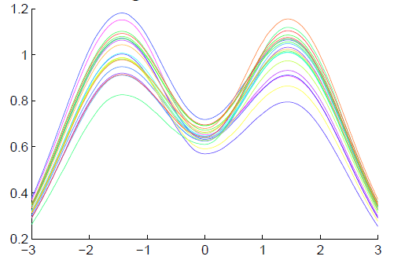
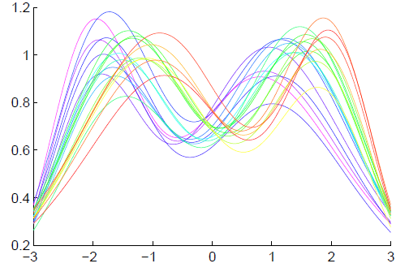
Functional Data Analysis
Insightful
Decomposition
Vertical Variation
Horiz’l
Var’n

Slide 3
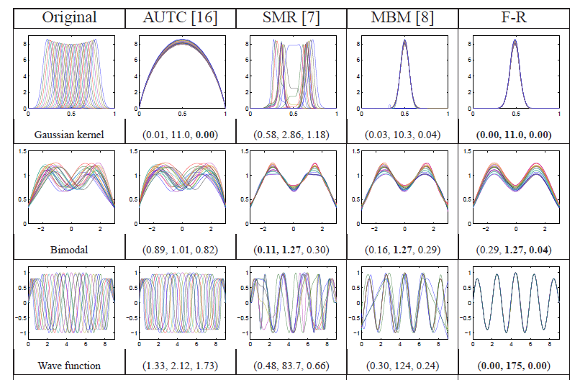
Challenge (Illustrated)
Thanks to Wei Wu

Slide 4
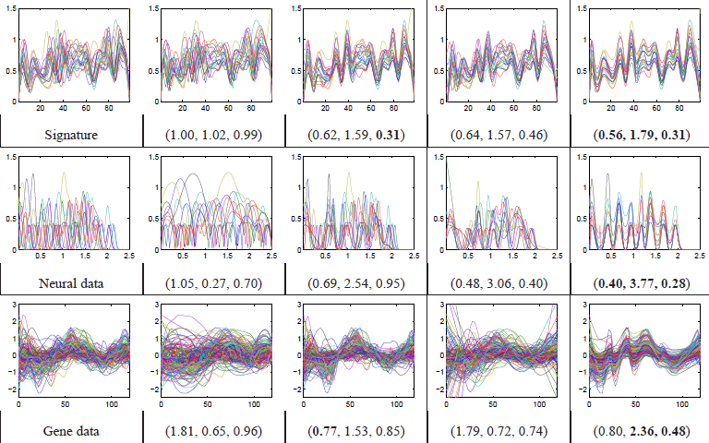
Challenge (Illustrated)
Thanks to Wei Wu

Slide 5
Time Warping Intuition
Elastically Stretch & Compress Axis
$γ\left(x\right)$

Slide 6
Curve Registration
Say curves $f_{1}(x)$ and $f_{2}(x)$ are equivalent,
$$f_{1}≈f_{2}$$
When $∃γ$ so that
$$f_{1}\left(γ\left(x\right)\right)=f_{1}∘γ\left(x\right)=f_{2}(x)$$

Slide 7
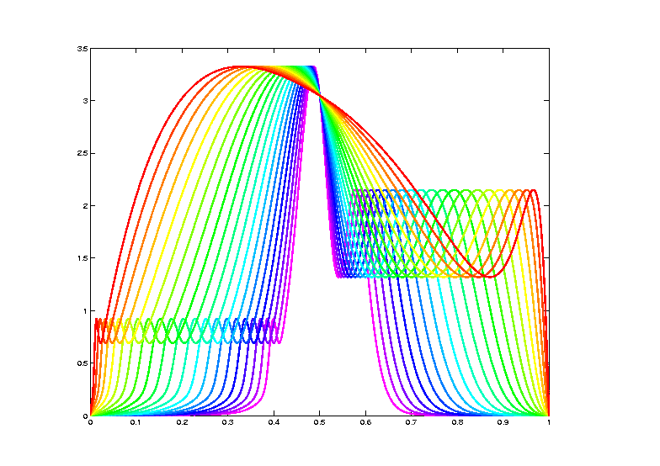
Data Objects I
Equivalence Classes of Curves
(Set of All
Warps of
Given Curve)
Notation: $\left[f\right]=\left\{f∘γ: γ∈Γ\right\}$
for a “representor” $f\left(x\right)$

Slide 8
Metrics in Curve Space
$$\inf_{γ}\left\|f_{1}−\left(f_{2}∘γ\right)\right\|≠\inf_{γ}\left\|f_{2}−\left(f_{1}∘γ\right)\right\|$$
Note:
Very
Different
L² norms
Thanks to
Xiaosun Lu

Slide 9
Metrics in Curve Space
Warp Invariant Metric $d$
Developed in context of:
Likelihood Geometry
Fisher – Rao Metric:
$$d_{FR}\left(f_{1},f_{2}\right)=d_{FR}\left(f_{1}∘γ,f_{2}∘γ\right)$$

Slide 10
Metrics in Curve Space
Fisher – Rao Metric:
Computation Based on
Square Root Velocity Function (SRVF)
$$q_{f}\left(t\right)=\frac{\dot{f}\left(t\right)}{\sqrt{\left|\dot{f}\left(t\right)\right|}}$$
Where
$\dot{f}\left(t\right)=\frac{∂}{∂t}f(t)$
Signed Version
Of Square Root
Derivative

Slide 11
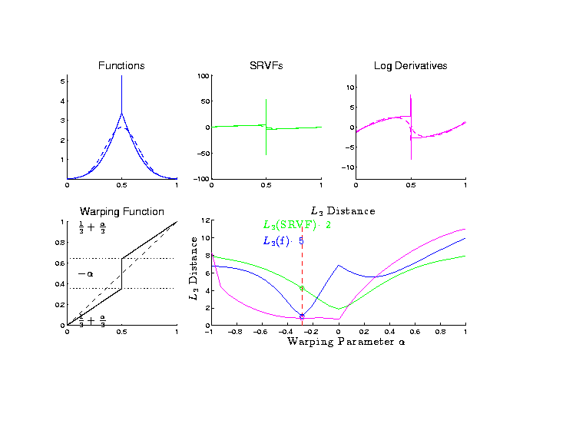
Metrics in Curve Space
Why
square
roots?

Slide 12
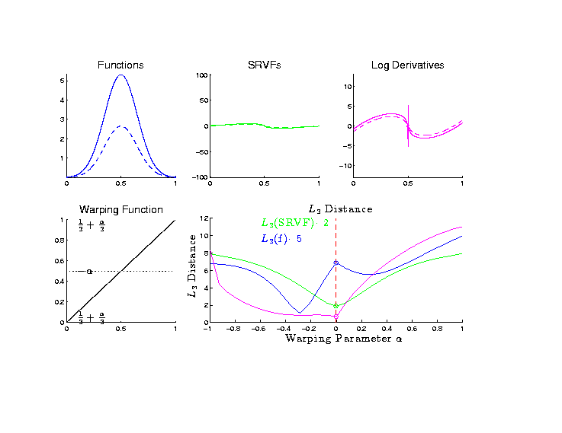
Metrics in Curve Space
Why
square
roots?

Slide 13
Metrics in Curve Space
Note on SRVF representation:
$$d_{FR}\left(f_{1},f_{2}\right)={\left\|q_{1}−q_{2}\right\|}_{2}$$
Can show: Warp Invariance
$$d_{FR}\left(f_{1},f_{2}\right)=d_{FR}\left(f_{1}∘γ,f_{2}∘γ\right)$$
Follows from Jacobean calculation

Slide 14
Metrics in Curve Quotient Space
Above was Invariance for Individual Curves
Now extend to:
Equivalence Classes of Curves
I.e. Orbits as Data Objects
I.e. Quotient Space

Slide 15
Metrics in Curve Quotient Space
Define Metric on Equivalence Classes:
For $\left[f_{1}\right]$ & $\left[f_{2}\right]$, i.e. $\left[q_{1}\right]$ & $\left[q_{2}\right]$
$$d\left(\left[f_{1}\right],\left[f_{2}\right]\right)=\inf_{γ∈Γ}\left\|q_{1}−q_{2}∘γ\right\|$$
Independent of Choice of $f_{1}$ & $f_{2}$
By Warp Invariance

Slide 16
Mean in Curve Quotient Space
Benefit of a Metric:
Allows Definition of a “Mean”
Fréchet Mean
Geodesic Mean
Barycenter
Karcher Mean

Slide 17
Mean in Curve Quotient Space
“Most Representative” $μ_{n}$ in$\left[μ\right]$
Given a candidate $μ$
Consider warps to each $q_{i}$
Choose $μ_{n}$ to make
Karcher mean of warps = Identity
(under Fisher Rao metric)

Slide 18
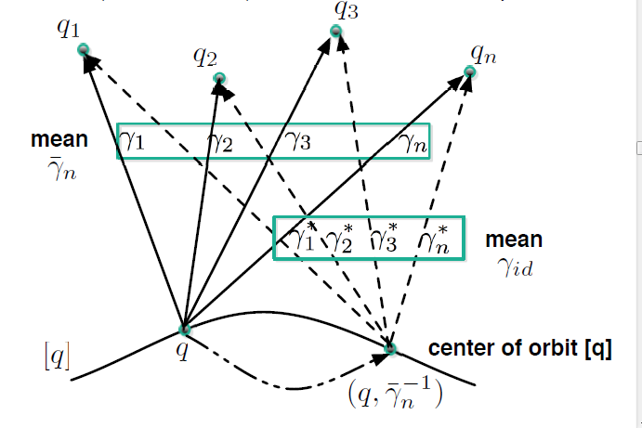
Mean in Curve Quotient Space
“Most Representative” $μ_{n}$ in$\left[μ\right]$
Thanks to Anuj Srivastava

Slide 19
More Data Objects
Final Curve Warps:
Warp Each Data Curve, $f_{1}, ⋯,f_{n}$
To Template Mean, $μ_{n}$
Denote Warp Functions $γ_{1}, ⋯,γ_{n}$
Gives (Roughly Speaking):
Vertical Components $f_{1}∘γ_{1}, ⋯,f_{n}∘γ_{n}$
(Aligned Curves)
Horizontal Components $γ_{1}, ⋯,γ_{n}$
Data Objects I

Slide 20
More Data Objects
Data Objects II
Final Curve Warps:
Warp Each Data Curve, $f_{1}, ⋯,f_{n}$
To Template Mean, $μ_{n}$
Denote Warp Functions $γ_{1}, ⋯,γ_{n}$
Gives (Roughly Speaking):
Vertical Components $f_{1}∘γ_{1}, ⋯,f_{n}∘γ_{n}$
(Aligned Curves)
Horizontal Components $γ_{1}, ⋯,γ_{n}$
~ Kendall’s Shapes

Slide 21
More Data Objects
Final Curve Warps:
Warp Each Data Curve, $f_{1}, ⋯,f_{n}$
To Template Mean, $μ_{n}$
Denote Warp Functions $γ_{1}, ⋯,γ_{n}$
Gives (Roughly Speaking):
Vertical Components $f_{1}∘γ_{1}, ⋯,f_{n}∘γ_{n}$
(Aligned Curves)
Horizontal Components $γ_{1}, ⋯,γ_{n}$
Data Objects III
~ Chang’s Transfo’s

Slide 22
Computation
Several Variations of
Dynamic Programming
Done by Eric Klassen, Wei Wu

Slide 23
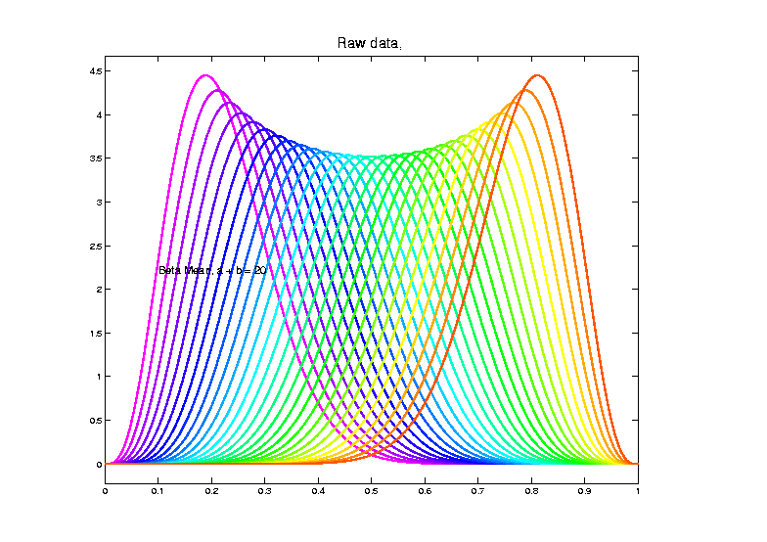
Toy Example
Raw
Data

Slide 24
Toy Example
Raw
Data
Both
Horizontal
And
Vertical
Variation

Slide 25
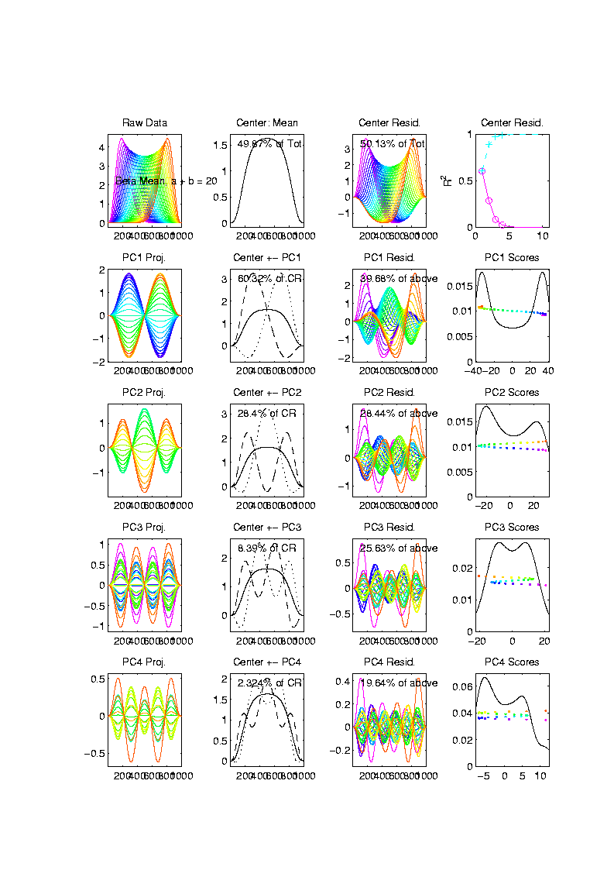
Toy Example
Conventional
PCA
Projections

Slide 26
Toy Example
Conventional
PCA
Projections
Power
Spread
Across
Spectrum

Slide 27
Toy Example
Conventional
PCA
Projections
Power
Spread
Across
Spectrum

Slide 28
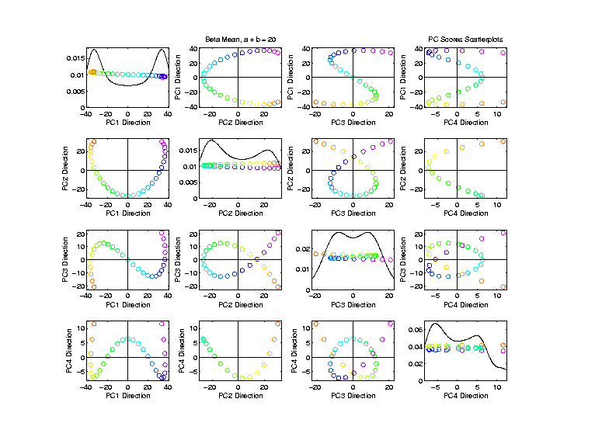
Toy Example
Conventional
PCA
Scores

Slide 29
Toy Example
Conventional
PCA
Scores
Views of
1-d Curve
Bending
Through
4 Dim’ns’

Slide 30
Toy Example
Conventional
PCA
Scores
Patterns
Are
“Harmonics”
In Scores

Slide 31
Toy Example
Scores Plot
Shows Data
Are “1”
Dimensional
So Need
Improved
PCA Decomp.

Slide 32
Visualization
Vertical Variation:
PCA on Aligned Curves, $f_{1}∘γ_{1}, ⋯,f_{n}∘γ_{n}$
Projected Curves

Slide 33
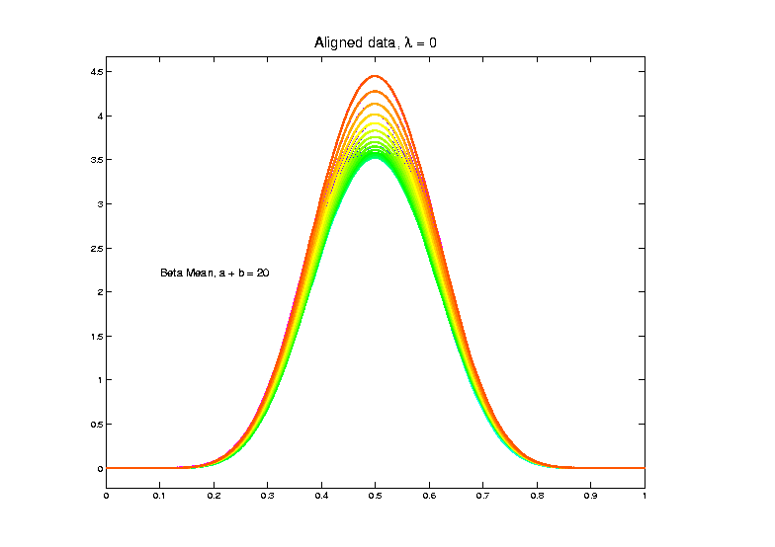
Toy Example
Aligned
Curves
(Clear
1-d
Vertical
Var’n)

Slide 34
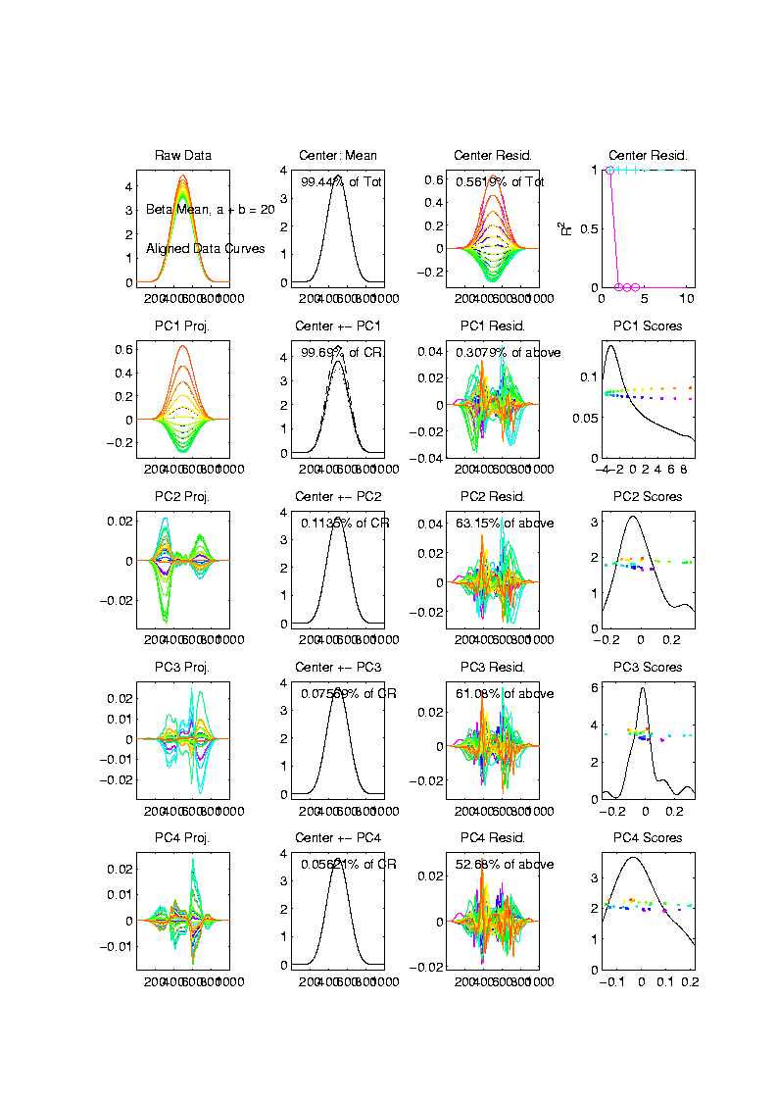
Toy Example
Aligned
Curve
PCA
Projections
All Var’n
In 1st
Component

Slide 35
Visualization
Horizontal Variation:
PCA on Warps, $γ_{1}, ⋯,γ_{n}$
Projected Curves

Slide 36
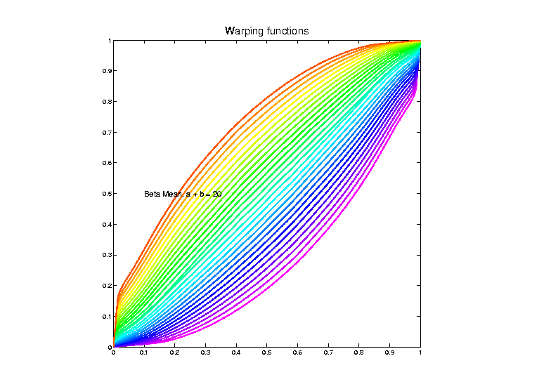
Toy Example
Estimated
Warps

Slide 37
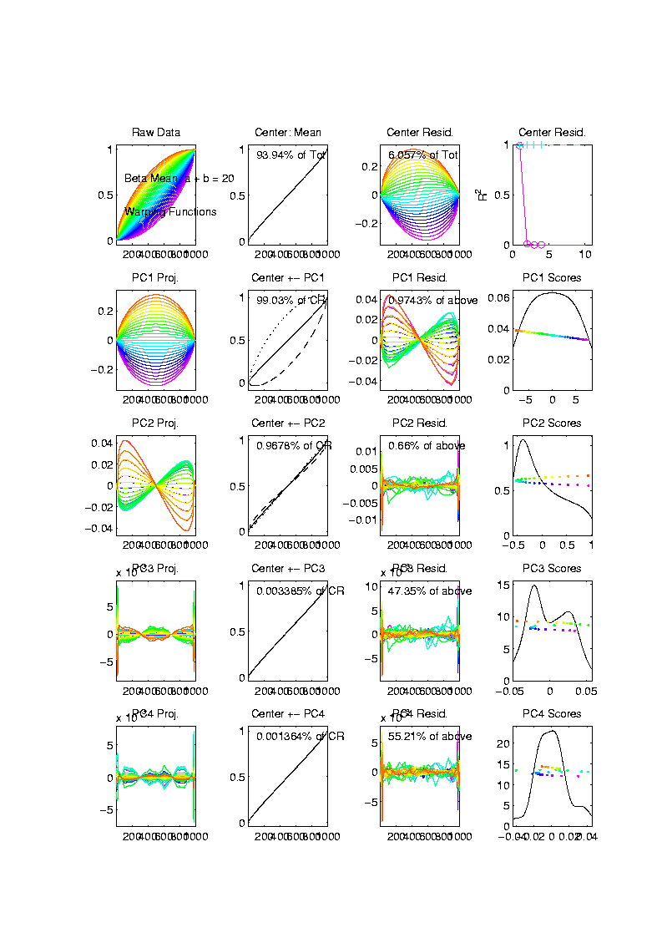
Toy Example
Warps,
PC
Projections

Slide 38
Toy Example
Warps,
PC
Projections
Mostly
1st PC

Slide 39
Toy Example
Warps,
PC
Projections
Mostly
1st PC,
But 2nd
Helps Some

Slide 40
Toy Example
Warps,
PC
Projections
Rest is
Not
Important

Slide 41
Toy Example
Horizontal Var’n Visualization Challenge:
(Complicated) Warps Hard to Interpret
Approach:
Apply Warps to Template Mean
(PCA components)

Slide 42
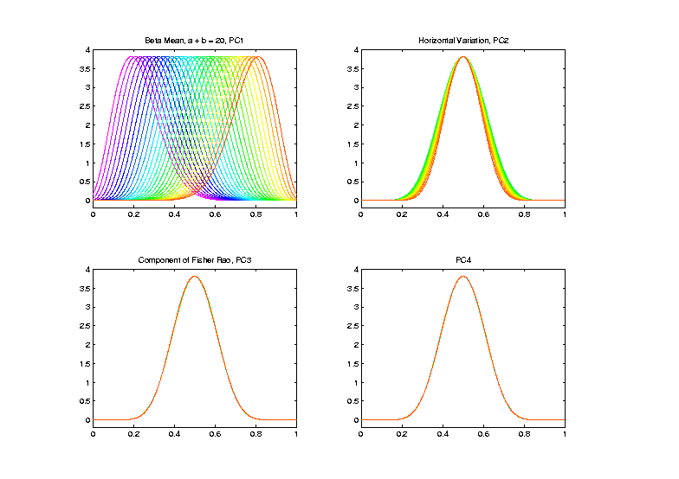
Toy Example
Warp
Compon’ts
(+ Mean)
Applied to
Template
Mean

Slide 43
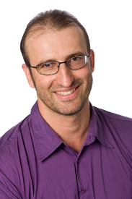
TIC testbed
Serious Data Challenge:
TIC (Total Ion Count) Chromatograms
Modern type of “chemical spectra”
Thanks to Peter
Hoffmann

Slide 44
TIC testbed
Serious Data Challenge:
TIC (Total Ion Count) Chromatograms
Reference: Koch et al (2014)

Slide 45
TIC testbed
Raw Data: 15 TIC Curves (5 Colors)

Slide 46
TIC testbed
Special Feature: Answer Key of Known Peaks
Found by
Major
Time &
Labor
Investment

Slide 47
TIC testbed
Special Feature: Answer Key of Known Peaks
Goal:
Find
Warps
To Align
These

Slide 48
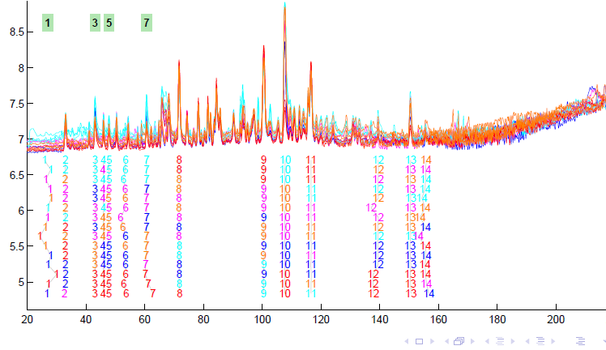
TIC testbed
Fisher – Rao Alignment

Slide 49
TIC testbed
Fisher – Rao Alignment
Spike-In
Peaks

Slide 50
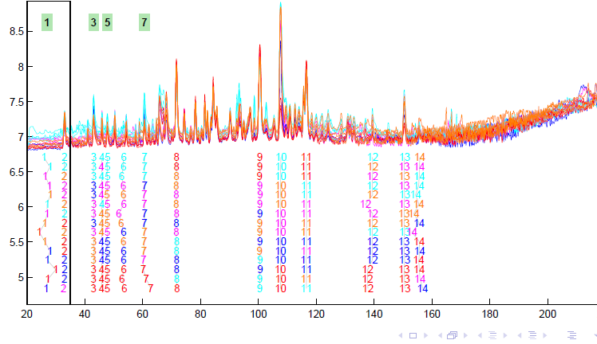
TIC testbed
Next Zoom in on This Region

Slide 51
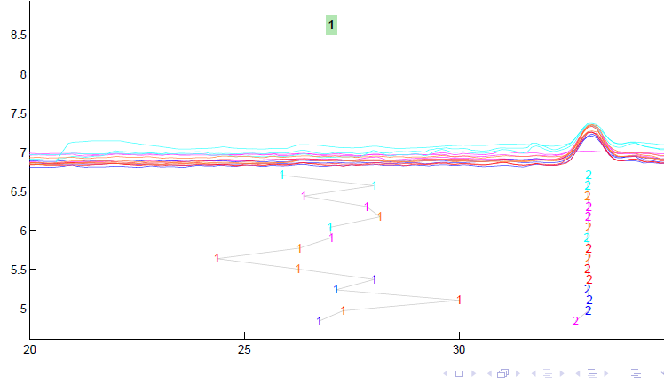
TIC testbed
Zoomed Fisher – Rao Alignment

Slide 52
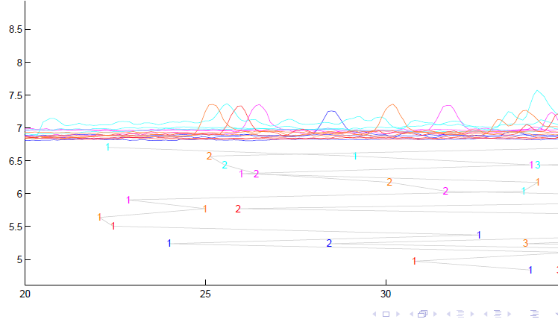
TIC testbed
Before Alignment

Slide 53
TIC testbed
Next Zoom in on This Region

Slide 54
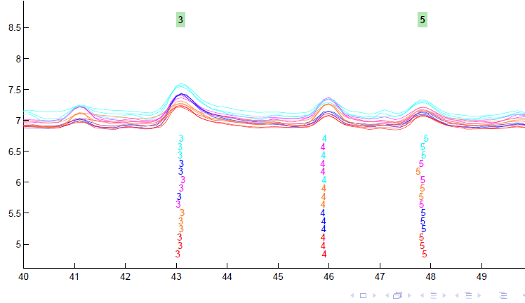
TIC testbed
Zoomed Fisher – Rao Alignment

Slide 55
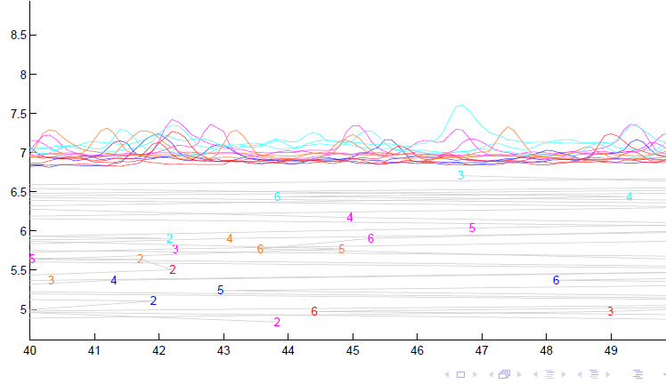
TIC testbed
Before Alignment

Slide 56
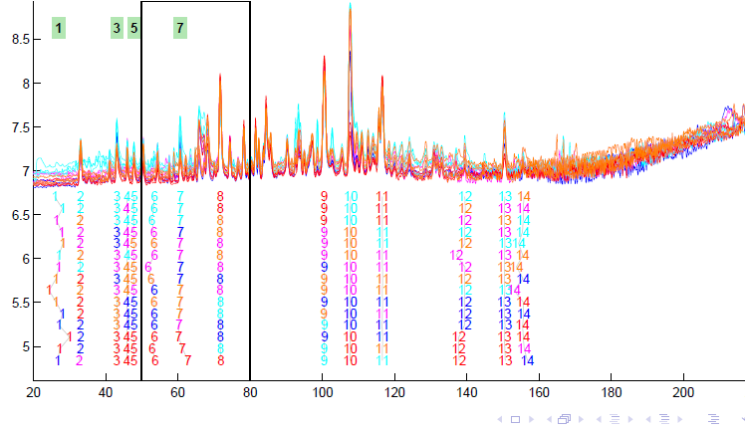
TIC testbed
Next Zoom in on This Region

Slide 57
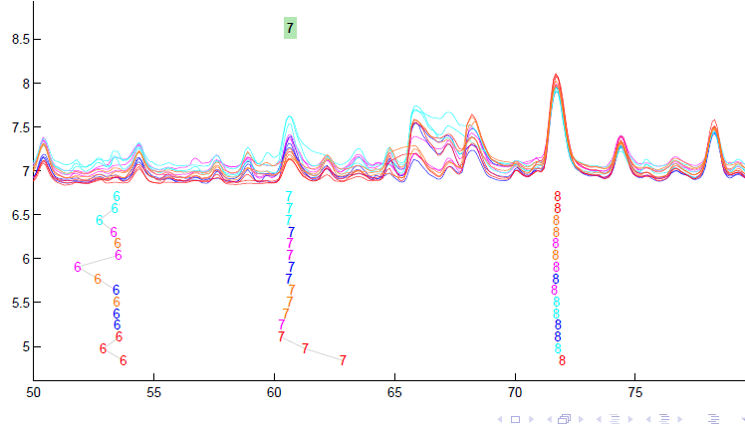
TIC testbed
Zoomed Fisher – Rao Alignment

Slide 58
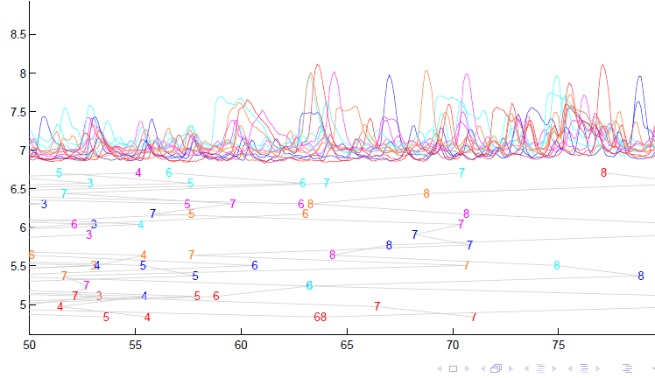
TIC testbed
Before Fisher-Rao Alignment

Slide 59
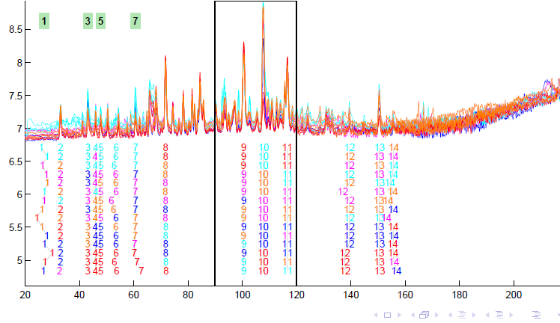
TIC testbed
Next Zoom in on This Region

Slide 60
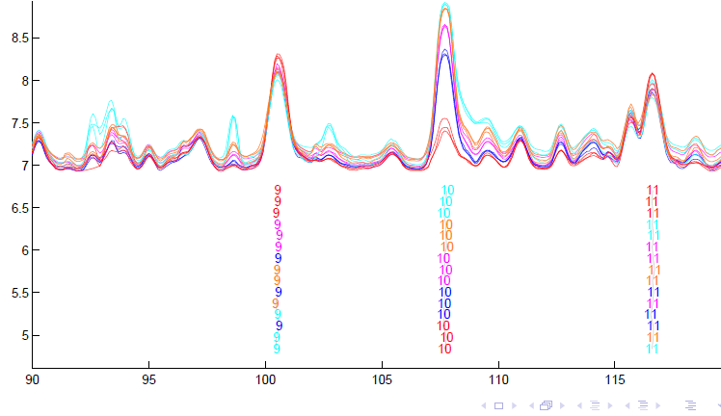
TIC testbed
Zoomed Fisher – Rao Alignment

Slide 61
TIC testbed
Zoomed Fisher – Rao Alignment
Note:
Very
Challenging

Slide 62
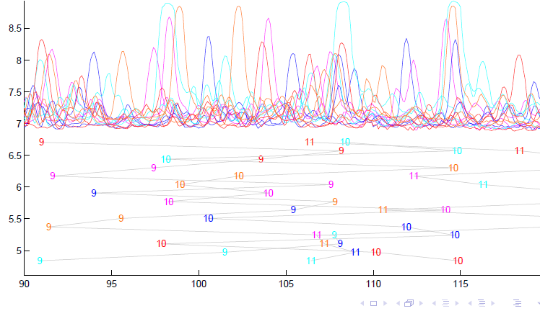
TIC testbed
Before Alignment

Slide 63
TIC testbed
Next Zoom in on This Region

Slide 64
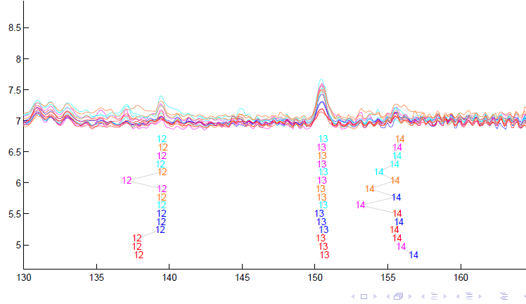
TIC testbed
Zoomed Fisher – Rao Alignment

Slide 65
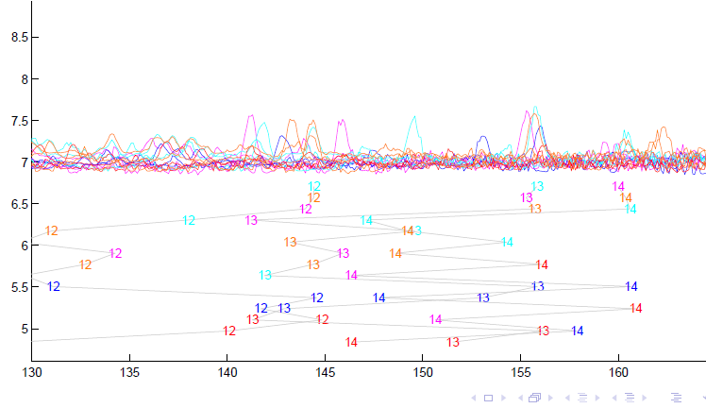
TIC testbed
Before Alignment

Slide 66
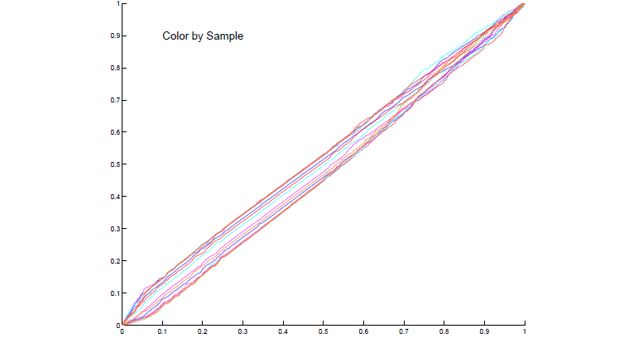
TIC testbed
Warping Functions

Slide 67
Refined Calculations
More Recent Development:
Better Exploit Manifold Data Space:
$$q_{i}∈S^{d}$$
Principal Nested Spheres
Reference: Yu et al (2017)

Slide 68
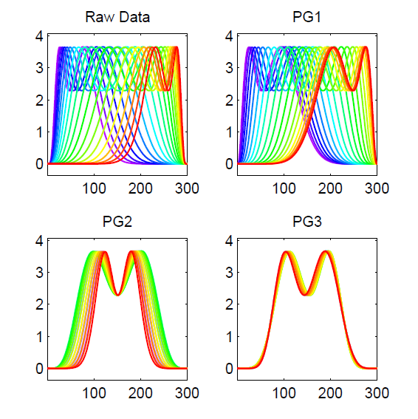
PNS on SRVF Sphere
Toy Example
Tangent Space PCA
(on Horiz. Var’n)
Thanks to Xiaosun Lu

Slide 69
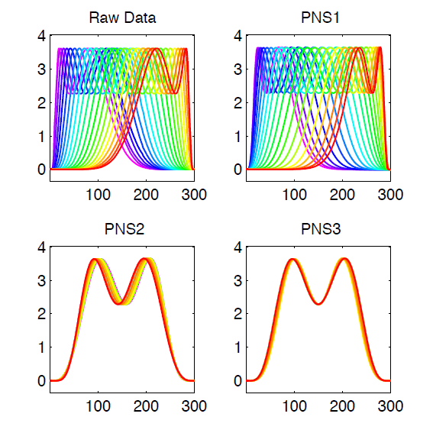
PNS on SRVF Sphere
Toy Example
PNS Projections
(Fewer Modes)

Slide 70
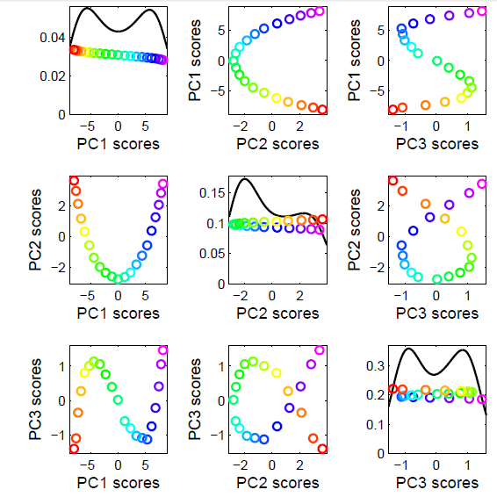
PNS on SRVF Sphere
Toy Example
Tangent Space PCA
Note: 3 Comp’s
Needed for This

Slide 71
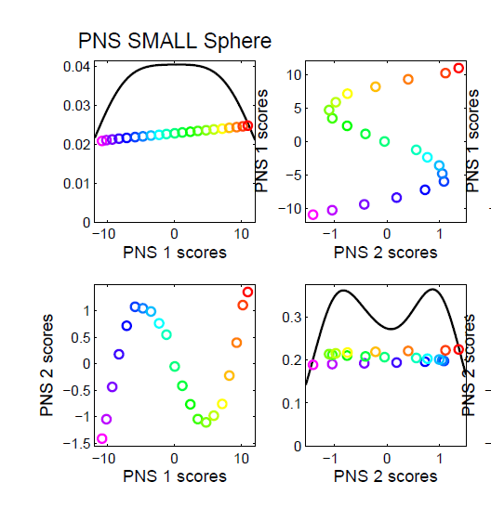
PNS on SRVF Sphere
Toy Example
PNS Projections
Only 2 for This

Slide 72
PNS on SRVF Sphere
Toy Example
Parametrized
By Values
At 1/3 And 2/3

Slide 73
PNS on SRVF Sphere
Toy Example
View As Points
Tangent Plane PC 1
PNS 1
Boundary of
Nonnegative
Orthant

Slide 74
PNS on SRVF Sphere
Toy Example
Curves from
Tangent Plane PC 1
Note: Some Are
No Longer Warps!

Slide 75
PNS on SRVF Sphere
Toy Example
View As Points
PNS 1
Good 1-d
Approx.

Slide 76
PNS on SRVF Sphere
Toy Example
Recall Original
Warps

Slide 77
PNS on SRVF Sphere
Toy Example
Another View
$∗$ Raw Warps
$⊡$Tangent PC1
$∘$ PNS 1

Slide 78
PNS on SRVF Sphere
Real Data Analysis: Blood Glucose Curves
Interpolation to Handle Missing Data

Slide 79
PNS on SRVF Sphere
Real Data Analysis: Blood Glucose Curves
Results of Fisher Rao Decomposition

Slide 80
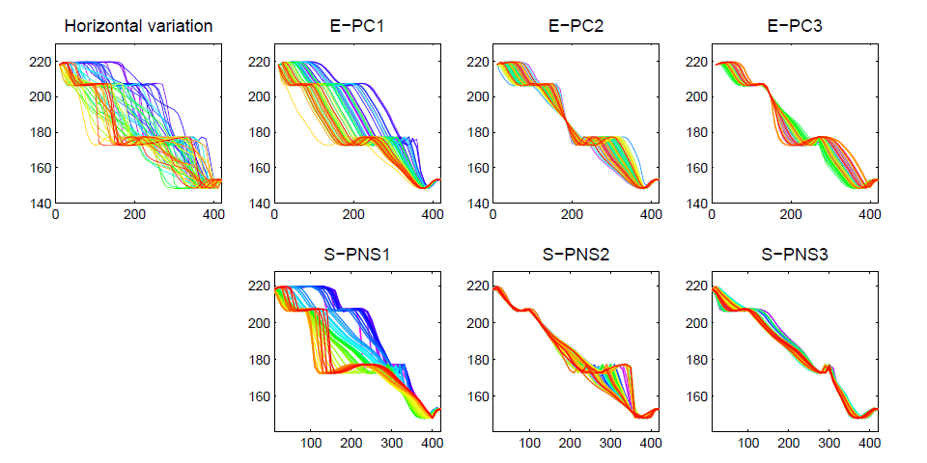
PNS on SRVF Sphere
Real Data Analysis: Blood Glucose Curves

Slide 81
PNS on SRVF Sphere
Real Data Analysis: Blood Glucose Curves
Understand PNS 1 Mode
Of Variation, Using
Equally Spaced Scores

Slide 82
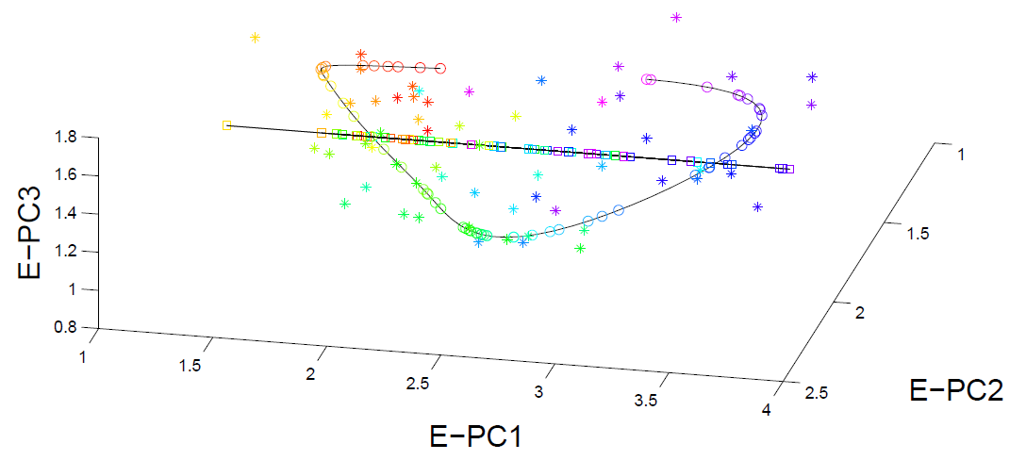
PNS on SRVF Sphere
Real Data Analysis: Blood Glucose Curves

Slide 83
Juggling Data
Michael Newton – U. Wisconsin
Data from Ramsay et al (2014)
(Vertical Location vs. Time)
While Juggling
Thanks of Theravive.com

Slide 84
Juggling Data
Time
Traces
Cut Into
Time
Blocks:
(Data
Objects)

Slide 85
Juggling Data
Ampitude – Phase Variation Decomposition
(Analysis from Lu & Marron (2014))

Slide 86
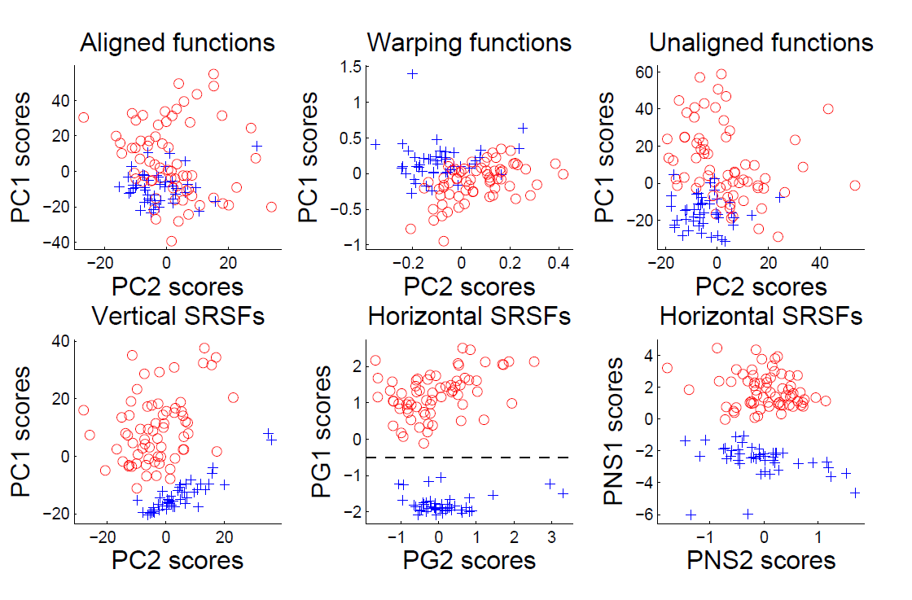
Juggling Data
Clustering In Phase Variation Space:

Slide 87
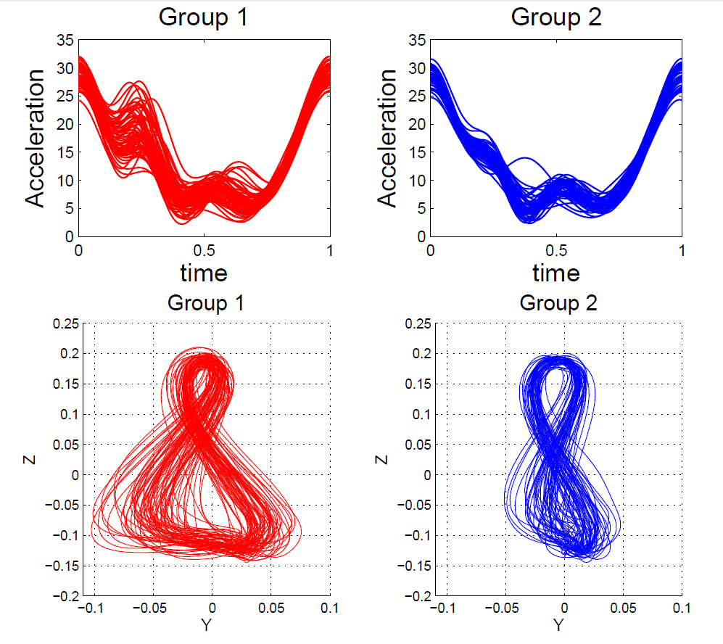
Juggling Data
Interpretation
of Clusters

Slide 88
References for Much More
Big Picture Survey:
Marron et al (2015)
Results of a Competition:
Marron et al (2014)

Slide 89
Overview
Curve Registration is Slippery
Thus, Careful Mathematics is Useful
Fisher-Rao Approach:
Gets the Math Right
Intuitively Sensible
Computable
Generalizable
Worth the Complication

Slide 90
Probability Distributions as Data Objects
Interesting Question:
What is “Best” Representation?
(Which Function ~ Distributions?)
Density Function? (Very Interpretable)
Cumulative Distribution Function
Quantile Function (Recall Inverse of CDF)

Slide 91
Probability Distributions as Data Objects
Recall Representations of Distributions

Slide 92
Probability Distributions as Data Objects
Recall Representations of Distributions

Slide 93
Probability Distributions as Data Objects
Recall Representations of Distributions

Slide 94
Probability Distributions as Data Objects
Recall Representations of Distributions

Slide 95
Probability Distributions as Data Objects
Interesting Question:
What is “Best” Representation?
(Which Function ~ Distributions?)
Density Function? (Very Interpretable)
Cumulative Distribution Function
Quantile Function (Recall Inverse of CDF)

Slide 96
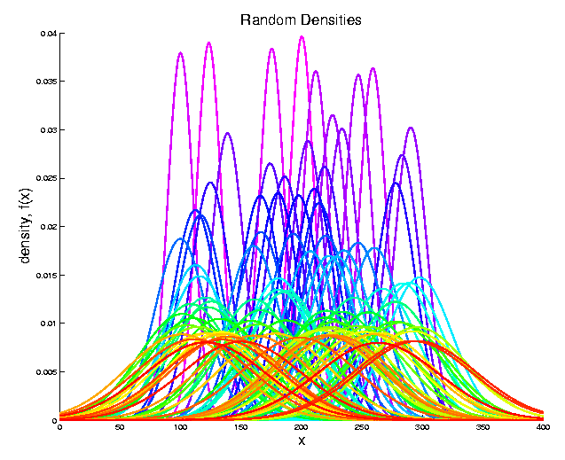
Probability Distributions as Data Objects
Consider Set of Random Gaussian Densities
(Differing
$μ$ & $σ^{2}$)

Slide 97
Probability Distributions as Data Objects
PCA of
Random
Densities
Power
Spread
Across
Spectrum

Slide 98
Probability Distributions as Data Objects
PCA of
Random
Densities
Note:
Harmonics

Slide 99
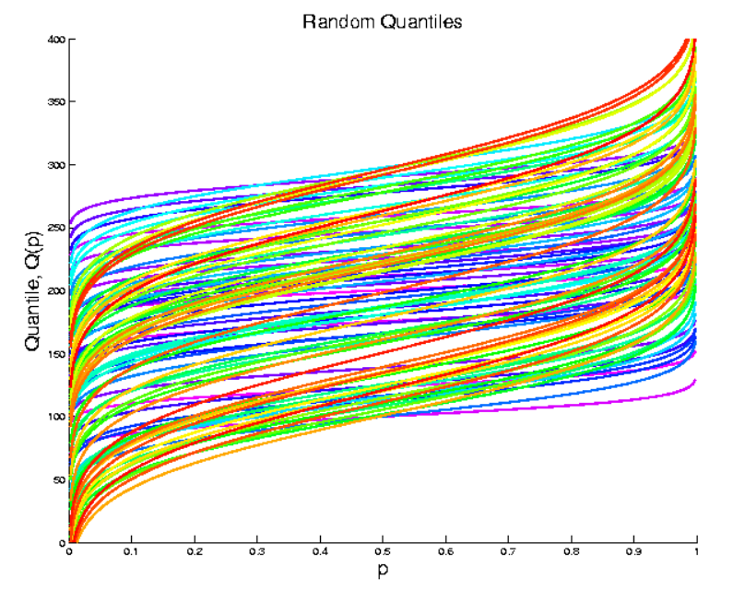
Probability Distributions as Data Objects
Now Try Quantile Representation (Same E.g.)

Slide 100
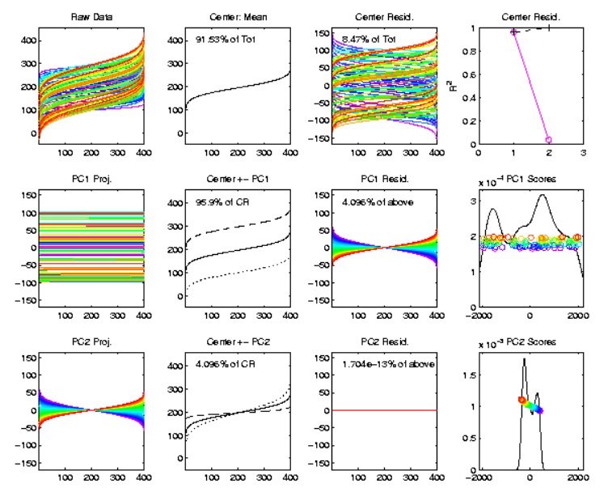
Probability Distributions as Data Objects
PCA of
Quantile
Rep’ns
Only 2
Modes!
Shift
Tilt

Slide 101
Probability Distributions as Data Objects
Conclusion:
Quantile Representation Best for Typical 2 “First” Modes of Variation
(Essentially Linear Modes)
Density & C. D. F. Generally Much Worse
(Natural Modes are Non-Linear)

Slide 102
Participant Presentations
Yumeng Wang
Efficacy Analysis
Jiawei Xu
Childbirth and Breast Cancer Risk

