Slide 1
An Interesting Question
How generally applicable is
Backwards approach to PCA?
An Attractive Answer:
James Damon, UNC Mathematics
Key Idea: Express Backwards PCA as
Nested Series of Constraints

Slide 2
General View of Backwards PCA
Define Nested Spaces via Constraints
E.g. SVD $S_{k}=\left\{x :x=\sum_{j=1}^{k}{c_{j}\vec{u_{j}}}\right\}$
Now Define:
$$S_{k−1}=\left\{x∈S_{k} :\left\langle x,\vec{u_{k}}\right\rangle =0\right\}$$
Constraint Gives Nested Reduction of Dim’n

Slide 3
Vectors of Angles
Vectors of Angles as Data Objects
$$\left(\begin{matrix}θ_{1} \\ ⋮ \\ θ_{d}\end{matrix}\right)∈{\left(S^{1}\right)}^{d}$$
Slice space ${\left(S^{1}\right)}^{d}$ with hyperplanes????
(ala Principal Nested Spheres)

Slide 4
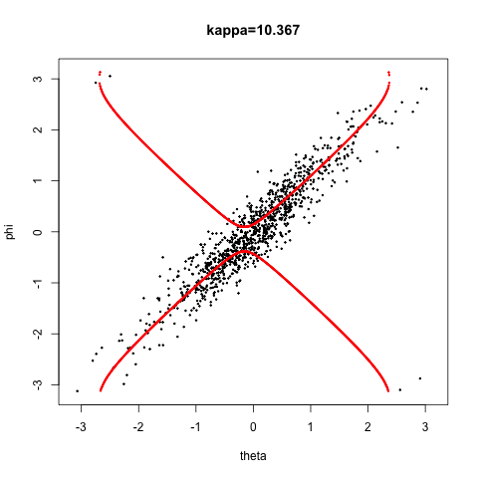
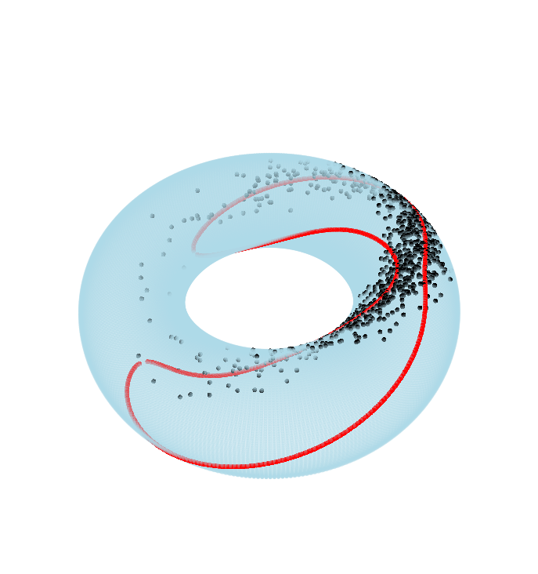
Vectors of Angles
E.g. $d=2$, Data w/ “Single Mode of Var’n”
Best Fitting Planar Slice gives Bimodal Dist’n
Special Thanks to
Eduardo García-Portugués

Slide 5
Torus Space $S^{1}×S^{1}$
Try To
Fit A
Geodesic
Challenge:
Can Get
Arbitrarily
Close

Slide 6
Torus Space $S^{1}×S^{1}$
Fit Nested
Sub-Manifold

Slide 7
PNS Main Idea
Data Objects: $X_{1},⋯,X_{n}∈S_{d}⊆ℝ^{d+1}$
Where $S_{d}$ is a $d$ dimensional manifold
Consider a nested series of sub-manifolds:
$$𝒮=\left\{S_{0},⋯,S_{d−1}\right\}$$
where for $j=0,⋯,d−1$
$dim\left(S_{j}\right)=j$ and $S_{j}⊆S_{j+1}$
Goal: Fit all of $𝒮$ simultaneously to $X_{1},⋯X_{n}$

Slide 8
General Background
Call each $S_{j}$ a stratum,
so $𝒮$ is a manifold stratification
To be fit to $X_{1},⋯X_{n}$
New Approach:
Simultaneously fit $𝒮=\left\{S_{0},⋯,S_{d−1}\right\}$
Nested Submanifold (NS)

Slide 9
Projection Notation
For $j=0,⋯,d−1$ let $P^{(k)}$ denote the telescoping projection onto $S_{k}$
I.e. for $X∈S_{d}$
$P^{(k)}=P_{k}\left(P_{k+1}\left(⋯P_{d−1}\left(X\right)\right)\right)$
Note: This projection is fundamental to Backwards PCA methods

Slide 10
PNS Components
For a given $𝒮$, represent a point $X∈S_{d}$
by its Nested Submanifold components:
$\left\{c_{1}\left(X\right),⋯,c_{d}(X)\right\}$
where for $j=1,⋯,d$
$c_{j}\left(X\right)=P^{\left(j\right)}\left(X\right)−P^{\left(j−1\right)}(X)$
In the sense that “$A−B$” means the shortest geodesic arc between $A$ & $B$

Slide 11
Nested Submanifold Fits
Simultaneous Fit Criteria?
Based on Stratum-Wise Sums of Squares
For $j=1,⋯,d$ define
$${SS}_{j}=\sum_{i=1}^{n}{{d\left(P^{\left(j\right)}\left(X_{i}\right),P^{\left(j−1\right)}\left(X_{i}\right)\right)}^{2}}$$
Uses “lengths” of NS Components:
$$c_{j}\left(X\right)=P^{\left(j\right)}\left(X\right)−P^{\left(j−1\right)}(X)$$

Slide 12
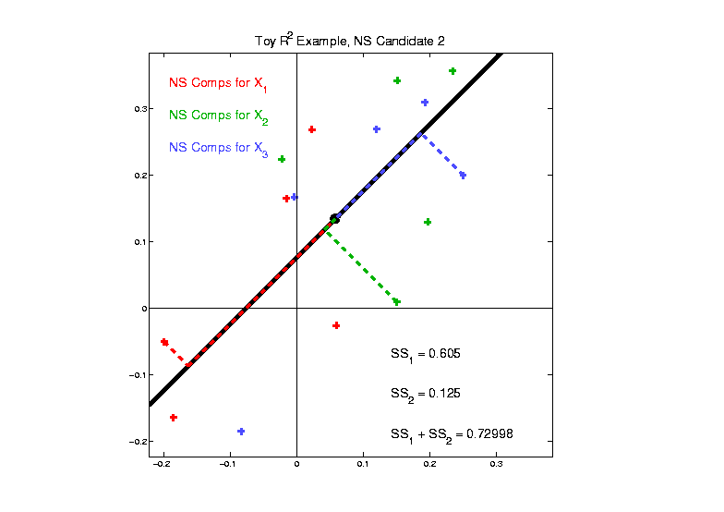
NS Components in $ℝ^{2}$
NS Candidate 2
(Shifted
$S_{0}$ to
Sample
Mean)
Note: Both
${SS}_{1}$ & ${SS}_{2}$
Decrease

Slide 13
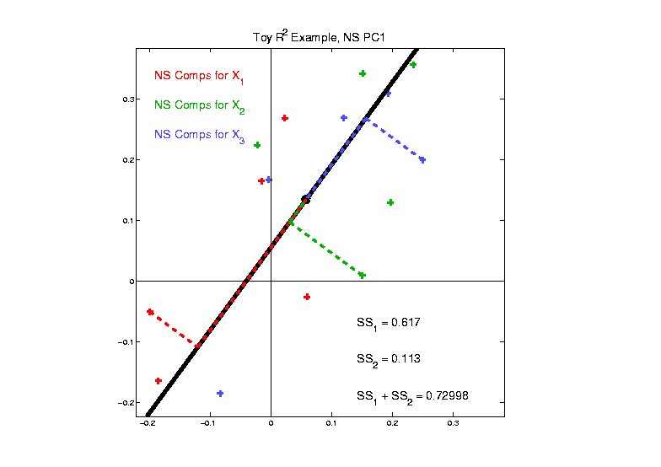
NS Components in $ℝ^{2}$
NS based
On PC1
Note:
${SS}_{1} ↑$
${SS}_{2} ↓$
Yet ${SS}_{1}+{ SS}_{2}$ is Constant
(Pythagorean Thm)

Slide 14
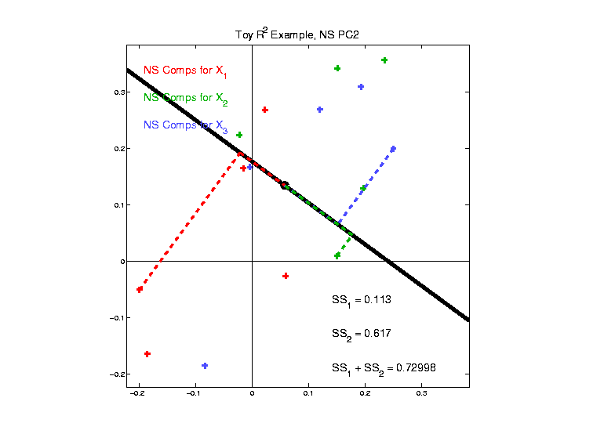
NS Components in $ℝ^{2}$
NS based
On PC2
Note:
${SS}_{1} ↓$
${SS}_{2} ↑$
${SS}_{1}+ {SS}_{2}$ is Constant
(Pythagorean Thm)

Slide 15
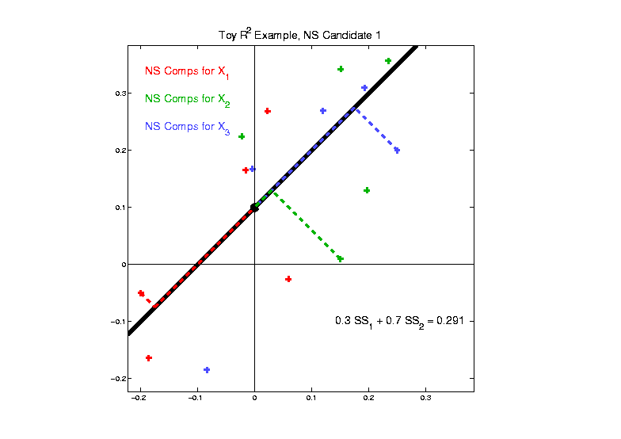
NS Components in $ℝ^{2}$
NS Candidate 1

Slide 16
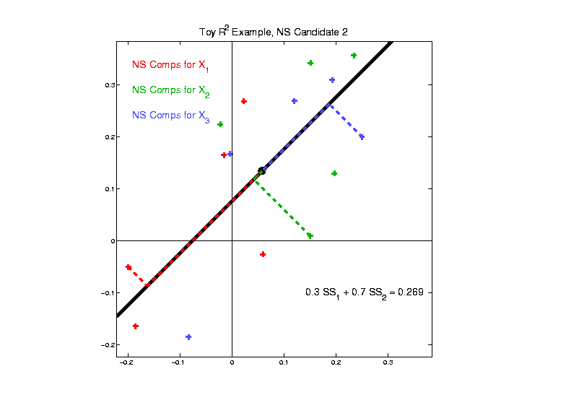
NS Components in $ℝ^{2}$
NS Candidate 2
$0.3×{SS}_{1}+0.7×{SS}_{2} ↓$

Slide 17
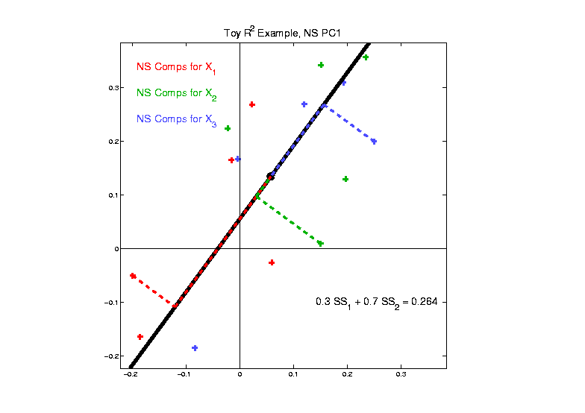
NS Components in $ℝ^{2}$
NS based
On PC1
$0.3×{SS}_{1}+0.7×{SS}_{2} ↓$

Slide 18
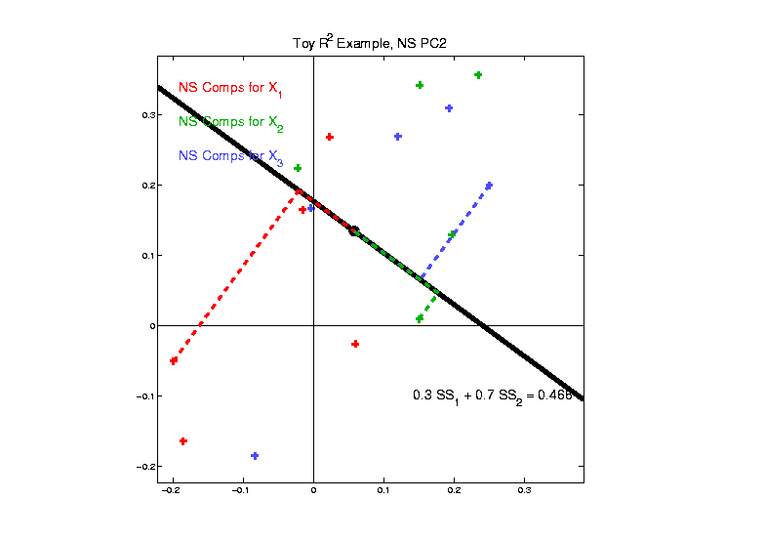
NS Components in $ℝ^{2}$
NS based
On PC2
$0.3×{SS}_{1}+0.7×{SS}_{2} ↑$

Slide 19
Nested Submanifold Fits
Simultaneously fit $𝒮=\left\{S_{0},⋯,S_{d−1}\right\}$
Simultaneous Fit Criterion?
$$w_{1}{SS}_{1}+w_{2}{SS}_{2}+⋯+w_{d}{SS}_{d}$$
Above Suggests Want:
$$w_{1}<w_{2}<⋯<w_{d}$$
Works for Euclidean PCA (?)

Slide 20
Nested Submanifold Fits
Simultaneous Fit Criterion?
$$w_{1}{SS}_{1}+w_{2}{SS}_{2}+⋯+w_{d}{SS}_{d}$$
Above Suggests Want:
$$w_{1}<w_{2}<⋯<w_{d}$$
Important Predecessor
Pennec (2016)
AUC Criterion: $w_{j}∝(j−1)$

Slide 21
Pennec’s Area Under the Curve
$$100\%$$
Based on
Scree Plot
$${SS}_{1}$$
$${SS}_{2}$$
$${SS}_{3}$$
$${SS}_{4}$$
$$1$$
2
$$3$$
$$4$$
Component Index

Slide 22
Pennec’s Area Under the Curve
$$100\%$$
Based on
Scree Plot
Cumulative
$${SS}_{1}$$
$${SS}_{2}$$
$${SS}_{3}$$
$${SS}_{4}$$
$$1$$
2
$$3$$
$$4$$
Component Index

Slide 23
Pennec’s Area Under the Curve
$$100\%$$
Based on
Scree Plot
Cumulative
Area =
${SS}_{2}+2{SS}_{3}+3{SS}_{4}$
$${SS}_{1}$$
$${SS}_{2}$$
$${SS}_{3}$$
$${SS}_{4}$$
$$1$$
$$2$$
$$3$$
$$4$$
Component Index

Slide 24
Torus Space $S^{1}×S^{1}$
Fit Nested
Sub-Manifold
Choice of
$w_{1}$ & $w_{2}$ in:
$w_{1}{SS}_{1}+w_{2}{SS}_{2}$
???

Slide 25
Torus Space $S^{1}×S^{1}×⋯×S^{1}$
Tiled ${(−π,π]}^{d}$ embedding is complicated
(maybe OK for low rank approx.)
Instead Consider Nested Sub-Torii
Work in Progress with Garcia, Wood, Le
Key Factor: Important Modes of Variation

Slide 26
OODA Big Picture
New Topic:
Curve Registration
Main Reference:
Srivastava et al (2011)

Slide 27
Collaborators
Anuj Srivastava (Florida State U.)
Wei Wu (Florida State U.)
Derek Tucker (Florida State U.)
Xiaosun Lu (U. N. C.)
Inge Koch (U. Adelaide)
Peter Hoffmann (U. Adelaide)
J. O. Ramsay (McGill U.)
Laura Sangalli (Milano Polytech.)

Slide 28
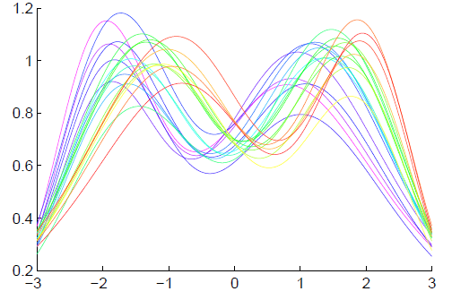
Context
Functional Data Analysis
Curves as Data Objects
Toy Example:

Slide 29
Context
Functional Data Analysis
Curves as Data Objects
Toy Example:
How Can We
Understand
Variation?

Slide 30
Context
Functional Data Analysis
Curves as Data Objects
Toy Example:
How Can We
Understand
Variation?

Slide 31
Context
Functional Data Analysis
Curves as Data Objects
Toy Example:
How Can We
Understand
Variation?

Slide 32
Functional Data Analysis
Insightful
Decomposition

Slide 33
Functional Data Analysis
Insightful
Decomposition
Horiz’l
Var’n

Slide 34
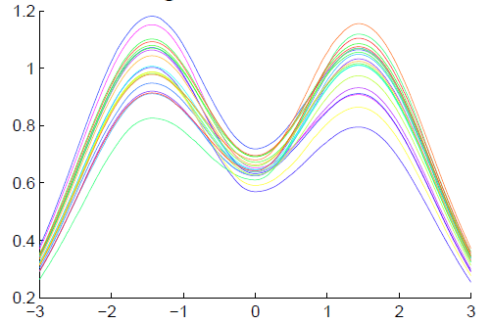
Functional Data Analysis
Insightful
Decomposition
Vertical Variation
Horiz’l
Var’n

Slide 35
Challenge
Fairly Large Literature
Many (Diverse) Past Attempts
Limited Success (in General)
Surprisingly Slippery
(even mathematical formulation)

Slide 36
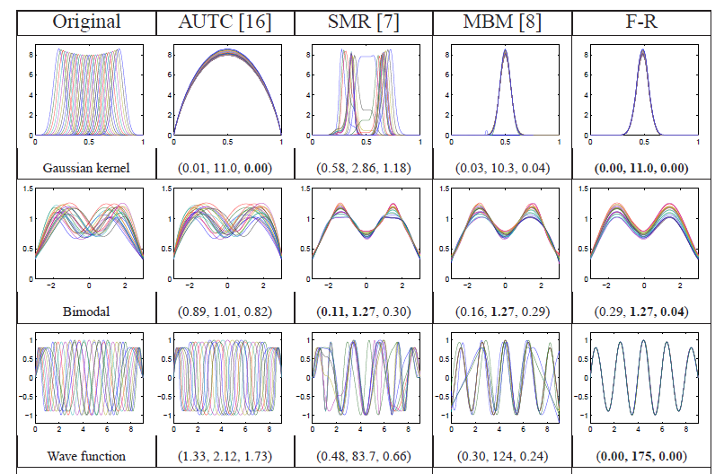
Challenge (Illustrated)
Thanks to Wei Wu

Slide 37
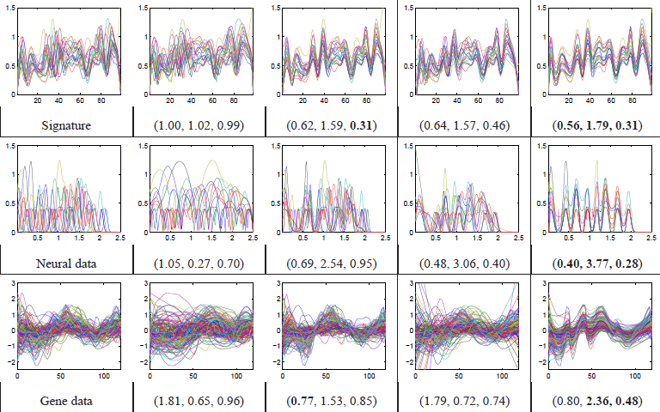
Challenge (Illustrated)
Thanks to Wei Wu

Slide 38
Functional Data Analysis
Appropriate
Mathematical
Framework?
Vertical Variation
Horiz’l
Var’n

Slide 39
Landmark Based Shape Analysis
Approach: Identify objects that are:
Translations
Rotations
Scalings
of each other
Mathematics: Equivalence Relation
Results in: Equivalence Classes
Which become the Data Objects

Slide 40
Landmark Based Shape Analysis
Equivalence Classes become Data Objects
a.k.a. “Orbits”
Mathematics: Called “Quotient Space”
, , , , , ,

Slide 41
Curve Registration
What are the
Data Objects?
Vertical Variation
Horiz’l
Var’n

Slide 42
Curve Registration
What are the Data Objects?
Consider “Time Warpings”
$γ:\left[0,1\right] → [0,1]$ (smooth)
More Precisely: Diffeomorphisms

Slide 43
Curve Registration
Diffeomorphisms
$γ:\left[0,1\right] → [0,1]$
$γ$ is 1 to 1
$γ$ is onto
(thus $γ$ is invertible)
Differentiable
$γ^{−1}$ is Differentiable

Slide 44
Time Warping Intuition
Elastically Stretch & Compress Axis

Slide 45
Time Warping Intuition
Elastically Stretch & Compress Axis
$γ\left(x\right)=x$
(identity)

Slide 46
Time Warping Intuition
Elastically Stretch & Compress Axis
$γ\left(x\right)$

Slide 47
Time Warping Intuition
Elastically Stretch & Compress Axis
$γ\left(x\right)$

Slide 48
Time Warping Intuition
Elastically Stretch & Compress Axis
$γ\left(x\right)$

Slide 49
Curve Registration
Say curves $f_{1}(x)$ and $f_{2}(x)$ are equivalent,
$$f_{1}≈f_{2}$$
When $∃γ$ so that
$$f_{1}\left(γ\left(x\right)\right)=f_{1}∘γ\left(x\right)=f_{2}(x)$$

Slide 50
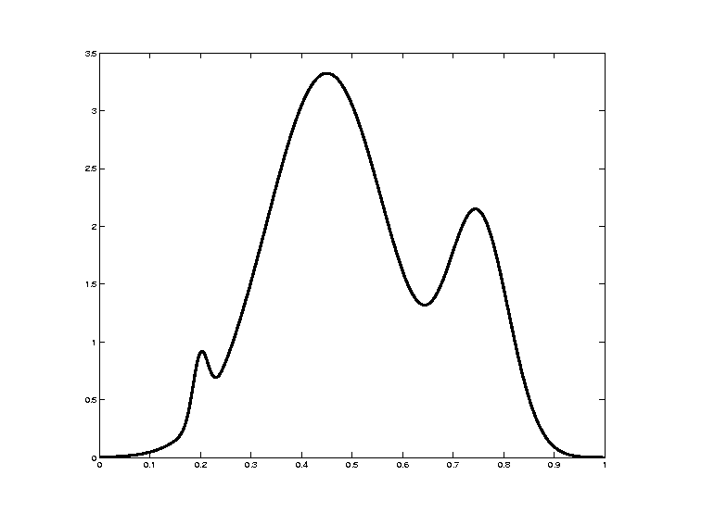
Curve Registration
Toy Example: Starting Curve, $f\left(x\right)$

Slide 51
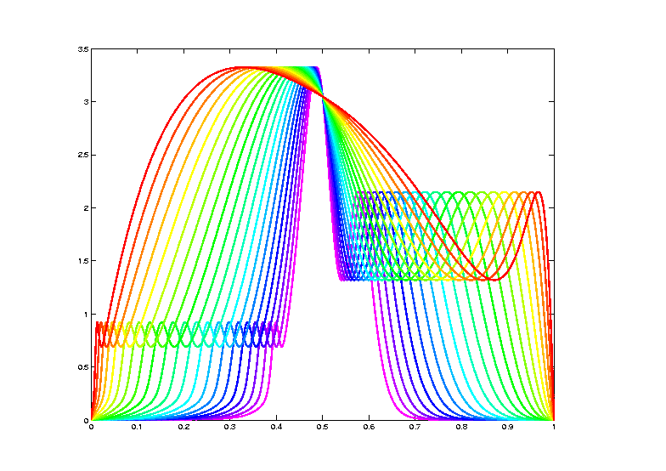
Curve Registration
Toy Example: Equivalent Curves, $\left[f\left(x\right)\right]$

Slide 52
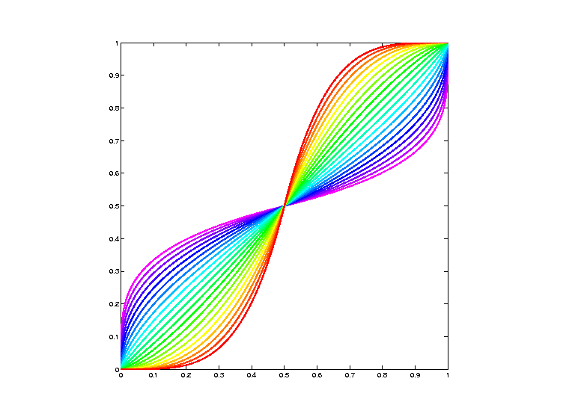
Curve Registration
Toy Example: Warping Functions

Slide 53
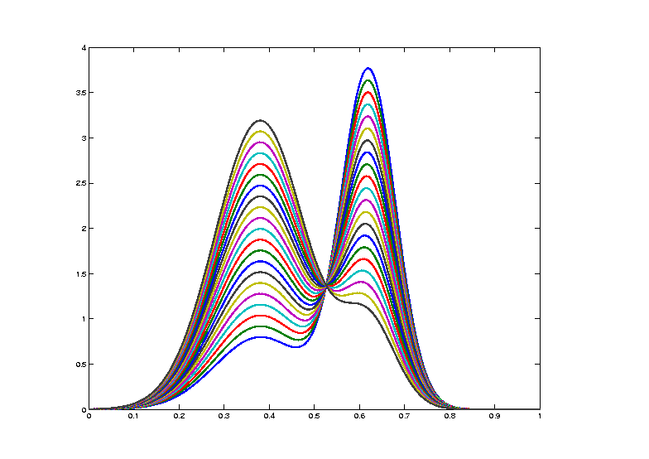
Curve Registration
Toy Example: Non-Equivalent Curves
Cannot
Warp
Into
Each
Other

Slide 54
Data Objects I
Equivalence Classes of Curves
(parallel to Kendall shape analysis)

Slide 55
Data Objects I
Equivalence Classes of Curves
(Set of All
Warps of
Given Curve)
Notation: $\left[f\right]=\left\{f∘γ: γ∈Γ\right\}$
for a “representor” $f\left(x\right)$

Slide 56
Data Objects I
Equivalence Classes of Curves
(Set of All
Warps of
Given Curve)
Next Task:
Find Metric on Space of Curves

Slide 57
Metrics in Curve Space
Find Metric on Equivalence Classes
Start with Warp Invariant Metric on Curves
& Extend

Slide 58
Metrics in Curve Space
Traditional Approach to Curve Registration:
Align curves, say $f_{1}$ and $f_{2}$
By finding optimal time warp, $γ$, so:
$$\inf_{γ}\left\|f_{1}−\left(f_{2}∘γ\right)\right\|$$
Vertical var’n: PCA after alignment
Horizontal var’n: PCA on $γ$s

Slide 59
Metrics in Curve Space
Problem:
Don’t have proper metric
Since:
$$d\left(f_{1},f_{2}\right)≠d\left(f_{2},f_{1}\right)$$
Because:
$$\inf_{γ}\left\|f_{1}−\left(f_{2}∘γ\right)\right\|≠\inf_{γ}\left\|f_{2}−\left(f_{1}∘γ\right)\right\|$$

Slide 60
Metrics in Curve Space
$$\inf_{γ}\left\|f_{1}−\left(f_{2}∘γ\right)\right\|≠\inf_{γ}\left\|f_{2}−\left(f_{1}∘γ\right)\right\|$$
Thanks to
Xiaosun Lu

Slide 61
Metrics in Curve Space
$$\inf_{γ}\left\|f_{1}−\left(f_{2}∘γ\right)\right\|≠\inf_{γ}\left\|f_{2}−\left(f_{1}∘γ\right)\right\|$$
Note:
Very
Different
L² norms
Thanks to
Xiaosun Lu

Slide 62
Metrics in Curve Space
Solution:
Look for Warp Invariant Metric $d$
Where:
$$d\left(f_{1},f_{2}\right)=d\left(f_{1}∘γ,f_{2}∘γ\right)$$

Slide 63
Metrics in Curve Space
$$d\left(f_{1},f_{2}\right)=d\left(f_{1}∘γ,f_{2}∘γ\right)$$
I.e. Have “Parallel”
Representatives
Of Equivalence
Classes

Slide 64
Metrics in Curve Space
Warp Invariant Metric $d$
Developed in context of:
Likelihood Geometry
Fisher – Rao Metric:
$$d_{FR}\left(f_{1},f_{2}\right)=d_{FR}\left(f_{1}∘γ,f_{2}∘γ\right)$$

Slide 65
Metrics in Curve Space
Fisher – Rao Metric:
Computation Based on
Square Root Velocity Function (SRVF)
$$q_{f}\left(t\right)=\frac{\dot{f}\left(t\right)}{\sqrt{\left|\dot{f}\left(t\right)\right|}}$$
Where
$\dot{f}\left(t\right)=\frac{∂}{∂t}f(t)$
Signed Version
Of Square Root
Derivative

Slide 66
Metrics in Curve Space
Square Root Velocity Function (SRVF)
$$q_{f}\left(t\right)=\frac{\dot{f}\left(t\right)}{\sqrt{\left|\dot{f}\left(t\right)\right|}}$$
$$f\left(t\right)=f\left(0\right)+\int_{0}^{t}{q_{f}\left(s\right)\left|q_{f}\left(s\right)\right|ds}$$

Slide 67
Metrics in Curve Space
Fisher – Rao Metric:
Computation Based on SRVF:
$$d_{FR}\left(f_{1},f_{2}\right)={\left\|q_{1}−q_{2}\right\|}_{2}$$
So work with SRVF,
Since much easier to compute.

Slide 68
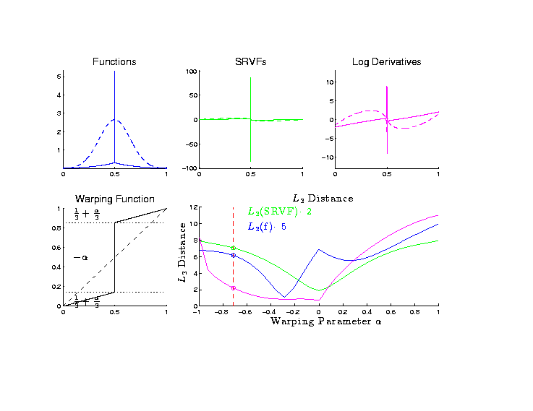
Metrics in Curve Space
Why
square
roots?
Thanks to
Xiaosun Lu

Slide 69
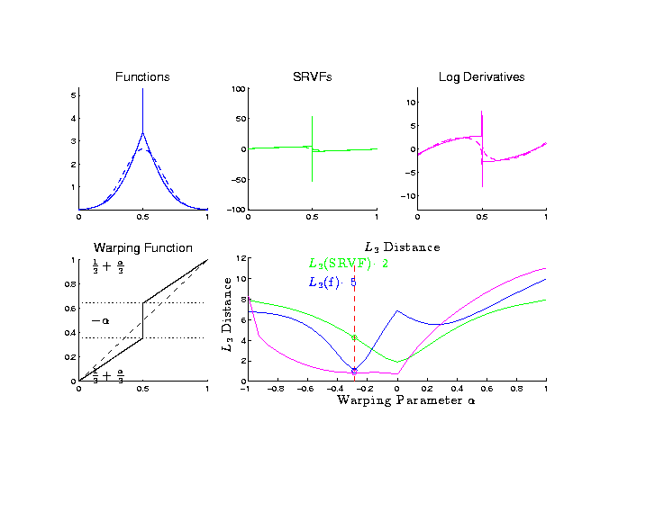
Metrics in Curve Space
Why
square
roots?

Slide 70
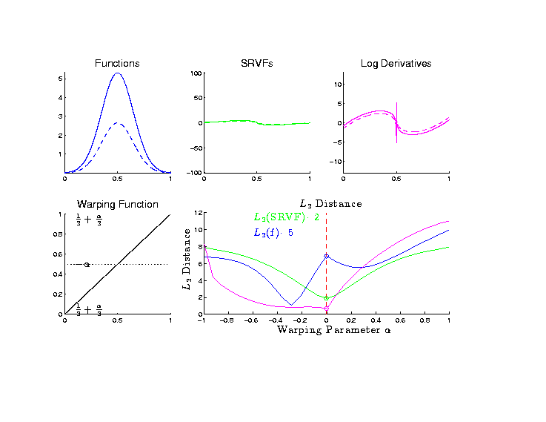
Metrics in Curve Space
Why
square
roots?

Slide 71
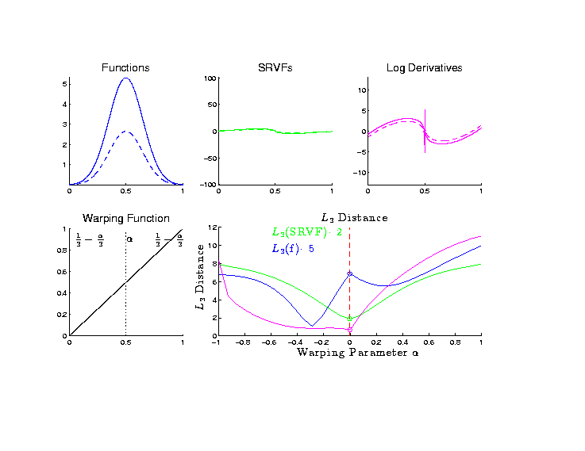
Metrics in Curve Space
Why
square
roots?

Slide 72
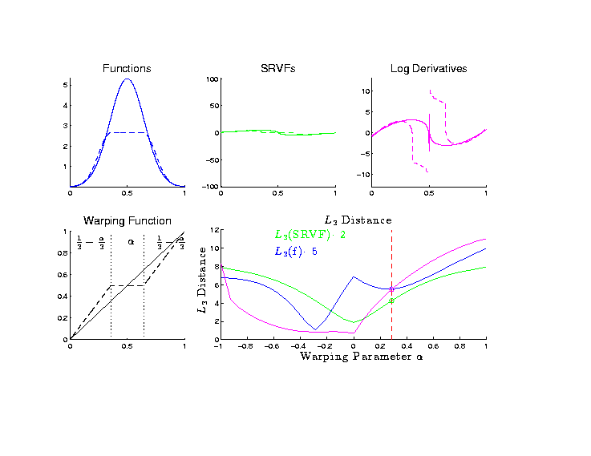
Metrics in Curve Space
Why
square
roots?

Slide 73
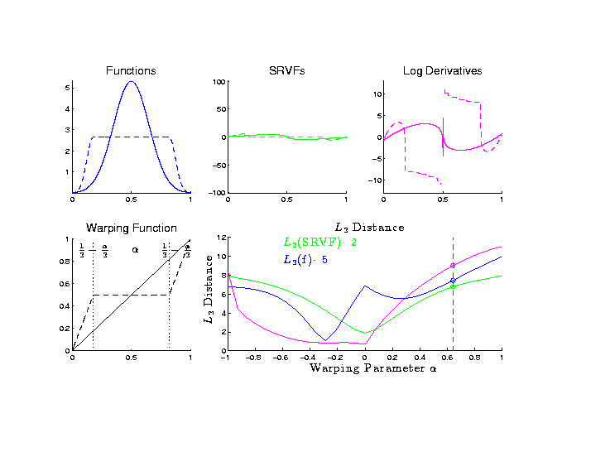
Metrics in Curve Space
Why
square
roots?

Slide 74
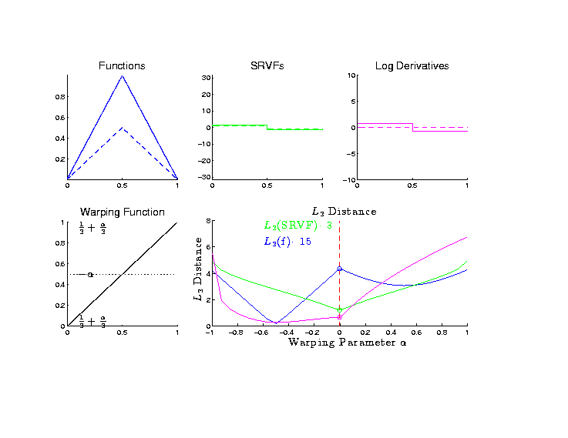
Metrics in Curve Space
Why
square
roots?

Slide 75
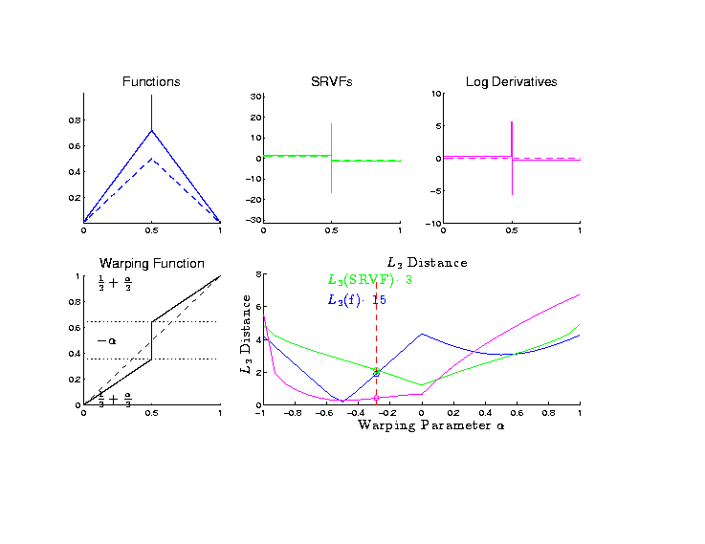
Metrics in Curve Space
Why
square
roots?

Slide 76
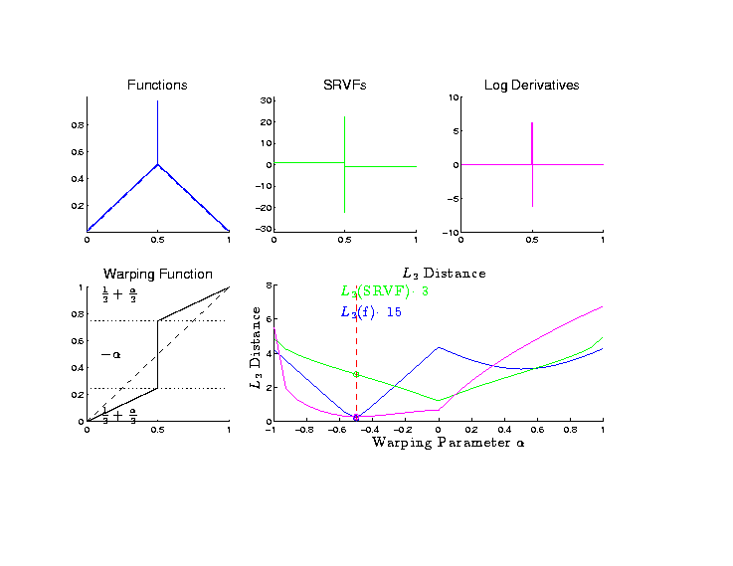
Metrics in Curve Space
Why
square
roots?

Slide 77
Metrics in Curve Space
Why
square
roots? Dislikes Pinching
Focusses Well On
Peaks of Unequal Height

Slide 78
Metrics in Curve Space
Note on SRVF representation:
$$d_{FR}\left(f_{1},f_{2}\right)={\left\|q_{1}−q_{2}\right\|}_{2}$$
Can show: Warp Invariance
$$d_{FR}\left(f_{1},f_{2}\right)=d_{FR}\left(f_{1}∘γ,f_{2}∘γ\right)$$
Follows from Jacobean calculation

Slide 79
Metrics in Curve Quotient Space
Above was Invariance for Individual Curves
Now extend to:
Equivalence Classes of Curves
I.e. Orbits as Data Objects
I.e. Quotient Space

Slide 80
Metrics in Curve Quotient Space
Define Metric on Equivalence Classes:
For $\left[f_{1}\right]$ & $\left[f_{2}\right]$, i.e. $\left[q_{1}\right]$ & $\left[q_{2}\right]$
$$d\left(\left[f_{1}\right],\left[f_{2}\right]\right)=\inf_{γ∈Γ}\left\|q_{1}−q_{2}∘γ\right\|$$
Independent of Choice of $f_{1}$ & $f_{2}$
By Warp Invariance

Slide 81
Mean in Curve Quotient Space
Benefit of a Metric:
Allows Definition of a “Mean”
Fréchet Mean
Geodesic Mean
Barycenter
Karcher Mean

Slide 82
Mean in Curve Quotient Space
Given Equivalence Class Data Objects:
$$\left[f_{1}\right], \left[f_{2}\right], ⋯,\left[f_{n}\right]$$
The Karcher Mean is:
$$\left[μ\right]={argmin}_{\left[q\right]}\sum_{i=1}^{n}{{d\left(\left[q\right],\left[q_{i}\right]\right)}^{2}}$$

Slide 83
Mean in Curve Quotient Space
The Karcher Mean is:
$$\left[μ\right]={argmin}_{\left[q\right]}\sum_{i=1}^{n}{{d\left(\left[q\right],\left[q_{i}\right]\right)}^{2}}$$
Intuition: Recall, for Euclidean Data
Minimizer = Conventional $\overline{X}$

Slide 84
Mean in Curve Quotient Space
Next Define “Most Representative”
Choice of $μ_{n}$
As Representer of$\left[μ\right]$

Slide 85
Mean in Curve Quotient Space
“Most Representative” $μ_{n}$ in$\left[μ\right]$
Given a candidate $μ$
Consider warps to each $q_{i}$
Choose $μ_{n}$ to make
Karcher mean of warps = Identity
(under Fisher Rao metric)

Slide 86
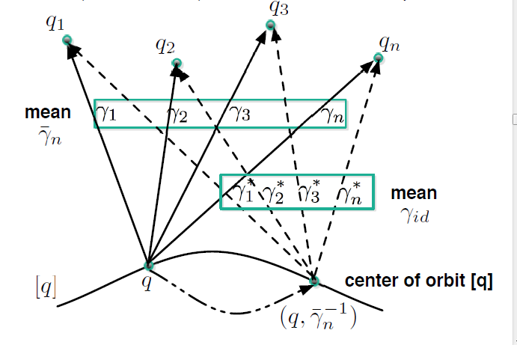
Mean in Curve Quotient Space
“Most Representative” $μ_{n}$ in$\left[μ\right]$
Thanks to Anuj Srivastava

Slide 87
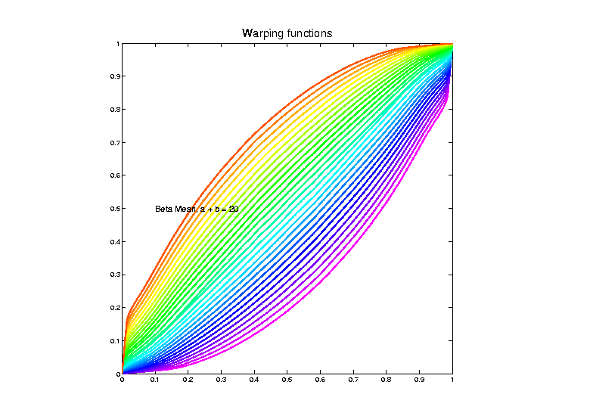
Toy Example – (Details Later)
Estimated
Warps
(Note:
Represented
With Karcher
Mean At
Identity)

Slide 88
Mean in Curve Quotient Space
“Most Representative” $μ_{n}$ in$\left[μ\right]$
Terminology: The “Template Mean”

Slide 89
More Data Objects
Final Curve Warps:
Warp Each Data Curve, $f_{1}, ⋯,f_{n}$
To Template Mean, $μ_{n}$
Denote Warp Functions $γ_{1}, ⋯,γ_{n}$
Gives (Roughly Speaking):
Vertical Components $f_{1}∘γ_{1}, ⋯,f_{n}∘γ_{n}$
(Aligned Curves)
Horizontal Components $γ_{1}, ⋯,γ_{n}$
Data Objects I

Slide 90
More Data Objects
Data Objects II
Final Curve Warps:
Warp Each Data Curve, $f_{1}, ⋯,f_{n}$
To Template Mean, $μ_{n}$
Denote Warp Functions $γ_{1}, ⋯,γ_{n}$
Gives (Roughly Speaking):
Vertical Components $f_{1}∘γ_{1}, ⋯,f_{n}∘γ_{n}$
(Aligned Curves)
Horizontal Components $γ_{1}, ⋯,γ_{n}$
~ Kendall’s Shapes

Slide 91
More Data Objects
Final Curve Warps:
Warp Each Data Curve, $f_{1}, ⋯,f_{n}$
To Template Mean, $μ_{n}$
Denote Warp Functions $γ_{1}, ⋯,γ_{n}$
Gives (Roughly Speaking):
Vertical Components $f_{1}∘γ_{1}, ⋯,f_{n}∘γ_{n}$
(Aligned Curves)
Horizontal Components $γ_{1}, ⋯,γ_{n}$
Data Objects III
~ Chang’s Transfo’s

Slide 92
Computation
Several Variations of
Dynamic Programming
Done by Eric Klassen, Wei Wu

Slide 93
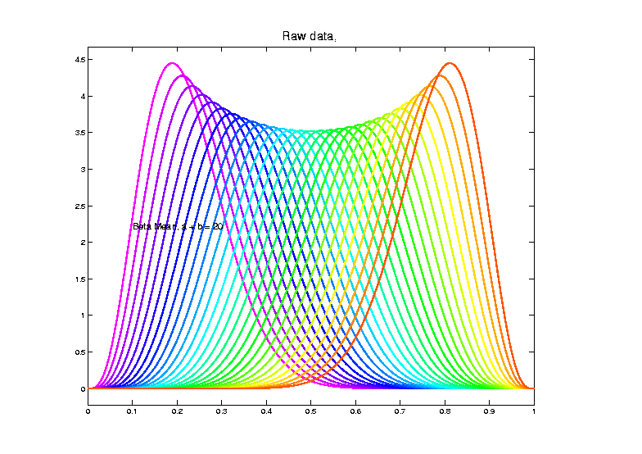
Toy Example
Raw
Data

Slide 94
Toy Example
Raw
Data
Both
Horizontal
And
Vertical
Variation

Slide 95
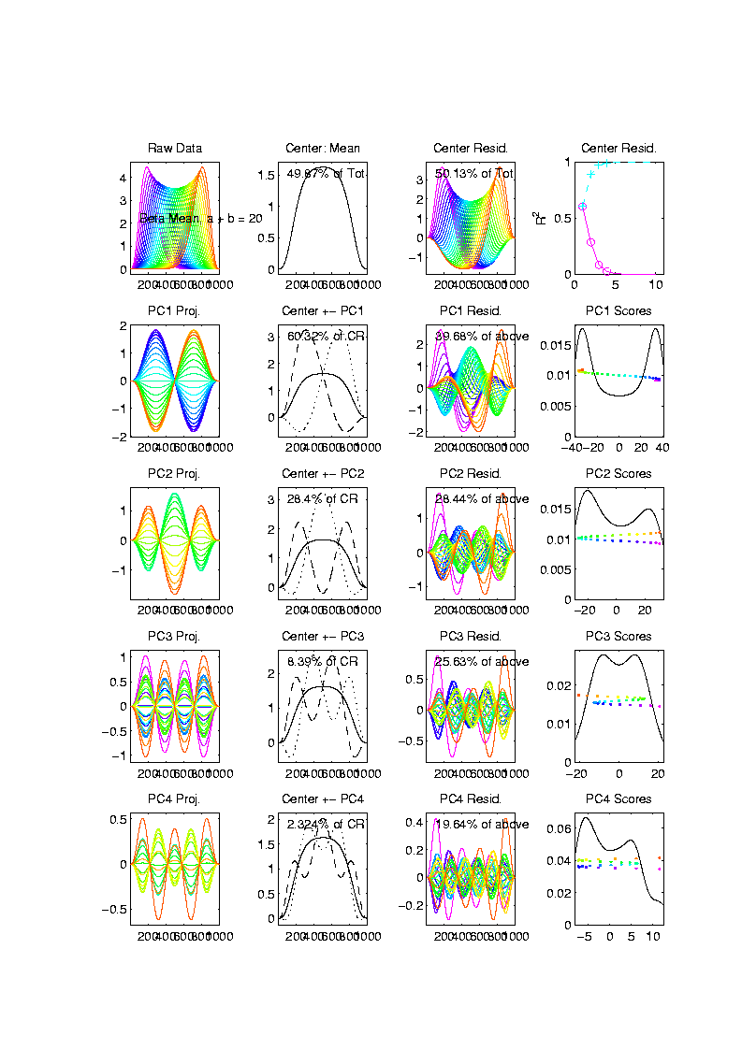
Toy Example
Conventional
PCA
Projections

Slide 96
Toy Example
Conventional
PCA
Projections
Power
Spread
Across
Spectrum

Slide 97
Toy Example
Conventional
PCA
Projections
Power
Spread
Across
Spectrum

Slide 98
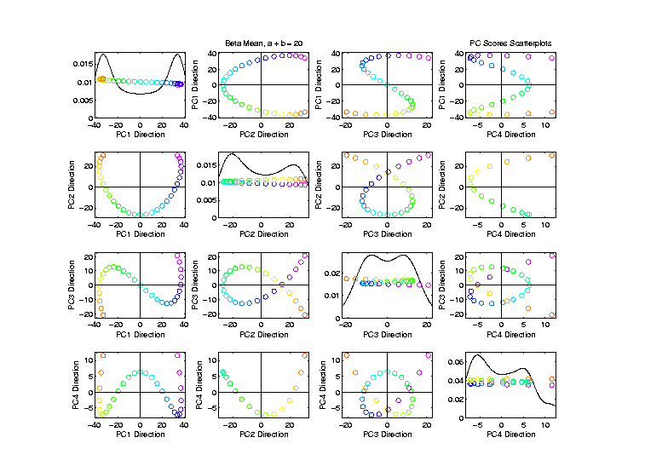
Toy Example
Conventional
PCA
Scores

Slide 99
Toy Example
Conventional
PCA
Scores
Views of
1-d Curve
Bending
Through
4 Dim’ns’

Slide 100
Toy Example
Conventional
PCA
Scores
Patterns
Are
“Harmonics”
In Scores

Slide 101
Toy Example
Scores Plot
Shows Data
Are “1”
Dimensional
So Need
Improved
PCA Decomp.

Slide 102
Visualization
Vertical Variation:
PCA on Aligned Curves, $f_{1}∘γ_{1}, ⋯,f_{n}∘γ_{n}$
Projected Curves

Slide 103
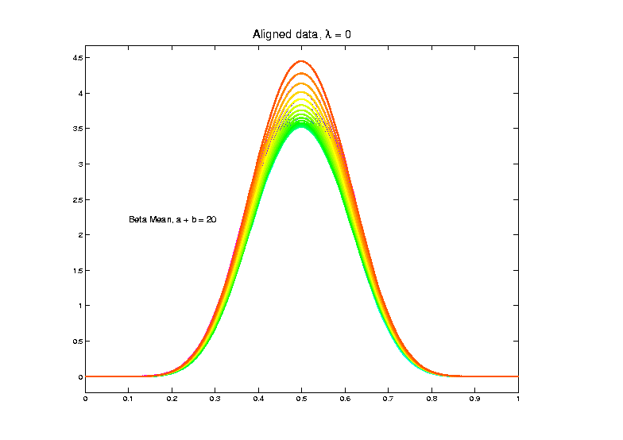
Toy Example
Aligned
Curves
(Clear
1-d
Vertical
Var’n)

Slide 104
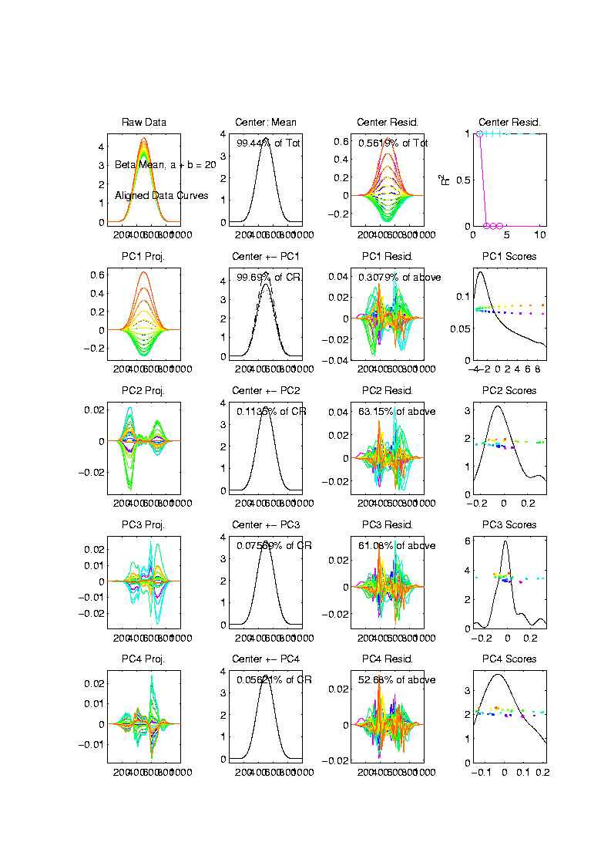
Toy Example
Aligned
Curve
PCA
Projections
All Var’n
In 1st
Component

Slide 105
Visualization
Horizontal Variation:
PCA on Warps, $γ_{1}, ⋯,γ_{n}$
Projected Curves

Slide 106
Toy Example
Estimated
Warps

Slide 107
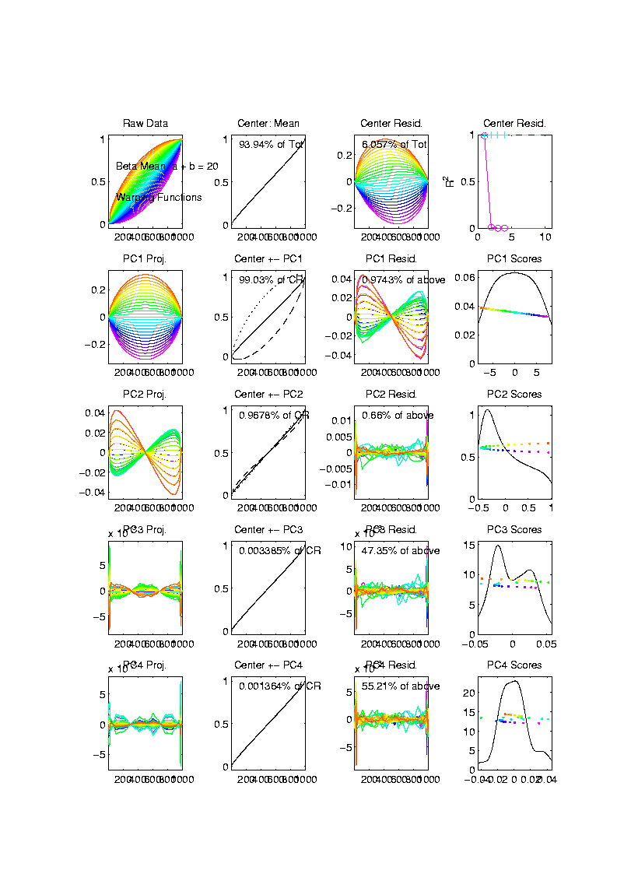
Toy Example
Warps,
PC
Projections

Slide 108
Toy Example
Warps,
PC
Projections
Mostly
1st PC

Slide 109
Toy Example
Warps,
PC
Projections
Mostly
1st PC,
But 2nd
Helps Some

Slide 110
Toy Example
Warps,
PC
Projections
Rest is
Not
Important

Slide 111
Toy Example
Horizontal Var’n Visualization Challenge:
(Complicated) Warps Hard to Interpret
Approach:
Apply Warps to Template Mean
(PCA components)

Slide 112
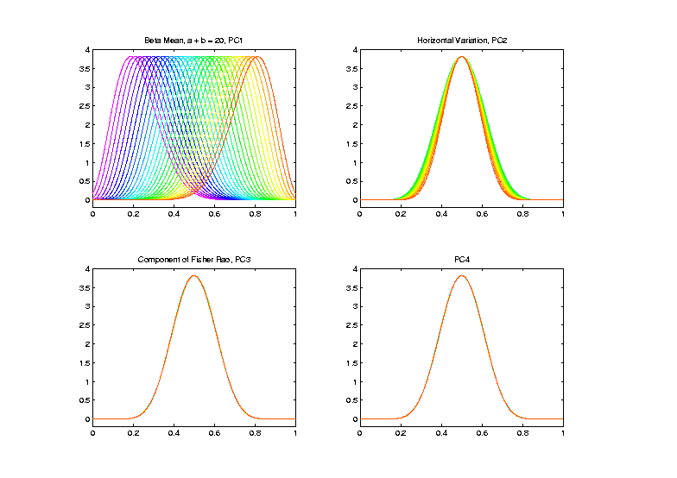
Toy Example
Warp
Compon’ts
(+ Mean)
Applied to
Template
Mean

Slide 113
Participant Presentations
Xi Yang
Multi-View Weighted Network
Hang Yu
Introduction to multiple kernel learning
Zhipeng Ding
Fast Predictive Simple Geodesic Regression

