Slide 1
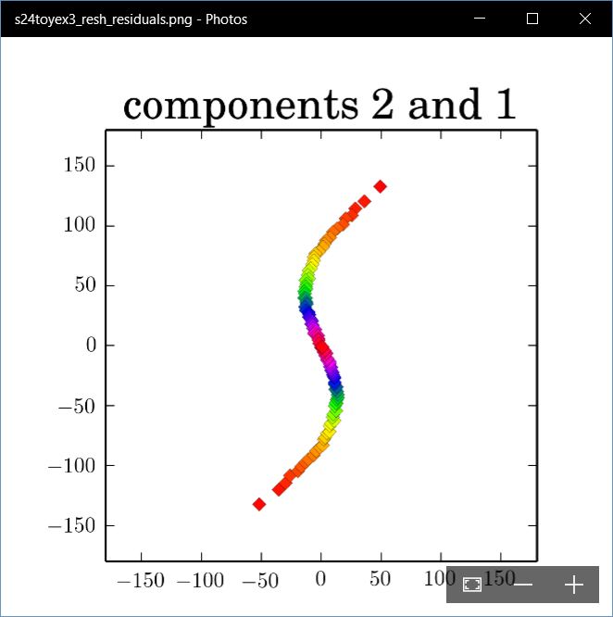
Polysphere PCA-type Analysis
Deeper New Methodology: PPCA
For Polysphere
~Toy Example
Pretty Good But
Still Some
Distortion
Thanks to B. Eltzner

Slide 2
Principal Nested Spheres
Main Goal:
Extend Principal Arc Analysis ($S^{2}$ to $S^{k}$)
Jung et al (2012)
Important Landmark:
This Motivated Backwards PCA

Slide 3
Backwards PCA
Replace usual forwards view of PCA
Data → PC1 (1-d approx)
→ PC2 (1-d approx of Data-PC1)
→ PC1 U PC2 (2-d approx)
$⋱$
→ PC1 U … U PCr
(r-d approx)

Slide 4
Backwards PCA
With a backwards approach to PCA
Data → PC1 U … U PCr (r-d approx)
→ PC1 U … U PC(r-1)
$⋱$
→ PC1 U PC2 (2-d approx)
→ PC1 (1-d approx)

Slide 5
Backwards PCA
Euclidean Settings:
Forwards PCA = Backwards PCA
(Pythagorean Theorem,
ANOVA Decomposition)
So Not Interesting
But Very Different in Non-Euclidean Settings
(Backwards is Better !?!)

Slide 6
Backwards PCA
Important Property of PCA:
Nested Series of Approximations
$$\left\{{PC}_{1}\right\}⊆\left\{{PC}_{1}{,PC}_{2}\right\}⊆\left\{{PC}_{1}{,PC}_{2},{PC}_{3}\right\}⊆⋯$$
(Often taken for granted)
(Desirable in Non-Euclidean Settings)

Slide 7
An Interesting Question
How generally applicable is
Backwards approach to PCA?
An Application:
Nonnegative Matrix Factorization
= PCA in Positive Orthant
Think $X ≈LS$
With ≥ 0 Constraints (on both $L$ & $S$)

Slide 8
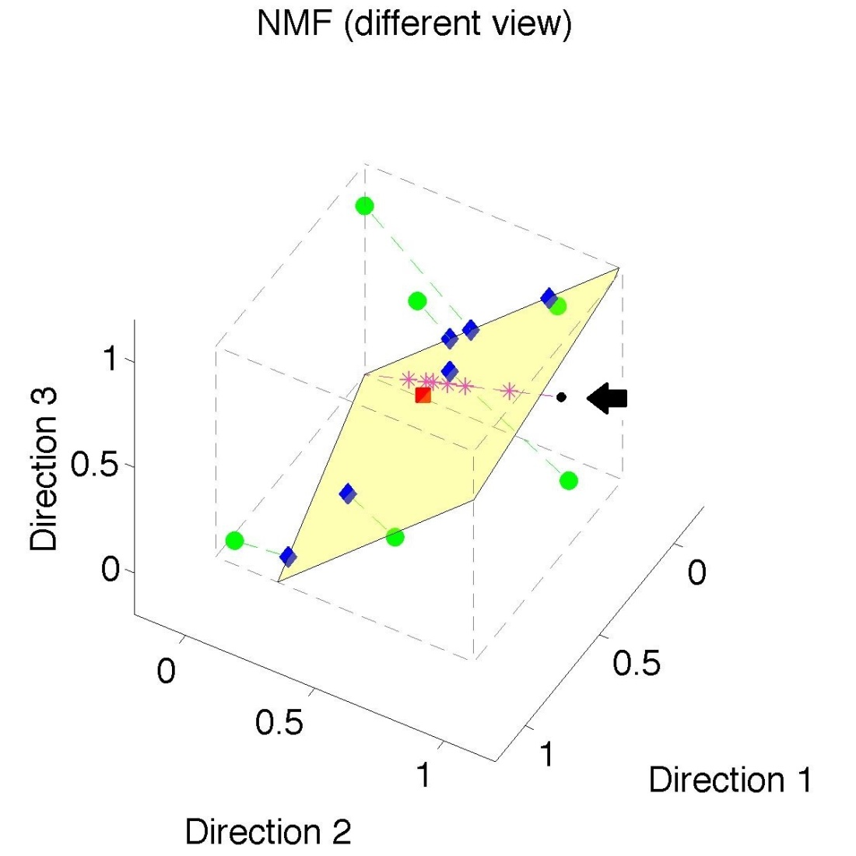
Nonnegative Matrix Factorization
Standard NMF
But Note
Not Nested
No “Multi-scale”
Analysis Possible
(Scores Plot?!?)

Slide 9
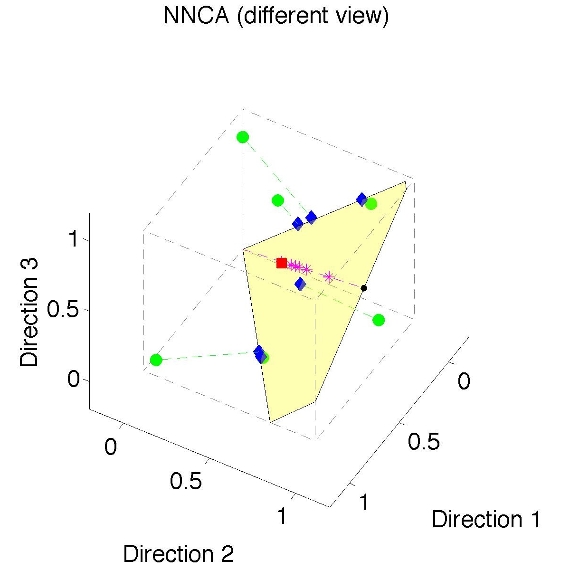
Nonnegative Nested Cone Analysis
Same Toy
Data Set
Rank 1
Approx.
Properly
Nested

Slide 10
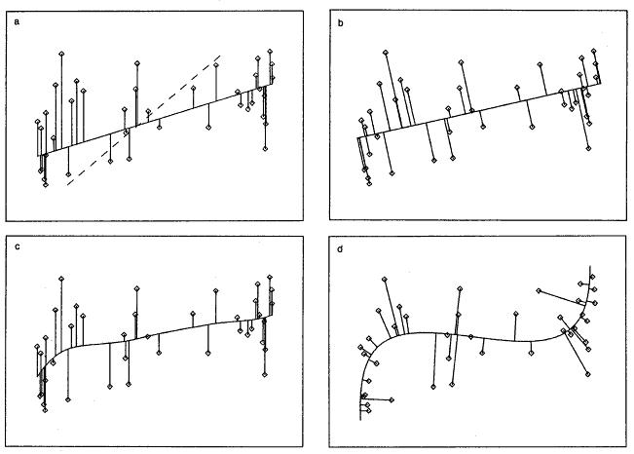
1st Principal Curve
Linear Reg’n
Proj’s Reg’n
Usual Smooth
Princ’l Curve

Slide 11
Manifold Learning
Key Component:
Principal Surfaces
LeBlanc & Tibshirani (1996)
Challenge:
Can have any dimensional surface,
But how to nest???
Proposal: Backwards Approach

Slide 12
An Interesting Question
How generally applicable is
Backwards approach to PCA?
An Attractive Answer

Slide 13
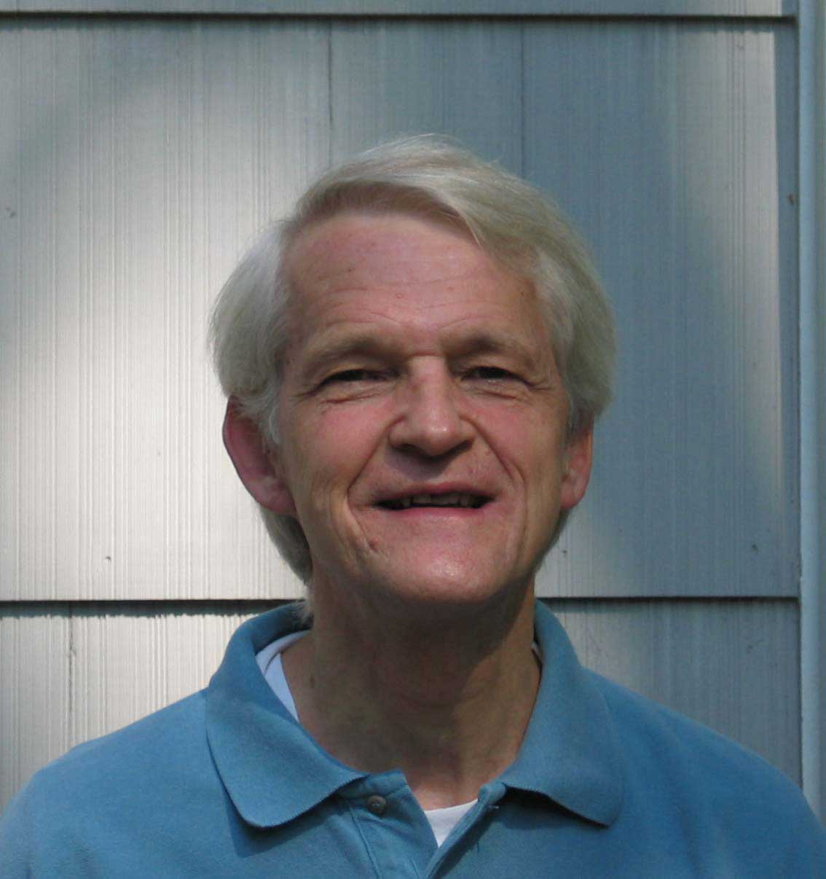
An Interesting Question
How generally applicable is
Backwards approach to PCA?
An Attractive Answer:
James Damon, UNC Mathematics
Geometry
Singularity
Theory

Slide 14
An Interesting Question
How generally applicable is
Backwards approach to PCA?
An Attractive Answer:
James Damon, UNC Mathematics
Damon and Marron (2014)

Slide 15
An Interesting Question
How generally applicable is
Backwards approach to PCA?
An Attractive Answer:
James Damon, UNC Mathematics
Key Idea: Express Backwards PCA as
Nested Series of Constraints

Slide 16
General View of Backwards PCA
Define Nested Spaces via Constraints
Satisfying More Constraints $⇒$
$⇒$ Smaller Subspaces

Slide 17
General View of Backwards PCA
Define Nested Spaces via Constraints
E.g. SVD
(Singular Value Decomposition =
= Not Mean Centered PCA)
(notationally very clean)

Slide 18
General View of Backwards PCA
Define Nested Spaces via Constraints
E.g. SVD
Have $k$ Nested Subspaces:
$$S_{1}⊆S_{2}⊆⋯⊆S_{d}$$

Slide 19
General View of Backwards PCA
Define Nested Spaces via Constraints
E.g. SVD $S_{k}=\left\{x :x=\sum_{j=1}^{k}{c_{j}\vec{u_{j}}}\right\}$
$k$-th SVD Subspace
Scores
Loading Vectors

Slide 20
General View of Backwards PCA
Define Nested Spaces via Constraints
E.g. SVD $S_{k}=\left\{x :x=\sum_{j=1}^{k}{c_{j}\vec{u_{j}}}\right\}$
Now Define:
$$S_{k−1}=\left\{x∈S_{k} :\left\langle x,\vec{u_{k}}\right\rangle =0\right\}$$

Slide 21
General View of Backwards PCA
Define Nested Spaces via Constraints
E.g. SVD $S_{k}=\left\{x :x=\sum_{j=1}^{k}{c_{j}\vec{u_{j}}}\right\}$
Now Define:
$$S_{k−1}=\left\{x∈S_{k} :\left\langle x,\vec{u_{k}}\right\rangle =0\right\}$$
Constraint Gives Nested Reduction of Dim’n

Slide 22
General View of Backwards PCA
Define Nested Spaces via Constraints
Backwards PCA
Reduce Using Affine Constraints

Slide 23
General View of Backwards PCA
Define Nested Spaces via Constraints
Backwards PCA
Principal Nested Spheres
Use Affine Constraints (Planar Slices)
In Ambient Space

Slide 24
General View of Backwards PCA
Define Nested Spaces via Constraints
Backwards PCA
Principal Nested Spheres
Principal Surfaces
Spline Constraint Within Previous?
{Been Done Already???}

Slide 25
General View of Backwards PCA
Define Nested Spaces via Constraints
Backwards PCA
Principal Nested Spheres
Principal Surfaces
Other Manifold Data Spaces
Sub-Manifold Constraints??
(Algebraic Geometry)

Slide 26
General View of Backwards PCA
Define Nested Spaces via Constraints
Backwards PCA
Principal Nested Spheres
Principal Surfaces
Other Manifold Data Spaces
Tree Spaces
Suitable Constraints???

Slide 27
Vectors of Angles
Vectors of Angles as Data Objects
$$\left(\begin{matrix}θ_{1} \\ ⋮ \\ θ_{d}\end{matrix}\right)∈{\left(S^{1}\right)}^{d}$$
Torus Type Space
Useful in Structural Chemistry
(sequences of bond angles)

Slide 28
Vectors of Angles
Vectors of Angles as Data Objects
$$\left(\begin{matrix}θ_{1} \\ ⋮ \\ θ_{d}\end{matrix}\right)∈{\left(S^{1}\right)}^{d}$$
Slice space ${\left(S^{1}\right)}^{d}$ with hyperplanes????
(ala Principal Nested Spheres)

Slide 29
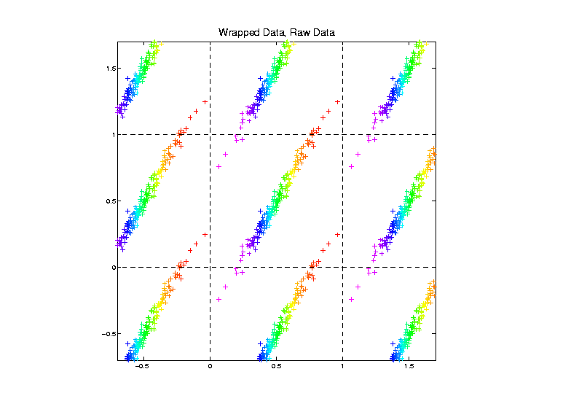
Vectors of Angles
Tiled
Embedding
In
$\left[0,1\right]×[0,1]$

Slide 30
Vectors of Angles
Slice space ${\left(S^{1}\right)}^{d}$ with hyperplanes????
An Approach: Embed ${\left(S^{1}\right)}^{d}$ in $ℝ^{2d}$
E.g. $d=2$:
$$\left(\begin{matrix}θ_{1} \\ θ_{2}\end{matrix}\right)→\left(\begin{matrix}\begin{matrix}\cos{θ_{1}} \\ \sin{θ_{1}}\end{matrix} \\ \begin{matrix}\cos{θ_{2}} \\ \sin{θ_{2}}\end{matrix}\end{matrix}\right)$$

Slide 31
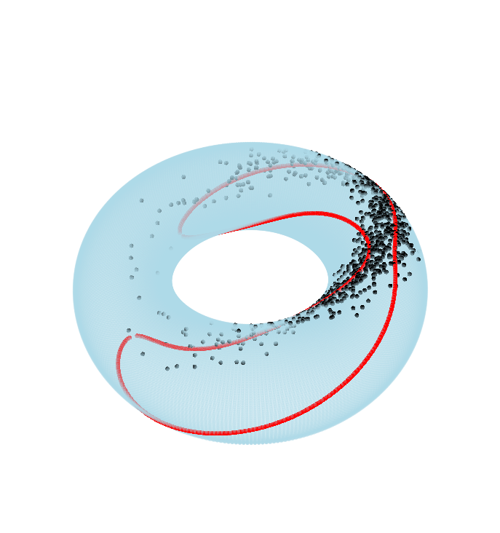
Vectors of Angles
Embedding for $d=2$ (in $ℝ^{4}$):
$$\left(\begin{matrix}θ_{1} \\ θ_{2}\end{matrix}\right)→\left(\begin{matrix}\begin{matrix}\cos{θ_{1}} \\ \sin{θ_{1}}\end{matrix} \\ \begin{matrix}\cos{θ_{2}} \\ \sin{θ_{2}}\end{matrix}\end{matrix}\right)$$
Note: Different
from $ℝ^{3}$ “donut”
(treats angles “same”)

Slide 32
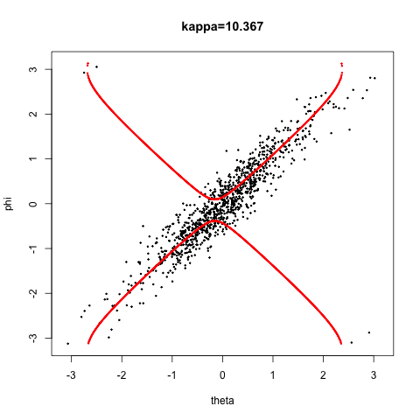
Vectors of Angles
E.g. $d=2$, Data w/ “Single Mode of Var’n”
Best Fitting Planar Slice gives Bimodal Dist’n
Special Thanks to
Eduardo García-Portugués

Slide 33
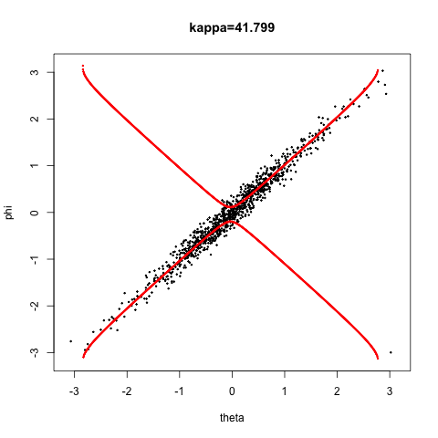
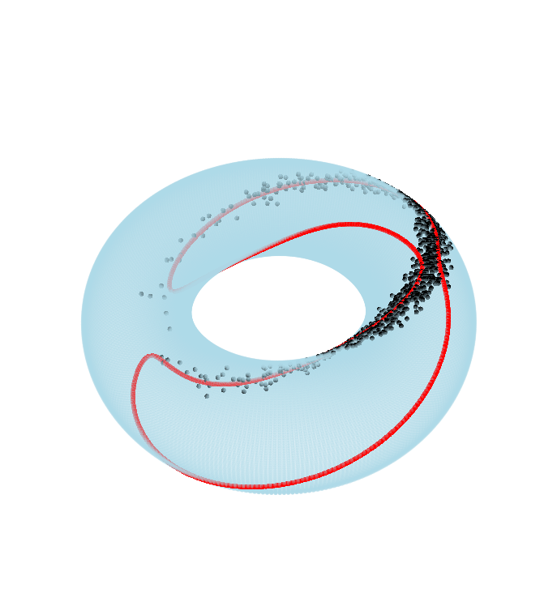
Vectors of Angles
E.g. $d=2$, Data w/ “Single Mode of Var’n”
Gets worse for tighter distribution
Special Thanks to
Eduardo García-Portugués

Slide 34
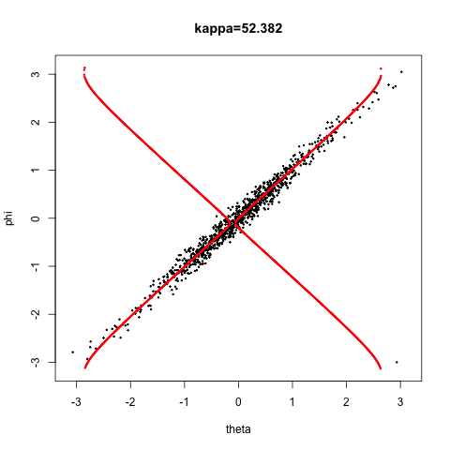
Vectors of Angles
E.g. $d=2$, Data w/ “Single Mode of Var’n”
Just slightly tighter gives:
Disconnected Approx’ing Manifold
Special Thanks to
Eduardo García-Portugués

Slide 35
Vectors of Angles
Vectors of Angles as Data Objects
$$\left(\begin{matrix}θ_{1} \\ ⋮ \\ θ_{d}\end{matrix}\right)∈{\left(S^{1}\right)}^{d}$$
Slice space ${\left(S^{1}\right)}^{d}$ with hyperplanes????
Gives clumsy lower d “subspaces”
Algebraic Geometry $⟹$ better slicing?

Slide 36
Vectors of Angles
Vectors of Angles as Data Objects
$$\left(\begin{matrix}θ_{1} \\ ⋮ \\ θ_{d}\end{matrix}\right)∈{\left(S^{1}\right)}^{d}$$
Slice space ${\left(S^{1}\right)}^{d}$ with hyperplanes????
Gives clumsy lower d “subspaces”
Try Another Approach

Slide 37
Torus Space $S^{1}×S^{1}$
Tiled
Embedding
In
$\left[0,1\right]×[0,1]$

Slide 38
Torus Space $S^{1}×S^{1}$
Zoomed
In
View

Slide 39
Torus Space $S^{1}×S^{1}$
Try To
Fit A
Geodesic
Challenge:
Can Get
Arbitrarily
Close

Slide 40
Torus Space $S^{1}×S^{1}$
Wilfrid Kendall Idea: Reward Locality
Implementation: Fit Nested Submanifold
$$𝒮=\left\{S_{0},S_{1}\right\}$$
Simultaneously
Centerpoint
Geodesic

Slide 41
Torus Space $S^{1}×S^{1}$
Fit Nested
Sub-Manifold

Slide 42
Nested Submanifold Fits
Major Motivation of Simultaneous Fits:
Barycentric Subspace
Approach of
Xavier Pennec
Pennec (2015)

Slide 43
PNS Terminology
Principal Nested Submanifolds
Motivation: Flag
(Nested Sequence of Subspaces)
Want Non-Subspace Versions
(e.g. Non-Great Circles on Spheres)

Slide 44
PNS Main Idea
Data Objects: $X_{1},⋯,X_{n}∈S_{d}⊆ℝ^{d+1}$
Where $S_{d}$ is a $d$ dimensional manifold
Consider a nested series of sub-manifolds:
$$𝒮=\left\{S_{0},⋯,S_{d−1}\right\}$$
where for $j=0,⋯,d−1$
$dim\left(S_{j}\right)=j$ and $S_{j}⊆S_{j+1}$
Goal: Fit all of $𝒮$ simultaneously to $X_{1},⋯X_{n}$

Slide 45
General Background
Call each $S_{j}$ a stratum,
so $𝒮$ is a manifold stratification
To be fit to $X_{1},⋯X_{n}$
Conventional Approach 1:
$S_{0}$ only, i.e. Fréchet Mean, in $ℝ^{2}$

Slide 46
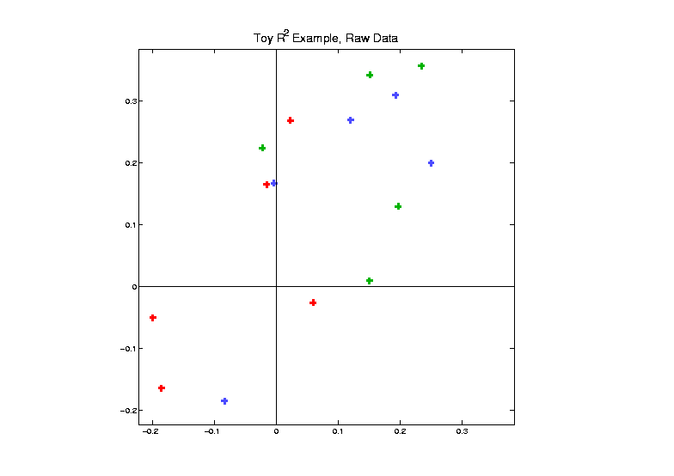
Fréchet Mean in $ℝ^{2}$
Toy
Data
Set

Slide 47
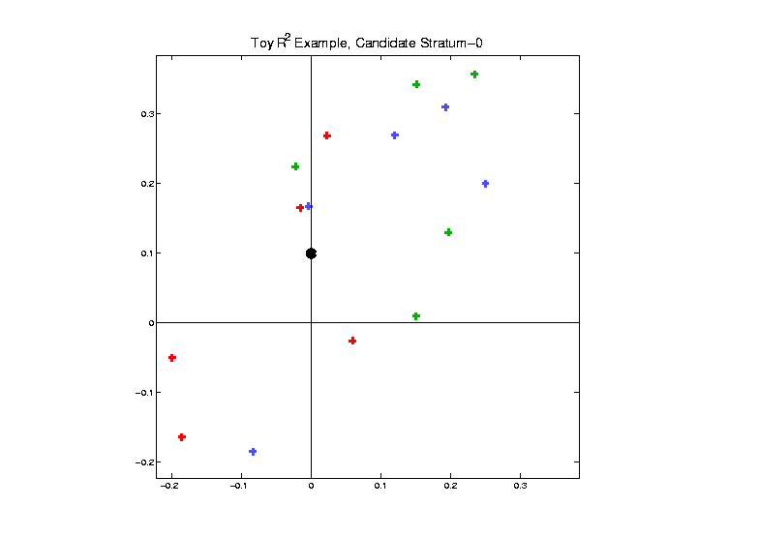
Fréchet Mean in $ℝ^{2}$
Candidate
Fit of
0-dim
Stratum
(point)

Slide 48
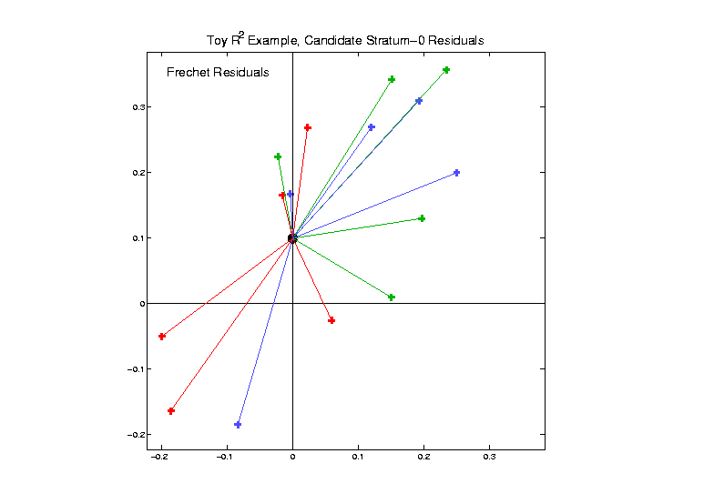
Fréchet Mean in $ℝ^{2}$
Residuals
In Sense
Of Fréchet

Slide 49
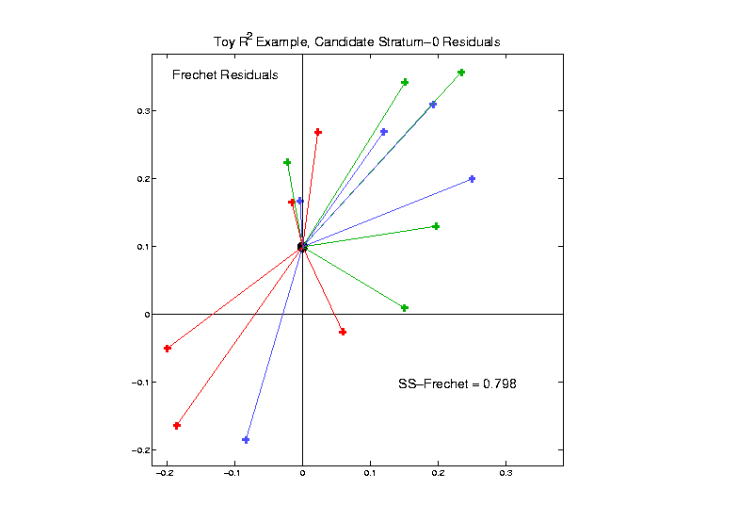
Fréchet Mean in $ℝ^{2}$
Fréchet
Sum of
Squares
Criterion

Slide 50
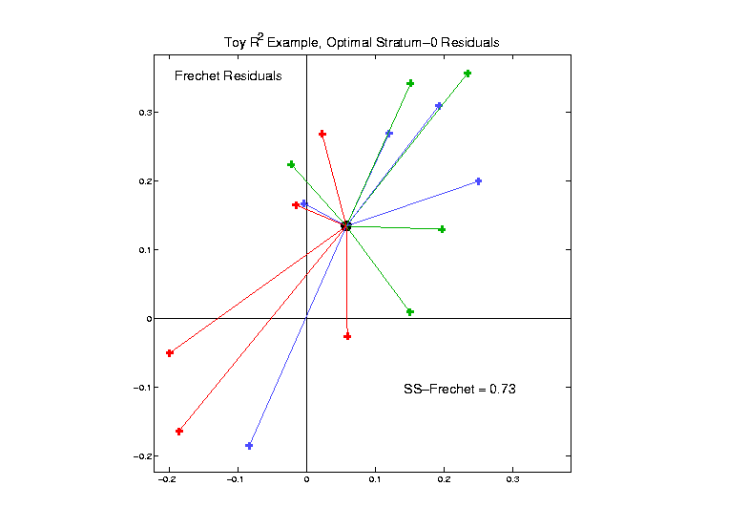
Fréchet Mean in $ℝ^{2}$
Minimum
Fréchet
Sum of
Squares

Slide 51
General Background
Call each $S_{j}$ a stratum,
so $𝒮$ is a manifold stratification
To be fit to $X_{1},⋯X_{n}$
Conventional Approach 2:
$S_{1}$ only, i.e. PC 1 line, in $ℝ^{2}$

Slide 52
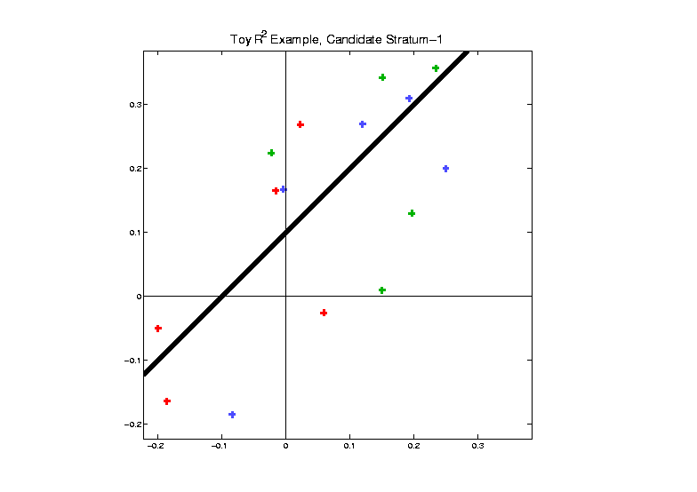
PC 1 line, in $ℝ^{2}$
Candidate
Fit of
1-dim
Stratum
(line)

Slide 53
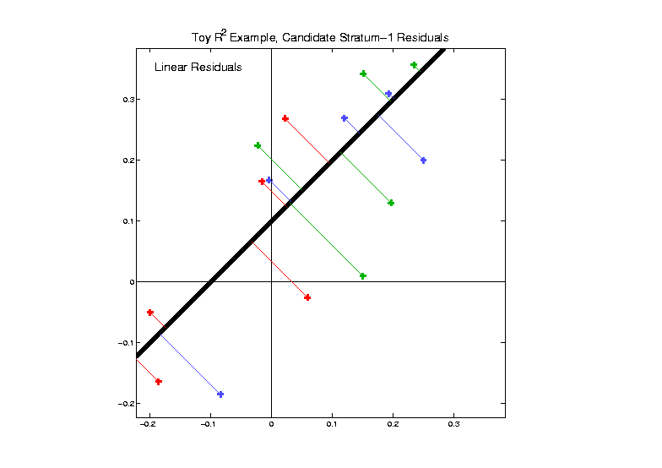
PC 1 line, in $ℝ^{2}$
Residuals
In PC
Sense
Of Linear
Fit

Slide 54
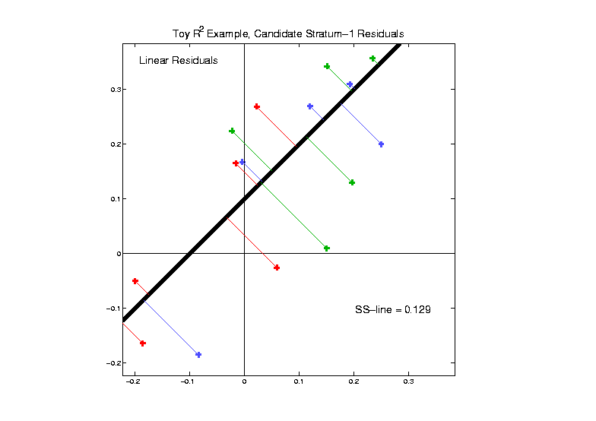
PC 1 line, in $ℝ^{2}$
Corresponding
Residual
Sum Of
Squares

Slide 55
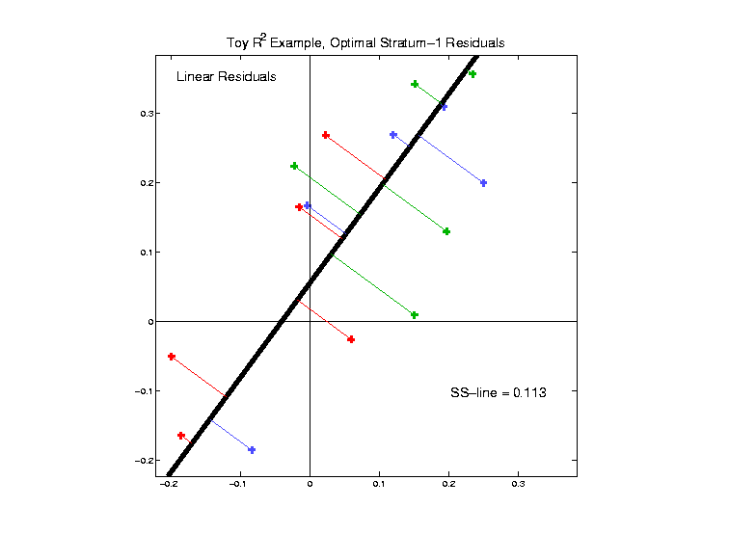
PC 1 line, in $ℝ^{2}$
Minimum
Of Linear
Residual
Sum Of
Squares

Slide 56
General Background
Call each $S_{j}$ a stratum,
so $𝒮$ is a manifold stratification
To be fit to $X_{1},⋯X_{n}$
New Approach:
Simultaneously fit $𝒮=\left\{S_{0},⋯,S_{d−1}\right\}$
Nested Submanifold (NS)

Slide 57
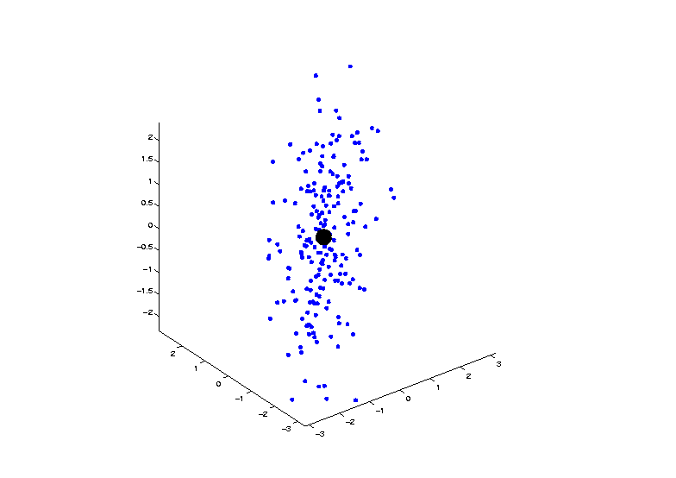
Nested Submanifolds in $ℝ^{3}$
Fit 0-dim Submanifold $S_{0}$ (i.e. mean)

Slide 58
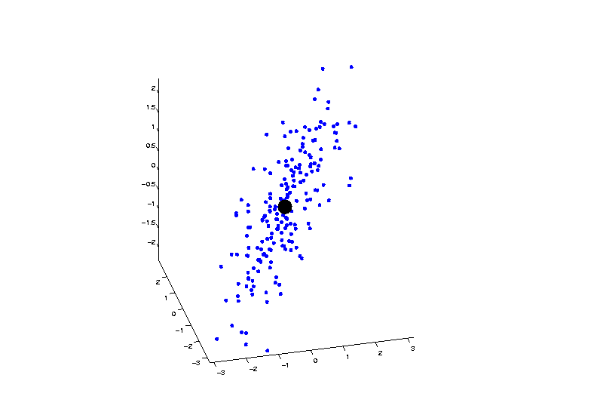
Nested Submanifolds in $ℝ^{3}$
Fit 0-dim Submanifold $S_{0}$ (i.e. mean)

Slide 59
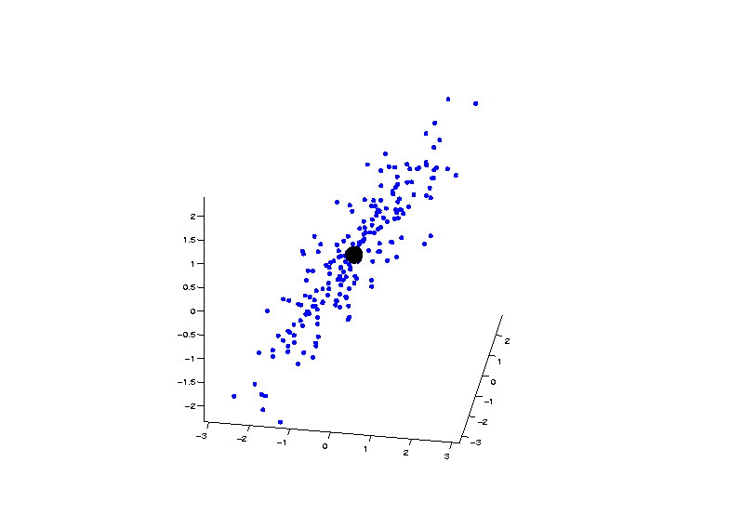
Nested Submanifolds in $ℝ^{3}$
Fit 0-dim Submanifold $S_{0}$ (i.e. mean)

Slide 60
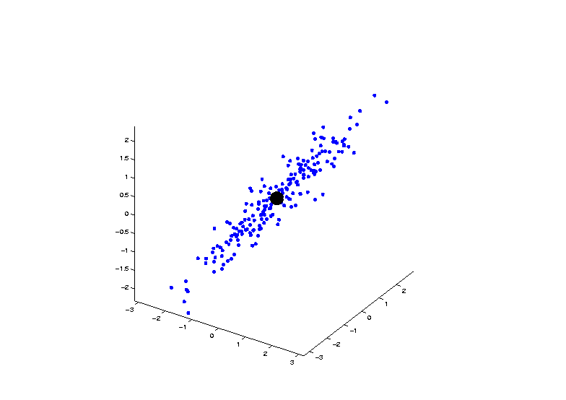
Nested Submanifolds in $ℝ^{3}$
Fit 0-dim Submanifold $S_{0}$ (i.e. mean)

Slide 61
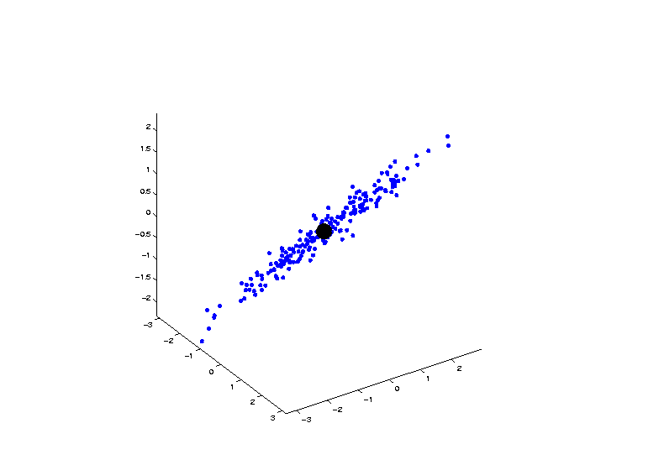
Nested Submanifolds in $ℝ^{3}$
Fit 0-dim Submanifold $S_{0}$ (i.e. mean)

Slide 62
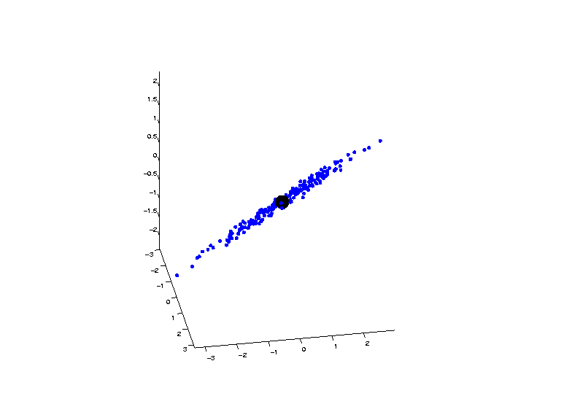
Nested Submanifolds in $ℝ^{3}$
Fit 0-dim Submanifold $S_{0}$ (i.e. mean)

Slide 63
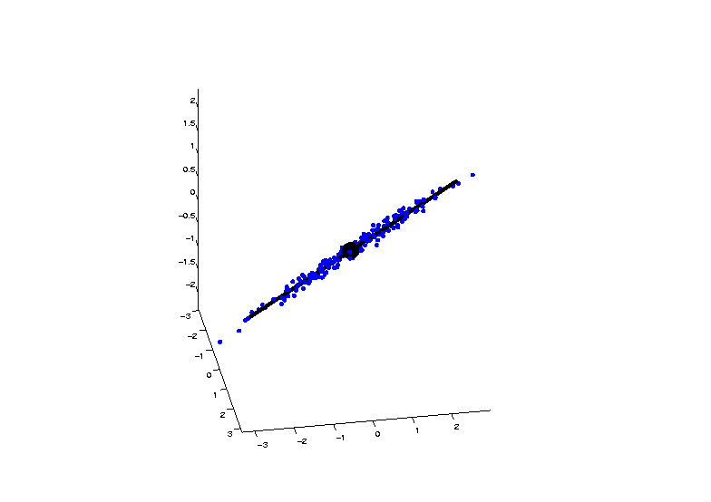
Nested Submanifolds in $ℝ^{3}$
Fit Nested Submanifolds $S_{0}∪S_{1}$

Slide 64
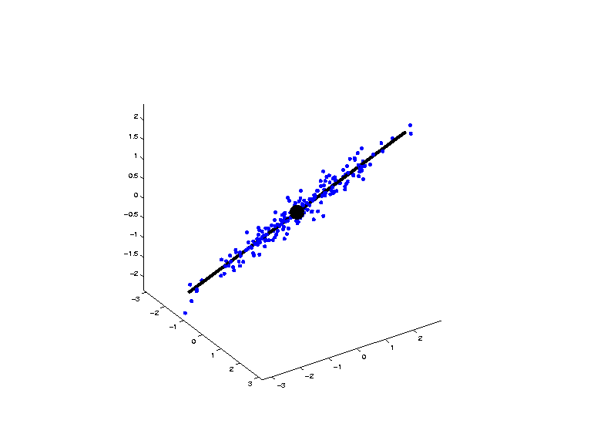
Nested Submanifolds in $ℝ^{3}$
Fit Nested Submanifolds $S_{0}∪S_{1}$

Slide 65
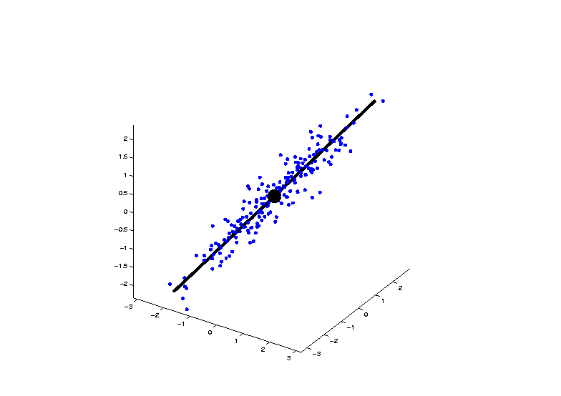
Nested Submanifolds in $ℝ^{3}$
Fit Nested Submanifolds $S_{0}∪S_{1}$

Slide 66
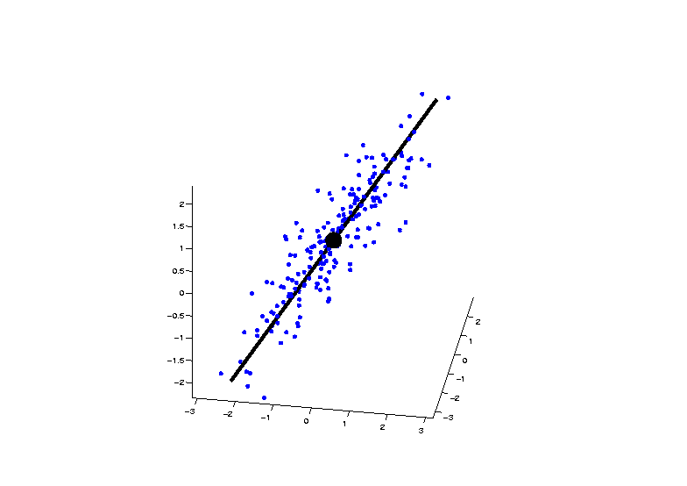
Nested Submanifolds in $ℝ^{3}$
Fit Nested Submanifolds $S_{0}∪S_{1}$

Slide 67
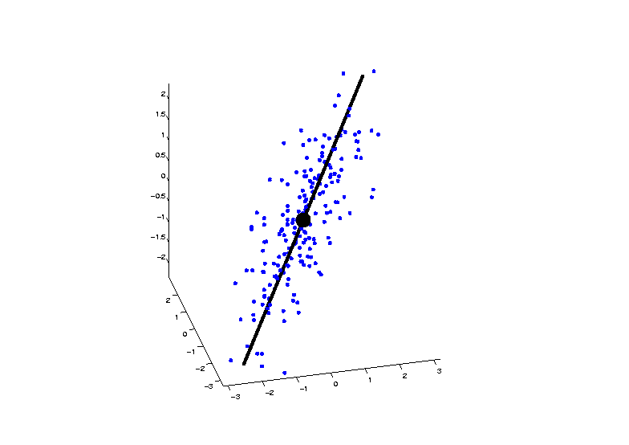
Nested Submanifolds in $ℝ^{3}$
Fit Nested Submanifolds $S_{0}∪S_{1}$

Slide 68
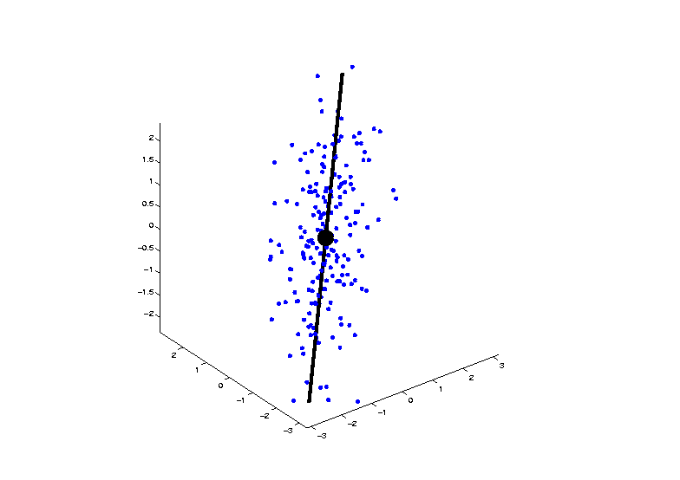
Nested Submanifolds in $ℝ^{3}$
Fit Nested Submanifolds $S_{0}∪S_{1}$

Slide 69
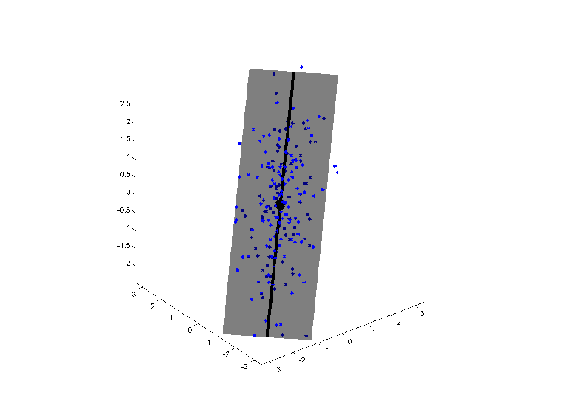
Nested Submanifolds in $ℝ^{3}$
Fit Nested Submanifolds $S_{0}∪S_{1}∪S_{2}$

Slide 70
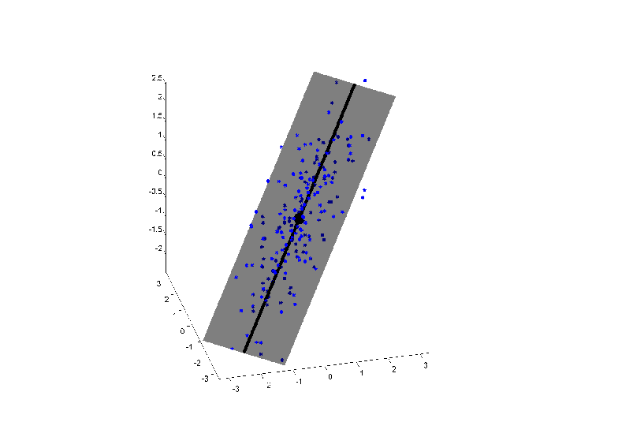
Nested Submanifolds in $ℝ^{3}$
Fit Nested Submanifolds $S_{0}∪S_{1}∪S_{2}$

Slide 71
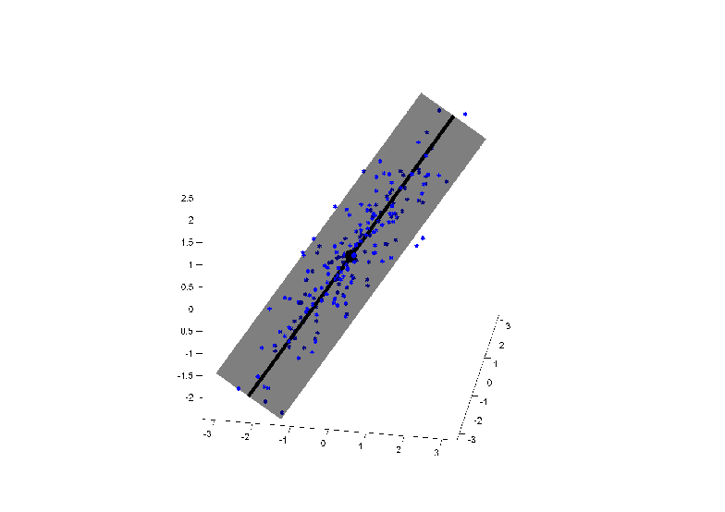
Nested Submanifolds in $ℝ^{3}$
Fit Nested Submanifolds $S_{0}∪S_{1}∪S_{2}$

Slide 72
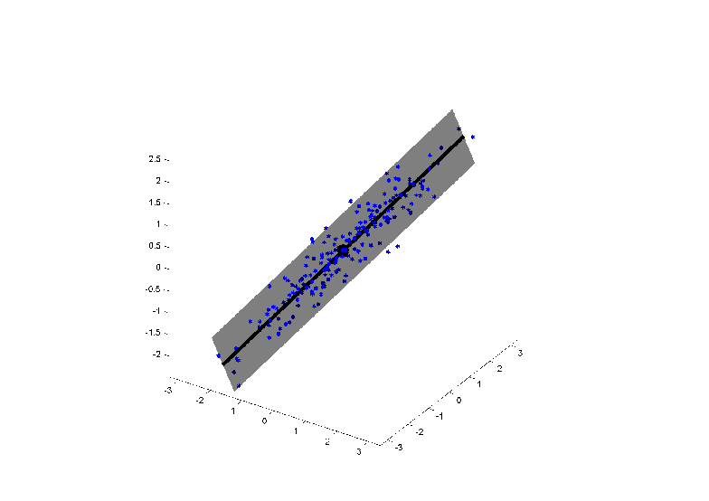
Nested Submanifolds in $ℝ^{3}$
Fit Nested Submanifolds $S_{0}∪S_{1}∪S_{2}$

Slide 73
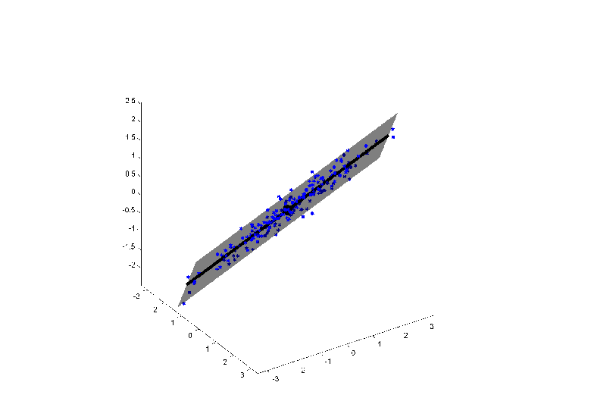
Nested Submanifolds in $ℝ^{3}$
Fit Nested Submanifolds $S_{0}∪S_{1}∪S_{2}$

Slide 74
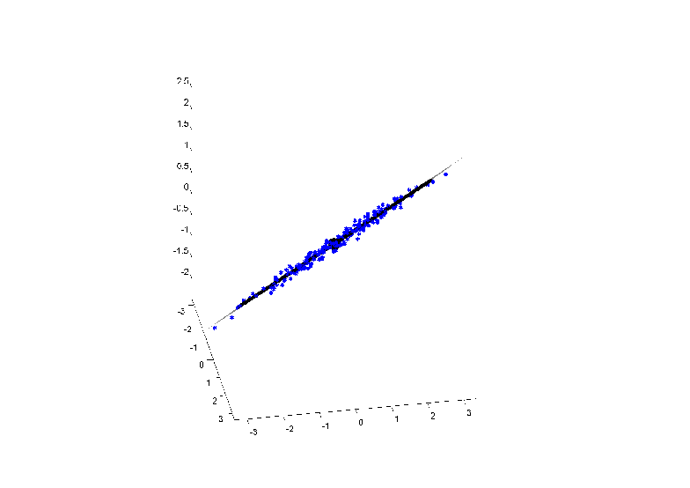
Nested Submanifolds in $ℝ^{3}$
Fit Nested Submanifolds $S_{0}∪S_{1}∪S_{2}$

Slide 75
Nested Submanifold Fits
Forwards Fit:
Sequentially Fit $𝒮=\left\{S_{0},⋯,S_{d−1}\right\}$
As:
$S_{0}$ then $S_{1}$ then$⋯$ then $S_{d−1}$
Usual Explanation of Euclidean PCA

Slide 76
Nested Submanifold Fits
Backwards Fit:
Sequentially Fit $𝒮=\left\{S_{0},⋯,S_{d−1}\right\}$
As:
$S_{d−1}$ then $S_{d−2}$ then$⋯$ then $S_{0}$
Useful for constructing many
non-Euclidean analogs of PCA
(Via Nested Relations)

Slide 77
Nested Submanifold Fits
Key Pennec Observation:
Both Forwards and Backwards Approaches
Are Greedy Searches
Often Sub-Optimal

Slide 78
Projection Notation
For $j=0,⋯,d−1$ let $P_{j}$ denote the projection operator onto $S_{j}$
I.e. for $X∈S_{d}$
$P_{j}\left(X\right)=arg\min_{x∈S_{j}}{d\left(x,X\right)}$
where $d$ is the manifold distance

Slide 79
Projection Notation
For $j=0,⋯,d−1$ let $P^{(k)}$ denote the telescoping projection onto $S_{k}$
I.e. for $X∈S_{d}$
$P^{(k)}=P_{k}\left(P_{k+1}\left(⋯P_{d−1}\left(X\right)\right)\right)$
Note: This projection is fundamental to Backwards PCA methods

Slide 80
PNS Components
For a given $𝒮$, represent a point $X∈S_{d}$
by its Nested Submanifold components:
$\left\{c_{1}\left(X\right),⋯,c_{d}(X)\right\}$
where for $j=1,⋯,d$
$c_{j}\left(X\right)=P^{\left(j\right)}\left(X\right)−P^{\left(j−1\right)}(X)$
In the sense that “$A−B$” means the shortest geodesic arc between $A$ & $B$

Slide 81
NS Components in $ℝ^{2}$
Candidate
Nested
Submanifold
$𝒮=\left\{S_{0},S_{1}\right\}$

Slide 82
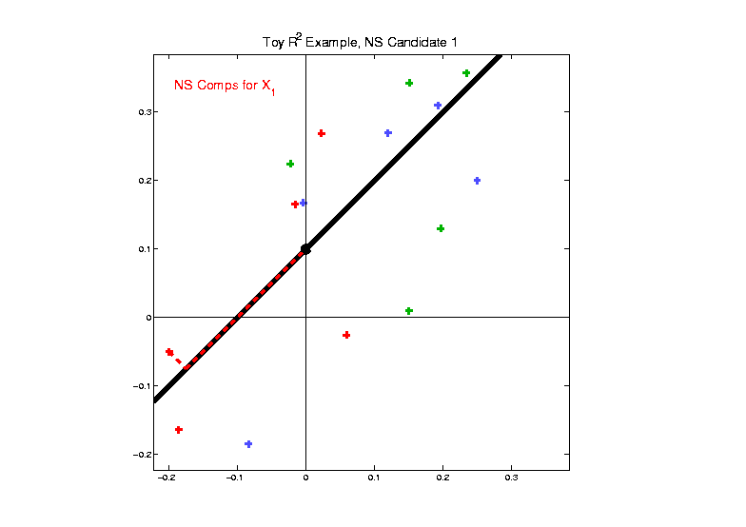
NS Components in $ℝ^{2}$
Candidate NS
Components
For $X_{1}$:
$c_{1}\left(X_{1}\right)$
$c_{2}\left(X_{1}\right)$

Slide 83
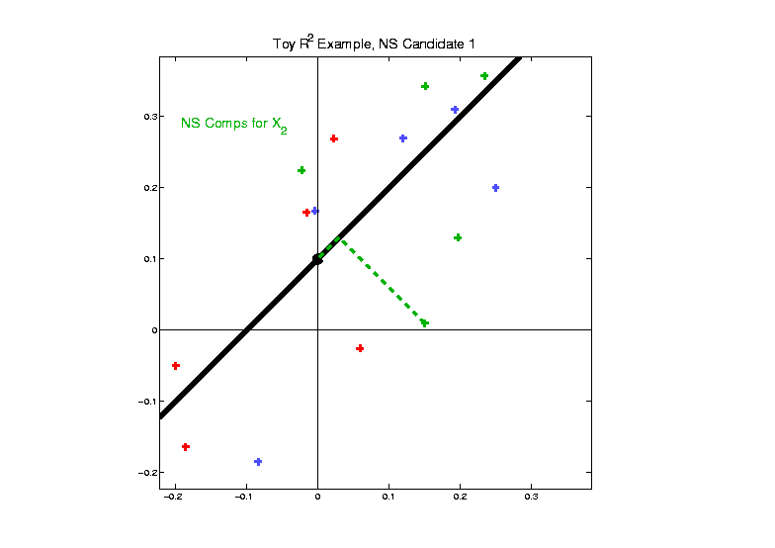
NS Components in $ℝ^{2}$
Candidate NS
Components
For $X_{2}$:
$c_{1}\left(X_{2}\right)$
$c_{2}\left(X_{2}\right)$

Slide 84
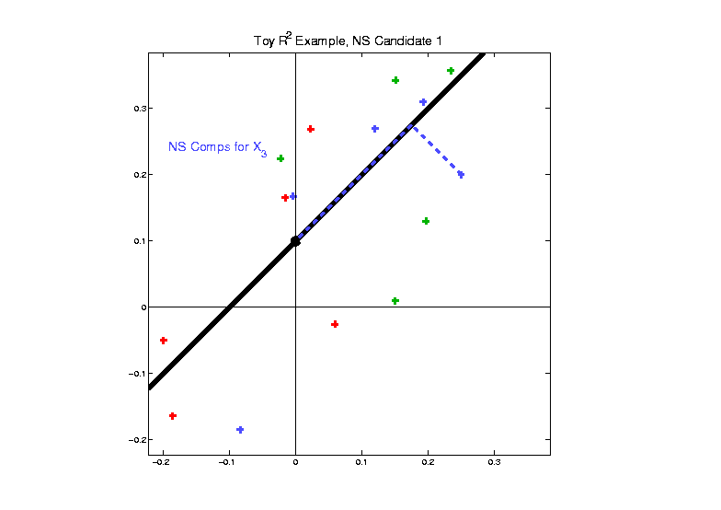
NS Components in $ℝ^{2}$
Candidate NS
Components
For $X_{3}$:
$c_{1}\left(X_{3}\right)$
$c_{2}\left(X_{3}\right)$

Slide 85
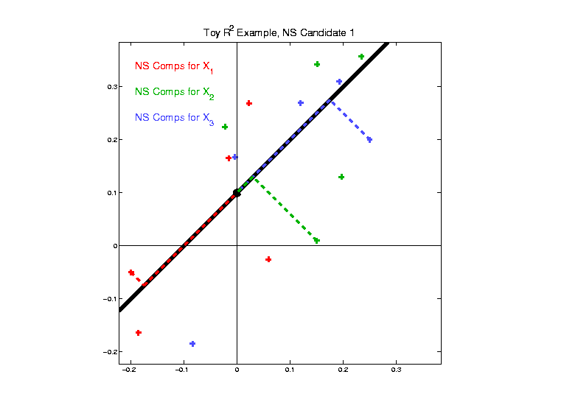
NS Components in $ℝ^{2}$
Candidate NS
Components
For All 3

Slide 86
Nested Submanifold Fits
New Approach:
Simultaneously fit $𝒮=\left\{S_{0},⋯,S_{d−1}\right\}$
Nested Submanifold (NS)
Simultaneous Fit Criteria?

Slide 87
Nested Submanifold Fits
Simultaneous Fit Criteria?
Based on Stratum-Wise Sums of Squares
For $j=1,⋯,d$ define
$${SS}_{j}=\sum_{i=1}^{n}{{d\left(P^{\left(j\right)}\left(X_{i}\right),P^{\left(j−1\right)}\left(X_{i}\right)\right)}^{2}}$$
Uses “lengths” of NS Components:
$$c_{j}\left(X\right)=P^{\left(j\right)}\left(X\right)−P^{\left(j−1\right)}(X)$$

Slide 88
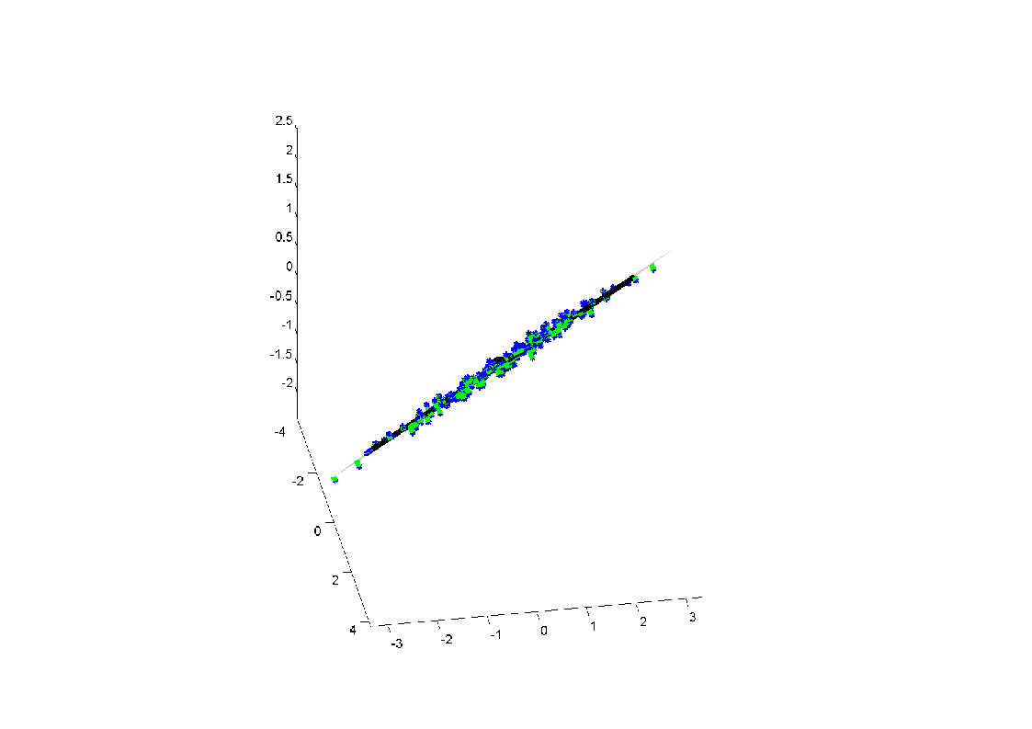
SS of NS Components in $ℝ^{3}$
${SS}_{3}=\sum_{i=1}^{n}{{d\left(P^{\left(3\right)}\left(X_{i}\right),P^{\left(2\right)}\left(X_{i}\right)\right)}^{2}}$

Slide 89
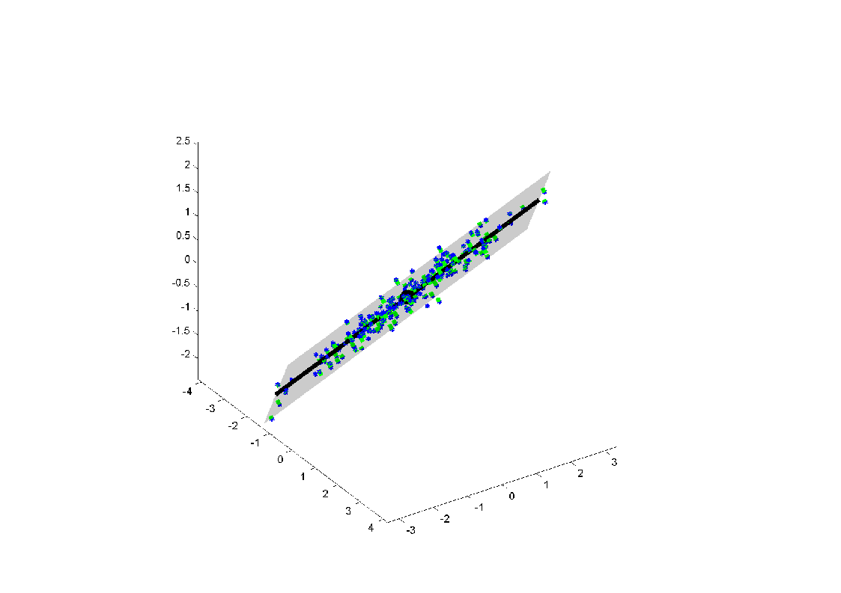
SS of NS Components in $ℝ^{3}$
${SS}_{3}=\sum_{i=1}^{n}{{d\left(P^{\left(3\right)}\left(X_{i}\right),P^{\left(2\right)}\left(X_{i}\right)\right)}^{2}}$

Slide 90
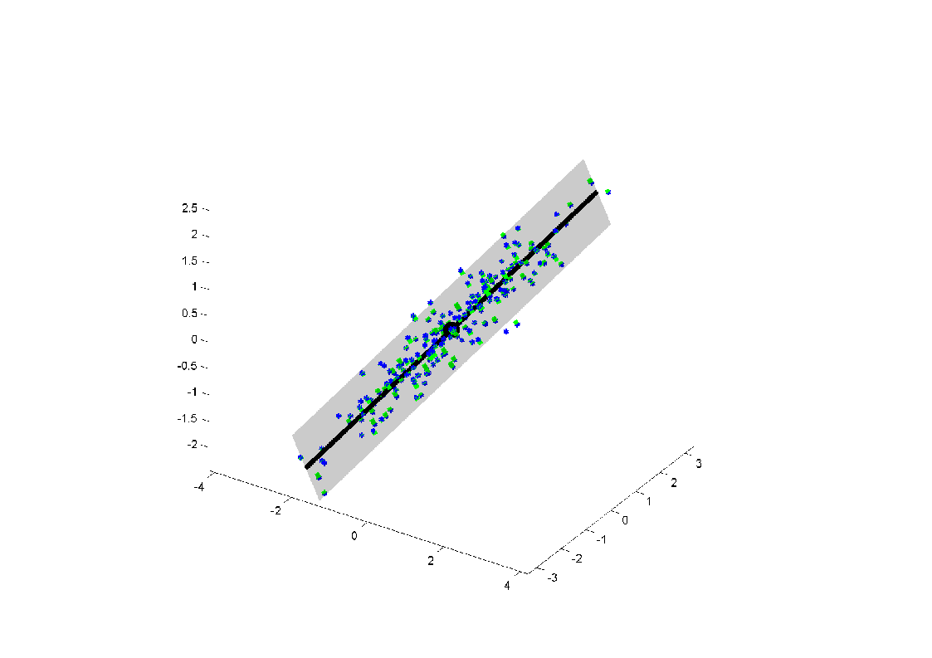
SS of NS Components in $ℝ^{3}$
${SS}_{3}=\sum_{i=1}^{n}{{d\left(P^{\left(3\right)}\left(X_{i}\right),P^{\left(2\right)}\left(X_{i}\right)\right)}^{2}}$

Slide 91
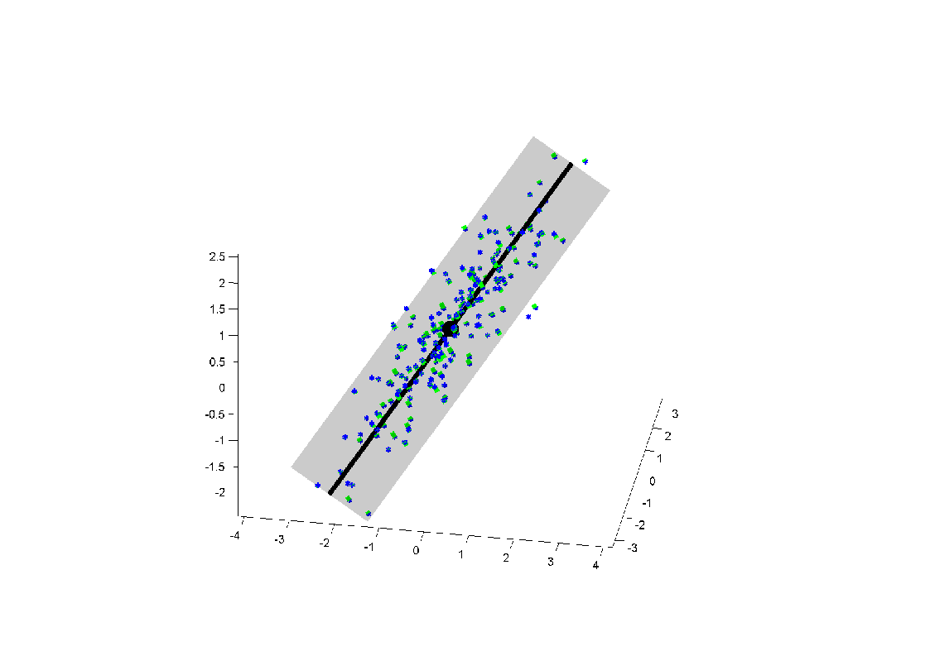
SS of NS Components in $ℝ^{3}$
${SS}_{3}=\sum_{i=1}^{n}{{d\left(P^{\left(3\right)}\left(X_{i}\right),P^{\left(2\right)}\left(X_{i}\right)\right)}^{2}}$

Slide 92
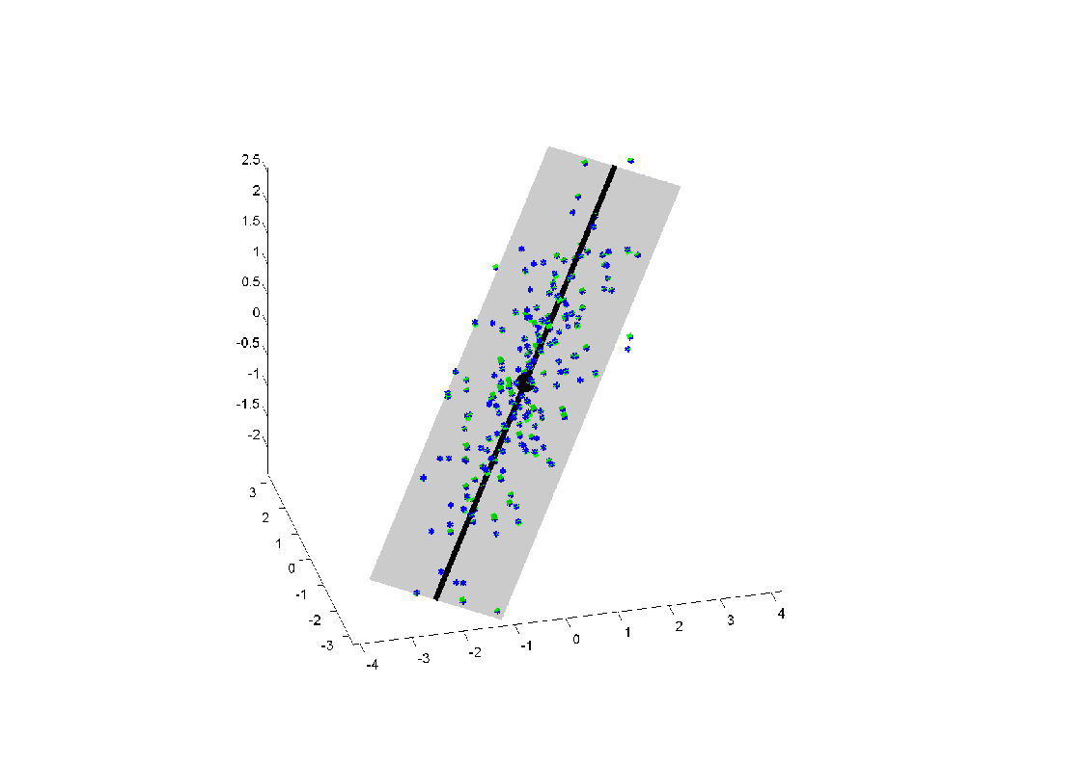
SS of NS Components in $ℝ^{3}$
${SS}_{3}=\sum_{i=1}^{n}{{d\left(P^{\left(3\right)}\left(X_{i}\right),P^{\left(2\right)}\left(X_{i}\right)\right)}^{2}}$

Slide 93
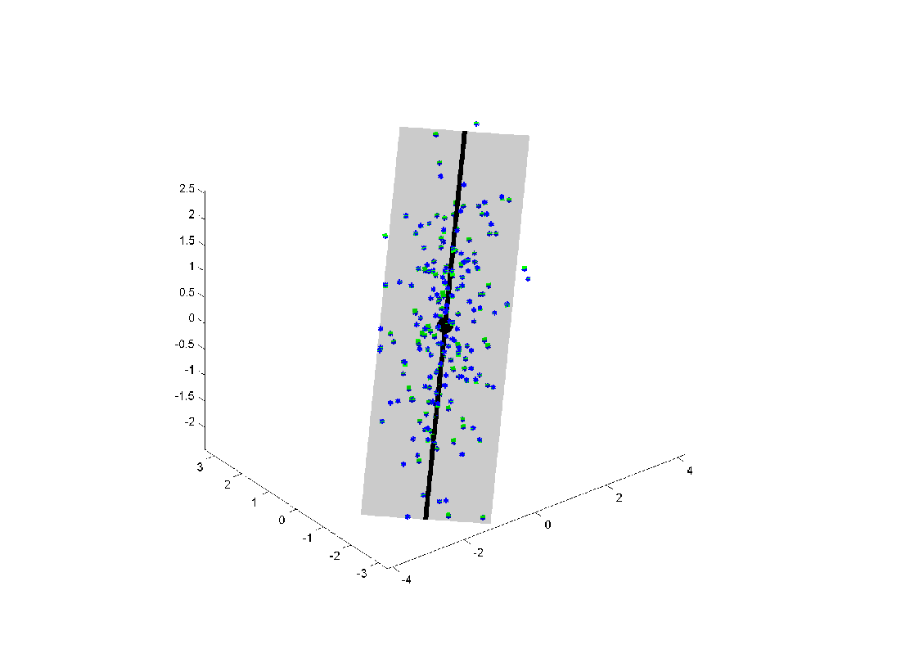
SS of NS Components in $ℝ^{3}$
${SS}_{3}=\sum_{i=1}^{n}{{d\left(P^{\left(3\right)}\left(X_{i}\right),P^{\left(2\right)}\left(X_{i}\right)\right)}^{2}}$

Slide 94
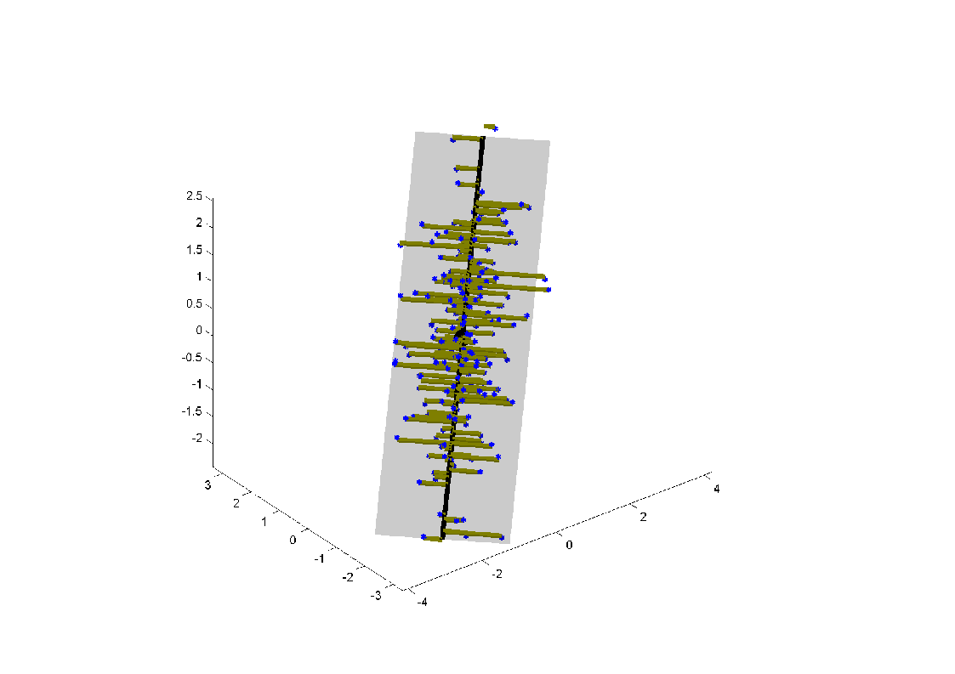
SS of NS Components in $ℝ^{3}$
${SS}_{2}=\sum_{i=1}^{n}{{d\left(P^{\left(2\right)}\left(X_{i}\right),P^{\left(1\right)}\left(X_{i}\right)\right)}^{2}}$

Slide 95
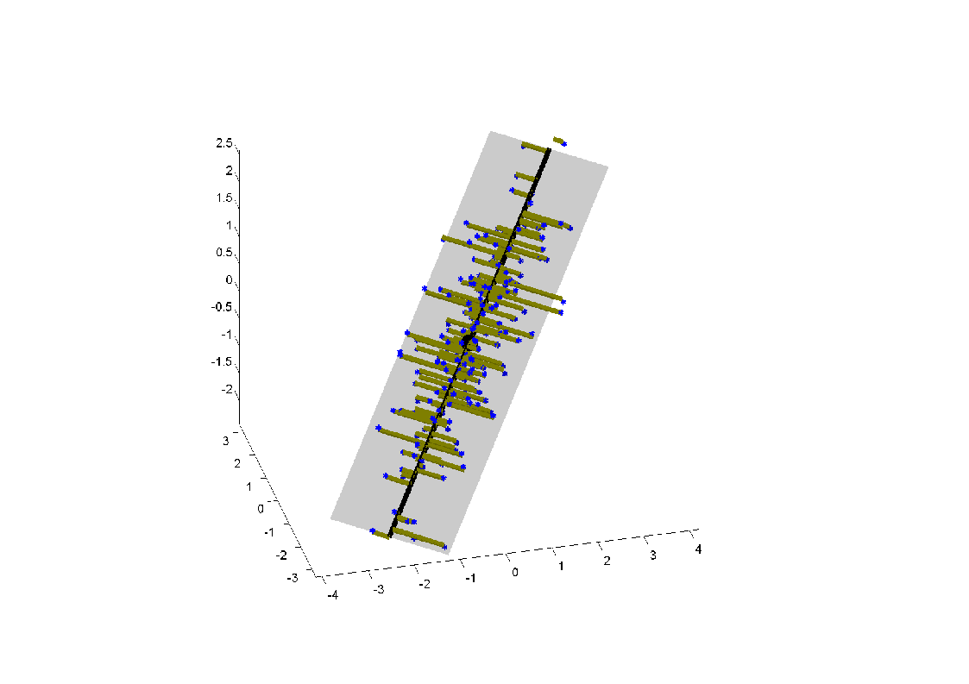
SS of NS Components in $ℝ^{3}$
${SS}_{2}=\sum_{i=1}^{n}{{d\left(P^{\left(2\right)}\left(X_{i}\right),P^{\left(1\right)}\left(X_{i}\right)\right)}^{2}}$

Slide 96
SS of NS Components in $ℝ^{3}$
${SS}_{2}=\sum_{i=1}^{n}{{d\left(P^{\left(2\right)}\left(X_{i}\right),P^{\left(1\right)}\left(X_{i}\right)\right)}^{2}}$

Slide 97
SS of NS Components in $ℝ^{3}$
${SS}_{2}=\sum_{i=1}^{n}{{d\left(P^{\left(2\right)}\left(X_{i}\right),P^{\left(1\right)}\left(X_{i}\right)\right)}^{2}}$

Slide 98
SS of NS Components in $ℝ^{3}$
${SS}_{2}=\sum_{i=1}^{n}{{d\left(P^{\left(2\right)}\left(X_{i}\right),P^{\left(1\right)}\left(X_{i}\right)\right)}^{2}}$

Slide 99
SS of NS Components in $ℝ^{3}$
${SS}_{2}=\sum_{i=1}^{n}{{d\left(P^{\left(2\right)}\left(X_{i}\right),P^{\left(1\right)}\left(X_{i}\right)\right)}^{2}}$

Slide 100
SS of NS Components in $ℝ^{3}$
${SS}_{1}=\sum_{i=1}^{n}{{d\left(P^{\left(1\right)}\left(X_{i}\right),P^{\left(0\right)}\left(X_{i}\right)\right)}^{2}}$

Slide 101
SS of NS Components in $ℝ^{3}$
${SS}_{1}=\sum_{i=1}^{n}{{d\left(P^{\left(1\right)}\left(X_{i}\right),P^{\left(0\right)}\left(X_{i}\right)\right)}^{2}}$

Slide 102
SS of NS Components in $ℝ^{3}$
${SS}_{1}=\sum_{i=1}^{n}{{d\left(P^{\left(1\right)}\left(X_{i}\right),P^{\left(0\right)}\left(X_{i}\right)\right)}^{2}}$

Slide 103
SS of NS Components in $ℝ^{3}$
${SS}_{1}=\sum_{i=1}^{n}{{d\left(P^{\left(1\right)}\left(X_{i}\right),P^{\left(0\right)}\left(X_{i}\right)\right)}^{2}}$

Slide 104
SS of NS Components in $ℝ^{3}$
${SS}_{1}=\sum_{i=1}^{n}{{d\left(P^{\left(1\right)}\left(X_{i}\right),P^{\left(0\right)}\left(X_{i}\right)\right)}^{2}}$

Slide 105
SS of NS Components in $ℝ^{3}$
${SS}_{1}=\sum_{i=1}^{n}{{d\left(P^{\left(1\right)}\left(X_{i}\right),P^{\left(0\right)}\left(X_{i}\right)\right)}^{2}}$

Slide 106
Nested Submanifolds in $ℝ^{2}$
Candidate
Nested
Submanifold
$𝒮=\left\{S_{0},S_{1}\right\}$
(i.e. point
$∪$ line)

Slide 107
NS Components in $ℝ^{2}$
NS Candidate 1

Slide 108
NS Components in $ℝ^{2}$
NS Candidate 2
(Shifted
$S_{0}$ to
Sample
Mean)
Note: Both
${SS}_{1}$ & ${SS}_{2}$
Decrease

Slide 109
NS Components in $ℝ^{2}$
NS based
On PC1
Note:
${SS}_{1} ↑$
${SS}_{2} ↓$
Yet ${SS}_{1}+{ SS}_{2}$ is Constant
(Pythagorean Thm)

Slide 110
NS Components in $ℝ^{2}$
NS based
On PC2
Note:
${SS}_{1} ↓$
${SS}_{2} ↑$
${SS}_{1}+ {SS}_{2}$ is Constant
(Pythagorean Thm)

Slide 111
NS Components in $ℝ^{2}$
NS Candidate 1

Slide 112
NS Components in $ℝ^{2}$
NS Candidate 2
$0.3×{SS}_{1}+0.7×{SS}_{2} ↓$

Slide 113
NS Components in $ℝ^{2}$
NS based
On PC1
$0.3×{SS}_{1}+0.7×{SS}_{2} ↓$

Slide 114
NS Components in $ℝ^{2}$
NS based
On PC2
$0.3×{SS}_{1}+0.7×{SS}_{2} ↑$

Slide 115
Nested Submanifold Fits
Simultaneously fit $𝒮=\left\{S_{0},⋯,S_{d−1}\right\}$
Simultaneous Fit Criterion?
$$w_{1}{SS}_{1}+w_{2}{SS}_{2}+⋯+w_{d}{SS}_{d}$$
Above Suggests Want:
$$w_{1}<w_{2}<⋯<w_{d}$$
Works for Euclidean PCA (?)

Slide 116
Nested Submanifold Fits
Simultaneous Fit Criterion?
$$w_{1}{SS}_{1}+w_{2}{SS}_{2}+⋯+w_{d}{SS}_{d}$$
Above Suggests Want:
$$w_{1}<w_{2}<⋯<w_{d}$$
Important Predecessor
Pennec (2016)
AUC Criterion: $w_{j}∝(j−1)$

Slide 117
Participant Presentations
Shengjie Chai
Cancer Metastesis
Di Qin
Kernel PCA
Yaoyu Chen
Introduction to Generative Adversarial Networks

