Slide 1
Manifold Descriptor Spaces
Fréchet Mean of Numbers:
$$\overline{X}=arg\min_{x}{\sum_{i=1}^{n}{{\left(X_{i}−x\right)}^{2}}}$$
Fréchet Mean in Euclidean Space ($ℝ^{d}$):
$$\overline{\underline{X}}=arg\min_{x}{\sum_{i=1}^{n}{{\left\|{\underline{X}}_{i}−\underline{x}\right\|}^{2}}}=arg\min_{x}{\sum_{i=1}^{n}{{d\left({\underline{X}}_{i},\underline{x}\right)}^{2}}}$$
(Intrinsic) Fréchet Mean on a Manifold:
Replace Euclidean $d$ by Geodesic $d$

Slide 2
PCA for s-reps
PCA on non-Euclidean spaces?
(i.e. on Lie Groups / Symmetric Spaces)
T. Fletcher: Principal Geodesic Analysis
Idea: replace “linear summary of data”
With “geodesic summary of data”…

Slide 3
Challenge for Principal Geodesic Analysis
Data
On $S^{2}$
Geodesic
Mean(s)
Tangent Plane
Projections

Slide 4
PCA Extensions for Data on Manifolds
Fletcher (Principal Geodesic Anal.)
Best fit of geodesic to data
Constrained to go through geodesic mean
Huckemann, Hotz & Munk (Geod. PCA)
Huckemann et al (2011)

Slide 5
PCA Extensions for Data on Manifolds
Fletcher (Principal Geodesic Anal.)
Best fit of geodesic to data
Constrained to go through geodesic mean
Huckemann, Hotz & Munk (Geod. PCA)
Best fit of any geodesic to data
Counterexample:
Data follows Tropic of Capricorn

Slide 6
PCA Extensions for Data on Manifolds
Fletcher (Principal Geodesic Anal.)
Best fit of geodesic to data
Constrained to go through geodesic mean
Huckemann, Hotz & Munk (Geod. PCA)
Best fit of any geodesic to data
Jung, Foskey & Marron (Princ. Arc Anal.)
Best fit of any circle to data
(motivated by conformal maps)

Slide 7
Principal Arc Analysis
Jung, Foskey & Marron (2011)
Best fit of any circle to data
Can give better fit than geodesics
Observed for simulated s-rep example

Slide 8
Principal Nested Spheres
Move plane
To Minimize
$\sum_{i}{{resid}_{i}^{2}}$
Keep signed
${resid}_{i}$ as
PNS-$d$ scores
$$S^{d}$$

Slide 9
Composite Principal Nested Spheres
Idea: Use Principal Nested Spheres
Over Large Products of $S^{2}$ and $ℝ^{d}$
Approach: Use Principal Nested Spheres
to Linearize $S^{2}$ Components
Then Concatenate All & Use PCA
HDLSS asymptotics?
(When have many s-rep atoms?)

Slide 10
Composite Principal Nested Spheres
Impact on Segmentation:
PGA Segmentation: used ~20 comp’s
CPNS Segmentation: only need ~13
Resulted in visually better fits to data

Slide 11
Extension to s-rep Space
Challenge:
Vectors of $S^{2}$ Directions as Data Objects
$$\left(\begin{matrix}\left(θ_{1},φ_{1}\right) \\ ⋮ \\ \left(θ_{d},φ_{d}\right)\end{matrix}\right)∈{\left(S^{2}\right)}^{d}$$
Polysphere Type Space

Slide 12
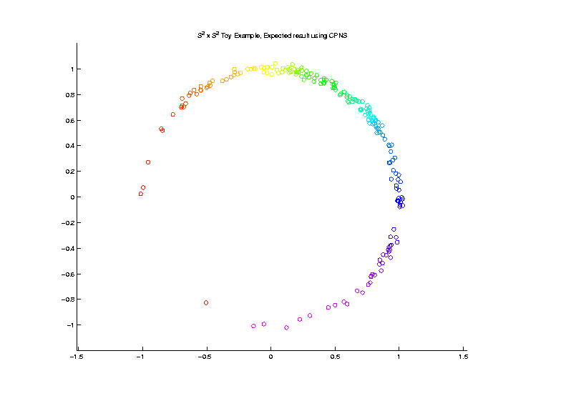
Extension to s-rep Space
Challenge: $S^{2}×S^{2}$ Polysphere Space
Generator Of
Toy Example
Wrap $x$ around
1st Copy of $S^{2}$
Wrap $y$ around
2nd Copy of $S^{2}$

Slide 13
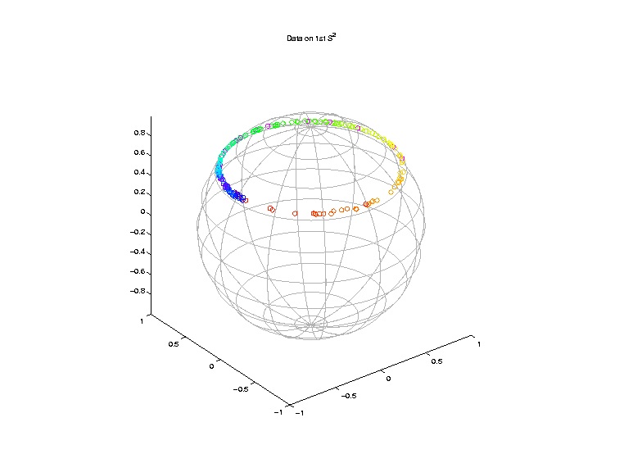
Extension to s-rep Space
Challenge: $S^{2}×S^{2}$ Polysphere Space
Note Colors
From $x$ In
Generator

Slide 14
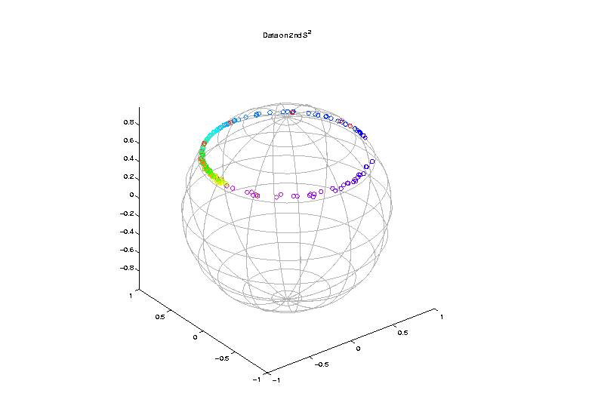
Extension to s-rep Space
Challenge: $S^{2}×S^{2}$ Polysphere Space
Note Colors
From $y$ In
Generator

Slide 15
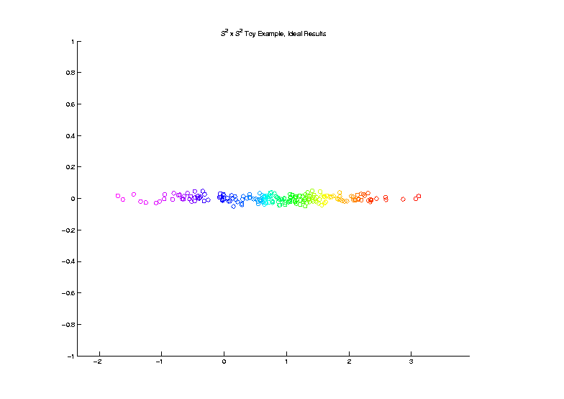
Extension to s-rep Space
Challenge: $S^{2}×S^{2}$ Polysphere Space
Desired Answer
From A PCA

Slide 16
Extension to s-rep Space
Challenge: $S^{2}×S^{2}$ Polysphere Space
CPNS:
Gets 1-d Comps,
But Wrong
Dependence
(Strong Distortion)
Thanks to Sungkyu Jung

Slide 17
Polysphere PCA
Deeper New Methodology: PPCA
For Polysphere Spaces (e.g. s-reps)
Find Approximating Sphere
Then do PNS (Better Signal Compression)

Slide 18
Polysphere PCA
Deeper New Methodology: PPCA
For Polysphere Spaces (e.g. s-reps)
Reference: Elzner et al (2015)
Benjamin Eltzner Stephan Huckemann Sungkyu Jung

Slide 19
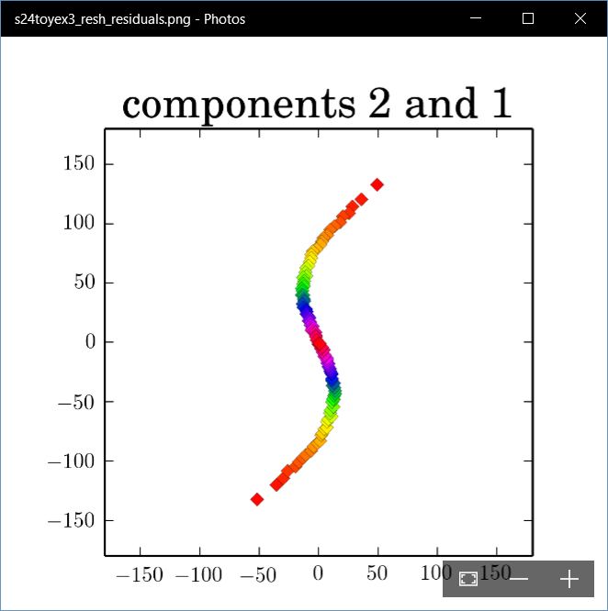
Polysphere PCA-type Analysis
Deeper New Methodology: PPCA
For Polysphere
~Toy Example
Pretty Good But
Still Some
Distortion
Thanks to B. Eltzner

Slide 20
Principal Nested Spheres
Main Goal:
Extend Principal Arc Analysis ($S^{2}$ to $S^{k}$)
Jung et al (2012)
Important Landmark:
This Motivated Backwards PCA

Slide 21
Backwards PCA
Key Idea:
Replace usual forwards view of PCA
With a backwards approach to PCA

Slide 22
Terminology
Multiple linear regression:
Stepwise approaches:
Forwards: Start small, iteratively add variables to model
Backwards: Start with all, iteratively remove variables from model

Slide 23
Illust’n of PCA View: Recall Raw Data
Notes:
EgView1p1RawData.ps

Slide 24
Illust’n of PCA View: PC1 Projections
Notes:
EgView1p51proj3dPC1.ps

Slide 25
Illust’n of PCA View: PC2 Projections
Notes:
EgView1p52proj3dPC2.ps

Slide 26
Illust’n of PCA View: Projections on PC1,2 plane
Notes:
EgView1p54proj3dPC12.ps

Slide 27
Backwards PCA
Replace usual forwards view of PCA
Data → PC1 (1-d approx)
→ PC2 (1-d approx of Data-PC1)
→ PC1 U PC2 (2-d approx)
$⋱$
→ PC1 U … U PCr
(r-d approx)

Slide 28
Backwards PCA
With a backwards approach to PCA
Data → PC1 U … U PCr (r-d approx)
→ PC1 U … U PC(r-1)
$⋱$
→ PC1 U PC2 (2-d approx)
→ PC1 (1-d approx)

Slide 29
Backwards PCA
Euclidean Settings:
Forwards PCA = Backwards PCA
(Pythagorean Theorem,
ANOVA Decomposition)
So Not Interesting
But Very Different in Non-Euclidean Settings
(Backwards is Better !?!)

Slide 30
Backwards PCA
Important Property of PCA:
Nested Series of Approximations
$$\left\{{PC}_{1}\right\}⊆\left\{{PC}_{1}{,PC}_{2}\right\}⊆\left\{{PC}_{1}{,PC}_{2},{PC}_{3}\right\}⊆⋯$$
(Often taken for granted)
(Desirable in Non-Euclidean Settings)

Slide 31
Backwards PCA
Desirability of Nesting:
Multi-Scale Analysis Makes Sense
Scores Visualization Makes Sense

Slide 32
An Interesting Question
How generally applicable is
Backwards approach to PCA?
Discussion:
Jung et al (2010)
Pizer et al (2013)

Slide 33
An Interesting Question
How generally applicable is
Backwards approach to PCA?
Anywhere this is already being done???

Slide 34
An Interesting Question
How generally applicable is
Backwards approach to PCA?
An Application:
Nonnegative Matrix Factorization
= PCA in Positive Orthant
Think $X ≈LS$
With ≥ 0 Constraints (on both $L$ & $S$)

Slide 35
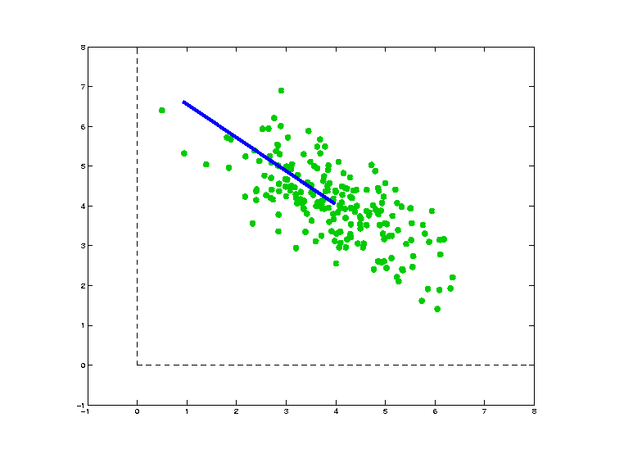
Nonnegative Matrix Factorization
Isn’t This
Just PCA?
In the
Nonnegative
Orthant?
No, Most PC Directions Leave Orthant

Slide 36
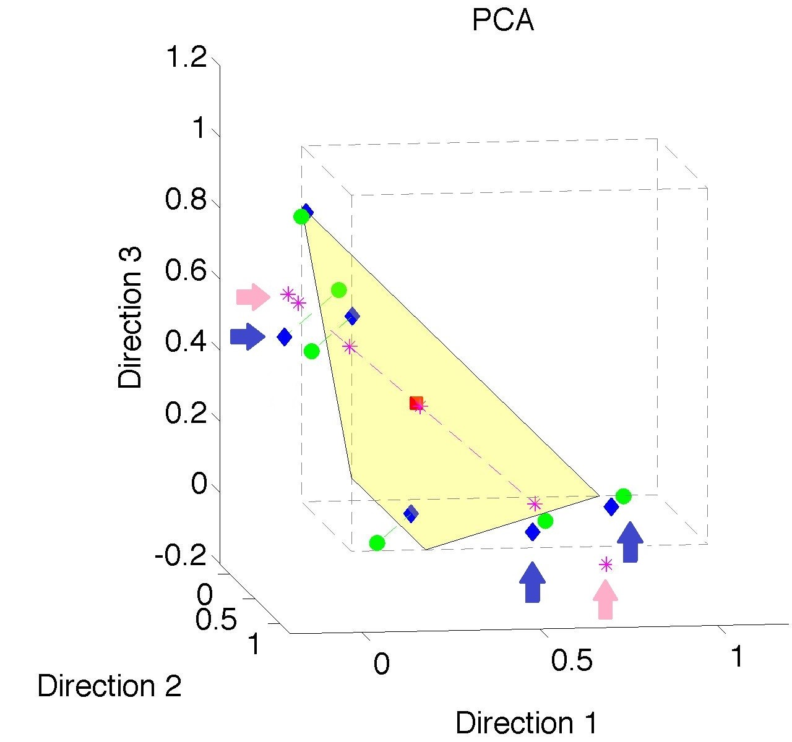
Nonnegative Matrix Factorization
Isn’t This
Just PCA?
Data
(Near
Orthant
Faces)

Slide 37
Nonnegative Matrix Factorization
Isn’t This
Just PCA?
Data
Mean
(Centered
Analysis)

Slide 38
Nonnegative Matrix Factorization
Isn’t This
Just PCA?
Data
Mean
PC1 Projections
Leave Orthant!

Slide 39
Nonnegative Matrix Factorization
Isn’t This
Just PCA?
Data
Mean
PC1 Projections
PC1 $⋃$ 2 Proj’ns
Leave Orthant!

Slide 40
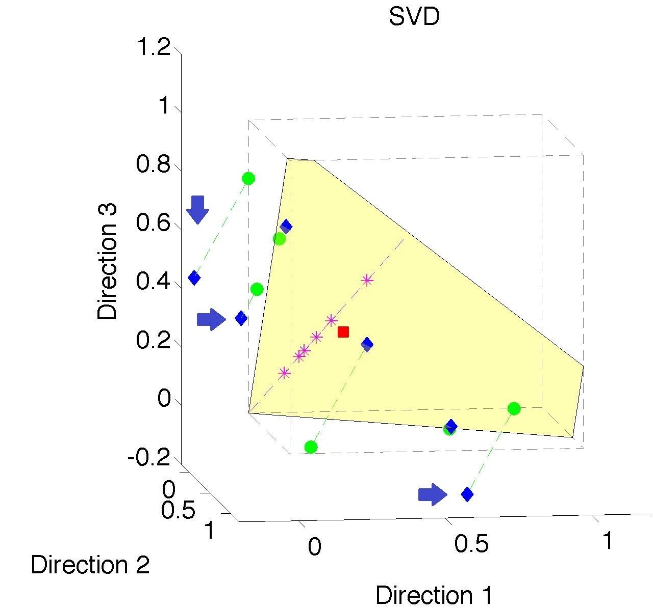
Nonnegative Matrix Factorization
Note:
Problem not
Fixed by
SVD
(“Uncentered
PCA”)
Orthant Leaving Gets Worse

Slide 41
Nonnegative Matrix Factorization
Standard Approach:
Lee & Seung (1999):
Formulate & Solve Optimization
Major Challenge:
Not Nested, ($k=3 ≉ k=4$)

Slide 42
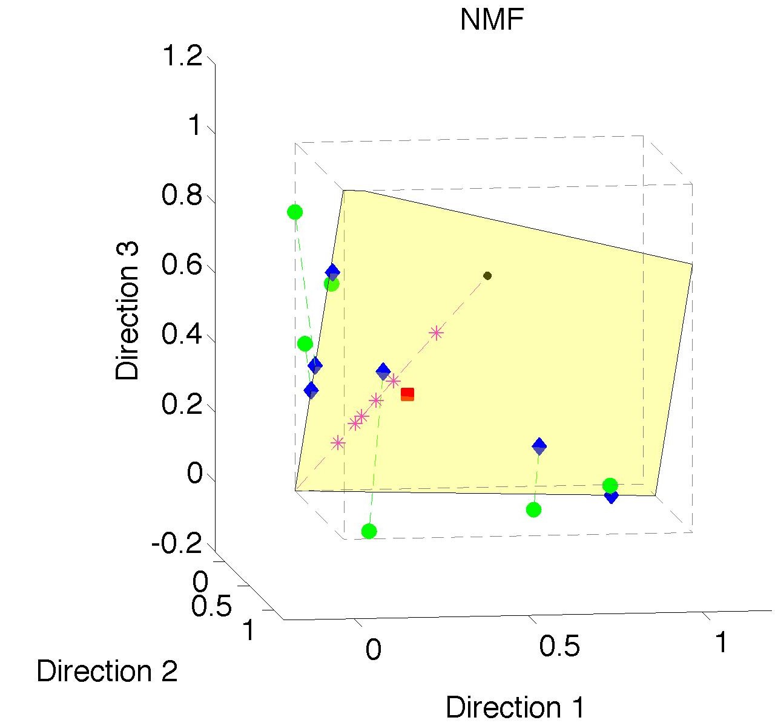
Nonnegative Matrix Factorization
Standard NMF
(Projections
All Inside
Orthant)

Slide 43
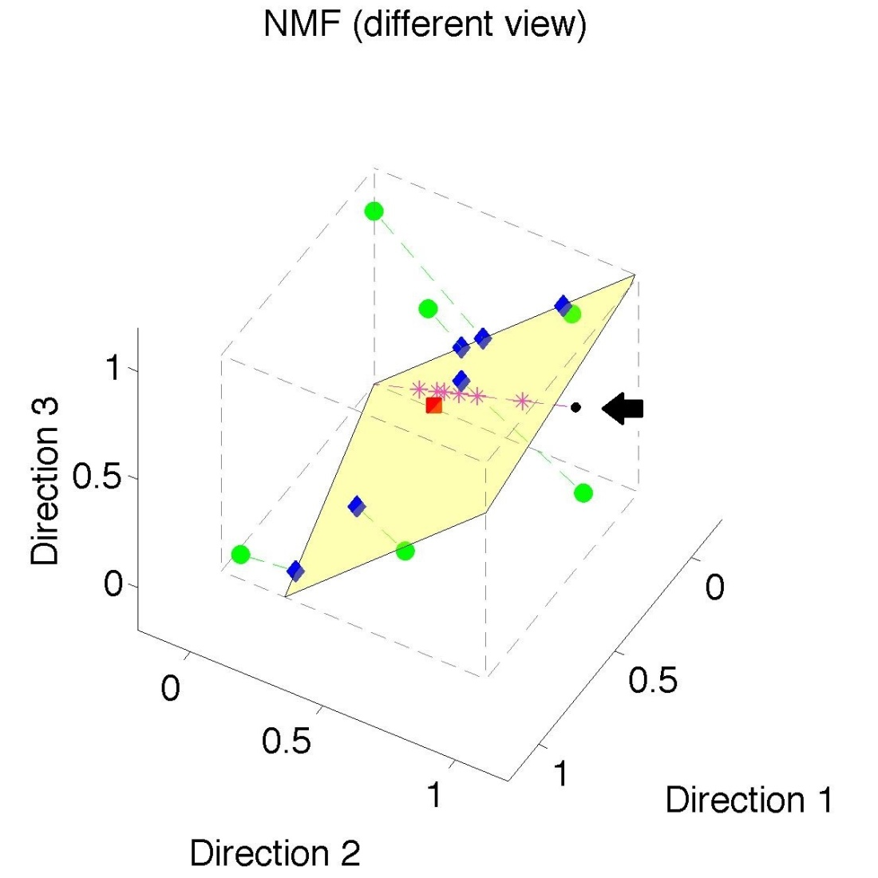
Nonnegative Matrix Factorization
Standard NMF
But Note
Not Nested
No “Multi-scale”
Analysis Possible
(Scores Plot?!?)

Slide 44
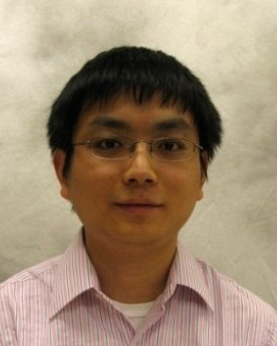
Nonnegative Matrix Factorization
Improved Version:
Use Backwards PCA Idea
“Nonnegative Nested Cone Analysis”
Collaborator:
Lingsong Zhang (Purdue)
Zhang, Lu, Marron (2015)

Slide 45
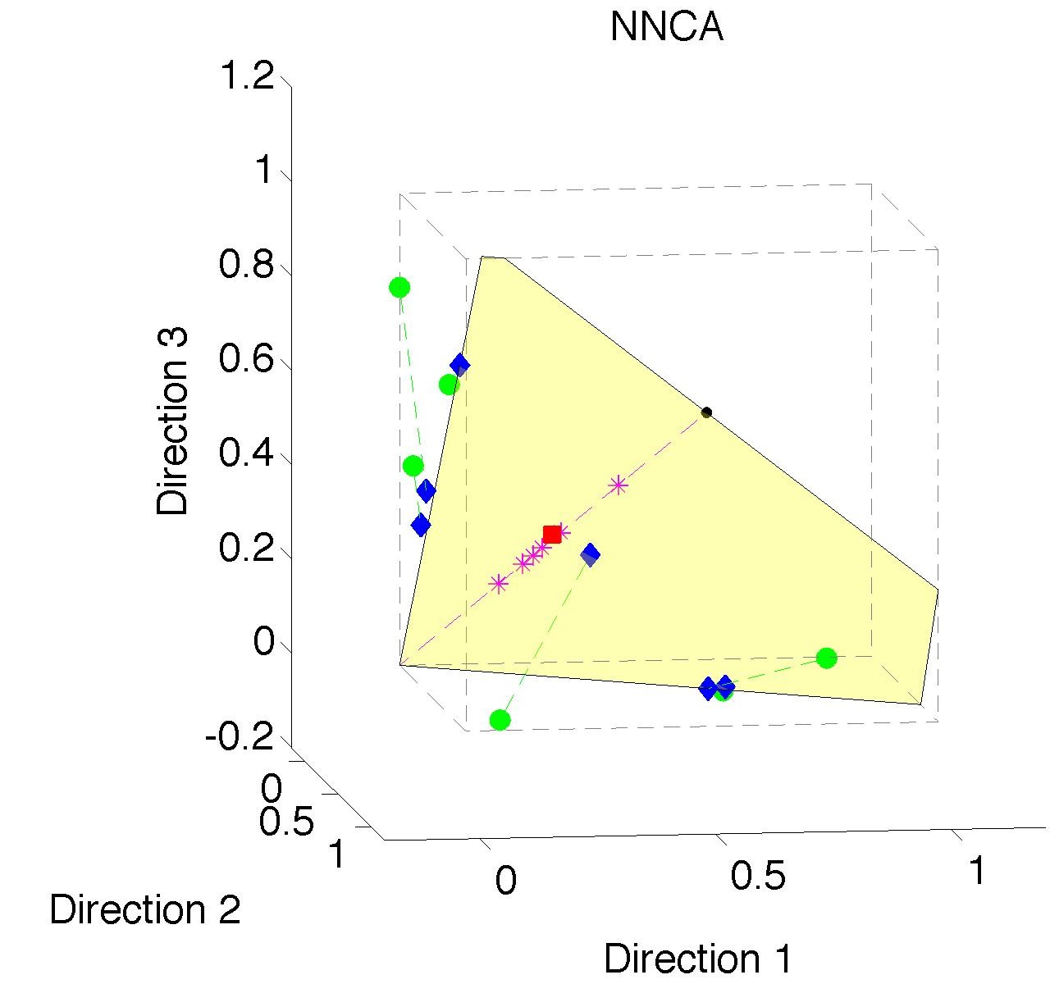
Nonnegative Nested Cone Analysis
Same Toy
Data Set
All
Projections
In Orthant

Slide 46
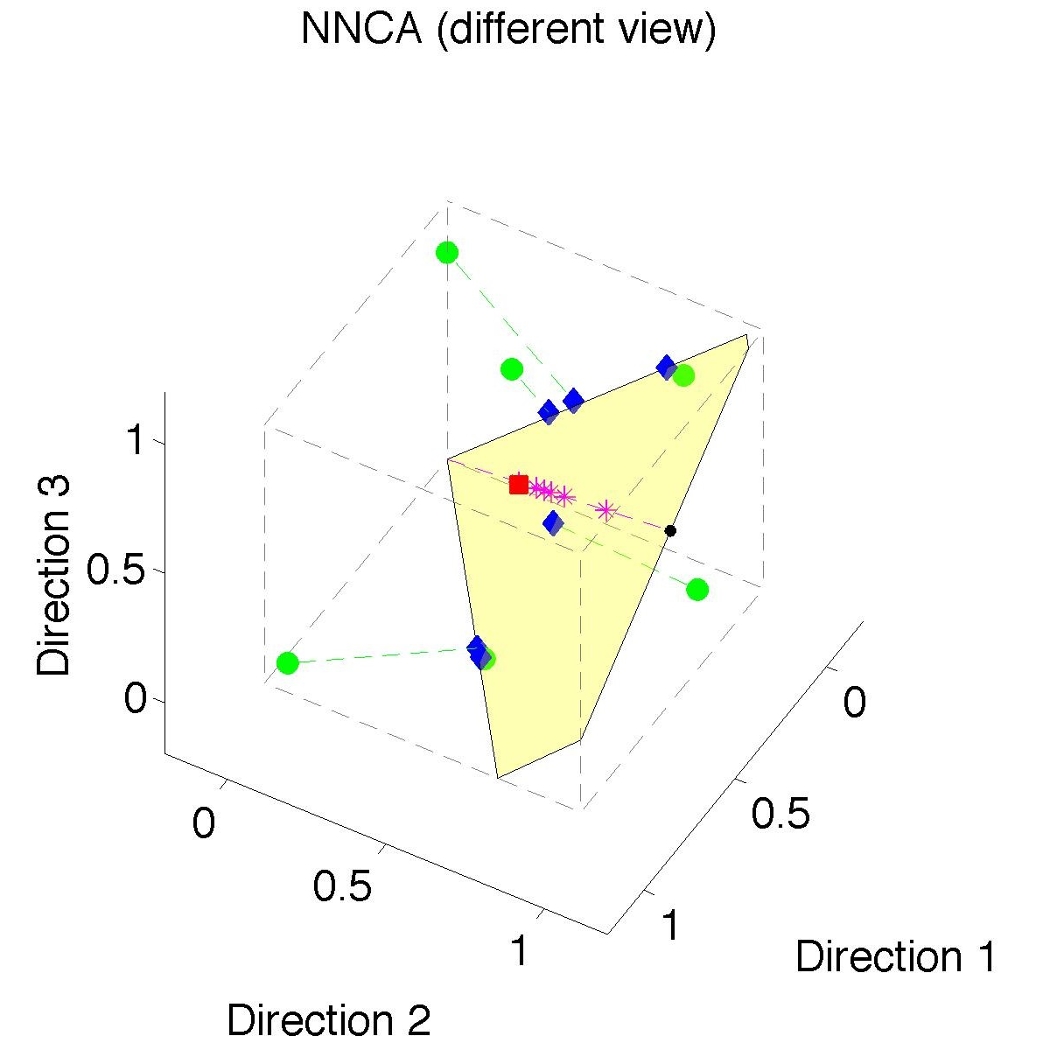
Nonnegative Nested Cone Analysis
Same Toy
Data Set
Rank 1
Approx.
Properly
Nested

Slide 47
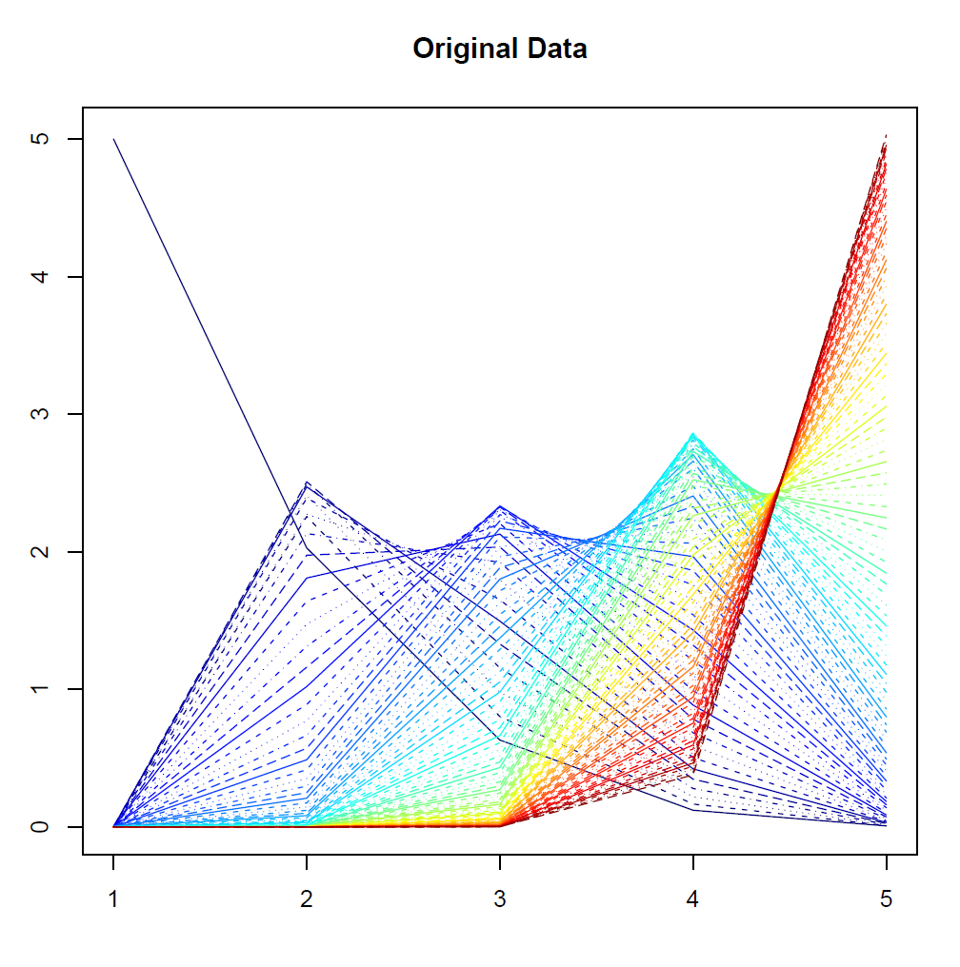
Nonnegative Nested Cone Analysis
5-d Toy
Example
(Rainbow
Colored
by Peak
Order)

Slide 48
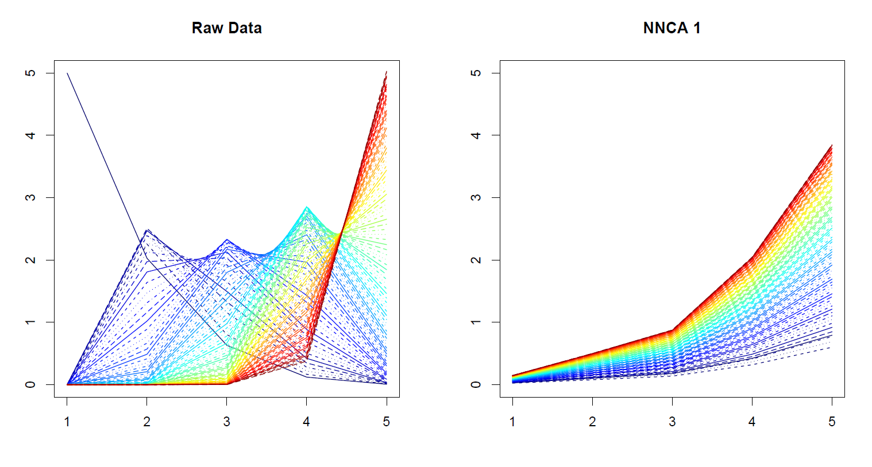
Nonnegative Nested Cone Analysis
5-d Toy Example Rank 1 NNCA Approx.

Slide 49
Nonnegative Nested Cone Analysis
5-d Toy Example Rank 2 NNCA Approx.

Slide 50
Nonnegative Nested Cone Analysis
5-d Toy Example Rank 2 NNCA Approx.
Nonneg.
Basis
Elements
(Not Trivial)

Slide 51
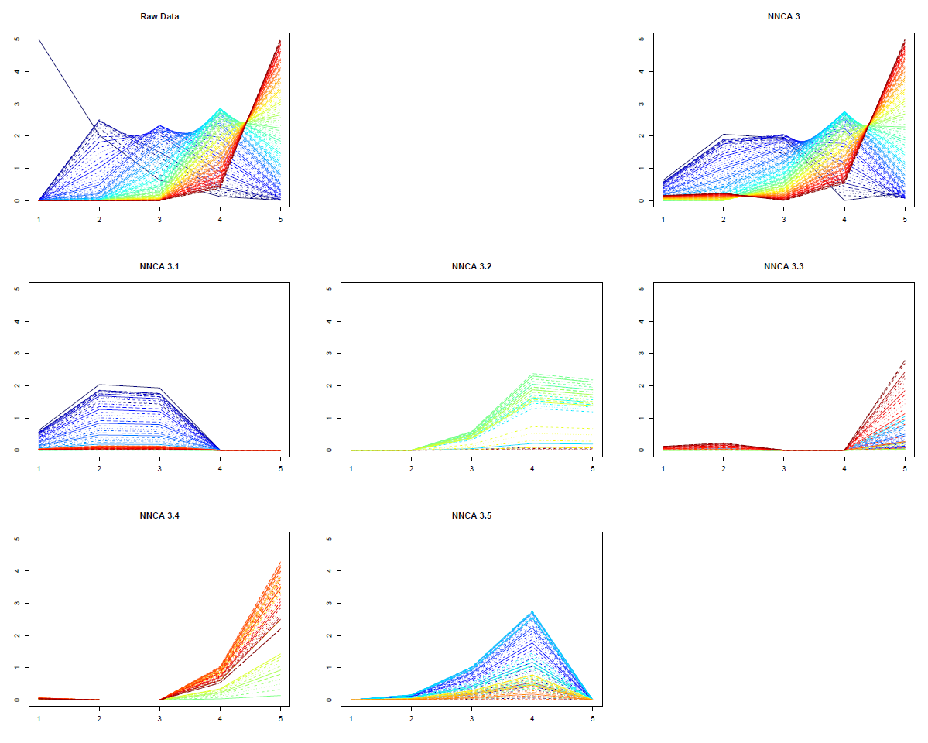
Nonnegative Nested Cone Analysis
5-d Toy Example Rank 3 NNCA Approx.
Current
Research:
How Many
Nonneg.
Basis El’ts
Needed?

Slide 52
An Interesting Question
How generally applicable is
Backwards approach to PCA?
Potential Application: Principal Curves
Hastie & Stuetzle, (1989)
(Foundation of Manifold Learning)

Slide 53
Manifold Learning
Goal: Find lower dimensional manifold that well approximates data
ISOmap
Tenenbaum, et al (2000)
Local Linear Embedding
Roweis & Saul (2000)

Slide 54
1st Principal Curve
Linear Reg’n
Usual Smooth

Slide 55
1st Principal Curve
Linear Reg’n
Proj’s Reg’n
Usual Smooth

Slide 56
1st Principal Curve
Linear Reg’n
Proj’s Reg’n
Usual Smooth
Princ’l Curve

Slide 57
Manifold Learning
How generally applicable is
Backwards approach to PCA?
Potential Application: Principal Curves
Perceived Major Challenge:
How to find 2nd Principal Curve?

Slide 58
Manifold Learning
Key Component:
Principal Surfaces
LeBlanc & Tibshirani (1996)
Challenge:
Can have any dimensional surface,
But how to nest???
Proposal: Backwards Approach

Slide 59
Participant Presentations
Aman Barot
Introduction to Deep learning
Pooja Saha
LASSO regression
Yue Jiang
CART

