Slide 1
Landmark Based Shape Analysis
Equivalence Classes become Data Objects
Mathematics: Called “Quotient Space”
Intuitive Representation: Manifold
(curved surface)

Slide 2
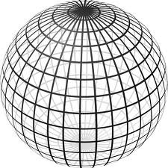
Landmark Based Shape Analysis
Triangle Shape Space: Represent as Sphere
R⁶ → R⁴ → R³ →
scaling
(thanks to Wikipedia)

Slide 3
Landmark Based Shape Analysis
Triangle Shape Space: Represent as Sphere
Equilateral
Triangles
Hemispheres
Are
Reflections
Co-Linear
Point Triples

Slide 4
Image Object Representation
Major Approaches for Image Data Objects:
Landmark Representations
Boundary Representations
Skeletal Representations

Slide 5
Skeletal Representations
3-d S-Rep Example: From Ja-Yeon Jeong
Bladder – Prostate - Rectum
In Male Pelvis
~Valve on Bladder
Common Area for Cancer in Males
Goal: Design Radiation Treatment
Hit Prostate
Miss Bladder & Rectum
Over Course of Many Days
Notes:
OODA.ppt

Slide 6
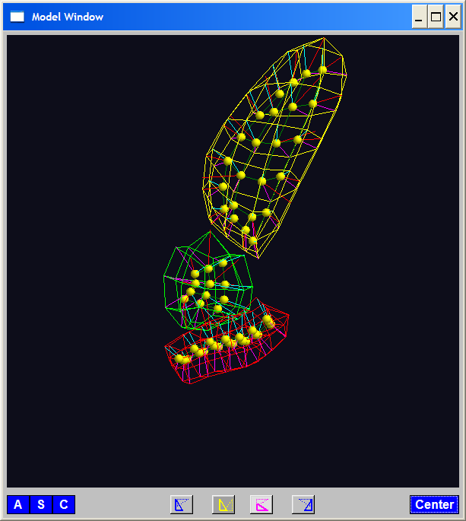
Skeletal Representations
3-d S-Rep Example: From Ja-Yeon Jeong
Bladder – Prostate - Rectum
Atoms - Spokes - Implied Boundary
Notes:
OODA.ppt

Slide 7
Skeletal Representations
Statistical Challenge
Many direct products of:
Locations $∈ ℝ^{2}$, $ℝ^{3}$
Radii $>0$
Angles (not comparable)
Appropriate View:
Data Lie on Curved Manifold
Embedded in higher dim’al Eucl’n Space

Slide 8
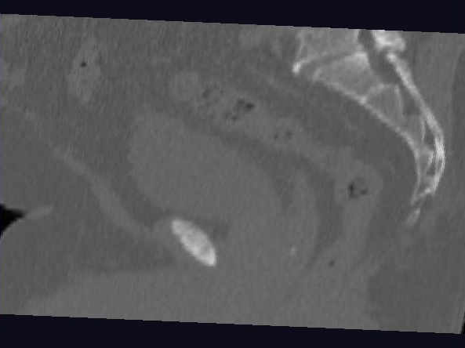
Male Pelvis – Raw Data
One CT Slice
(in 3d image)
Tail Bone
Rectum
Bladder
Prostate

Slide 9
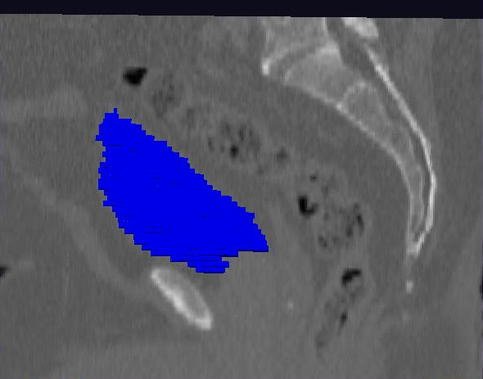
Male Pelvis – Raw Data
Bladder:
manual segmentation
Slice by slice
Reassembled

Slide 10
3-d s-reps
S-rep model fitting
Easy, when starting from binary (blue)
But very expensive (30 – 40 minutes technician’s time)
Want automatic approach
Challenging, because of poor contrast, noise, …
Need to borrow information across training sample
Use Bayes approach: prior & likelihood → posterior
~Conjugate Gaussians, but there are issues:
Major HLDSS challenges
Manifold aspect of data
Handle With Variation on PCA
Careful Handling Very Useful

Slide 11
Data Lying On a Manifold
Major issue: s-reps live in $ℝ^{3}×ℝ^{+}×S^{2}×S^{2}$
(locations, radius and angles)
E.g. “average” of: $2^{°}, 3^{°}, {358}^{°}, {359}^{°}=$ ???
Should
Use Unit
Circle
Structure
x
x
x
x

Slide 12
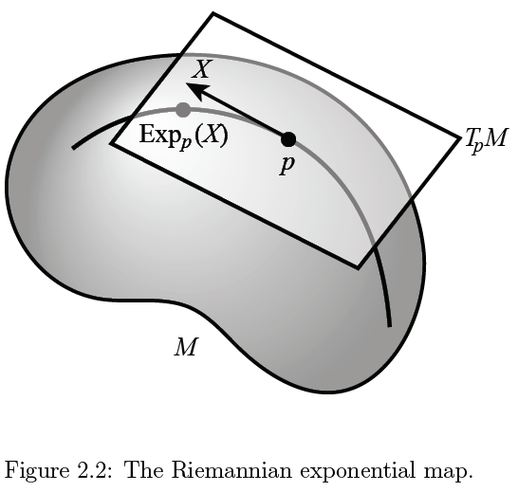
Manifold Descriptor Spaces
Important Mappings:
Plane → Surface:
$\exp_{p}$
Surface → Plane
$\log_{p}$
(matrix versions)

Slide 13
Manifold Descriptor Spaces
Natural Choice of $p$
For Data Analysis
A “Centerpoint”
Hard To Use:
$\overline{X}=\frac{1}{n}\sum_{i=1}^{n}{X_{i}}$

Slide 14
Manifold Descriptor Spaces
Extrinsic Centerpoint
Compute:
$\overline{X}=\frac{1}{n}\sum_{i=1}^{n}{X_{i}}$
Anyway
And Project Back
To Manifold

Slide 15
Manifold Descriptor Spaces
Intrinsic Centerpoint
Work “Really
Inside” The
Manifold

Slide 16
Manifold Descriptor Spaces
Useful General Notion of Center:
Fréchet Mean
Fréchet (1948)
Works in Any Metric Space (e.g. Manifolds)

Slide 17
Manifold Descriptor Spaces
Fréchet Mean of Numbers:
$$\overline{X}=arg\min_{x}{\sum_{i=1}^{n}{{\left(X_{i}−x\right)}^{2}}}$$
Fréchet Mean in Euclidean Space ($ℝ^{d}$):
$$\overline{\underline{X}}=arg\min_{x}{\sum_{i=1}^{n}{{\left\|{\underline{X}}_{i}−\underline{x}\right\|}^{2}}}=arg\min_{x}{\sum_{i=1}^{n}{{d\left({\underline{X}}_{i},\underline{x}\right)}^{2}}}$$
(Intrinsic) Fréchet Mean on a Manifold:
Replace Euclidean $d$ by Geodesic $d$

Slide 18
Manifold Descriptor Spaces
Geodesics:
Idea:
March Along Manifold Without Turning
(Defined in Tangent Plane)

Slide 19
Manifold Descriptor Spaces
Geodesics:
Idea:
March Along Manifold Without Turning
(Defined in Tangent Plane)
E.g. Surface of the Earth: Great Circle
E.g. Lines of Longitude (Not Latitude…)

Slide 20
Manifold Descriptor Spaces
Geodesic Distance:
Given Points $x$ & $y$, define
$$d\left(x,y\right)=\min_{g:geodesic from x to y}{length(g)}$$
Can Show:
$d$ is a metric (distance)

Slide 21
Manifold Descriptor Spaces
Fréchet Mean of Numbers:
$$\overline{X}=arg\min_{x}{\sum_{i=1}^{n}{{\left(X_{i}−x\right)}^{2}}}$$
Fréchet Mean in Euclidean Space ($ℝ^{d}$):
$$\overline{\underline{X}}=arg\min_{x}{\sum_{i=1}^{n}{{\left\|{\underline{X}}_{i}−\underline{x}\right\|}^{2}}}=arg\min_{x}{\sum_{i=1}^{n}{{d\left({\underline{X}}_{i},\underline{x}\right)}^{2}}}$$
(Intrinsic) Fréchet Mean on a Manifold:
Replace Euclidean $d$ by Geodesic $d$

Slide 22
Manifold Descriptor Spaces
Fréchet Mean of Numbers:
$$\overline{X}=arg\min_{x}{\sum_{i=1}^{n}{{\left(X_{i}−x\right)}^{2}}}$$
Well Known in Robust Statistics:
Replace Euclidean Distance
With Robust Distance, e.g. $L^{2}$ with $L^{1}$
Reduces Influence of Outliers
Gives Other Notions of Robust Median

Slide 23
Manifold Descriptor Spaces
Directional Data Examples of Fréchet Mean:
Not always easily interpretable

Slide 24
Manifold Descriptor Spaces
Directional Data Examples of Fréchet Mean:
Not always easily interpretable
Think about distances along arc
Not about “points in $ℝ^{2}$”
Sum of squared distances
strongly feels the largest
Not always unique
But unique with probability one
Non-unique requires strong symmetry
But possible to have many means

Slide 25
Manifold Descriptor Spaces
Directional Data Examples of Fréchet Mean:
Not always sensible notion of center

Slide 26
Manifold Descriptor Spaces
Directional Data Examples of Fréchet Mean:
Not always sensible notion of center
Sometimes prefer top & bottom?
At end: farthest points from data
Not continuous Function of Data
Jump from 1 – 2
Jump from 2 – 8
All False for Euclidean Mean
But all happen generally for Manifold Data
(for positively curved space)

Slide 27
Manifold Descriptor Spaces
Directional Data Examples of Fréchet Mean:
Also of interest is Fréchet Variance:
$${\hat{σ}}^{2}=\min_{\underline{x}}{\frac{1}{n}\sum_{i=1}^{n}{{d\left({\underline{X}}_{i},\underline{x}\right)}^{2}}}$$
Works like Euclidean sample variance
Note values in movie, reflecting spread in data
Note theoretical version:
$$σ^{2}=\min_{\underline{x}}{E_{\underline{X}}}{d\left(\underline{X},\underline{x}\right)}^{2}$$
Useful for Laws of Large Numbers, etc.

Slide 28
PCA for s-reps
PCA on non-Euclidean spaces?
(i.e. on Lie Groups / Symmetric Spaces)
T. Fletcher: Principal Geodesic Analysis
(2004 UNC CS PhD Dissertation)

Slide 29
PCA for s-reps
PCA on non-Euclidean spaces?
(i.e. on Lie Groups / Symmetric Spaces)
T. Fletcher: Principal Geodesic Analysis
Idea: replace “linear summary of data”
With “geodesic summary of data”…

Slide 30
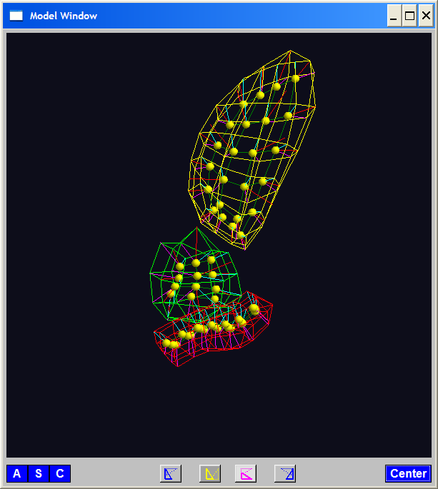
PGA for s-reps, Bladder-Prostate-Rectum
Bladder – Prostate – Rectum, 1 person, 17 days
PG 1 PG 2 PG 3
(analysis by Ja Yeon Jeong)

Slide 31
PGA for s-reps, Bladder-Prostate-Rectum
Bladder – Prostate – Rectum, 1 person, 17 days
PG 1 PG 2 PG 3
(analysis by Ja Yeon Jeong)

Slide 32
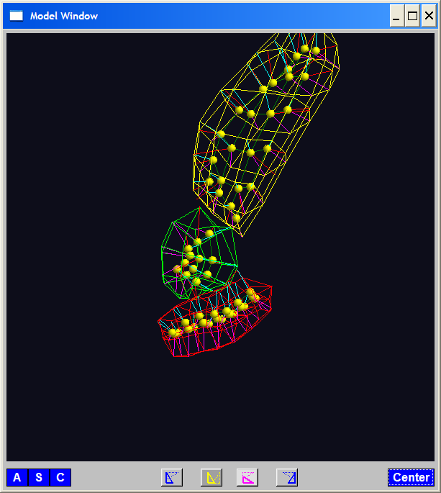
PGA for s-reps, Bladder-Prostate-Rectum
Bladder – Prostate – Rectum, 1 person, 17 days
PG 1 PG 2 PG 3
(analysis by Ja Yeon Jeong)

Slide 33
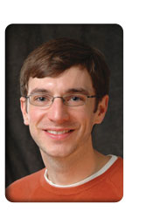
PCA Extensions for Data on Manifolds
Fletcher (Principal Geodesic Anal.)
Best fit of geodesic to data

Slide 34
PCA Extensions for Data on Manifolds
Fletcher (Principal Geodesic Anal.)
Best fit of geodesic to data
Constrained to go through geodesic mean

Slide 35
PCA Extensions for Data on Manifolds
Fletcher (Principal Geodesic Anal.)
Best fit of geodesic to data
Constrained to go through geodesic mean
Happens mean
Naturally contained
in $ℝ^{d}$ in best
fit line

Slide 36
PCA Extensions for Data on Manifolds
Fletcher (Principal Geodesic Anal.)
Best fit of geodesic to data
Constrained to go through geodesic mean
Extreme
3 Point
Examples

Slide 37
Challenge for Principal Geodesic Analysis
Data
On $S^{2}$
(Sphere)
Scattered
Along
Equator

Slide 38
Challenge for Principal Geodesic Analysis
Data
On $S^{2}$
Geodesic
Mean(s)

Slide 39
Challenge for Principal Geodesic Analysis
Data
On $S^{2}$
Geodesic
Mean(s)
Tangent Plane

Slide 40
Challenge for Principal Geodesic Analysis
Data
On $S^{2}$
Geodesic
Mean(s)
Tangent Plane
Projections

Slide 41
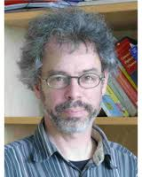
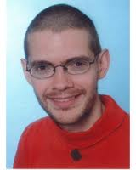
PCA Extensions for Data on Manifolds
Fletcher (Principal Geodesic Anal.)
Best fit of geodesic to data
Constrained to go through geodesic mean
Huckemann, Hotz & Munk (Geod. PCA)
Huckemann et al (2011)

Slide 42
PCA Extensions for Data on Manifolds
Fletcher (Principal Geodesic Anal.)
Best fit of geodesic to data
Constrained to go through geodesic mean
Huckemann, Hotz & Munk (Geod. PCA)
Best fit of any geodesic to data

Slide 43
PCA Extensions for Data on Manifolds
Fletcher (Principal Geodesic Anal.)
Best fit of geodesic to data
Constrained to go through geodesic mean
Huckemann, Hotz & Munk (Geod. PCA)
Best fit of any geodesic to data
Counterexample:
Data follows Tropic of Capricorn

Slide 44
PCA Extensions for Data on Manifolds
Fletcher (Principal Geodesic Anal.)
Best fit of geodesic to data
Constrained to go through geodesic mean
Huckemann, Hotz & Munk (Geod. PCA)
Best fit of any geodesic to data
Jung, Foskey & Marron (Princ. Arc Anal.)
Jung et al (2011)

Slide 45
PCA Extensions for Data on Manifolds
Fletcher (Principal Geodesic Anal.)
Best fit of geodesic to data
Constrained to go through geodesic mean
Huckemann, Hotz & Munk (Geod. PCA)
Best fit of any geodesic to data
Jung, Foskey & Marron (Princ. Arc Anal.)
Best fit of any circle to data
(motivated by conformal maps)

Slide 46
PCA Extensions for Data on Manifolds

Slide 47
Principal Arc Analysis
Jung, Foskey & Marron (2011)
Best fit of any circle to data
Can give better fit than geodesics

Slide 48
Principal Arc Analysis
Jung, Foskey & Marron (2011)
Best fit of any circle to data
Can give better fit than geodesics
Observed for simulated s-rep example

Slide 49
Challenge being addressed

Slide 50
Landmark Based Shape Analysis
Kendall
Bookstein
Dryden &
Mardia
(recall major monographs)

Slide 51
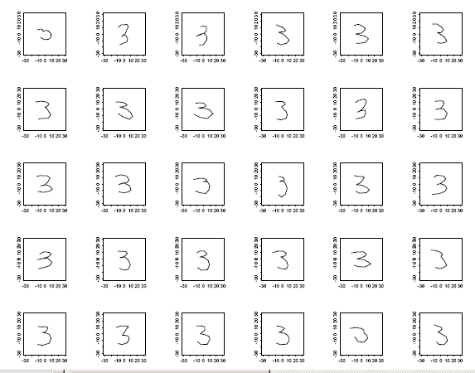
Landmark Based Shape Analysis
Kendall
Bookstein
Dryden &
Mardia
Digit 3 Data

Slide 52
Landmark Based Shape Analysis
Kendall
Bookstein
Dryden &
Mardia
Digit 3 Data
(digitized to 13 landmarks)

Slide 53
Variation on Landmark Based Shape
Typical Viewpoint:
Variation in Shape is Goal
Other Variation+ is Nuisance
Recall Main Idea:
Represent Shapes as Coordinates
“Mod Out” Transl’n, Rotat’n, Scale
Shapes (Equiv. Classes) as Data Objects

Slide 54
Variation on Landmark Based Shape
Typical Viewpoint:
Variation in Shape is Goal
Other Variation+ is Nuisance
Interesting Alternative:
Study Variation in Transformation
Treat Shape as Nuisance

Slide 55
Variation on Landmark Based Shape
Context: Study of Tectonic Plates
Movement of Earth’s Crust (over time)
Take Motions as Data Objects
Interesting Alternative:
Study Variation in Transformation
Treat Shape as Nuisance

Slide 56
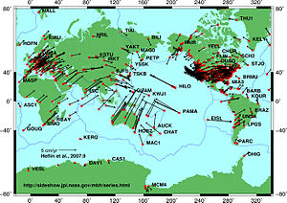
Variation on Landmark Based Shape
Context: Study of Tectonic Plates
Movement of Earth’s Crust (over time)
Take Motions as Data Objects
Royer & Chang (1991)
Thanks to Wikipedia

Slide 57
Landmark Based Shape Analysis
Kendall
Bookstein
Dryden &
Mardia
Digit 3 Data

Slide 58
Landmark Based Shape Analysis
Key Step: mod out
Translation
Scaling
Rotation
Result:
Data Objects ←→
←→ points on Manifold ( ~ S^{2k-4})

Slide 59
Landmark Based Shape Analysis
Currently popular approaches to PCA on $S^{k}$:
Early: PCA on projections
Fletcher: Geodesics through mean
(Tangent Plane Analysis)

Slide 60
Landmark Based Shape Analysis
Currently popular approaches to PCA on $S^{k}$:
Early: PCA on projections
Fletcher: Geodesics through mean
Huckemann, et al: Any Geodesic
New Approach:
Principal Nested Sphere Analysis

Slide 61
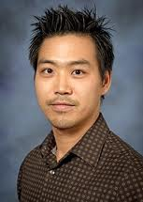
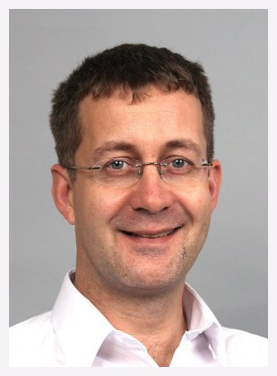
Principal Nested Spheres
Main Goal:
Extend Principal Arc Analysis ($S^{2}$ to $S^{k}$)
Jung, Dryden & Marron (2012)

Slide 62
Principal Nested Spheres
Main Goal:
Extend Principal Arc Analysis ($S^{2}$ to $S^{k}$)

Slide 63
Principal Nested Spheres
Jung et al (2012)
Context:
$d$ – dim
Sphere
(in $ℝ^{d+1}$)
$$S^{d}$$

Slide 64
Principal Nested Spheres
For data $∈S^{d}$
Find Projec’ns
Onto $S^{d−1}$
(determined
by slicing
plane)
Along Surface
$$S^{d}$$

Slide 65
Principal Nested Spheres
Move plane
To Minimize
$\sum_{i}{{resid}_{i}^{2}}$
Keep signed
${resid}_{i}$ as
PNS-$d$ scores
$$S^{d}$$

Slide 66
Principal Nested Spheres
Now consider
Projections
As Data in
Subsphere
$S^{d−1}$
Repeat for
PNS $d−1$
Scores
$$S^{d−1}$$

Slide 67
Digit 3 data: Principal variations of the shape
Princ. geodesics by PNS
Principal arcs by PNS

Slide 68
Composite Principal Nested Spheres
Idea: Use Principal Nested Spheres
Over Large Products of $S^{2}$ and $ℝ^{d}$
Vectors whose entries are
Angles on sphere and reals

Slide 69
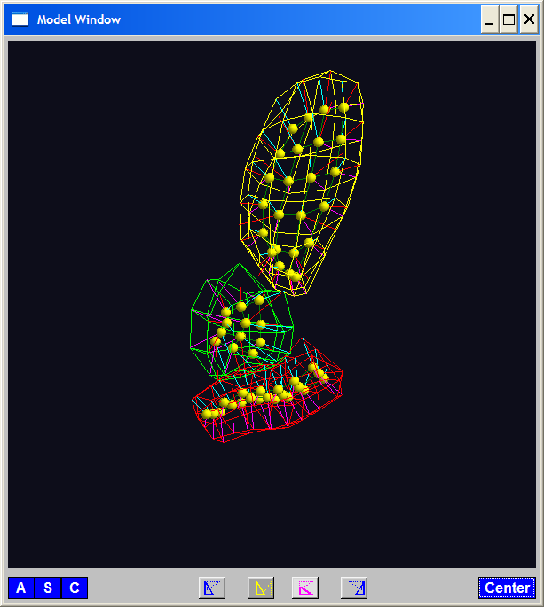
Composite Principal Nested Spheres
Idea: Use Principal Nested Spheres
Over Large Products of $S^{2}$ and $ℝ^{d}$
Motivation:
s-reps

Slide 70
Composite Principal Nested Spheres
Idea: Use Principal Nested Spheres
Over Large Products of $S^{2}$ and $ℝ^{d}$
Approach: Use Principal Nested Spheres
to Linearize $S^{2}$ Components

Slide 71
Composite Principal Nested Spheres
Idea: Use Principal Nested Spheres
Over Large Products of $S^{2}$ and $ℝ^{d}$
Approach: Use Principal Nested Spheres
to Linearize $S^{2}$ Components
Then Concatenate All & Use PCA
HDLSS asymptotics?
(When have many s-rep atoms?)

Slide 72
Composite Principal Nested Spheres
HDLSS asymptotics?
Simple Case: $S^{2}×S^{2}×⋯×S^{2}$
$d$

Slide 73
Composite Principal Nested Spheres
HDLSS asymptotics?
Simple Case: $S^{2}×S^{2}×⋯×S^{2}$
Study $\lim_{d→∞}{}$
Get Geometric Representation?
Distances $\sim d^{\frac{1}{2}}$
Random ~ Rotation
Modulo Rotation → Unit Simplex $×d^{\frac{1}{2}}$

Slide 74
Composite Principal Nested Spheres
HDLSS asymptotics?
Simple Case: $S^{2}×S^{2}×⋯×S^{2}$
Study $\lim_{d→∞}{}$
Get Geometric Representation?
Apparent Challenge: $S^{2}$ is Bounded
(So Can’t Have Distances ${\sim d}^{\frac{1}{2}}→∞$???)

Slide 75
Composite Principal Nested Spheres
HDLSS asymptotics?
Simple Case: $S^{2}×S^{2}×⋯×S^{2}$
Study $\lim_{d→∞}{}$
Get Geometric Representation?
Apparent Challenge: $S^{2}$ is Bounded
(So Can’t Have Distances ${\sim d}^{\frac{1}{2}}→∞$???)
Careful, Have Big Product of $S^{2}$s

Slide 76
Composite Principal Nested Spheres
HDLSS asymptotics?
Even Simpler (But Bounded) Case: $\left[0,1\right]×\left[0,1\right]×⋯×\left[0,1\right]$
Unit Cube in $ℝ^{d},$Study $\lim_{d→∞}{}$
Diagonal Length = $d^{\frac{1}{2}}$
Length Between Random Points $\sim d^{\frac{1}{2}}$
Note: # Edges $\sim 2d$, # Diagonals $\sim 2^{d}$

Slide 77
Composite Principal Nested Spheres
HDLSS asymptotics?
Even Simpler (But Bounded) Case: $\left[0,1\right]×\left[0,1\right]×⋯×\left[0,1\right]$
Unit Cube in $ℝ^{d},$Study $\lim_{d→∞}{}$
Diagonal Length = $d^{\frac{1}{2}}$
Length Between Random Points $\sim d^{\frac{1}{2}}$
Get Similar Geometric Representation

Slide 78
Composite Principal Nested Spheres
HDLSS asymptotics?
Simple Case: $S^{2}×S^{2}×⋯×S^{2}$
Study $\lim_{d→∞}{}$
Get Geometric Representation?
Yes, Sen et al (2008)

Slide 79
Composite Principal Nested Spheres
HDLSS asymptotics?
Simple Case: $S^{2}×S^{2}×⋯×S^{2}$
Study $\lim_{d→∞}{}$
Get Geometric Representation?
Consistency of CPNS???
(Open Problem)

Slide 80
Composite Principal Nested Spheres
Impact on Segmentation:
PGA Segmentation: used ~20 comp’s
CPNS Segmentation: only need ~13
Resulted in visually better fits to data

Slide 81
Participant Presentations
Mark He
Commuting networks amongst US counties
Adam Waterbury
Reproducing Kernels for FDA

