Slide 1
Q-Q plots
Need to understand sampling variation
Approach: Q-Q envelope plot
Simulate from Theoretical Dist’n
Samples of same size
About 100 samples gives
“good visual impression”
Overlay resulting 100 QQ-curves
To visually convey natural sampling variation

Slide 2
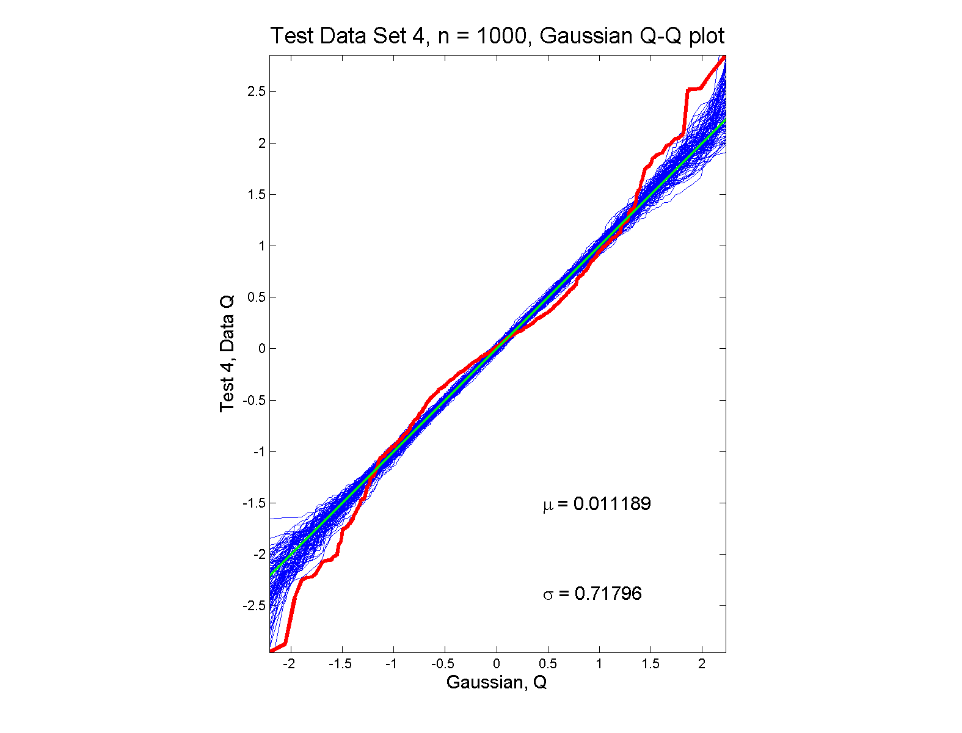
Q-Q plots
non-Gaussian (?) departures from line?

Slide 3
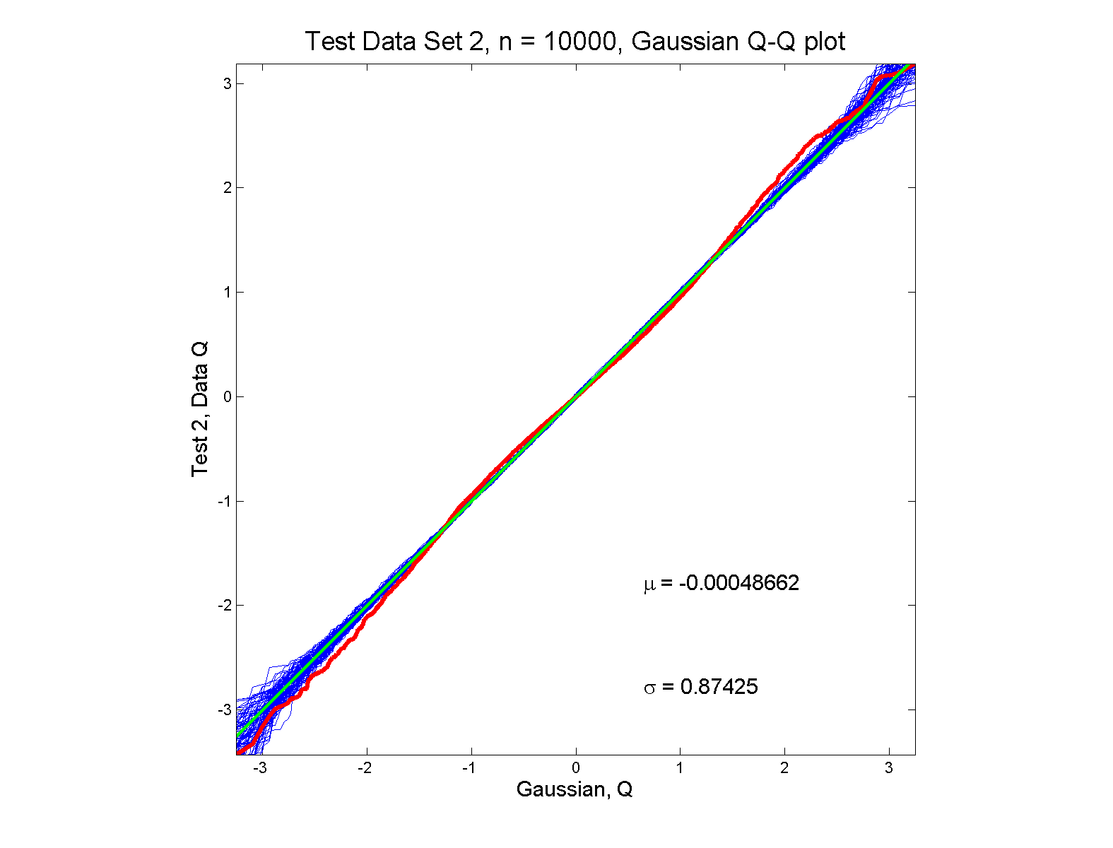
Q-Q plots
Gaussian? departures from line?

Slide 4
SigClust Estimation of Background Noise
n = 533, d = 9456

Slide 5
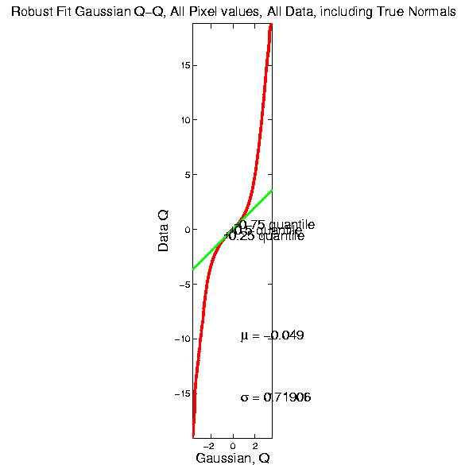
SigClust Estimation of Background Noise

Slide 6
SigClust Estimation of Background Noise
Distribution clearly not Gaussian
Except near the middle
Q-Q curve is very linear there
(closely follows 45º line)
Suggests Gaussian approx. is good there
And that MAD scale estimate is good
(Always a good idea to do such diagnostics)

Slide 7
SigClust Real Data Results
Summary of Perou 500 SigClust Results:
Lum & Norm vs. Her2 & Basal, p-val = 10⁻¹⁹
Luminal A vs. B, p-val = 0.0045
Her 2 vs. Basal, p-val = 10⁻¹⁰
Split Luminal A, p-val = 10⁻⁷
Split Luminal B, p-val = 0.058
Split Her 2, p-val = 0.10
Split Basal, p-val = 0.005

Slide 8
SigClust Real Data Results
Summary of Perou 500 SigClust Results:
All previous splits were real
Most not able to split further
Exception is Basal, already known
Chuck Perou has good intuition!
(insight about signal vs. noise)
How good are others???

Slide 9
Shapes As Data Objects
Several Different Notions of Shape
Oldest and Best Known (in Statistics):
Landmark Based

Slide 10
Landmark Based Shape Analysis
Clearly different shapes:
But what about: ?
(just translation and rotation of,
but different points in R⁶)

Slide 11
Landmark Based Shape Analysis
Approach: Identify objects that are:
Translations
Rotations
Scalings
of each other

Slide 12
Landmark Based Shape Analysis
Approach: Identify objects that are:
Translations
Rotations
Scalings
of each other
Mathematics: Equivalence Relation

Slide 13
Equivalence Relations
Useful Mathematical Device
Weaker generalization of “=“ for a set
Main consequence:
Partitions Set Into Equivalence Classes
For “=“, Equivalence Classes Are Singletons

Slide 14
Equivalence Relations
Common Example: Modulo Arithmetic
(E.g. Clock Arithmetic, mod 12)
3 hours after 11:00 is 2:00 …
Hours are equivalence classes:
{1} = {1:00, 13:00, …}
{2} = {2:00, 14:00, …}
$$⋮$$

Slide 15
Equivalence Relations
Common Example: Modulo Arithmetic
(E.g. Clock Arithmetic, mod 12)
For $a, b, c ∈ ℤ$, Say $a≡b (mod c)$
When $\left(b −a\right)$ is divisible by $c$
Clock e.g. $14−2=12$, so $14≡2 (mod 12)$
i.e. 14:00 is “identified with” 2:00

Slide 16
Equivalence Relations
For $a, b, c ∈ ℤ$, Say $a≡b (mod c)$
When $\left(b −a\right)$ is divisible by $c$
E.g. Binary Arithmetic, mod $2$
Equivalence classes:
$\left\{0\right\}=\left\{⋯,−2,0,2,4,⋯\right\}$
$$\left\{1\right\}=\left\{⋯,−1,1,3,5,⋯\right\}$$
(just evens and odds)

Slide 17
Equivalence Relations
Another Example: Vector Subspaces
E.g. Say $\left(\begin{matrix}x_{1} \\ y_{1}\end{matrix}\right)≈\left(\begin{matrix}x_{2} \\ y_{2}\end{matrix}\right)$ when $y_{1}=y_{2}$
Equiv. Classes are indexed by $y∈ℝ^{1},$
And are: $\left\{y\right\}=\left\{\left(\begin{matrix}x \\ y\end{matrix}\right)∈ℝ^{2}:x∈ℝ^{1}\right\}$
i.e. Horizontal lines (same $y$ coordinate)

Slide 18
Equivalence Relations
Deeper Example: Transformation Groups
Based on Group Theory

Slide 19
Group Theory
In Abstract Algebra:
A Group is a Set, Together with an Operation
$$G=\left(S,∗\right)$$
Which is:
Closed: $s_{1}∗s_{2}∈S$
Associative: $\left(s_{1}∗s_{2}\right)∗s_{3}=s_{1}∗\left(s_{2}∗s_{3}\right)$
Has an identity, $i$: $s∗i=s$
Invertible: $∃s^{−1}$ so that $s^{−1}∗s=i$

Slide 20
Group Theory
Examples of Groups:
$\left(ℤ,+\right)$
$\left(ℝ\backslash \left\{0\right\},×\right)$
(Permutations,Composition)
(Invertible Functions,Composition)

Slide 21
Equivalence Relations
Deeper Example: Transformation Groups
For $g∈G$, operating on a set $S$
Say $s_{1}≈s_{2}$ when $∃$ $g$ where $g\left(s_{1}\right)=s_{2}$
Equivalence Classes:
$$\left\{s_{i}\right\}=\left\{s_{j}∈S:s_{j}=g\left(s_{i}\right), for some g∈G\right\}$$
Terminology: Also called orbits

Slide 22
Equivalence Relations
Deeper Example: Group Transformations
Above Examples Are Special Cases
Modulo Arithmetic
$$G= \left\{g:ℤ→ℤ :g\left(z\right)=z+kc, for k∈ℤ\right\}$$
(Orbits are $\left\{0\right\},\left\{1\right\},⋯,\left\{c−1\right\}$)

Slide 23
Equivalence Relations
Deeper Example: Group Transformations
Above Examples Are Special Cases
Modulo Arithmetic
Vector Subspace of $ℝ^{2}$
$$G=\left\{g:ℝ^{2}{→ℝ}^{2} :g\left(\begin{matrix}x \\ y\end{matrix}\right)=\left(\begin{matrix}x′ \\ y\end{matrix}\right), x′∈ℝ\right\}$$
(Orbits are horizontal lines, shifts of $ℝ$)

Slide 24
Equivalence Relations
Deeper Example: Group Transformations
Above Examples Are Special Cases
Modulo Arithmetic
Vector Subspace of $ℝ^{2}$
General Vector Subspace $V$
$G$ maps $V$ into $V$
(Orbits are Shifts of $V$, indexed by $V^{⊥}$)

Slide 25
Equivalence Relations
Deeper Example: Group Transformations
Above Examples Are Special Cases
Modulo Arithmetic
Vector Subspace of $ℝ^{2}$
General Vector Subspace $V$
Shape: $G=$ Group of “Similarities”
(translations, rotations, scalings)

Slide 26
Equivalence Relations
Deeper Example: Group Transformations
Mathematical Terminology:
Quotient Operation
Set of Equiv. Classes = Quotient Space
Denoted $S/G$

Slide 27
Landmark Based Shape Analysis
Approach: Identify objects that are:
Translations
Rotations
Scalings
of each other

Slide 28
Landmark Based Shape Analysis
Approach: Identify objects that are:
Translations
Rotations
Scalings
of each other
Mathematics: Equivalence Relation
Results in: Equivalence Classes
Which become the Data Objects

Slide 29
Landmark Based Shape Analysis
Equivalence Classes become Data Objects
Mathematics: Called “Quotient Space”
Intuitive Representation: Manifold
(curved surface)

Slide 30
Landmark Based Shape Analysis
Triangle Shape Space: Represent as Sphere

Slide 31
Landmark Based Shape Analysis
Triangle Shape Space: Represent as Sphere
R⁶ → R⁴
translation

Slide 32
Landmark Based Shape Analysis
Triangle Shape Space: Represent as Sphere
R⁶ → R⁴ → R³
rotation
, , , , , ,

Slide 33
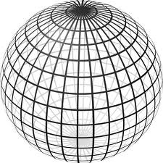
Landmark Based Shape Analysis
Triangle Shape Space: Represent as Sphere
R⁶ → R⁴ → R³ →
scaling
(thanks to Wikipedia)
, , , , , ,

Slide 34
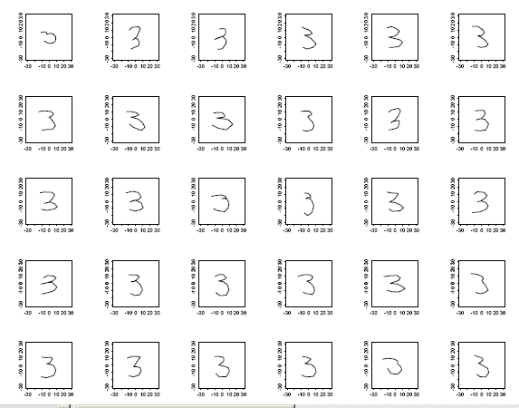
Landmark Based Shape Analysis
Kendall
Bookstein
Dryden &
Mardia
Digit 3 Data

Slide 35
Landmark Based Shape Analysis
Kendall
Bookstein
Dryden &
Mardia
Digit 3 Data
(digitize to 13 landmarks)

Slide 36
OODA in Image Analysis
First Generation Problems:
Denoising
Segmentation
Registration
(all about single images,
still interesting challenges)

Slide 37
OODA in Image Analysis
Second Generation Problems:
Populations of Images
Understanding Population Variation
Discrimination (a.k.a. Classification)
Complex Data Structures (& Spaces)
HDLSS Statistics

Slide 38
Image Object Representation
Major Approaches for Image Data Objects:
Landmark Representations
Boundary Representations
Skeletal Representations

Slide 39
Landmark Representations
Landmarks for Fly Wing Data:
Thanks to George Gilchrist

Slide 40
Landmark Representations
Major Drawback of Landmarks:
Need to always find each landmark
Need same relationship
I.e. Landmarks need to correspond
Often fails for medical images
E.g. How many corresponding landmarks on a set of kidneys, livers or brains???

Slide 41
Boundary Representations
Traditional Major Sets of Ideas:
Triangular Meshes
Survey: Owen (1998)
Active Shape Models
Cootes, et al (1993)
Fourier Boundary Representations
Keleman, et al (1997 & 1999)

Slide 42
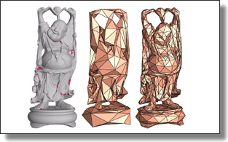
Boundary Representations
Example of triangular mesh rep’n:
From:www.geometry.caltech.edu/pubs.html

Slide 43
Boundary Representations
Main Drawback:
Correspondence
For OODA (on vectors of parameters):
Need to “match up points”
Notes:
43

Slide 44
Boundary Representations
Main Drawback:
Correspondence
For OODA (on vectors of parameters):
Need to “match up points”
Easy to find triangular mesh
Lots of research on this driven by gamers
Notes:
44

Slide 45
Boundary Representations
Main Drawback:
Correspondence
For OODA (on vectors of parameters):
Need to “match up points”
Easy to find triangular mesh
Lots of research on this driven by gamers
Challenge to match mesh across objects
There are some interesting ideas…
Notes:
45

Slide 46
Boundary Representations
Correspondence for Mesh Objects:
Active Shape Models (PCA – like)
Notes:
46

Slide 47
Boundary Representations
Correspondence for Mesh Objects:
Active Shape Models (PCA – like)
Automatic Landmark Choice
Cates, et al (2007)
Based on Optimization Problem:
Good Correspondence & Separation
(Formulate via Entropy)
Notes:
47

Slide 48
Skeletal Representations
Main Idea:
Represent Objects as:
Discretized skeletons (medial atoms)
Plus spokes from center to edge
Which imply a boundary
Very accessible early reference:
Yushkevich, et al (2001)

Slide 49
Skeletal Representations
2-d S-Rep Example:
Corpus Callosum
(Yushkevich)
Notes:
CCMsciznormRaw.avi

Slide 50
Skeletal Representations
2-d S-Rep Example:
Corpus Callosum
(Yushkevich)
Atoms
Notes:
CCMsciznormRaw.avi

Slide 51
Skeletal Representations
2-d S-Rep Example:
Corpus Callosum
(Yushkevich)
Atoms
Spokes
Notes:
CCMsciznormRaw.avi

Slide 52
Skeletal Representations
2-d S-Rep Example:
Corpus Callosum
(Yushkevich)
Atoms
Spokes
Implied
Boundary
Notes:
CCMsciznormRaw.avi

Slide 53
Skeletal Representations
3-d S-Rep Example: From Ja-Yeon Jeong
Bladder – Prostate - Rectum
Notes:
OODA.ppt

Slide 54
Skeletal Representations
3-d S-Rep Example: From Ja-Yeon Jeong
Bladder – Prostate - Rectum
In Male Pelvis
~Valve on Bladder
Notes:
OODA.ppt

Slide 55
Skeletal Representations
3-d S-Rep Example: From Ja-Yeon Jeong
Bladder – Prostate - Rectum
In Male Pelvis
~Valve on Bladder
Common Area for Cancer in Males
Notes:
OODA.ppt

Slide 56
Skeletal Representations
3-d S-Rep Example: From Ja-Yeon Jeong
Bladder – Prostate - Rectum
In Male Pelvis
~Valve on Bladder
Common Area for Cancer in Males
Goal: Design Radiation Treatment
Hit Prostate
Miss Bladder & Rectum
Over Course of Many Days
Notes:
OODA.ppt

Slide 57
Skeletal Representations
3-d S-Rep Example: From Ja-Yeon Jeong
Bladder – Prostate - Rectum
Atoms (yellow dots)
Notes:
OODA.ppt

Slide 58
Skeletal Representations
3-d S-Rep Example: From Ja-Yeon Jeong
Bladder – Prostate - Rectum
Atoms - Spokes (line segments)
Notes:
OODA.ppt

Slide 59
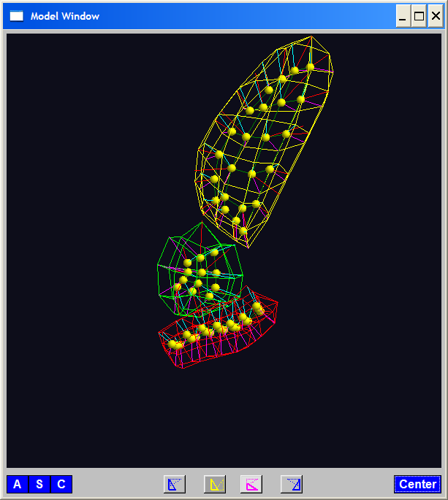
Skeletal Representations
3-d S-Rep Example: From Ja-Yeon Jeong
Bladder – Prostate - Rectum
Atoms - Spokes - Implied Boundary
Notes:
OODA.ppt

Slide 60
Skeletal Representations
3-d S-Rep Example: From Ja-Yeon Jeong
Bladder – Prostate - Rectum
Atoms - Spokes - Implied Boundary
Notes:
OODA.ppt

Slide 61
Skeletal Representations
3-d S-reps: there are several variations
Two choices:
From
Fletcher
(2004)
Notes:
fletcher_thesis.pdf

Slide 62
Skeletal Representations
Detailed discussion of mathematics of S-reps:
Siddiqi, K. and Pizer, S. M. (2008)
Notes:
fletcher_thesis.pdf

Slide 63
Skeletal Representations
Statistical Challenge
S-rep parameters are:
Locations $∈ ℝ^{2}$, $ℝ^{3}$
Radii
Angles (not comparable)
Stuffed into a long vector
I.e. many direct products of these

Slide 64
Skeletal Representations
Statistical Challenge
Many direct products of:
Locations $∈ ℝ^{2}$, $ℝ^{3}$
Radii
Angles (not comparable)
Appropriate View:
Data Lie on Curved Manifold
Embedded in higher dim’al Eucl’n Space

Slide 65
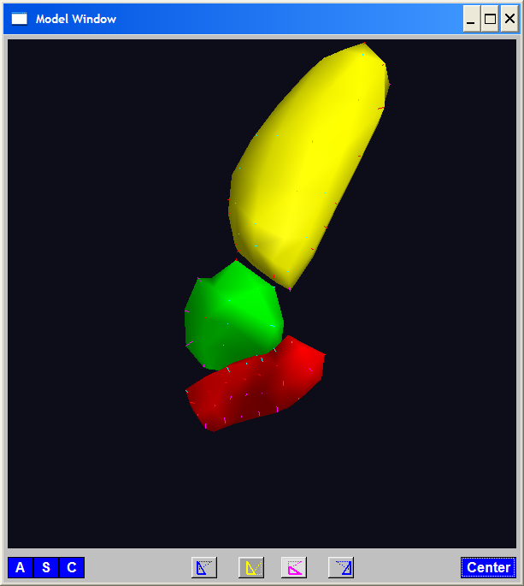
A Challenging Example
Male Pelvis
Bladder – Prostate – Rectum

Slide 66
A Challenging Example
Male Pelvis
Bladder – Prostate – Rectum
How do they move over time (days)?
(all within same person)

Slide 67
A Challenging Example
Male Pelvis
Bladder – Prostate – Rectum
How do they move over time (days)?
Critical to Radiation Treatment (cancer)
Work with 3-d CT
(“Computed Tomography”,
= 3d version of X-ray)

Slide 68
A Challenging Example
Male Pelvis
Bladder – Prostate – Rectum
How do they move over time (days)?
Critical to Radiation Treatment (cancer)
Work with 3-d CT
Very Challenging to Segment
Find boundary of each object?
Represent each Object?

Slide 69
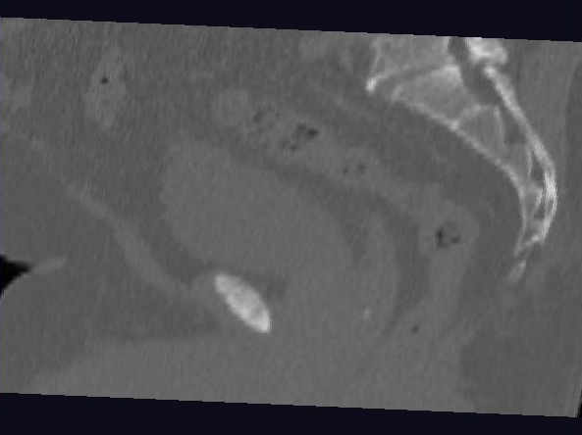
Male Pelvis – Raw Data
One CT Slice
(in 3d image)
Like X-ray:
White = Dense
(Bone)
Black = Gas

Slide 70
Male Pelvis – Raw Data
One CT Slice
(in 3d image)
Tail Bone

Slide 71
Male Pelvis – Raw Data
One CT Slice
(in 3d image)
Tail Bone
Rectum

Slide 72
Male Pelvis – Raw Data
One CT Slice
(in 3d image)
Tail Bone
Rectum
Bladder

Slide 73
Male Pelvis – Raw Data
One CT Slice
(in 3d image)
Tail Bone
Rectum
Bladder
Prostate

Slide 74
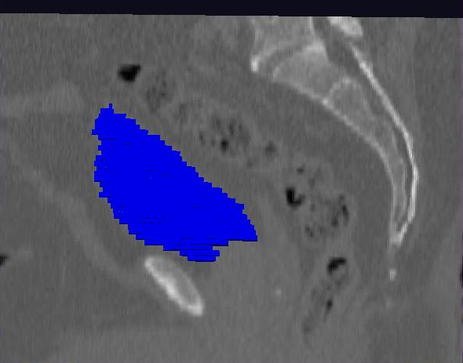
Male Pelvis – Raw Data
Bladder:
manual segmentation
Slice by slice
Reassembled

Slide 75
Male Pelvis – Raw Data
Bladder:
Slices:
Reassembled in 3d
How to represent?
Thanks: Ja-Yeon Jeong

Slide 76
Object Representation
Landmarks (hard to find)
Boundary Rep’ns (no correspondence)
Medial representations
Find “skeleton”
Discretize as “atoms” called S-reps
(for Skeletal Representation)

Slide 77
3-d s-reps
Bladder – Prostate – Rectum (multiple objects, J. Y. Jeong)
Medial Atoms provide “skeleton”
Implied Boundary from “spokes” → “surface”

Slide 78
3-d s-reps
S-rep model fitting
Easy, when starting from binary (blue)
But very expensive (30 – 40 minutes technician’s time)
Want automatic approach
Challenging, because of poor contrast, noise, …
Need to borrow information across training sample
Use Bayes approach: prior & likelihood → posterior
(A surrogate for “anatomical knowledge”)

Slide 79
3-d s-reps
S-rep model fitting
Easy, when starting from binary (blue)
But very expensive (30 – 40 minutes technician’s time)
Want automatic approach
Challenging, because of poor contrast, noise, …
Need to borrow information across training sample
Use Bayes approach: prior & likelihood → posterior
~Conjugate Gaussians
(Embarassingly Straightforward?)

Slide 80
3-d s-reps
S-rep model fitting
Easy, when starting from binary (blue)
But very expensive (30 – 40 minutes technician’s time)
Want automatic approach
Challenging, because of poor contrast, noise, …
Need to borrow information across training sample
Use Bayes approach: prior & likelihood → posterior
~Conjugate Gaussians, but there are issues:
Major HLDSS challenges
Manifold aspect of data
Handle With Variation on PCA
Careful Handling Very Useful

Slide 81
3-d s-reps
S-rep model fitting
Very Successful
Jeong (2009)

Slide 82
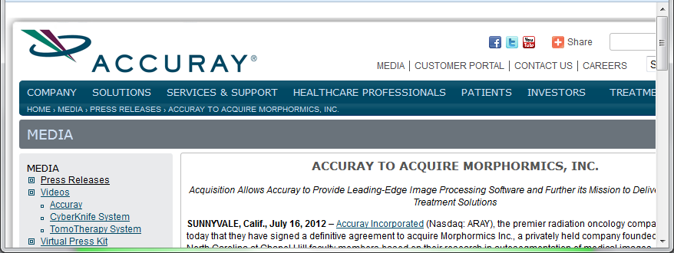
3-d s-reps
S-rep model fitting
Very Successful
Jeong (2009)
Basis of Startup Company: Morphormics
Since Purchased
By Accuray

Slide 83
Mildly Non-Euclidean Spaces
Statistical Analysis of S-rep Data
Recall: Many direct products of:
Locations
Radii
Angles
Useful View: Data Objects on Curved Manifold
Data in non-Euclidean Space
But only mildly non-Euclidean

Slide 84
Data Lying On a Manifold
Major issue: s-reps live in $ℝ^{3}×ℝ^{+}×S^{2}×S^{2}$
(locations, radius and angles)
Note on Terminology:
Manifold Data ≠ Manifold Learning

Slide 85
Data Lying On a Manifold
Major issue: s-reps live in $ℝ^{3}×ℝ^{+}×S^{2}×S^{2}$
(locations, radius and angles)
Note on Terminology:
Manifold Data ≠ Manifold Learning
Data Naturally Lie on Known Manifold

Slide 86
Data Lying On a Manifold
Major issue: s-reps live in $ℝ^{3}×ℝ^{+}×S^{2}×S^{2}$
(locations, radius and angles)
Note on Terminology:
Manifold Data ≠ Manifold Learning
Try to Find Low-d Aprox’ing Manifold

Slide 87
Data Lying On a Manifold
Major issue: s-reps live in $ℝ^{3}×ℝ^{+}×S^{2}×S^{2}$
(locations, radius and angles)
E.g. “average” of: $2^{°}, 3^{°}, {358}^{°}, {359}^{°}=$ ???
${\sum_{i}{θ_{i}}}/4$ ?

Slide 88
Data Lying On a Manifold
Major issue: s-reps live in $ℝ^{3}×ℝ^{+}×S^{2}×S^{2}$
(locations, radius and angles)
E.g. “average” of: $2^{°}, 3^{°}, {358}^{°}, {359}^{°}=$ ???
${\sum_{i}{θ_{i}}}/4$
x
x
x
x

Slide 89
Data Lying On a Manifold
Major issue: s-reps live in $ℝ^{3}×ℝ^{+}×S^{2}×S^{2}$
(locations, radius and angles)
E.g. “average” of: $2^{°}, 3^{°}, {358}^{°}, {359}^{°}=$ ???
Should
Use Unit
Circle
Structure
x
x
x
x

Slide 90
Data Lying On a Manifold
Major issue: s-reps live in $ℝ^{3}×ℝ^{+}×S^{2}×S^{2}$
(locations, radius and angles)
E.g. “average” of: $2^{°}, 3^{°}, {358}^{°}, {359}^{°}=$ ???
Natural Data Space is:
Smooth, Curved Manifold
(Differential Geometry)

Slide 91
Manifold Descriptor Spaces
Standard Statistical Example:
Directional Data (aka Circular Data)
Idea: Angles as Data Objects
Wind Directions
Magnetic Compass Headings
Cracks in Mines

Slide 92
Manifold Descriptor Spaces
Standard Statistical Example:
Directional Data (aka Circular Data)
Reasonable View:
Points on Unit Circle

Slide 93
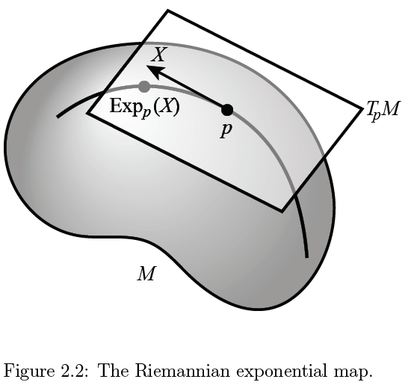
Manifold Descriptor Spaces
Main Idea:
Curved Surface,
With “Approximating
Tangent Plane”
At Each Point, $p$
(In Limit of Shrinking
Neighborhoods)

Slide 94
Manifold Descriptor Spaces
Important Mappings:
Plane → Surface:
$\exp_{p}$

Slide 95
Manifold Descriptor Spaces
Important Mappings:
Plane → Surface:
$\exp_{p}$
Important Point:
Common Length
(along surface)

Slide 96
Manifold Descriptor Spaces
Important Mappings:
Plane → Surface:
$\exp_{p}$
Surface → Plane
$\log_{p}$

Slide 97
Manifold Descriptor Spaces
Log & Exp Memory Device:
Complex Numbers
Exponential:
Tangent Plane → Manifold
(Note: Common Length)

Slide 98
Manifold Descriptor Spaces
Log & Exp Memory Device:
Complex Numbers
Exponential:
Tangent Plane → Manifold
Logarithm:
Manifold → Tangent Plane

Slide 99
Manifold Descriptor Spaces
Important Mappings:
Plane → Surface:
$\exp_{p}$
Surface → Plane
$\log_{p}$
(matrix versions)

Slide 100
Manifold Descriptor Spaces
Natural Choice of $p$
For Data Analysis
A “Centerpoint”
Hard To Use:
$\overline{X}=\frac{1}{n}\sum_{i=1}^{n}{X_{i}}$

Slide 101
Manifold Descriptor Spaces
Extrinsic Centerpoint
Compute:
$\overline{X}=\frac{1}{n}\sum_{i=1}^{n}{X_{i}}$
Anyway
And Project Back
To Manifold

Slide 102
Manifold Descriptor Spaces
Intrinsic Centerpoint
Work “Really
Inside” The
Manifold

Slide 103
Participant Presentations
Gang Li
Boosting Methods
Peiyao Wang
Sparse gradient learning
Michael Conroy
Regularized PCA

