Slide 1
SWISS Score
Avg. Pairwise SWISS – Toy Examples

Slide 2
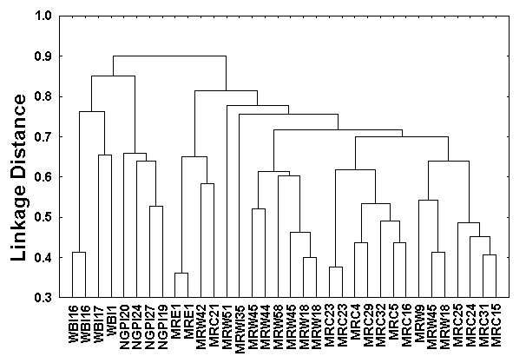
Hiearchical Clustering
Aggregate or Split, to get Dendogram
Aggregate:
Start With
Individuals,
Move Up,
End Up With
All in 1 Cluster

Slide 3
Hiearchical Clustering
Aggregate or Split, to get Dendogram
Split:
Start With
All in 1 Cluster,
Move Down,
End With
Individuals

Slide 4
Hiearchical Clustering
Vertical Axis in Dendogram:
Based on:
Distance Metric
(Ǝ many, e.g. $L^{2}$, $L^{1}$, $L^{∞}$, …)
Linkage Function
(Reflects Clustering Type)
A Lot of “Art” Involved

Slide 5
SigClust
Statistical Significance of Clusters
in HDLSS Data
When is a cluster “really there”?
Liu et al (2007), Huang et al (2014)

Slide 6
Statistical Significance of Clusters
Basis of SigClust Approach:
What defines: A Single Cluster?
A Gaussian distribution (Sarle & Kou 1993)
So define SigClust test based on:
2-means cluster index (measure) as statistic
Gaussian null distribution
Currently compute by simulation
Possible to do this analytically???

Slide 7
SigClust Gaussian null distribut’n
Estimated Mean, $μ$ (of Gaussian dist’n)?
1st Key Idea: Can ignore this
By appealing to shift invariance of CI
When Data are (rigidly) shifted
CI remains the same
So enough to simulate with mean 0
Other uses of invariance ideas?

Slide 8
SigClust Gaussian null distribut’n
2nd Key Idea: Mod Out Rotations
Replace full Cov. by diagonal matrix
As done in PCA eigen-analysis
$$Σ=MDM^{t}$$
But then “not like data”???
OK, since k-means clustering (i.e. CI) is
rotation invariant
(assuming e.g. Euclidean Distance)

Slide 9
SigClust Gaussian null distribut’n
3rd Key Idea: Factor Analysis Model
Model Covariance as: Biology + Noise
$$Σ=Σ_{B}+{σ_{N}}^{2}×I$$
Where
$Σ_{B}$ is “fairly low dimensional”
${σ_{N}}^{2}$ is estimated from background noise

Slide 10
SigClust Gaussian null distribut’n
Estimation of Background Noise ${σ_{N}}^{2}$:
For all expression values (as numbers)
Use robust estimate of scale
Median Absolute Deviation (MAD)
(from the median)
$${median}_{i}\left|X_{i}−{median}_{i^{′}}\left(X_{i^{′}}\right)\right|$$

Slide 11
SigClust Gaussian null distribut’n
Estimation of Background Noise ${σ_{N}}^{2}$:
For all expression values (as numbers)
Use robust estimate of scale
Median Absolute Deviation (MAD)
(from the median)
Rescale to put on same scale as s. d.:
$$\hat{σ}=\frac{{MAD}_{data}}{{MAD}_{N\left(0,1\right)}}$$

Slide 12
SigClust Estimation of Background Noise
Hope: Most
Entries are
“Pure Noise,
(Gaussian)”
A Few (<< ¼)
Are Biological
Signal –
Outliers
How to Check?

Slide 13
Q-Q plots
Approaches to:
Fitting probability distributions to data
Histograms
Kernel Density Estimates
Drawbacks: often not best view
(for determining goodness of fit)

Slide 14
Q-Q plots
Consider Testbed of 4 Toy Examples:
non-Gaussian!
non-Gaussian(?)
Gaussian
Gaussian?
(Will use these names several times)

Slide 15
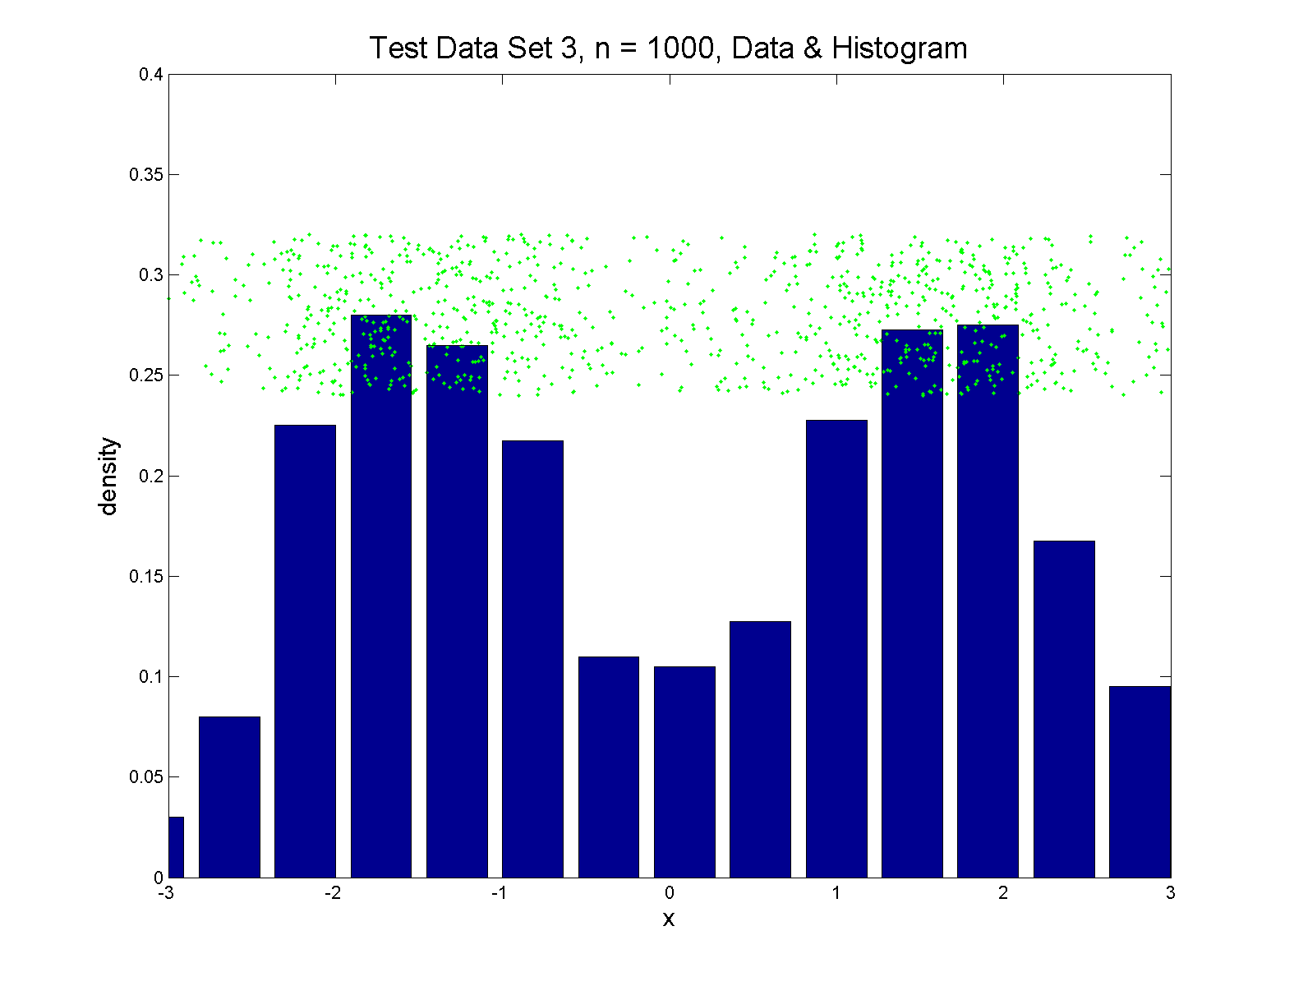
Q-Q plots
Simple Toy Example, non-Gaussian!

Slide 16
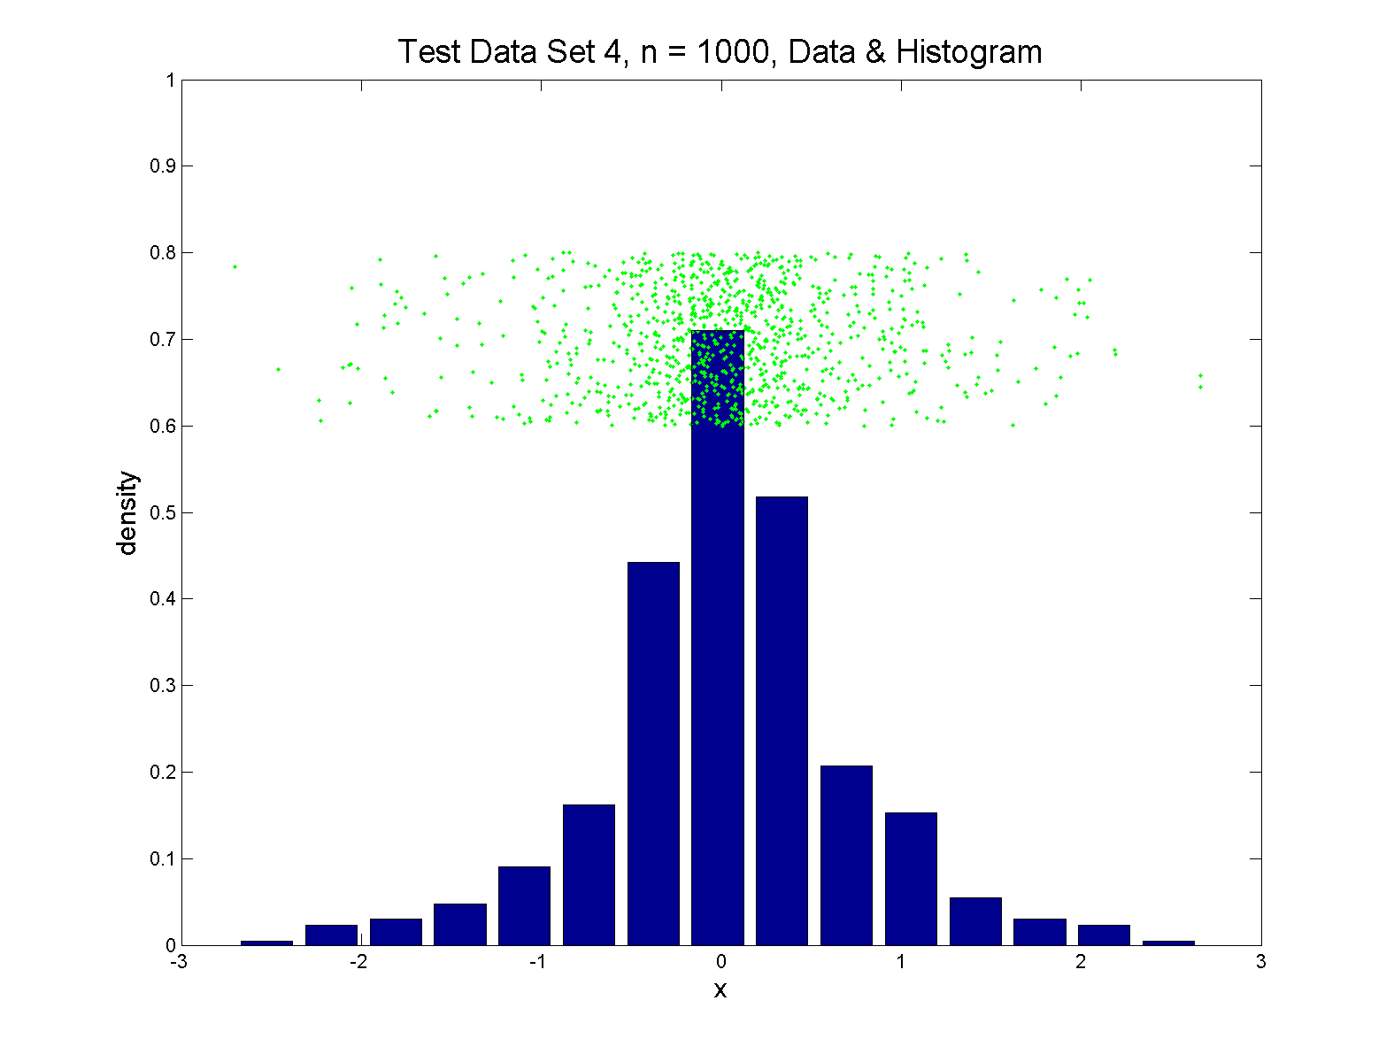
Q-Q plots
Simple Toy Example, non-Gaussian(?)

Slide 17
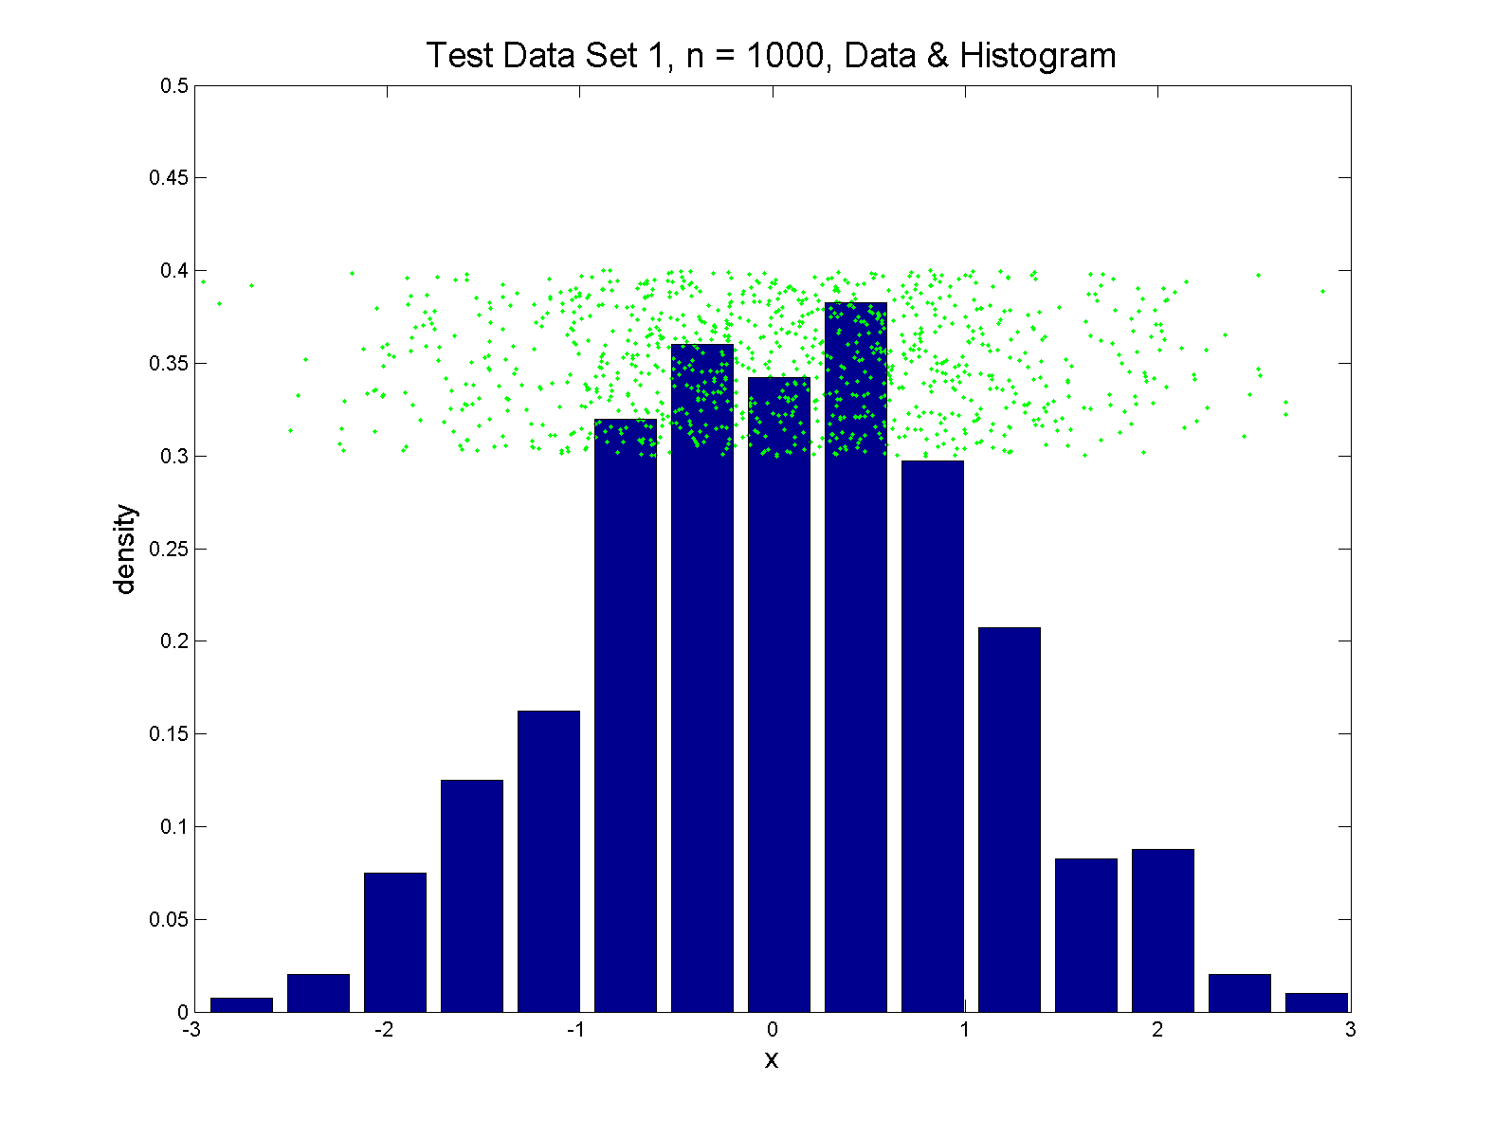
Q-Q plots
Simple Toy Example, Gaussian

Slide 18
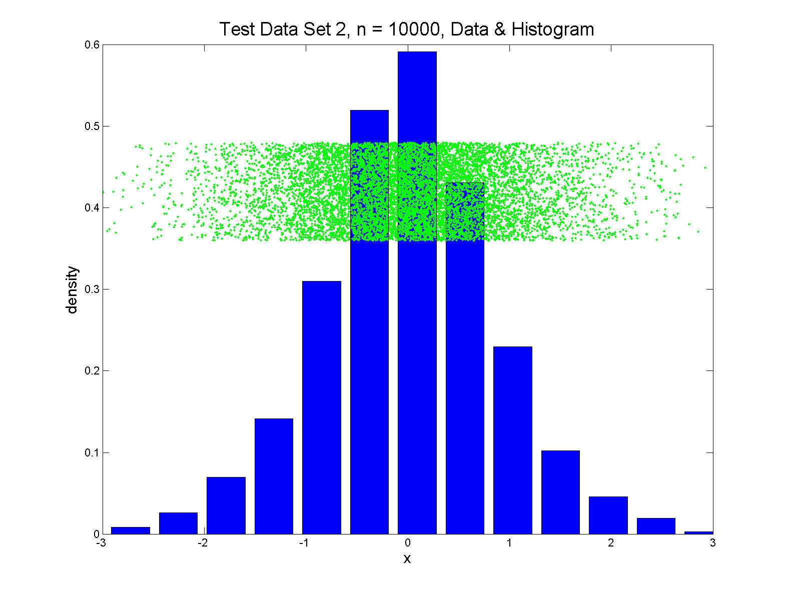
Q-Q plots
Simple Toy Example, Gaussian?

Slide 19
Q-Q plots
Direct Visualizations:
Empirical CDF plot:
plot $\hat{p}=\frac{i}{n}, i=1,⋯,n$
vs. grid of $\hat{q}$ (sorted data) values
Quantile plot (inverse):
plot $\hat{q}$
vs. $\hat{p}$

Slide 20
Q-Q plots
Comparison Visualizations:
(compare a theoretical with an empirical)
P-P plot:
plot $\hat{p}$ vs. $p$
for a grid of $q$ values
Note: Have essentially already used this:
Called it the “ROC Curve”

Slide 21
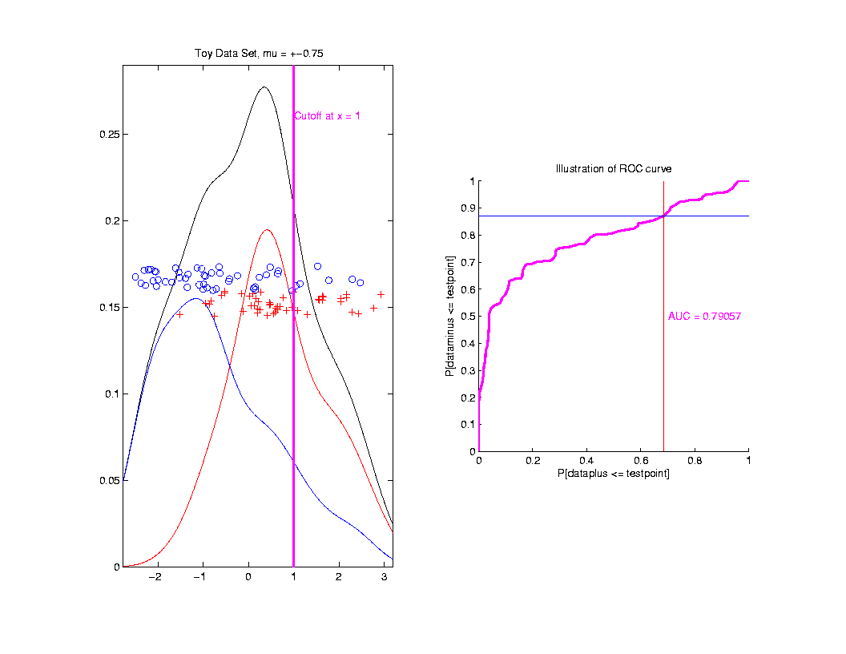
ROC Curve
Slide
Cutoff
To
Trace
Out
Curve
Plot $\hat{p}$ vs. $p$
For Grid of $q$ Values

Slide 22
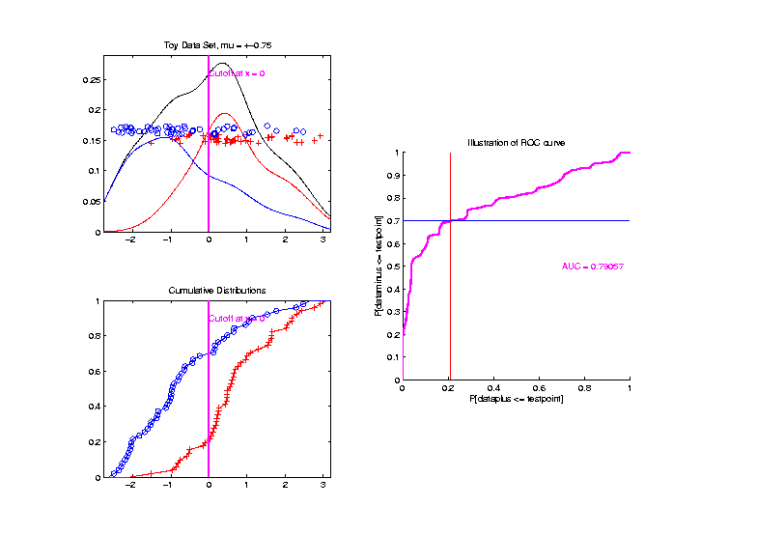
ROC Curve – CDF View
Slide
Cutoff
To
Trace
Out
Curve

Slide 23
Q-Q plots
Comparison Visualizations:
(compare a theoretical with an empirical)
P-P plot:
plot $\hat{p}$ vs. $p$
for a grid of $q$ values
Q-Q plot:
plot $\hat{q}$ vs. $q$
for a grid of $p$ values

Slide 24
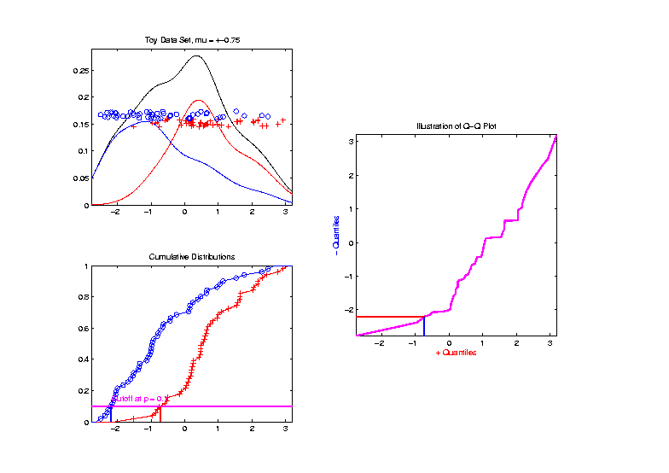
Q-Q plots
Slide
Cutoff
To
Trace
Out
Curve

Slide 25
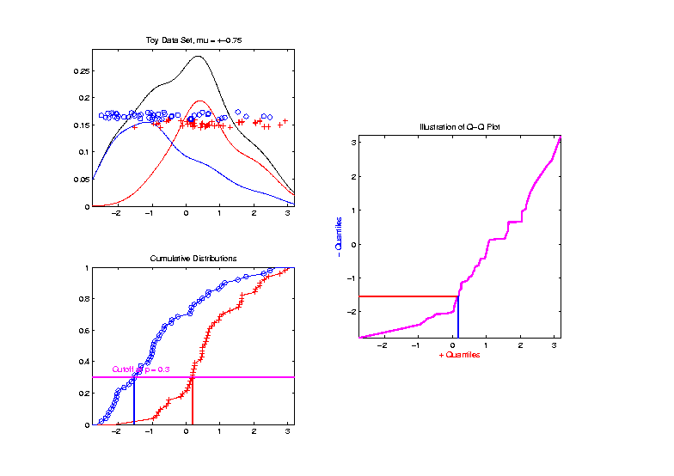
Q-Q plots
Slide
Cutoff
To
Trace
Out
Curve

Slide 26
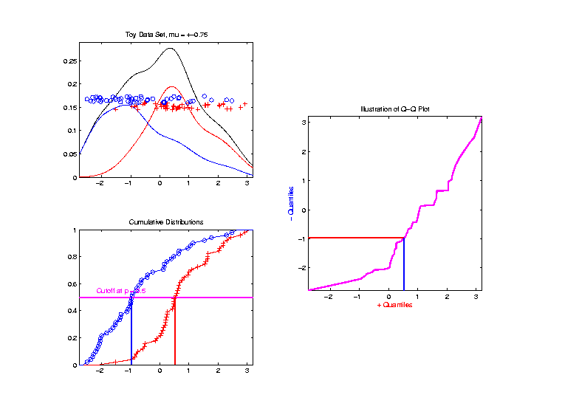
Q-Q plots
Slide
Cutoff
To
Trace
Out
Curve

Slide 27
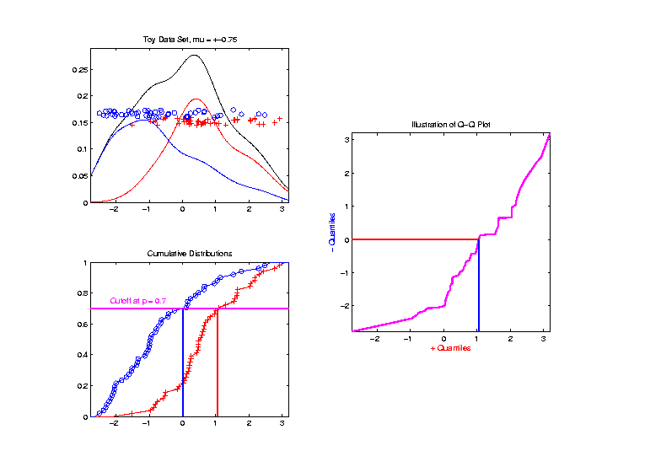
Q-Q plots
Slide
Cutoff
To
Trace
Out
Curve

Slide 28
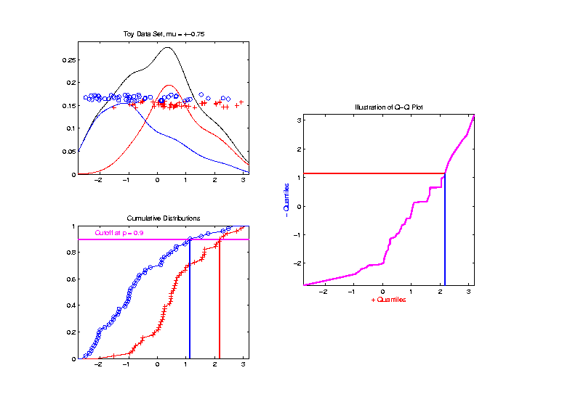
Q-Q plots
Slide
Cutoff
To
Trace
Out
Curve

Slide 29
Q-Q plots
Illustrative graphic (toy data set):
From $N\left(0,1\right)$ Distribution

Slide 30
Q-Q plots
Illustrative graphic (toy data set):
Generated $n=5$ data points

Slide 31
Q-Q plots
Illustrative graphic (toy data set):

Slide 32
Q-Q plots
Illustrative graphic (toy data set):
Empirical Qs near Theoretical Qs
when
Q-Q curve is near 45⁰ line
(general use of Q-Q plots)

Slide 33
Alternate Viewpoints
P-P Plot = ROC Curve:
Study Differences Between Data Sets
Focus on Main Body of Distributions
Q-Q Plot: For Checking
Empirical Distribution
vs.
Theoretical Distribution
Focus on Tails

Slide 34
Alternate Terminology
P-P Plot = ROC Curve
Q-Q Plot
Related Measures:
Precision & Recall

Slide 35
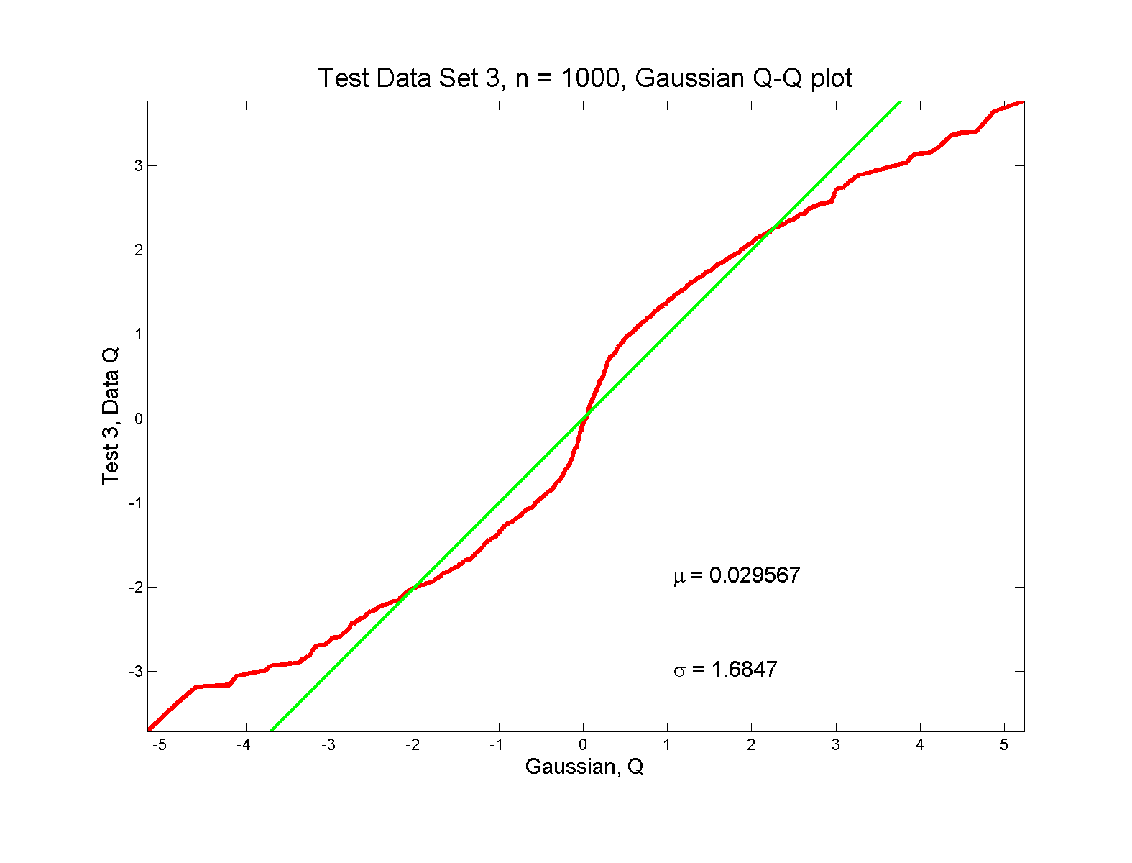
Q-Q plots
non-Gaussian! departures from line?

Slide 36
Q-Q plots
non-Gaussian! departures from line?
Seems different from line?
2 modes turn into wiggles?
Less strong feature
Been proposed to study modality

Slide 37
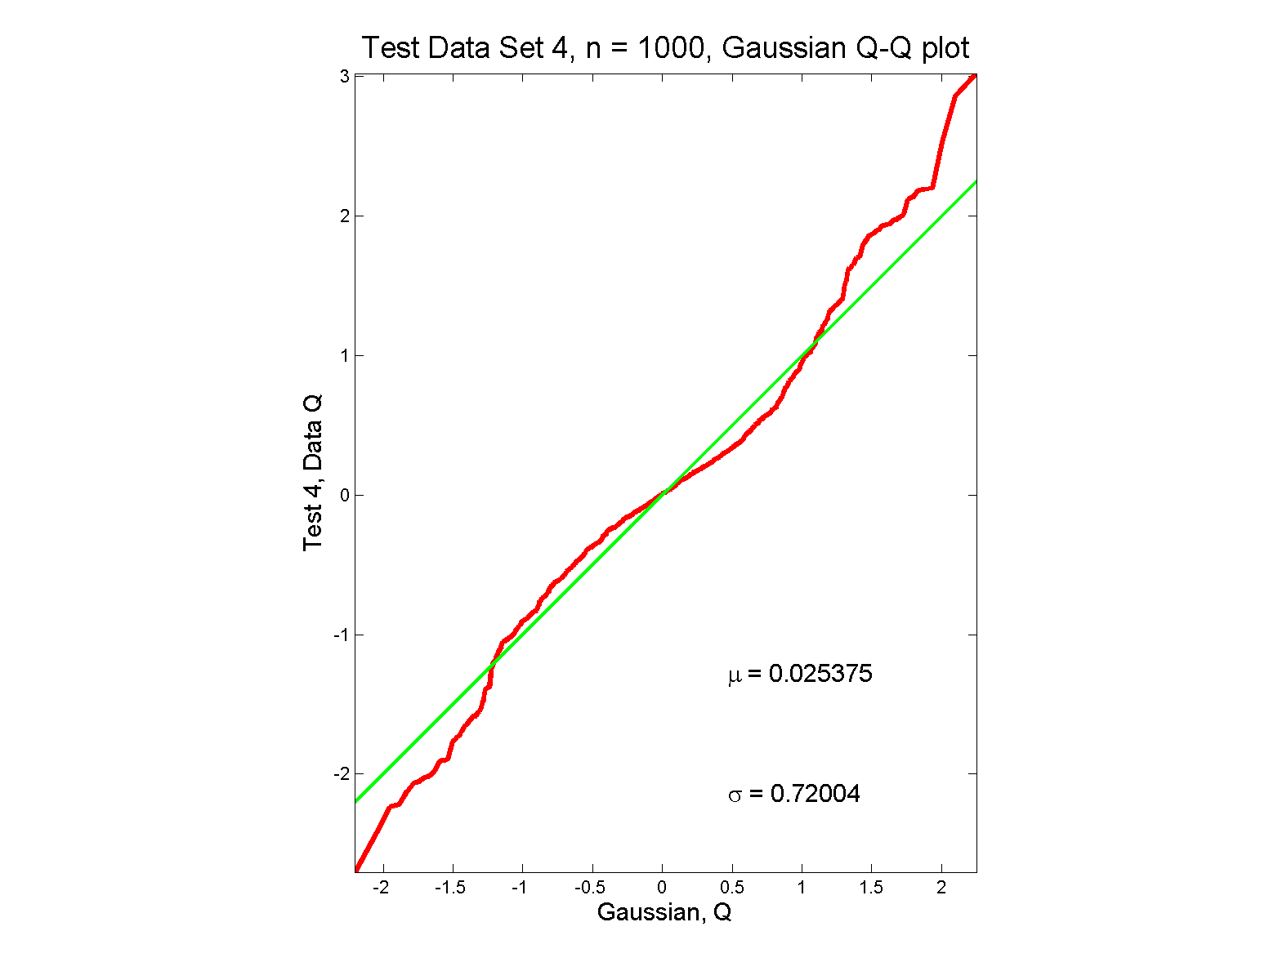
Q-Q plots
non-Gaussian (?) departures from line?

Slide 38
Q-Q plots
non-Gaussian (?) departures from line?
Seems different from line?
Harder to say this time?
What is signal & what is noise?
Need to understand sampling variation

Slide 39
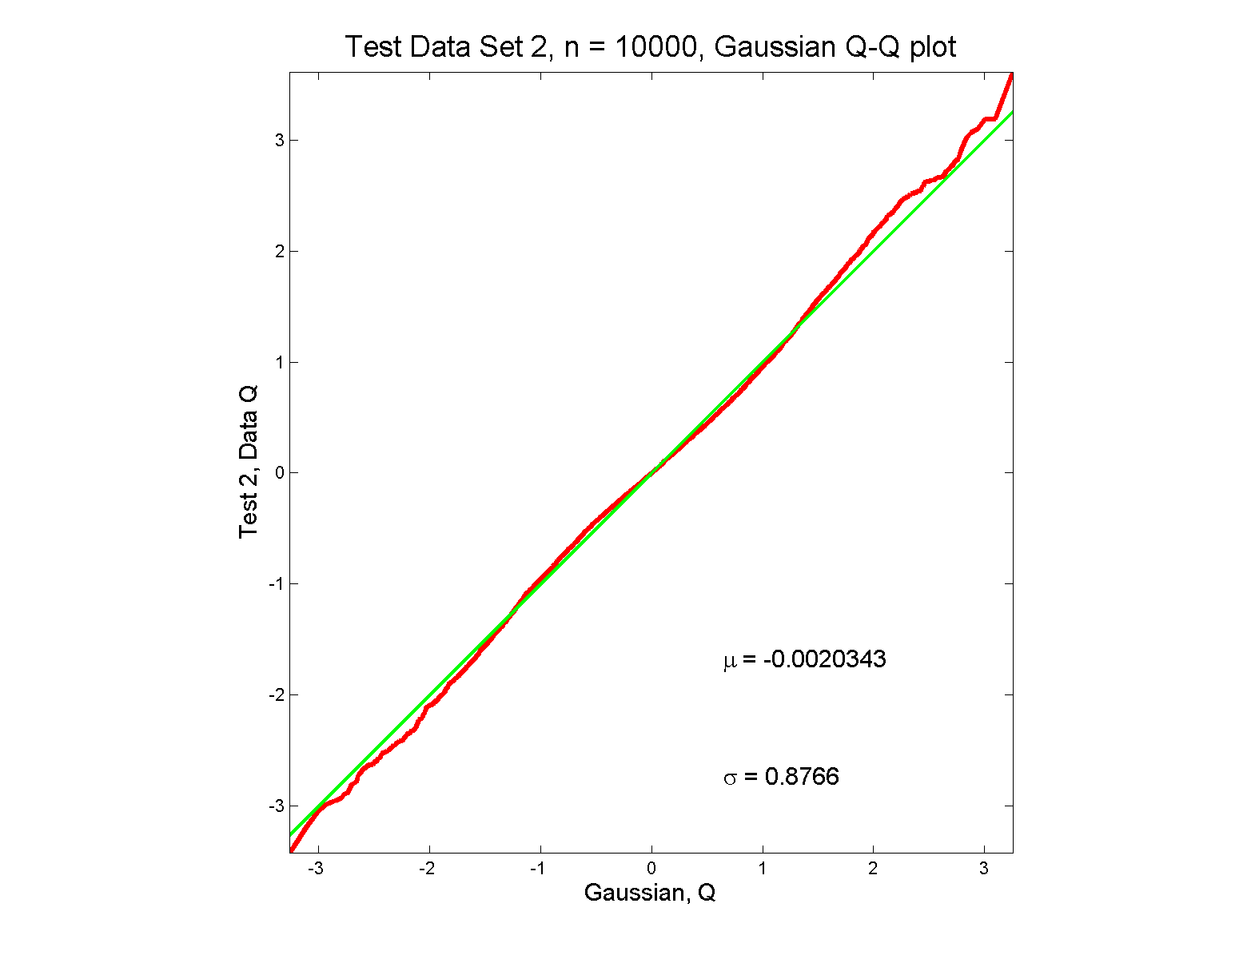
Q-Q plots
Gaussian? departures from line?

Slide 40
Q-Q plots
Gaussian? departures from line?
Looks much like?
Wiggles all random variation?
But there are n = 10,000 data points…
How to assess signal & noise?
Need to understand sampling variation

Slide 41
Q-Q plots
Need to understand sampling variation
Approach: Q-Q envelope plot
Simulate from Theoretical Dist’n
Samples of same size
About 100 samples gives
“good visual impression”
Overlay resulting 100 QQ-curves
To visually convey natural sampling variation

Slide 42
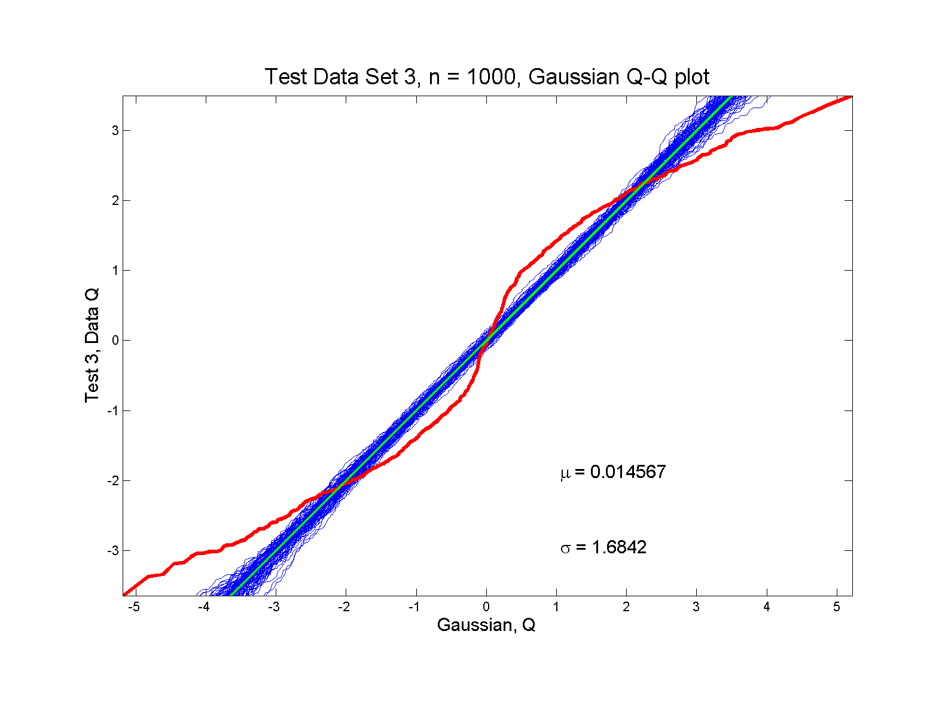
Q-Q plots
non-Gaussian! departures from line?

Slide 43
Q-Q plots
non-Gaussian! departures from line?
Envelope Plot shows:
Departures are significant
Clear these data are not Gaussian
Q-Q plot gives clear indication

Slide 44
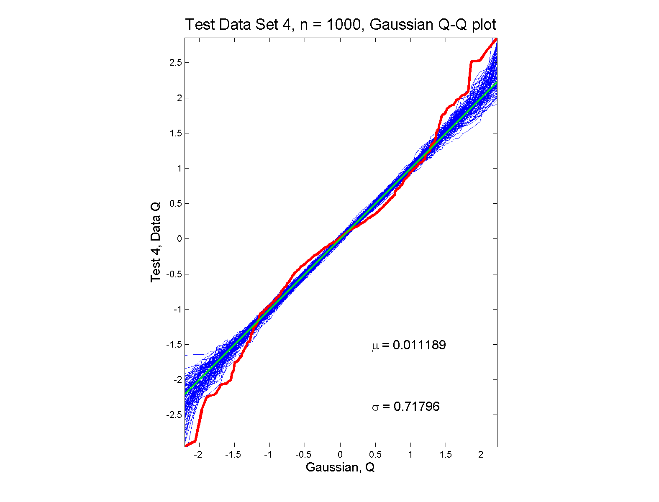
Q-Q plots
non-Gaussian (?) departures from line?

Slide 45
Q-Q plots
non-Gaussian (?) departures from line?
Envelope Plot shows:
Departures are significant
Clear these data are not Gaussian
Recall not so clear from e.g. histogram
Q-Q plot gives clear indication
Envelope plot reflects sampling variation

Slide 46
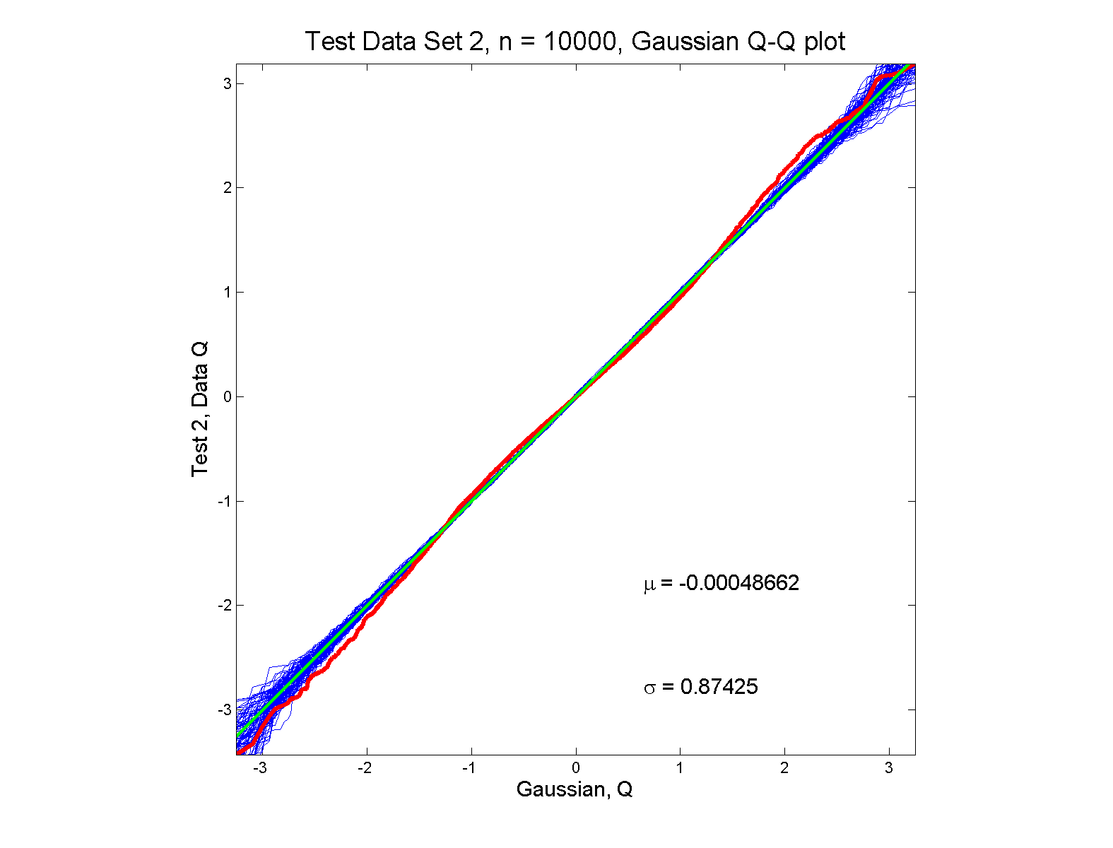
Q-Q plots
Gaussian? departures from line?

Slide 47
Q-Q plots
Gaussian? departures from line?
Harder to see
But clearly there
Conclude non-Gaussian
Really needed n = 10,000 data points…
(why bigger sample size was used)
Envelope plot reflects sampling variation

Slide 48
Q-Q plots
What were these distributions?
Non-Gaussian!
0.5 N(-1.5,0.75²) + 0.5 N(1.5,0.75²)
Non-Gaussian (?)
0.4 N(0,1) + 0.3 N(0,0.5²) + 0.3 N(0,0.25²)
Gaussian
Gaussian?
0.7 N(0,1) + 0.3 N(0,0.5²)

Slide 49
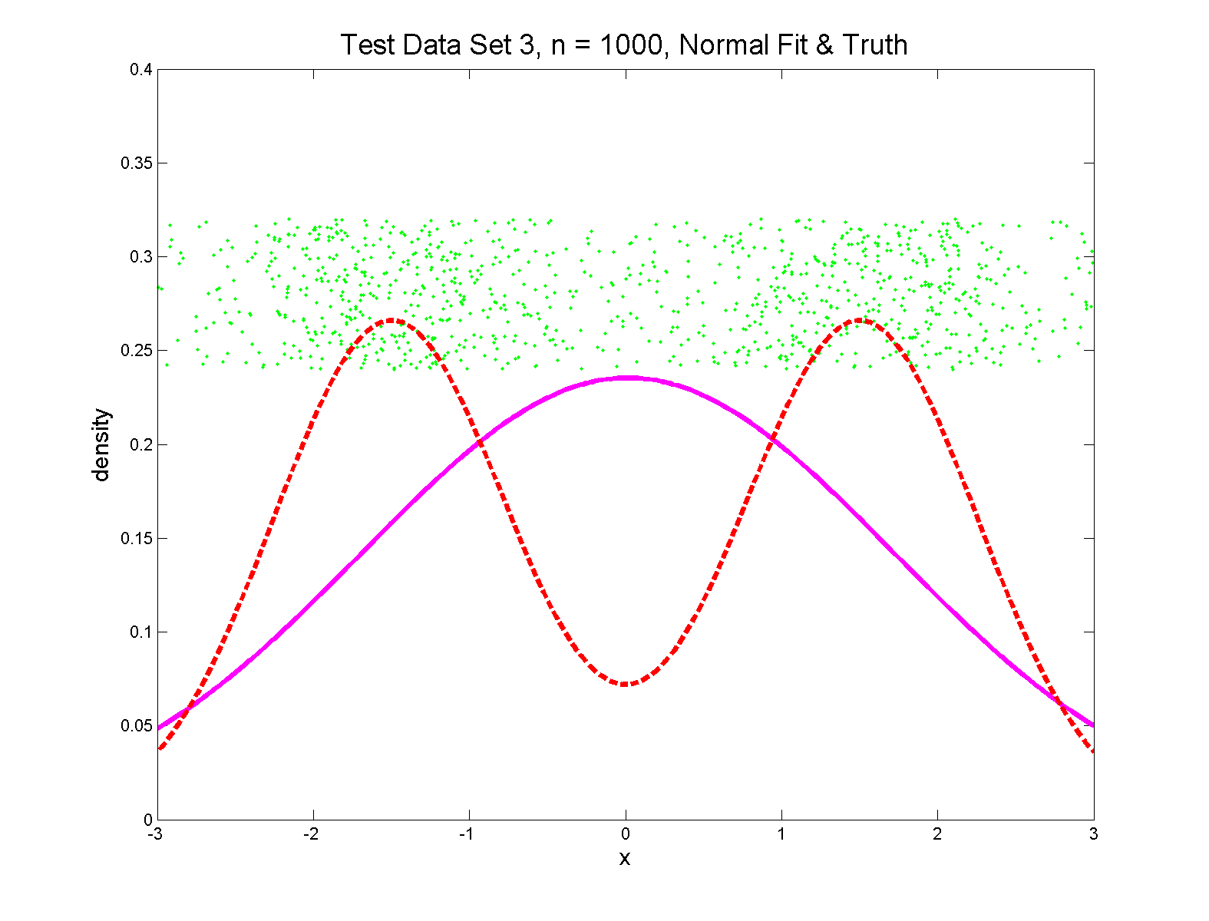
Q-Q plots
Non-Gaussian! .5 N(-1.5,0.75²) + 0.5 N(1.5,0.75²)

Slide 50
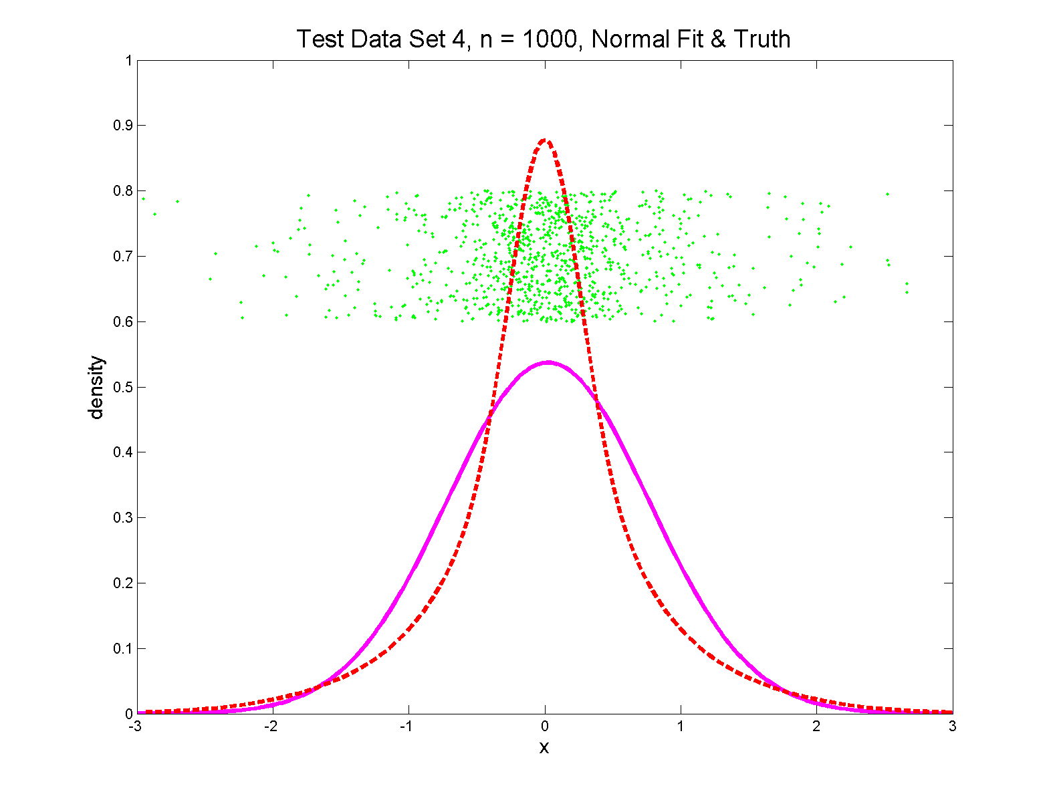
Q-Q plots
Non-Gaussian (?) 0.4 N(0,1) + 0.3 N(0,0.5²) + 0.3 N(0,0.25²)

Slide 51
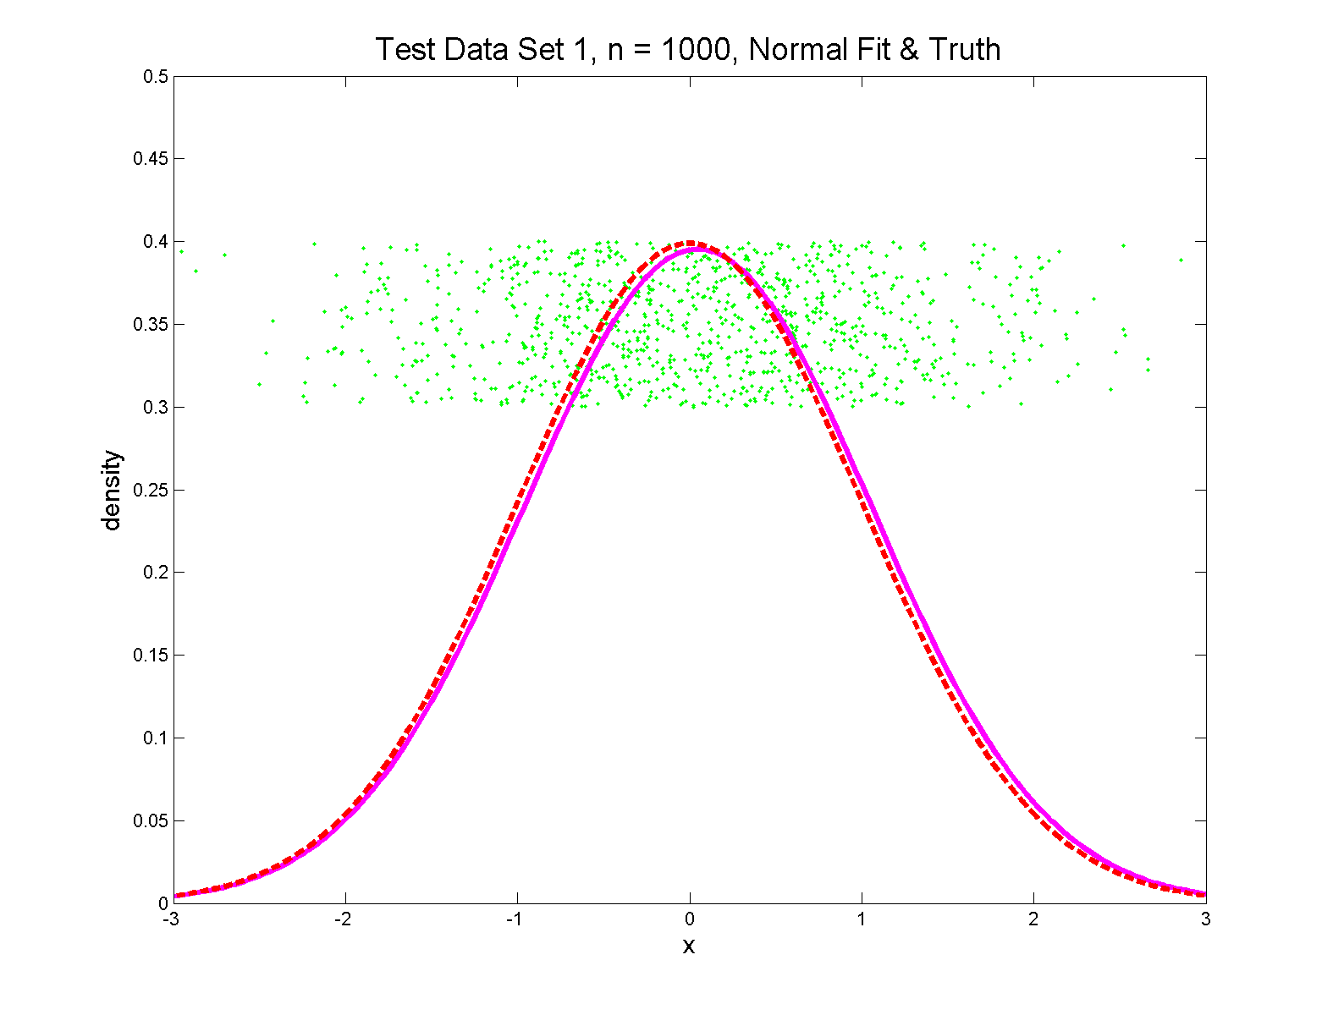
Q-Q plots
Gaussian

Slide 52
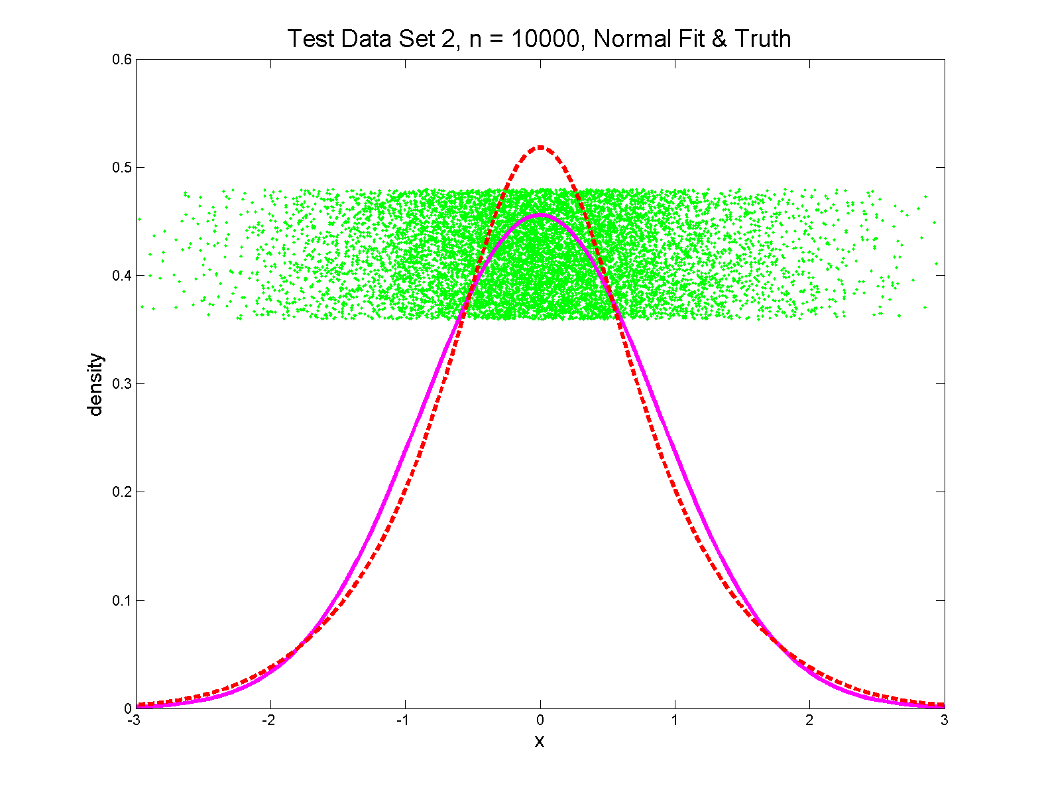
Q-Q plots
Gaussian? 0.7 N(0,1) + 0.3 N(0,0.5²)

Slide 53
Q-Q Envelope Plots
Marron’s Matlab Software:
qqLM.m
In General Directory

Slide 54
Q-Q plots
Variations on Q-Q Plots:
For $N\left(μ,σ^{2}\right)$ theoretical distribution:
$$p=P\left\{X≤q\right\}=Φ\left(\frac{q−μ}{σ}\right)$$
Solving for $q$ gives
$$q=μ+σΦ^{−1}\left(p\right)=μ+σz$$
Where $z$ is the Standard Normal Quantile

Slide 55
Q-Q plots
Variations on Q-Q Plots:
Solving for $q$ gives
$$q=μ+σΦ^{−1}\left(p\right)=μ+σz$$
So Q-Q plot against Standard Normal
is linear
With slope $σ$ and intercept $μ$

Slide 56
Q-Q plots
Variations on Q-Q Plots:
Can replace Gaussian with other dist’ns
Can compare 2 theoretical distn’s
Can compare 2 empirical distn’s
Could also Vary P-P plots = ROC curves

Slide 57
SigClust Estimation of Background Noise
n = 533, d = 9456

Slide 58
SigClust Estimation of Background Noise
Overall distribution has strong kurtosis
Shown by height of kde relative to
MAD based Gaussian fit
Mean and Median both ~ 0
SD ~ 1, driven by few large values
MAD ~ 0.7, driven by bulk of data

Slide 59
SigClust Estimation of Background Noise
Central part of distribution
“seems to look Gaussian”
But recall density does not provide
great diagnosis of Gaussianity
Better to look at Q-Q plot

Slide 60
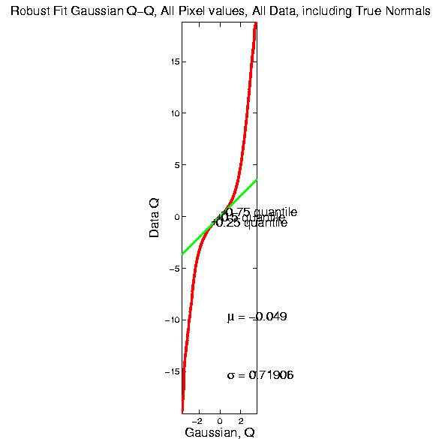
SigClust Estimation of Background Noise

Slide 61
SigClust Estimation of Background Noise
Distribution clearly not Gaussian
Except near the middle
Q-Q curve is very linear there
(closely follows 45º line)
Suggests Gaussian approx. is good there
And that MAD scale estimate is good
(Always a good idea to do such diagnostics)

Slide 62
SigClust Estimation of Background Noise
Now Check Effect of
Using SD, not MAD

Slide 63
SigClust Estimation of Background Noise
Checks that estimation of $σ$ matters
Show sample s.d. is indeed too large
As expected
Variation assessed by Q-Q envelope plot
Shows variation not negligible
Not surprising with n ~ 5 million

Slide 64
SigClust Gaussian null distribut’n
Estimation of Biological Covariance $Σ_{B}$:
Keep only “large” eigenvalues $λ_{1},λ_{2},⋯,λ_{d}$
Defined as $>{σ_{N}}^{2}$
So for null distribution, use eigenvalues:
$$\max_{}\left(λ_{1},{σ_{N}}^{2}\right),⋯,\max_{}\left(λ_{d},{σ_{N}}^{2}\right)$$

Slide 65
SigClust Estimation of Eigenval’s

Slide 66
SigClust Estimation of Eigenval’s
All eigenvalues $>{σ_{N}}^{2}$!
Suggests biology is very strong here!
I.e. very strong signal to noise ratio
Have more structure than can analyze
(with only 533 data points)
Data are very far from pure noise
So don’t actually use Factor Anal. Model
Instead end up with estim’d eigenvalues

Slide 67
SigClust Estimation of Eigenval’s
Do we need the factor model?
Explore this with another data set
(with fewer genes)
This time:
n = 315 cases
d = 306 genes

Slide 68
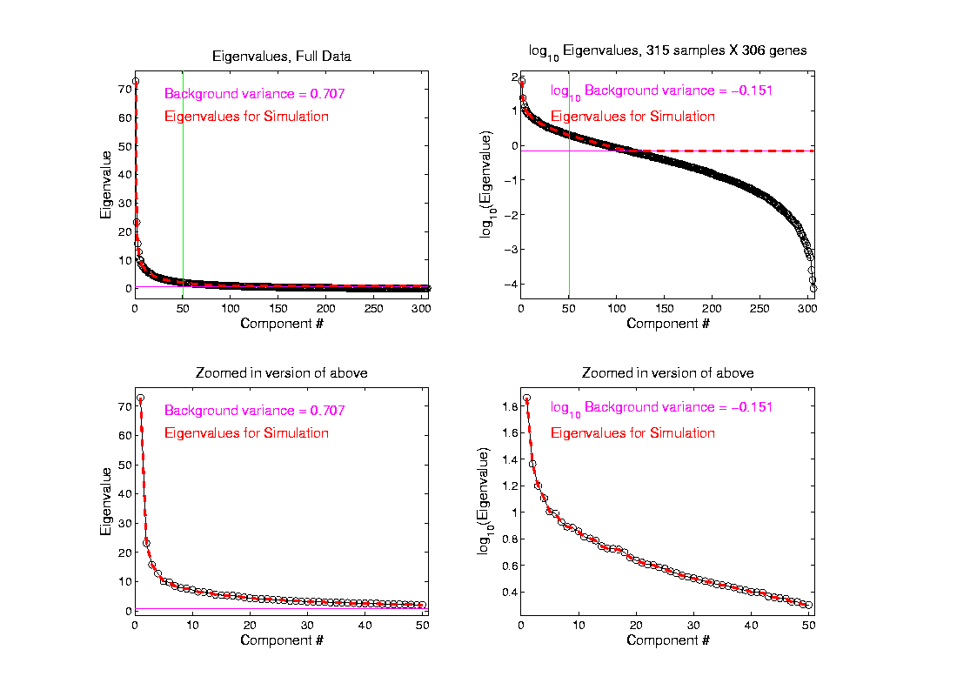
SigClust Estimation of Eigenval’s

Slide 69
SigClust Estimation of Eigenval’s
Try another data set, with fewer genes
This time:
First ~110 eigenvalues $>{σ_{N}}^{2}$
Rest are negligible
So threshold smaller ones at ${σ_{N}}^{2}$

Slide 70
SigClust Gaussian null distribution - Simulation
Now simulate from null distribution using:
$\left(\begin{matrix}X_{1,i} \\ ⋮ \\ X_{d,i}\end{matrix}\right)$ where $X_{j,i} \sim N\left(0,λ_{j}\right)$ (indep.)
Again rotation invariance makes this work
(and location invariance)

Slide 71
SigClust Gaussian null distribution - Simulation
Then compare data CI,
With simulated null population CIs
Spirit similar to DiProPerm
But now significance happens for
smaller values of CI

Slide 72
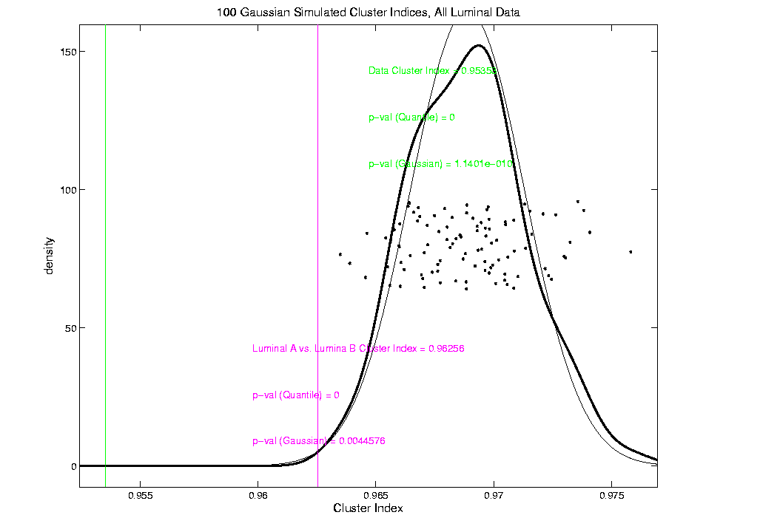
An example (details to follow)
P-val = 0.0045

Slide 73
SigClust Modalities
Two major applications:
Test significance of given clusterings
(e.g. for those found in heat map)
(Use given class labels)
Test if known cluster can be further split
(Use 2-means class labels)

Slide 74
SigClust Real Data Results
Analyze Perou 500 breast cancer data
(large cross study combined data set)
Current folklore: 5 classes
Luminal A
Luminal B
Normal
Her 2
Basal

Slide 75
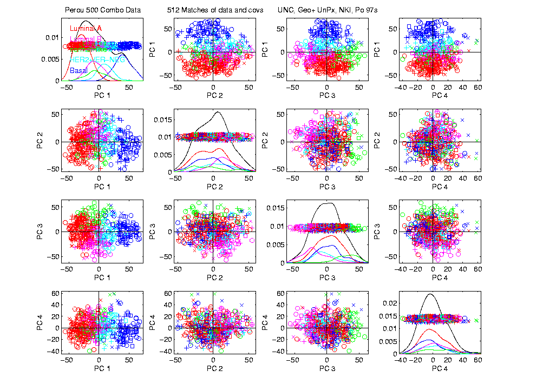
Perou 500 PCA View – real clusters???

Slide 76
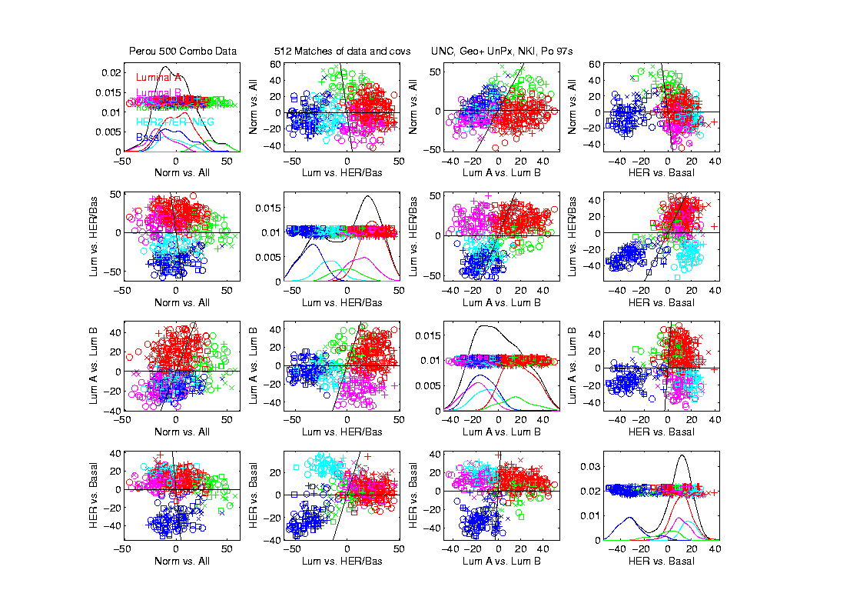
Perou 500 DWD Dir’ns View – real clusters???

Slide 77
Perou 500 – Fundamental Question
Are Luminal A &
Luminal B really
distinct clusters?
Famous for
Far Different
Survivability

Slide 78
SigClust Results for Luminal A vs. Luminal B
P-val = 0.0045

Slide 79
SigClust Results for Luminal A vs. Luminal B
Get p-values from:
Empirical Quantile
From simulated sample CIs
Fit Gaussian Quantile
Don’t “believe these”
But useful for comparison
Especially when Empirical Quantile = 0
Note: Currently Replaced by “Z-Scores”

Slide 80
SigClust Results for Luminal A vs. Luminal B
Test significance of given clusterings
Empirical p-val = 0
Definitely 2 clusters
Gaussian fit p-val = 0.0045
same strong evidence
Conclude these really are two clusters

Slide 81
SigClust Results for Luminal A vs. Luminal B
Test if known cluster can be further split
Empirical p-val = 0
definitely 2 clusters
Gaussian fit p-val = 10⁻¹⁰
Stronger evidence than above
Such comparison is value of Gaussian fit
Makes sense (since CI is min possible)
Conclude these really are two clusters

Slide 82
SigClust Real Data Results
Summary of Perou 500 SigClust Results:
Lum & Norm vs. Her2 & Basal, p-val = 10⁻¹⁹
Luminal A vs. B, p-val = 0.0045
Her 2 vs. Basal, p-val = 10⁻¹⁰
Split Luminal A, p-val = 10⁻⁷
Split Luminal B, p-val = 0.058
Split Her 2, p-val = 0.10
Split Basal, p-val = 0.005

Slide 83
SigClust Real Data Results
Summary of Perou 500 SigClust Results:
All previous splits were real
Most not able to split further
Exception is Basal, already known
Chuck Perou has good intuition!
(insight about signal vs. noise)
How good are others???

Slide 84
SigClust Real Data Results
Experience with Other Data Sets: Similar
Smaller data sets: less power
Gene filtering: more power
Lung Cancer: more distinct clusters

Slide 85
SigClust Real Data Results
Some Personal Observations
Experienced Analysts Impressively Good
SigClust can save them time
SigClust can help them with skeptics
SigClust essential for non-experts

Slide 86
SigClust Overview
Works Well When Factor Part Not Used

Slide 87
SigClust Overview
Works Well When Factor Part Not Used
Sample Eigenvalues Always Valid
But Can be Too Conservative

Slide 88
SigClust Overview
Works Well When Factor Part Not Used
Sample Eigenvalues Always Valid
But Can be Too Conservative
Above Factor Threshold Anti-Conservative

Slide 89
SigClust Overview
Works Well When Factor Part Not Used
Sample Eigenvalues Always Valid
But Can be Too Conservative
Above Factor Threshold Anti-Conservative
Problem Fixed by Soft Thresholding
(Huang et al, 2014)

Slide 90
SigClust Open Problems
Improved Eigenvalue Estimation
(Random Matrix Theory)
More attention to Local Minima in 2-means Clustering
Theoretical Null Distributions
Inference for k > 2 means Clustering
Multiple Comparison Issues

Slide 91
Big Picture
Object Oriented Data Analysis
Have done detailed study of Data Objects
In Euclidean Space, $ℝ^{d}$
Next: OODA in Non-Euclidean Spaces

Slide 92
Shapes As Data Objects
Several Different Notions of Shape
Oldest and Best Known (in Statistics):
Landmark Based

Slide 93
Shapes As Data Objects
Landmark Based Shape Analysis:
Kendall (et al 1999)
Bookstein (1991)
Dryden & Mardia (1998, revision coming)
(Note: these are summarizing
Monographs, $∃$ many papers)

Slide 94
Shapes As Data Objects
Landmark Based Shape Analysis:
Kendall (et al 1999)
Bookstein (1991)
Dryden & Mardia (1998, revision coming)
Recommended as Most Accessible

Slide 95
Landmark Based Shape Analysis
Start by Representing Shapes
Data Object

Slide 96
Landmark Based Shape Analysis
Start by Representing Shapes by
Landmarks (points in R² or R³)
$$\left(x_{1},y_{1}\right)$$
$$\left(x_{2},y_{2}\right)$$
$$\left(x_{3},y_{3}\right)$$

Slide 97
Landmark Based Shape Analysis
Start by Representing Shapes by
Landmarks (points in R² or R³)
$$\left(x_{1},y_{1}\right)$$
$$\left(x_{2},y_{2}\right)$$
$$\left(x_{3},y_{3}\right)$$
Descriptor

Slide 98
Landmark Based Shape Analysis
Clearly different shapes:

Slide 99
Landmark Based Shape Analysis
Clearly different shapes:
But what about: ?

Slide 100
Landmark Based Shape Analysis
Clearly different shapes:
But what about: ?
(just translation and rotation of,
but different points in R⁶)

Slide 101
Landmark Based Shape Analysis
Note: Shape should be same over different:
Translations

Slide 102
Landmark Based Shape Analysis
Note: Shape should be same over different:
Translations
Rotations

Slide 103
Landmark Based Shape Analysis
Note: Shape should be same over different:
Translations
Rotations
Scalings

Slide 104
Landmark Based Shape Analysis
Approach: Identify objects that are:
Translations
Rotations
Scalings
of each other

Slide 105
Landmark Based Shape Analysis
Approach: Identify objects that are:
Translations
Rotations
Scalings
of each other
Mathematics: Equivalence Relation

Slide 106
Participant Presentations
Aniish Sridhar
Analytics Competition
Aditya Balaram
Single Pass PCA

