Slide 1
Radial DWD
Main Idea:
Linear Classifiers Good When Each Class Lives in a Distinct Region
Hard When All Members Of One Class Are Outliers in a Random Direction
Notes:
1

Slide 2
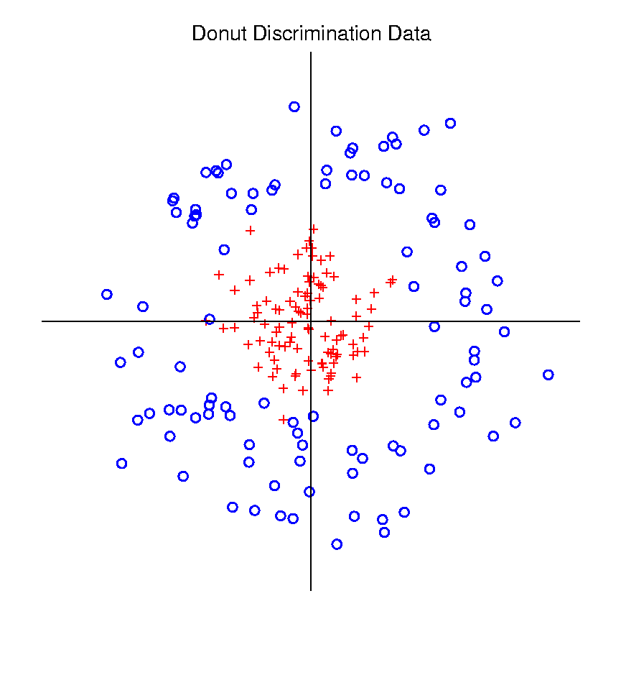
Radial DWD
Hard When All Members Of One Class Are Outliers in a Random Direction
Think HDLSS
Version of
Notes:
2

Slide 3
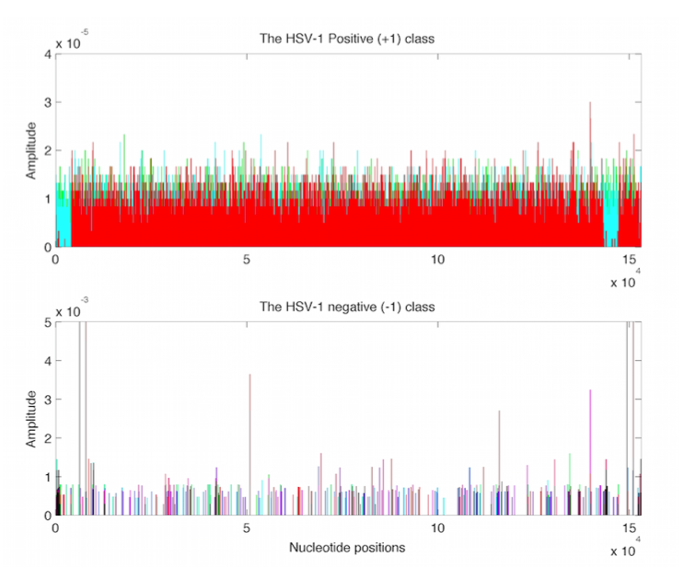
Virus Hunting
Look at
Data:
Note:
Heights
Orders of
Magnitude
-5 << -3
Different
Notes:
3

Slide 4
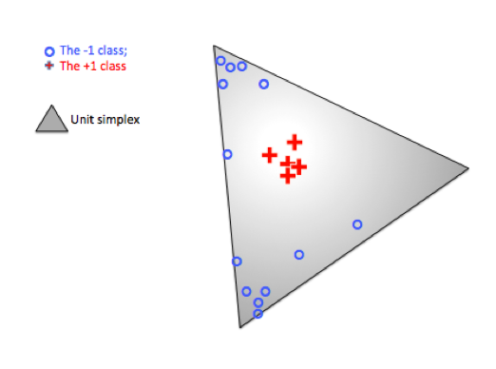
Radial DWD
Thought
Model:
+ Class
Near Center
- Class At
Random
Corners
Note: $∃$ Many ($d$) Corners
Notes:
4

Slide 5
Radial DWD
Consider Training Data
But What About
Test Point In A
Different Corner
???
Notes:
5

Slide 6
Virus Hunting
Compare With Other Classifiers
Even Kernel SVM Fails!!!
Reason:
Test Data
Lies In
Corners
With No
Training
Data
Notes:
6

Slide 7
Radial DWD
Verify With Simulation Study
Note: Very Similar Behavior!
Notes:
7

Slide 8
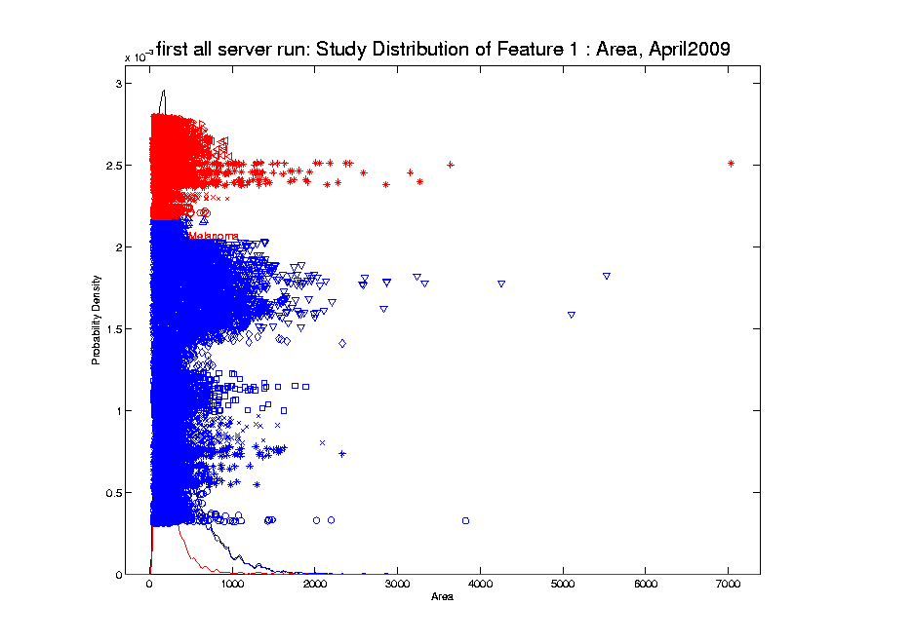
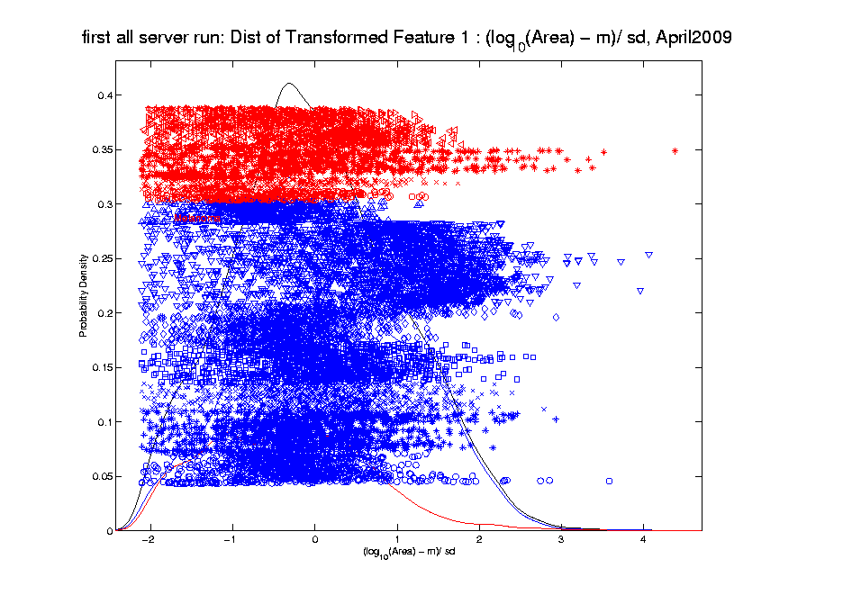
Melanoma Data
Recall From 9/5/17:
Studied
Transformation
Of This
Data

Slide 9
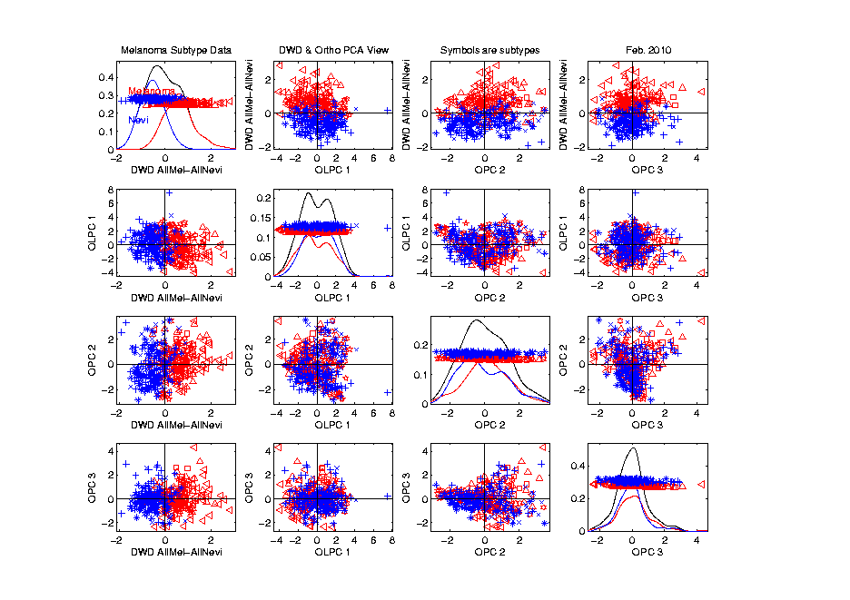
Melanoma Data
Rotate
To DWD
Direction
“Good”
Separation
???

Slide 10
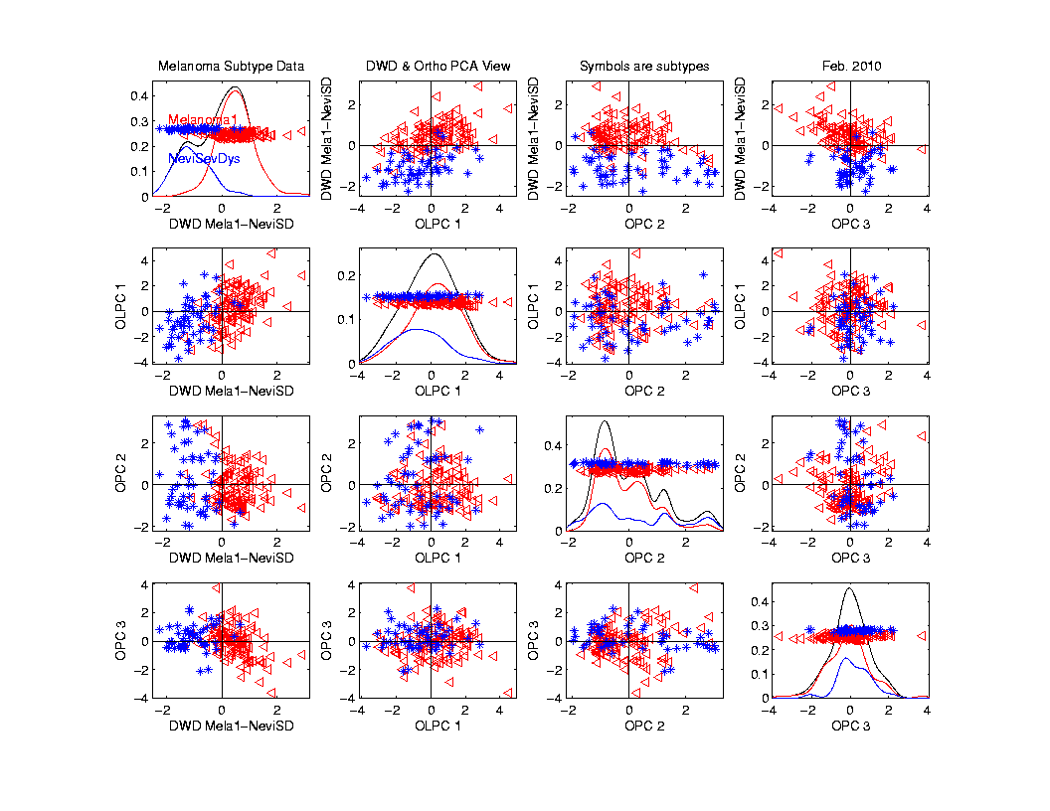
Melanoma Data
Rotate
To DWD
& Ortho PCs
Better
Separation
Than Full
Data???

Slide 11
ROC Curve
Challenge:
Measure “Goodness of Separation”
Approach from Signal Detection:
Receiver Operator Characteristic
(ROC) Curve
Developed in WWII, History in
Green and Swets (1966)

Slide 12
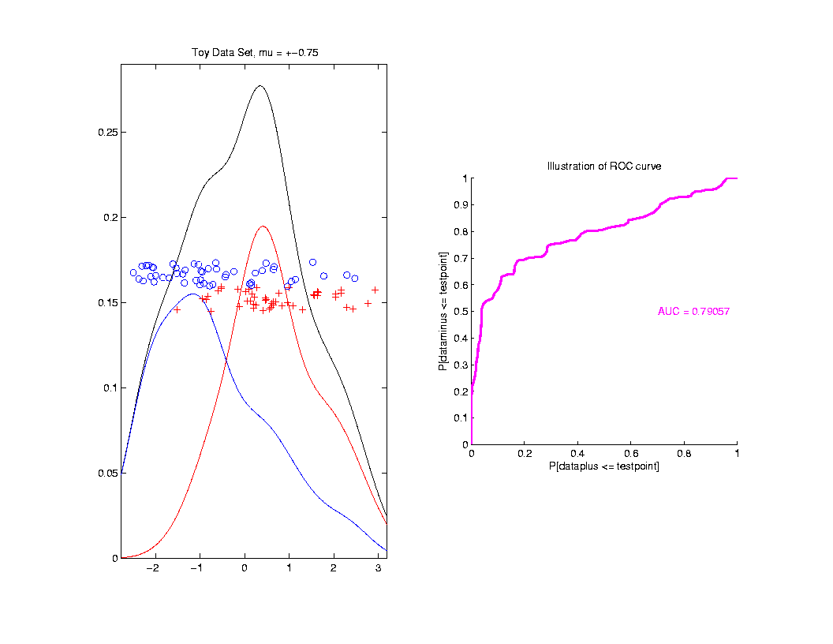
ROC Curve
Summarize
& Compare
Using
Area
Under
Curve
(AUC)

Slide 13
ROC Curve
Interpretation of AUC:
Very Context Dependent
Radiology:
“> 70% has Predictive Usefulness”
Varies Field by Field
Bigger is Better

Slide 14
Melanoma Data
Recall Question:
Which Gives Better Separation of
Melanoma vs. Nevi
DWD on All Melanoma vs. All Nevi
DWD on Melanoma 1 vs. Sev. Dys. Nevi

Slide 15
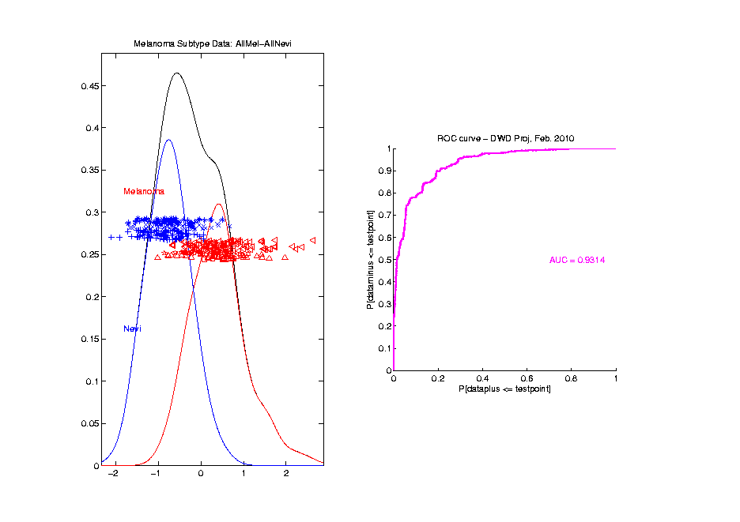
Melanoma Data
Full Data
ROC
Analysis
AUC = 0.93

Slide 16
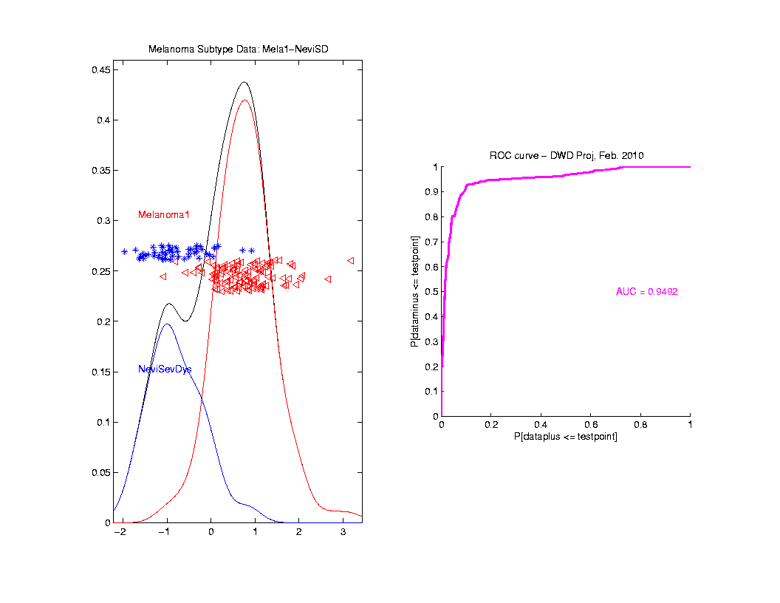
Melanoma Data
SubClass
ROC
Analysis
AUC = 0.95
Better,
Makes
Intuitive
Sense

Slide 17
Clusters in data
Common Statistical Task:
Find Clusters in Data
Interesting sub-populations?
Important structure in data?
How to do this?
PCA & visualization is very simple approach
There is a large literature of other methods
(will study more later)

Slide 18
PCA to find clusters
Main Lesson:
PCA is limited at finding clusters
Revealed by NCI60 data
Recall Microarray data
With 8 known different cancer types
PCA does not find all 8 clusters
Recall only finds dirn’s of max variation
Does not use class label information

Slide 19
PCA to find clusters
A deeper example:
Mass Flux Data
Data from Enrica Bellone,
National Center for Atmospheric Research
Mass Flux for quantifying cloud types
How does mass change when moving into a cloud

Slide 20
PCA to find clusters
PCA of Mass Flux Data:

Slide 21
PCA to find clusters
Summary of PCA of Mass Flux Data:
Mean:
Captures General Mountain Shape
PC1:
Generally overall height of peak
shows up nicely in mean +- plot (2nd col)
3 apparent clusters in scores plot
Are those “really there”?
If so, could lead to interesting discovery
If not, could waste effort in investigation

Slide 22
PCA to find clusters
Summary of PCA of Mass Flux Data:
PC2:
Location of peak
again mean +- plot very useful here
PC3:
Width adjustment
again see most clearly in mean +- plot
Maybe non-linear modes of variation???

Slide 23
PCA to find clusters
Return to Investigation of PC1 Clusters:
Can see 3 bumps in smooth histogram
Main Question:
Important structure
or
sampling variability?
Approach: SiZer
(SIgnificance of ZERo crossings of deriv.)

Slide 24
Statistical Smoothing
In 1 Dimension
(Numbers as Data Objects)

Slide 25
Statistical Smoothing
In 1 Dimension, 2 Major Settings:
Density Estimation
“Histograms”
Nonparametric Regression
“Scatterplot Smoothing”

Slide 26
Density Estimation
E.g. Hidalgo Stamp Data
Thicknesses of Postage Stamps
Produced in Mexico
Over ~ 70 years
During 1800s
Paper produced in several factories?
How many factories? (Records lost)
Brought to statistical literature by:
Izenman and Sommer (1988)

Slide 27
Density Estimation
E.g. Hidalgo Stamp Data
Thicknesses of Postage Stamps
Produced in Mexico
Over ~ 70 years
During 1800s
Paper produced in several factories?
(Thicknesses vary by up to factor of 2)

Slide 28
Density Estimation
E.g. Hidalgo Stamp Data
A histogram
“Oversmoothed”
Bin Width too
large?
Miss important
structure?

Slide 29
Density Estimation
E.g. Hidalgo Stamp Data
Another histogram
Smaller binwidth
Suggests 2 modes?
2 factories making
the paper?

Slide 30
Density Estimation
E.g. Hidalgo Stamp Data
Another histogram
Smaller binwidth
Suggests 6 modes?
6 factories making
the paper?

Slide 31
Density Estimation
E.g. Hidalgo Stamp Data
Another histogram
Even smaller binwidth
Suggests many modes?
Really believe
modes are “there”?
Or just sampling
variation?

Slide 32
Density Estimation
E.g. Hidalgo Stamp Data
Critical Issue for histograms:
Choice of binwidth (well understood?)

Slide 33
Histograms
Less Well Understood Issue:
Choice of bin location
Major impact on number of modes (2-7)
All for same binwidth

Slide 34
Histograms
Choice of bin location:
What is going on?
Compare with Average Histogram

Slide 35
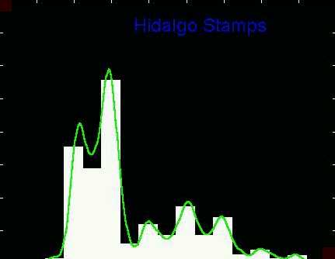
Density Estimation
Compare shifts with Average Histogram
For 7 mode shift
Peaks line up with bin centers
So shifted histo’s
find peaks

Slide 36
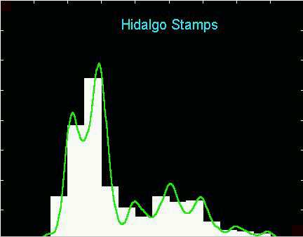
Density Estimation
Compare shifts with Average Histogram
For 2 (3?) mode shift
Peaks split between bins
So shifted histo’s
miss peaks

Slide 37
Density Estimation
Histogram Drawbacks:
Need to choose bin width
Need to choose bin location
But Average Histogram reveals structure
So should use that, instead of histo
Name: Kernel Density Estimate

Slide 38
Kernel Density Estimation
Chondrite Data:
Stony (metal) Meteorites (hit the earth)
So have a chunk of rock
Study “% of silica”
From how many sources?
Only 22 rocks…
Histogram hopeless?
Brought to statistical literature by:
Good and Gaskins (1980)

Slide 39
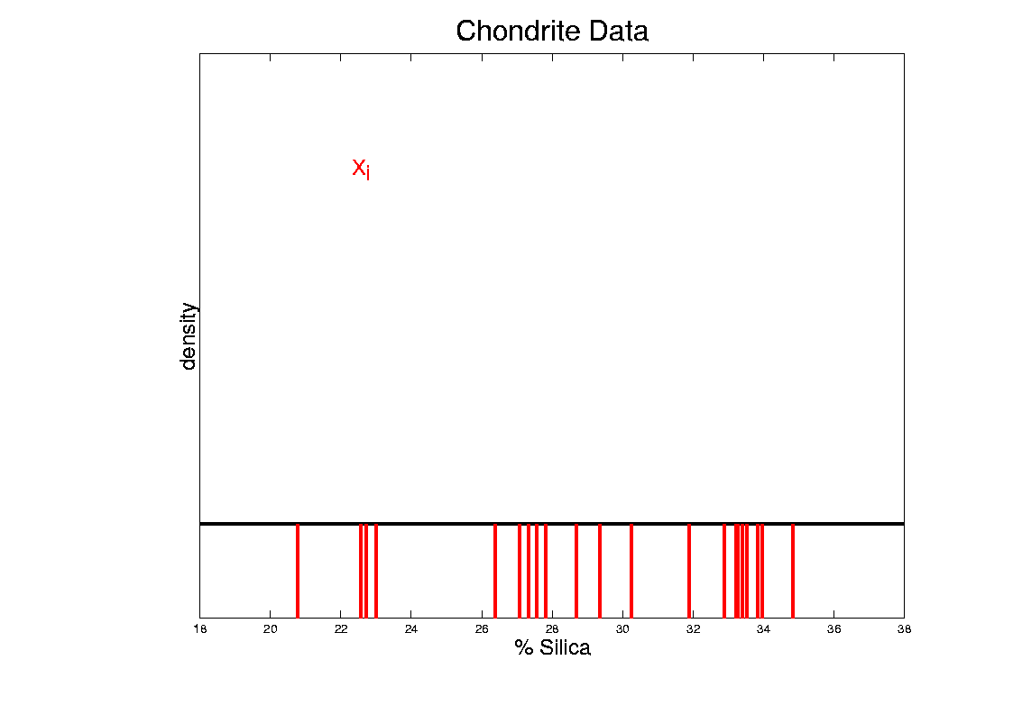
Kernel Density Estimation
Chondrite Data:
Represent points by red bars
Where are data “more dense”?

Slide 40
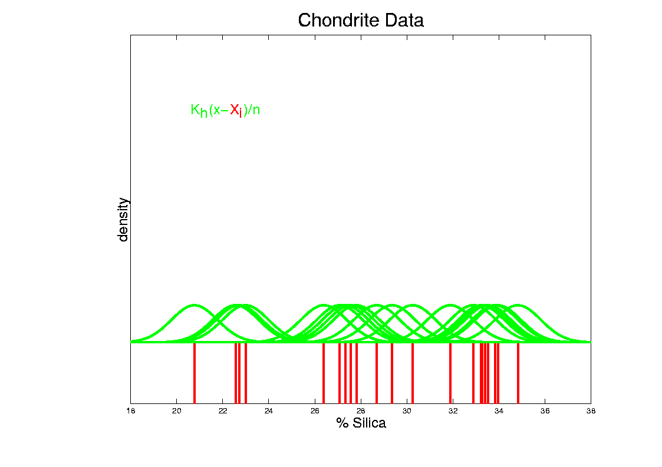
Kernel Density Estimation
Chondrite Data:
Put probability mass 1/n at each point
Smooth piece of “density”

Slide 41
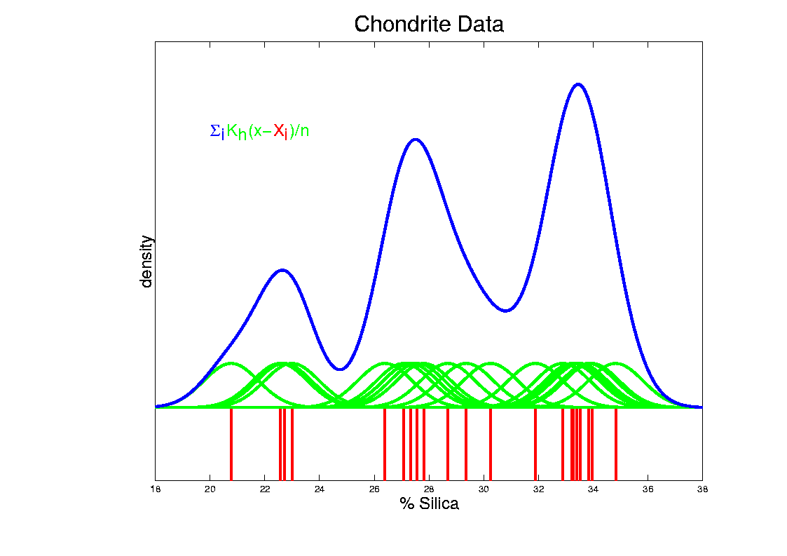
Kernel Density Estimation
Chondrite Data:
Sum pieces to estimate density
Suggests 3 modes (rock sources)

Slide 42
Kernel Density Estimation
Mathematical Notation:
$${\hat{f}}_{h}\left(x\right)=\frac{1}{n}\sum_{i=1}^{n}{K_{h}\left(x−X_{i}\right)}$$
Where
Window shape given by “kernel”,
$$K_{h}\left(∙\right)=\frac{1}{h}K\left(\frac{∙}{h}\right)$$
Window width given by “bandwidth”, $h$

Slide 43
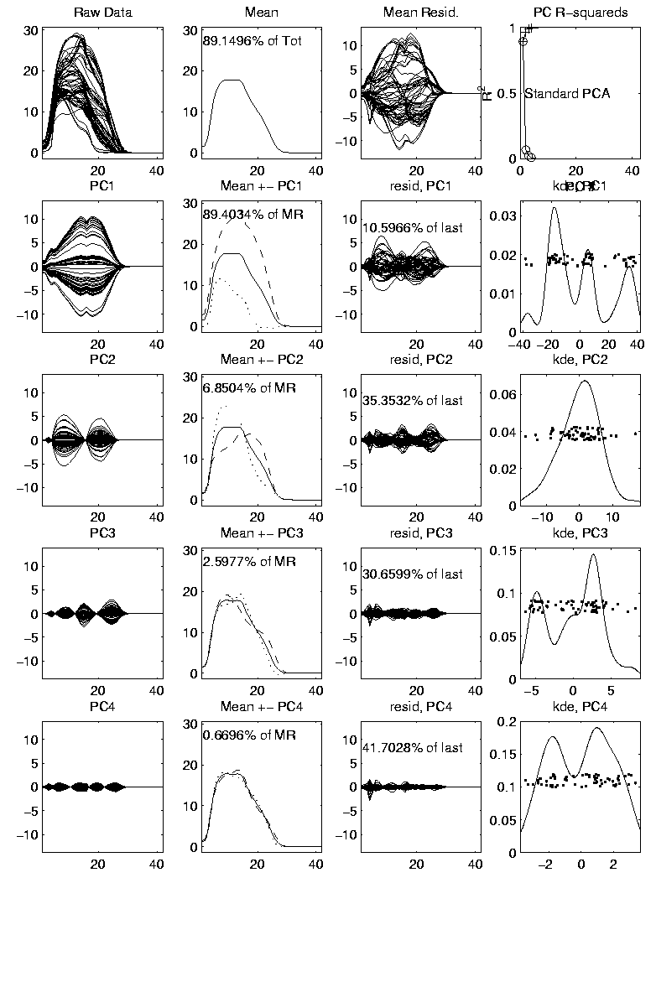
Kernel Density Estimation
Mathematical Notation:
$${\hat{f}}_{h}\left(x\right)=\frac{1}{n}\sum_{i=1}^{n}{K_{h}\left(x−X_{i}\right)}$$
This
Was
Used
In PCA
Graphics

Slide 44
Kernel Density Estimation
Choice of kernel (window shape)?
Controversial issue
Want Computational Speed?
Want Statistical Efficiency?
Want Smooth Estimates?
There is more, but personal choice:
Gaussian
Good Overall Reference:
Wand and Jones (1994)

Slide 45
Kernel Density Estimation
Choice of bandwidth (window width)?
Very important to performance
Fundamental Issue:
Which modes are “really there”?

Slide 46
Density Estimation
How to use histograms if you must:
Undersmooth (minimizes bin edge effect)
Human eye is OK at “post-smoothing”

Slide 47
Statistical Smoothing
2 Major Settings:
Density Estimation
“Histograms”
Nonparametric Regression
“Scatterplot Smoothing”

Slide 48
Scatterplot Smoothing
E.g. Bralower Fossil Data
Prof. of Geosciences
Penn. State Univ.

Slide 49
Scatterplot Smoothing
E.g. Bralower Fossil Data
Study Global Climate
Time scale of millions of years
Data points are fossil shells
Dated by surrounding material
Ratio of Isotopes of Strontium
(differences in 4th decimal point!)
Surrogate for Sea Level (Ice Ages)
Data seem to have structure…

Slide 50
Scatterplot Smoothing
E.g. Bralower Fossil Data

Slide 51
Scatterplot Smoothing
E.g. Bralower Fossil Data
Way to bring out structure:
Smooth the data
Methods of smoothing?
Local Averages
Splines (several types)
Fourier – trim high frequencies
Other bases
…
Also controversial

Slide 52
Scatterplot Smoothing
E.g. Bralower Fossil Data – some smooths

Slide 53
Scatterplot Smoothing
A simple approach: local averages
Given data: $\left(X_{1},Y_{1}\right),⋯,\left(X_{n},Y_{n}\right)$
Model in regression form:
$$E\left(Y_{i}\right)=m\left(X_{i}\right), i=1,⋯,n$$
How to estimate $m\left(x\right)$?

Slide 54
Scatterplot Smoothing
A simple approach: local averages
Given a kernel window function:
$$K_{h}\left(x\right)=\frac{1}{h}K\left(\frac{x}{h}\right)$$
Estimate the curve $m\left(x\right)$
by a $K_{h}$ weighted local average:
$${\hat{m}}_{h}\left(x\right)=\frac{\sum_{i=1}^{n}{K_{h}\left(x−X_{i}\right)Y_{i}}}{\sum_{i=1}^{n}{K_{h}\left(x−X_{i}\right)}}$$

Slide 55
Scatterplot Smoothing
Interesting representation of local average:
Given kernel window weights,
$$K_{h}\left(x\right)=\frac{1}{h}K\left(\frac{x}{h}\right)$$
Local Constant Least Squares Fit to Data:
$${\hat{m}}_{h}\left(x\right)={argmin}_{a}\sum_{i=1}^{n}{K_{h}\left(x−X_{i}\right){\left(Y_{i}−a\right)}^{2}}$$

Slide 56
Scatterplot Smoothing
Local Constant Fits (visually):
“Moving Average”
Window width $h$ is critical (~ k.d.e.)

Slide 57
Scatterplot Smoothing
Interesting variation:
Local linear fit to data:
Given kernel window weights, $K_{h}\left(x\right)=\frac{1}{h}K\left(\frac{x}{h}\right)$
$${\hat{m}}_{h}\left(x\right)={argmin}_{a}\sum_{i=1}^{n}{K_{h}\left(x−X_{i}\right){\left(Y_{i}−\left(bX_{i}+a\right)\right)}^{2}}$$

Slide 58
Scatterplot Smoothing
Local Linear Fits (visually):
“Intercept of Moving Fit Line”
Window width $h$ is critical (~ k.d.e.)

Slide 59
Scatterplot Smoothing
Another variation:
“Intercept of Moving Polynomial Fit”
Window width $h$ is critical (~ k.d.e.)

Slide 60
Scatterplot Smoothing
Local Polynomial Smoothing
What is best polynomial degree?
Once again controversial…
Advocates for all of 0, 1, 2, 3.
Depends on personal weighting of factors involved
Good reference:
Fan & Gijbels (1995)
Personal choice: degree 1, local linear

Slide 61
Scatterplot Smoothing
E.g. Bralower Fossils – local linear smooths

Slide 62
Scatterplot Smoothing
Smooths of Bralower Fossil Data:
Oversmoothed misses structure
Undersmoothed feels sampling noise?
About right shows 2 valleys:
One seems clear
Is other one really there?
Same question as above…

Slide 63
Kernel Density Estimation
Choice of bandwidth (window width)?
Very important to performance
Fundamental Issue:
Which modes are “really there”?

Slide 64
Kernel Density Estimation
Choice of bandwidth (window width)?
Very important to performance
Data Based Choice?
Controversial Issue
Many recommendations
Suggested Reference:
Jones, Marron & Sheather (1996)
Never a consensus…

Slide 65
Kernel Density Estimation
Choice of bandwidth (window width)?
Alternate Choice:
Consider all of them!
I.e. look at whole spectrum of smooths
Can see different structure
At different smoothing levels
Connection to Scale Space
E.g. Stamps data
How many modes?
All answers are there….

Slide 66
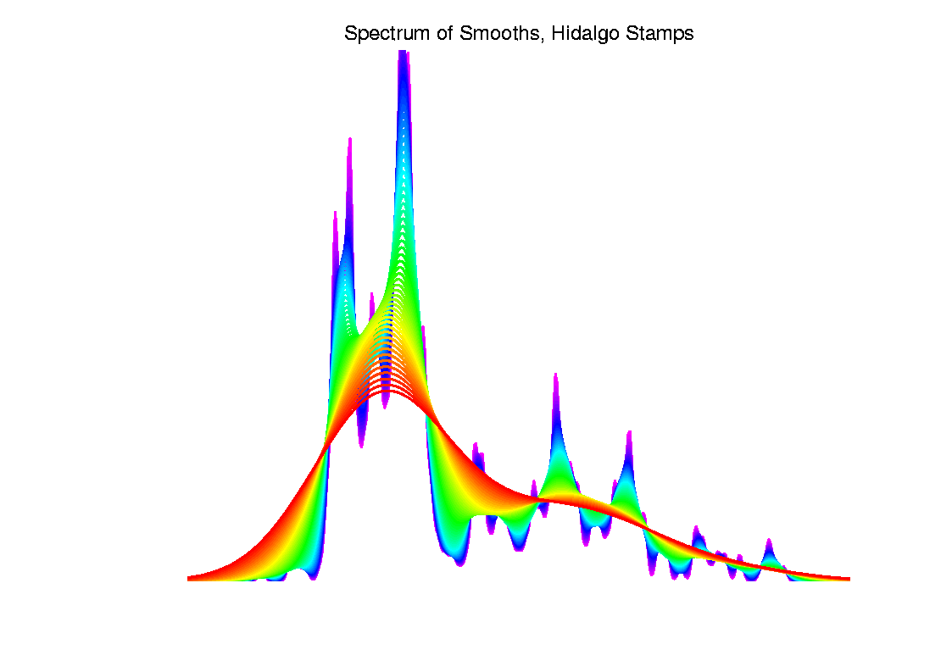
Kernel Density Estimation

Slide 67
Statistical Smoothing
Fundamental Question
For both of
Density Estimation: “Histograms”
Regression: “Scatterplot Smoothing”
Which bumps are “really there”?
vs. “artifacts of sampling noise”?

Slide 68
SiZer Background
Scale Space – Idea from Computer Vision
Goal: Teach Computers to “See”
Modern Research:
Extract “Information” from Images
Early Theoretical work

Slide 69
SiZer Background
Scale Space – Idea from Computer Vision
Conceptual basis:
Oversmoothing = “view from afar”
(macroscopic)
Undersmoothing = “zoomed in view”
(microscopic)
Main idea: all smooths contain useful information, so study “full spectrum”
(i. e. all smoothing levels)
Recommended reference: Lindeberg (1994)

Slide 70
Participant Presentations
Brendan Brown
Chen Shen
Wesley Hamilton
Topological Data Analysis

