Slide 1
SiZer Background
SiZer:
Significance of Zero crossings, of the derivative, in scale space
Combines:
needed statistical inference
novel visualization
To get: a powerful exploratory data analysis method
Main references:
Chaudhuri & Marron (1999)
Hannig & Marron (2006)

Slide 2
SiZer Background
SiZer Visual presentation:
Color map over scale space:
Blue: slope significantly upwards
(derivative CI above 0)
Red: slope significantly downwards
(derivative CI below 0)
Purple: slope insignificant
(derivative CI contains 0)

Slide 3
SiZer Background
E.g. - Marron & Wand (1992) Trimodal #9
Increasing $n$
Only 1 Signif’t Mode
Now 2 Signif’t Modes
Finally all 3 Modes

Slide 4
PCA to find clusters
Return to PCA of Mass Flux Data:
Notes:
MassFlux1d1p1.ps

Slide 5
PCA to find clusters
SiZer analysis of Mass Flux, PC1
All 3
Signif’t
Notes:
MassFlux1d1p1s.ps

Slide 6
SiZer Study of Dist’n of Angles
Notes:
CellCycTh200SiZer.ps

Slide 7
Reclassification of Major Genes
Notes:
CellCycTh200ScatPlot.ps

Slide 8
Compare to Previous Classif’n
Notes:
CellCyc2dSpellClass.ps

Slide 9
Clustering
Idea: Given data ${\underline{X}}_{1},⋯,{\underline{X}}_{n}$
Assign each object to a class
Of similar objects
Completely data driven
I.e. assign labels to data
“Unsupervised Learning”
Contrast to Classification (Discrimination)
With predetermined given classes
“Supervised Learning”

Slide 10
K-means Clustering
Clustering Goal:
Given data ${\underline{X}}_{1},⋯,{\underline{X}}_{n}$
Choose classes $C_{1},⋯,C_{K}$
To miminize
$$CI\left(C_{1},⋯,C_{K}\right)=\frac{\sum_{j=1}^{K}{\sum_{i∈C_{j}}{{\left\|{\underline{X}}_{i}−{\overline{\underline{X}}}_{j}\right\|}^{2}}}}{\sum_{i=1}^{n}{{\left\|{\underline{X}}_{i}−\overline{\underline{X}}\right\|}^{2}}}$$

Slide 11
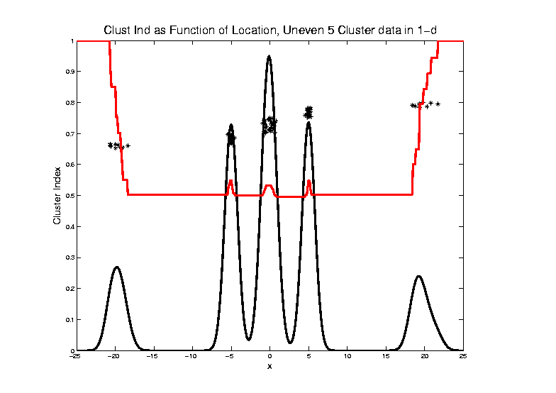
2-means Clustering

Slide 12
2-means Clustering
Study CI, using simple 1-d examples
Over changing Classes (moving b’dry)
Multi-modal data → interesting effects
Can have 4 (or more) local mins
(even in 1 dimension, with K = 2)

Slide 13
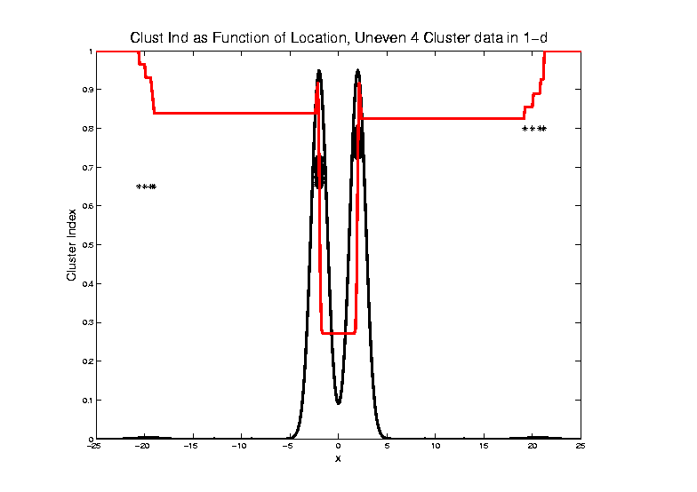
2-means Clustering

Slide 14
2-means Clustering
Study CI, using simple 1-d examples
Over changing Classes (moving b’dry)
Multi-modal data → interesting effects
Local mins can be hard to find
i.e. iterative procedures can “get stuck”
(even in 1 dimension, with K = 2)

Slide 15
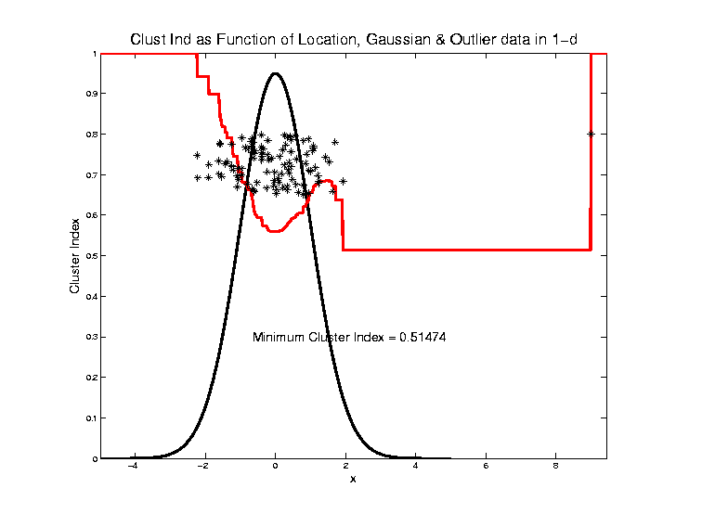
2-means Clustering

Slide 16
2-means Clustering
Study CI, using simple 1-d examples
Effect of a single outlier?
Can create local minimum
Can also yield a global minimum
This gives a one point class
Can make CI arbitrarily small
(really a “good clustering”???)

Slide 17
SWISS Score
Another Application of CI (Cluster Index)
Cabanski et al (2010)
Idea: Use CI in bioinformatics to
“measure quality of data preprocessing”
Philosophy: Clusters Are Scientific Goal
So Want to Accentuate Them

Slide 18
SWISS Score
Nice Graphical Introduction:
$$SWISS=CI\left(C_{1},⋯,C_{K}\right)=\frac{\sum_{j=1}^{K}{\sum_{i∈C_{j}}{{\left\|{\underline{X}}_{i}−{\overline{\underline{X}}}_{j}\right\|}^{2}}}}{\sum_{i=1}^{n}{{\left\|{\underline{X}}_{i}−\overline{\underline{X}}\right\|}^{2}}}$$

Slide 19
SWISS Score
Nice Graphical Introduction:
$$SWISS=CI\left(C_{1},⋯,C_{K}\right)=\frac{\sum_{j=1}^{K}{\sum_{i∈C_{j}}{{\left\|{\underline{X}}_{i}−{\overline{\underline{X}}}_{j}\right\|}^{2}}}}{\sum_{i=1}^{n}{{\left\|{\underline{X}}_{i}−\overline{\underline{X}}\right\|}^{2}}}$$

Slide 20
SWISS Score
Revisit Toy Examples (2-d):
Which are “More Clustered?”

Slide 21
SWISS Score
Toy Examples (2-d):
Which are “More Clustered?”

Slide 22
SWISS Score
Toy Examples (2-d):
Which are “More Clustered?”

Slide 23
SWISS Score
Now Consider $K>2$:
$$SWISS=CI\left(C_{1},⋯,C_{K}\right)=\frac{\sum_{j=1}^{K}{\sum_{i∈C_{j}}{{\left\|{\underline{X}}_{i}−{\overline{\underline{X}}}_{j}\right\|}^{2}}}}{\sum_{i=1}^{n}{{\left\|{\underline{X}}_{i}−\overline{\underline{X}}\right\|}^{2}}}$$
How well does it work?

Slide 24
SWISS Score
$K=3$, Toy Example:

Slide 25
SWISS Score
$K=3$, Toy Example:

Slide 26
SWISS Score
$K=3$, Toy Example:

Slide 27
SWISS Score
$K=3$, Toy Example:
But C
Seems
“Better
Clustered”

Slide 28
SWISS Score
K-Class SWISS:
Instead of using K-Class CI
Use Average of Pairwise SWISS Scores

Slide 29
SWISS Score
K-Class SWISS:
Instead of using K-Class CI
Use Average of Pairwise SWISS Scores
(Preserves [0,1] Range)

Slide 30
SWISS Score
Avg. Pairwise SWISS – Toy Examples

Slide 31
SWISS Score
Additional Feature:
Ǝ Hypothesis Tests:
H₁: SWISS₁ < 1
H₁: SWISS₁ < SWISS₂
Permutation Based
See Cabanski et al (2010)

Slide 32
Clustering
A Very Large Area
K-Means is Only One Approach
Has its Drawbacks
(Many Toy Examples of This)
Ǝ Many Other Approaches
Important (And Broad) Class
Hierarchical Clustering

Slide 33
Hiearchical Clustering
Idea: Consider Either:
Bottom Up Aggregation:
One by One Combine Data
Top Down Splitting:
All Data in One Cluster & Split
Through Entire Data Set, to get Dendogram

Slide 34
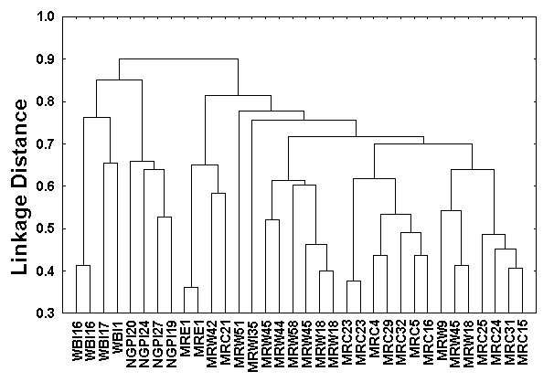
Hiearchical Clustering
Aggregate or Split, to get Dendogram
Thanks to US EPA: water.epa.gov

Slide 35
Hiearchical Clustering
Aggregate or Split, to get Dendogram
Aggregate:
Start With
Individuals

Slide 36
Hiearchical Clustering
Aggregate or Split, to get Dendogram
Aggregate:
Start With
Individuals,
Move Up

Slide 37
Hiearchical Clustering
Aggregate or Split, to get Dendogram
Aggregate:
Start With
Individuals,
Move Up

Slide 38
Hiearchical Clustering
Aggregate or Split, to get Dendogram
Aggregate:
Start With
Individuals,
Move Up

Slide 39
Hiearchical Clustering
Aggregate or Split, to get Dendogram
Aggregate:
Start With
Individuals,
Move Up

Slide 40
Hiearchical Clustering
Aggregate or Split, to get Dendogram
Aggregate:
Start With
Individuals,
Move Up,
End Up With
All in 1 Cluster

Slide 41
Hiearchical Clustering
Aggregate or Split, to get Dendogram
Split:
Start With
All in 1 Cluster

Slide 42
Hiearchical Clustering
Aggregate or Split, to get Dendogram
Split:
Start With
All in 1 Cluster,
Move Down

Slide 43
Hiearchical Clustering
Aggregate or Split, to get Dendogram
Split:
Start With
All in 1 Cluster,
Move Down,
End With
Individuals

Slide 44
Hiearchical Clustering
Vertical Axis in Dendogram:
Based on:
Distance Metric
(Ǝ many, e.g. $L^{2}$, $L^{1}$, $L^{∞}$, …)
Linkage Function
(Reflects Clustering Type)
A Lot of “Art” Involved

Slide 45
Hiearchical Clustering
Dendogram Interpretation
Branch
Length
Reflects
Cluster
Strength

Slide 46
SigClust
Statistical Significance of Clusters
in HDLSS Data
When is a cluster “really there”?
Liu et al (2007), Huang et al (2014)

Slide 47
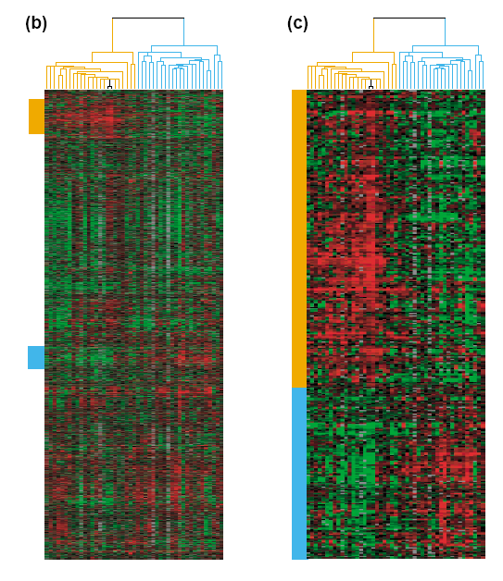
Common Microarray Analytic Approach: Clustering
From: Perou et al (2000)
d = 1161 genes
Zoomed to “relevant”
Gene subsets

Slide 48
Interesting Statistical Problem
For HDLSS data:
When clusters seem to appear
E.g. found by clustering method
How do we know they are really there?
Question asked by Neil Hayes
Define appropriate statistical significance?
Can we calculate it?

Slide 49
First Approaches: Hypo Testing
e.g. Direction, Projection, Permutation
Hypothesis test of:
Significant difference between sub-populations

Slide 50
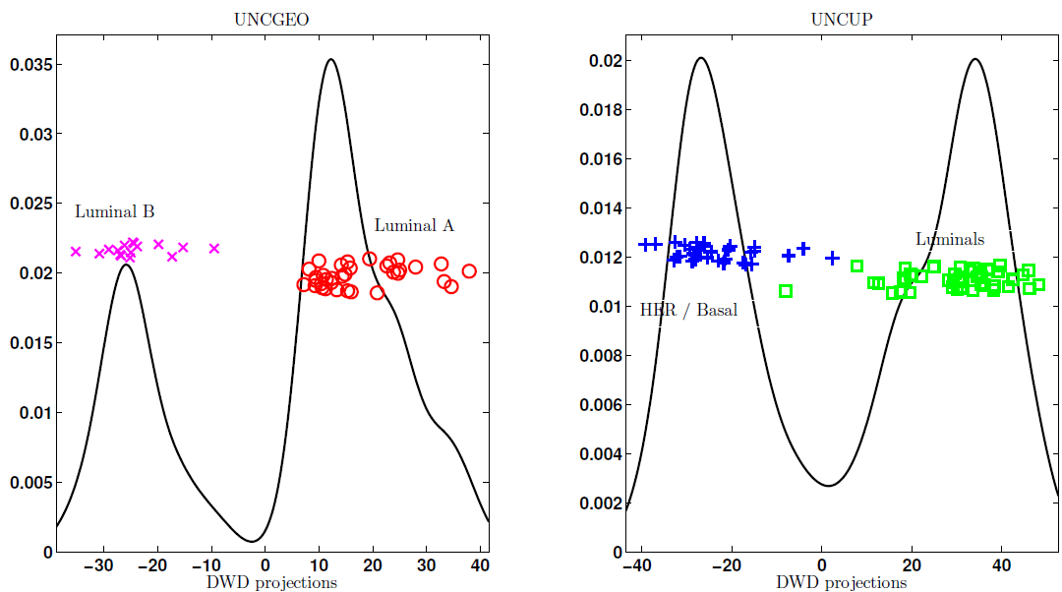
DiProPerm Hypothesis Test
Two
Examples
Which Is
“More
Distinct”?
Visually Better Separation?
Thanks to Katie Hoadley

Slide 51
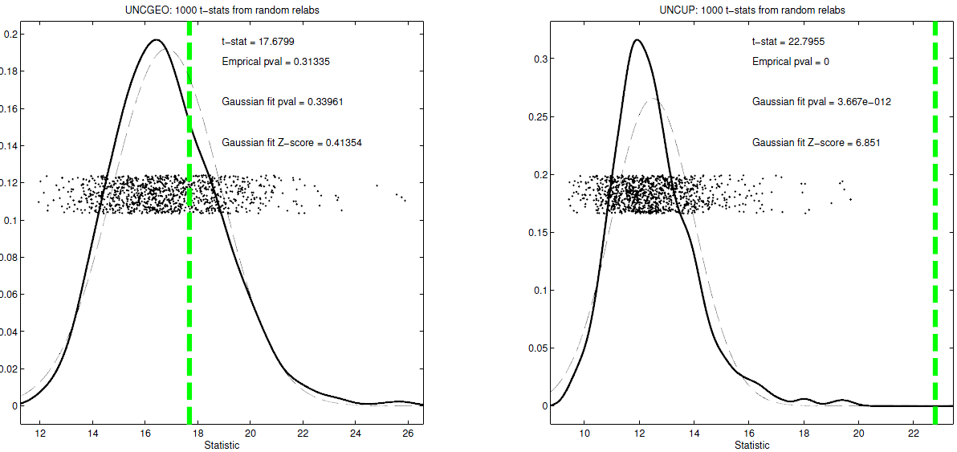
DiProPerm Hypothesis Test
Two
Examples
Which Is
“More
Distinct”?
Stronger Statistical Significance!
Thanks to Katie Hoadley

Slide 52
First Approaches: Hypo Testing
e.g. Direction, Projection, Permutation
Hypothesis test of:
Significant difference between sub-populations
Effective and Accurate
I.e. Sensitive and Specific
There exist several such tests
But critical point is:
What result implies about clusters

Slide 53
Clarifying Simple Example
Why Population Difference Tests cannot indicate clustering
Andrew Nobel Observation
For Gaussian Data (Clearly 1 Cluster!)
Assign Extreme Labels
(e.g. by clustering)
Subpopulations are signif’ly different

Slide 54
Simple Gaussian Example
Clearly only 1 Cluster in this Example
But Extreme Relabelling looks different
Extreme T-stat strongly significant
Indicates 2 clusters in data

Slide 55
Simple Gaussian Example
Results:
Random relabelling T-stat is not significant
But extreme T-stat is strongly significant
This comes from clustering operation
Conclude sub-populations are different
Now see that:
Not the same as clusters really there
Need a new approach to study clusters

Slide 56
Statistical Significance of Clusters
Basis of SigClust Approach:
What defines: A Single Cluster?
A Gaussian distribution (Sarle & Kou 1993)
So define SigClust test based on:
2-means cluster index (measure) as statistic
Gaussian null distribution
Currently compute by simulation
Possible to do this analytically???

Slide 57
SigClust Statistic – 2-Means Cluster Index
Measure of non-Gaussianity:
2-means Cluster Index
Familiar Criterion from k-means Clustering
Within Class Sum of Squared Distances to Class Means
Prefer to divide (normalize) by Overall Sum of Squared Distances to Mean
Puts on scale of proportions

Slide 58
SigClust Statistic – 2-Means Cluster Index
Measure of non-Gaussianity:
2-means Cluster Index:
$$CI\left(C_{1},⋯,C_{K}\right)=\frac{\sum_{j=1}^{K}{\sum_{i∈C_{j}}{{\left\|{\underline{X}}_{i}−{\overline{\underline{X}}}_{j}\right\|}^{2}}}}{\sum_{i=1}^{n}{{\left\|{\underline{X}}_{i}−\overline{\underline{X}}\right\|}^{2}}}$$
“Within Class Var’n” / “Total Var’n”
Class Index Sets
Class Means

Slide 59
SigClust Gaussian null distribut’n
Which Gaussian (for null)?
Standard (sphered) normal?
No, not realistic
Rejection not strong evidence for clustering
Could also get that from a-spherical Gaussian
Need Gaussian more like data:
Need Full $N_{d}\left(μ,Σ\right)$ model
Challenge: Parameter Estimation
Recall HDLSS Context

Slide 60
SigClust Gaussian null distribut’n
Estimated Mean, $μ$ (of Gaussian dist’n)?
1st Key Idea: Can ignore this
By appealing to shift invariance of CI
When Data are (rigidly) shifted
CI remains the same
So enough to simulate with mean 0
Other uses of invariance ideas?

Slide 61
SigClust Gaussian null distribut’n
Challenge: how to estimate cov. Matrix $Σ$?
Number of parameters: $\frac{d\left(d+1\right)}{2}$
E.g. Perou 500 data:
Dimension $d=9674$
so $\frac{d\left(d+1\right)}{2}=46,797,975$
But Sample Size $n=533$
Impossible in HDLSS settings????
Way around this problem?

Slide 62
SigClust Gaussian null distribut’n
2nd Key Idea: Mod Out Rotations
Replace full Cov. by diagonal matrix
As done in PCA eigen-analysis
$$Σ=MDM^{t}$$
But then “not like data”???
OK, since k-means clustering (i.e. CI) is
rotation invariant
(assuming e.g. Euclidean Distance)

Slide 63
SigClust Gaussian null distribut’n
2nd Key Idea: Mod Out Rotations
Only need to estimate diagonal matrix
But still have HDLSS problems?
E.g. Perou 500 data:
Dimension $d=9674$
Sample Size $n=533$
Still need to estimate $d=9674$ param’s

Slide 64
SigClust Gaussian null distribut’n
3rd Key Idea: Factor Analysis Model
Model Covariance as: Biology + Noise
$$Σ=Σ_{B}+{σ_{N}}^{2}×I$$
Where
$Σ_{B}$ is “fairly low dimensional”
${σ_{N}}^{2}$ is estimated from background noise

Slide 65
SigClust Gaussian null distribut’n
Estimation of Background Noise ${σ_{N}}^{2}$:
Reasonable model (for each gene):
Expression = Signal + Noise
“noise” is roughly Gaussian
“noise” terms essentially independent
(across genes)

Slide 66
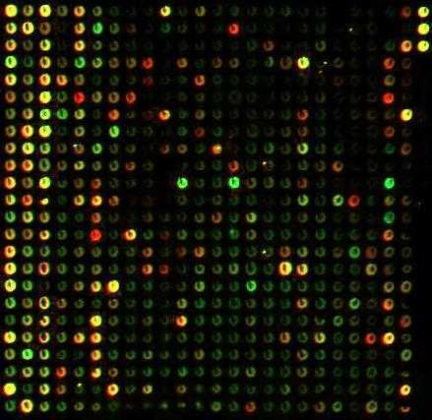
SigClust Gaussian null distribut’n
Estimation of Background Noise ${σ_{N}}^{2}$:
Model OK, since
data come from
light intensities
at colored spots

Slide 67
SigClust Gaussian null distribut’n
Estimation of Background Noise ${σ_{N}}^{2}$:
For all expression values (as numbers)
(Each Entry of $d×n$ Data matrix)

Slide 68
SigClust Gaussian null distribut’n
Estimation of Background Noise ${σ_{N}}^{2}$:
For all expression values (as numbers)
Use robust estimate of scale
Median Absolute Deviation (MAD)
(from the median)
$${median}_{i}\left|X_{i}−{median}_{i^{′}}\left(X_{i^{′}}\right)\right|$$

Slide 69
SigClust Gaussian null distribut’n
Estimation of Background Noise ${σ_{N}}^{2}$:
For all expression values (as numbers)
Use robust estimate of scale
Median Absolute Deviation (MAD)
(from the median)
Rescale to put on same scale as s. d.:
$$\hat{σ}=\frac{{MAD}_{data}}{{MAD}_{N\left(0,1\right)}}$$

Slide 70
SigClust Estimation of Background Noise
n = 533, d = 9456

Slide 71
SigClust Estimation of Background Noise
Hope: Most
Entries are
“Pure Noise,
(Gaussian)”

Slide 72
SigClust Estimation of Background Noise
Hope: Most
Entries are
“Pure Noise,
(Gaussian)”
A Few (<< ¼)
Are Biological
Signal –
Outliers

Slide 73
SigClust Estimation of Background Noise
Hope: Most
Entries are
“Pure Noise,
(Gaussian)”
A Few (<< ¼)
Are Biological
Signal –
Outliers
How to Check?

Slide 74
Q-Q plots
An aside:
Fitting probability distributions to data
Does Gaussian distribution “fit”???
If not, why not?
Fit in some part of the distribution?
(e.g. in the middle only?)

Slide 75
Q-Q plots
Approaches to:
Fitting probability distributions to data
Histograms
Kernel Density Estimates
Drawbacks: often not best view
(for determining goodness of fit)

Slide 76
Q-Q plots
Consider Testbed of 4 Toy Examples:
non-Gaussian!
non-Gaussian(?)
Gaussian
Gaussian?
(Will use these names several times)

Slide 77
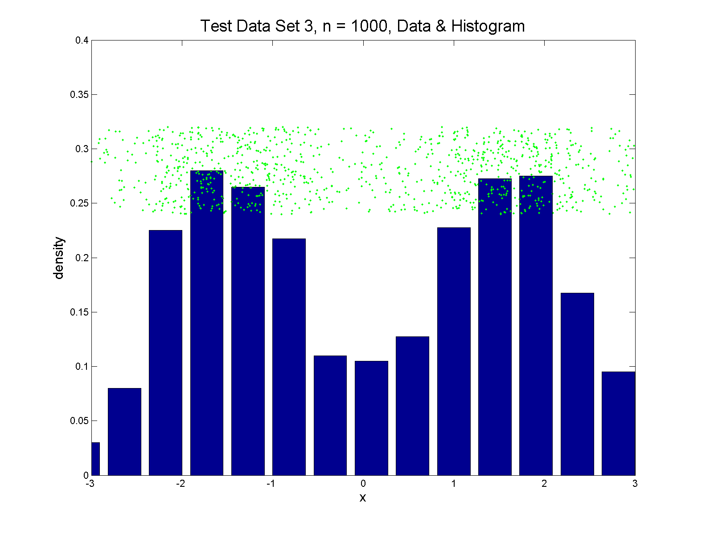
Q-Q plots
Simple Toy Example, non-Gaussian!

Slide 78
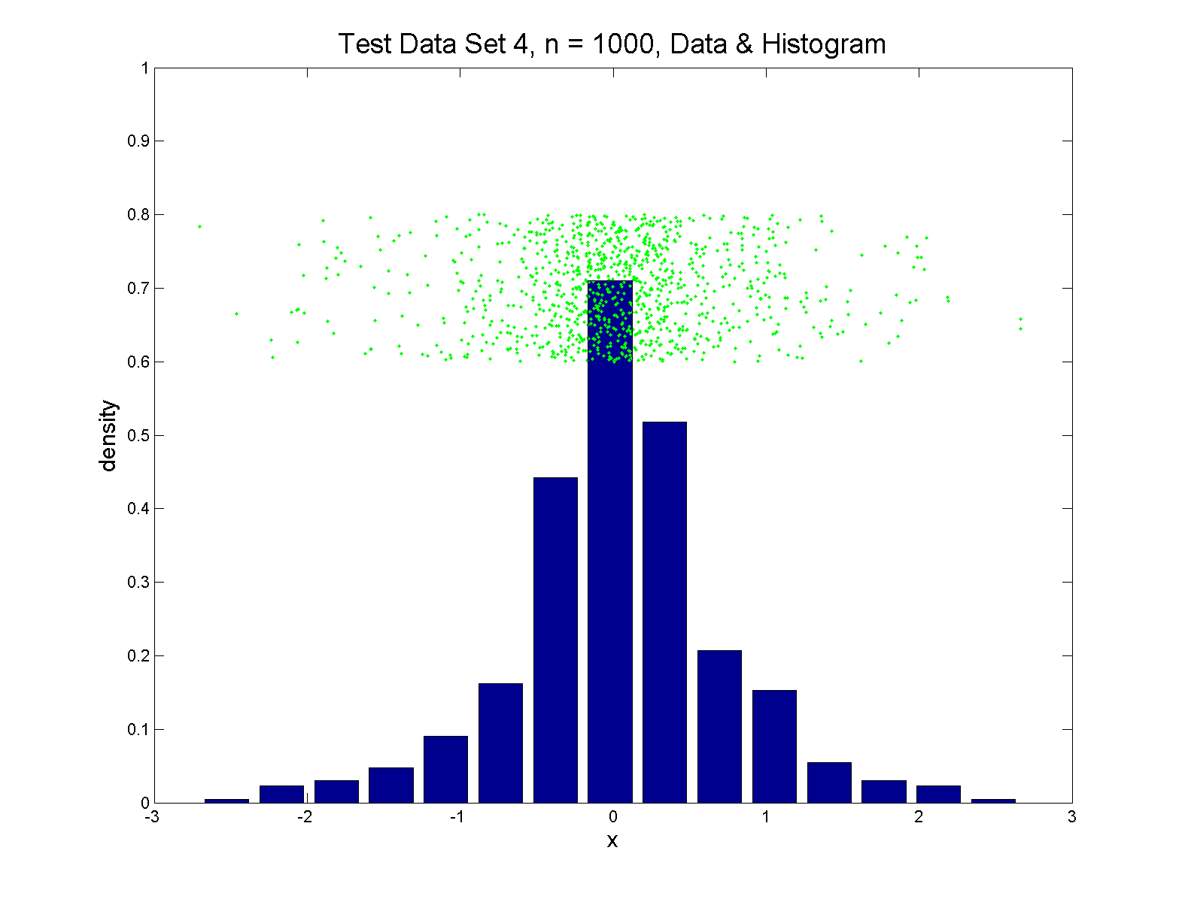
Q-Q plots
Simple Toy Example, non-Gaussian(?)

Slide 79
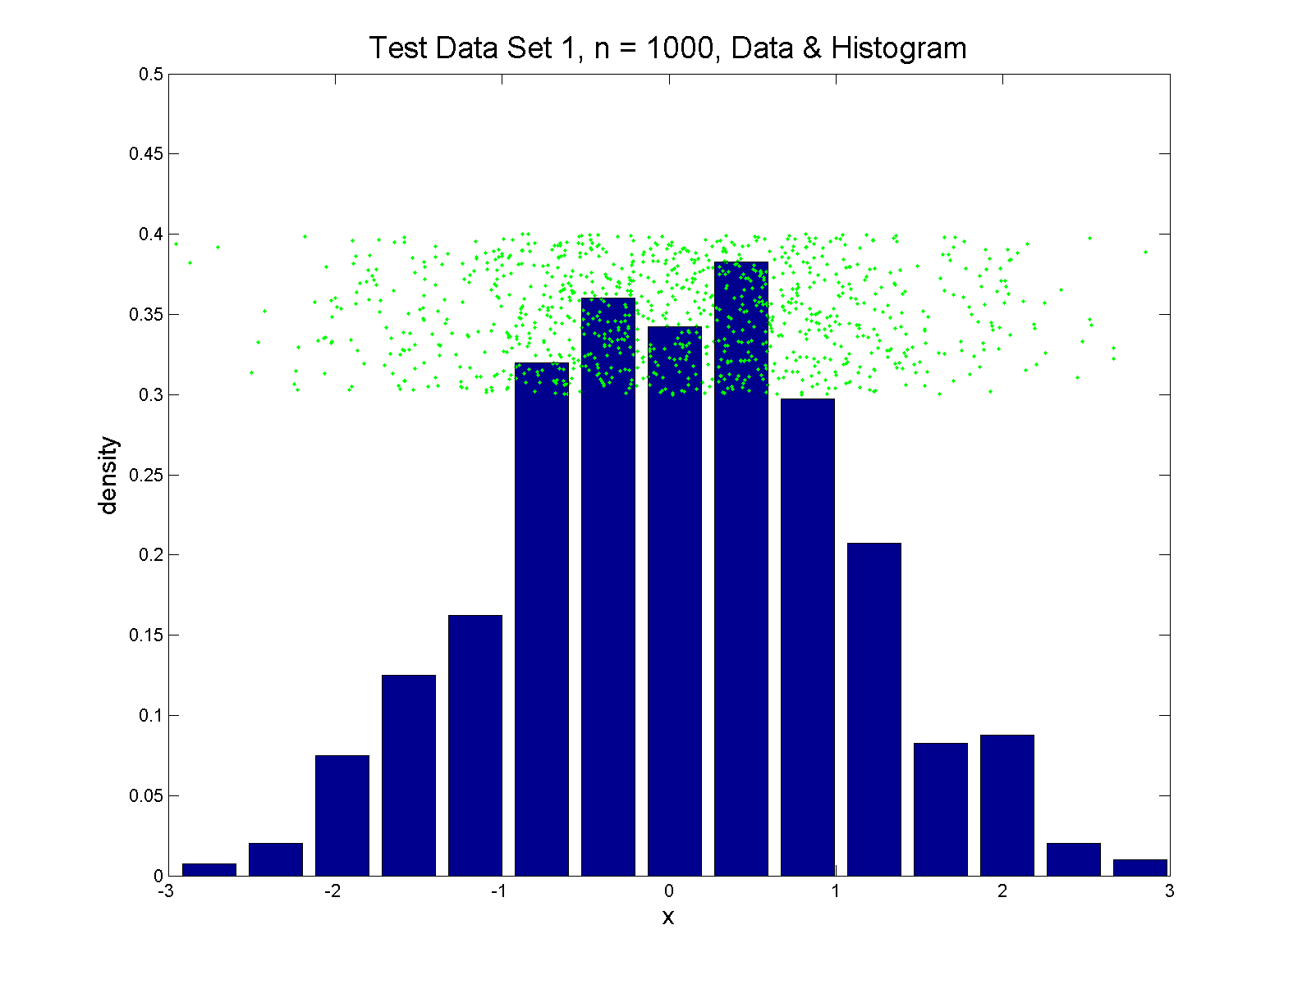
Q-Q plots
Simple Toy Example, Gaussian

Slide 80
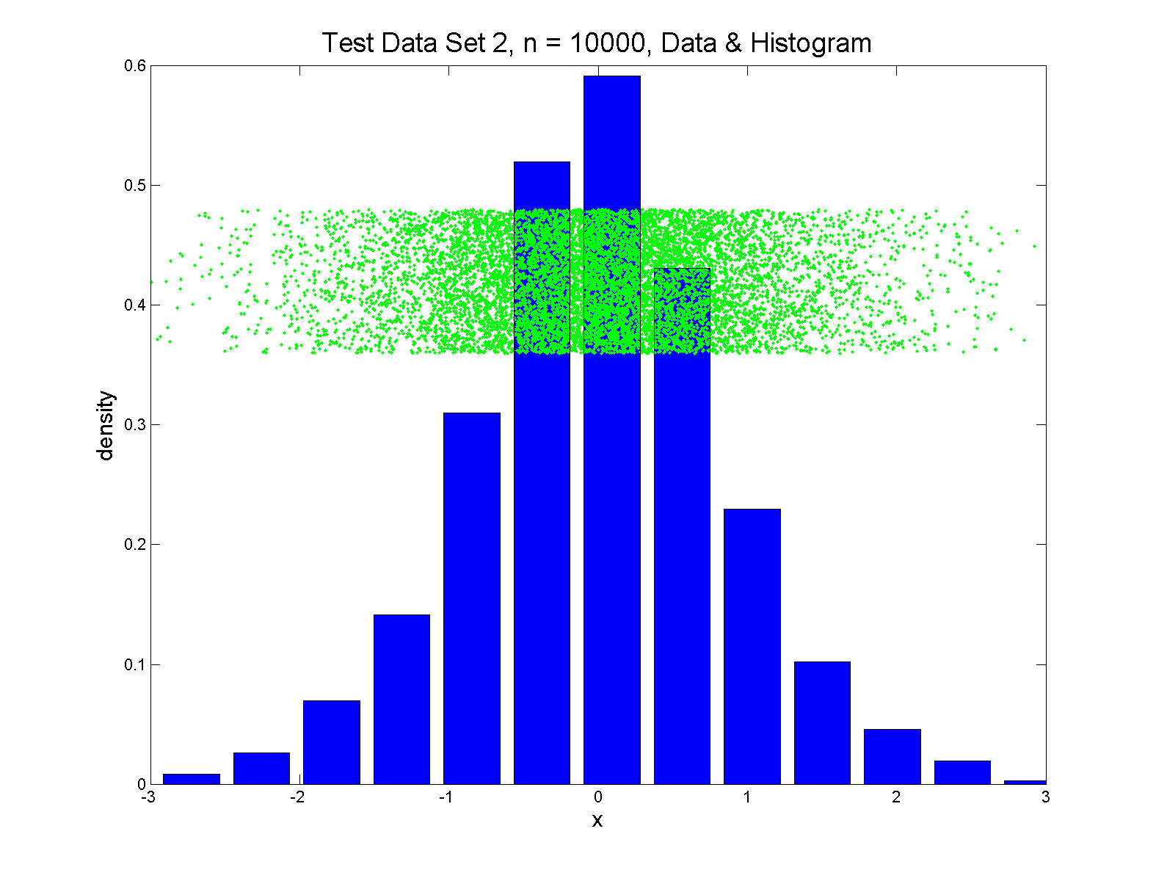
Q-Q plots
Simple Toy Example, Gaussian?

Slide 81
Q-Q plots
Notes:
Bimodal → see non-Gaussian with histo
Other cases: hard to see
Conclude:
Histogram poor at assessing Gauss’ity

Slide 82
Q-Q plots
Standard approach to checking Gaussianity
QQ – plots
Background:
Graphical Goodness of Fit
Fisher (1983)

Slide 83
Q-Q plots
Background: Graphical Goodness of Fit
Basis:
Cumulative Distribution Function (CDF)
$$F\left(x\right)=P\left\{X≤x\right\}$$
Probability quantile notation:
for "probability” $p$ and "quantile" $q$
$p=F\left(q\right)$ $q=F^{−1}\left(p\right)$

Slide 84
Q-Q plots
Probability quantile notation:
for "probability” $p$ and "quantile" $q$
$p=F\left(q\right)$ $q=F^{−1}\left(p\right)$
Thus $F^{−1}$ is called the quantile function

Slide 85
Q-Q plots
Two types of CDF:
Theoretical
$$p=F\left(q\right)=P\left\{X≤q\right\}$$
Empirical, based on data $X_{1},⋯,X_{n}$
$$\hat{p}=\hat{F}\left(q\right)=\frac{\#\left\{i:X_{i}≤q\right\}}{n}$$

Slide 86
Q-Q plots
Direct Visualizations:
Empirical CDF plot:
plot $\hat{p}=\frac{i}{n}, i=1,⋯,n$
vs. grid of $\hat{q}$ (sorted data) values
Quantile plot (inverse):
plot $\hat{q}$
vs. $\hat{p}$

Slide 87
Q-Q plots
Comparison Visualizations:
(compare a theoretical with an empirical)
P-P plot:
plot $\hat{p}$ vs. $p$
for a grid of $q$ values
Note: Have essentially already used this:
Called it the “ROC Curve”

Slide 88
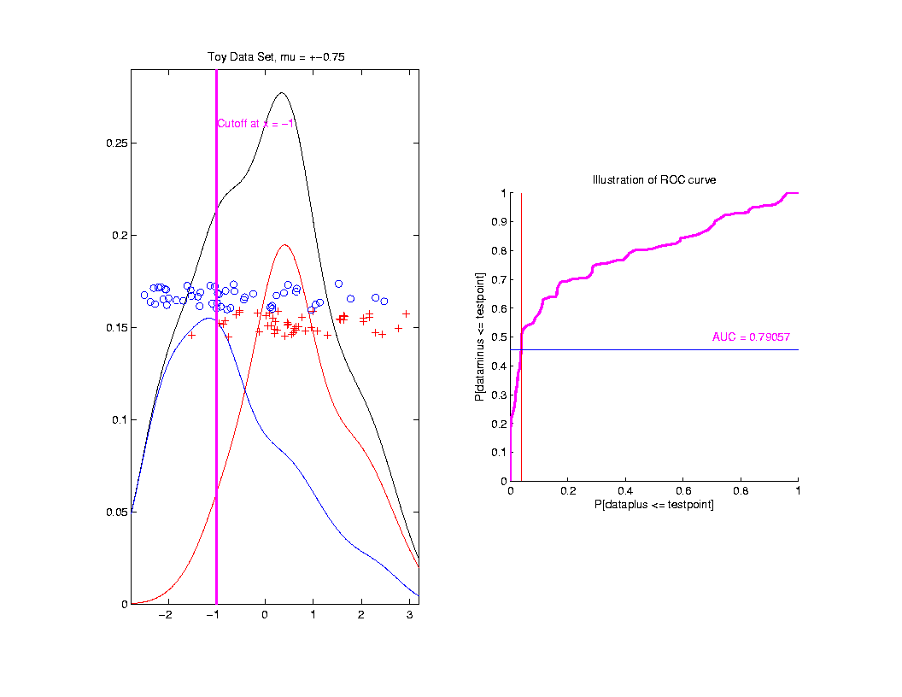
ROC Curve
Slide
Cutoff
To
Trace
Out
Curve

Slide 89
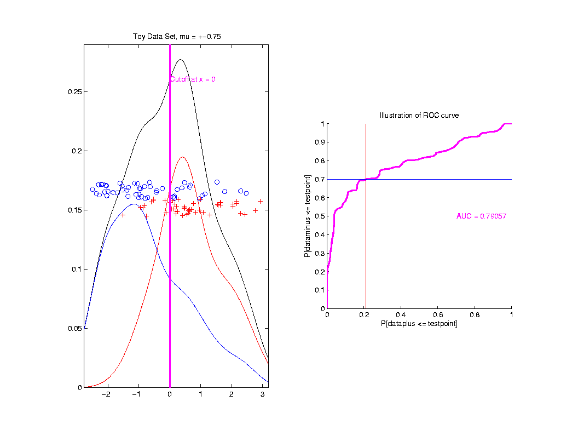
ROC Curve
Slide
Cutoff
To
Trace
Out
Curve

Slide 90
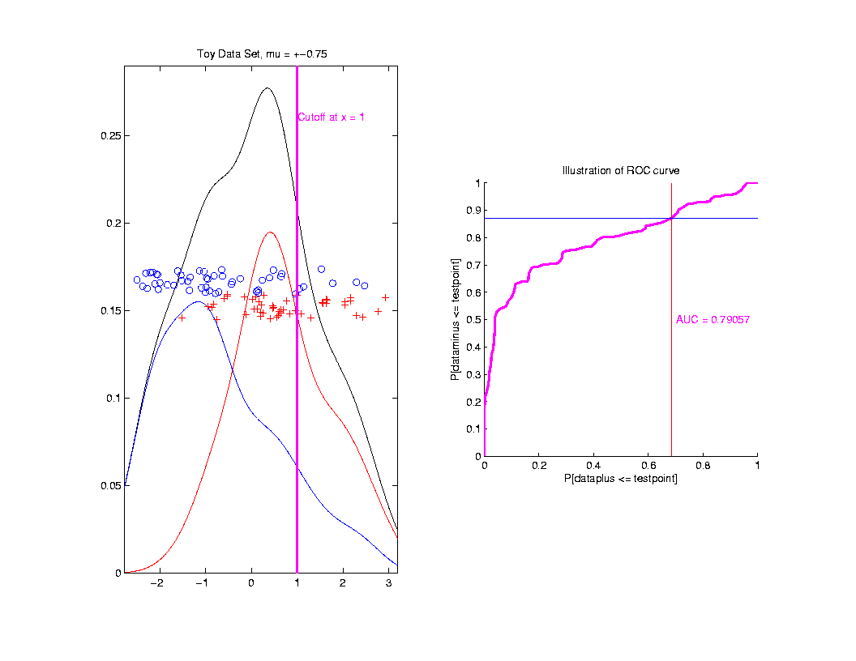
ROC Curve
Slide
Cutoff
To
Trace
Out
Curve
Plot $\hat{p}$ vs. $p$
For Grid of $q$ Values

Slide 91
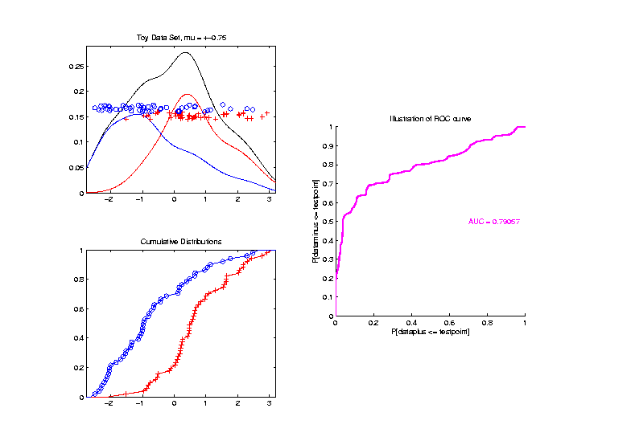
ROC Curve – CDF View
Next
Add
Cum.
Dist.
Funct.

Slide 92
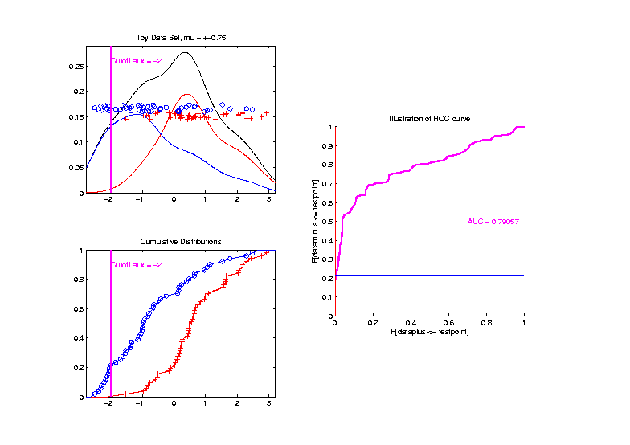
ROC Curve – CDF View
Slide
Cutoff
To
Trace
Out
Curve

Slide 93
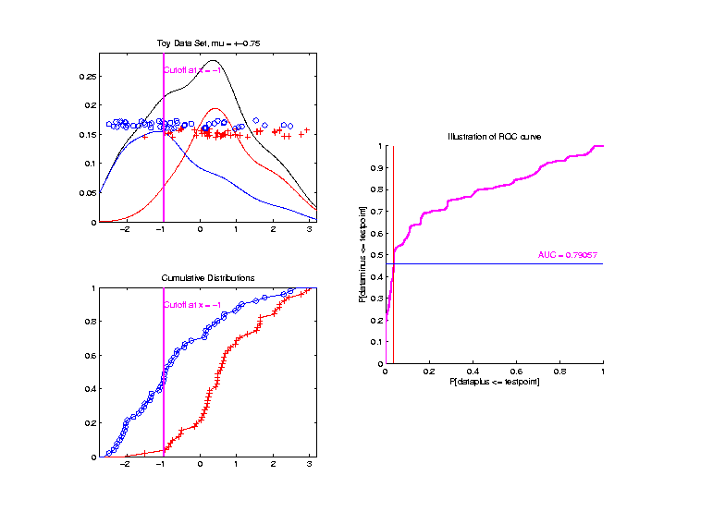
ROC Curve – CDF View
Slide
Cutoff
To
Trace
Out
Curve

Slide 94
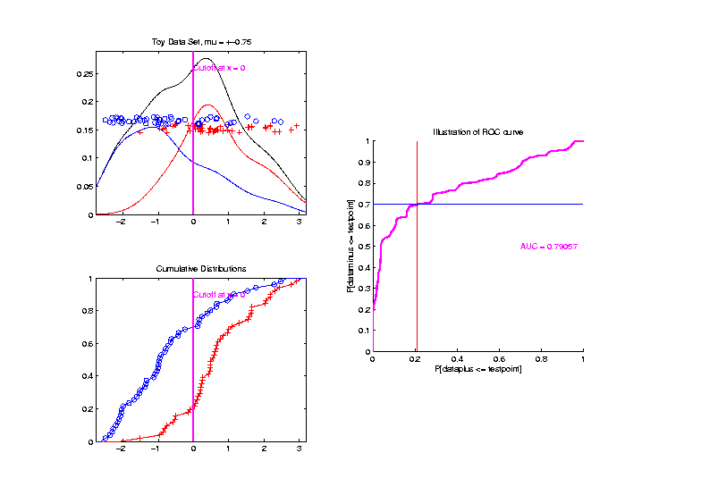
ROC Curve – CDF View
Slide
Cutoff
To
Trace
Out
Curve

Slide 95
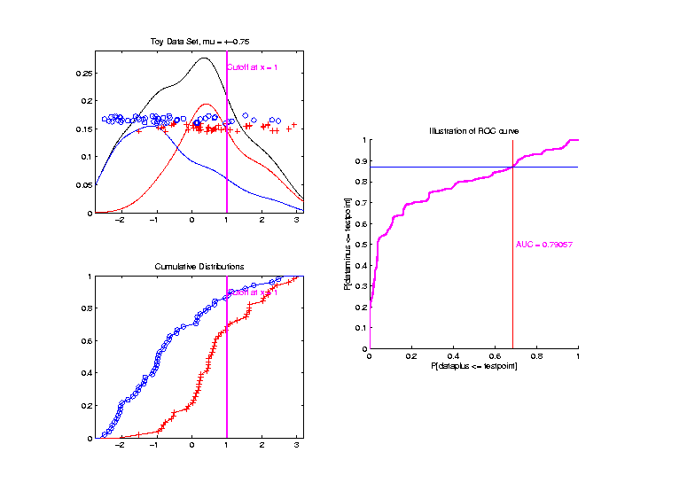
ROC Curve – CDF View
Slide
Cutoff
To
Trace
Out
Curve

Slide 96
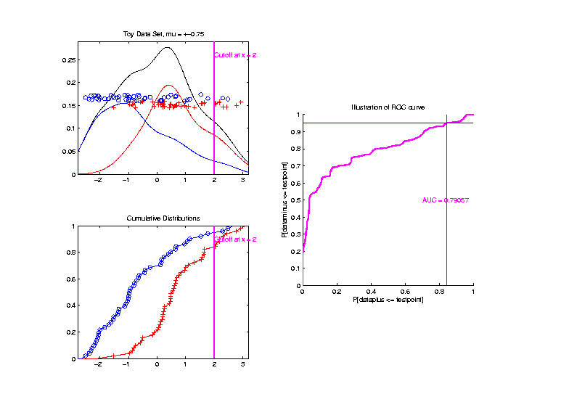
ROC Curve – CDF View
Slide
Cutoff
To
Trace
Out
Curve

Slide 97
Q-Q plots
Comparison Visualizations:
(compare a theoretical with an empirical)
P-P plot:
plot $\hat{p}$ vs. $p$
for a grid of $q$ values
Q-Q plot:
plot $\hat{q}$ vs. $q$
for a grid of $p$ values

Slide 98
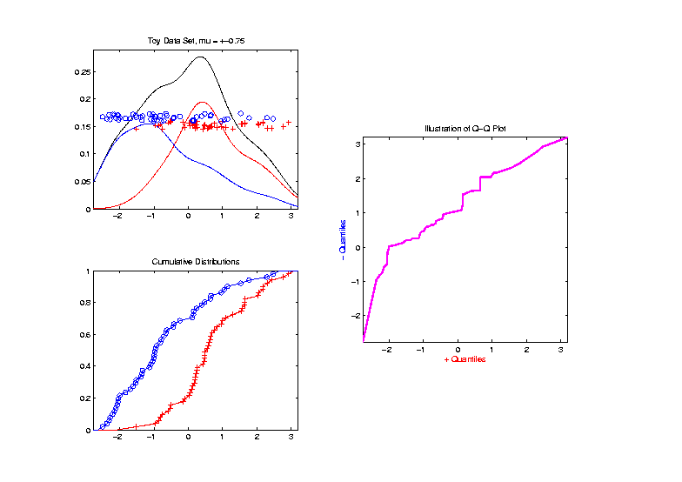
Q-Q plots
Replace
Grid
of $q$
Values
With
Grid
of $p$
Values

Slide 99
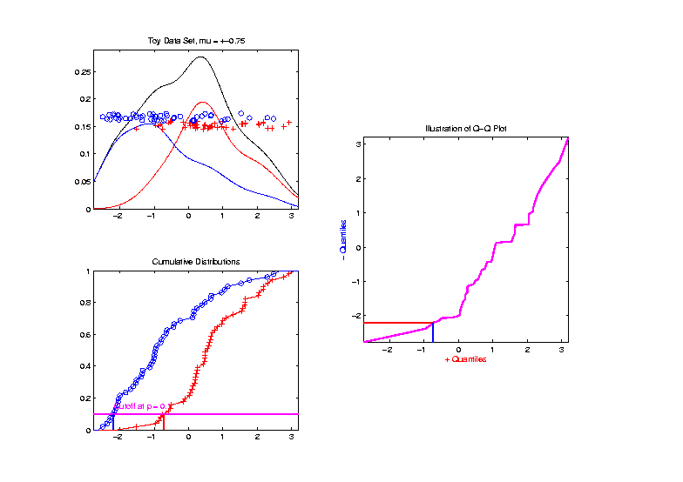
Q-Q plots
Slide
Cutoff
To
Trace
Out
Curve

Slide 100
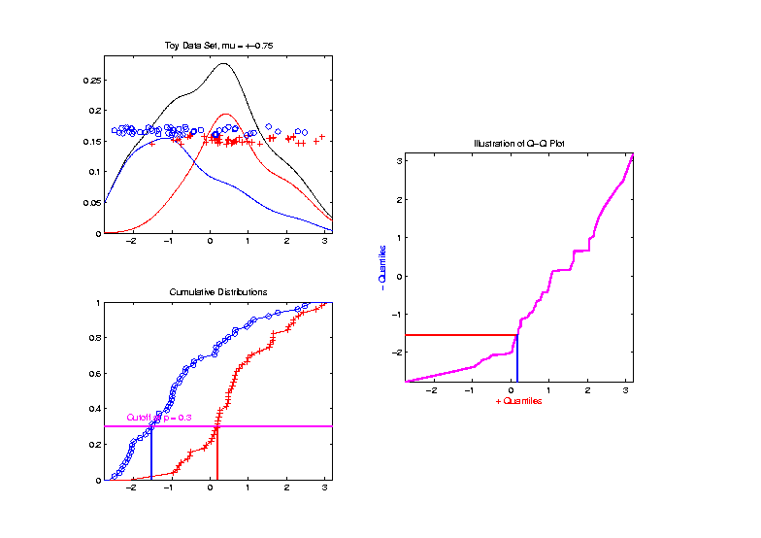
Q-Q plots
Slide
Cutoff
To
Trace
Out
Curve

Slide 101
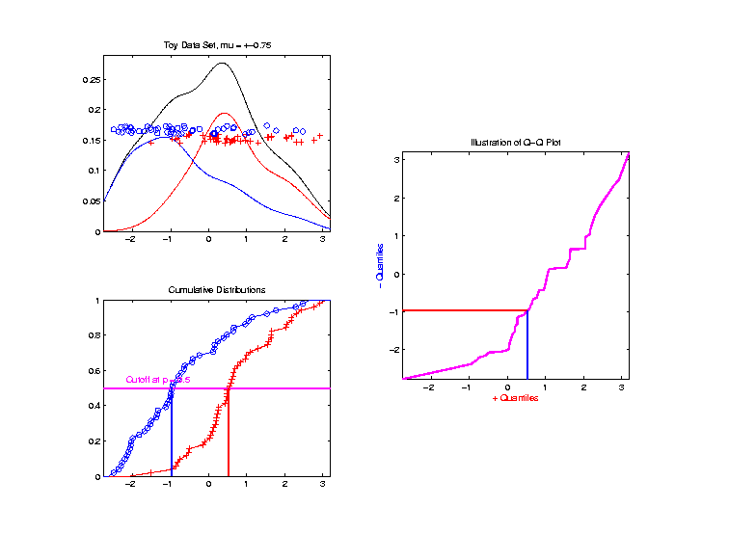
Q-Q plots
Slide
Cutoff
To
Trace
Out
Curve

Slide 102
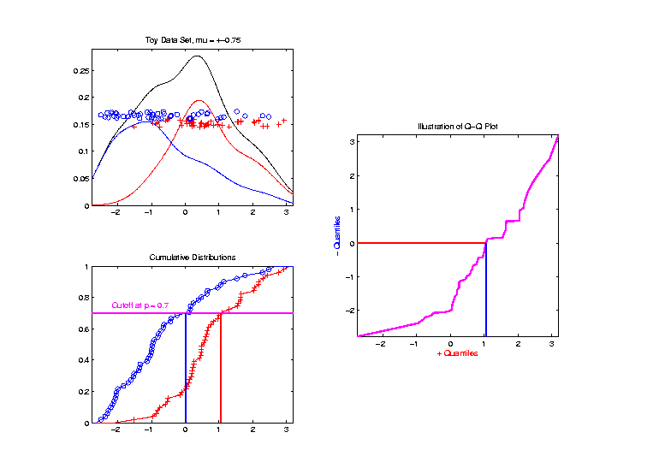
Q-Q plots
Slide
Cutoff
To
Trace
Out
Curve

Slide 103
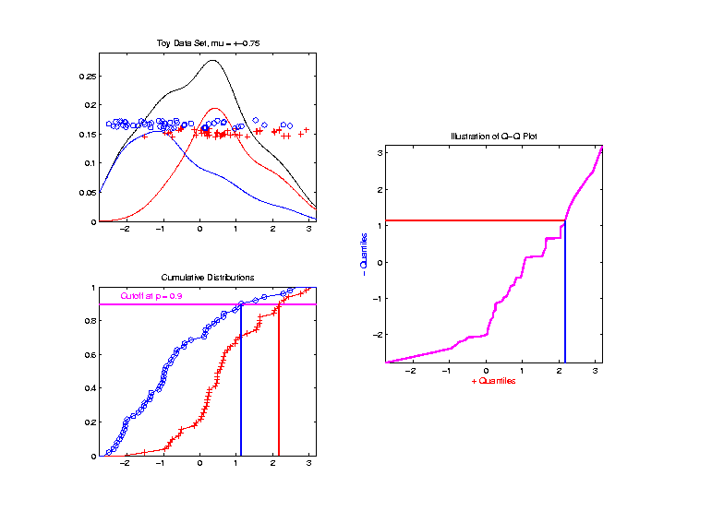
Q-Q plots
Slide
Cutoff
To
Trace
Out
Curve

Slide 104
Participant Presentations
Kevin Donovan
Random Forests
Matt Jansen
Text Mining

