Slide 1
Clusters in data
Common Statistical Task:
Find Clusters in Data
Interesting sub-populations?
Important structure in data?
How to do this?
PCA & visualization is very simple approach
There is a large literature of other methods
(will study more later)

Slide 2
PCA to find clusters
PCA of Mass Flux Data:

Slide 3
PCA to find clusters
Return to Investigation of PC1 Clusters:
Can see 3 bumps in smooth histogram
Main Question:
Important structure
or
sampling variability?
Approach: SiZer
(SIgnificance of ZERo crossings of deriv.)
OODA:
Confirmatory
Analysis

Slide 4
Statistical Smoothing
In 1 Dimension, 2 Major Settings:
Density Estimation
“Histograms”
Nonparametric Regression
“Scatterplot Smoothing”

Slide 5
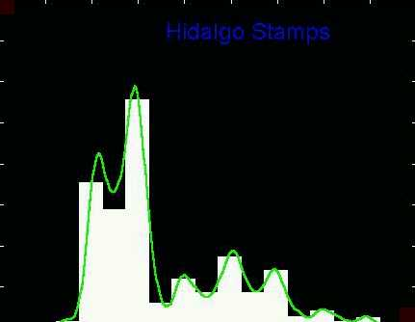
Density Estimation
Compare shifts with Average Histogram
For 7 mode shift
Peaks line up with bin centers
So shifted histo’s
find peaks

Slide 6
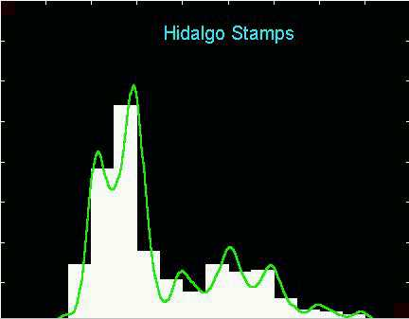
Density Estimation
Compare shifts with Average Histogram
For 2 (3?) mode shift
Peaks split between bins
So shifted histo’s
miss peaks
This Is Why Histograms
Were Not Used in Many
Displays of 1-d Dist’ns,
Earlier in Course

Slide 7
Density Estimation
Histogram Drawbacks:
Need to choose bin width
Need to choose bin location
But Average Histogram reveals structure
So should use that, instead of histo
Name: Kernel Density Estimate

Slide 8
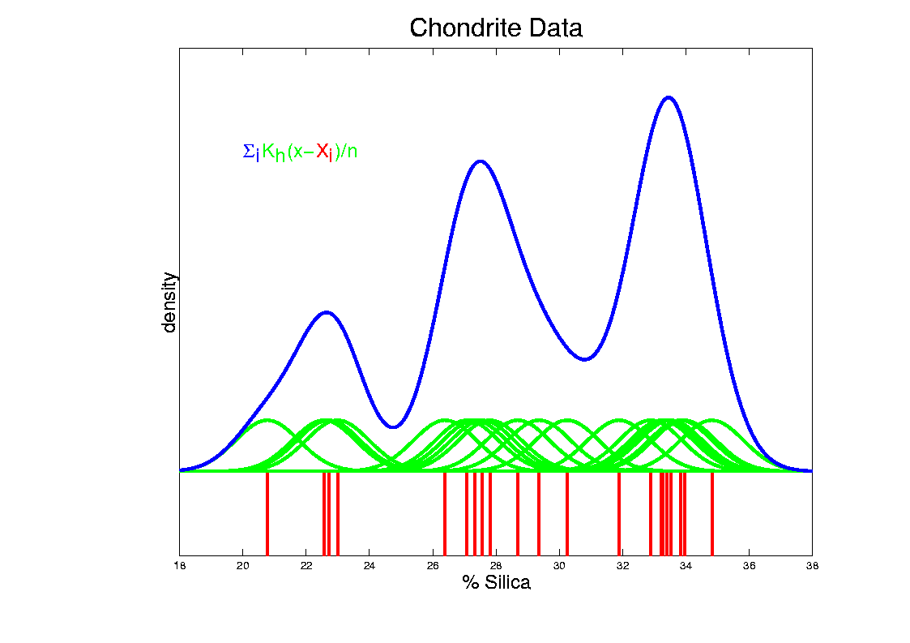
Kernel Density Estimation
Chondrite Data:
Sum pieces to estimate density
Suggests 3 modes (rock sources)

Slide 9
Statistical Smoothing
2 Major Settings:
Density Estimation
“Histograms”
Nonparametric Regression
“Scatterplot Smoothing”

Slide 10
Scatterplot Smoothing
E.g. Bralower Fossils – local linear smooths

Slide 11
Scatterplot Smoothing
Smooths of Bralower Fossil Data:
Oversmoothed misses structure
Undersmoothed feels sampling noise?
About right shows 2 valleys:
One seems clear
Is other one really there?
Same question as above…
Needs “Statistical Inference”,
i.e. Confirmatory Analysis

Slide 12
SiZer Background
Scale Space – Idea from Computer Vision
Goal: Teach Computers to “See”
Modern Research:
Extract “Information” from Images
Early Theoretical work

Slide 13
SiZer Background
Scale Space – Idea from Computer Vision
Conceptual basis:
Oversmoothing = “view from afar”
(macroscopic)
Undersmoothing = “zoomed in view”
(microscopic)
Main idea: all smooths contain useful information, so study “full spectrum”
(i. e. all smoothing levels)
Recommended reference: Lindeberg (1994)

Slide 14
SiZer Background
Fun Scale Space Views
(of Family Incomes Data)

Slide 15
SiZer Background
Fun Scale Space Views (Incomes Data)
Spectrum Overlay

Slide 16
SiZer Background
Fun Scale Space Views (Incomes Data)
Surface View

Slide 17
SiZer Background
Fun Scale Space Views
(of Family Incomes Data)
Note:
The scale space viewpoint makes
Data Dased Bandwidth Selection
Much less important
(than I once thought….)

Slide 18
SiZer Background
SiZer:
Significance of Zero crossings, of the derivative, in scale space
Combines:
needed statistical inference
novel visualization
To get: a powerful exploratory data analysis method
Main references:
Chaudhuri & Marron (1999)
Hannig & Marron (2006)

Slide 19
SiZer Background
Basic idea: a bump is characterized by:
an increase
followed by a decrease
Generalization:
Many features of interest captured
by sign of the slope of the smooth
Foundation of SiZer:
Statistical inference on slopes,
over scale space

Slide 20
SiZer Background
SiZer Visual presentation:
Color map over scale space:
Blue: slope significantly upwards
(derivative CI above 0)
Red: slope significantly downwards
(derivative CI below 0)
Purple: slope insignificant
(derivative CI contains 0)

Slide 21
SiZer Background
SiZer analysis of Fossils data:

Slide 22
SiZer Background
SiZer analysis of Fossils data:
Upper Left: Scatterplot, family of smooths, 1 highlighted
Upper Right: Scale space rep’n of family, with SiZer colors
Lower Left: SiZer map, more easy to view
Lower Right: SiCon map – replace slope by curvature
Slider (in movie viewer) highlights different smoothing levels

Slide 23
SiZer Background
SiZer analysis of Fossils data (cont.):
Oversmoothed (top of SiZer map):
Decreases at left, not on right
Medium smoothed (middle of SiZer map):
Main valley significant, and left most increase
Smaller valley not statistically significant
Undersmoothed (bottom of SiZer map):
“noise wiggles” not significant
Additional SiZer color: gray - not enough data for inference

Slide 24
SiZer Background
SiZer analysis of Fossils data (cont.):
Common Question: Which is right?
Decreases on left, then flat
(top of SiZer map)
Up, then down, then up again
(middle of SiZer map)
No significant features
(bottom of SiZer map)
Answer: All are right
Just different scales of view,
i.e. levels of resolution of data

Slide 25
SiZer Background
SiZer analysis of British Incomes data:

Slide 26
SiZer Background
SiZer analysis of British Incomes data:
Oversmoothed: Only one mode
Medium smoothed: Two modes, statistically significant
Confirmed by Schmitz & Marron, (1992)
Undersmoothed: many noise wiggles, not significant
Again: all are correct,
just different scales

Slide 27
SiZer Background
E.g. - Marron & Wand (1992) Trimodal #9
Increasing $n$
Only 1 Signif’t Mode
Now 2 Signif’t Modes
Finally all 3 Modes

Slide 28
SiZer Background
E.g. - Marron & Wand Discrete Comb #15
Increasing $n$
Coarse Bumps Only
Now Fine bumps too
Someday: “draw” local
Bandwidth on SiZer map

Slide 29
SiZer Background
Finance "tick data":
(time, price) of single stock transactions
Idea: "on line" version of SiZer
for viewing and understanding trends

Slide 30
SiZer Background
Finance "tick data":
(time, price) of single stock transactions
Idea: "on line" version of SiZer
for viewing and understanding trends
Notes:
trends depend heavily on scale
double points and more
background color transition
(flop over at top)

Slide 31
SiZer Background
Internet traffic data analysis:
SiZer analysis of
time series of
packet times
at internet hub (UNC)
Hannig, Marron,
and Riedi (2001)
Notes:
31

Slide 32
SiZer Background
Internet traffic data analysis:
SiZer analysis of
time series of packet times
at internet hub (UNC)
across very wide range of scales
needs more pixels than screen allows
thus do zooming view
(zoom in over time)
zoom in to yellow bd’ry in next frame
readjust vertical axis
Notes:
32

Slide 33
SiZer Background
Internet traffic data analysis (cont.)
Insights from SiZer analysis:
Coarse scales:
amazing amount of significant structure
Evidence of self-similar fractal type process?
Fewer significant features at small scales
But they exist, so not Poisson process
Poisson approximation OK at small scale???
Smooths (top part) stable at large scales?
Notes:
33

Slide 34
Dependent SiZer
Rondonotti, Marron, and Park (2007)
SiZer compares data with white noise
Inappropriate in time series
Dependent SiZer compares data with an assumed model
Visual Goodness of Fit test
Notes:
34

Slide 35
Dep’ent SiZer : 2002 Apr 13 Sat 1 pm – 3 pm
Internet Traffic At
UNC Main Link
2 hour span
Notes:
35

Slide 36
Dep’ent SiZer : 2002 Apr 13 Sat 1 pm – 3 pm
Big Spike in Traffic
Is “Really There”
Notes:
36

Slide 37
Dep’ent SiZer : 2002 Apr 13 Sat 1 pm – 3 pm
Zoom in for
Closer Look
Notes:
37

Slide 38
Zoomed view (to red region, i.e. “flat top”)
Strange “Hole in Middle”
Is “Really There”
Notes:
38

Slide 39
Zoomed view (to red region, i.e. “flat top”)
Zoom in for
Closer Look
Notes:
39

Slide 40
Further Zoom: finds very periodic behavior!
SiZer found interesting structure, but depends on scale
Notes:
40

Slide 41
Possible Physical Explanation
IP “Port Scan”
Common device of hackers
Searching for “break in points”
Send query to every possible (within UNC domain):
IP address
Port Number
Replies can indicate system weaknesses
Internet Traffic is hard to model
Notes:
41

Slide 42
SiZer Background
Historical Note & Acknowledgements:
Scale Space: S. M. Pizer
SiZer: Probal Chaudhuri
Main References:
Chaudhuri & Marron (1999)
Chaudhuri & Marron (2000)
Hannig & Marron (2006)

Slide 43
SiZer Background
Extension to 2-d:
Significance in Scale Space
Main Challenge: Visualization
References:
Godtliebsen et al (2002, 2004, 2006)

Slide 44
SiZer Overview
Would you like to try smoothing & SiZer?
Marron Software Website as Before
In “Smoothing” Directory:
kdeSM.m
nprSM.m
sizerSM.m
Recall: “>> help sizerSM” for usage

Slide 45
PCA to find clusters
Return to PCA of Mass Flux Data:
Notes:
MassFlux1d1p1.ps

Slide 46
PCA to find clusters
SiZer analysis of Mass Flux, PC1
Notes:
MassFlux1d1p1s.ps

Slide 47
PCA to find clusters
SiZer analysis of Mass Flux, PC1
All 3
Signif’t
Notes:
MassFlux1d1p1s.ps

Slide 48
PCA to find clusters
SiZer analysis of Mass Flux, PC1
Also in
Curvature
Notes:
MassFlux1d1p1s.ps

Slide 49
PCA to find clusters
SiZer analysis of Mass Flux, PC1
And in
Other
Comp’s
Notes:
MassFlux1d1p1s.ps

Slide 50
PCA to find clusters
SiZer analysis of Mass Flux, PC1
Conclusion:
Found 3 significant clusters!
Worth deeper investigation
Correspond to 3 known “cloud types”

Slide 51
Recall Yeast Cell Cycle Data
“Gene Expression” – Micro-array data
Data (after major preprocessing): Expression “level” of:
thousands of genes (d ~ 1,000s)
but only dozens of “cases” (n ~ 10s)
Interesting statistical issue:
High Dimension Low Sample Size data
(HDLSS)

Slide 52
Yeast Cell Cycle Data, FDA View
Central question:
Which genes are “periodic” over 2 cell cycles?
Notes:
CellCycRaw.ps

Slide 53
Yeast Cell Cycle Data, FDA View
Periodic
genes?
Naïve
approach:
Simple PCA
Notes:
spellman_alpah_complete_pca.ps

Slide 54
Yeast Cell Cycles, Freq. 2 Proj.
PCA on
Freq. 2
Periodic
Component
Of Data
Notes:
spellman_alpah_complete_proj_pca.ps

Slide 55
Frequency 2 Analysis
Project data onto 2-dim space of sin and cos (freq. 2)
Useful view: scatterplot
Angle (in polar coordinates) shows phase
Approach from Zhao, Marron & Wells (2004)

Slide 56
Frequency 2 Analysis
Notes:
CellCyc2dSpellClass.ps

Slide 57
Frequency 2 Analysis
Project data onto 2-dim space of sin and cos (freq. 2)
Useful view: scatterplot
Angle (in polar coordinates) shows phase
Colors: Spellman’s cell cycle phase classification
Black was labeled “not periodic”
Within class phases approx’ly same, but notable differences
Now try to improve “phase classification”

Slide 58
Yeast Cell Cycle
Revisit “phase classification”, approach:
Use outer 200 genes
(other numbers tried, less resolution)
Study distribution of angles
Use SiZer analysis
(finds significant bumps, etc., in histogram)
Carefully redrew boundaries
Check by studying k.d.e. angles

Slide 59
SiZer Study of Dist’n of Angles
Notes:
CellCycTh200SiZer.ps

Slide 60
Reclassification of Major Genes
Notes:
CellCycTh200ScatPlot.ps

Slide 61
Compare to Previous Classif’n
Notes:
CellCyc2dSpellClass.ps

Slide 62
New Subpopulation View
Notes:
CellCycTh200KDE.ps

Slide 63
New Subpopulation View
Note:
Subdensities
Have Same
Bandwidth &
Proportional
Areas
(so Σ = 1)
Notes:
CellCycTh200KDE.ps

Slide 64
Clustering
Idea: Given data ${\underline{X}}_{1},⋯,{\underline{X}}_{n}$
Assign each object to a class
Of similar objects
Completely data driven
I.e. assign labels to data
“Unsupervised Learning”
Contrast to Classification (Discrimination)
With predetermined given classes
“Supervised Learning”

Slide 65
Clustering
Important References:
MacQueen (1967)
Hartigan (1975)
Gersho and Gray (1992)
Kaufman and Rousseeuw (2005)
See Also: Wikipedia

Slide 66
K-means Clustering
Main Idea: for data ${\underline{X}}_{1},⋯,{\underline{X}}_{n}$
Partition indices $i=1,⋯,n$
among classes $C_{1},⋯$, $C_{K}$
Given index sets $C_{1},⋯$, $C_{K}$
that partition $\left\{1,⋯,n\right\}$
represent clusters by “class means”
i.e, ${\overline{\underline{X}}}_{j}=\frac{1}{\#\left(C_{j}\right)}\sum_{i∈C_{j}}{{\underline{X}}_{i}}$ (within class means)

Slide 67
K-means Clustering
Given index sets $C_{1},⋯$, $C_{K}$
Measure how well clustered, using
Within Class Sum of Squares
$$\sum_{j=1}^{K}{\sum_{i∈C_{j}}{{\left\|{\underline{X}}_{i}−{\overline{\underline{X}}}_{j}\right\|}^{2}}}$$

Slide 68
K-means Clustering
Common Variation:
Put on scale of proportions (i.e. in [0,1])
By dividing “within class SS”
by “overall SS”
Gives Cluster Index:
$$CI\left(C_{1},⋯,C_{K}\right)=\frac{\sum_{j=1}^{K}{\sum_{i∈C_{j}}{{\left\|{\underline{X}}_{i}−{\overline{\underline{X}}}_{j}\right\|}^{2}}}}{\sum_{i=1}^{n}{{\left\|{\underline{X}}_{i}−\overline{\underline{X}}\right\|}^{2}}}$$

Slide 69
K-means Clustering
Notes on Cluster Index:
$$CI\left(C_{1},⋯,C_{K}\right)=\frac{\sum_{j=1}^{K}{\sum_{i∈C_{j}}{{\left\|{\underline{X}}_{i}−{\overline{\underline{X}}}_{j}\right\|}^{2}}}}{\sum_{i=1}^{n}{{\left\|{\underline{X}}_{i}−\overline{\underline{X}}\right\|}^{2}}}$$
$CI=0$ when all data at cluster means
$CI$ small when $C_{1},⋯$,$C_{K}$ gives tight clusters
(within SS contains little variation)
$CI$ big when $C_{1},⋯$, $C_{K}$ gives poor clustering
(within SS contains most of variation)
$CI=1$ when all cluster means are same

Slide 70
K-means Clustering
Clustering Goal:
Given data ${\underline{X}}_{1},⋯,{\underline{X}}_{n}$
Choose classes $C_{1},⋯,C_{K}$
To miminize
$$CI\left(C_{1},⋯,C_{K}\right)=\frac{\sum_{j=1}^{K}{\sum_{i∈C_{j}}{{\left\|{\underline{X}}_{i}−{\overline{\underline{X}}}_{j}\right\|}^{2}}}}{\sum_{i=1}^{n}{{\left\|{\underline{X}}_{i}−\overline{\underline{X}}\right\|}^{2}}}$$

Slide 71
2-means Clustering
Study CI, using simple 1-d examples
Varying Standard Deviation

Slide 72
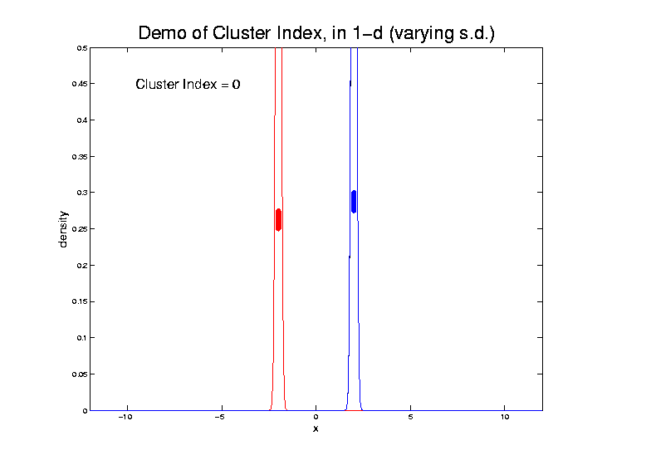
2-means Clustering

Slide 73
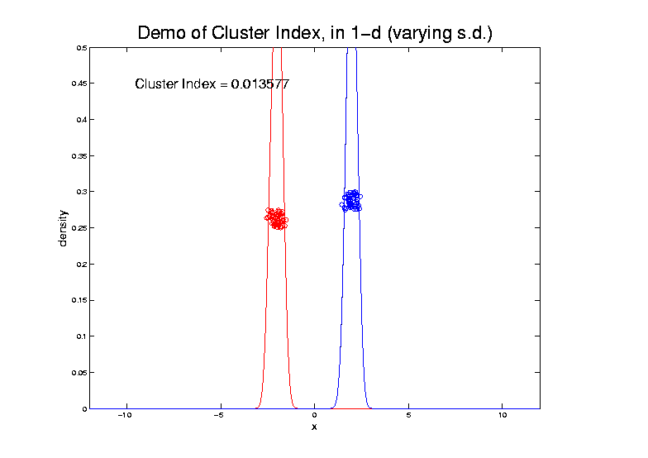
2-means Clustering

Slide 74
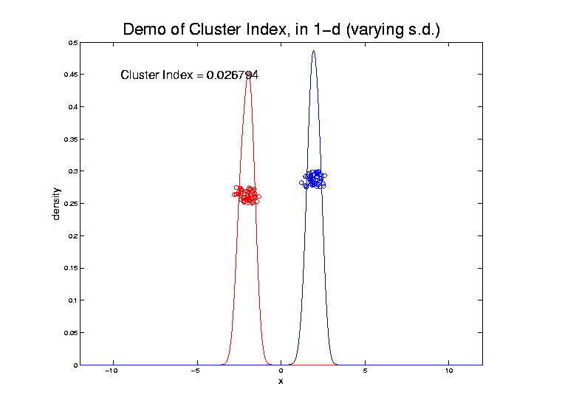
2-means Clustering

Slide 75
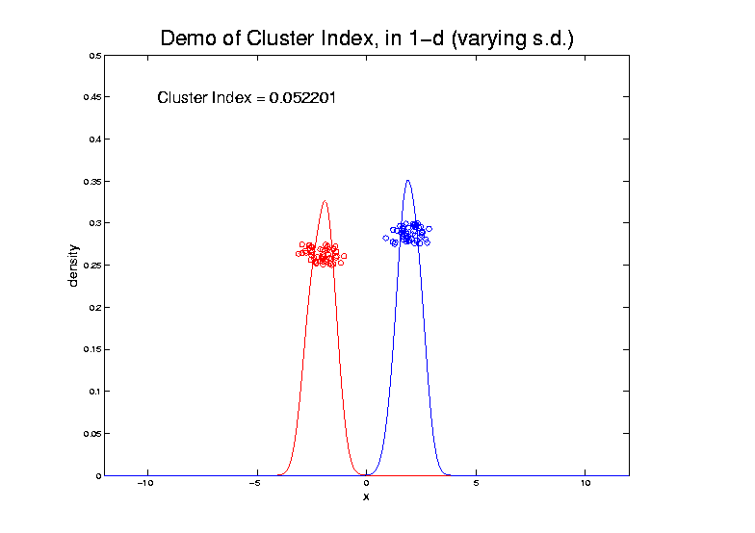
2-means Clustering

Slide 76
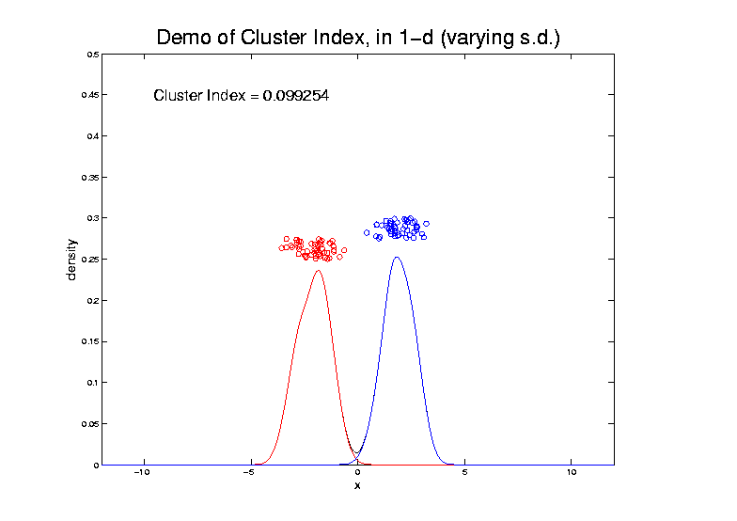
2-means Clustering

Slide 77
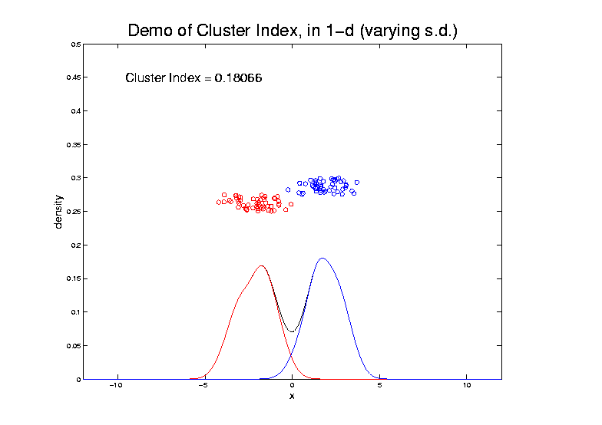
2-means Clustering

Slide 78
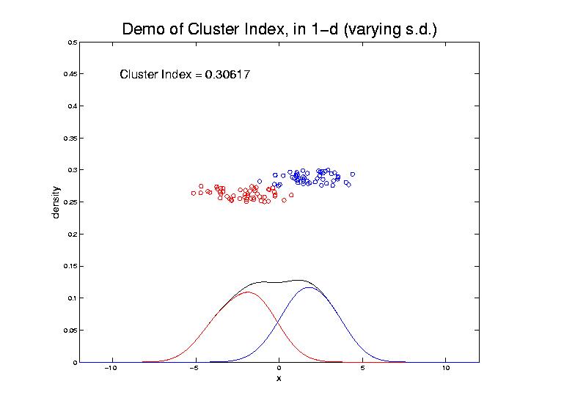
2-means Clustering

Slide 79
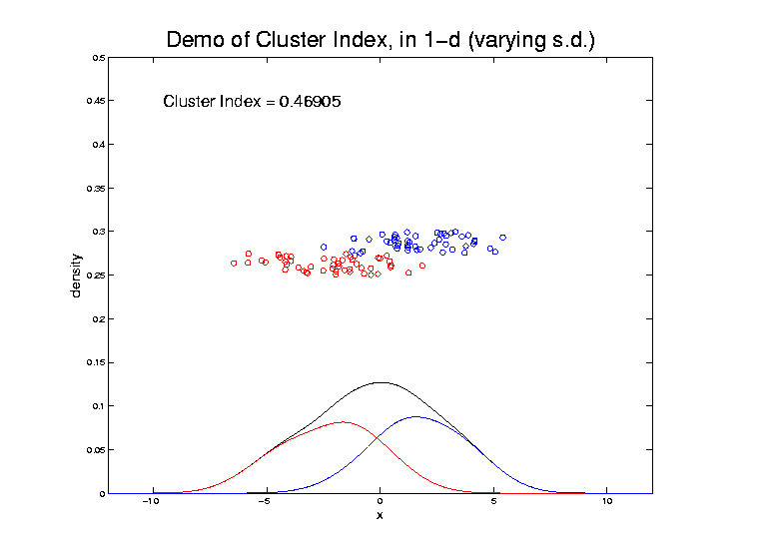
2-means Clustering

Slide 80
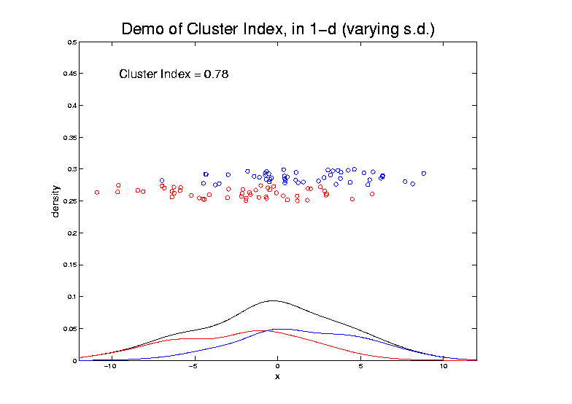
2-means Clustering

Slide 81
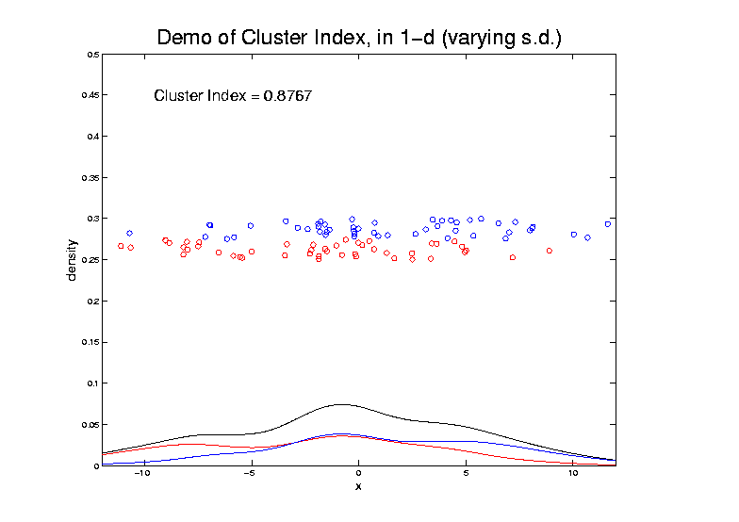
2-means Clustering

Slide 82
2-means Clustering
Study CI, using simple 1-d examples
Varying Standard Deviation
Varying Mean

Slide 83
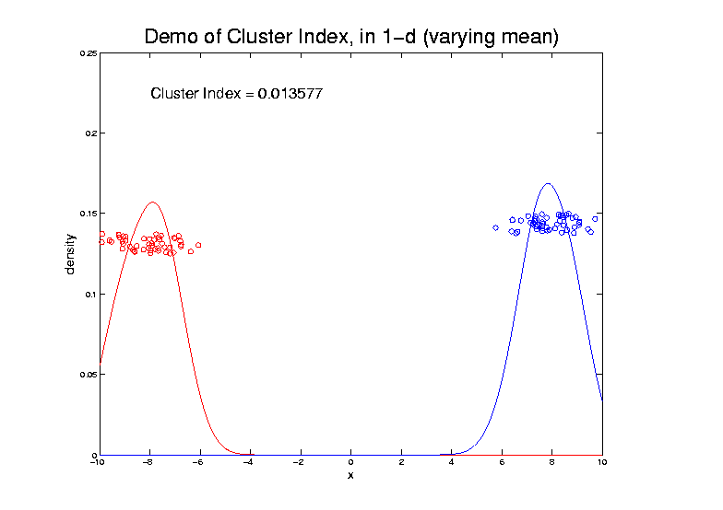
2-means Clustering

Slide 84
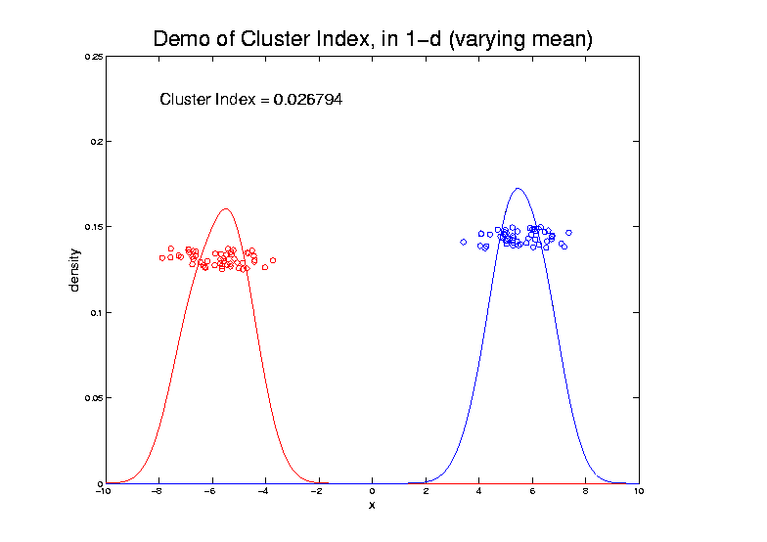
2-means Clustering

Slide 85
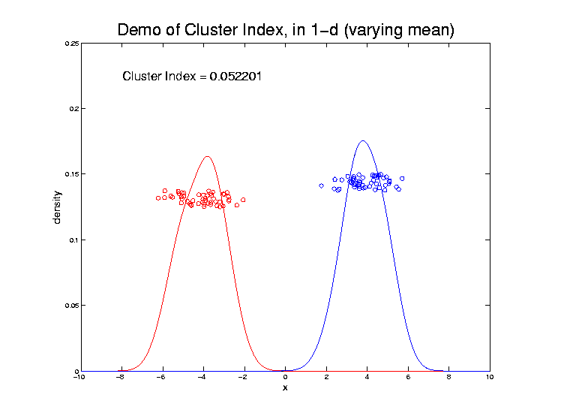
2-means Clustering

Slide 86
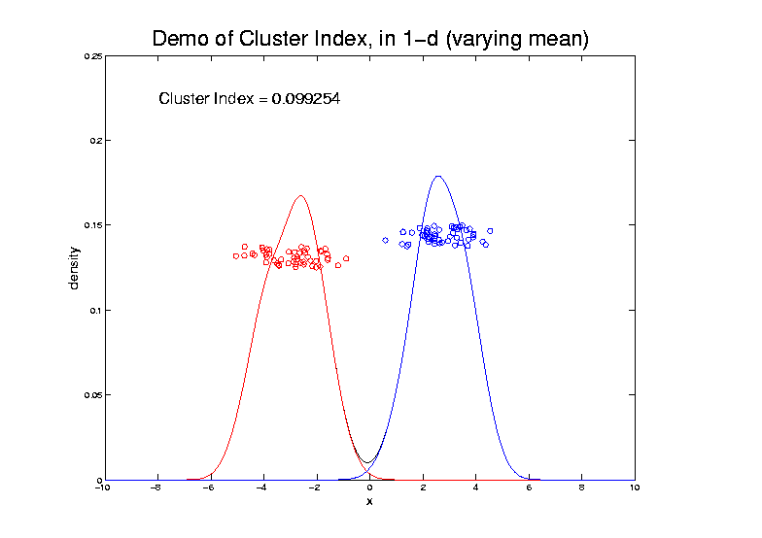
2-means Clustering

Slide 87
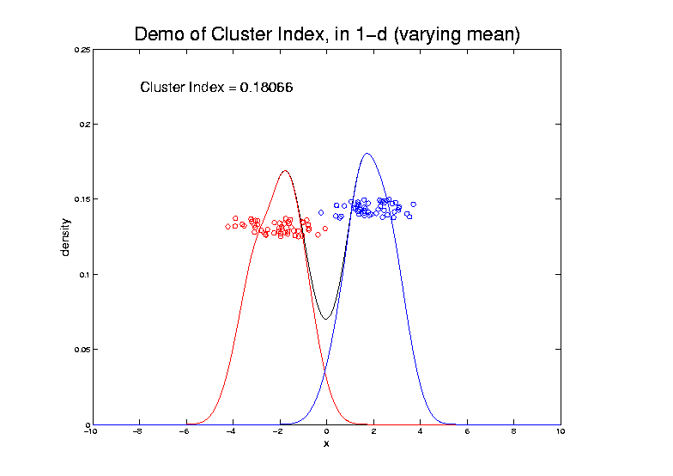
2-means Clustering

Slide 88
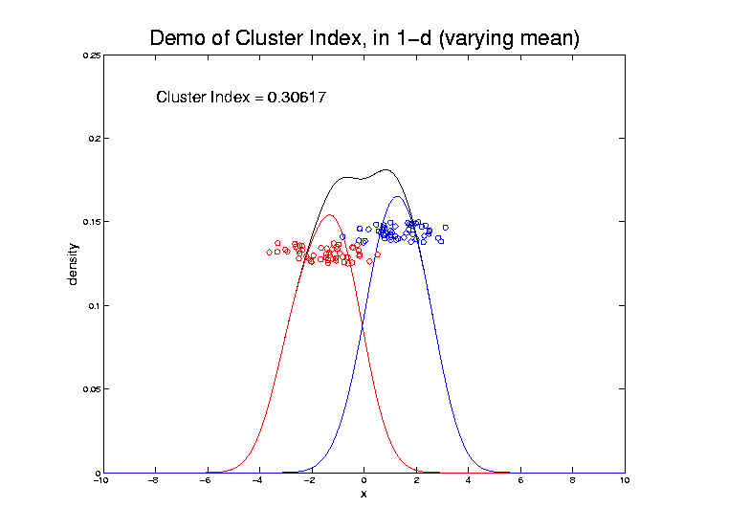
2-means Clustering

Slide 89
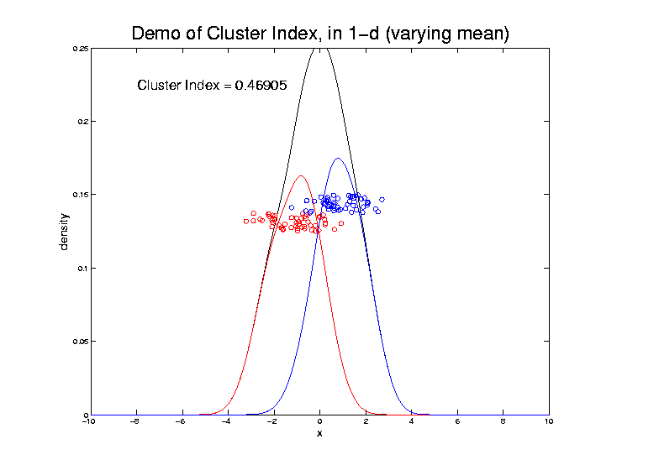
2-means Clustering

Slide 90
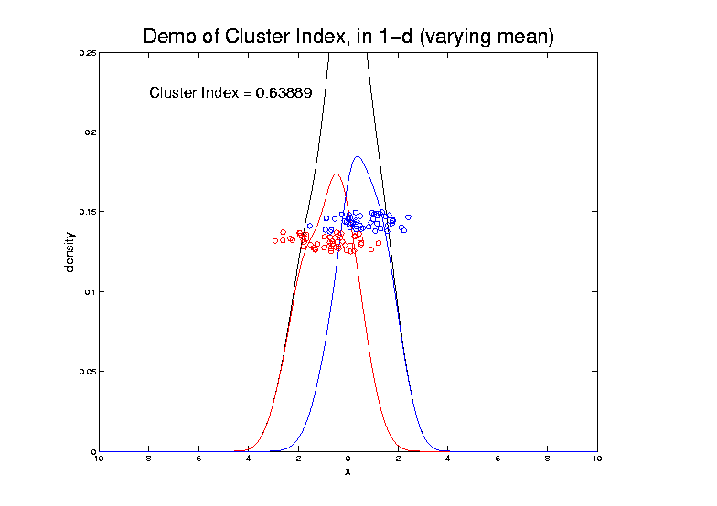
2-means Clustering

Slide 91
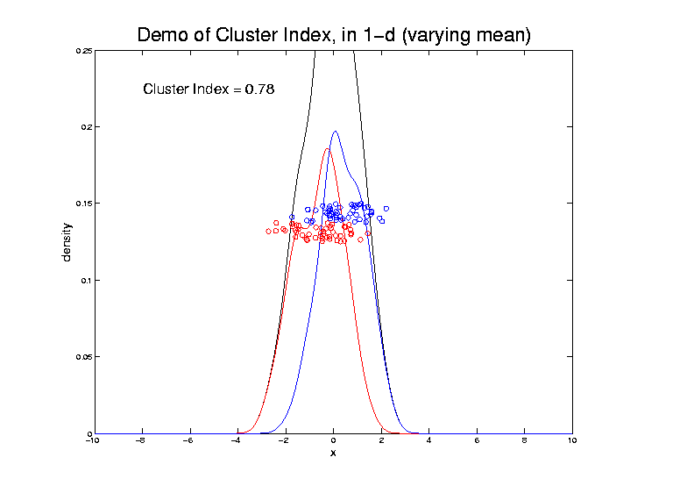
2-means Clustering

Slide 92
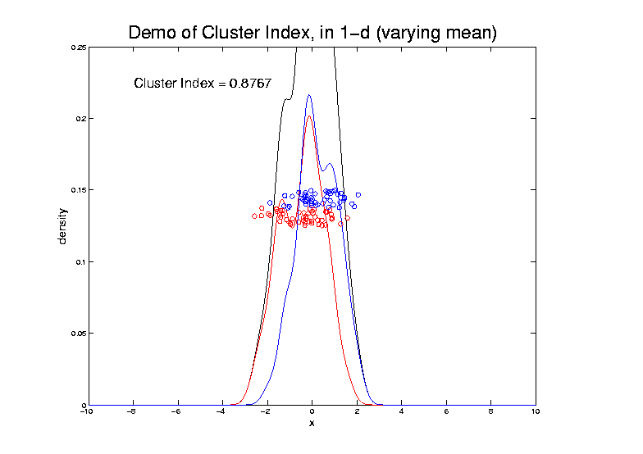
2-means Clustering

Slide 93
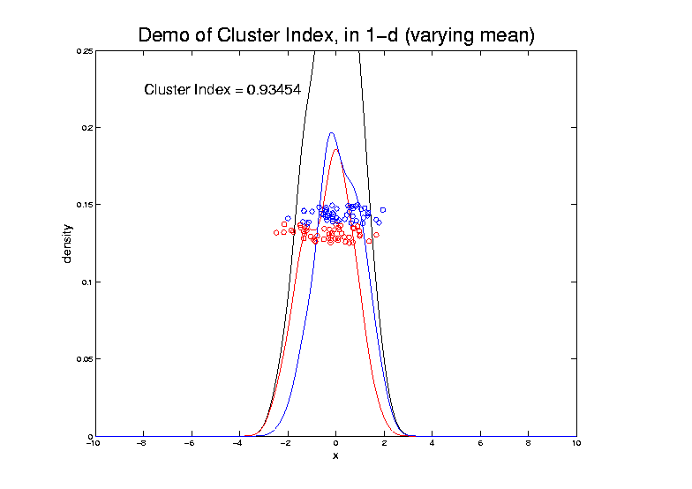
2-means Clustering

Slide 94
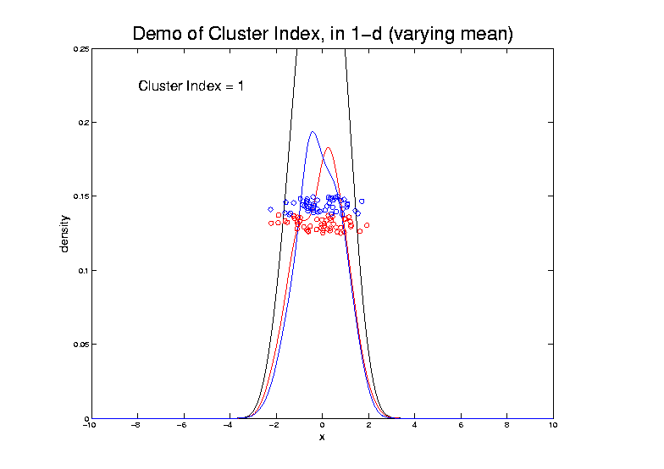
2-means Clustering

Slide 95
2-means Clustering
Study CI, using simple 1-d examples
Varying Standard Deviation
Varying Mean
Varying Proportion

Slide 96
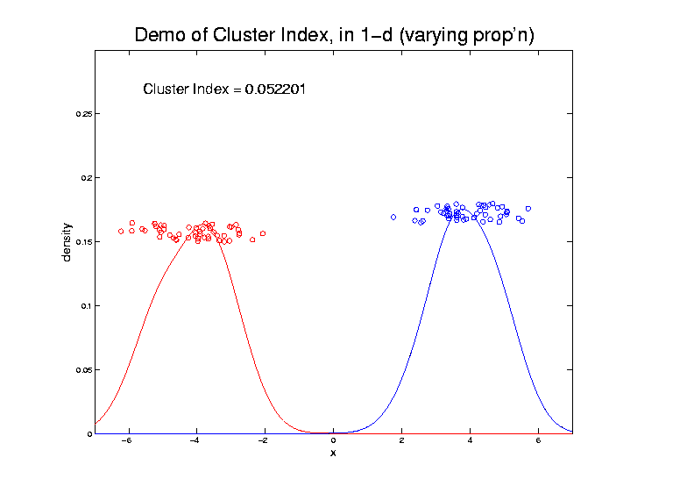
2-means Clustering

Slide 97
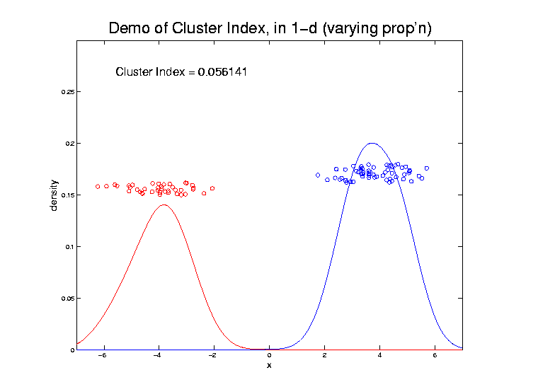
2-means Clustering

Slide 98
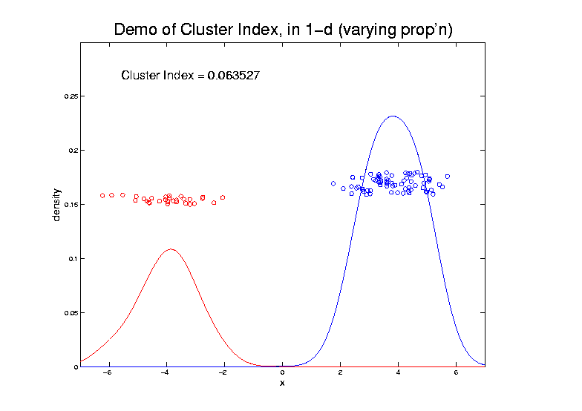
2-means Clustering

Slide 99
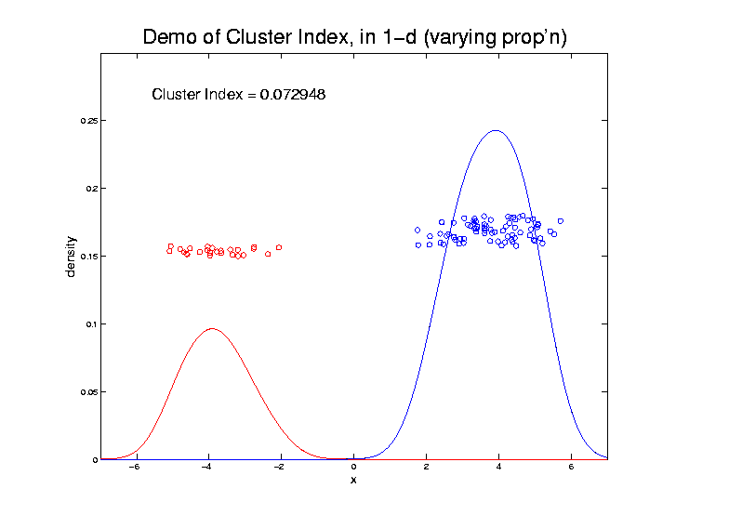
2-means Clustering

Slide 100
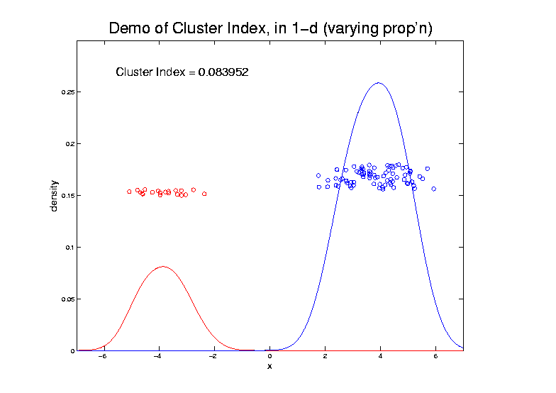
2-means Clustering

Slide 101
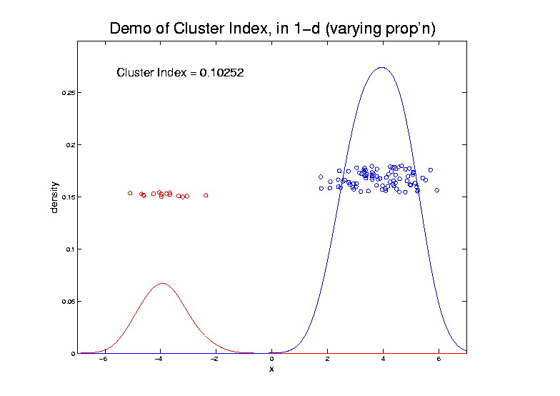
2-means Clustering

Slide 102
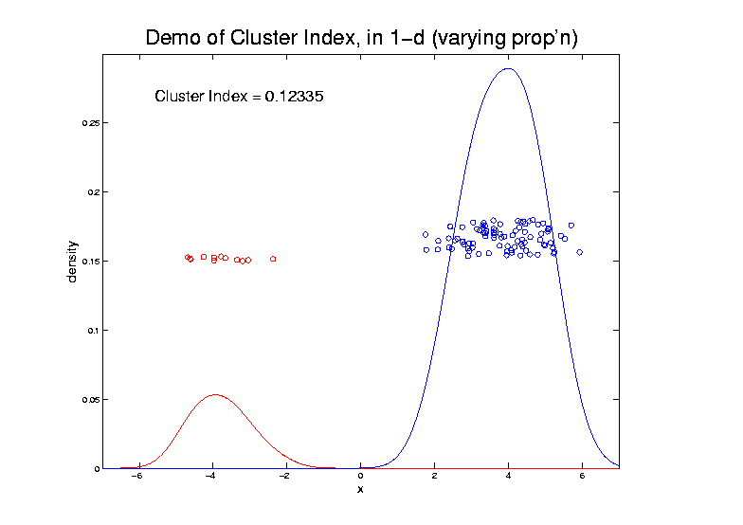
2-means Clustering

Slide 103
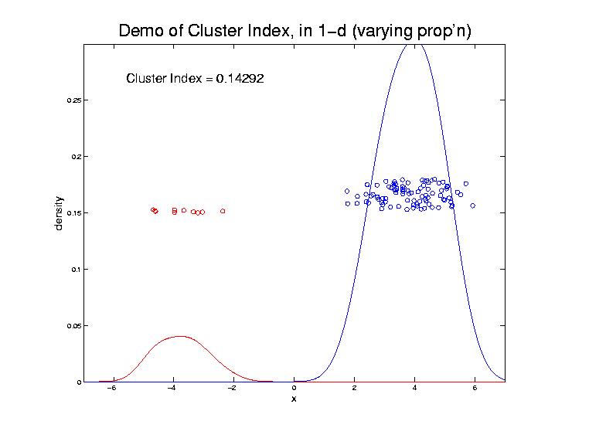
2-means Clustering

Slide 104
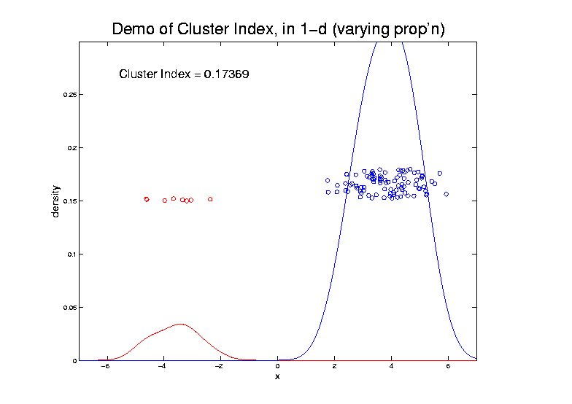
2-means Clustering

Slide 105
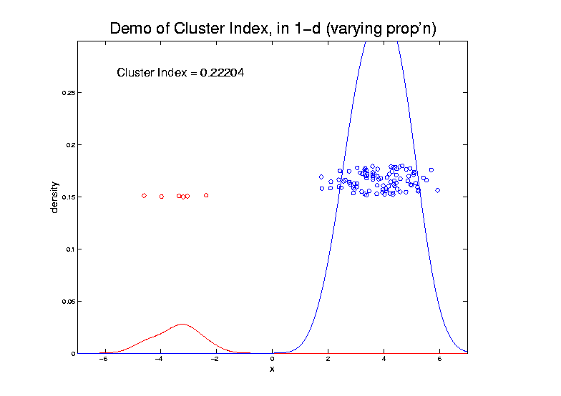
2-means Clustering

Slide 106
2-means Clustering

Slide 107
2-means Clustering

Slide 108
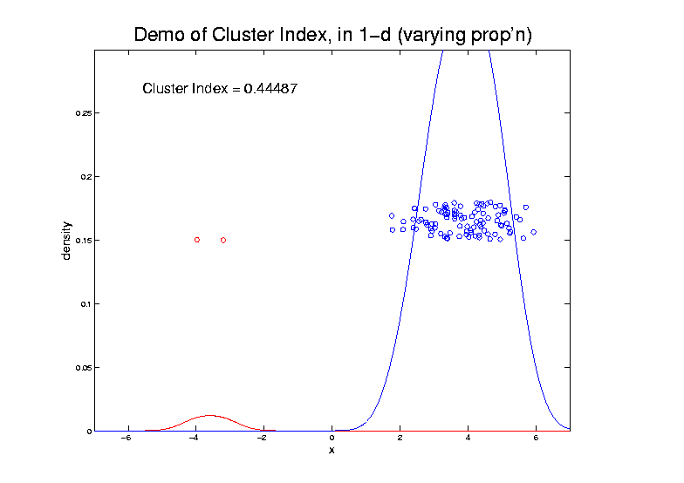
2-means Clustering

Slide 109
2-means Clustering

Slide 110
2-means Clustering
Study CI, using simple 1-d examples
Over changing Classes (moving b’dry)

Slide 111
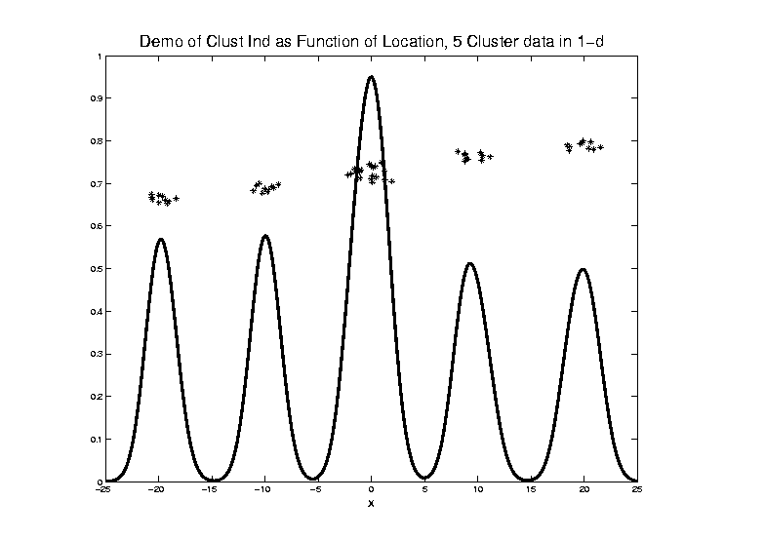
2-means Clustering

Slide 112
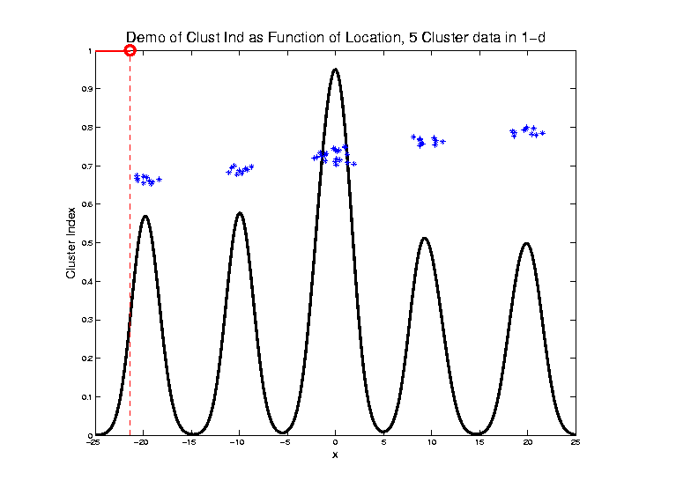
2-means Clustering

Slide 113
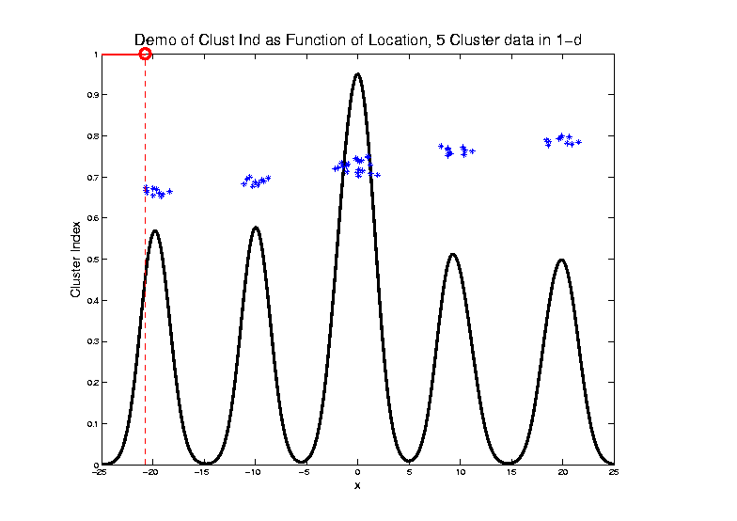
2-means Clustering

Slide 114
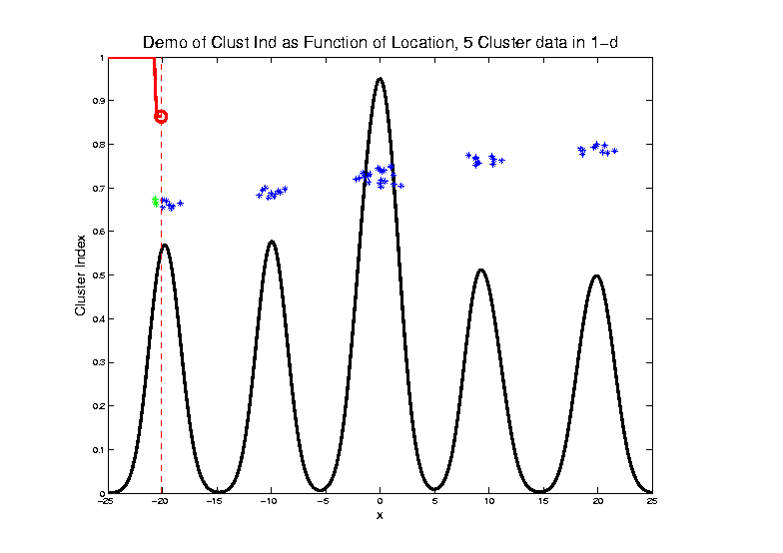
2-means Clustering
C. Index for
Clustering
Greens
& Blues

Slide 115
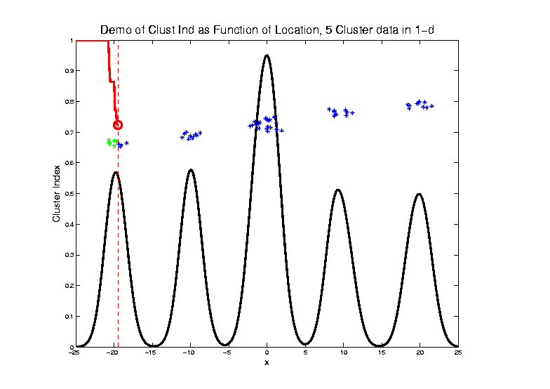
2-means Clustering

Slide 116
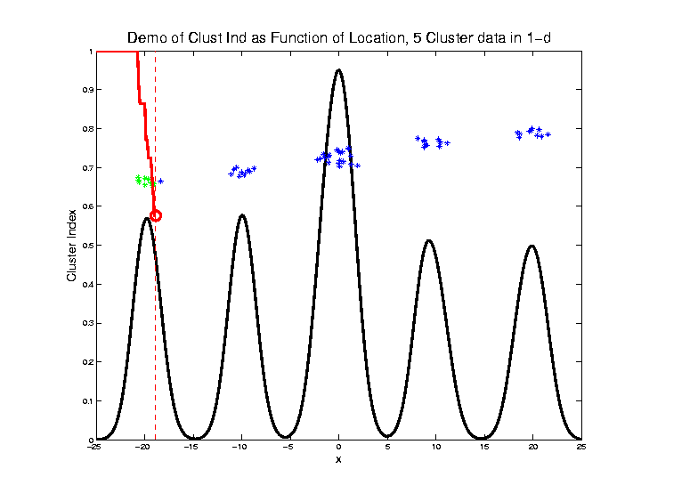
2-means Clustering

Slide 117
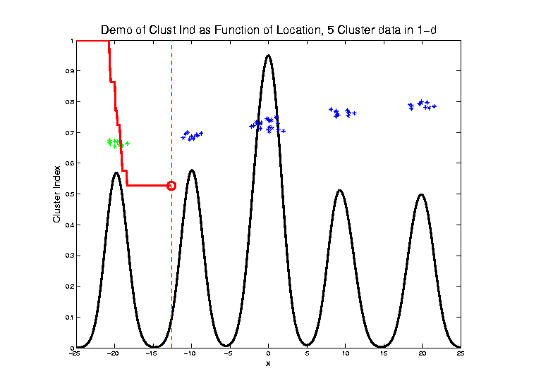
2-means Clustering

Slide 118
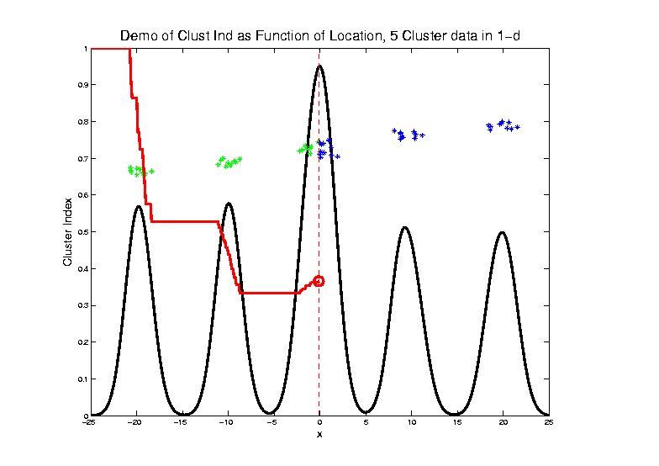
2-means Clustering

Slide 119
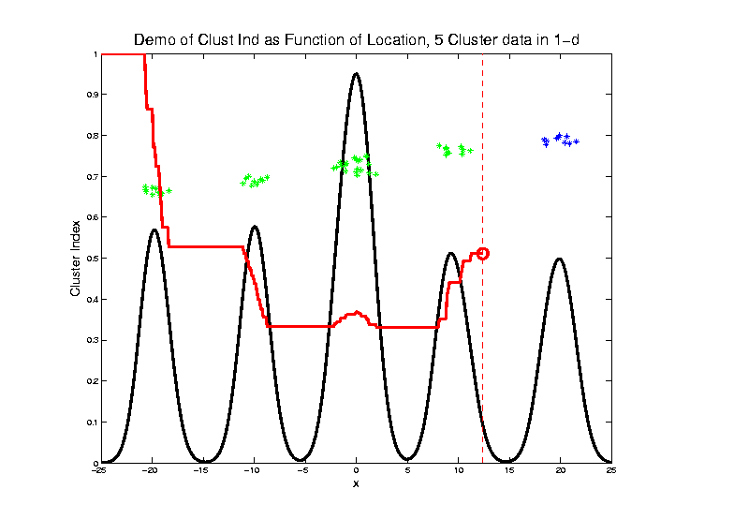
2-means Clustering

Slide 120
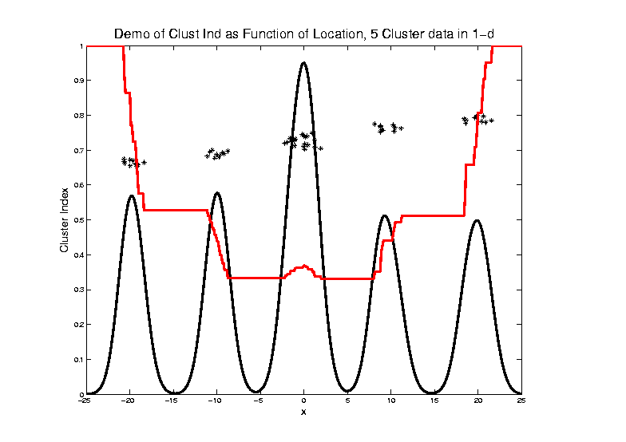
2-means Clustering
Curve Shows CI for Many
Reasonable Clusterings

Slide 121
2-means Clustering
Study CI, using simple 1-d examples
Over changing Classes (moving b’dry)
Multi-modal data → interesting effects
Multiple local minima (large number)
Maybe disconnected
Optimization (over $C_{1},⋯$, $C_{K}$) can be tricky…
(even in 1 dimension, with $K=2$)

Slide 122
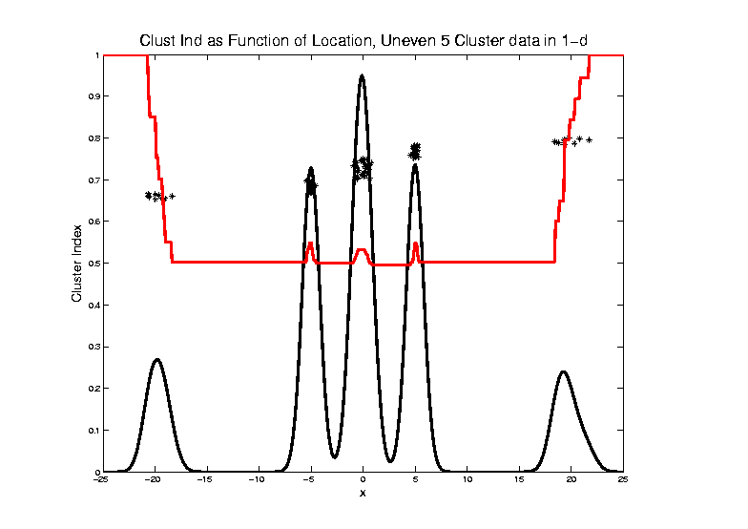
2-means Clustering

Slide 123
2-means Clustering
Study CI, using simple 1-d examples
Over changing Classes (moving b’dry)
Multi-modal data → interesting effects
Can have 4 (or more) local mins
(even in 1 dimension, with K = 2)

Slide 124
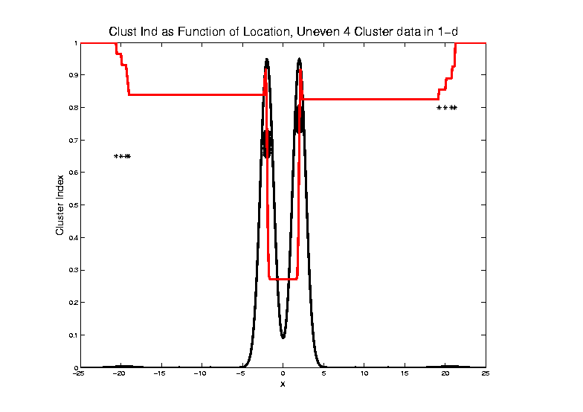
2-means Clustering

Slide 125
2-means Clustering
Study CI, using simple 1-d examples
Over changing Classes (moving b’dry)
Multi-modal data → interesting effects
Local mins can be hard to find
i.e. iterative procedures can “get stuck”
(even in 1 dimension, with K = 2)

Slide 126
2-means Clustering
Study CI, using simple 1-d examples
Effect of a single outlier?

Slide 127
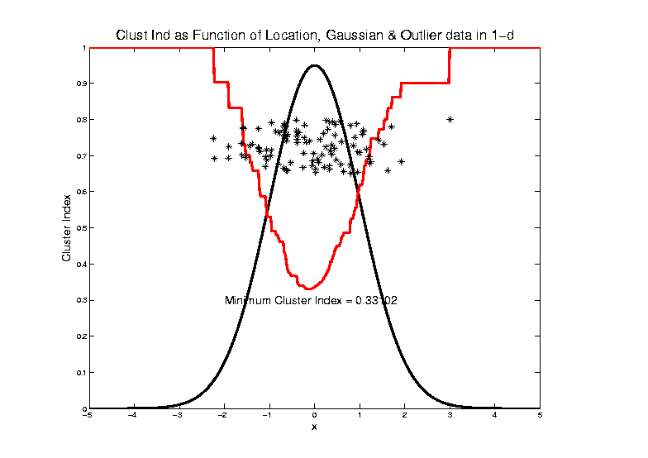
2-means Clustering

Slide 128
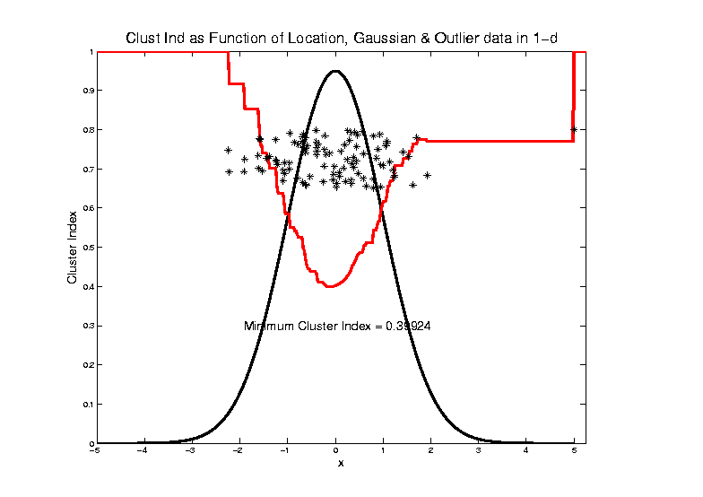
2-means Clustering

Slide 129
2-means Clustering

Slide 130
2-means Clustering

Slide 131
2-means Clustering

Slide 132
2-means Clustering

Slide 133
2-means Clustering

Slide 134
2-means Clustering

Slide 135
2-means Clustering

Slide 136
2-means Clustering

Slide 137
2-means Clustering

Slide 138
2-means Clustering
Study CI, using simple 1-d examples
Effect of a single outlier?
Can create local minimum
Can also yield a global minimum
This gives a one point class
Can make CI arbitrarily small
(really a “good clustering”???)

Slide 139
SWISS Score
Another Application of CI (Cluster Index)
Cabanski et al (2010)
Idea: Use CI in bioinformatics to
“measure quality of data preprocessing”
Philosophy: Clusters Are Scientific Goal
So Want to Accentuate Them

Slide 140
SWISS Score
Toy Examples (2-d):
Which are “More Clustered?”

Slide 141
SWISS Score
Toy Examples (2-d):
Which are “More Clustered?”

Slide 142
SWISS Score
SWISS =
Standardized Within class Sum of Squares
$$SWISS=CI\left(C_{1},⋯,C_{K}\right)=\frac{\sum_{j=1}^{K}{\sum_{i∈C_{j}}{{\left\|{\underline{X}}_{i}−{\overline{\underline{X}}}_{j}\right\|}^{2}}}}{\sum_{i=1}^{n}{{\left\|{\underline{X}}_{i}−\overline{\underline{X}}\right\|}^{2}}}$$

Slide 143
SWISS Score
SWISS =
Standardized Within class Sum of Squares
$$SWISS=CI\left(C_{1},⋯,C_{K}\right)=\frac{\sum_{j=1}^{K}{\sum_{i∈C_{j}}{{\left\|{\underline{X}}_{i}−{\overline{\underline{X}}}_{j}\right\|}^{2}}}}{\sum_{i=1}^{n}{{\left\|{\underline{X}}_{i}−\overline{\underline{X}}\right\|}^{2}}}$$

Slide 144
SWISS Score
SWISS =
Standardized Within class Sum of Squares
$$SWISS=CI\left(C_{1},⋯,C_{K}\right)=\frac{\sum_{j=1}^{K}{\sum_{i∈C_{j}}{{\left\|{\underline{X}}_{i}−{\overline{\underline{X}}}_{j}\right\|}^{2}}}}{\sum_{i=1}^{n}{{\left\|{\underline{X}}_{i}−\overline{\underline{X}}\right\|}^{2}}}$$

Slide 145
SWISS Score
Nice Graphical Introduction:
$$SWISS=CI\left(C_{1},⋯,C_{K}\right)=\frac{\sum_{j=1}^{K}{\sum_{i∈C_{j}}{{\left\|{\underline{X}}_{i}−{\overline{\underline{X}}}_{j}\right\|}^{2}}}}{\sum_{i=1}^{n}{{\left\|{\underline{X}}_{i}−\overline{\underline{X}}\right\|}^{2}}}$$

Slide 146
SWISS Score
Nice Graphical Introduction:
$$SWISS=CI\left(C_{1},⋯,C_{K}\right)=\frac{\sum_{j=1}^{K}{\sum_{i∈C_{j}}{{\left\|{\underline{X}}_{i}−{\overline{\underline{X}}}_{j}\right\|}^{2}}}}{\sum_{i=1}^{n}{{\left\|{\underline{X}}_{i}−\overline{\underline{X}}\right\|}^{2}}}$$

Slide 147
SWISS Score
Revisit Toy Examples (2-d):
Which are “More Clustered?”

Slide 148
SWISS Score
Toy Examples (2-d):
Which are “More Clustered?”

Slide 149
SWISS Score
Toy Examples (2-d):
Which are “More Clustered?”

Slide 150
Participant Presentation
Duyeol Lee
PCA in Credit Risk Modelling

