Slide 1
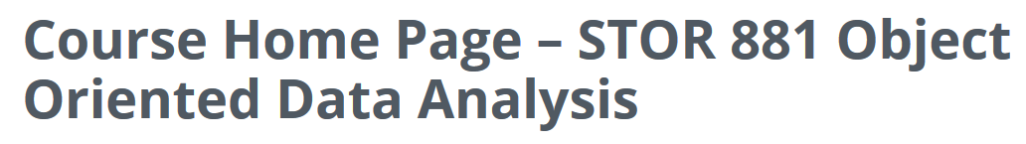
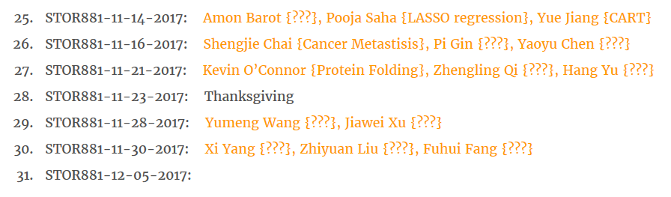
Participant Presentations
(10 Minute Talks)
Too many undetermined. Please help fill in.

Slide 2
SVM & DWD Tuning Parameter
Possible Approaches:
Visually Tuned
Simple Defaults
Cross Validation
Scale Space
(Work with Full Range of Choices,
Will Explore More Soon)
Notes:
2

Slide 3
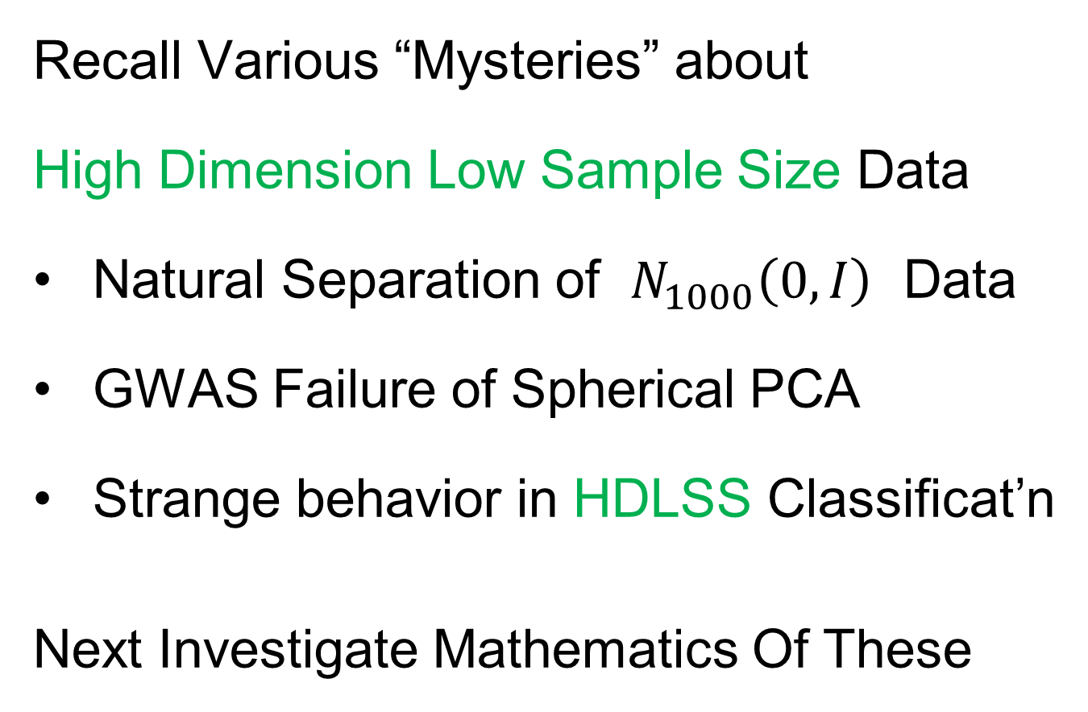
HDLSS Asymptotics
Recall Various “Mysteries” about
High Dimension Low Sample Size Data
Natural Separation of $N_{1000}\left(0,I\right)$ Data
GWAS Failure of Spherical PCA
Strange behavior in HDLSS Classificat’n
Next Investigate Mathematics Of These
Notes:
3

Slide 4
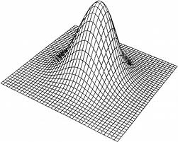
HDLSS Asymptotics: Simple Paradoxes
For $d$ dimensional Standard Normal dist’n:
$$\underline{Z}=\left(\begin{matrix}Z_{1} \\ ⋮ \\ Z_{d}\end{matrix}\right)\sim N_{d}\left(0,I_{d}\right)$$
Where are the Data?
Near Peak of Density?
Thanks to: psycnet.apa.org

Slide 5
HDLSS Asymptotics: Simple Paradoxes
As $d→∞$,
$$\left\|\underline{Z}\right\|=\sqrt{d}+O_{p}\left(1\right)$$
Data lie roughly on surface of sphere,
with radius $\sqrt{d}$
- Yet origin is point of highest density???
- Paradox resolved by:
density w. r. t. Lebesgue Measure
Notes:
5

Slide 6
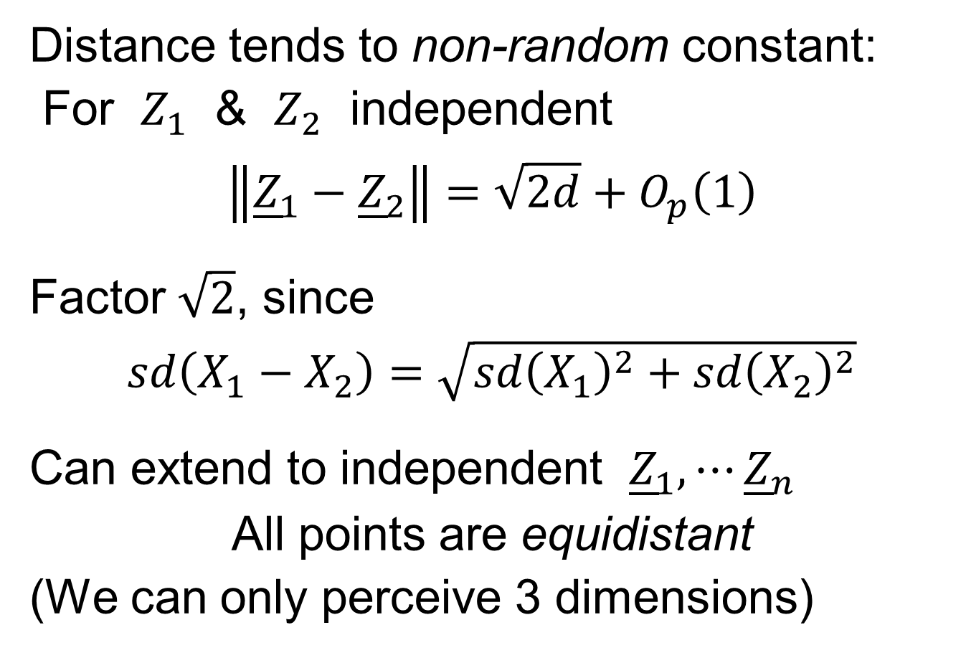
HDLSS Asymptotics: Simple Paradoxes
Distance tends to non-random constant:
For $Z_{1}$ & $Z_{2}$ independent
$$\left\|{\underline{Z}}_{1}−{\underline{Z}}_{2}\right\|=\sqrt{2d}+O_{p}\left(1\right)$$
Factor $\sqrt{2}$, since
$sd\left(X_{1}−X_{2}\right)=\sqrt{{sd\left(X_{1}\right)}^{2}+{sd\left(X_{2}\right)}^{2}}$
Can extend to independent ${\underline{Z}}_{1},⋯{\underline{Z}}_{n}$
All points are equidistant
(We can only perceive 3 dimensions)
Notes:
6

Slide 7
HDLSS Asymptotics: Simple Paradoxes
For $d$ dim’al Standard Normal dist’n:
${\underline{Z}}_{1}$ indep. of ${\underline{Z}}_{2}\sim N_{d}\left(\underline{0},I_{d}\right)$
High dim’al Angles (as $d→∞$):
$$Angle\left({\underline{Z}}_{1},{\underline{Z}}_{2}\right)={90}^{°}+O_{p}\left(d^{−1/2}\right)$$
- Everything is orthogonal???

Slide 8
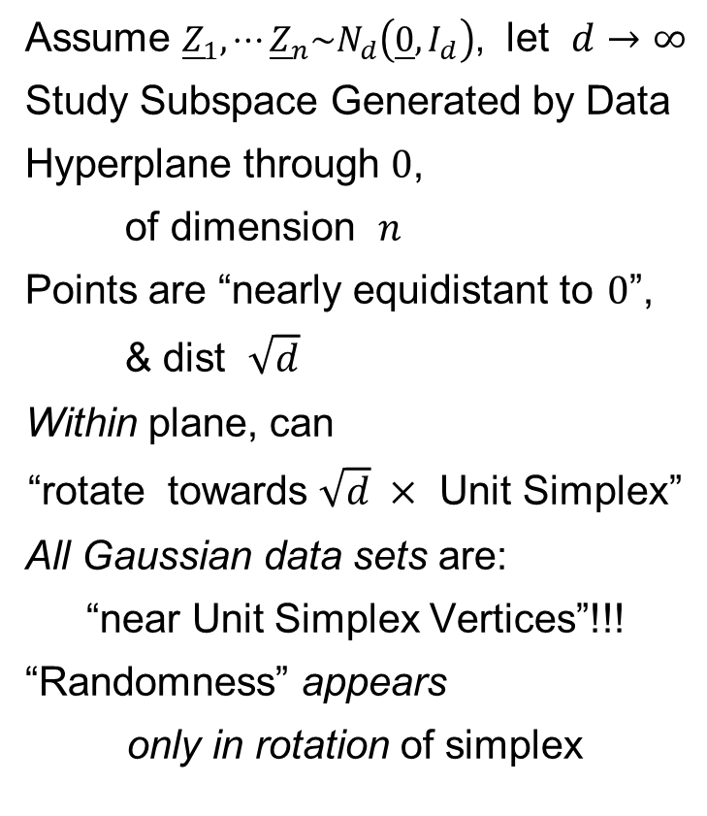
HDLSS Asy’s: Geometrical Represent’n
Assume ${\underline{Z}}_{1},⋯{\underline{Z}}_{n}\sim N_{d}\left(\underline{0},I_{d}\right)$, let $d→∞$
Study Subspace Generated by Data
Hyperplane through $0$,
of dimension $n$
Points are “nearly equidistant to $0$”,
& dist $\sqrt{d}$
Within plane, can
“rotate towards $\sqrt{d} ×$ Unit Simplex”
All Gaussian data sets are:
“near Unit Simplex Vertices”!!!
“Randomness” appears
only in rotation of simplex
Hall, Marron & Neeman (2005)

Slide 9
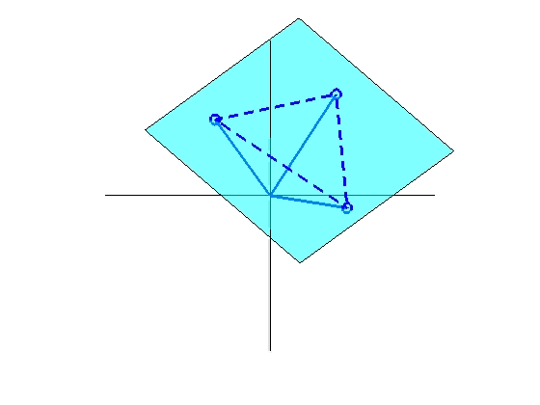
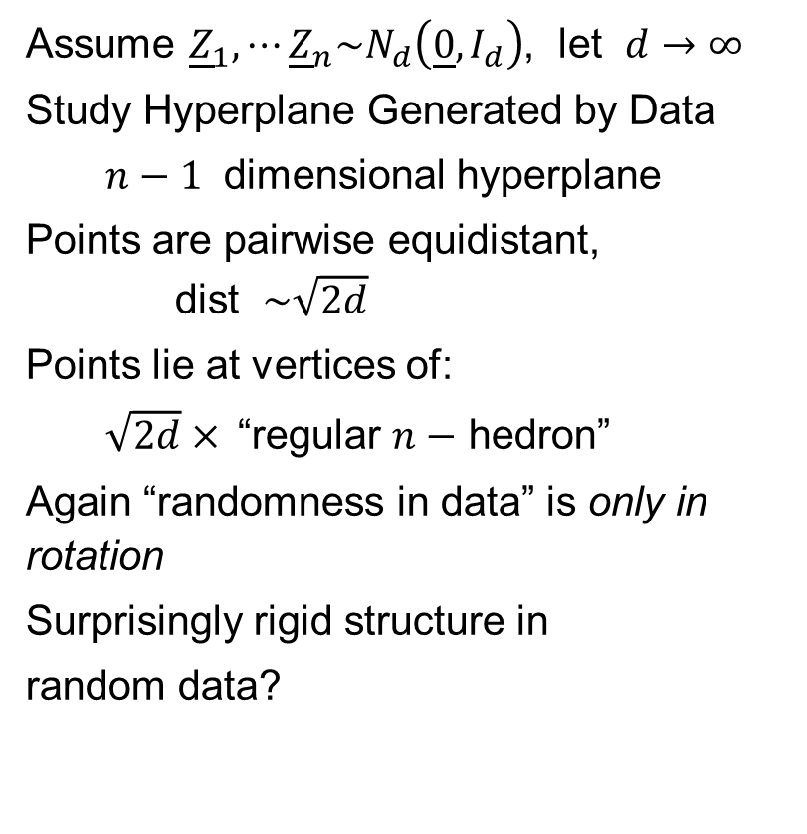
HDLSS Asy’s: Geometrical Represent’n
Assume ${\underline{Z}}_{1},⋯{\underline{Z}}_{n}\sim N_{d}\left(\underline{0},I_{d}\right)$, let $d→∞$
Study Hyperplane Generated by Data
$n−1$ dimensional hyperplane
Points are pairwise equidistant, dist $\sim \sqrt{2d}$
Points lie at vertices of:
$\sqrt{2d}×$“regular $n−$ hedron”
Again “randomness in data” is only in rotation
Surprisingly rigid structure in
random data?

Slide 10
HDLSS Asy’s: Geometrical Represen’tion
Simulation View: Shows “Rigidity after Rotation”

Slide 11
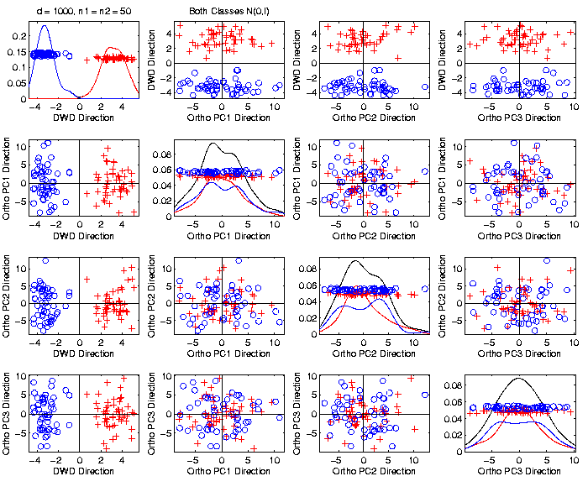
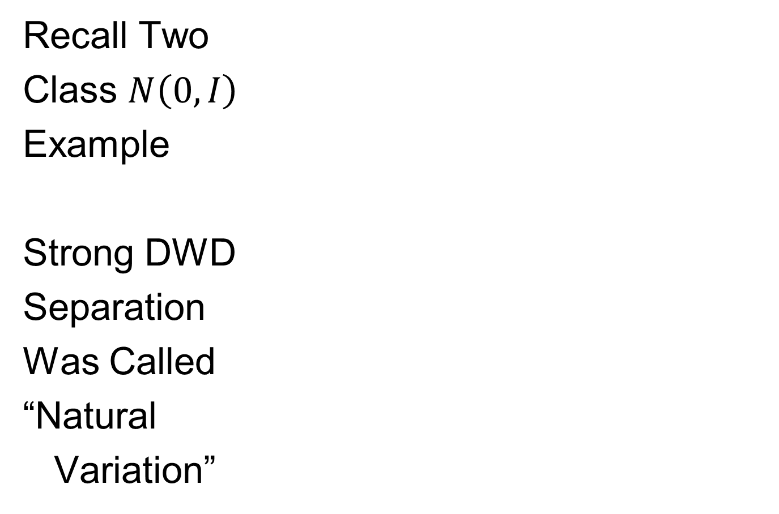
An Interesting HDLSS Explanation
Recall Two
Class $N\left(0,I\right)$
Example
Strong DWD
Separation
Was Called
“Natural
Variation”

Slide 12

An Interesting HDLSS Explanation
Recall Two
Class $N\left(0,I\right)$
Example
$\left\|\overline{x_{1}}−\overline{x_{2}}\right\|$
$≈6.3$

Slide 13
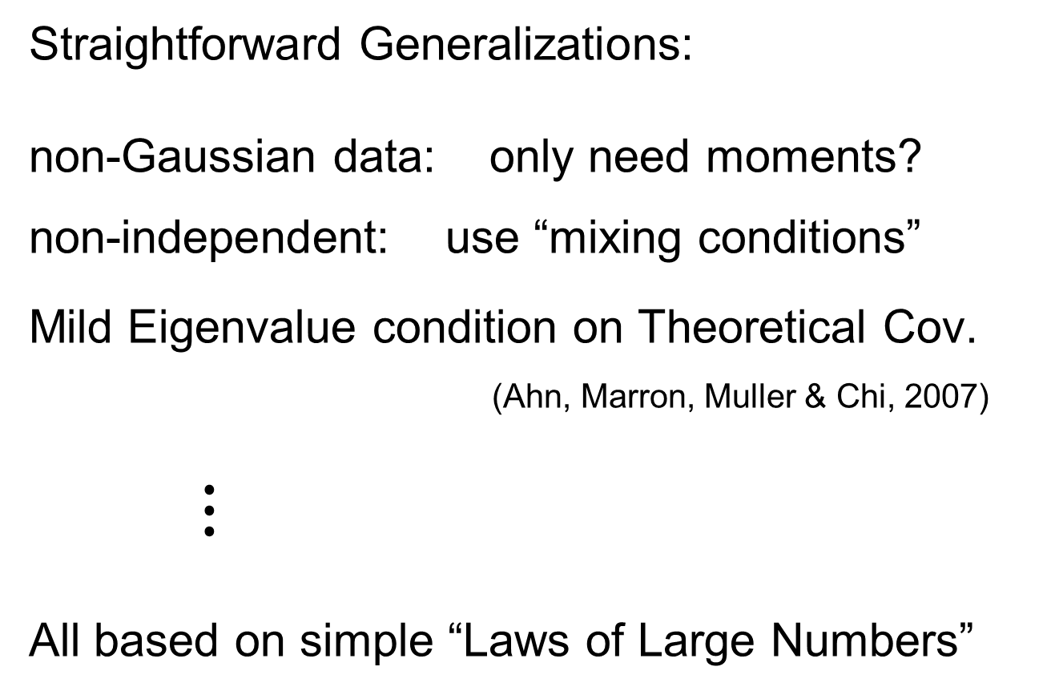
HDLSS Asy’s: Geometrical Represen’tion
Straightforward Generalizations:
non-Gaussian data: only need moments?
non-independent: use “mixing conditions”
Mild Eigenvalue condition on Theoretical Cov.
(Ahn, Marron, Muller & Chi, 2007)
$⋮$
All based on simple “Laws of Large Numbers”

Slide 14

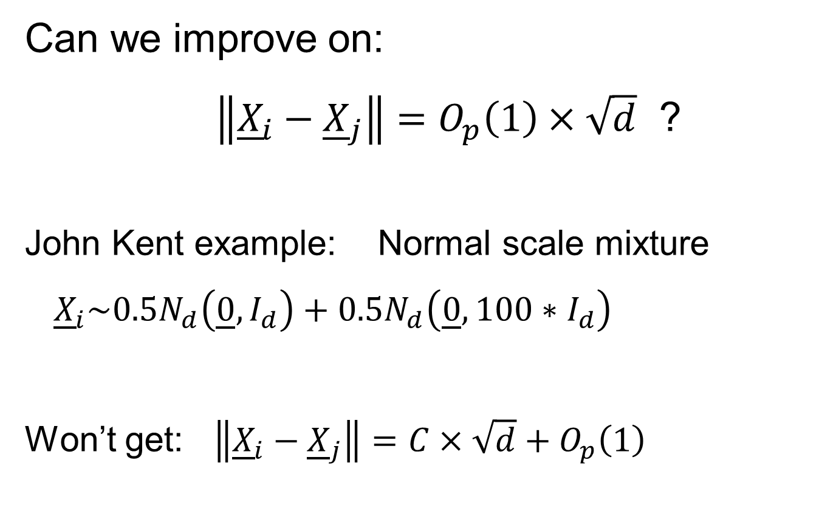
2nd Paper on HDLSS Asymptotics
Can we improve on:
$\left\|{\underline{X}}_{i}−{\underline{X}}_{j}\right\|=O_{p}\left(1\right)×\sqrt{d}$ ?
John Kent example: Normal scale mixture
${\underline{X}}_{i}\sim 0.5N_{d}\left(\underline{0},I_{d}\right)+0.5N_{d}\left(\underline{0},{100∗I}_{d}\right)$
Won’t get: $\left\|{\underline{X}}_{i}−{\underline{X}}_{j}\right\|=C×\sqrt{d}+O_{p}\left(1\right)$

Slide 15
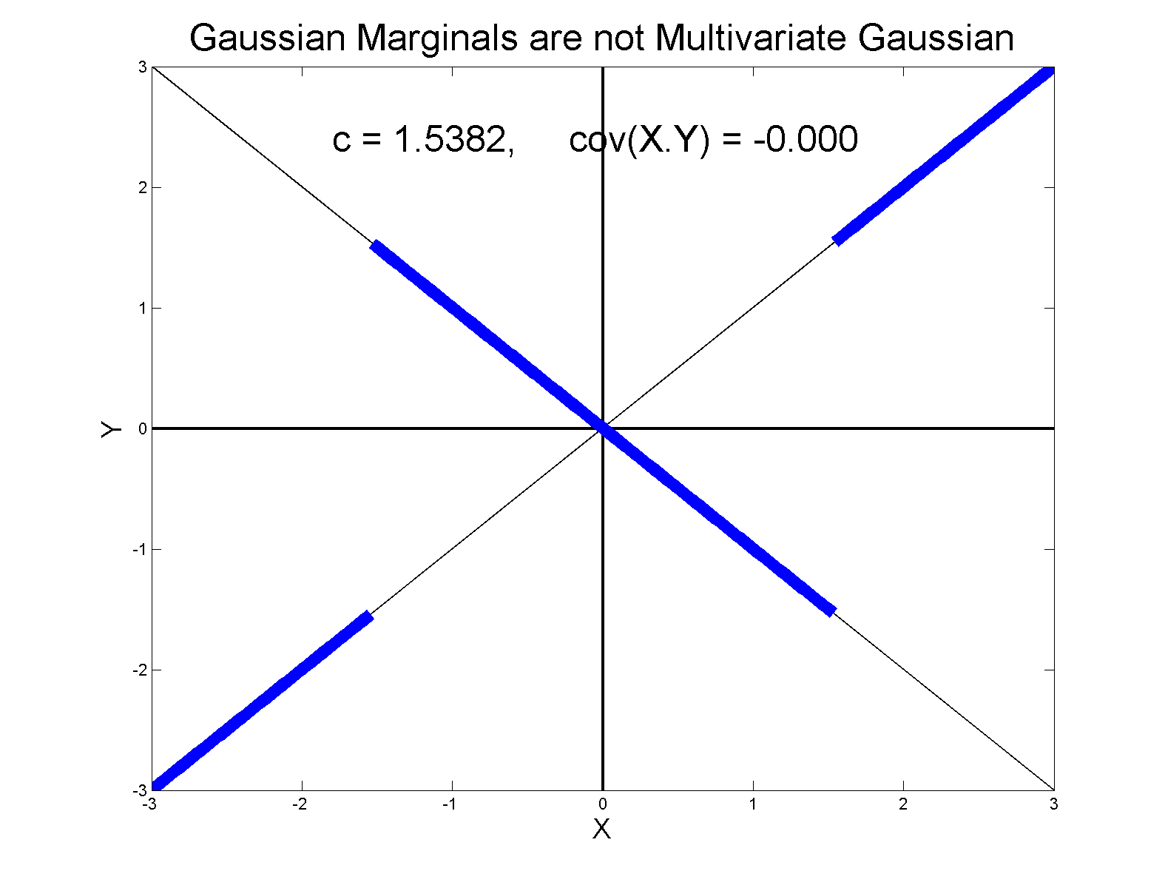
0 Covariance is not independence
Simple Example, c to make cov(X,Y) = 0

Slide 16
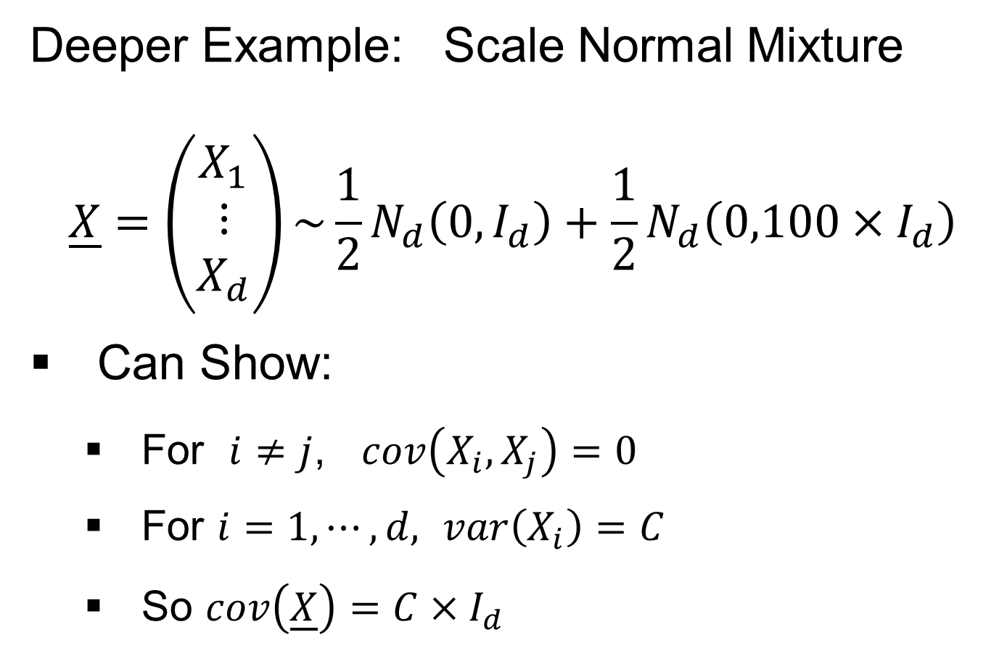
0 Covariance is not independence
Deeper Example: Scale Normal Mixture
$$\underline{X}=\left(\begin{matrix}X_{1} \\ ⋮ \\ X_{d}\end{matrix}\right)\sim {\frac{1}{2}N}_{d}\left(0,I_{d}\right)+\frac{1}{2}N_{d}\left(0,100×I_{d}\right)$$
Can Show:
  For $i≠j$, $cov\left(X_{i},X_{j}\right)=0$
  For $i=1,⋯,d,$ $var\left(X_{i}\right)=C$
  So $cov\left(\underline{X}\right)=C×I_{d}$

Slide 17
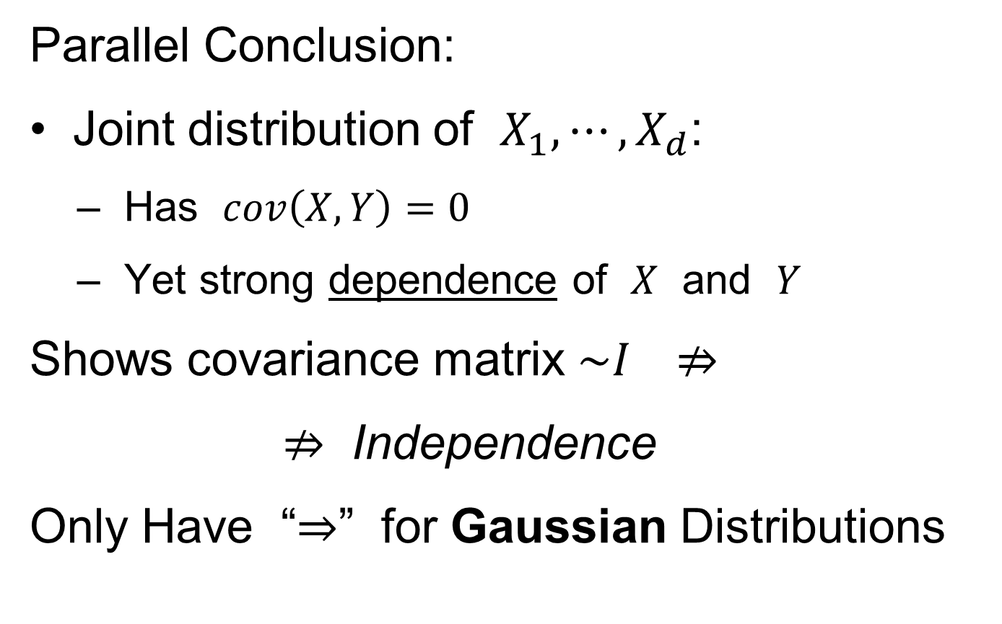
0 Covariance is not independence
Parallel Conclusion:
Joint distribution of $X_{1},⋯,X_{d}$:
  Has $cov\left(X,Y\right)=0$
  Yet strong dependence of $X$ and $Y$
Shows covariance matrix $\sim I ⇏$
$⇏$ Independence
Only Have “$⇒$” for Gaussian Distributions

Slide 18
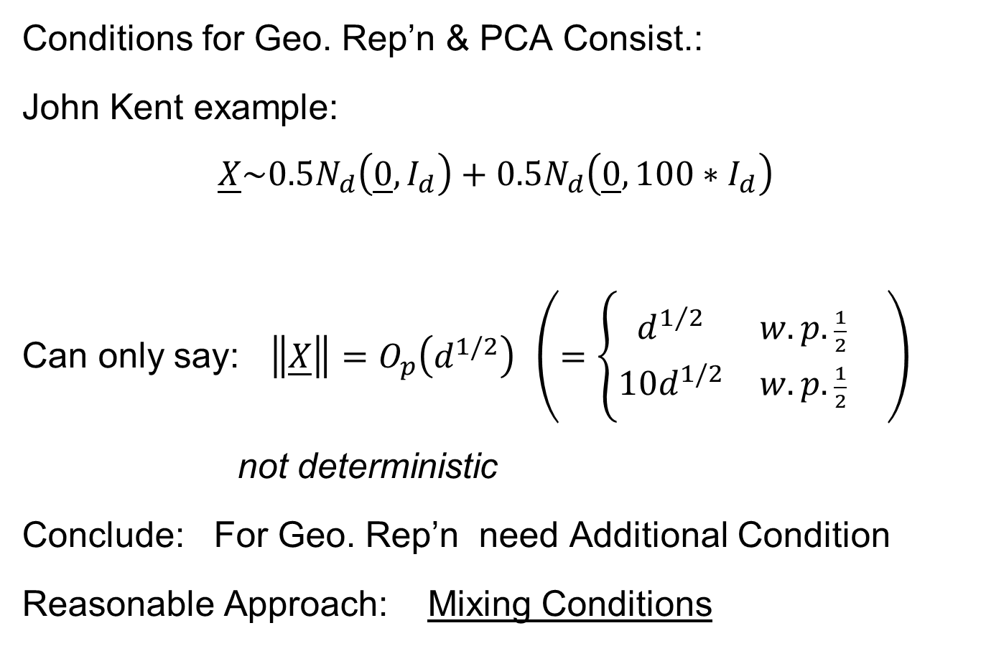
HDLSS Geometric Representation
Conditions for Geo. Rep’n & PCA Consist.:
John Kent example:
$$\underline{X}\sim 0.5N_{d}\left(\underline{0},I_{d}\right)+0.5N_{d}\left(\underline{0},{100∗I}_{d}\right)$$
Can only say: $\left\|\underline{X}\right\|=O_{p}\left(d^{1/2}\right)$ $\left(=\left\{\begin{matrix}d^{1/2} & w.p.\frac{1}{2} \\ 10d^{1/2} & w.p.\frac{1}{2}\end{matrix}\right. \right)$
not deterministic
Conclude: For Geo. Rep’n need Additional Condition
Reasonable Approach: Mixing Conditions

Slide 19
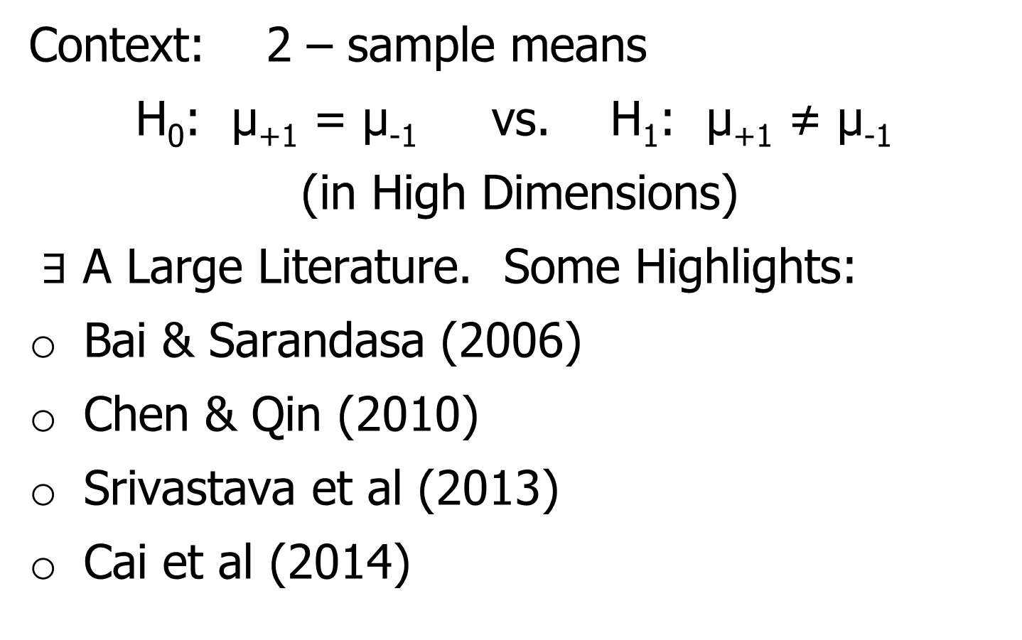
Mixing Conditions
Idea From Probability Theory:
Recall Standard Asymptotic Results, as $n→∞:$
Law of Large Numbers,
$$\overline{X}→μ$$
(“Weak” = in prob., “Strong” = a.s.)

Slide 20
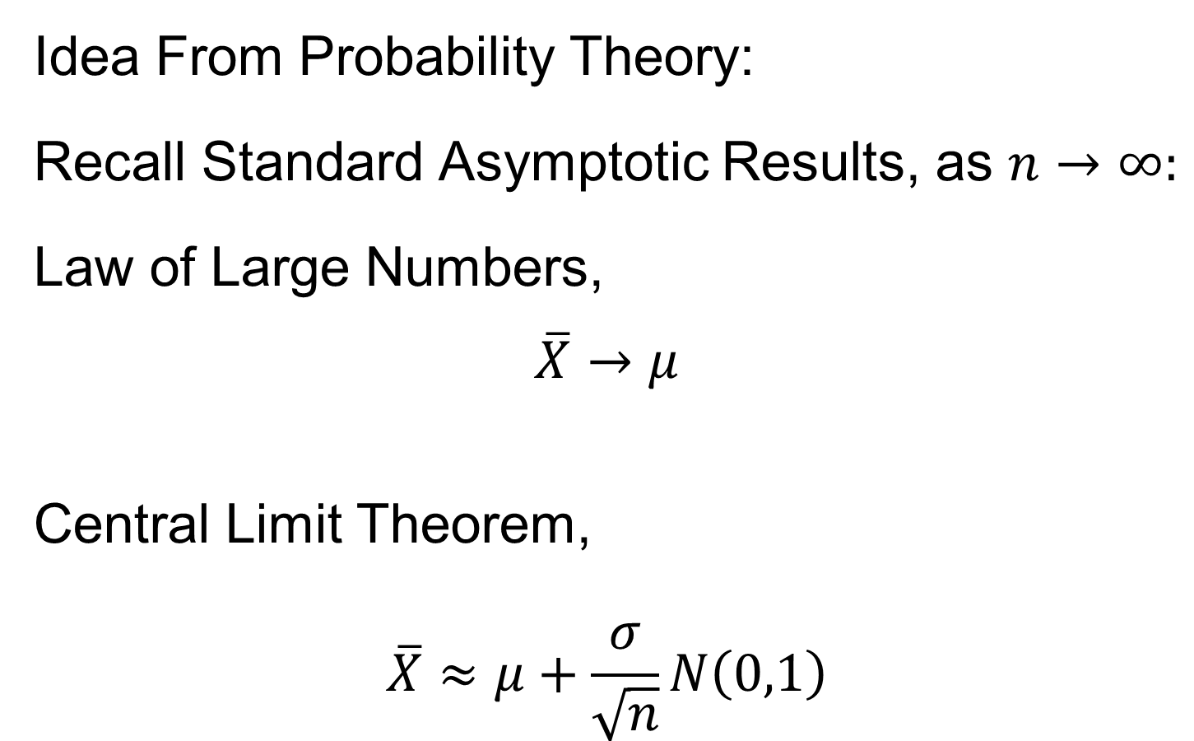
Mixing Conditions
Idea From Probability Theory:
Recall Standard Asymptotic Results, as $n→∞:$
Law of Large Numbers,
$$\overline{X}→μ$$
Central Limit Theorem,
$$\overline{X}≈μ+\frac{σ}{\sqrt{n}}N\left(0,1\right)$$

Slide 21
Mixing Conditions
Idea From Probability Theory:
Law of Large Numbers,
Central Limit Theorem,
Both have Technical Assumptions
(Usually Ignore ???)

Slide 22
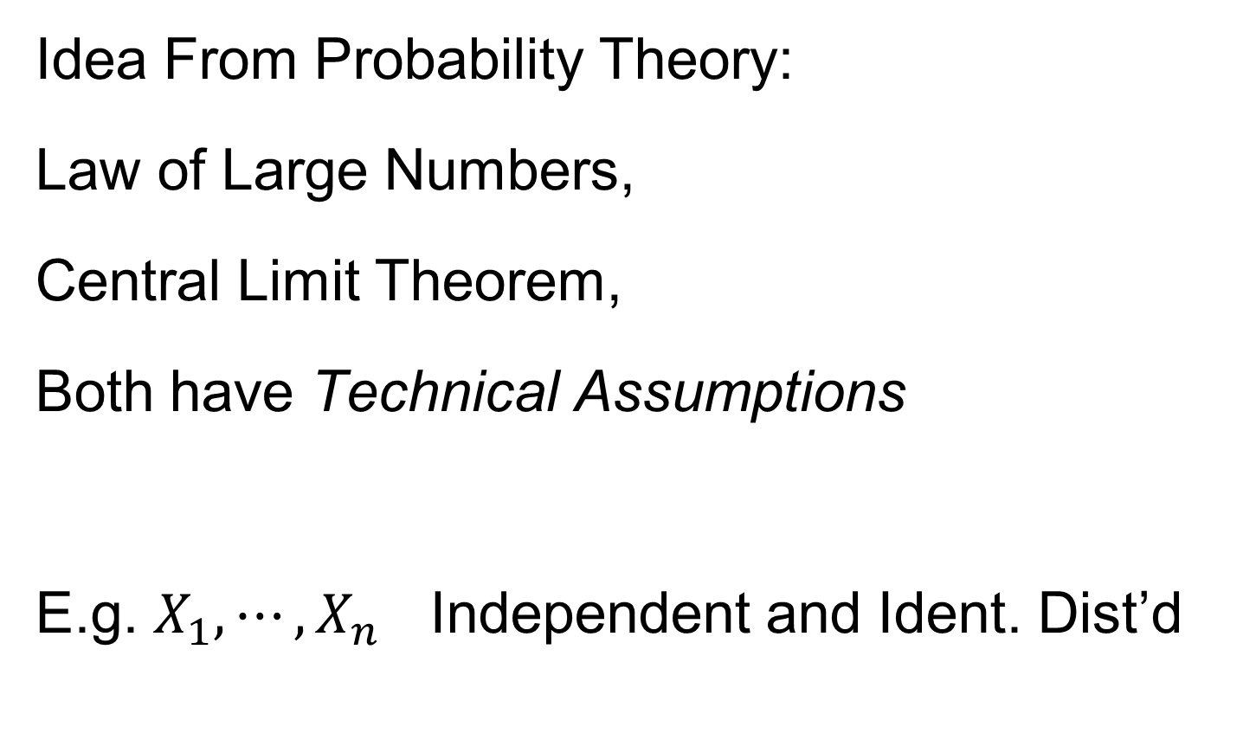
Mixing Conditions
Idea From Probability Theory:
Law of Large Numbers,
Central Limit Theorem,
Both have Technical Assumptions
E.g. $X_{1},⋯,X_{n}$ Independent and Ident. Dist’d

Slide 23
Mixing Conditions
Idea From Probability Theory:
Mixing Conditions:
Explore Weaker Assumptions, to Still Get
Law of Large Numbers,
Central Limit Theorem

Slide 24

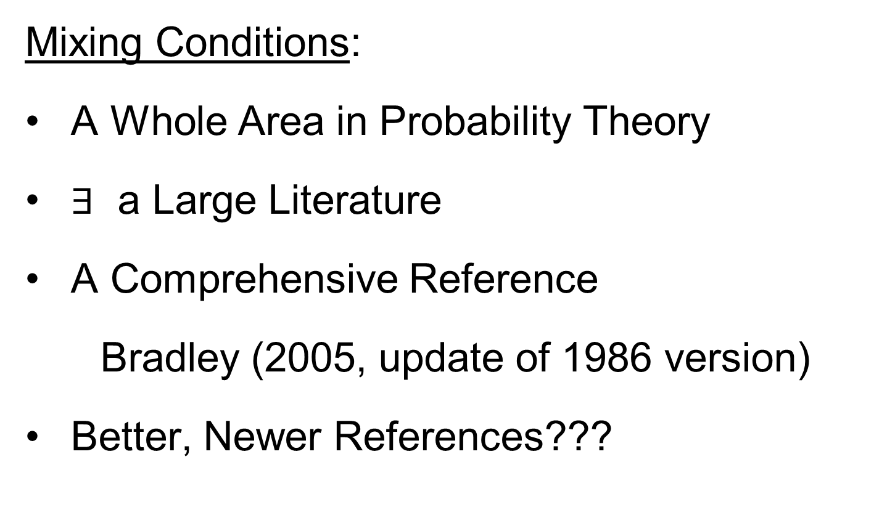
Mixing Conditions
Mixing Conditions:
A Whole Area in Probability Theory
$∃$ a Large Literature
A Comprehensive Reference
Bradley (2005, update of 1986 version)
Better, Newer References???

Slide 25
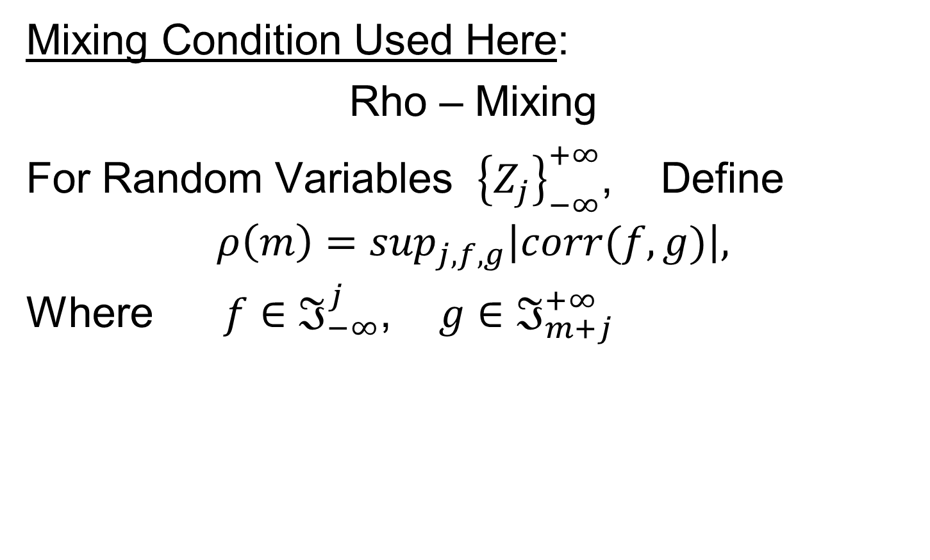
Mixing Conditions
Mixing Condition Used Here:
Rho – Mixing
For Random Variables ${\left\{Z_{j}\right\}}_{−∞}^{+∞}$, Define
$$ρ\left(m\right)=\sup_{j,f,g}\left|corr(f,g)\right|,$$
Where $f∈ℑ_{−∞}^{j}$, $g∈ℑ_{m+j}^{+∞}$

Slide 26
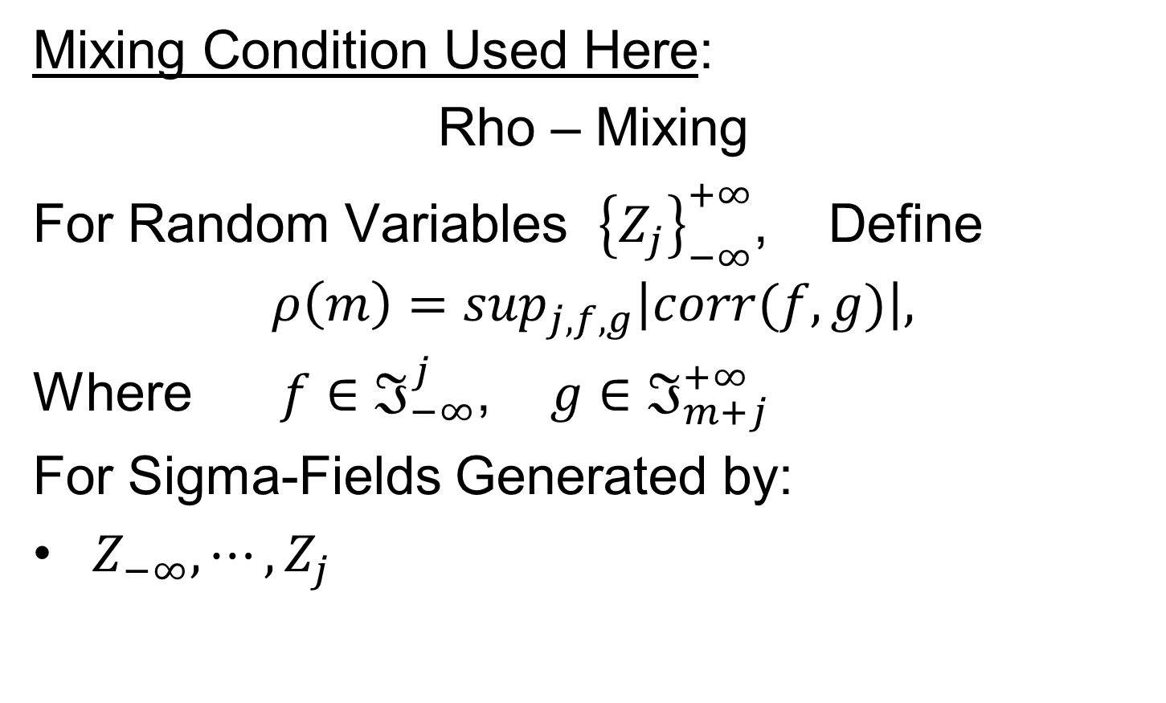
Mixing Conditions
Mixing Condition Used Here:
Rho – Mixing
For Random Variables ${\left\{Z_{j}\right\}}_{−∞}^{+∞}$, Define
$$ρ\left(m\right)=\sup_{j,f,g}\left|corr(f,g)\right|,$$
Where $f∈ℑ_{−∞}^{j}$, $g∈ℑ_{m+j}^{+∞}$
For Sigma-Fields Generated by:
$Z_{−∞},⋯,Z_{j}$

Slide 27
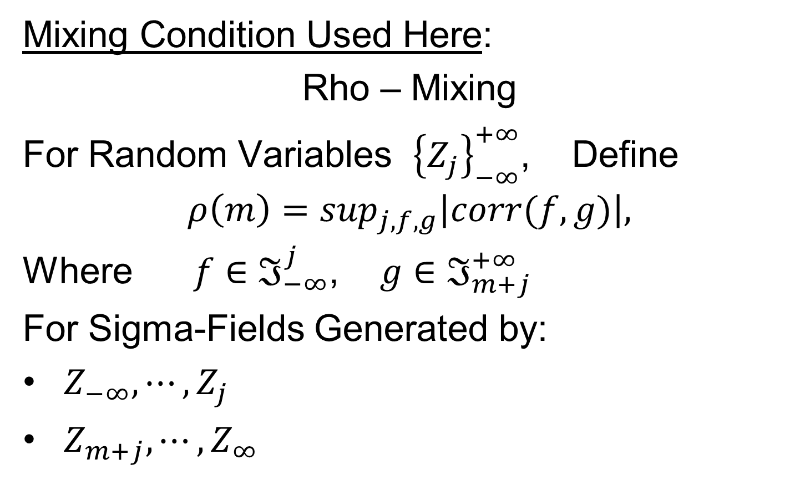
Mixing Conditions
Mixing Condition Used Here:
Rho – Mixing
For Random Variables ${\left\{Z_{j}\right\}}_{−∞}^{+∞}$, Define
$$ρ\left(m\right)=\sup_{j,f,g}\left|corr(f,g)\right|,$$
Where $f∈ℑ_{−∞}^{j}$, $g∈ℑ_{m+j}^{+∞}$
For Sigma-Fields Generated by:
$Z_{−∞},⋯,Z_{j}$
$Z_{m+j},⋯,Z_{∞}$

Slide 28
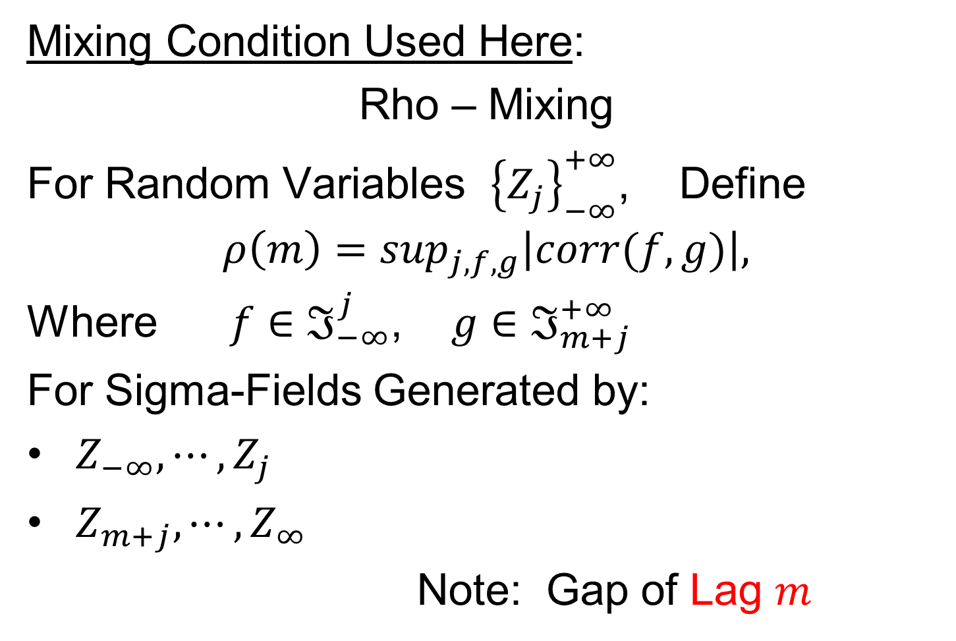
Mixing Conditions
Mixing Condition Used Here:
Rho – Mixing
For Random Variables ${\left\{Z_{j}\right\}}_{−∞}^{+∞}$, Define
$$ρ\left(m\right)=\sup_{j,f,g}\left|corr(f,g)\right|,$$
Where $f∈ℑ_{−∞}^{j}$, $g∈ℑ_{m+j}^{+∞}$
For Sigma-Fields Generated by:
$Z_{−∞},⋯,Z_{j}$
$Z_{m+j},⋯,Z_{∞}$
Note: Gap of Lag $m$

Slide 29
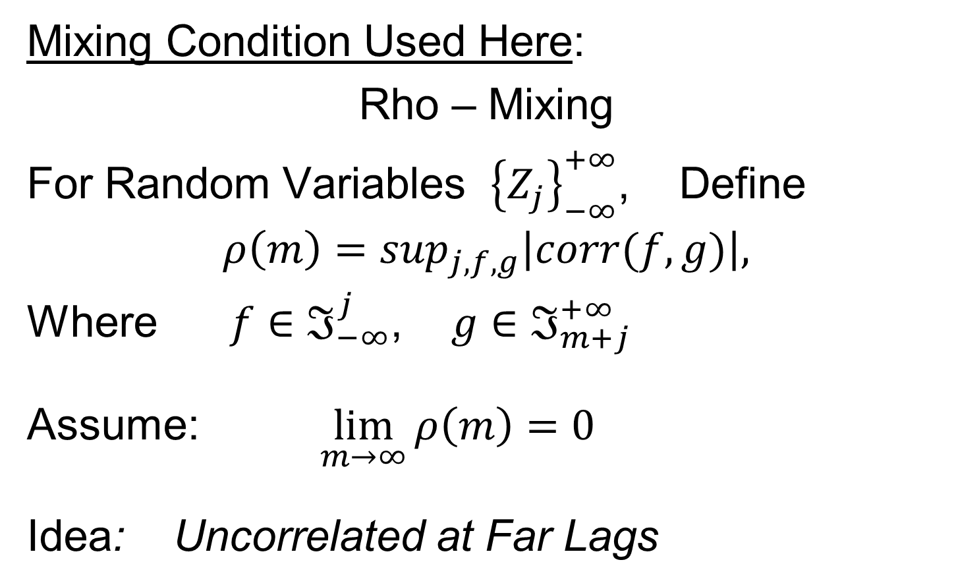
Mixing Conditions
Mixing Condition Used Here:
Rho – Mixing
For Random Variables ${\left\{Z_{j}\right\}}_{−∞}^{+∞}$, Define
$$ρ\left(m\right)=\sup_{j,f,g}\left|corr(f,g)\right|,$$
Where $f∈ℑ_{−∞}^{j}$, $g∈ℑ_{m+j}^{+∞}$
Assume: $\lim_{m→∞}{ρ\left(m\right)=0}$
Idea: Uncorrelated at Far Lags

Slide 30
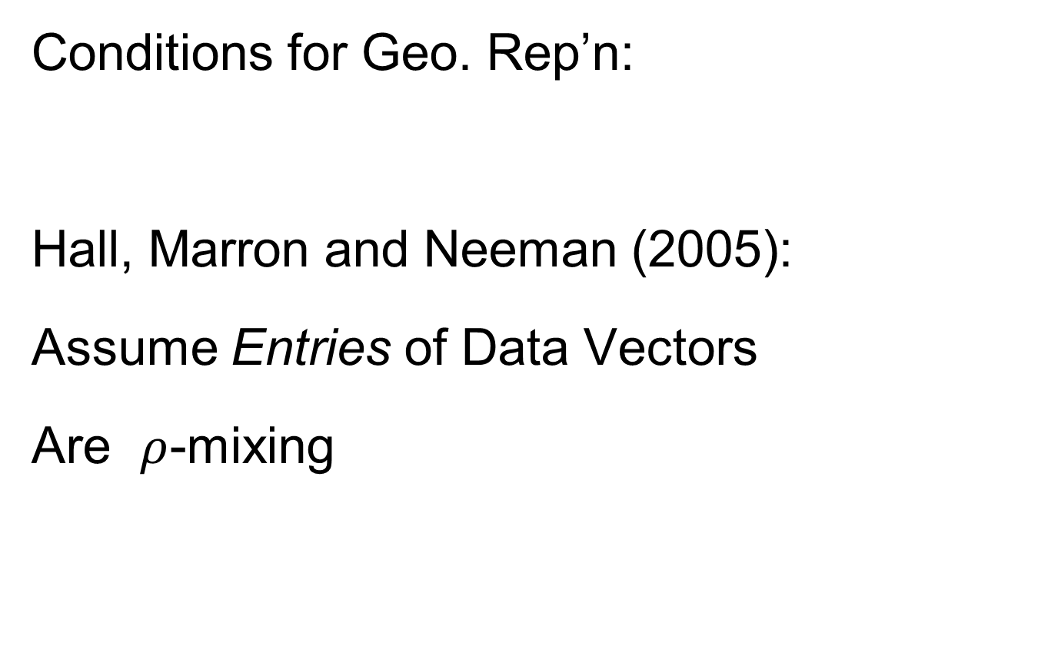
HDLSS Geometric Representation
Conditions for Geo. Rep’n:
Hall, Marron and Neeman (2005):
Assume Entries of Data Vectors
Are $ρ$-mixing

Slide 31
HDLSS Geometric Representation
Conditions for Geo. Rep’n:
Hall, Marron and Neeman (2005):
Drawback: Strong Assumption
(???)
In JRSS-B, since Biometrika Rejected

Slide 32
HDLSS Geometric Representation
Conditions for Geo. Rep’n:
Hall, Marron and Neeman (2005):
Later Realization:
This Mixing is Very Natural in
Genome Wide Association Studies
1st such: Klein et al (2005)

Slide 33
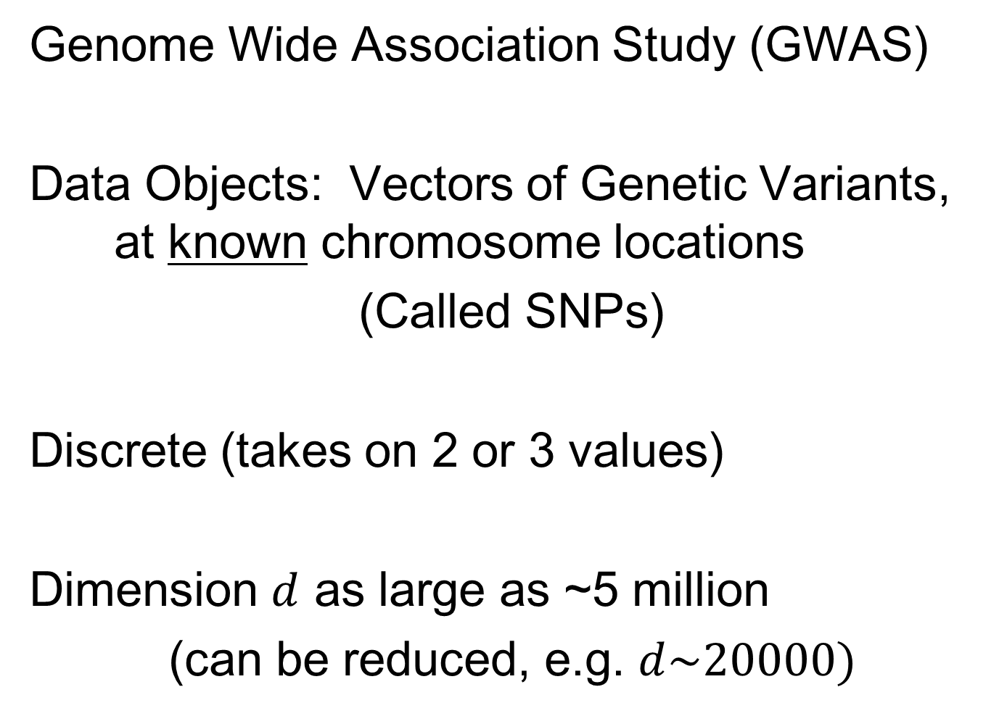
Recall GWAS Data Analysis
Genome Wide Association Study (GWAS)
Data Objects: Vectors of Genetic Variants, at known chromosome locations
(Called SNPs)
Discrete (takes on 2 or 3 values)
Dimension $d$ as large as ~5 million
(can be reduced, e.g. $d\sim 20000)$

Slide 34
HDLSS Geometric Representation
Conditions for Geo. Rep’n:
Series of Technical Improvements:
Ahn, Marron, Muller & Chi (2007)
Yata & Aoshima (2009, 2010a, 2010b, 2012, 2013)
(Fully Covariance Based,
No Mixing)

Slide 35
HDLSS Geometric Representation
Conditions for Geo. Rep’n:
Tricky Point: Classical Mixing Conditions
Require Notion of Time Ordering
Not Always Clear, e.g. Gene Expression

Slide 36
HDLSS Geometric Representation
Conditions for Geo. Rep’n:
Condition from Jung & Marron (2009):
where
Note: Not Gaussian (Allows Discrete)

Slide 37
HDLSS Geometric Representation
Conditions for Geo. Rep’n:
Condition from Jung & Marron (2009):
where
Define:
Standardized Version

Slide 38
HDLSS Geometric Representation
Conditions for Geo. Rep’n:
Condition from Jung & Marron (2009):
where
Define:
Assume: Ǝ a permutation,
So that is ρ-mixing

Slide 39

HDLSS Math. Stat. of PCA
Analysis from Jung & Marron (2009)

Slide 40
HDLSS Math. Stat. of PCA
Consistency & Strong Inconsistency
(Study Properties of PCA,
In Estimating Eigen-Directions & -Values)
[Assume Data are Mean Centered]

Slide 41

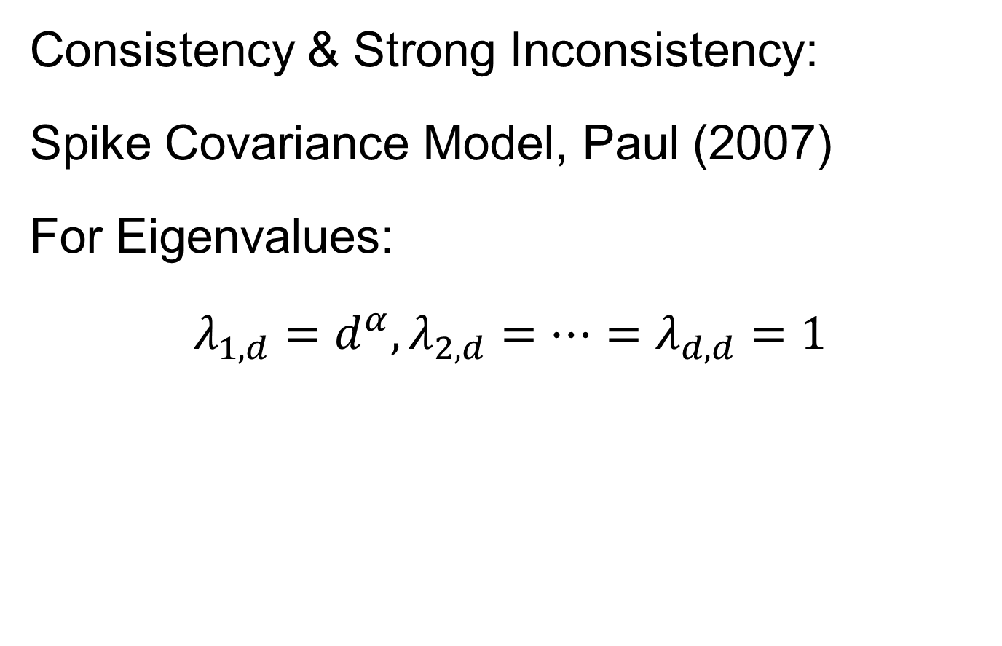
HDLSS Math. Stat. of PCA
Consistency & Strong Inconsistency:
Spike Covariance Model, Paul (2007)
For Eigenvalues:
$λ_{1,d}=d^{α},λ_{2,d}=⋯=λ_{d,d}=1$

Slide 42
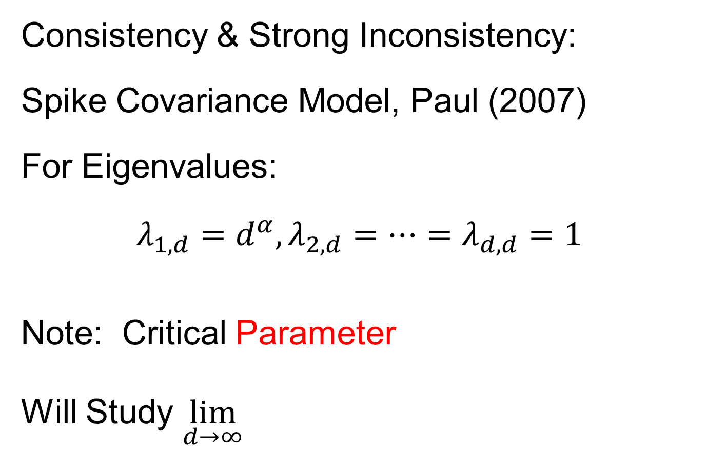
HDLSS Math. Stat. of PCA
Consistency & Strong Inconsistency:
Spike Covariance Model, Paul (2007)
For Eigenvalues:
$λ_{1,d}=d^{α},λ_{2,d}=⋯=λ_{d,d}=1$
Note: Critical Parameter
Will Study $\lim_{d→∞}{}$

Slide 43
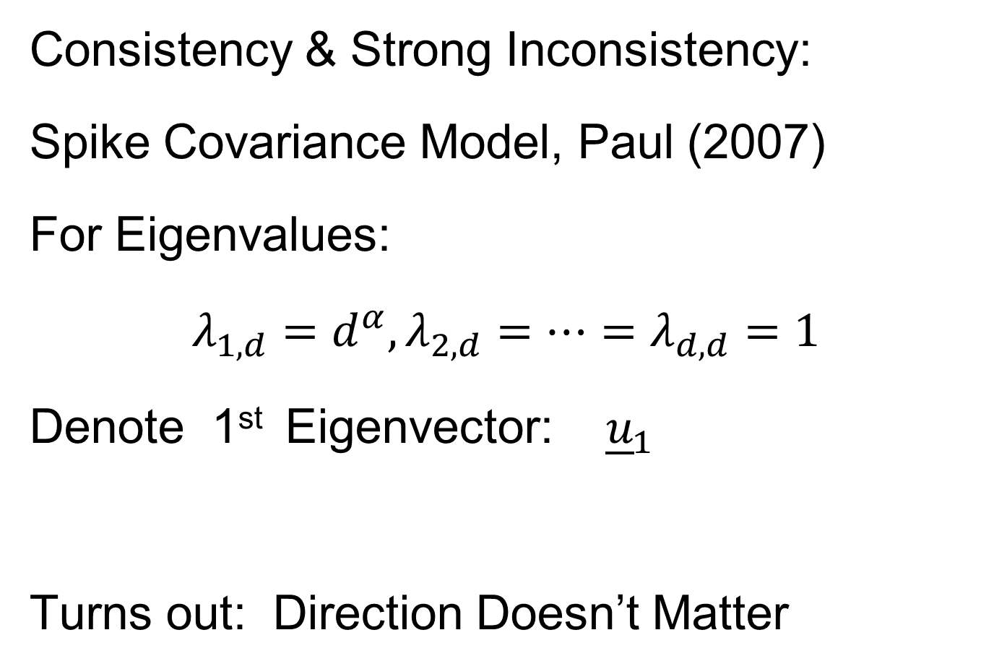
HDLSS Math. Stat. of PCA
Consistency & Strong Inconsistency:
Spike Covariance Model, Paul (2007)
For Eigenvalues:
$λ_{1,d}=d^{α},λ_{2,d}=⋯=λ_{d,d}=1$
Denote 1st Eigenvector: ${\underline{u}}_{1}$
Turns out: Direction Doesn’t Matter

Slide 44
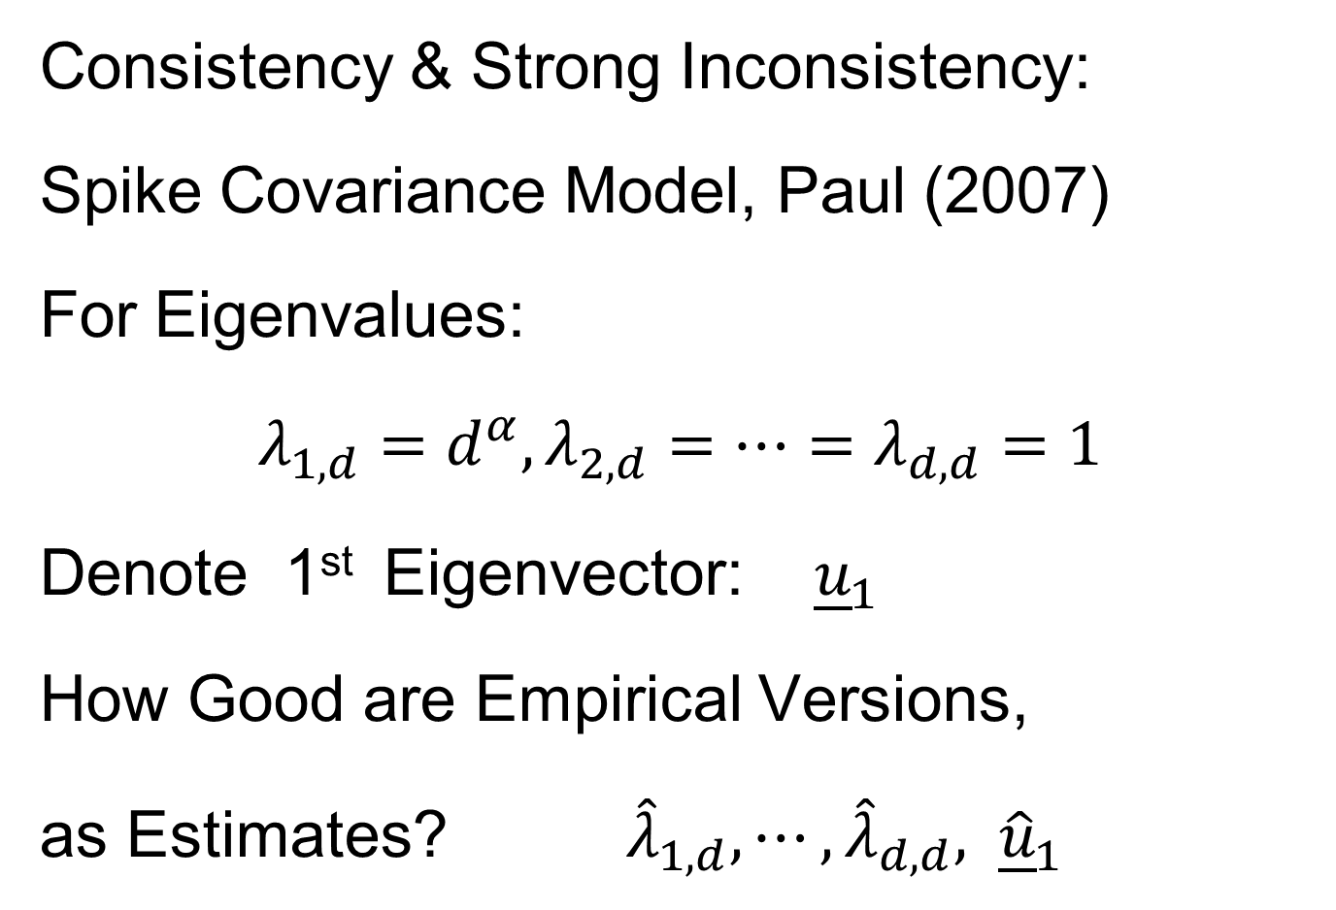
HDLSS Math. Stat. of PCA
Consistency & Strong Inconsistency:
Spike Covariance Model, Paul (2007)
For Eigenvalues:
$λ_{1,d}=d^{α},λ_{2,d}=⋯=λ_{d,d}=1$
Denote 1st Eigenvector: ${\underline{u}}_{1}$
How Good are Empirical Versions,
as Estimates? ${\hat{λ}}_{1,d},⋯,{\hat{λ}}_{d,d}, {\hat{\underline{u}}}_{1}$

Slide 45
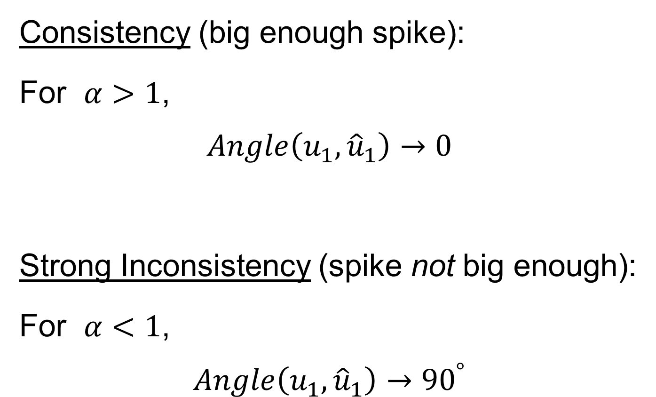
HDLSS Math. Stat. of PCA
Consistency (big enough spike):
For $α>1$,
$$Angle\left(u_{1},{\hat{u}}_{1}\right)→0$$
Strong Inconsistency (spike not big enough):
For $α<1$,
$$Angle\left(u_{1},{\hat{u}}_{1}\right)→{90}^{°}$$

Slide 46
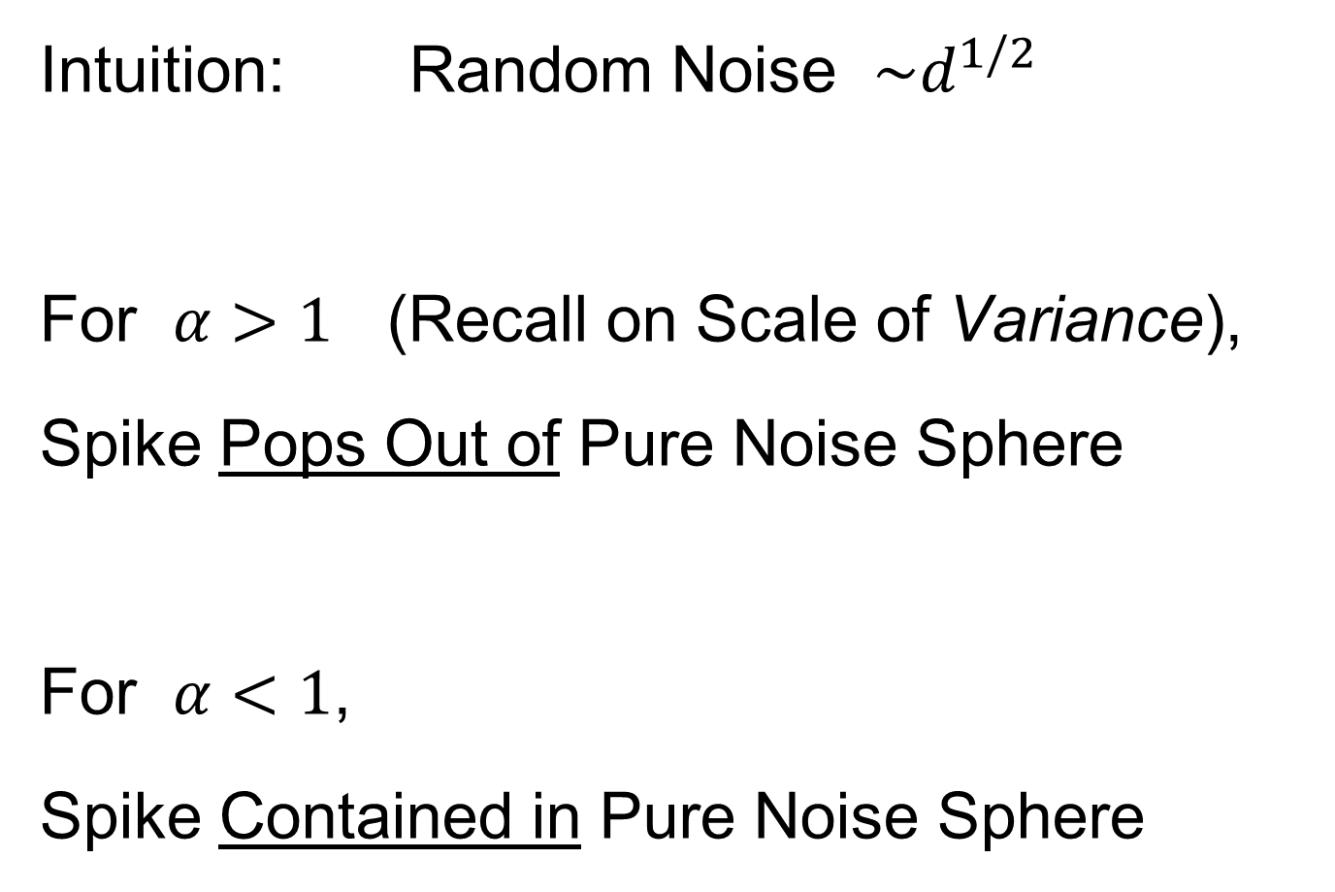
HDLSS Math. Stat. of PCA
Intuition: Random Noise $\sim d^{1/2}$
For $α>1$ (Recall on Scale of Variance),
Spike Pops Out of Pure Noise Sphere
For $α<1$,
Spike Contained in Pure Noise Sphere

Slide 47
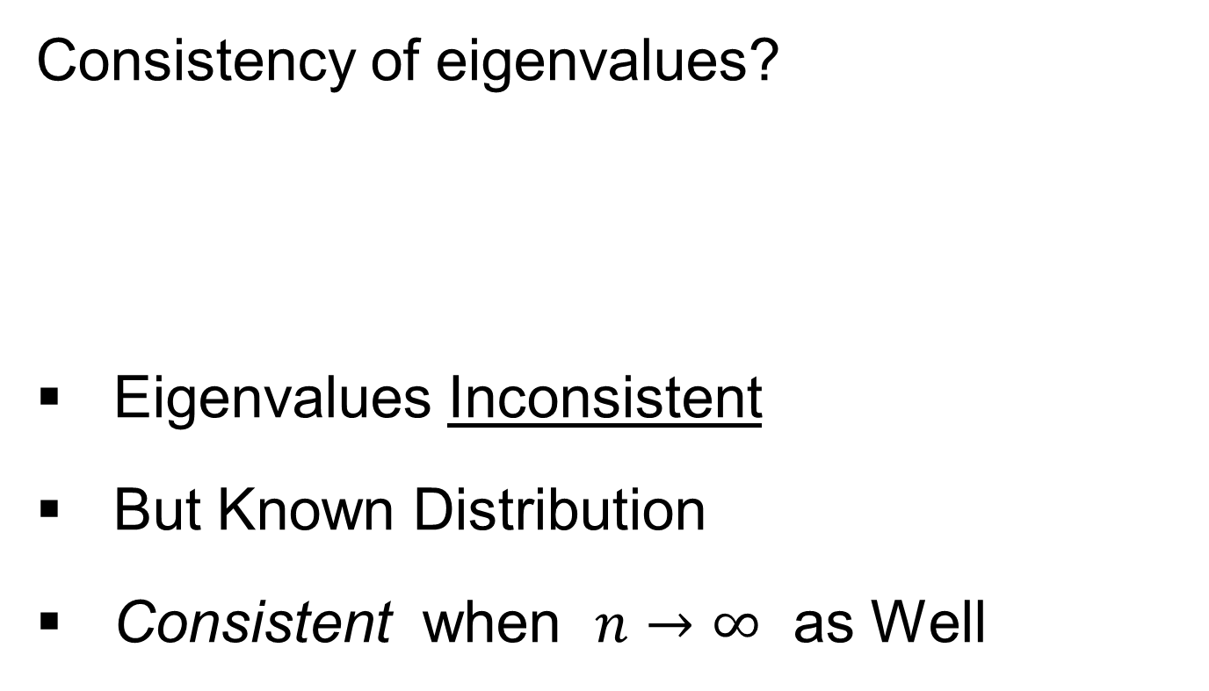
HDLSS Math. Stat. of PCA
Consistency of eigenvalues?
Eigenvalues Inconsistent
But Known Distribution
Consistent when $n→∞$ as Well

Slide 48

HDLSS Math. Stat. of PCA
Careful look at:
PCA Consistency - $α>1$ spike
(Reality Check, Suggested by Reviewer)

Slide 49
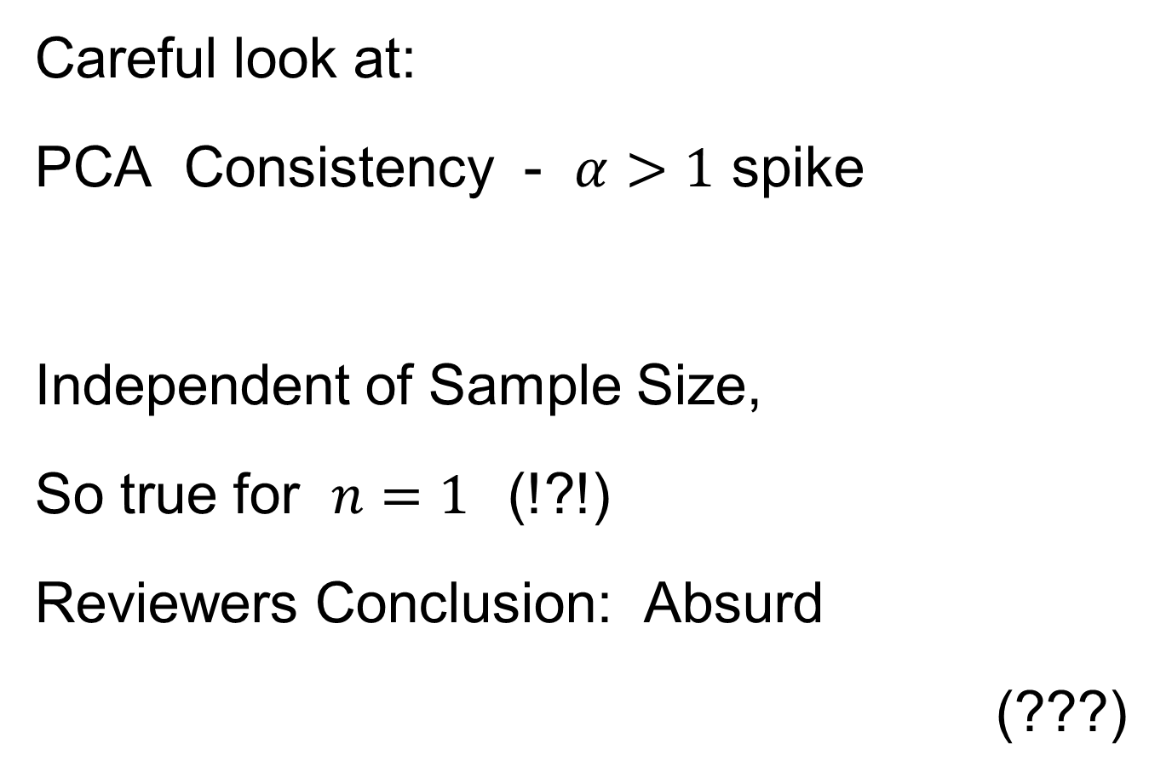
HDLSS Math. Stat. of PCA
Careful look at:
PCA Consistency - $α>1$ spike
Independent of Sample Size,
So true for $n=1$(!?!)
Reviewers Conclusion: Absurd
(???)
Shows assumption too strong for practice

Slide 50
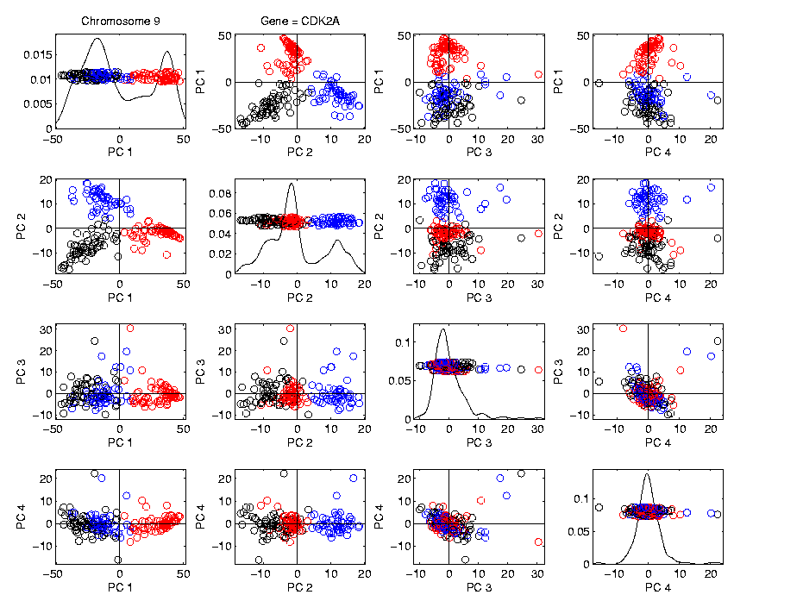
HDLSS Math. Stat. of PCA
HDLSS
PCA
Often
Finds
Signal,
Not Pure
Noise

Slide 51

HDLSS Math. Stat. of PCA
Recall
RNAseq
Example
$d\sim 1700$
$n=180$

Slide 52
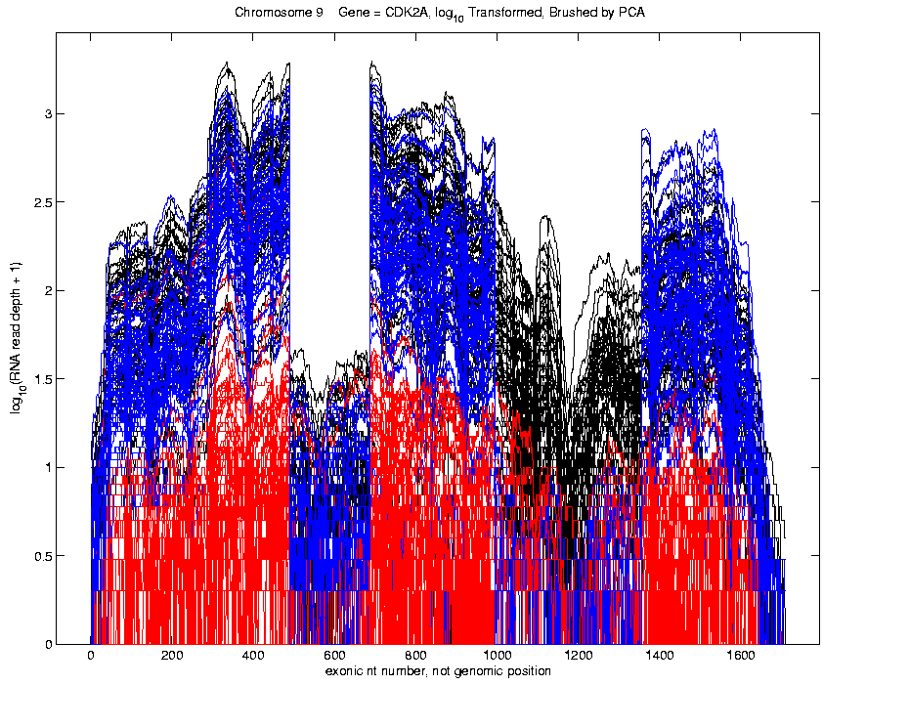
Functional Data Analysis
Manually
Brushed
Clusters
Clear
Alternate
Splicing
Not
Noise!

Slide 53
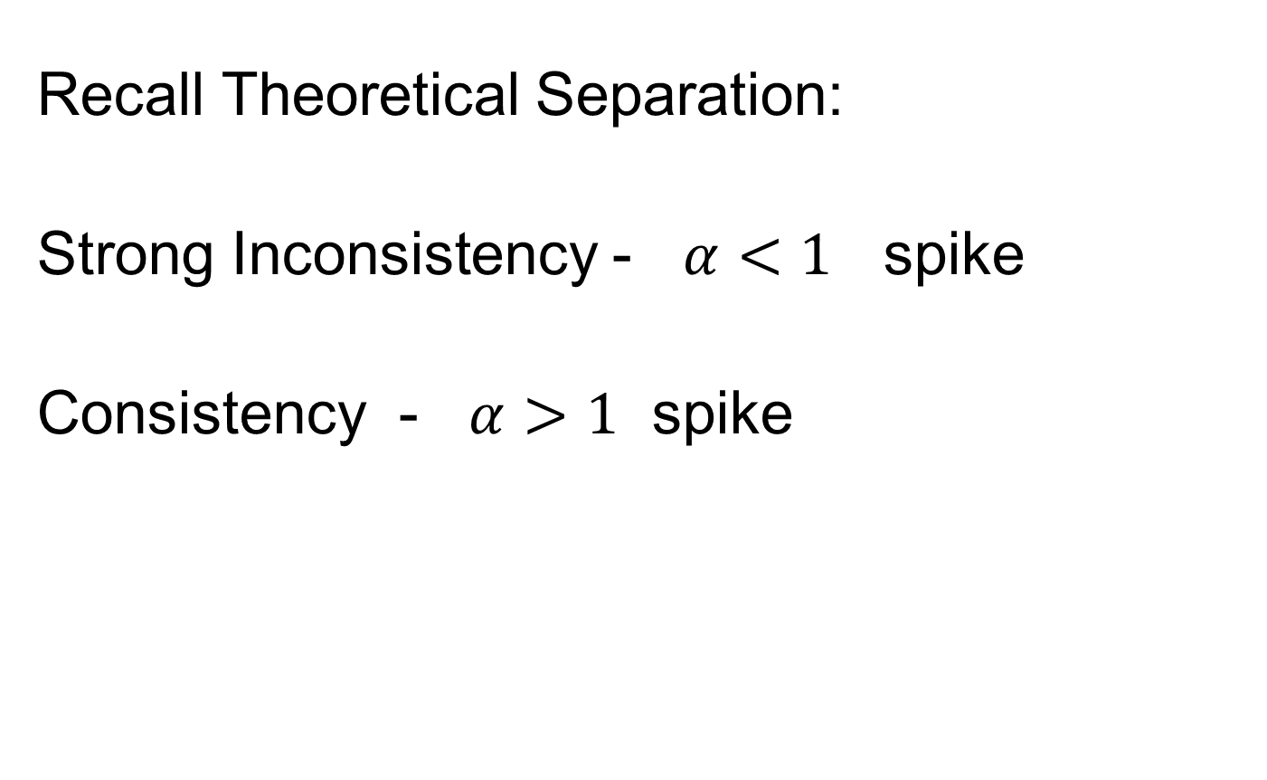
HDLSS Math. Stat. of PCA
Recall Theoretical Separation:
Strong Inconsistency - $α<1$ spike
Consistency - $α>1$ spike

Slide 54
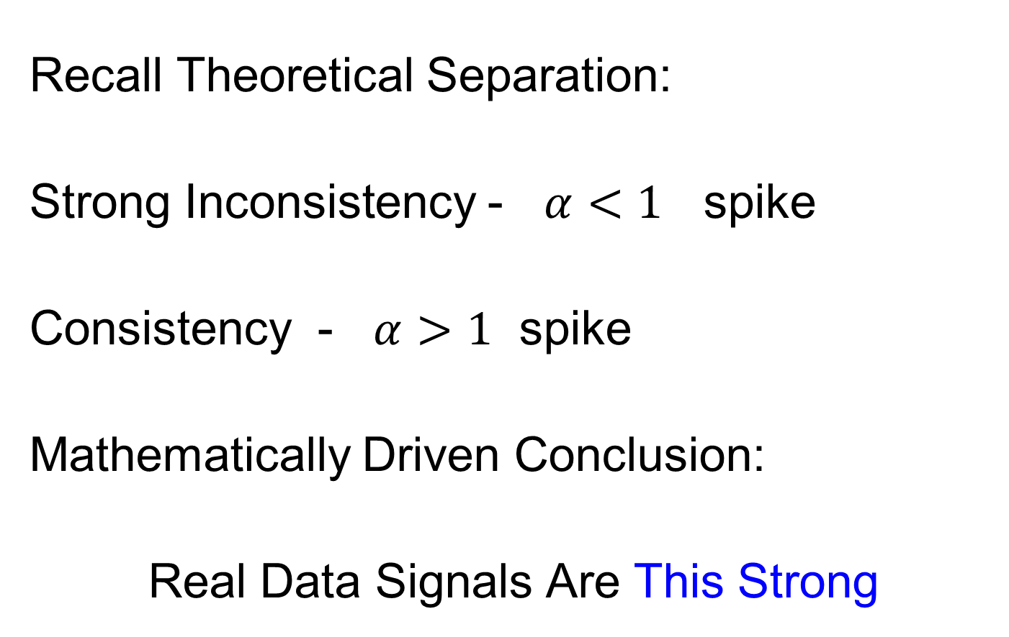
HDLSS Math. Stat. of PCA
Recall Theoretical Separation:
Strong Inconsistency - $α<1$ spike
Consistency - $α>1$ spike
Mathematically Driven Conclusion:
Real Data Signals Are This Strong

Slide 55
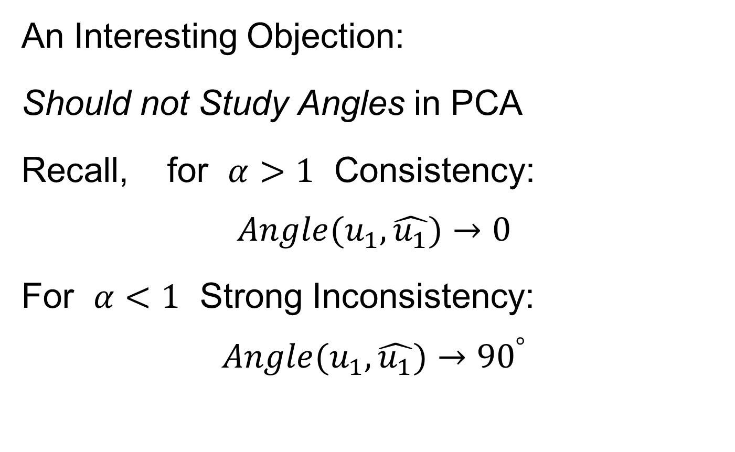
HDLSS Math. Stat. of PCA
An Interesting Objection:
Should not Study Angles in PCA
Recall, for $α>1$ Consistency:
$$Angle(u_{1},\hat{u_{1}})→0$$
For $α<1$ Strong Inconsistency:
$$Angle(u_{1},\hat{u_{1}})→{90}^{°}$$

Slide 56
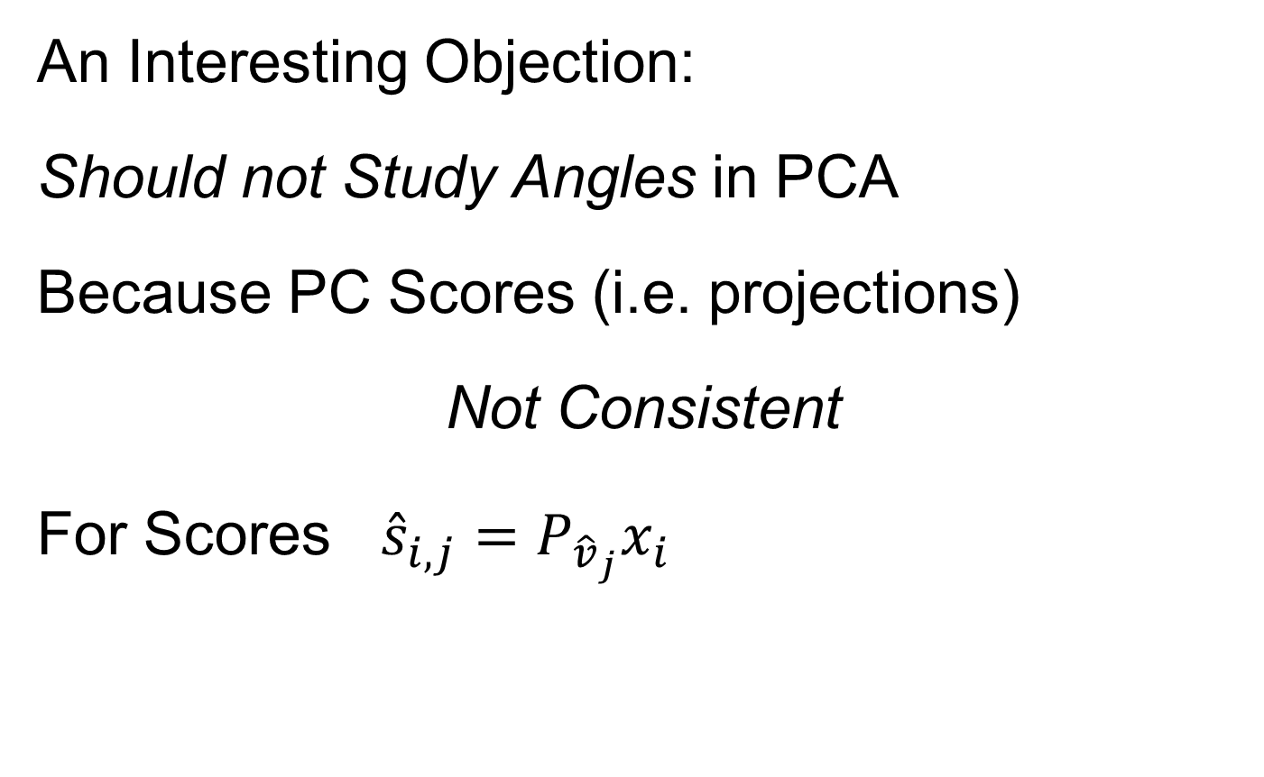
HDLSS Math. Stat. of PCA
An Interesting Objection:
Should not Study Angles in PCA
Because PC Scores (i.e. projections)
Not Consistent
For Scores ${\hat{s}}_{i,j}=P_{{\hat{v}}_{j}}x_{i}$
What we study in PCA scatterplots

Slide 57

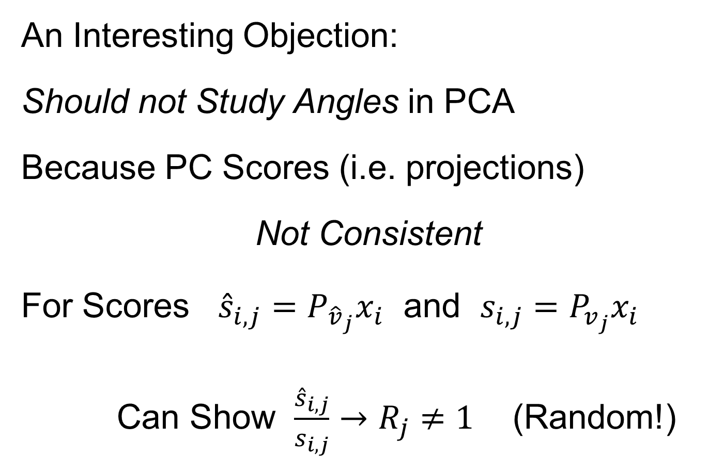
HDLSS Math. Stat. of PCA
An Interesting Objection:
Should not Study Angles in PCA
Because PC Scores (i.e. projections)
Not Consistent
For Scores ${\hat{s}}_{i,j}=P_{{\hat{v}}_{j}}x_{i}$ and $s_{i,j}=P_{v_{j}}x_{i}$
Can Show $\frac{{\hat{s}}_{i,j}}{s_{i,j}}→R_{j}≠1$ (Random!)
Due to Dan Shen

Slide 58
HDLSS Math. Stat. of PCA
PC Scores (i.e. projections)
Not Consistent
So how can PCA find Useful Signals in Data?

Slide 59
HDLSS Math. Stat. of PCA
HDLSS
PCA
Often
Finds
Signal,
Not Pure
Noise

Slide 60
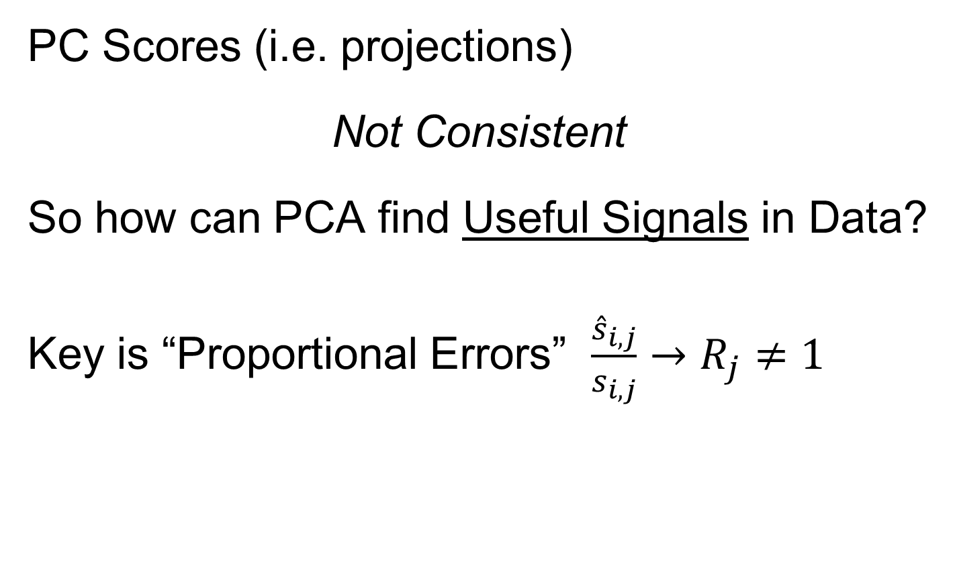
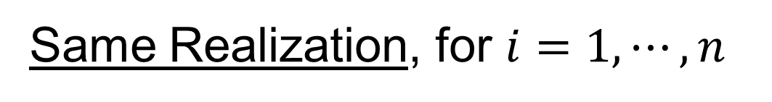
HDLSS Math. Stat. of PCA
PC Scores (i.e. projections)
Not Consistent
So how can PCA find Useful Signals in Data?
Key is “Proportional Errors” $\frac{{\hat{s}}_{i,j}}{s_{i,j}}→R_{j}≠1$
Same Realization, for $i=1,⋯,n$

Slide 61
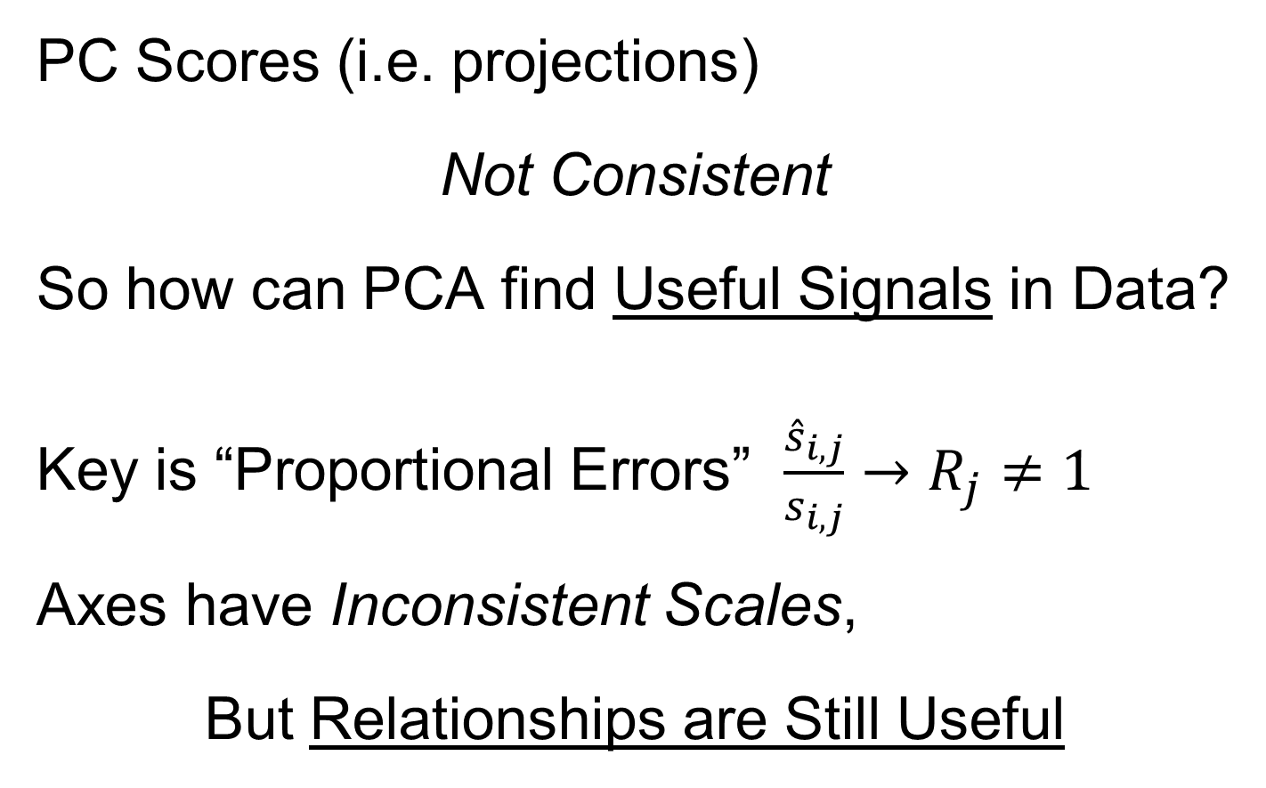
HDLSS Math. Stat. of PCA
PC Scores (i.e. projections)
Not Consistent
So how can PCA find Useful Signals in Data?
Key is “Proportional Errors” $\frac{{\hat{s}}_{i,j}}{s_{i,j}}→R_{j}≠1$
Axes have Inconsistent Scales,
But Relationships are Still Useful

Slide 62
HDLSS Math. Stat. of PCA
Numbers
On Axes
Are Wrong
But
Relationships
Are Right

Slide 63
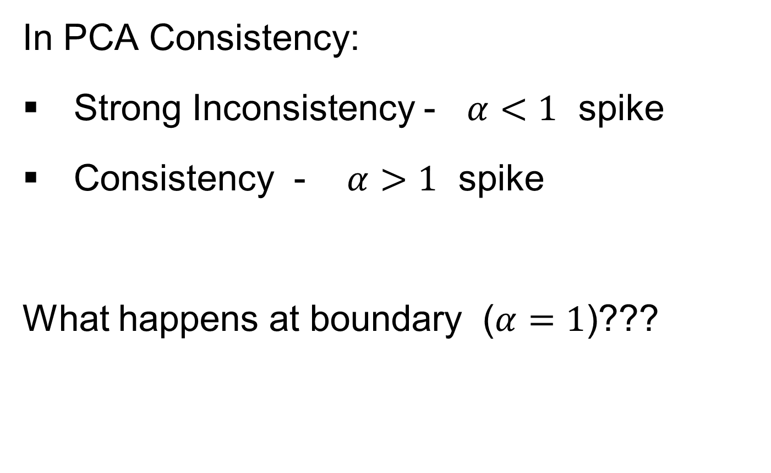
HDLSS Deep Open Problem
In PCA Consistency:
Strong Inconsistency - $α<1$ spike
Consistency - $α>1$ spike
What happens at boundary ($α=1$)???

Slide 64
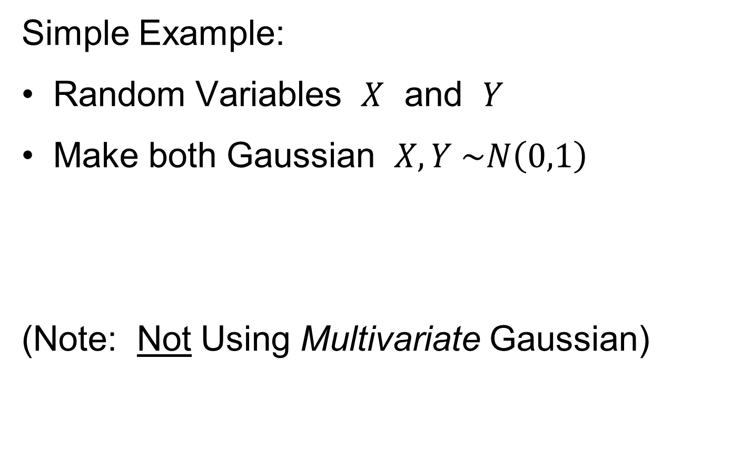
HDLSS Deep Open Problem
Result
In PCA Consistency:
Strong Inconsistency - $α<1$ spike
Consistency - $α>1$ spike
What happens at boundary ($α=1$)???
Ǝ interesting Limit Distn’s
Jung, Sen & Marron (2012)

Slide 65

HDLSS & Sparsity
Shen et al (2013)
Context: PCA, with many 0 entries in
direction vector $u_{1}$
Assumptions:
Spike Index $α$ (as above: $λ_{1}\sim d^{α}$)
Sparsity Index $β$:
# non-0 entries ~ $d^{β}$

Slide 66

HDLSS & Sparsity
PCA Context:
Spike Index $α$ (as above: $λ_{1}\sim d^{α}$)
Sparsity Index $β$: # non-0 entries ~ $d^{β}$
Compare:
Conventional Sample PCA
Sparse PCA: Shen & Huang (2008)
Over Parameters $α$ and $β$

Slide 67
1
0≤ α < β ≤1
0.7
β
0≤ α = β ≤1
Sparsity Index
α>1
0 ≤ β ≤1
0.5
0.3
0≤β<α≤1
0.1
0
0
0.2
0.4
0.6
0.8
1
Jung and Marron
α
Spike Index
Regular PCA: Inconsistent & Consistent

Slide 68
1
0≤ α < β ≤1
0.7
β
0≤ α = β ≤1
Sparsity Index
α>1
0 ≤ β ≤1
0.5
0.3
0≤β<α≤1
0.1
0
0
0.2
0.4
0.6
0.8
1
Jung and Marron
α
Spike Index
Sparse PCA: Inconsistent & New Consistency Region

Slide 69
HDLSS & Sparsity
Sparse PCA Opens Up Whole New
Region of Consistency

Slide 70

HDLSS & Other Asymptotics
Shen et al (2016)
Explores PCA Consistency under all of:
Classical: $d$ fixed, $n→∞$
Portnoy: $d, n→∞$, $d≪n$
Random Matrices: $d, n→∞$, $d \sim n$
HDMSS: $d, n→∞$, $d≫n$
HDLSS: $d→∞$, $n$ fixed

Slide 71
(A) Single Spike - Example 1.1
(B) Multi Spike - Example 1.2
Consistency
1
1
Sample Index
α + γ >1
γ
α + γ >1, γ >0
Sample Index (Johnstone and Lu (2009))
γ
Strong Inconsistency
0≤ α + γ <1
0≤ α + γ <1
(0,0)
Strong Inconsistency
1
Consistency
(0,0)
Strong Inconsistency
1
α
α
Subspace Consistency
Spike Index (Jung and Marron (2009))
Spike Index (Jung and Marron (2009))

Slide 72
(A) Single Spike - Example 1.1
(B) Multi Spike - Example 1.2
Consistency
1
1
Sample Index
α + γ >1
γ
α + γ >1, γ >0
Sample Index (Johnstone and Lu (2009))
γ
Strong Inconsistency
0≤ α + γ <1
0≤ α + γ <1
(0,0)
Strong Inconsistency
1
Consistency
(0,0)
Strong Inconsistency
1
α
α
Subspace Consistency
Spike Index (Jung and Marron (2009))
Spike Index (Jung and Marron (2009))

Slide 73
More HDLSS Asymptotics
Yata & Aoshima (2009,…,2012)
Natural Covariance Matrix Assumptions
(non-Gaussian)
Improvements on PCA
(Milder Consistency Cond.)
Using Clever Dual Space Calculations

Slide 74


HDLSS Analysis of DiProPerm
Wei et al (2015)
Background: HDLSS Hypothesis Testing
$H_{0}: μ_{1}=μ_{2}$ vs. $H_{0}: μ_{1}≠μ_{2}$
or
$H_{0}: ℒ_{1}=ℒ_{2}$ vs. $H_{0}: ℒ_{1}≠ℒ_{2}$

Slide 75

HDLSS Analysis of DiProPerm
Wei et al (2015)
Recall: N(0,1) data (both classes)

Slide 76
HDLSS Analysis of DiProPerm
Question:
Which Statistic to Summarize Projections?
2 – Sample t statistic
Mean Difference

Slide 77

HDLSS Analysis of DiProPerm
Which Statistic to Summarize Projections?
Does it Matter?
E.g. Both i.i.d with t(5) marginal
t-test summary rejects

Slide 78
HDLSS Analysis of DiProPerm
Yet both have mean 0
Reason: Less spread for original projection
E.g. Both i.i.d with t(5) marginal
t-test summary rejects

Slide 79

HDLSS Analysis of DiProPerm
Wei et al (2015)
Background: HDLSS Hypothesis Testing
$H_{0}: μ_{1}=μ_{2}$ vs. $H_{0}: μ_{1}≠μ_{2}$
or
$H_{0}: ℒ_{1}=ℒ_{2}$ vs. $H_{0}: ℒ_{1}≠ℒ_{2}$
Actually Being Tested

Slide 80


HDLSS Analysis of DiProPerm
Wei et al (2015), $n_{1}=n_{2}=2$
Mean Difference Summary:
Symmetry $⇒$ Correct Size

Slide 81


HDLSS Analysis of DiProPerm
Wei et al (2015), $n_{1}=n_{2}=2$
T Statistic Summary:
Assymmetry $⇒$ Wrong Size

Slide 82

HDLSS Analysis of DiProPerm
Wei et al (2015)
Mathematically Driven Recommendation:
Use Mean Difference Summary to Focus on:
$H_{0}: μ_{1}=μ_{2}$ vs. $H_{0}: μ_{1}≠μ_{2}$

Slide 83

HDLSS Robust PCA
Recall Robust PCA via Spherical Projection

Slide 84
HDLSS Robust PCA
Recall Robust PCA via Spherical Projection
Zhou and Marron (2015) showed:
No Outliers: Similar Performance
Outliers: Spherical PCA is Better

Slide 85
HDLSS GWAS Data Analysis
Recall that Robust PCA via Spherical Projection Failed for GWAS Data

Slide 86

GWAS Data Analysis
PCA View
Clear Ethnic
Groups
And Several
Outliers!
Eliminate With
Spherical PCA?

Slide 87

GWAS Data Analysis
Spherical
PCA
Looks Same?!?
What is
going on?
Will Explain
Later

Slide 88

HDLSS Asymptotics in Classification
Explanation:
HDLSS geometric representation
Recall in limit as $d→∞$ with $n$ fixed,
Data lie near surface of $\sqrt{d}$-sphere
Data tend to be ~orthogonal
Family members are half the same
Thus relatively small angle $\left(\sim {60}^{°}\right)$
Enough for families to dominate PCs
Spherical PC doesn’t change anything!

Slide 89


HDLSS Asymptotics in Classification
Recall in Simulations,
Methods Came Together, for High $d$

Slide 90
HDLSS Asymptotics in Classification
Explanation of Observed (Simulation) Behavior:
“everything similar for very high d ”
2 popn’s are 2 simplices (i.e. regular n-hedrons)
All are same distance from the other class
i.e. everything is a support vector
i.e. all sensible directions show “data piling”
so “sensible methods are all nearly the same”

Slide 91
HDLSS Asymptotics in Classification
Further Consequences of Geometric Represen’tion
1. DWD more stable than SVM
(based on deeper limiting distributions)
(reflects intuitive idea feeling sampling variation)
(something like mean vs. median)
Hall, Marron, Neeman (2005)
2. 1-NN rule inefficiency is quantified.
Hall, Marron, Neeman (2005)
3. Inefficiency of DWD for uneven sample size
(motivates weighted version)
Qiao, et al (2010)

Slide 92

HDLSS Asymptotics & Kernel Methods
Recall
Flexibility
From
Kernel
Embedding
Idea

Slide 93

HDLSS Asymptotics & Kernel Methods
Recall
Flexibility
From
Kernel
Embedding
Idea

Slide 94

HDLSS Asymptotics & Kernel Methods
Recall
Flexibility
From
Kernel
Embedding
Idea

Slide 95



HDLSS Asymptotics & Kernel Methods
Interesting Question:
Behavior in Very High Dimension?
Answer: El Karoui (2010)
In Random Matrix Limit, $n\sim d→∞$
Kernel Embedded Classifiers ~
~ Linear Classifiers

Slide 96
HDLSS Asymptotics & Kernel Methods
Interesting Question:
Behavior in Very High Dimension?
Implications for DWD:
Recall Main Advantage is for High d
So Not Clear Embedding Helps
Thus Not Yet Implemented in DWD

Slide 97

Twiddle ratios of subtypes
2-d Toy
Example
Unbalanced
Mixture

Slide 98
Why not adjust by means?
DWD robust against non-proportional subtypes…
Mathematical Statistical Question:
Are there mathematics behind this?
Notes:
98

Slide 99

HDLSS Data Combo Mathematics
Liu (2007) Dissertation Results:
Simple Unbalanced Cluster Model
Growing at rate $d^{α}$ as $d→∞$
Answers depend on $α$
Visualization of setting….

Slide 100

HDLSS Data Combo Mathematics

Slide 101

HDLSS Data Combo Mathematics

Slide 102
HDLSS Data Combo Mathematics
Asymptotic Results (as )
Let denote ratio between subgroup sizes

Slide 103
HDLSS Data Combo Mathematics
Asymptotic Results (as ):
For , PAM Inconsistent
Angle(PAM,Truth)
For , PAM Strongly Inconsistent
Angle(PAM,Truth)

Slide 104
HDLSS Data Combo Mathematics
Asymptotic Results (as ):
For , DWD Inconsistent
Angle(DWD,Truth)
For , DWD Strongly Inconsistent
Angle(DWD,Truth)

Slide 105
HDLSS Data Combo Mathematics
Value of and , for sample size ratio :
, only when
Otherwise for , both are Inconsistent

Slide 106
HDLSS Data Combo Mathematics
Comparison between PAM and DWD?
I.e. between and ?

Slide 107

HDLSS Data Combo Mathematics
Comparison between PAM and DWD?

Slide 108
HDLSS Data Combo Mathematics
Comparison between PAM and DWD?
I.e. between and ?
Shows Strong Difference
Explains Above Empirical Observation

Slide 109
Participant Presentation
Jack Prothero
Image Textures

