Slide 1
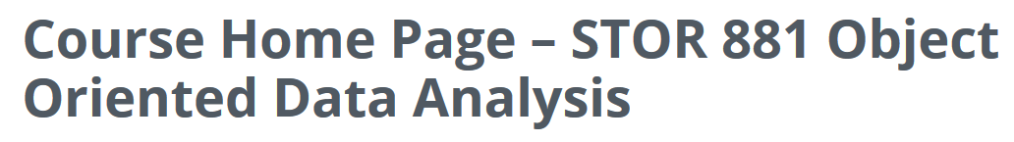
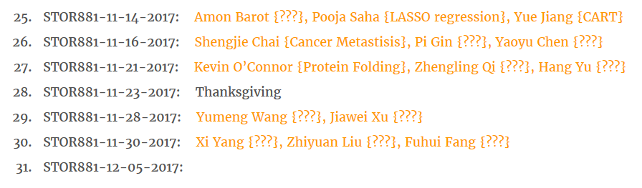
Participant Presentations
(10 Minute Talks)
Too many undetermined. Please help fill in.

Slide 2
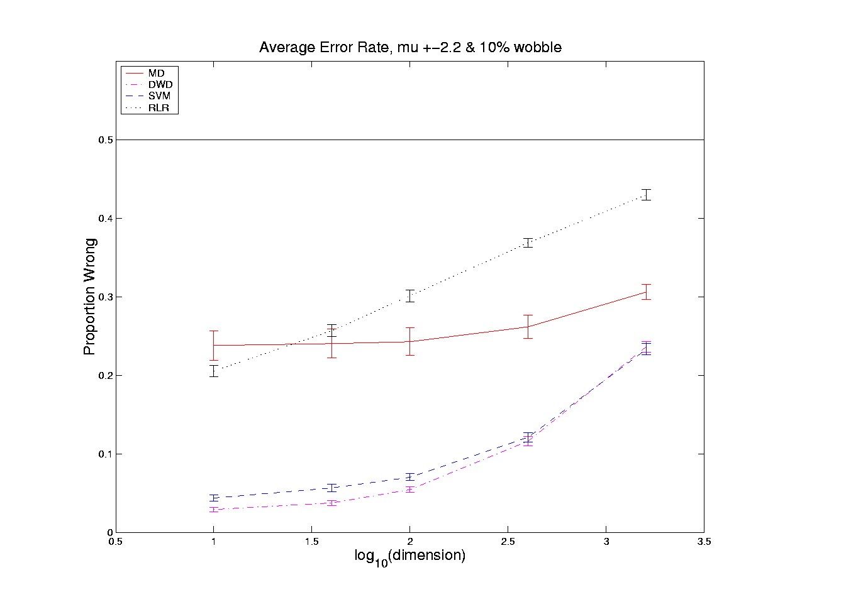
HDLSS Discrim’n Simulations
Wobble Mixture:
Notes:
DWD1figGBig.ps

Slide 3
Batch and Source Adjustment
  Important Application
  of
  Distance Weighted Discrimination

Slide 4
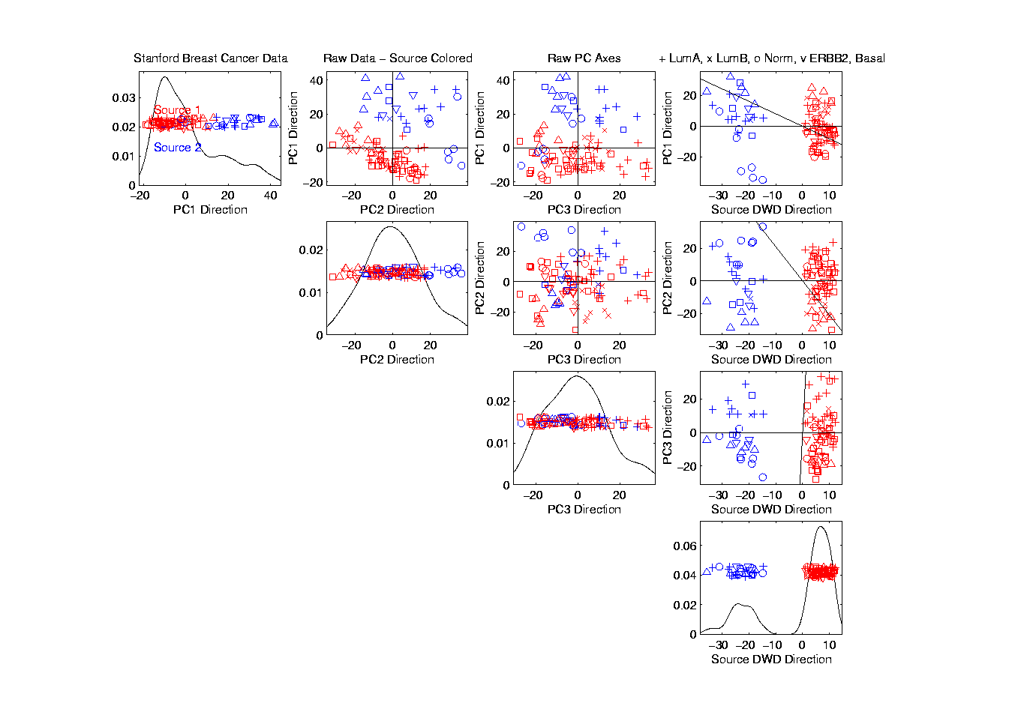
Source Batch Adj: PC 1-3 & DWD direction

Slide 5
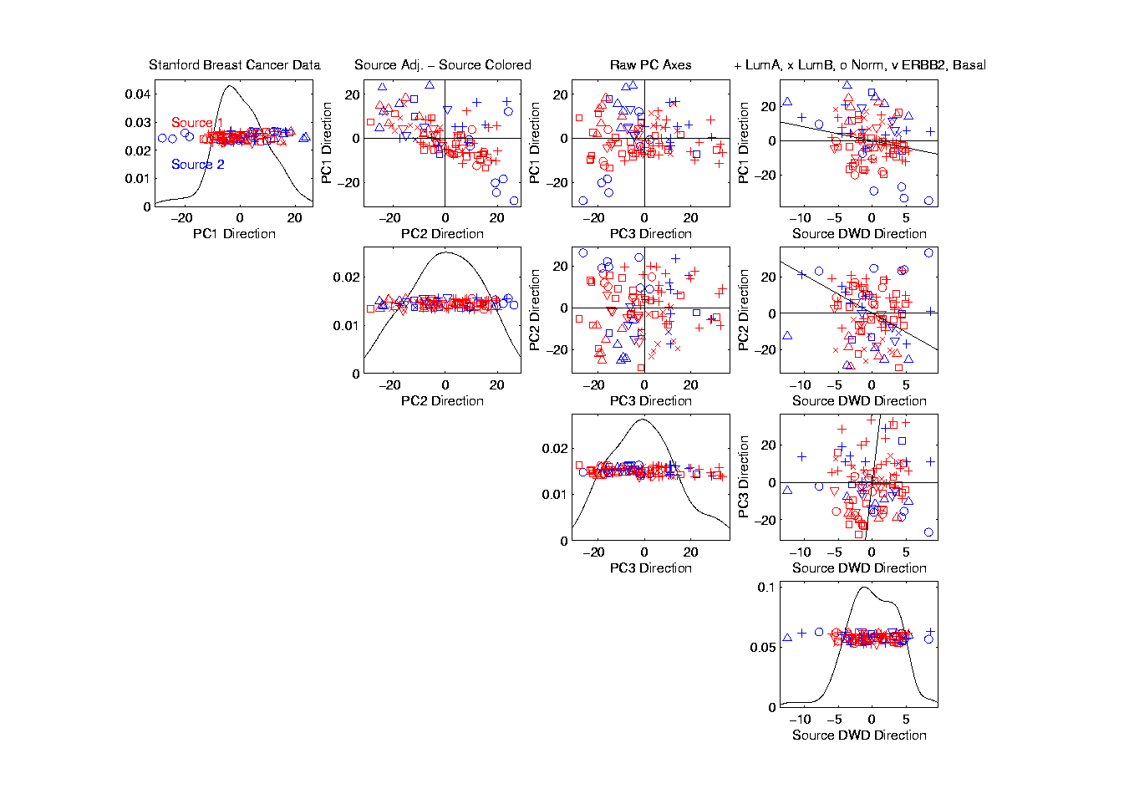
Source Batch Adj: DWD Source Adjustment

Slide 6
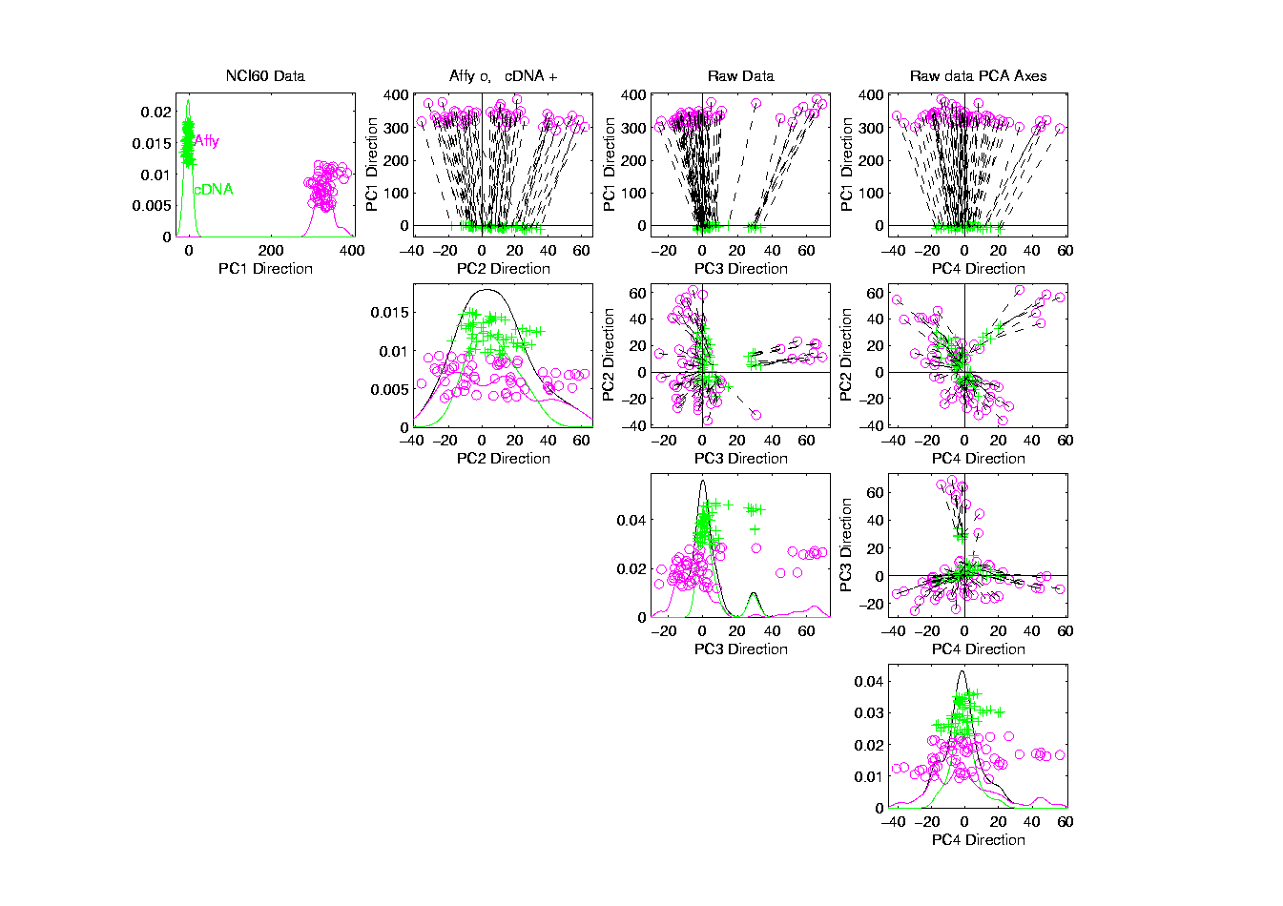
NCI 60: Raw Data, Platform Colored

Slide 7
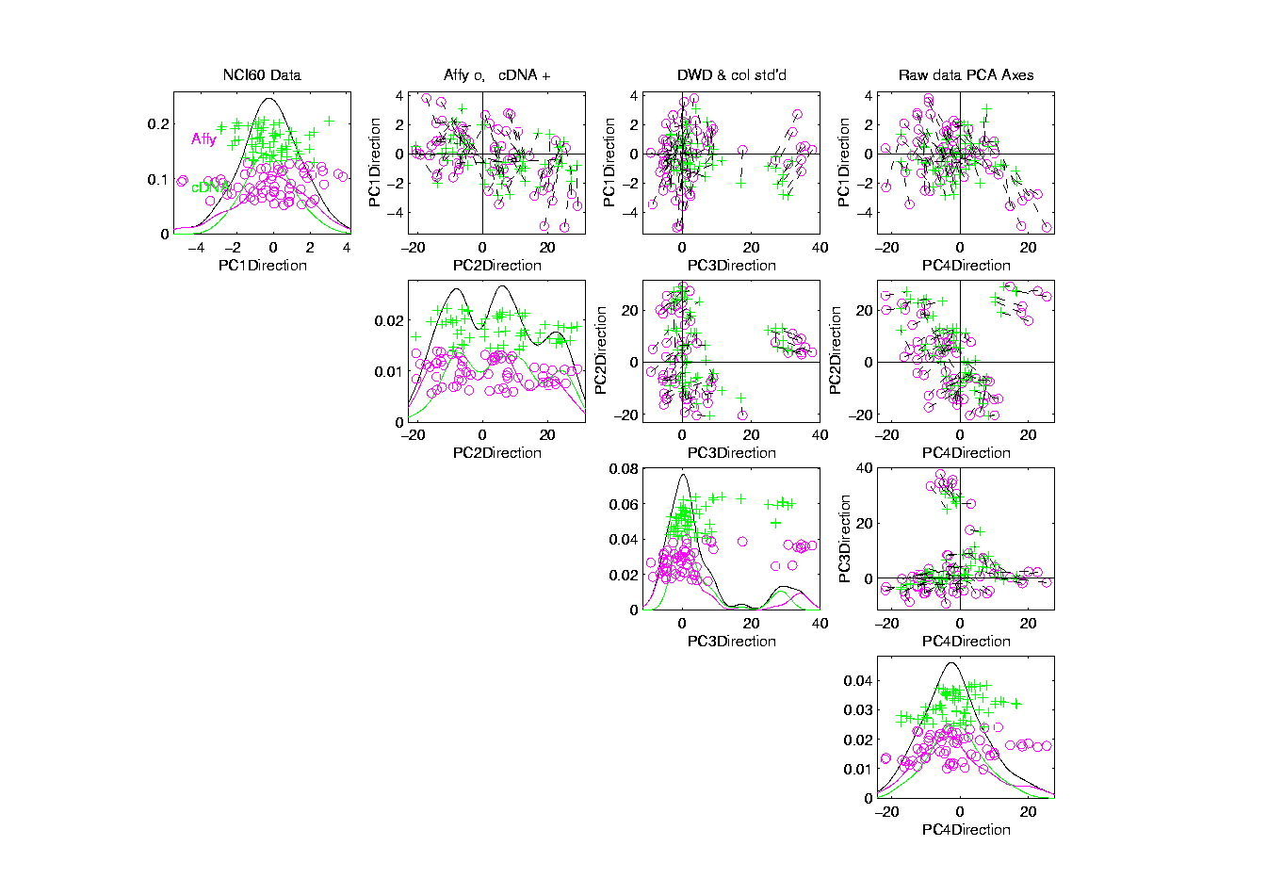
NCI 60: Fully Adjusted Data, Platform Colored

Slide 8
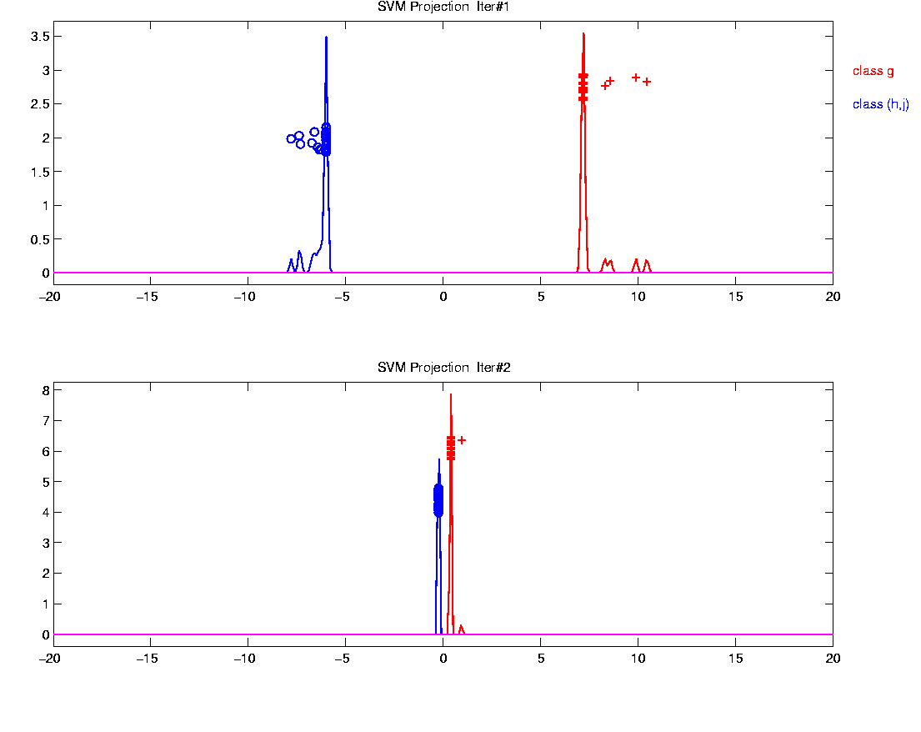
Why not adjust using SVM?
Major Problem: Proj’d Distrib’al Shape
Triangular Dist’ns (opposite skewed)
Does not allow sensible rigid shift

Slide 9
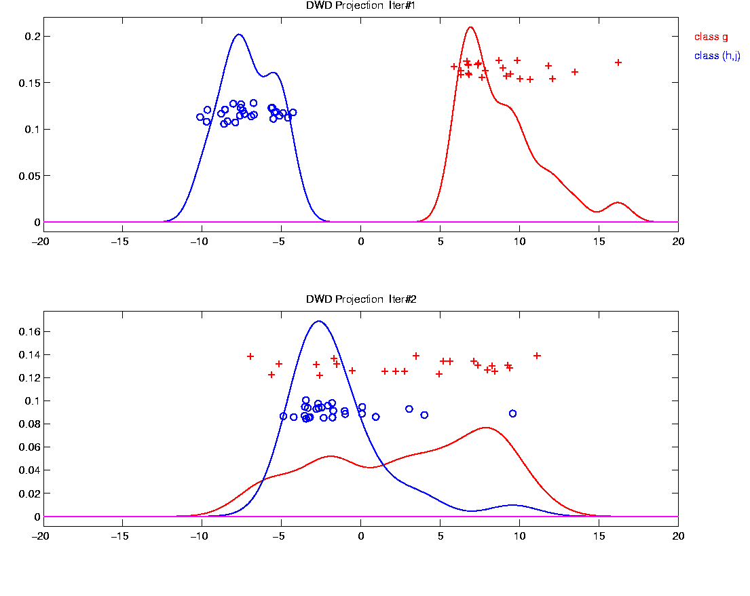
Why not adjust using SVM?
Nicely Fixed by DWD
Projected Dist’ns near Gaussian
Sensible to shift

Slide 10
Why not adjust by means?
DWD is complicated: value added?
Because it is “cool”
  Recall Improves SVM for HDLSS
Good Empirical Success
  Routinely Used in Perou Lab
  Many Comparisons Done
  Similar Lessons from Wistar
Proven Statistical Power

Slide 11
Why not adjust by means?
But Why Not PAM (~Mean Difference)?
Simpler is Better
Why not means, i.e. point cloud centerpoints?
Elegant Answer: Xuxin Liu, et al (2009)

Slide 12
Why not adjust by means?
But Why Not PAM (~Mean Difference)?
Simpler is Better
Why not means, i.e. point cloud centerpoints?
Drawback to PAM:
Poor Handling of Unbalanced Biological Subtypes
DWD more Resistant to Unbalance

Slide 13
Why not adjust by means?
Toy Example:
  Gaussian Clusters
  Two batches (denoted: + o)
  Two subtypes (red and blue)
  Goal: bring together
  + ←→ o and also + ←→ o
  Challenge: unequal biological ratios within batches

Slide 14
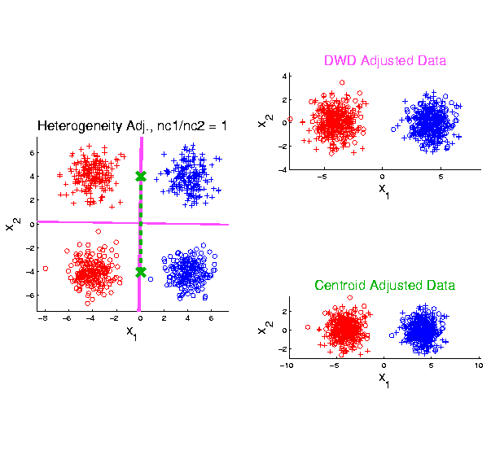
Twiddle ratios of subtypes
2-d Toy
Example
Balanced
Mixture

Slide 15
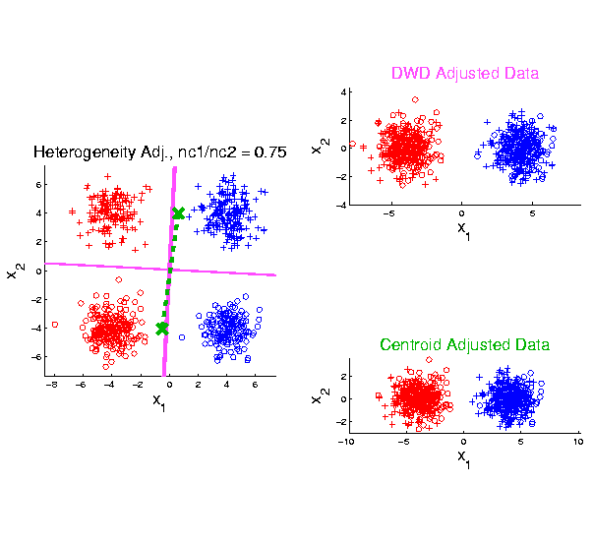
Twiddle ratios of subtypes
2-d Toy
Example
Unbalanced
Mixture
(Through
“decimation”)

Slide 16
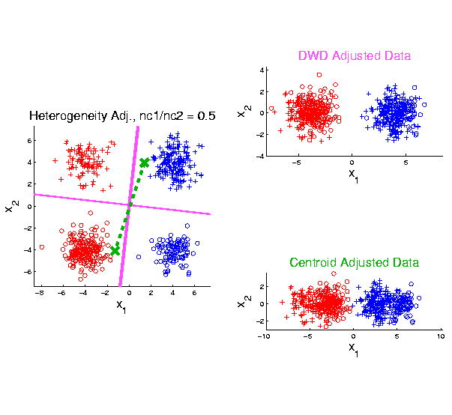
Twiddle ratios of subtypes
2-d Toy
Example
Unbalanced
Mixture
(Diminishing
Discriminatory
Power)

Slide 17
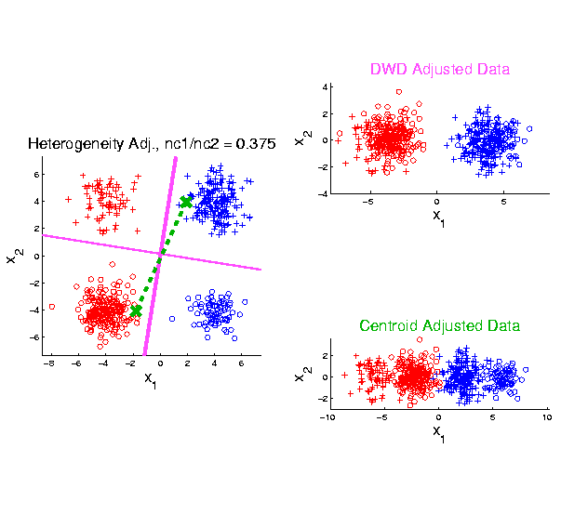
Twiddle ratios of subtypes
2-d Toy
Example
Unbalanced
Mixture

Slide 18
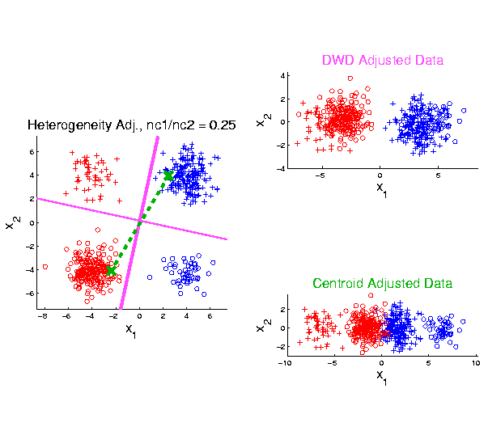
Twiddle ratios of subtypes
2-d Toy
Example
Unbalanced
Mixture

Slide 19
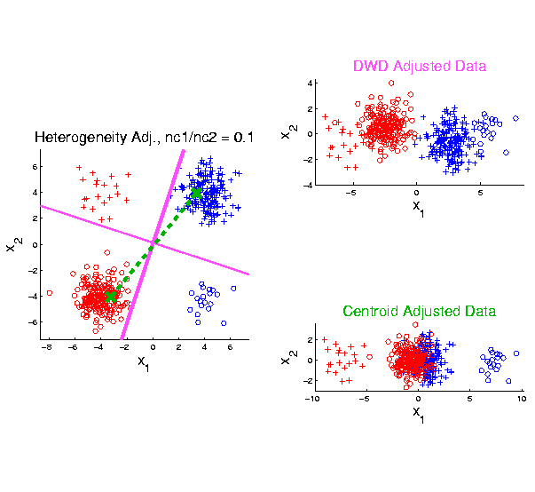
Twiddle ratios of subtypes
2-d Toy
Example
Unbalanced
Mixture
Note: Losing
Distinction
To Be Studied

Slide 20
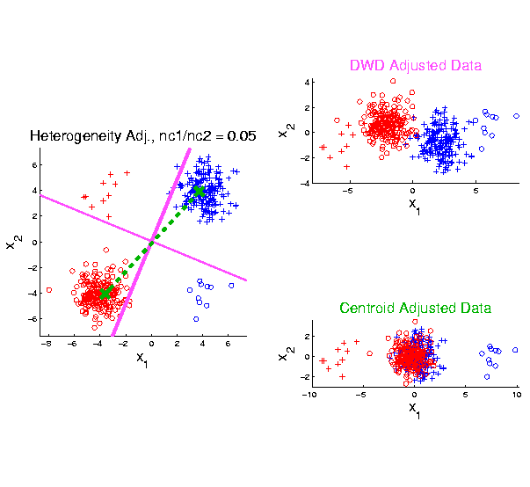
Twiddle ratios of subtypes
2-d Toy
Example
Unbalanced
Mixture

Slide 21
Why not adjust by means?
DWD robust against non-proportional subtypes…
Mathematical Statistical Question:
Are there mathematics behind this?
Notes:
21

Slide 22
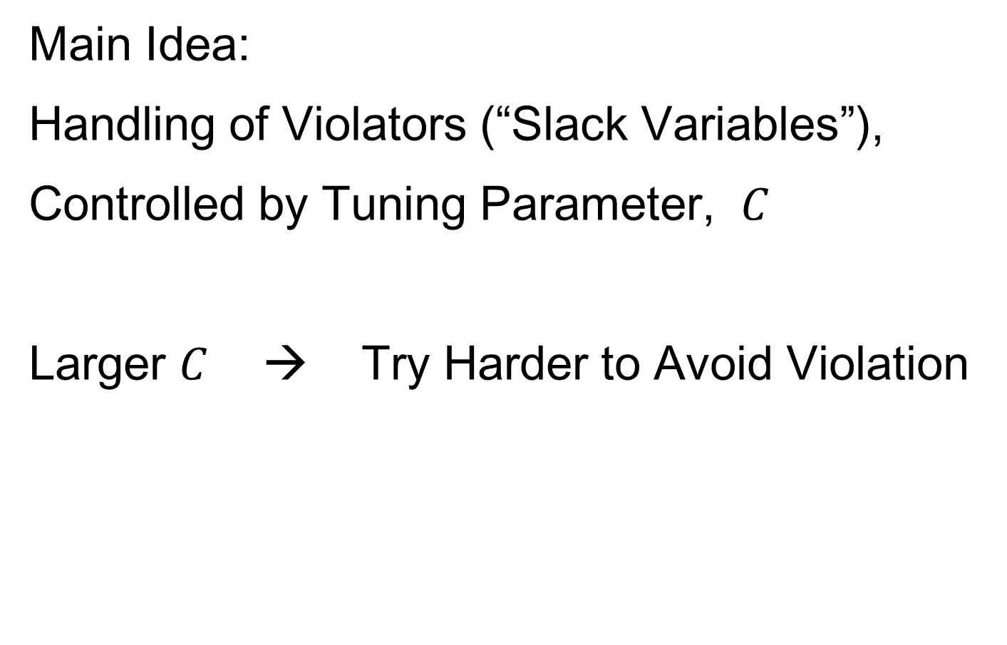
SVM & DWD Tuning Parameter
Main Idea:
Handling of Violators (“Slack Variables”),
Controlled by Tuning Parameter, $C$
Larger $C$ → Try Harder to Avoid Violation
Notes:
22

Slide 23
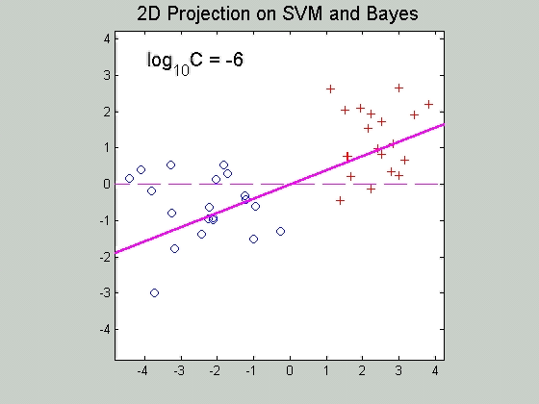

SVM Tuning Parameter
Recall Movie over $C$ for SVM:
Notes:
23

Slide 24
SVM & DWD Tuning Parameter
Possible Approaches:
Visually Tuned
(Can be Effective,
But Takes Time,
Requires Expertise)
Notes:
24

Slide 25
SVM & DWD Tuning Parameter
Possible Approaches:
Visually Tuned
Simple Defaults
DWD: 100 / median pairwise distance
(Surprisingly Useful, Simple Answer)
Notes:
25

Slide 26
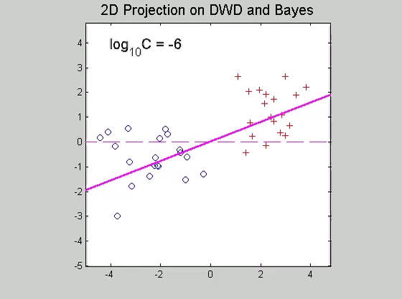
SVM & DWD Tuning Parameter
Simple Default DWD:
100 / median pairwise distance
Notes:
26

Slide 27
SVM & DWD Tuning Parameter
Possible Approaches:
Visually Tuned
Simple Defaults
DWD: 100 / median pairwise distance
(Surprisingly Useful, Simple Answer)
SVM: 1000
(Works Well Sometimes, Not Others)
Notes:
27

Slide 28
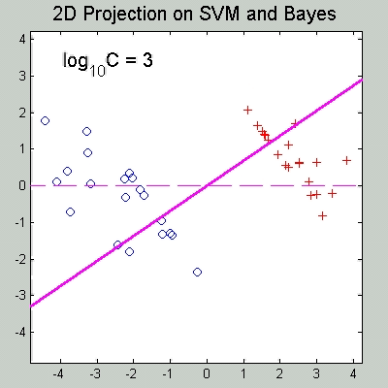
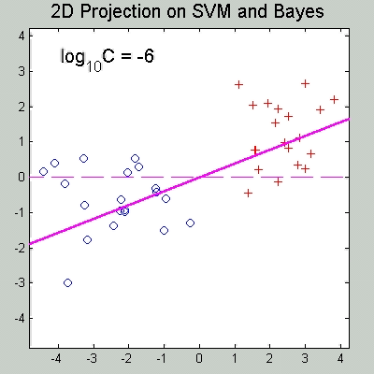
SVM & DWD Tuning Parameter
Simple Default, SVM: 1000
{from Carmichael & Marron (2017)}
Hard Margin SVM
vs. Trimmed Mean Diff.
Notes:
28

Slide 29
SVM & DWD Tuning Parameter
Possible Approaches:
Visually Tuned
Simple Defaults
(Works Well for DWD,
Less Effective for SVM)
Notes:
29

Slide 30
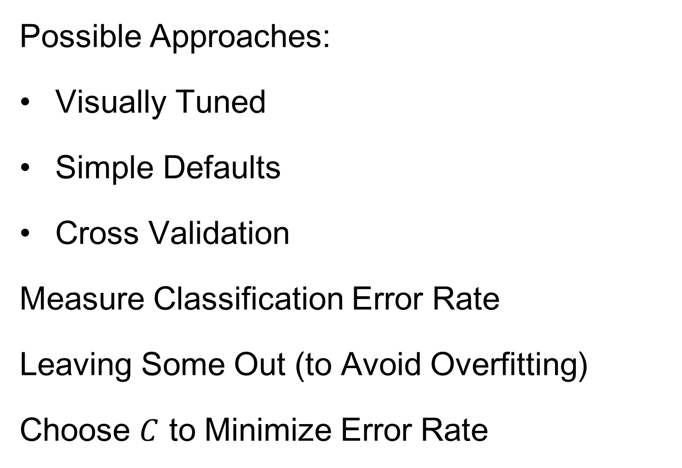
SVM & DWD Tuning Parameter
Possible Approaches:
Visually Tuned
Simple Defaults
Cross Validation
Measure Classification Error Rate
Leaving Some Out (to Avoid Overfitting)
Choose $C$ to Minimize Error Rate
Notes:
30

Slide 31
SVM & DWD Tuning Parameter
Possible Approaches:
Visually Tuned
Simple Defaults
Cross Validation
(Very Popular – Useful for SVM,
But Comes at Computational Cost)
Notes:
31

Slide 32
SVM & DWD Tuning Parameter
Possible Approaches:
Visually Tuned
Simple Defaults
Cross Validation
Scale Space
(Work with Full Range of Choices,
Will Explore More Soon)
Notes:
32

Slide 33
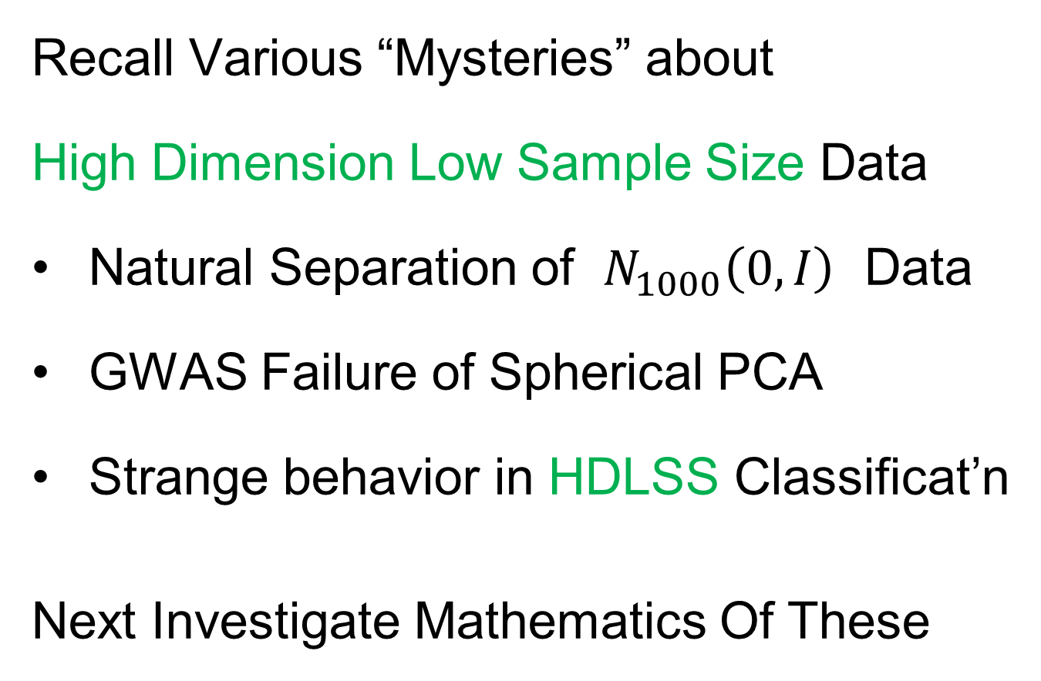
HDLSS Asymptotics
Recall Various “Mysteries” about
High Dimension Low Sample Size Data
Natural Separation of $N_{1000}\left(0,I\right)$ Data
GWAS Failure of Spherical PCA
Strange behavior in HDLSS Classificat’n
Next Investigate Mathematics Of These
Notes:
33

Slide 34

HDLSS Asymptotics
Modern Mathematical Statistics:
Based on asymptotic analysis
Notes:
34

Slide 35
HDLSS Asymptotics
Modern Mathematical Statistics:
Based on asymptotic analysis
I.e. Uses limiting operations
Almost always $\lim_{n→∞}{}$
Workhorse Method for Much Insight:
Laws of Large Numbers (Consistency)
Central Limit Theorems (Quantify Errors)
Notes:
35

Slide 36
HDLSS Asymptotics
Modern Mathematical Statistics:
Based on asymptotic analysis
I.e. Uses limiting operations
Almost always $\lim_{n→∞}{}$
Occasional misconceptions:
  Indicates behavior for large samples
  Thus only makes sense for “large” samples
  Models phenomenon of “increasing data”
  So other flavors are useless???
Notes:
36

Slide 37
HDLSS Asymptotics
Modern Mathematical Statistics:
Based on asymptotic analysis
Real Reasons:
  Approximation provides insights
  Can find simple underlying structure
  In complex situations
Thus various flavors are fine:
$$\lim_{n→∞}{} \lim_{d→∞}{} \lim_{n,d→∞}{} \lim_{σ→0}{}$$
Even desirable! (find additional insights)
Notes:
37

Slide 38
HDLSS Asymptotics
Personal Observations:
HDLSS world is…
Surprising (many times!)
[Think I’ve got it, and then …]
Mathematically Beautiful (?)
Practically Relevant

Slide 39
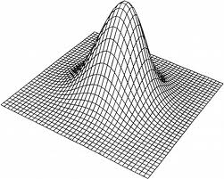
HDLSS Asymptotics: Simple Paradoxes
For $d$ dimensional Standard Normal dist’n:
$$\underline{Z}=\left(\begin{matrix}Z_{1} \\ ⋮ \\ Z_{d}\end{matrix}\right)\sim N_{d}\left(0,I_{d}\right)$$
Where are the Data?
Near Peak of Density?
Thanks to: psycnet.apa.org

Slide 40
HDLSS Asymptotics: Simple Paradoxes
For $d$ dimensional Standard Normal dist’n:
$$\underline{Z}=\left(\begin{matrix}Z_{1} \\ ⋮ \\ Z_{d}\end{matrix}\right)\sim N_{d}\left(0,I_{d}\right)$$
Euclidean Distance to Origin (as $d→∞$)
(measure how close to peak)

Slide 41
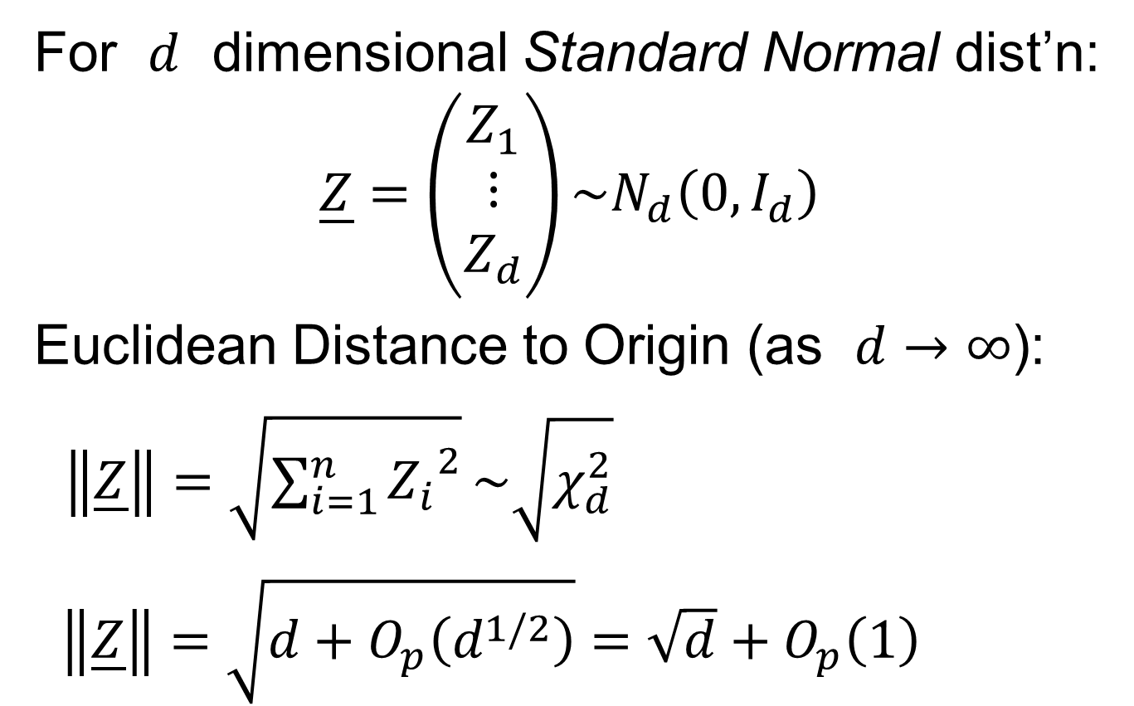
HDLSS Asymptotics: Simple Paradoxes
For $d$ dimensional Standard Normal dist’n:
$$\underline{Z}=\left(\begin{matrix}Z_{1} \\ ⋮ \\ Z_{d}\end{matrix}\right)\sim N_{d}\left(0,I_{d}\right)$$
Euclidean Distance to Origin (as $d→∞$):
$\left\|\underline{Z}\right\|=\sqrt{\sum_{i=1}^{n}{{Z_{i}}^{2}}}\sim \sqrt{χ_{d}^{2}}$
$\left\|\underline{Z}\right\|=\sqrt{d+O_{p}\left(d^{1/2}\right)}=\sqrt{d}+O_{p}\left(1\right)$

Slide 42
HDLSS Asymptotics: Simple Paradoxes
As $d→∞$,
$$\left\|\underline{Z}\right\|=\sqrt{d}+O_{p}\left(1\right)$$
Data lie roughly on surface of sphere,
with radius $\sqrt{d}$
- Yet origin is point of highest density???
- Paradox resolved by:
density w. r. t. Lebesgue Measure
Notes:
42

Slide 43
HDLSS Asymptotics: Simple Paradoxes
- Paradox resolved by:
density w. r. t. Lebesgue Measure
Consider Volume of Unit Sphere in $ℝ^{d}$
Find As: Integral In Sph’l Coordinates
$$V_{d}=\iiint{Jdθ_{1}⋯dθ_{d}dr}$$
Notes:
43

Slide 44
HDLSS Asymptotics: Simple Paradoxes
- Paradox resolved by:
density w. r. t. Lebesgue Measure
Consider Volume of Unit Sphere in $ℝ^{d}$
Find As: Integral In Sph’l Coordinates
$$V_{d}=\iiint{Jdθ_{1}⋯dθ_{d}dr}$$
Look At Integrand w.r.t. $r$
Can Show: Puts ~ All Weight Near $r=1$
Notes:
44

Slide 45
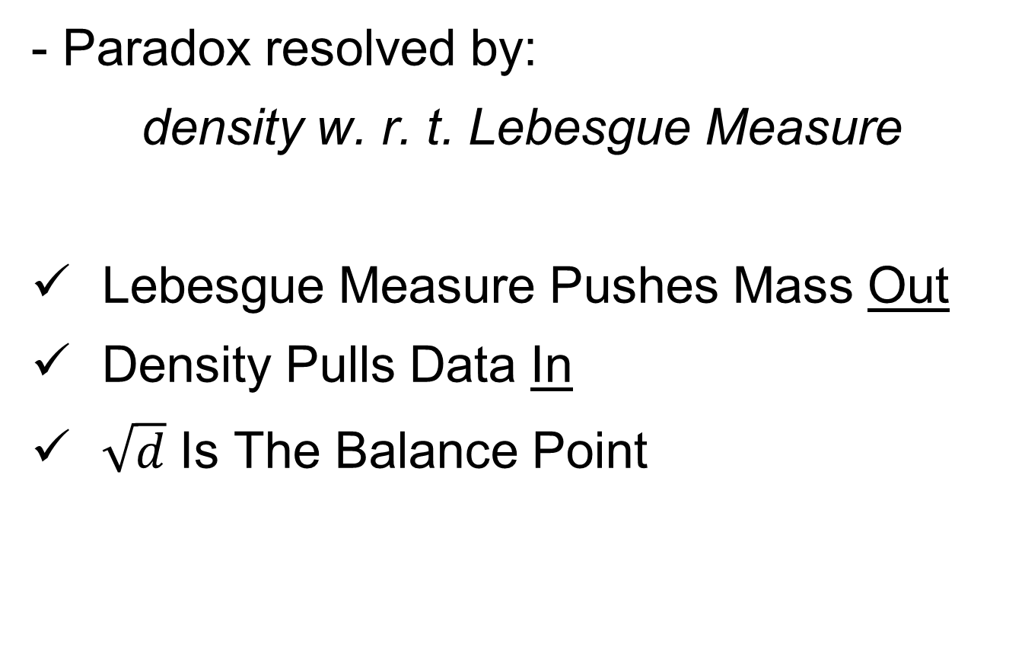
HDLSS Asymptotics: Simple Paradoxes
- Paradox resolved by:
density w. r. t. Lebesgue Measure
Lebesgue Measure Pushes Mass Out
Density Pulls Data In
$\sqrt{d}$ Is The Balance Point
Notes:
45

Slide 46
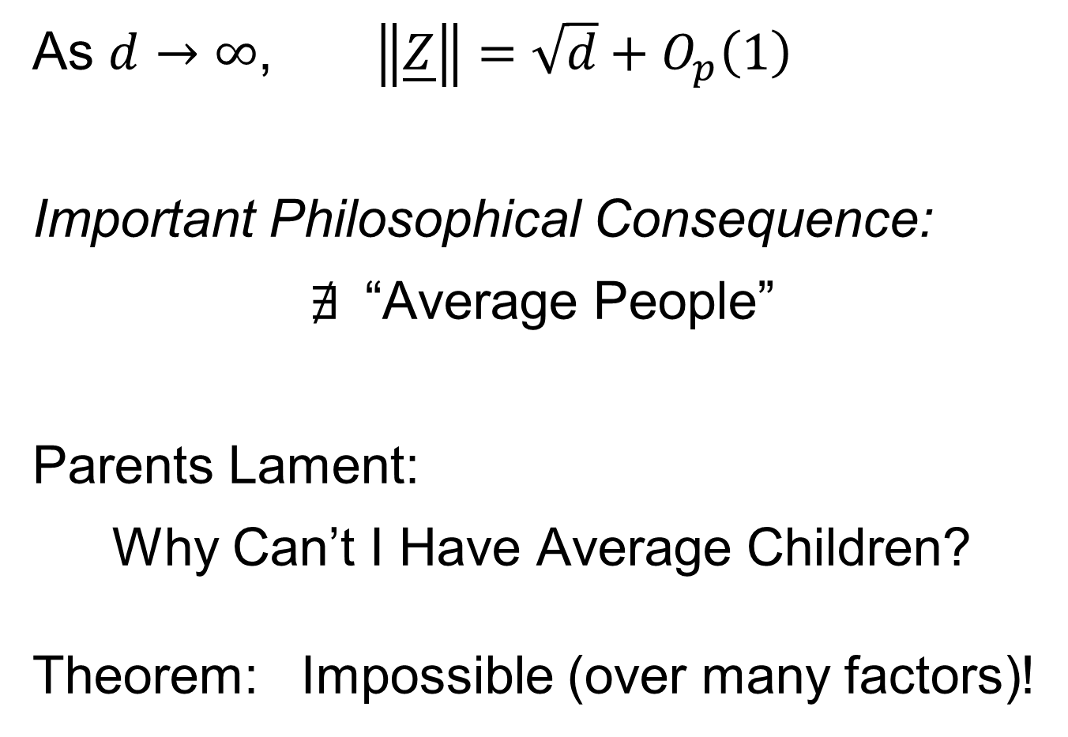
HDLSS Asymptotics: Simple Paradoxes
As $d→∞$, $\left\|\underline{Z}\right\|=\sqrt{d}+O_{p}\left(1\right)$
Important Philosophical Consequence:
$∄$“Average People”
Parents Lament:
Why Can’t I Have Average Children?
Theorem: Impossible (over many factors)!
Notes:
46

Slide 47
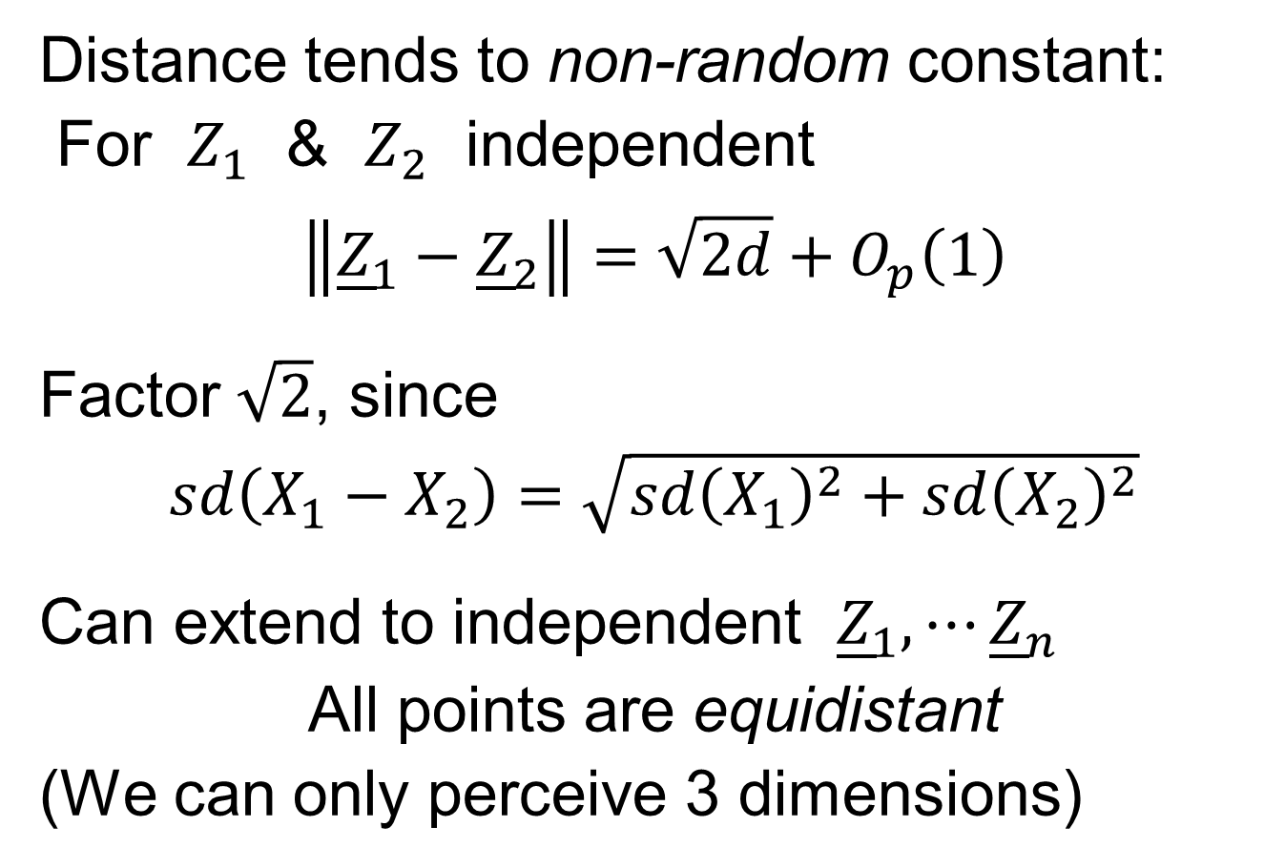
HDLSS Asymptotics: Simple Paradoxes
Distance tends to non-random constant:
For $Z_{1}$ & $Z_{2}$ independent
$$\left\|{\underline{Z}}_{1}−{\underline{Z}}_{2}\right\|=\sqrt{2d}+O_{p}\left(1\right)$$
Factor $\sqrt{2}$, since
$sd\left(X_{1}−X_{2}\right)=\sqrt{{sd\left(X_{1}\right)}^{2}+{sd\left(X_{2}\right)}^{2}}$
Can extend to independent ${\underline{Z}}_{1},⋯{\underline{Z}}_{n}$
All points are equidistant
(We can only perceive 3 dimensions)
Notes:
47

Slide 48
HDLSS Asymptotics: Simple Paradoxes
Recall Reason Why
Perceptual System from Ancestors
They Needed to Find Food
Food Exists in 3-d World
(We can only perceive 3 dimensions)
Notes:
48

Slide 49
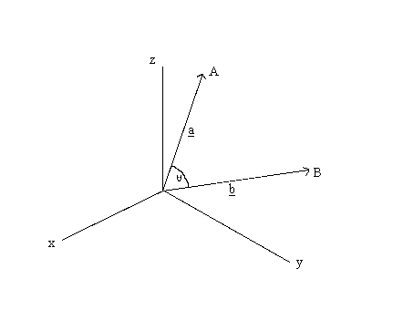
HDLSS Asymptotics: Simple Paradoxes
For $d$ dim’al Standard Normal dist’n:
${\underline{Z}}_{1}$ indep. of ${\underline{Z}}_{2}\sim N_{d}\left(\underline{0},I_{d}\right)$
High dim’al Angles (as $d→∞$):
As vectors from the Origin
$\left(\cos^{−1}\left({{\underline{u}}_{1}}^{t}{\underline{u}}_{2}\right)\right)$
Thanks to: members.tripod.com

Slide 50
HDLSS Asymptotics: Simple Paradoxes
For $d$ dim’al Standard Normal dist’n:
${\underline{Z}}_{1}$ indep. of ${\underline{Z}}_{2}\sim N_{d}\left(\underline{0},I_{d}\right)$
High dim’al Angles (as $d→∞$):
$$Angle\left({\underline{Z}}_{1},{\underline{Z}}_{2}\right)={90}^{°}+O_{p}\left(d^{−1/2}\right)$$
- Everything is orthogonal???

Slide 51

HDLSS Asy’s: Geometrical Represent’n
Assume ${\underline{Z}}_{1},⋯{\underline{Z}}_{n}\sim N_{d}\left(\underline{0},I_{d}\right)$, let $d→∞$
Study Subspace Generated by Data
Hall, Marron & Neeman (2005)

Slide 52

HDLSS Asy’s: Geometrical Represent’n
Assume ${\underline{Z}}_{1},⋯{\underline{Z}}_{n}\sim N_{d}\left(\underline{0},I_{d}\right)$, let $d→∞$
Study Subspace Generated by Data
Hyperplane through $0$,
of dimension $n$
Hall, Marron & Neeman (2005)

Slide 53

HDLSS Asy’s: Geometrical Represent’n
Assume ${\underline{Z}}_{1},⋯{\underline{Z}}_{n}\sim N_{d}\left(\underline{0},I_{d}\right)$, let $d→∞$
Study Subspace Generated by Data
Hyperplane through $0$,
of dimension $n$
Points are “nearly equidistant to $0$”,
& dist $\sqrt{d}$
Hall, Marron & Neeman (2005)

Slide 54
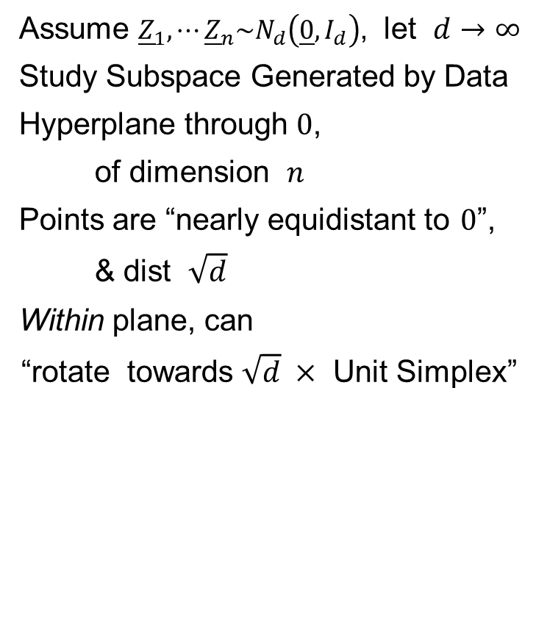
HDLSS Asy’s: Geometrical Represent’n
Assume ${\underline{Z}}_{1},⋯{\underline{Z}}_{n}\sim N_{d}\left(\underline{0},I_{d}\right)$, let $d→∞$
Study Subspace Generated by Data
Hyperplane through $0$,
of dimension $n$
Points are “nearly equidistant to $0$”,
& dist $\sqrt{d}$
Within plane, can
“rotate towards $\sqrt{d} ×$ Unit Simplex”
Hall, Marron & Neeman (2005)

Slide 55

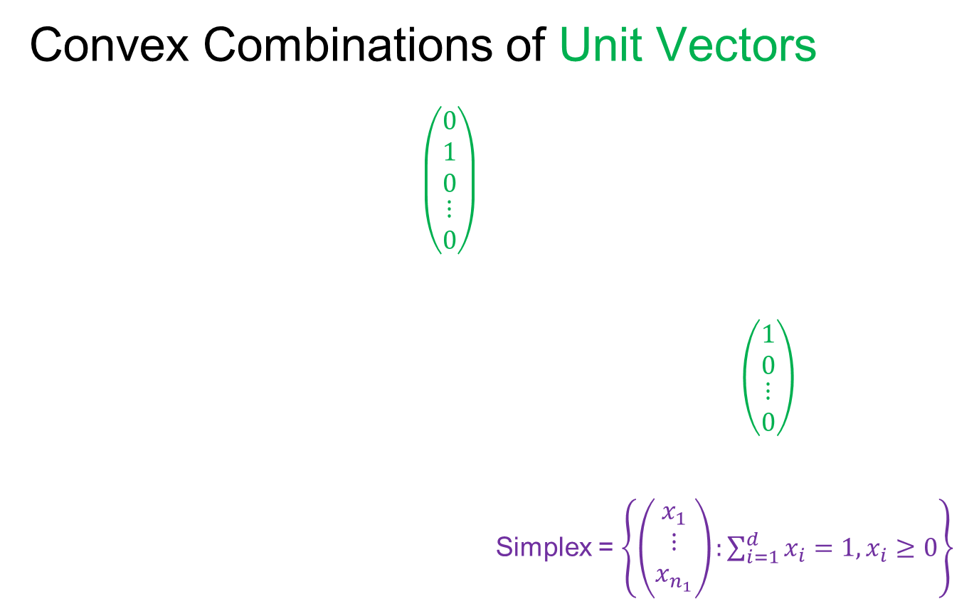
Unit Simplex in $ℝ^{d}$
Convex Combinations of Unit Vectors
$\left(\begin{matrix}\begin{matrix}0 \\ 1 \\ 0\end{matrix} \\ ⋮ \\ 0\end{matrix}\right)$
$\left(\begin{matrix}\begin{matrix}1 \\ 0\end{matrix} \\ \begin{matrix}⋮ \\ 0\end{matrix}\end{matrix}\right)$
Simplex = $\left\{\left(\begin{matrix}x_{1} \\ ⋮ \\ x_{n_{1}}\end{matrix}\right):\sum_{i=1}^{d}{x_{i}=1,x_{i}≥0}\right\}$

Slide 56
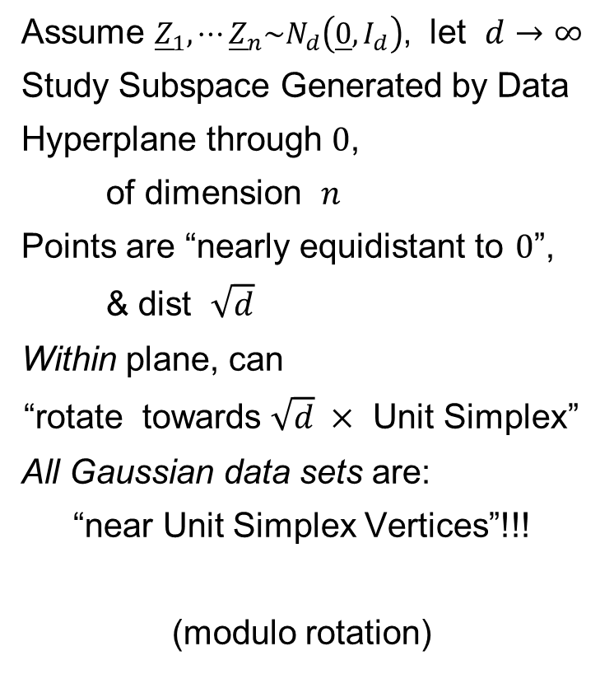
HDLSS Asy’s: Geometrical Represent’n
Assume ${\underline{Z}}_{1},⋯{\underline{Z}}_{n}\sim N_{d}\left(\underline{0},I_{d}\right)$, let $d→∞$
Study Subspace Generated by Data
Hyperplane through $0$,
of dimension $n$
Points are “nearly equidistant to $0$”,
& dist $\sqrt{d}$
Within plane, can
“rotate towards $\sqrt{d} ×$ Unit Simplex”
All Gaussian data sets are:
“near Unit Simplex Vertices”!!!
(modulo rotation)
Hall, Marron & Neeman (2005)

Slide 57
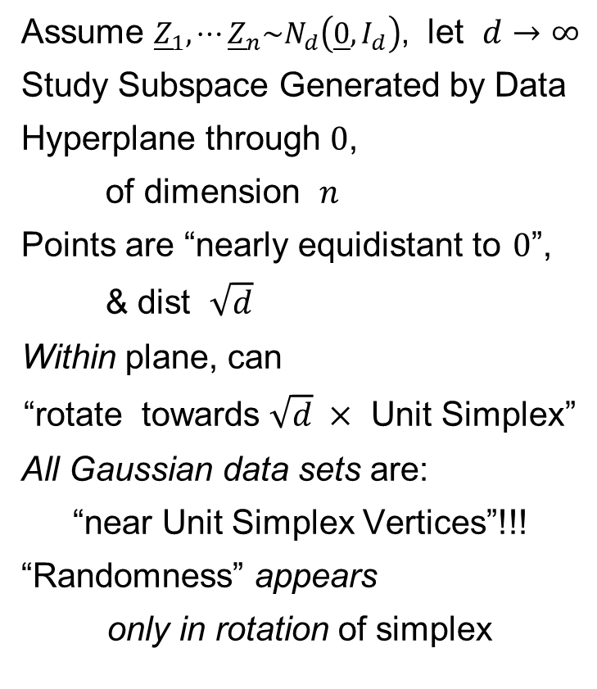
HDLSS Asy’s: Geometrical Represent’n
Assume ${\underline{Z}}_{1},⋯{\underline{Z}}_{n}\sim N_{d}\left(\underline{0},I_{d}\right)$, let $d→∞$
Study Subspace Generated by Data
Hyperplane through $0$,
of dimension $n$
Points are “nearly equidistant to $0$”,
& dist $\sqrt{d}$
Within plane, can
“rotate towards $\sqrt{d} ×$ Unit Simplex”
All Gaussian data sets are:
“near Unit Simplex Vertices”!!!
“Randomness” appears
only in rotation of simplex
Hall, Marron & Neeman (2005)

Slide 58
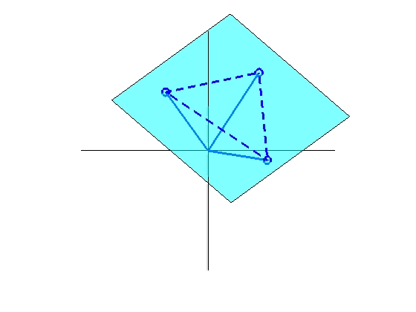
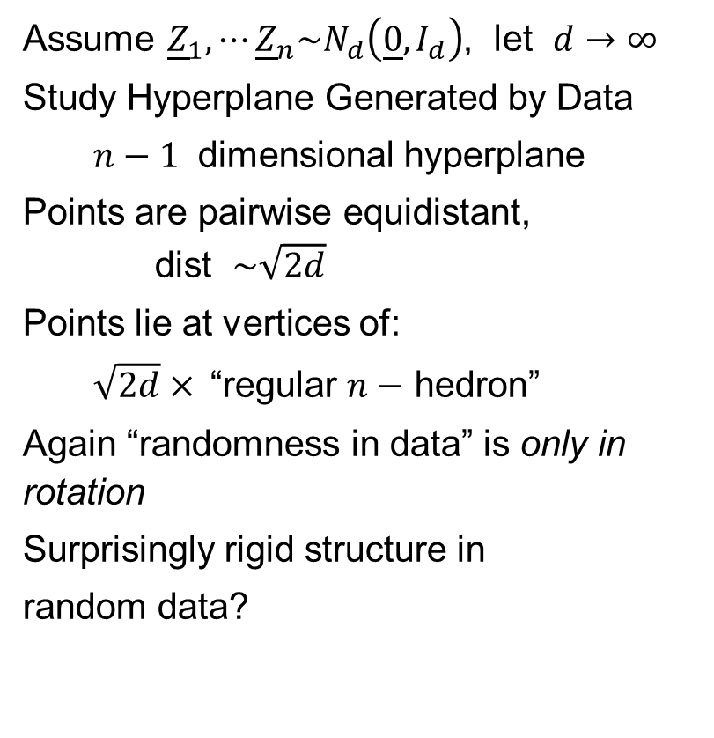
HDLSS Asy’s: Geometrical Represent’n
Assume ${\underline{Z}}_{1},⋯{\underline{Z}}_{n}\sim N_{d}\left(\underline{0},I_{d}\right)$, let $d→∞$
Study Hyperplane Generated by Data
$n−1$ dimensional hyperplane
Points are pairwise equidistant, dist $\sim \sqrt{2d}$
Points lie at vertices of:
$\sqrt{2d}×$“regular $n−$ hedron”
Again “randomness in data” is only in rotation
Surprisingly rigid structure in
random data?

Slide 59
HDLSS Asy’s: Geometrical Represen’tion
Simulation View: study “rigidity after rotation”
Simple 3 point data sets
In dimensions d = 2, 20, 200, 20000
Generate hyperplane of dimension 2
Rotate that to plane of screen
Rotate within plane, to make “comparable”
Repeat 10 times, use different colors

Slide 60
HDLSS Asy’s: Geometrical Represen’tion
Simulation View: Shows “Rigidity after Rotation”

Slide 61
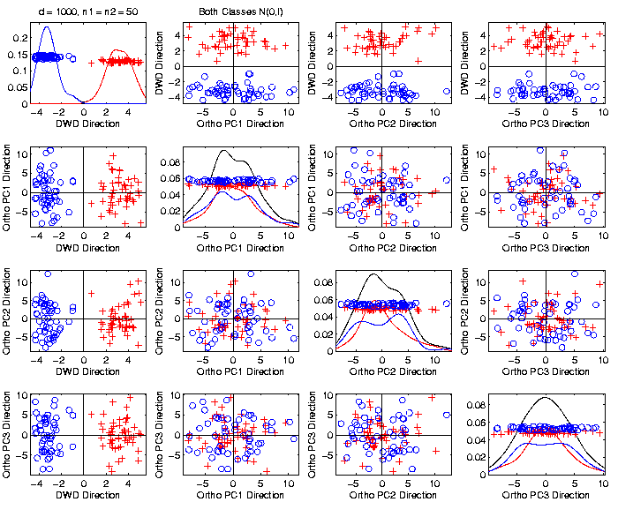
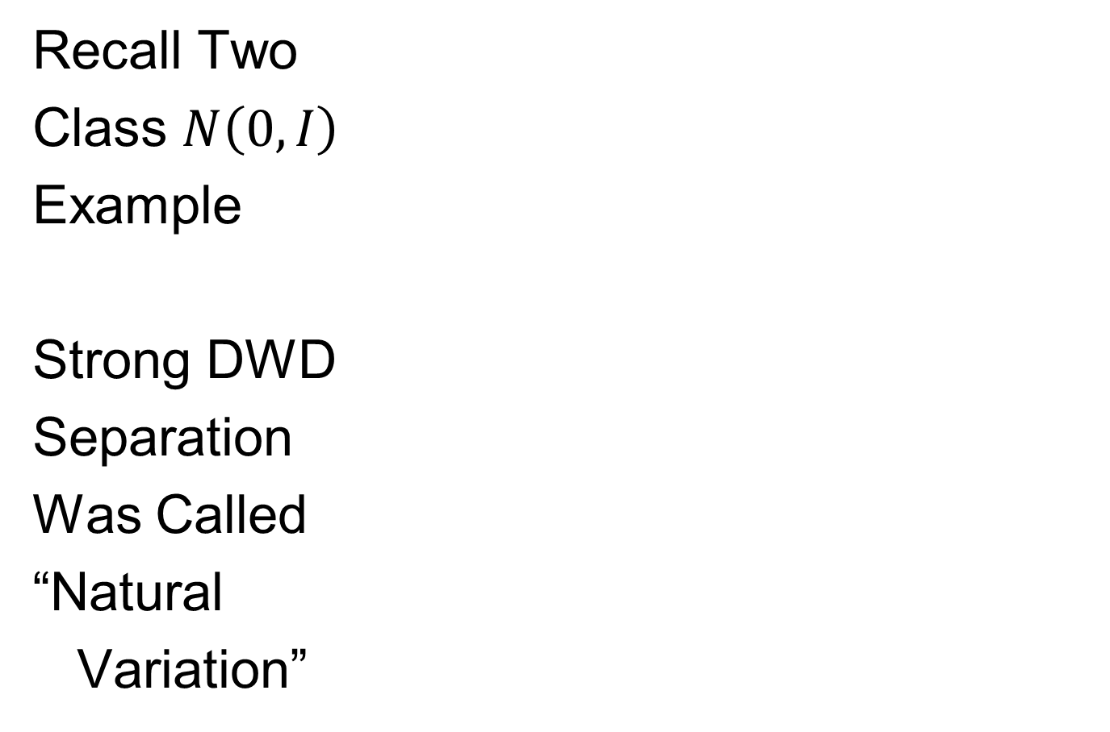
An Interesting HDLSS Explanation
Recall Two
Class $N\left(0,I\right)$
Example
Strong DWD
Separation
Was Called
“Natural
Variation”

Slide 62
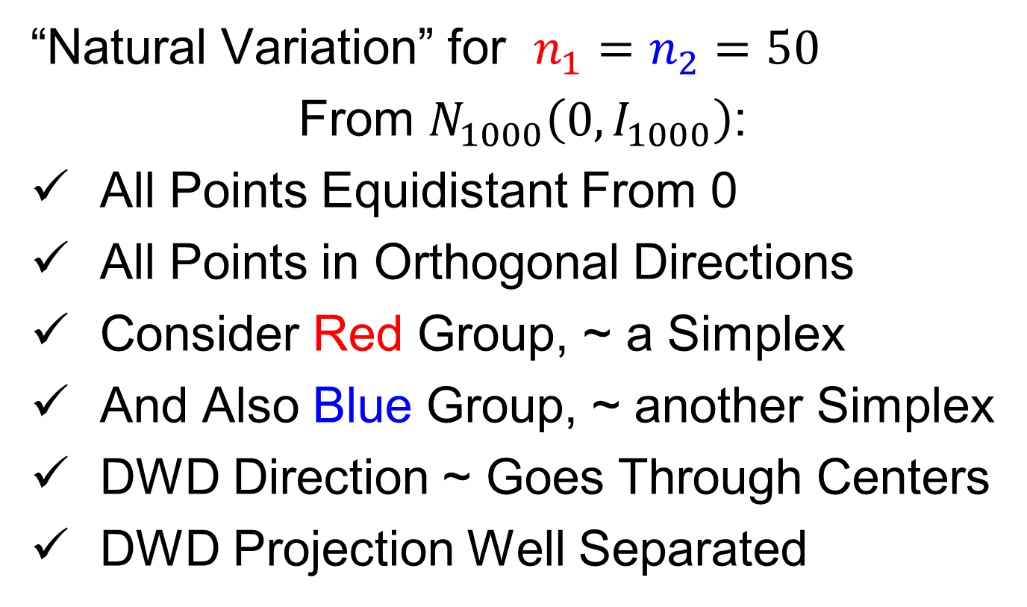
An Interesting HDLSS Explanation
“Natural Variation” for $n_{1}=n_{2}=50$
From $N_{1000}\left(0,I_{1000}\right)$:
All Points Equidistant From 0
All Points in Orthogonal Directions
Consider Red Group, ~ a Simplex
And Also Blue Group, ~ another Simplex
DWD Direction ~ Goes Through Centers
DWD Projection Well Separated

Slide 63
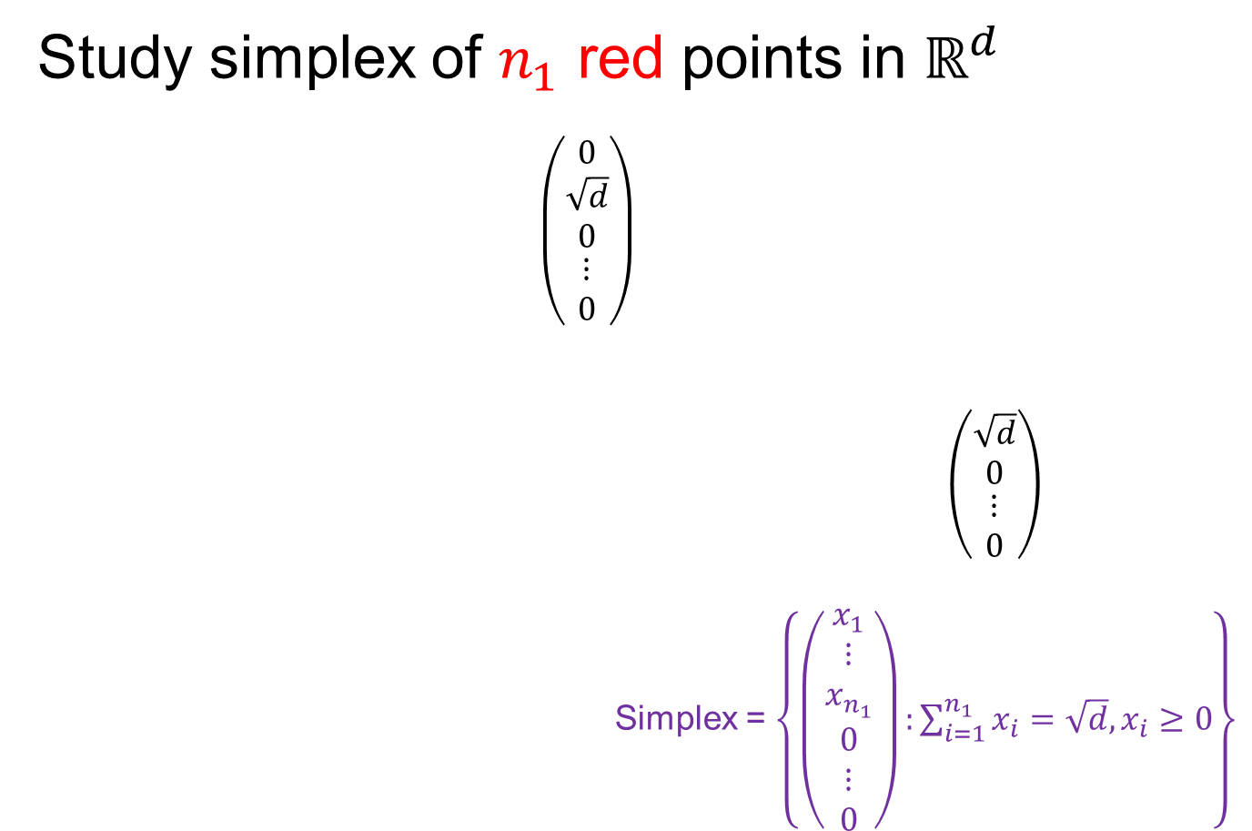
An Interesting HDLSS Explanation
Study simplex of $n_{1}$ red points in $ℝ^{d}$
$\left(\begin{matrix}\begin{matrix}0 \\ \sqrt{d} \\ 0\end{matrix} \\ ⋮ \\ 0\end{matrix}\right)$
$\left(\begin{matrix}\begin{matrix}\sqrt{d} \\ 0\end{matrix} \\ \begin{matrix}⋮ \\ 0\end{matrix}\end{matrix}\right)$
Simplex = $\left\{\left(\begin{matrix}\begin{matrix}x_{1} \\ ⋮ \\ x_{n_{1}}\end{matrix} \\ \begin{matrix}0 \\ ⋮ \\ 0\end{matrix}\end{matrix}\right):\sum_{i=1}^{n_{1}}{x_{i}=\sqrt{d},x_{i}≥0}\right\}$

Slide 64
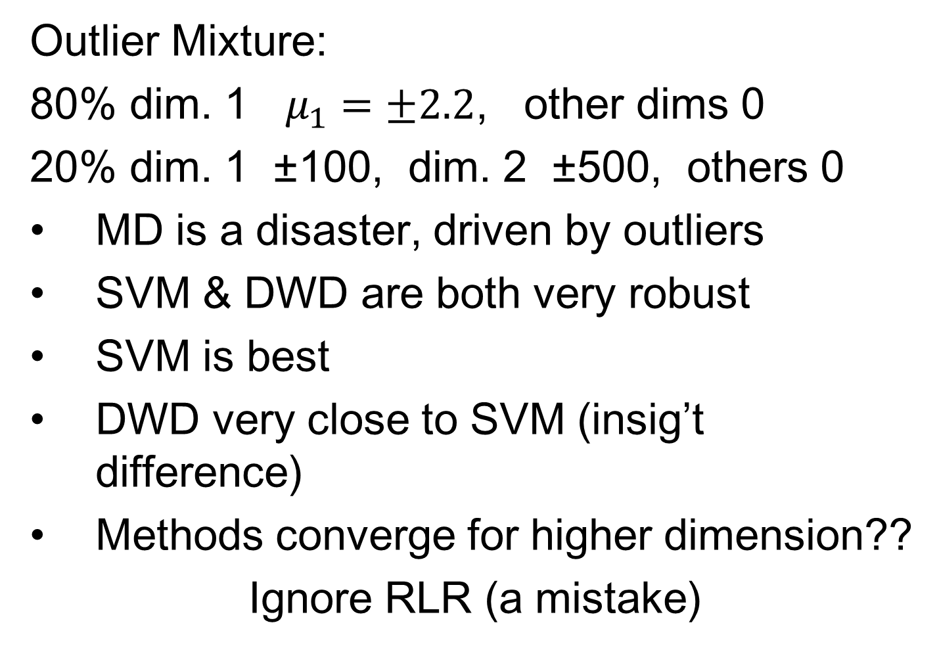
An Interesting HDLSS Explanation
Study simplex of $n_{1}$ red points in $ℝ^{d}$
so $\overline{x_{1}}=\left(\begin{matrix}\begin{matrix}{\sqrt{d}}/{n_{1}} \\ ⋮ \\ {\sqrt{d}}/{n_{1}}\end{matrix} \\ \begin{matrix}0 \\ ⋮ \\ 0\end{matrix}\end{matrix}\right)$
Mean $\overline{x_{1}}$ Points in Direction:
$\left(\begin{matrix}\begin{matrix}c \\ ⋮ \\ c\end{matrix} \\ \begin{matrix}0 \\ ⋮ \\ 0\end{matrix}\end{matrix}\right)$
and satisfies $n_{1}×c=\sqrt{d}$
Thus $c={\sqrt{d}}/{n_{1}}$

Slide 65
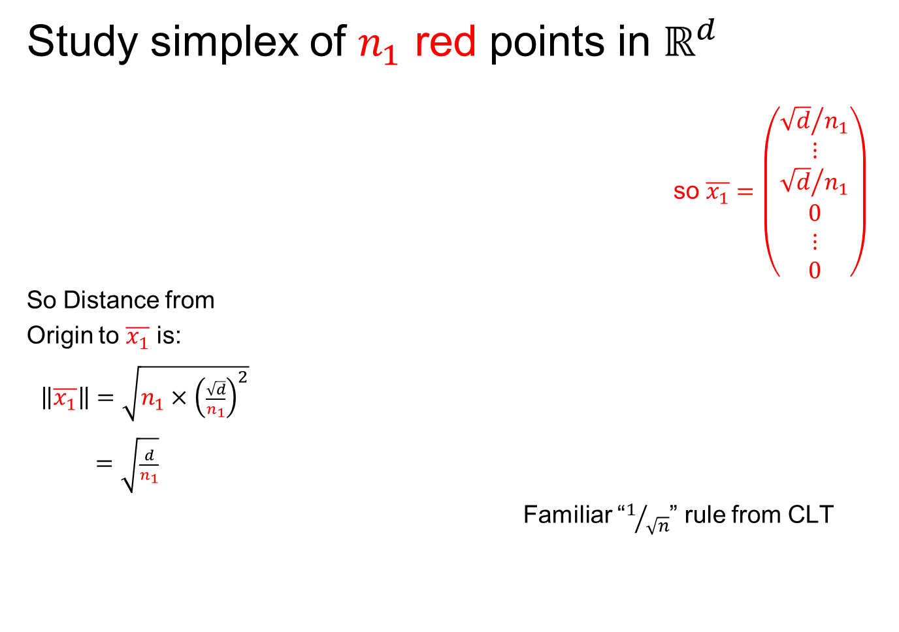
An Interesting HDLSS Explanation
Study simplex of $n_{1}$ red points in $ℝ^{d}$
so $\overline{x_{1}}=\left(\begin{matrix}\begin{matrix}{\sqrt{d}}/{n_{1}} \\ ⋮ \\ {\sqrt{d}}/{n_{1}}\end{matrix} \\ \begin{matrix}0 \\ ⋮ \\ 0\end{matrix}\end{matrix}\right)$
So Distance from
Origin to $\overline{x_{1}}$ is:
$\left\|\overline{x_{1}}\right\|=\sqrt{n_{1}×{\left(\frac{\sqrt{d}}{n_{1}}\right)}^{2}}$
$=\sqrt{\frac{d}{n_{1}}}$
Familiar “$1/{\sqrt{n}}$” rule from CLT

Slide 66
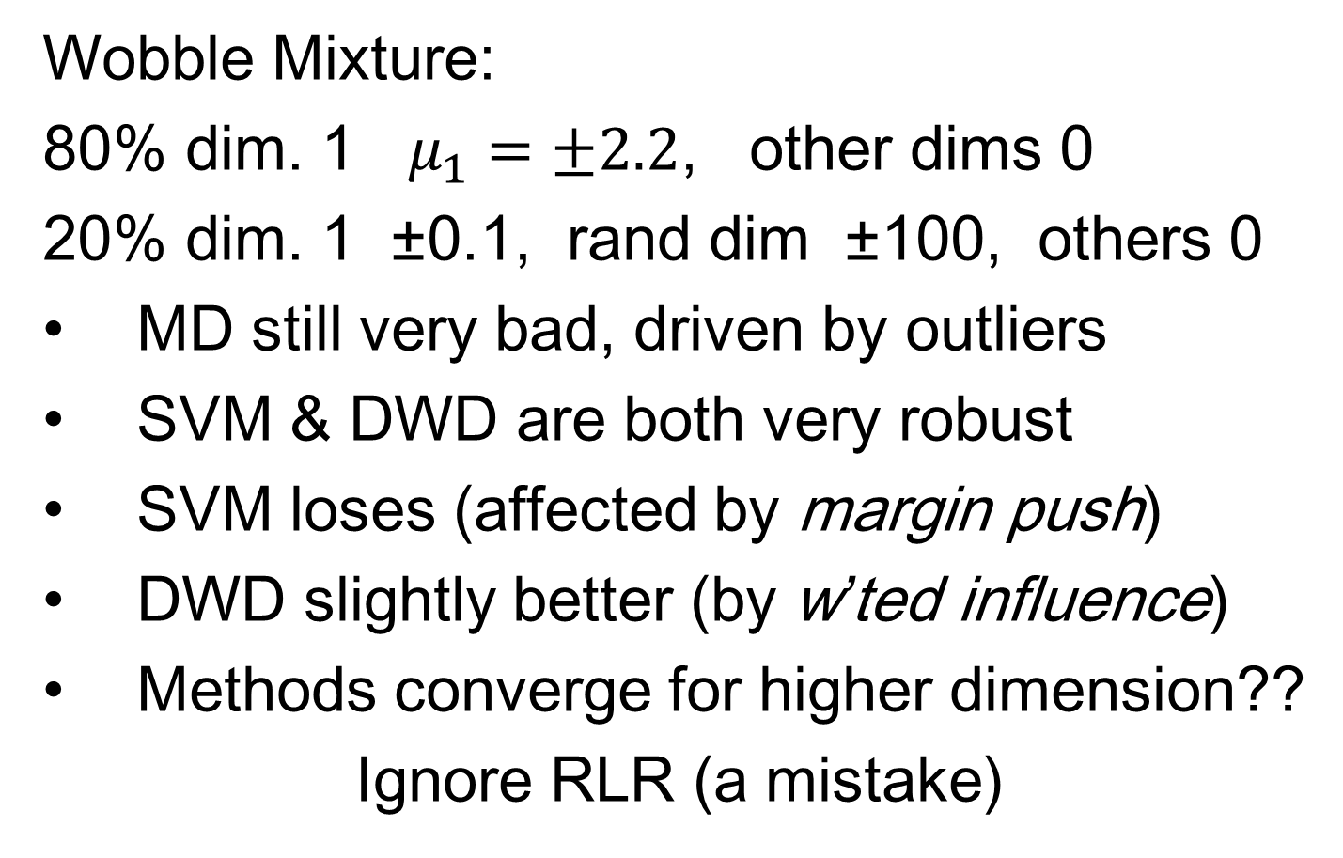
An Interesting HDLSS Explanation
Similar Analysis for $n_{2}$ blue points in $ℝ^{d}$:
$\left\|\overline{x_{2}}\right\|=\sqrt{\frac{d}{n_{2}}}$
Also note: $\overline{x_{1}}⊥\overline{x_{2}}$
(since in ortho subspaces)
So $\left\|\overline{x_{1}}−\overline{x_{2}}\right\|=\sqrt{\frac{d}{n_{1}}+\frac{d}{n_{2}}}$

Slide 67

An Interesting HDLSS Explanation
Recall Two
Class $N\left(0,I\right)$
Example
Plug In
These
Numbers

Slide 68

An Interesting HDLSS Explanation
Evaluate $\left\|\overline{x_{1}}−\overline{x_{2}}\right\|=\sqrt{\frac{d}{n_{1}}+\frac{d}{n_{2}}}$
$=\sqrt{\frac{1000}{50}+\frac{1000}{50}}$
$≈6.3$

Slide 69

An Interesting HDLSS Explanation
Recall Two
Class $N\left(0,I\right)$
Example
$\left\|\overline{x_{1}}−\overline{x_{2}}\right\|$
$≈6.3$

Slide 70
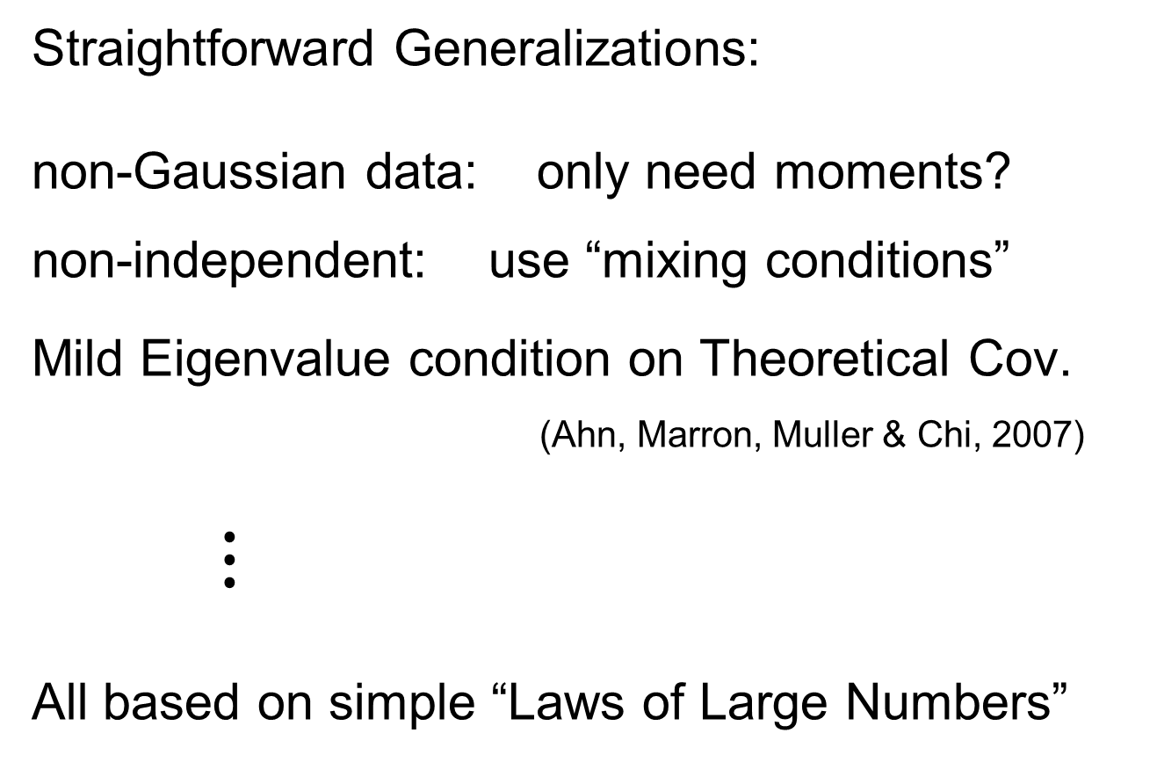
HDLSS Asy’s: Geometrical Represen’tion
Straightforward Generalizations:
non-Gaussian data: only need moments?
non-independent: use “mixing conditions”
Mild Eigenvalue condition on Theoretical Cov.
(Ahn, Marron, Muller & Chi, 2007)
$⋮$
All based on simple “Laws of Large Numbers”

Slide 71
2nd Paper on HDLSS Asymptotics
Ahn, Marron, Muller & Chi (2007)
  Assume 2nd Moments
  Assume no eigenvalues too large

Slide 72

2nd Paper on HDLSS Asymptotics
Ahn, Marron, Muller & Chi (2007)
  Assume 2nd Moments
  Assume no eigenvalues too large in sense:
For $ε=\frac{{\left(\sum_{j=1}^{d}{λ_{j}}\right)}^{2}}{d\sum_{j=1}^{d}{λ_{j}^{2}}}$ assume $ε^{−1}=o(d)$ i.e. $≫d^{−1}$

Slide 73

2nd Paper on HDLSS Asymptotics
Background:
In classical multivariate analysis, the statistic
$ε=\frac{{\left(\sum_{j=1}^{d}{λ_{j}}\right)}^{2}}{d\sum_{j=1}^{d}{λ_{j}^{2}}}$
Is called the “epsilon statistic”, John (1976)
And is used to test “sphericity” of dist’n,
i.e. “are all cov’nce eigenvalues the same?”
Likelihood
Ratio Stat.

Slide 74

2nd Paper on HDLSS Asymptotics
Can show: epsilon statistic: $ε=\frac{{\left(\sum_{j=1}^{d}{λ_{j}}\right)}^{2}}{d\sum_{j=1}^{d}{λ_{j}^{2}}}$
Satisfies: $ε∈\left(\frac{1}{d},\right.\left. 1\right]$
For spherical Normal, $ε=1$
Single extreme eigenvalue gives $ε≈\frac{1}{d}$
So assumption $ε≫d^{−1}$ is very mild

Slide 75

2nd Paper on HDLSS Asymptotics
Ahn, Marron, Muller & Chi (2007)
  Assume 2nd Moments
  Assume no eigenvalues too large, $ε≫d^{−1}$:
Then $\left\|{\underline{X}}_{i}−{\underline{X}}_{j}\right\|=O_{p}\left(1\right)×\sqrt{d}$
Not so strong as before:
$$\left\|{\underline{Z}}_{i}−{\underline{Z}}_{j}\right\|=\sqrt{2d}+O_{p}\left(1\right)$$

Slide 76


2nd Paper on HDLSS Asymptotics
Can we improve on:
$\left\|{\underline{X}}_{i}−{\underline{X}}_{j}\right\|=O_{p}\left(1\right)×\sqrt{d}$ ?
John Kent example: Normal scale mixture
${\underline{X}}_{i}\sim 0.5N_{d}\left(\underline{0},I_{d}\right)+0.5N_{d}\left(\underline{0},{100∗I}_{d}\right)$
Won’t get: $\left\|{\underline{X}}_{i}−{\underline{X}}_{j}\right\|=C×\sqrt{d}+O_{p}\left(1\right)$

Slide 77


3rd Paper on HDLSS Asymptotics
Get Geometrical Representation using
4th Moment Assumption
Stronger Covariance Matrix (only) Assum’n
Yata & Aoshima (2012)

Slide 78
0 Covariance is not independence
Key to Why Eigenvalues Alone Are Not Enough for Geometric Representation

Slide 79

0 Covariance is not independence
Simple Example:
Random Variables $X$ and $Y$
Make both Gaussian $X, Y \sim N\left(0,1\right)$
(Note: Not Using Multivariate Gaussian)

Slide 80

0 Covariance is not independence
Simple Example:
Random Variables $X$ and $Y$
Make both Gaussian $X, Y \sim N\left(0,1\right)$
With strong dependence
Yet $0$ covariance
Given $c>0$, define $Y=\left\{\begin{matrix}X & \left|X\right|>c \\ −X & \left|X\right|≤c\end{matrix}\right.$

Slide 81

0 Covariance is not independence
Simple Example:

Slide 82

0 Covariance is not independence
Simple Example:

Slide 83

0 Covariance is not independence
Simple Example, c to make cov(X,Y) = 0

Slide 84

0 Covariance is not independence
Simple Example:
Distribution is degenerate
Supported on diagonal lines
Not abs. cont. w.r.t. 2-d Lebesgue meas.
For small $c$, have $cov\left(X,Y\right)>0$
For large $c$, have $cov\left(X,Y\right)<0$
By continuity, $∃ c$ with $cov\left(X,Y\right)=0$

Slide 85

0 Covariance is not independence
Result:
Joint distribution of $X$ and $Y$:
  Has Gaussian marginals
  Has $cov\left(X,Y\right)=0$
  Yet strong dependence of $X$ and $Y$
  Thus not multivariate Gaussian
Shows Multivariate Gaussian means more
than Gaussian Marginals

Slide 86

0 Covariance is not independence
Deeper Example: Scale Normal Mixture
$$\underline{X}=\left(\begin{matrix}X_{1} \\ ⋮ \\ X_{d}\end{matrix}\right)\sim {\frac{1}{2}N}_{d}\left(0,I_{d}\right)+\frac{1}{2}N_{d}\left(0,100×I_{d}\right)$$
Can Show:
  For $i≠j$, $cov\left(X_{i},X_{j}\right)=0$
  For $i=1,⋯,d,$ $var\left(X_{i}\right)=C$
  So $cov\left(\underline{X}\right)=C×I_{d}$

Slide 87

0 Covariance is not independence
Deeper Example: Scale Normal Mixture
$$\underline{X}=\left(\begin{matrix}X_{1} \\ ⋮ \\ X_{d}\end{matrix}\right)\sim {\frac{1}{2}N}_{d}\left(0,I_{d}\right)+\frac{1}{2}N_{d}\left(0,100×I_{d}\right)$$
Can Show $cov\left(\underline{X}\right)=C×I_{d}$
Yet $X_{1},⋯,X_{d}$ are Strongly Dependent
(When one is large, others tend to be too)

Slide 88

0 Covariance is not independence
Parallel Conclusion:
Joint distribution of $X_{1},⋯,X_{d}$:
  Has $cov\left(X,Y\right)=0$
  Yet strong dependence of $X$ and $Y$
Shows covariance matrix $\sim I ⇏$
$⇏$ Independence
Only True for Gaussian Distributions

Slide 89

HDLSS Math. Stat. of PCA
Conditions for Geo. Rep’n & PCA Consist.:
John Kent example:
$$\underline{X}\sim 0.5N_{d}\left(\underline{0},I_{d}\right)+0.5N_{d}\left(\underline{0},{100∗I}_{d}\right)$$
Can only say: $\left\|\underline{X}\right\|=O_{p}\left(d^{1/2}\right)$ $\left(=\left\{\begin{matrix}d^{1/2} & w.p.\frac{1}{2} \\ 10d^{1/2} & w.p.\frac{1}{2}\end{matrix}\right. \right)$
not deterministic
Conclude: For Geo. Rep’n need Additional Condition
Reasonable Approach: Mixing Conditions

Slide 90
Participant Presentation
Yunxiao Liu
PCA in Econometrics

