Slide 1
Participant Presentations
(10 Minute Talks)
Too many undetermined. Please help fill in.

Slide 2
Return to Big Picture
Main statistical goals of OODA:
Understanding population structure
Low dim’al Projections, PCA …
Classification (i. e. Discrimination)
Understanding 2+ populations
Time Series of Data Objects
Chemical Spectra, Mortality Data
“Vertical Integration” of Data Types

Slide 3
Kernel Embedding
Aizerman, Braverman and Rozoner (1964)
Motivating idea:
Extend scope of linear discrimination,
By adding nonlinear components to data
(embedding in a higher dim’al space)
Better use of name:
nonlinear discrimination?

Slide 4
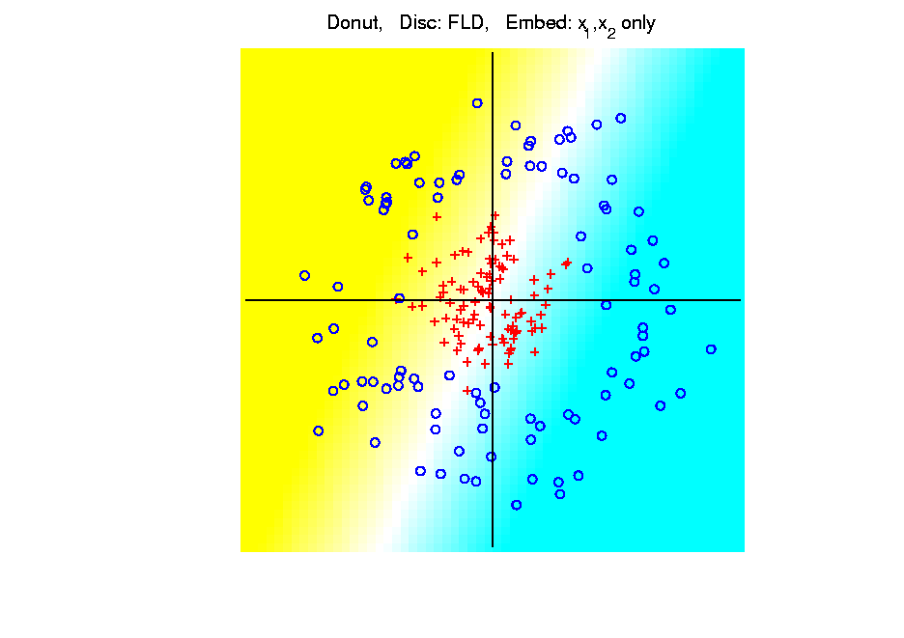
Kernel Embedding
Polynomial Embedding, Toy Example 3:
Donut
FLD
Original
Data
Very
Bad
Notes:
PEod1Raw.ps

Slide 5
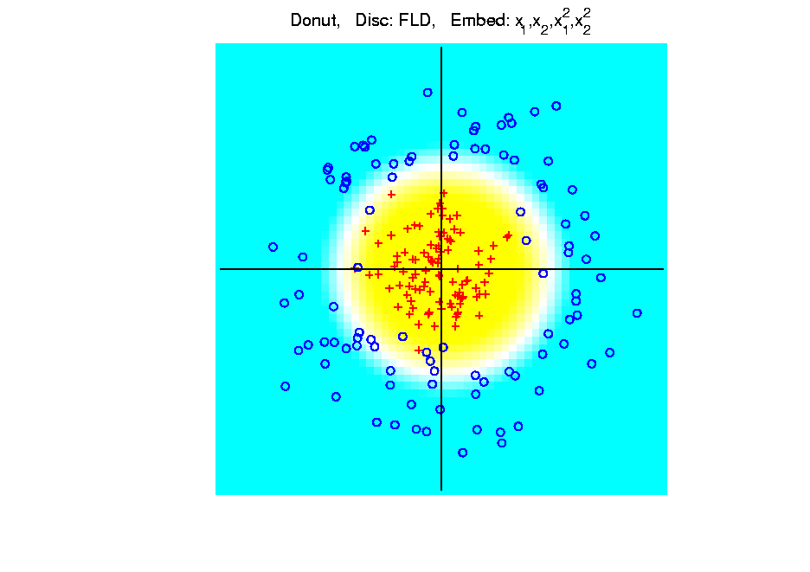
Kernel Embedding
Polynomial Embedding, Toy Example 3:
Donut
FLD
Good
Performance
(Slice of
Paraboloid)
Notes:
PEod1Raw.ps

Slide 6
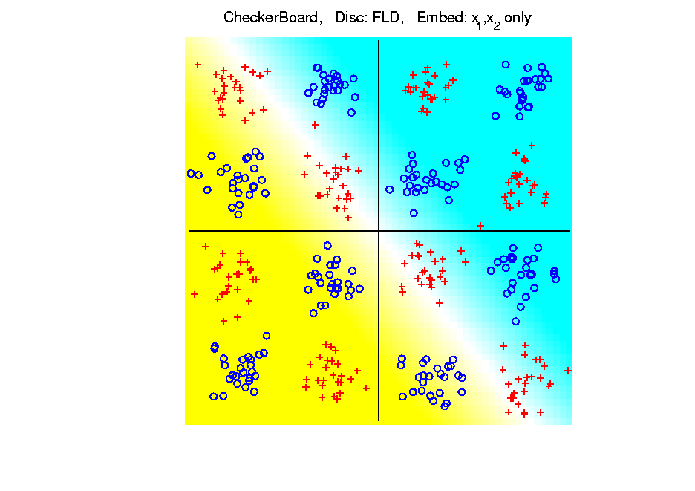
Kernel Embedding
Toy Example 4: Checkerboard
Very
Challenging!
FLD
Linear Is
Hopeless
Notes:
PEod1Raw.ps

Slide 7
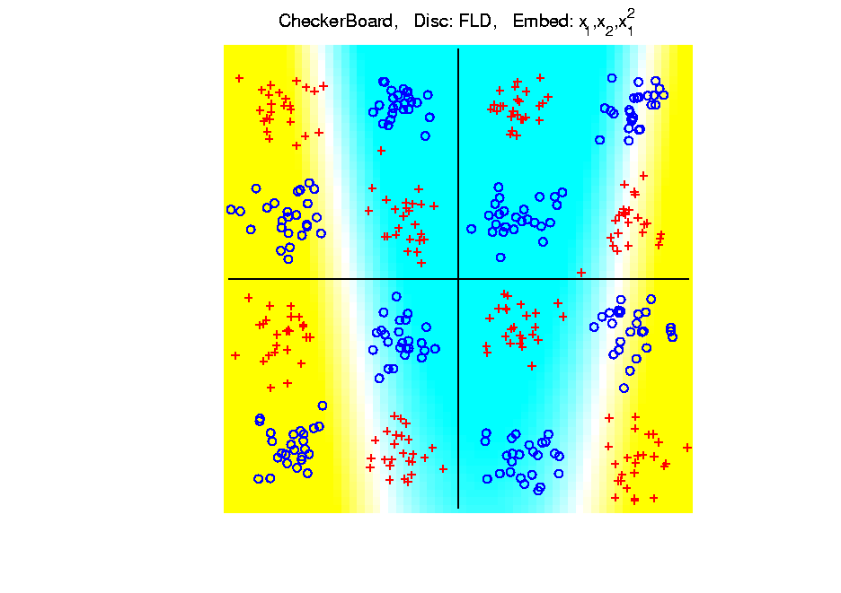
Kernel Embedding
Toy Example 4: Checkerboard
Very
Challenging!
FLD
Notes:
PEod1Raw.ps

Slide 8
Kernel Embedding
Toy Example 4: Checkerboard
Radial
Basis
Embedding
+ FLD
Is
Excellent!
Notes:
PEod1Raw.ps

Slide 9
Kernel Embedding
Drawbacks to naïve embedding:
Equally spaced grid too big in high $d$
Not computationally tractable $\left(g^{d}\right)$
Approach:
Evaluate only at data points
Not on full grid
But where data live

Slide 10
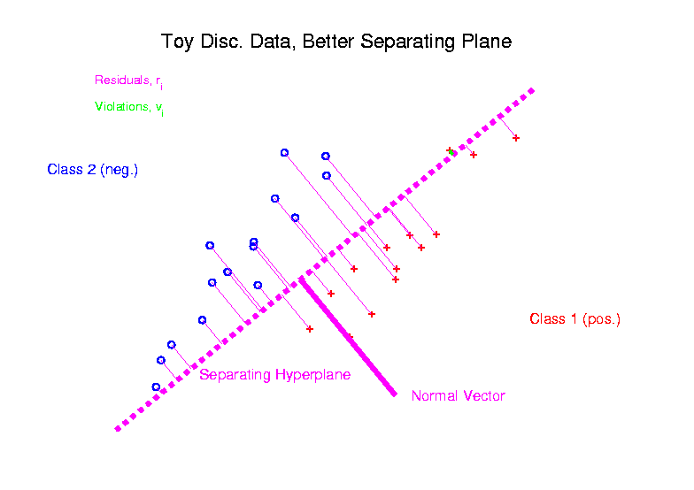
Support Vector Machines
Graphical View, using Toy Example:

Slide 11
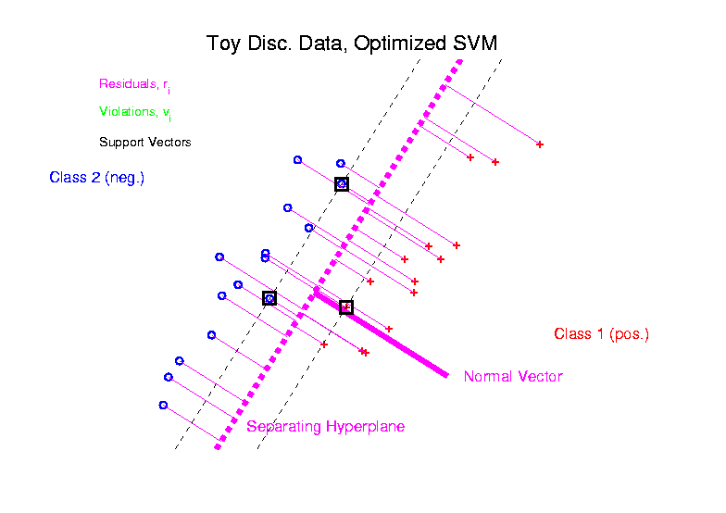
Support Vector Machines
Graphical View, using Toy Example:

Slide 12
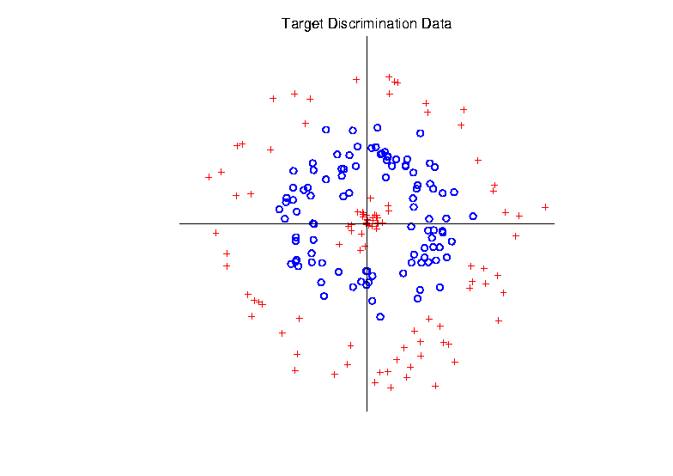
Support Vector Machines
Target Toy Data set:

Slide 13
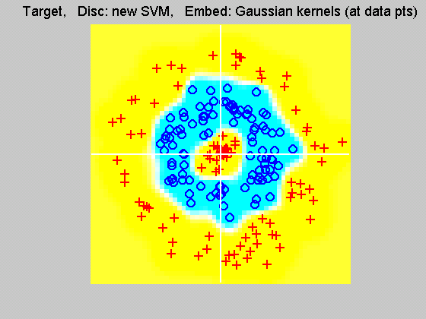
Support Vector Machines
Explicit Embedding, window σ = 0.1:
Gaussian
Kernel,
i.e.
Radial
Basis
Function

Slide 14
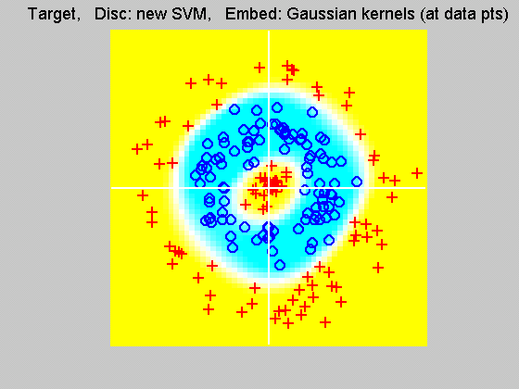
Support Vector Machines
Explicit Embedding, window σ = 1:
Pretty Big
Change
(Factor
of 10)

Slide 15
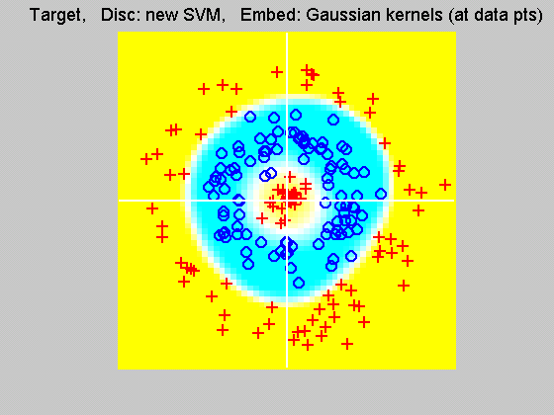
Support Vector Machines
Explicit Embedding, window σ = 10:
Not Quite
As Good
???

Slide 16
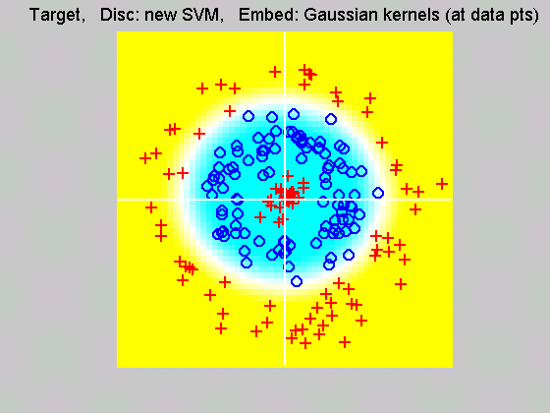
Support Vector Machines
Explicit Embedding, window σ = 100:
Note: Lost Center
(Over- Smoothed)

Slide 17
Support Vector Machines
Notes on Explicit Embedding:
Too small → Poor generalizability
Too big → miss important regions
Classical lessons from kernel smoothing
Surprisingly large “reasonable region”
I.e. parameter less critical (sometimes?)
Will study Later

Slide 18
SVMs, Tuning Parameter
Toy Example:
d = 50, Spherical Gaussian data
X=Axis: Opt. Dir’n Other: SVM Dir’n
Small C:
Where is the margin?
Small angle to optimal (generalizable)
Large C:
More data piling
Larger angle (less generalizable)
Bigger gap (but maybe not better???)
Between: Very small range

Slide 19
Distance Weighted Discrim’n
Improvement of SVM for HDLSS Data
Toy e.g.
$d=50$
indep. $N\left(0,1\right)$
$μ_{1}=±2$
$n_{+}=n_{−}=20$
(similar to
earlier movie)

Slide 20
Distance Weighted Discrim’n
Toy e.g.: Maximal Data Piling Direction
- Perfect
Separation
- Gross
Overfitting
- Large Angle
- Poor
Gen’ability
MDP

Slide 21
Distance Weighted Discrim’n
Toy e.g.: Support Vector Machine Direction
- Bigger Gap
- Smaller Angle
- Better
Gen’ability
- Feels support
vectors too
strongly???
- Ugly subpops?
- Improvement?

Slide 22
Distance Weighted Discrim’n
Toy e.g.: Distance Weighted Discrimination
- Addresses
these issues
- Smaller Angle
- Better
Gen’ability
- Nice subpops
- Replaces
min dist. by
avg. dist.

Slide 23
Distance Weighted Discrim’n
Based on Optimization Problem:
For “Residuals”:

Slide 24
Distance Weighted Discrim’n
Based on Optimization Problem:
Uses “poles” to push plane away from data

Slide 25
HDLSS Discrim’n Simulations
Main idea:
Comparison of
SVM (Support Vector Machine)
DWD (Distance Weighted Discrimination)
MD (Mean Difference, a.k.a. Centroid)
Linear versions, across dimensions
Notes:
25

Slide 26
HDLSS Discrim’n Simulations
Overall Approach:
Study different known phenomena
Spherical Gaussians
Outliers
Polynomial Embedding
Common Sample Sizes
$$n_{+}=n_{−}=25$$
But wide range of dimensions
$$d=10, 40, 100, 400, 1600$$

Slide 27
HDLSS Discrim’n Simulations
Criterion for Comparison:
Based on 100 Simulated Experiments
Each had $n_{+}=n_{−}=25$ Training Data
Assessed with $200$ Test Data Points
Recorded Misclassification Proportion

Slide 28
HDLSS Discrim’n Simulations
Spherical Gaussians:
Notes:
DWD1figEBig.ps

Slide 29
HDLSS Discrim’n Simulations
Spherical Gaussians:
Same setup as before
Means shifted in dim 1 only, $μ_{1}=±2.2$
All methods pretty good
Harder problem for higher dimension
SVM noticeably worse
MD best (Likelihood method)
DWD very close to MD
Methods converge for higher dimension??

Slide 30
HDLSS Discrim’n Simulations
Outlier Mixture:
Notes:
DWD1figFBig.ps

Slide 31
HDLSS Discrim’n Simulations
Outlier Mixture:
80% dim. 1 $μ_{1}=±2.2$, other dims 0
20% dim. 1 ±100, dim. 2 ±500, others 0
MD is a disaster, driven by outliers
SVM & DWD are both very robust
SVM is best
DWD very close to SVM (insig’t difference)
Methods converge for higher dimension??
Ignore RLR (a mistake)

Slide 32
HDLSS Discrim’n Simulations
Wobble Mixture:
Notes:
DWD1figGBig.ps

Slide 33
HDLSS Discrim’n Simulations
Wobble Mixture:
80% dim. 1 $μ_{1}=±2.2$, other dims 0
20% dim. 1 ±0.1, rand dim ±100, others 0
MD still very bad, driven by outliers
SVM & DWD are both very robust
SVM loses (affected by margin push)
DWD slightly better (by w’ted influence)
Methods converge for higher dimension??
Ignore RLR (a mistake)

Slide 34
HDLSS Discrim’n Simulations
Nested Spheres:
Notes:
DWD1figHBig.ps

Slide 35
HDLSS Discrim’n Simulations
Nested Spheres:
1st d/2 dim’s, Gaussian with var 1 or C
2nd d/2 dim’s, the squares of the 1st dim’s
(as for 2nd degree polynomial embedding)
Each method best somewhere
MD best in highest d (data non-Gaussian)
Methods not comparable (realistic)
Methods converge for higher dimension??
HDLSS space is a strange place
Ignore RLR (a mistake)

Slide 36
HDLSS Discrim’n Simulations
Conclusions:
Everything (sensible) is best sometimes
DWD often very near best
MD weak beyond Gaussian
Caution about simulations (and examples):
Very easy to cherry pick best ones
Good practice in Machine Learning
“Ignore method proposed, but read
paper for useful comparison of others”

Slide 37
HDLSS Discrim’n Simulations
Caution: There are additional players
E.g. Regularized Logistic Regression
looks also very competitive
Interesting Phenomenon:
All methods come together
in very high dimensions???

Slide 38
HDLSS Discrim’n Simulations
Can we say more about:
All methods come together
in very high dimensions???
Mathematical Statistical Question:
Mathematics behind this???
Notes:
38

Slide 39
Batch and Source Adjustment
Important Application
of
Distance Weighted Discrimination

Slide 40
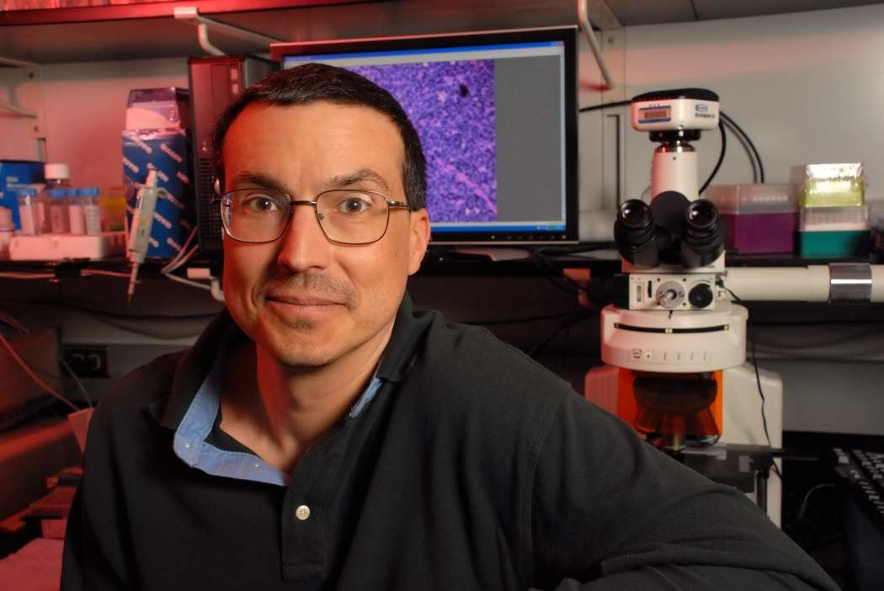
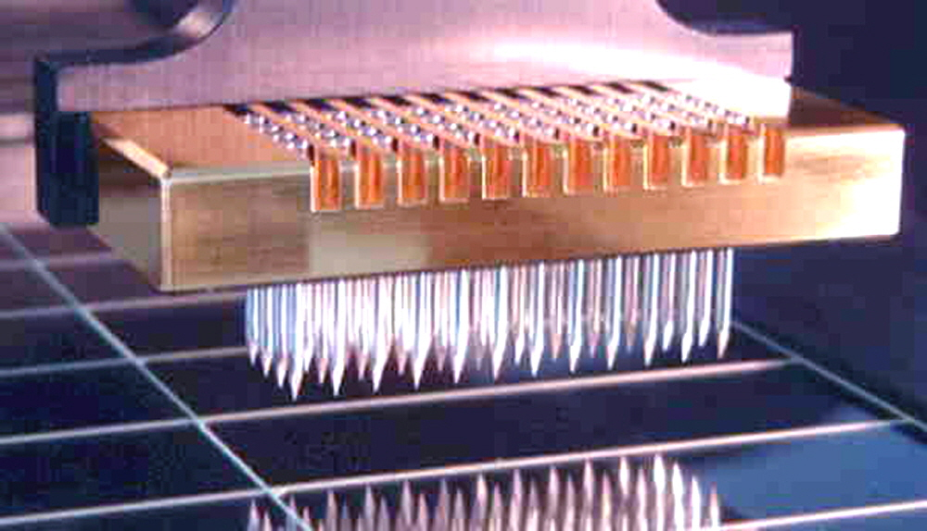
Batch and Source Adjustment
For Stanford Breast Cancer Data
From Perou et al (2000)
Microarray for Measuring Gene Expression
Old Style: Arrays Printed in Lab

Slide 41
Batch and Source Adjustment
For Stanford Breast Cancer Data
From Perou et al (2000)
Analysis in Benito et al (2004)
Adjust for Source Effects
Different sources of mRNA
Adjust for Batch Effects
Arrays fabricated at different times

Slide 42
Idea Behind Adjustment
Early Approach: Alter et al (2000)
Squash Out PC1 direction
Eliminates variation in that direction

Slide 43
Source Batch Adj: Raw Breast Cancer data

Slide 44
Source Batch Adj: Source Colors

Slide 45
Source Batch Adj: Batch Colors

Slide 46
Source Batch Adj: Biological Class Colors

Slide 47
Source Batch Adj: Biological Class Col. & Symbols

Slide 48
Source Batch Adj: Biological Class Symbols

Slide 49
Source Batch Adj: Source Colors

Slide 50
Source Batch Adj: PC 1-3 & DWD direction

Slide 51
Source Batch Adj: DWD Source Adjustment

Slide 52
Source Batch Adj: Source Adj’d, PCA view

Slide 53
Source Batch Adj: Source Adj’d, Class Colored

Slide 54
Source Batch Adj: Source Adj’d, Batch Colored

Slide 55
Source Batch Adj: Source Adj’d, 5 PCs

Slide 56
Source Batch Adj: S. Adj’d, Batch 1,2 vs. 3 DWD

Slide 57
Source Batch Adj: S. & B1,2 vs. 3 Adjusted

Slide 58
Source Batch Adj: S. & B1,2 vs. 3 Adj’d, 5 PCs

Slide 59
Source Batch Adj: S. & B Adj’d, B1 vs. 2 DWD

Slide 60
Source Batch Adj: S. & B Adj’d, B1 vs. 2 Adj’d

Slide 61
Source Batch Adj: S. & B Adj’d, 5 PC view

Slide 62
Source Batch Adj: S. & B Adj’d, 4 PC view

Slide 63
Source Batch Adj: S. & B Adj’d, Class Colors

Slide 64
Source Batch Adj: S. & B Adj’d, Adj’d PCA

Slide 65
DWD: Why not PC1?
PC 1 Direction feels variation, not classes
Also eliminates (important?) within class variation

Slide 66
DWD: Why not PC1?
Direction driven by classes
“Sliding” maintains (important?) within class variation

Slide 67
E. g. even worse for PCA
PC1 direction is worst possible

Slide 68
But easy for DWD
Since DWD uses class label information

Slide 69
DWD does not solve all problems
Only handles means, not differing variation
Alternative: Shabalin et al (2008)

Slide 70
Interesting Benchmark Data Set
NCI 60 Cell Lines
Interesting benchmark, since same cells
Data Web available:
http://discover.nci.nih.gov/datasetsNature2000.jsp
Both cDNA and Affymetrix Platforms
Different from Breast Cancer Data
Which had no common samples

Slide 71
NCI 60: Raw Data, Platform Colored

Slide 72
NCI 60: Raw Data

Slide 73
NCI 60: Raw Data, Before DWD Adjustment

Slide 74
NCI 60: Before & After DWD adjustment

Slide 75
NCI 60: Before & After, new scales

Slide 76
NCI 60: After DWD

Slide 77
NCI 60: DWD adjusted data

Slide 78
NCI 60: Before Column Mean Adjustment

Slide 79
NCI 60: Before & After Column Mean Adjustment

Slide 80
NCI 60: Before & After Col. Mean Adj., Rescaled

Slide 81
NCI 60: After DWD & Column Mean Adj.

Slide 82
NCI 60: DWD & Column Mean Adjusted

Slide 83
NCI 60: Before Column Stand. Dev. Adjustment

Slide 84
NCI 60: Before and After Column S.D. Adjustment

Slide 85
NCI 60: Before and After Col. S.D. Adj., Rescaled

Slide 86
NCI 60: After Column Stand. Dev. adjustment

Slide 87
NCI 60: Fully Adjusted Data

Slide 88
NCI 60: Fully Adjusted Data, Platform Colored

Slide 89
NCI 60: Fully Adjusted Data, Melanoma Cluster
BREAST.MDAMB435
BREAST.MDN
MELAN.MALME3M
MELAN.SKMEL2
MELAN.SKMEL5
MELAN.SKMEL28
MELAN.M14
MELAN.UACC62
MELAN.UACC257

Slide 90
NCI 60: Fully Adjusted Data, Leukemia Cluster
LEUK.CCRFCEM
LEUK.K562
LEUK.MOLT4
LEUK.HL60
LEUK.RPMI8266
LEUK.SR

Slide 91
Recall DWD Appl’n: Visualization
Recall PCA limitations
DWD uses class info
Hence can “better separate known classes”
Did this for pairs of classes
(DWD just on those, ignore others)
Carefully choose pairs in NCI 60 data
Shows Effectiveness of Adjustment

Slide 92
NCI 60: Views using DWD Dir’ns (focus on biology)

Slide 93
DWD Visualization of NCI 60 Data
Recall most cancer types clearly distinct
(Renal, CNS, Ovar, Leuk, Colon, Melan)
Using these carefully chosen directions
Others less clear cut
NSCLC (at least 3 subtypes)
Breast (4 published subtypes)
DWD adjustment was very effective
(very few black connectors visible)

Slide 94
HDLSS Asymptotics
Recall Various “Mysteries” about
High Dimension Low Sample Size Data
Natural Separation of $N_{1000}\left(0,I\right)$ Data
Notes:
94

Slide 95
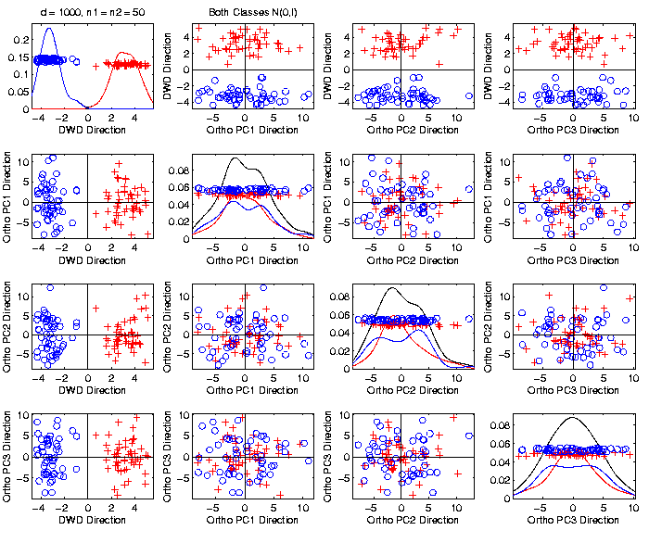
Caution
Toy 2-Class
Example
Separation
Is Natural
Sampling
Variation
(Will Study in Detail Later)

Slide 96
HDLSS Asymptotics
Recall Various “Mysteries” about
High Dimension Low Sample Size Data
Natural Separation of $N_{1000}\left(0,I\right)$ Data
GWAS Failure of Spherical PCA
Notes:
96

Slide 97
GWAS Data Analysis
PCA View
Clear Ethnic
Groups
And Several
Outliers!
Eliminate With
Spherical PCA?

Slide 98
GWAS Data Analysis
Spherical
PCA
Looks Same?!?
What is
going on?
Will Explain
Later

Slide 99
HDLSS Asymptotics
Recall Various “Mysteries” about
High Dimension Low Sample Size Data
Natural Separation of $N_{1000}\left(0,I\right)$ Data
GWAS Failure of Spherical PCA
Strange behavior in HDLSS Classificat’n
Notes:
99

Slide 100
HDLSS Discrimination
Mean Difference (Centroid) Method
Far more stable over dimensions
Because is likelihood ratio solution
(for known variance - Gaussians)
Doesn’t feel HDLSS boundary
Eventually becomes too good?!?
Widening gap between clusters?!?
Careful: angle to optimal grows
So lose generalizability (since noise inc’s)
HDLSS data present some odd effects…

Slide 101
HDLSS Discrimination
Mean Difference (Centroid) Method
Far more stable over dimensions
Because is likelihood ratio solution
(for known variance - Gaussians)
Doesn’t feel HDLSS boundary
Eventually becomes too good?!?
Widening gap between clusters?!?
Careful: angle to optimal grows
So lose generalizability (since noise inc’s)
HDLSS data present some odd effects…

Slide 102
HDLSS Discrim’n Simulations
Can we say more about:
All methods come together
in very high dimensions???
Mathematical Statistical Question:
Mathematics behind this???
Notes:
102

Slide 103
HDLSS Asymptotics
Recall Various “Mysteries” about
High Dimension Low Sample Size Data
Natural Separation of $N_{1000}\left(0,I\right)$ Data
GWAS Failure of Spherical PCA
Strange behavior in HDLSS Classificat’n
Next Investigate Mathematics Of These
Notes:
103

Slide 104
HDLSS Asymptotics
Modern Mathematical Statistics:
Based on asymptotic analysis
Notes:
104

Slide 105
HDLSS Asymptotics
Modern Mathematical Statistics:
Based on asymptotic analysis
I.e. Uses limiting operations
Almost always $\lim_{n→∞}{}$
Workhorse Method for Much Insight:
Laws of Large Numbers (Consistency)
Central Limit Theorems (Quantify Errors)
Notes:
105

Slide 106
HDLSS Asymptotics
Modern Mathematical Statistics:
Based on asymptotic analysis
I.e. Uses limiting operations
Almost always $\lim_{n→∞}{}$
Occasional misconceptions:
Indicates behavior for large samples
Thus only makes sense for “large” samples
Models phenomenon of “increasing data”
So other flavors are useless???
Notes:
106

Slide 107
HDLSS Asymptotics
Modern Mathematical Statistics:
Based on asymptotic analysis
Real Reasons:
Approximation provides insights
Can find simple underlying structure
In complex situations
Thus various flavors are fine:
$$\lim_{n→∞}{} \lim_{d→∞}{} \lim_{n,d→∞}{} \lim_{σ→0}{}$$
Even desirable! (find additional insights)
Notes:
107

Slide 108
HDLSS Asymptotics
Personal Observations:
HDLSS world is…
Surprising (many times!)
[Think I’ve got it, and then …]
Mathematically Beautiful (?)
Practically Relevant

Slide 109
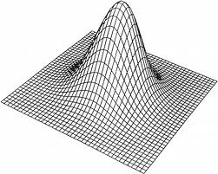
HDLSS Asymptotics: Simple Paradoxes
For $d$ dimensional Standard Normal dist’n:
$$\underline{Z}=\left(\begin{matrix}Z_{1} \\ ⋮ \\ Z_{d}\end{matrix}\right)\sim N_{d}\left(0,I_{d}\right)$$
Where are the Data?
Near Peak of Density?
Thanks to: psycnet.apa.org

Slide 110
HDLSS Asymptotics: Simple Paradoxes
For $d$ dimensional Standard Normal dist’n:
$$\underline{Z}=\left(\begin{matrix}Z_{1} \\ ⋮ \\ Z_{d}\end{matrix}\right)\sim N_{d}\left(0,I_{d}\right)$$
Euclidean Distance to Origin (as $d→∞$)
(measure how close to peak)

Slide 111
HDLSS Asymptotics: Simple Paradoxes
For $d$ dimensional Standard Normal dist’n:
$$\underline{Z}=\left(\begin{matrix}Z_{1} \\ ⋮ \\ Z_{d}\end{matrix}\right)\sim N_{d}\left(0,I_{d}\right)$$
Euclidean Distance to Origin (as $d→∞$):
$\left\|\underline{Z}\right\|=\sqrt{\sum_{i=1}^{n}{{Z_{i}}^{2}}}\sim \sqrt{χ_{d}^{2}}$
$\left\|\underline{Z}\right\|=\sqrt{d+O_{p}\left(d^{1/2}\right)}=\sqrt{d}+O_{p}\left(1\right)$

Slide 112
HDLSS Asymptotics: Simple Paradoxes
As $d→∞$,
$$\left\|\underline{Z}\right\|=\sqrt{d}+O_{p}\left(1\right)$$
Data lie roughly on surface of sphere,
with radius $\sqrt{d}$
- Yet origin is point of highest density???
- Paradox resolved by:
density w. r. t. Lebesgue Measure
Notes:
112

Slide 113
HDLSS Asymptotics: Simple Paradoxes
- Paradox resolved by:
density w. r. t. Lebesgue Measure
Consider Volume of Unit Sphere in $ℝ^{d}$
Find As: Integral In Sph’l Coordinates
$$V_{d}=\iiint{Jdθ_{1}⋯dθ_{d}dr}$$
Notes:
113

Slide 114
HDLSS Asymptotics: Simple Paradoxes
- Paradox resolved by:
density w. r. t. Lebesgue Measure
Consider Volume of Unit Sphere in $ℝ^{d}$
Find As: Integral In Sph’l Coordinates
$$V_{d}=\iiint{Jdθ_{1}⋯dθ_{d}dr}$$
Look At Integrand w.r.t. $r$
Can Show: Puts ~ All Weight Near $r=1$
Notes:
114

Slide 115
HDLSS Asymptotics: Simple Paradoxes
- Paradox resolved by:
density w. r. t. Lebesgue Measure
Lebesgue Measure Pushes Mass Out
Density Pulls Data In
$\sqrt{d}$ Is The Balance Point
Notes:
115

Slide 116
HDLSS Asymptotics: Simple Paradoxes
As $d→∞$, $\left\|\underline{Z}\right\|=\sqrt{d}+O_{p}\left(1\right)$
Important Philosophical Consequence:
$∄$“Average People”
Parents Lament:
Why Can’t I Have Average Children?
Theorem: Impossible (over many factors)!
Notes:
116

Slide 117
HDLSS Asymptotics: Simple Paradoxes
Distance tends to non-random constant:
For $Z_{1}$ & $Z_{2}$ independent
$$\left\|{\underline{Z}}_{1}−{\underline{Z}}_{2}\right\|=\sqrt{2d}+O_{p}\left(1\right)$$
Factor $\sqrt{2}$, since
$sd\left(X_{1}−X_{2}\right)=\sqrt{{sd\left(X_{1}\right)}^{2}+{sd\left(X_{2}\right)}^{2}}$
Can extend to independent ${\underline{Z}}_{1},⋯{\underline{Z}}_{n}$
All points are equidistant
(We can only perceive 3 dimensions)
Notes:
117

Slide 118
HDLSS Asymptotics: Simple Paradoxes
Recall Reason Why
Perceptual System from Ancestors
They Needed to Find Food
Food Exists in 3-d World
(We can only perceive 3 dimensions)
Notes:
118

Slide 119
Participant Presentations
Jonathan Williams
Bayesian Hidden Markov Models
Ruibin Ma
Generalized Cylindrical Surface Deformation

