Slide 1
Participant Presentations
(10 Minute Talks)

Slide 2
Return to Big Picture
Main statistical goals of OODA:
Understanding population structure
Low dim’al Projections, PCA …
Classification (i. e. Discrimination)
Understanding 2+ populations
Time Series of Data Objects
Chemical Spectra, Mortality Data
“Vertical Integration” of Data Types

Slide 3
Classical Discrimination
Summary of FLD vs. GLR:
Tilted Point Clouds Data
FLD good
GLR good
Donut Data
FLD bad
GLR good
X Data
FLD bad
GLR OK, not great
Classical Conclusion: GLR generally better
(will see a different answer for HDLSS data)

Slide 4
HDLSS Discrimination
Main HDLSS issues:
Sample Size, $n$ < Dimension, $d$
Singular covariance matrix
So can’t use matrix inverse
I.e. can’t standardize (sphere) the data
(requires root inverse covariance)
Can’t do classical multivariate analysis

Slide 5
HDLSS Discrimination
Application of Generalized Inverse to FLD:
Direction (Normal) Vector:
$${\underline{n}}_{FLD}={\left({\hat{Σ}}^{w}\right)}^{−}\left({\underline{\overline{X}}}^{+}−{\underline{\overline{X}}}^{−}\right)$$
Intercept:
$$μ_{FLD}=\left(\frac{1}{2}{\underline{\overline{X}}}^{+}+\frac{1}{2}{\underline{\overline{X}}}^{−}\right)$$
Have replaced ${\left({\hat{Σ}}^{w}\right)}^{−1}$ by ${\left({\hat{Σ}}^{w}\right)}^{−}$

Slide 6
HDLSS Discrimination
FLD in Increasing Dimensions:
Far beyond HDLSS boun’ry (d=70-1000):
Quality degrades
Projections look terrible
(populations overlap)
And Generalizability falls apart, as well
Asymptotics worked out by Bickel & Levina (2004)
Problem is estimation of $d×d$ covariance matrix

Slide 7
HDLSS Discrimination
Mean Difference (Centroid) Method
Far more stable over dimensions
Because is likelihood ratio solution
(for known variance - Gaussians)
Doesn’t feel HDLSS boundary
Eventually becomes too good?!?
Widening gap between clusters?!?
Careful: angle to optimal grows
So lose generalizability (since noise inc’s)
HDLSS data present some odd effects…

Slide 8
Maximal Data Piling
Strange FLD effect at HDLSS boundary:
Data Piling:
For each class,
all data
project to
single
value

Slide 9
Maximal Data Piling
How to compute ${\underline{v}}_{MDP}$?
Can show (Ahn & Marron 2009):
$${\underline{v}}_{MDP}={\hat{Σ}}^{−1}\left({\underline{\overline{X}}}^{+}−{\underline{\overline{X}}}^{−}\right)$$
Recall FLD formula:
$${\underline{v}}_{FLD}={\left({\hat{Σ}}^{w}\right)}^{−1}\left({\underline{\overline{X}}}^{+}−{\underline{\overline{X}}}^{−}\right)$$
Only difference is global vs. within class
Covariance Estimates!

Slide 10
Maximal Data Piling
Visual similarity of ${\underline{v}}_{MDP}$ & ${\underline{v}}_{FLD}$?
Can show (Ahn & Marron 2009), for $d<n$:
$${{\underline{v}}_{MDP}}/{\left\|{\underline{v}}_{MDP}\right\|}={{\underline{v}}_{FLD}}/{\left\|{\underline{v}}_{FLD}\right\|}$$
I.e. directions are the same!
How can this be?
Note lengths are different…
Study from transformation viewpoint

Slide 11
Maximal Data Piling
Alternate approach: Optimization Viewpoint
Find a direction vector, $\underline{v}$ ($\left\|\underline{v}\right\|=1$), to
$\max_{\underline{v}}{\frac{{\left(\overline{PX^{+}}−\overline{PX^{−}}\right)}^{2}}{V^{+}+V^{−}}}$
Where for $⨀$ = +,-
$\overline{PX^{⨀}}=Avg\left({\underline{v}}^{t}X^{⨀}\right)$ = Average Proj’n
$V^{⨀}=var({\underline{v}}^{t}X^{⨀})$ = Variance of Proj’ns
Within Class
Variation
Between Class
Variation

Slide 12
Maximal Data Piling
Alternate approach: Optimization Viewpoint
Find a direction vector, $\underline{v}$ ($\left\|\underline{v}\right\|=1$), to
$\max_{\underline{v}}{\frac{{\left(\overline{PX^{+}}−\overline{PX^{−}}\right)}^{2}}{V^{+}+V^{−}}}$
Case 1: $d≤n−2$
Solutions are:
${\underline{v}}_{FLD}∝{\left({\hat{Σ}}^{w}\right)}^{−}\left({\underline{\overline{X}}}^{+}−{\underline{\overline{X}}}^{−}\right)$
${\underline{v}}_{MDP}∝{\hat{Σ}}^{−}\left({\underline{\overline{X}}}^{+}−{\underline{\overline{X}}}^{−}\right)$
Common
Practice In
Literature:
Assume
This, But
Not Make It
Very Clear

Slide 13
Maximal Data Piling
$\max_{\underline{v}}{\frac{{\left(\overline{PX^{+}}−\overline{PX^{−}}\right)}^{2}}{V^{+}+V^{−}}}$
Case 2: $d≥n−1$
Solution is:
${\underline{v}}_{MDP}={\hat{Σ}}^{−}\left({\underline{\overline{X}}}^{+}−{\underline{\overline{X}}}^{−}\right)$
But not:
${\underline{v}}_{FLD}={\left({\hat{Σ}}^{w}\right)}^{−}\left({\underline{\overline{X}}}^{+}−{\underline{\overline{X}}}^{−}\right)$
Point
Not Made
Anywhere
Else???

Slide 14
Maximal Data Piling
Recurring, over-arching, issue:
HDLSS space is a weird place

Slide 15
Kernel Embedding
Aizerman, Braverman and Rozoner (1964)
Motivating idea:
Extend scope of linear discrimination,
By adding nonlinear components to data
(embedding in a higher dim’al space)
Better use of name:
nonlinear discrimination?

Slide 16
Kernel Embedding
But in the “quadratic
embedded domain”,
$\left\{\left(x,x^{2}\right):x∈ℝ\right\}⊂ℝ^{2}$
linear separation
can give 3 parts

Slide 17
Kernel Embedding
But in the quadratic embedded domain
$\left\{\left(x,x^{2}\right):x∈ℝ\right\}⊂ℝ^{2}$
Linear separation can give 3 parts
original data space lies in 1d manifold
very sparse region of $ℝ^{2}$
curvature of manifold gives:
better linear separation
can have any 2 break points
(2 points $⟹$ line)

Slide 18
Kernel Embedding
General View: for original data matrix:
$$\left(\begin{matrix}x_{11} & ⋯ & x_{1n} \\ ⋮ & ⋱ & ⋮ \\ x_{d1} & ⋯ & x_{dn}\end{matrix}\right)$$
add rows:
i.e. embed in
Higher
Dimensional
space
$$\left(\begin{matrix}\begin{matrix}x_{11} \\ ⋮ \\ x_{d1}\end{matrix} & & \begin{matrix}x_{1n} \\ ⋮ \\ x_{dn}\end{matrix} \\ \begin{matrix}x_{11}^{2} \\ ⋮ \\ x_{d1}^{2}\end{matrix} & ⋯ & \begin{matrix}x_{1n}^{2} \\ ⋮ \\ x_{dn1}^{2}\end{matrix} \\ \begin{matrix}x_{11}x_{21} \\ ⋮\end{matrix} & & \begin{matrix}x_{1d}x_{2d} \\ ⋮\end{matrix}\end{matrix}\right)$$

Slide 19
Kernel Embedding
Embedded Fisher Linear Discrimination:
Choose Class +1, for any ${\underline{x}}^{0}∈ℝ^{d}$ when:
$${{\underline{x}}^{0}}^{t}{{\hat{Σ}}^{w}}^{−1}\left({\underline{\overline{X}}}^{(+)}−{\underline{\overline{X}}}^{(−)}\right)≥\frac{1}{2}{\left({\underline{\overline{X}}}^{(+)}−{\underline{\overline{X}}}^{(−)}\right){\hat{Σ}}^{w}}^{−1}\left({\underline{\overline{X}}}^{(+)}−{\underline{\overline{X}}}^{(−)}\right)$$
in embedded space.
Image of class boundaries in original space is nonlinear
Allows more complicated class regions
Can also do Gaussian Lik. Rat. (or others)
Compute image by classifying points from original space

Slide 20
Kernel Embedding
Visualization for Toy Examples:
Have Linear Disc. In Embedded Space
Study Effect in Original Data Space
Via Implied Nonlinear Regions
Challenge: Hard to Explicitly Compute

Slide 21
Kernel Embedding
Visualization for Toy Examples:
Have Linear Disc. In Embedded Space
Study Effect in Original Data Space
Via Implied Nonlinear Regions
Approach:
Use Test Set in Original Space
(dense equally spaced grid)
Apply embedded discrimination Rule
Color Using the Result

Slide 22
Kernel Embedding
Recall Classifier Display Device:
Parallel Clouds
Use Yellow for Grid
Points Assigned
to Plus Class
Use Cyan for Grid
Points Assigned
to Minus Class
Notes:
PEod1Raw.ps

Slide 23
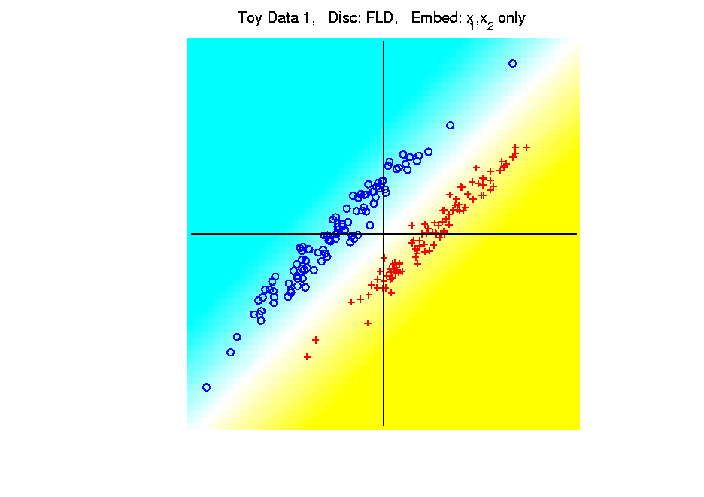
Kernel Embedding
Polynomial Embedding, Toy Example 1:
Parallel Clouds
FLD
Original
Data
Notes:
PEod1Raw.ps

Slide 24
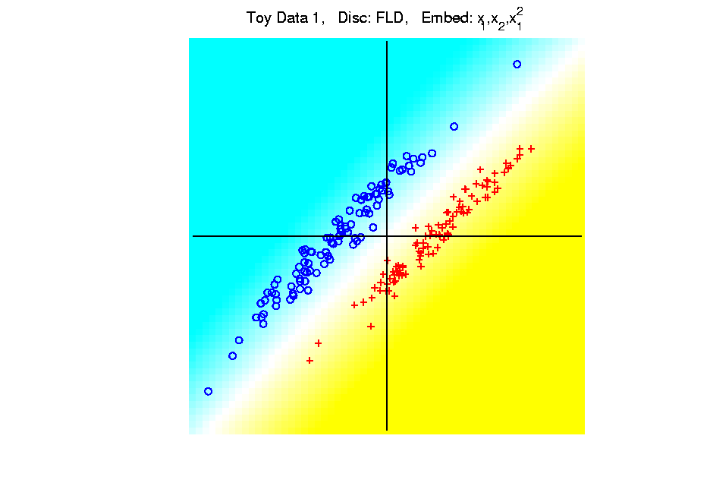
Kernel Embedding
Polynomial Embedding, Toy Example 1:
Parallel Clouds
FLD
Notes:
PEod1Raw.ps

Slide 25
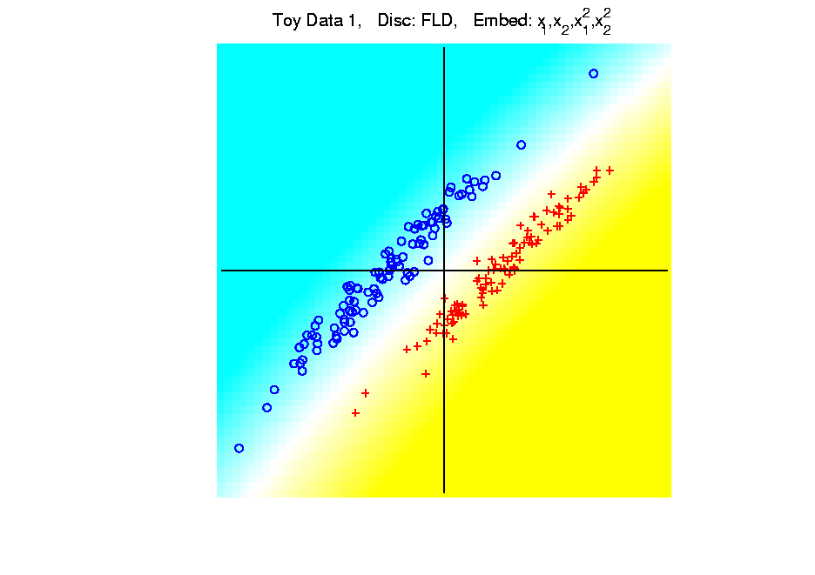
Kernel Embedding
Polynomial Embedding, Toy Example 1:
Parallel Clouds
FLD
Notes:
PEod1Raw.ps

Slide 26
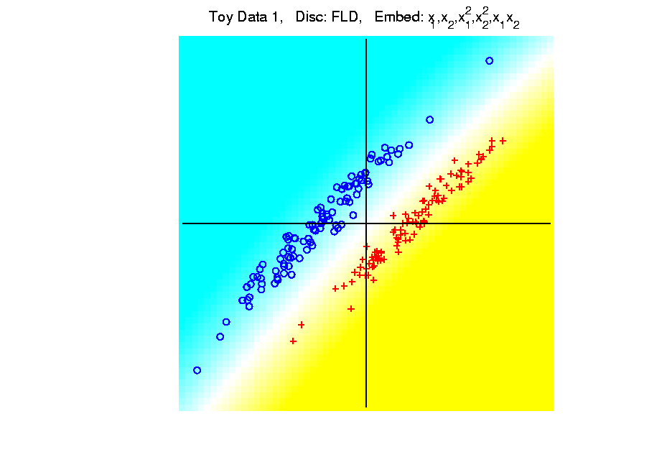
Kernel Embedding
Polynomial Embedding, Toy Example 1:
Parallel Clouds
FLD
Notes:
PEod1Raw.ps

Slide 27
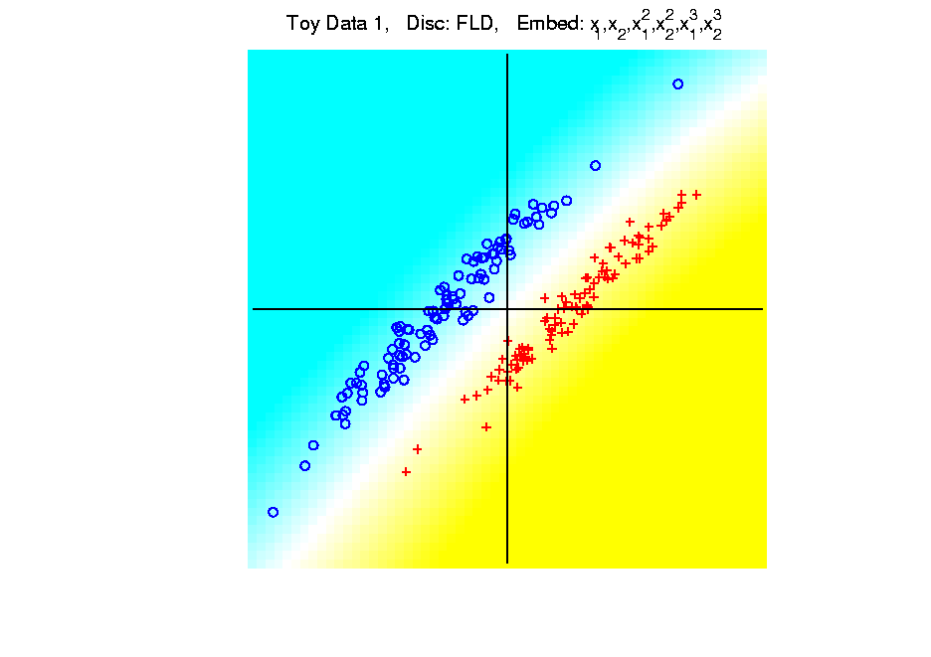
Kernel Embedding
Polynomial Embedding, Toy Example 1:
Parallel Clouds
FLD
All Stable
& Very Good
Since No Better
Separation in
Embedded Space
Notes:
PEod1Raw.ps

Slide 28
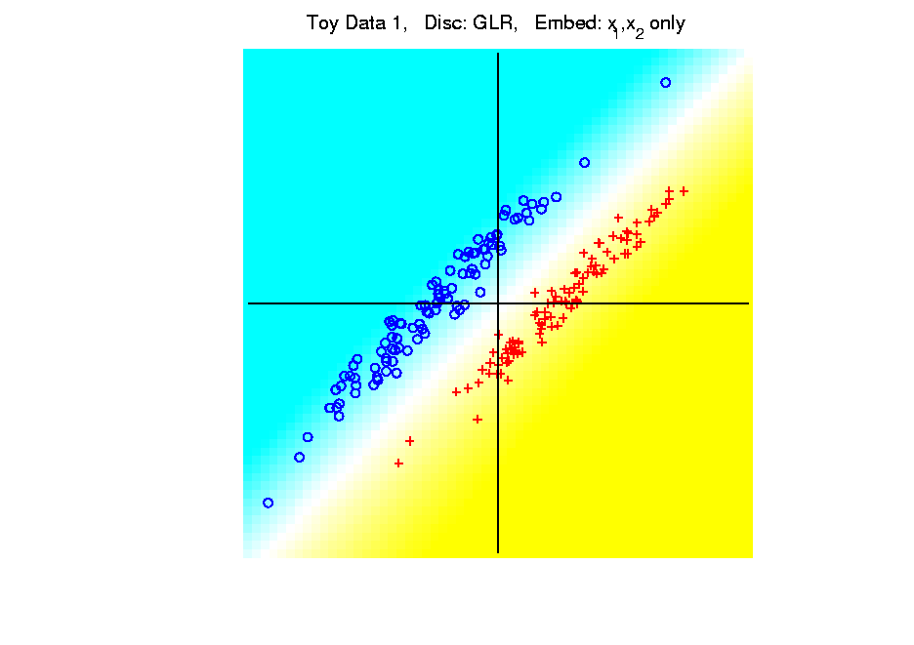
Kernel Embedding
Polynomial Embedding, Toy Example 1:
Parallel Clouds
GLR
Original
Data
Notes:
PEod1Raw.ps

Slide 29
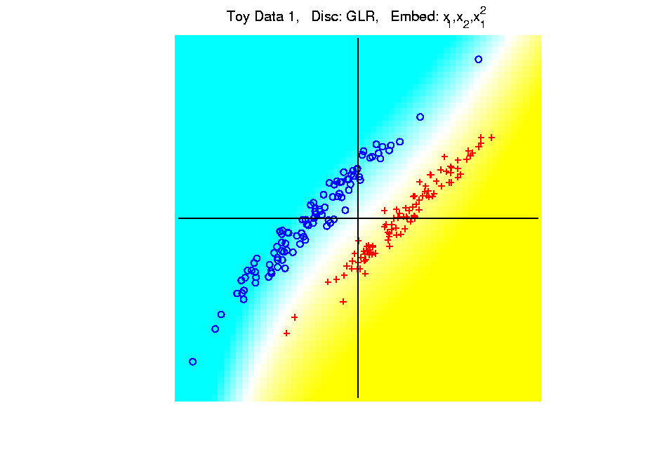
Kernel Embedding
Polynomial Embedding, Toy Example 1:
Parallel Clouds
GLR
Notes:
PEod1Raw.ps

Slide 30
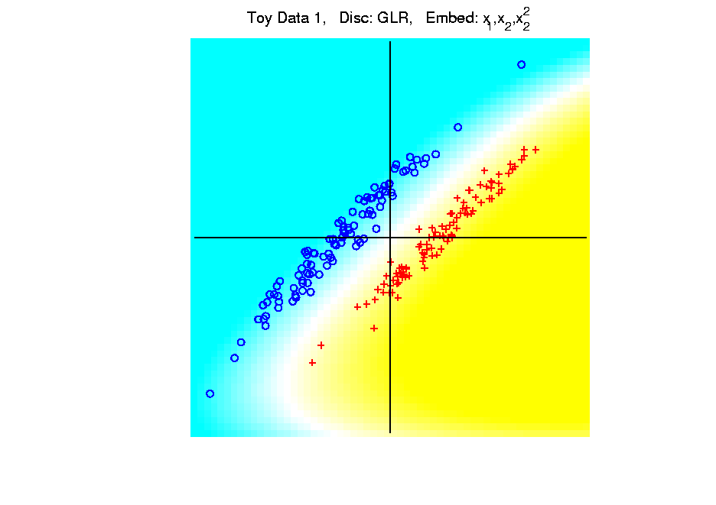
Kernel Embedding
Polynomial Embedding, Toy Example 1:
Parallel Clouds
GLR
Notes:
PEod1Raw.ps

Slide 31
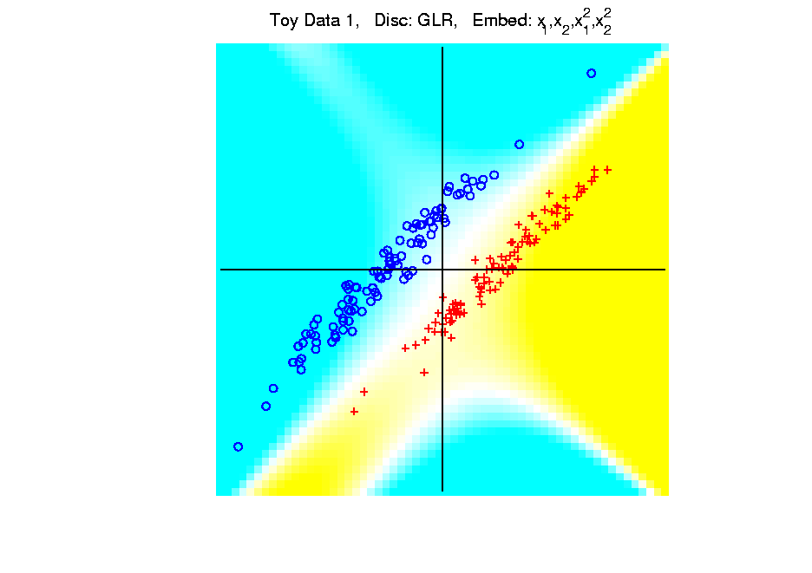
Kernel Embedding
Polynomial Embedding, Toy Example 1:
Parallel Clouds
GLR
Notes:
PEod1Raw.ps

Slide 32
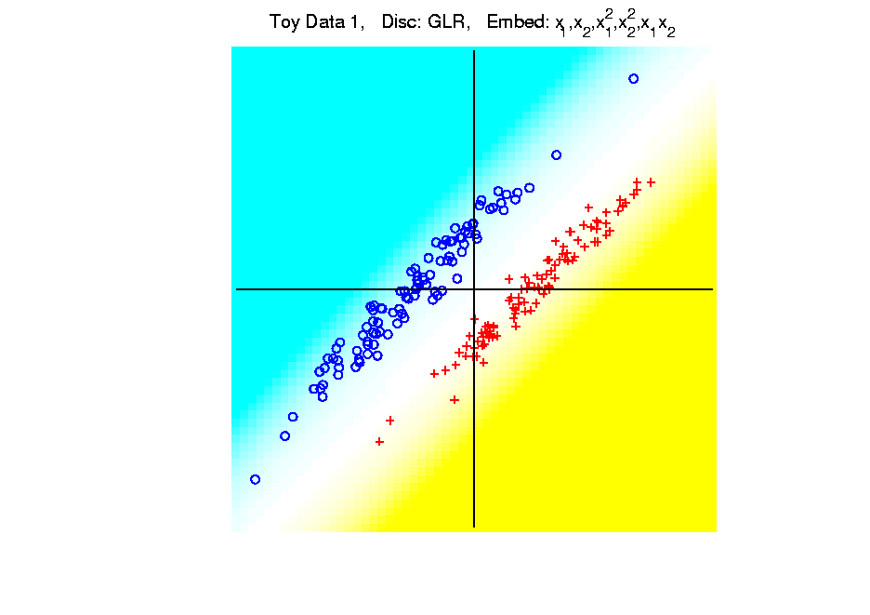
Kernel Embedding
Polynomial Embedding, Toy Example 1:
Parallel Clouds
GLR
Notes:
PEod1Raw.ps

Slide 33
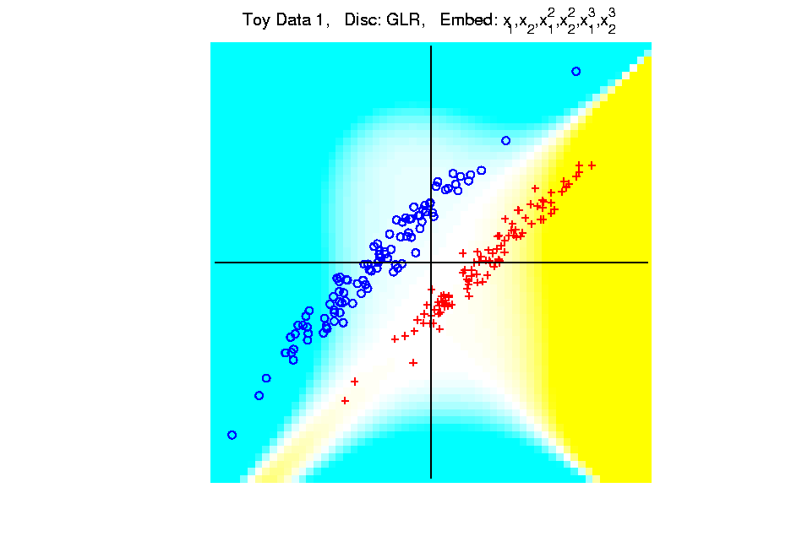
Kernel Embedding
Polynomial Embedding, Toy Example 1:
Parallel Clouds
GLR
Unstable
Subject to
Overfitting
Too Much Flexibility
In Embedded Space
Notes:
PEod1Raw.ps

Slide 34
Kernel Embedding
Polynomial Embedding, Toy Example 2:
Split X
Very Challenging
For Linear
Approaches
Notes:
PEod1Raw.ps

Slide 35
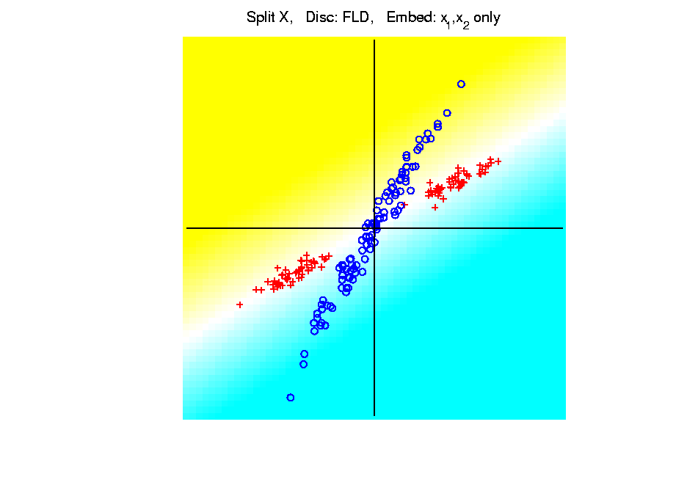
Kernel Embedding
Polynomial Embedding, Toy Example 2:
Split X
FLD
Original
Data
Notes:
PEod1Raw.ps

Slide 36
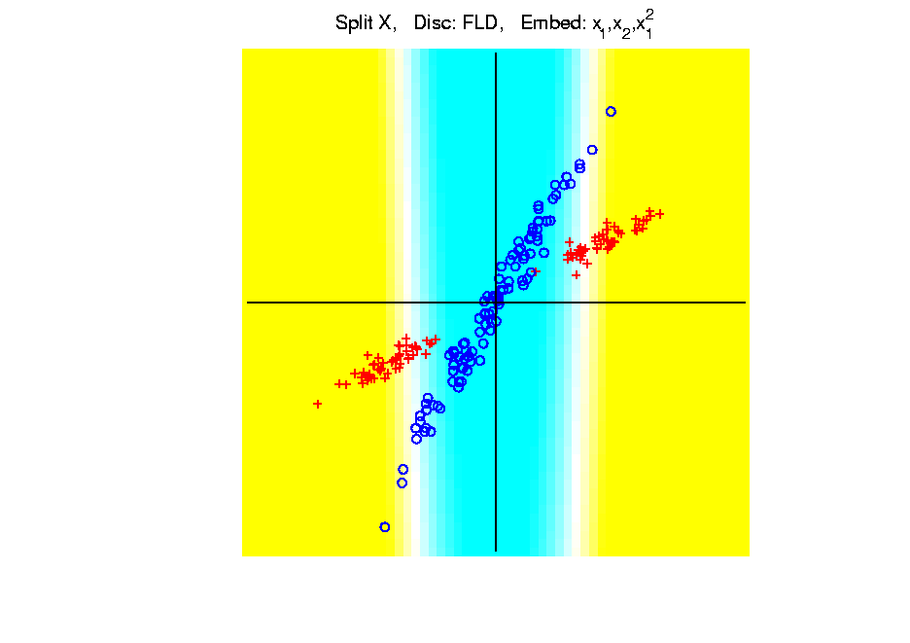
Kernel Embedding
Polynomial Embedding, Toy Example 2:
Split X
FLD
Slightly
Better
Notes:
PEod1Raw.ps

Slide 37
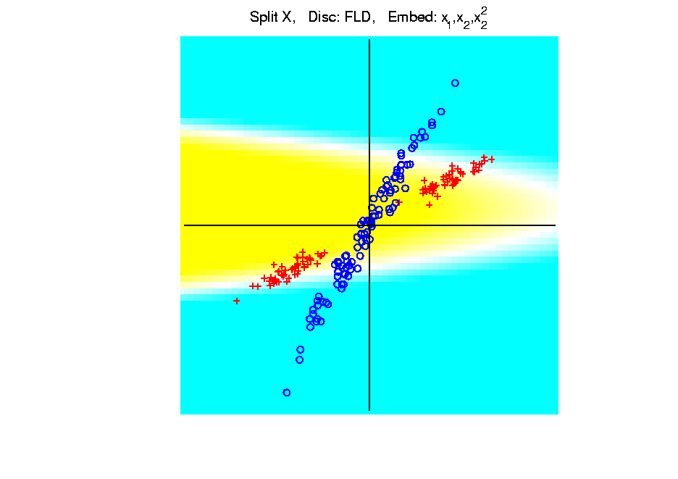
Kernel Embedding
Polynomial Embedding, Toy Example 2:
Split X
FLD
Notes:
PEod1Raw.ps

Slide 38
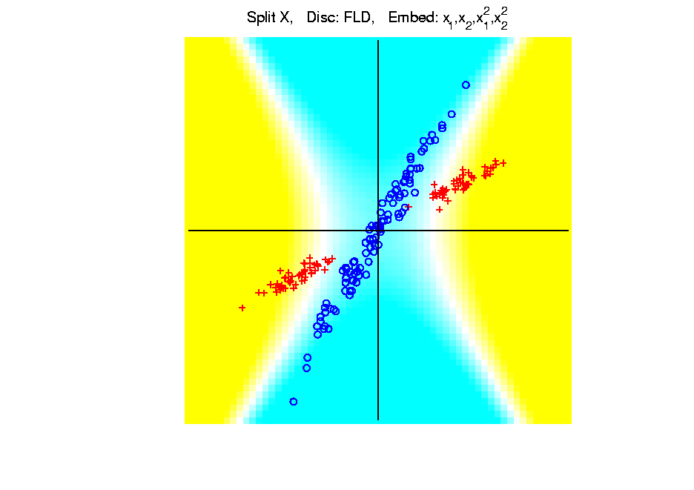
Kernel Embedding
Polynomial Embedding, Toy Example 2:
Split X
FLD
Very Good
Effective
Hyperbola
Notes:
PEod1Raw.ps

Slide 39
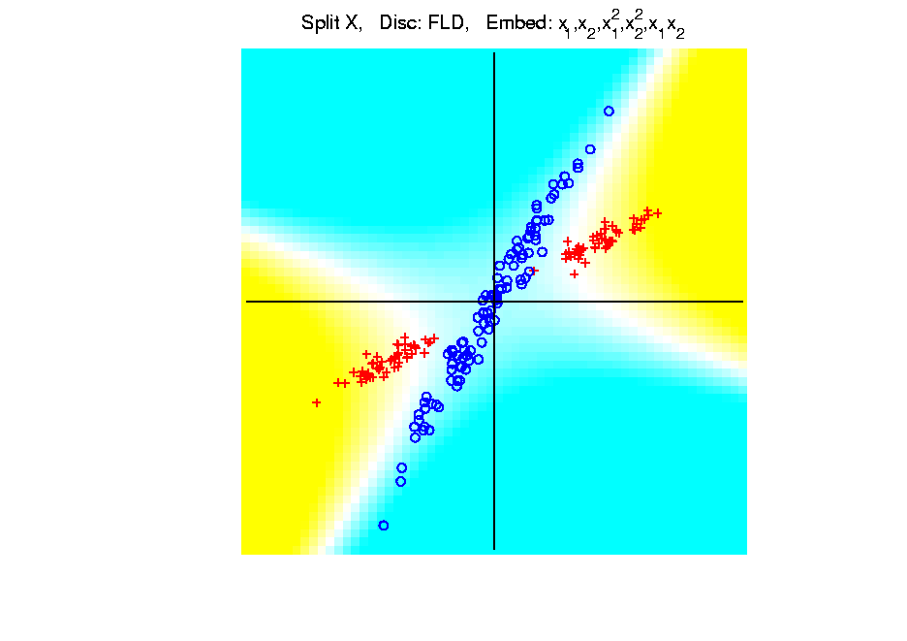
Kernel Embedding
Polynomial Embedding, Toy Example 2:
Split X
FLD
Notes:
PEod1Raw.ps

Slide 40
Kernel Embedding
Polynomial Embedding, Toy Example 2:
Split X
FLD
Robust
Against
Overfitting
Notes:
PEod1Raw.ps

Slide 41
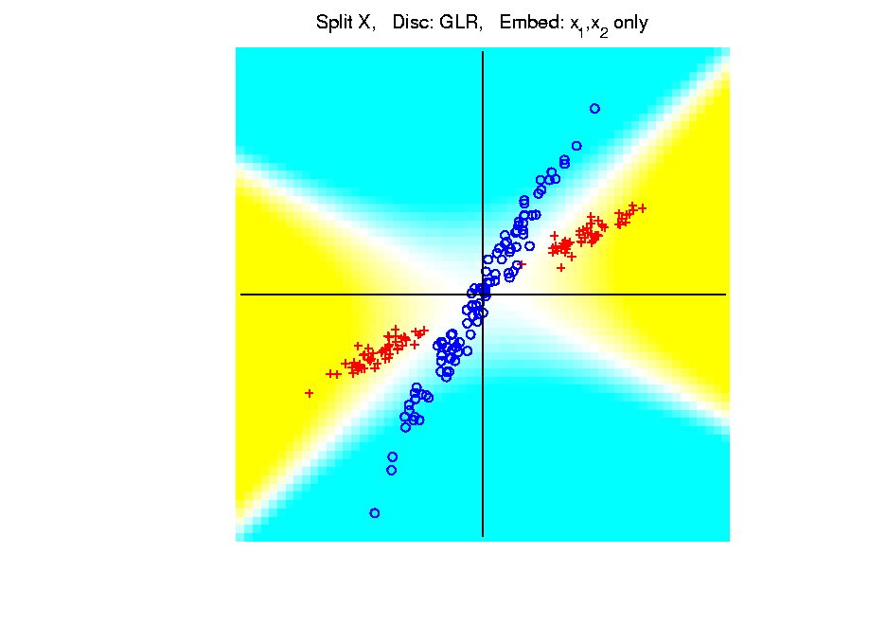
Kernel Embedding
Polynomial Embedding, Toy Example 2:
Split X
GLR
Original
Data
Looks
Very
Good
Notes:
PEod1Raw.ps

Slide 42
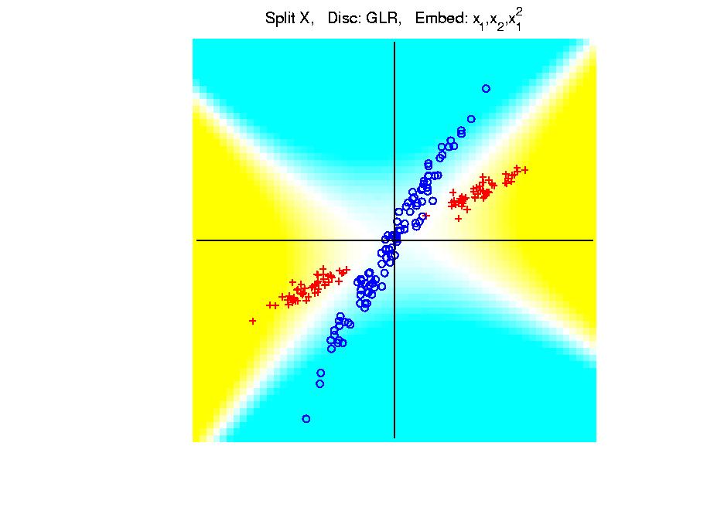
Kernel Embedding
Polynomial Embedding, Toy Example 2:
Split X
GLR
Notes:
PEod1Raw.ps

Slide 43
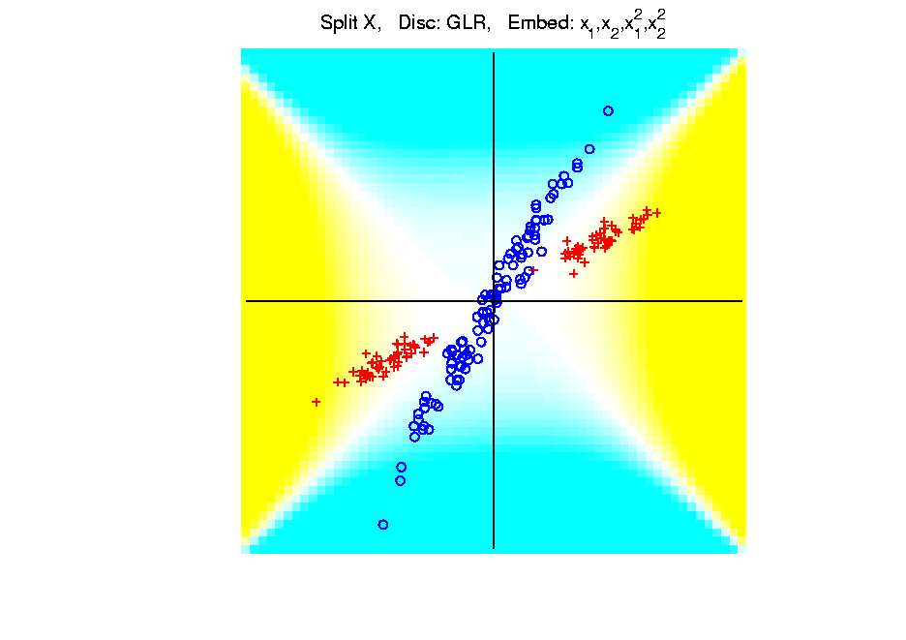
Kernel Embedding
Polynomial Embedding, Toy Example 2:
Split X
GLR
Reasonably
Stable
Never Ellipse
Around Blues
Notes:
PEod1Raw.ps

Slide 44
Kernel Embedding
Polynomial Embedding, Toy Example 3:
Donut
Very Challenging
For Any Linear
Approach
Notes:
PEod1Raw.ps

Slide 45
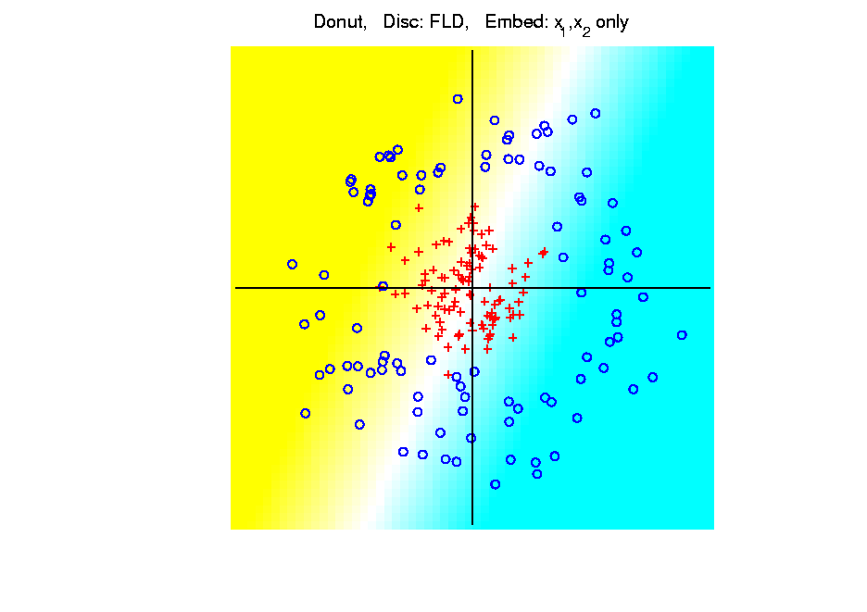
Kernel Embedding
Polynomial Embedding, Toy Example 3:
Donut
FLD
Original
Data
Very
Bad
Notes:
PEod1Raw.ps

Slide 46
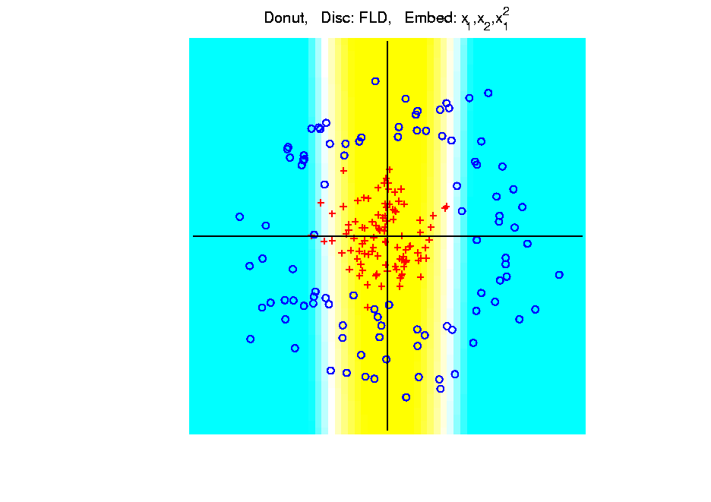
Kernel Embedding
Polynomial Embedding, Toy Example 3:
Donut
FLD
Somewhat
Better
(Parabolic Fold)
Notes:
PEod1Raw.ps

Slide 47
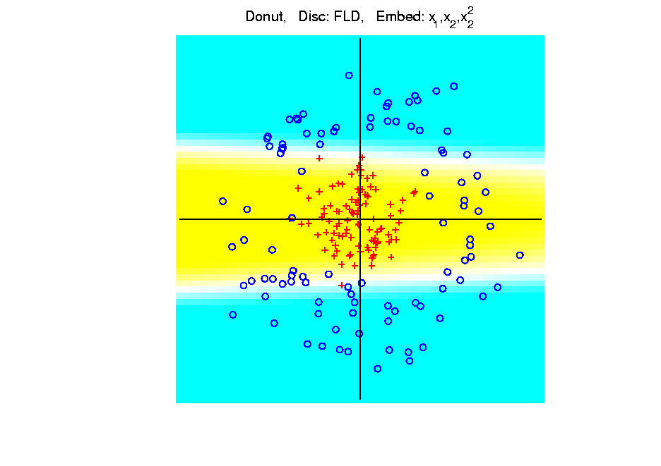
Kernel Embedding
Polynomial Embedding, Toy Example 3:
Donut
FLD
Somewhat
Better
(Other Fold)
Notes:
PEod1Raw.ps

Slide 48
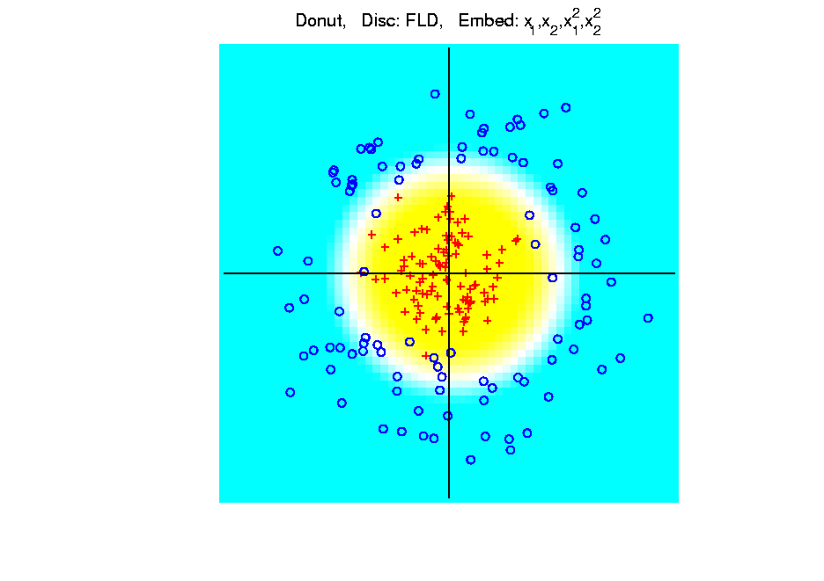
Kernel Embedding
Polynomial Embedding, Toy Example 3:
Donut
FLD
Good
Performance
(Slice of
Paraboloid)
Notes:
PEod1Raw.ps

Slide 49
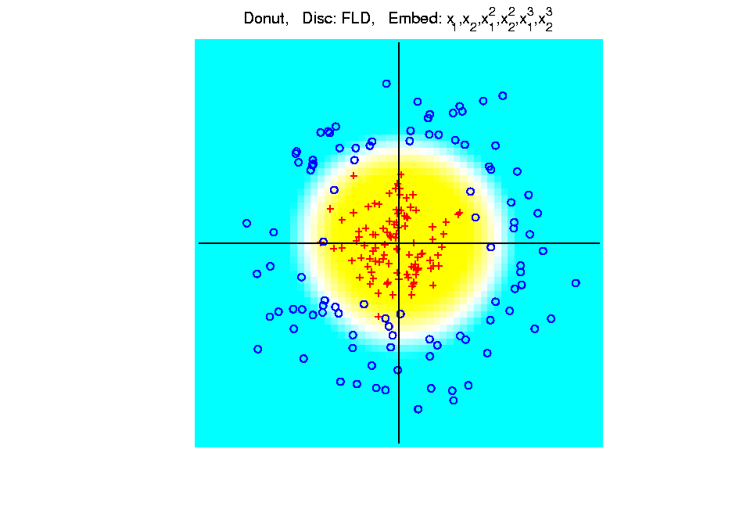
Kernel Embedding
Polynomial Embedding, Toy Example 3:
Donut
FLD
Robust
Against
Overfitting
Notes:
PEod1Raw.ps

Slide 50
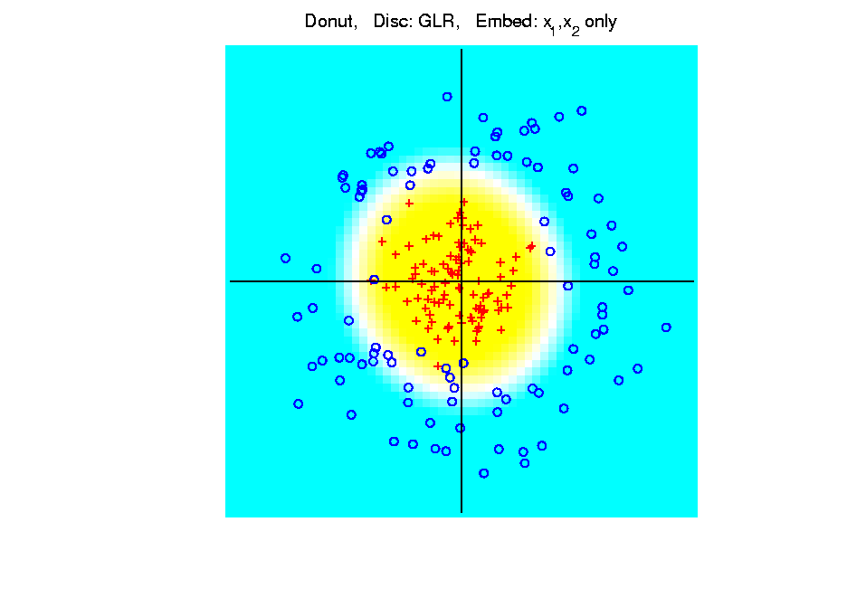
Kernel Embedding
Polynomial Embedding, Toy Example 3:
Donut
GLR
Original
Data
Best With
No Embedding?
Notes:
PEod1Raw.ps

Slide 51
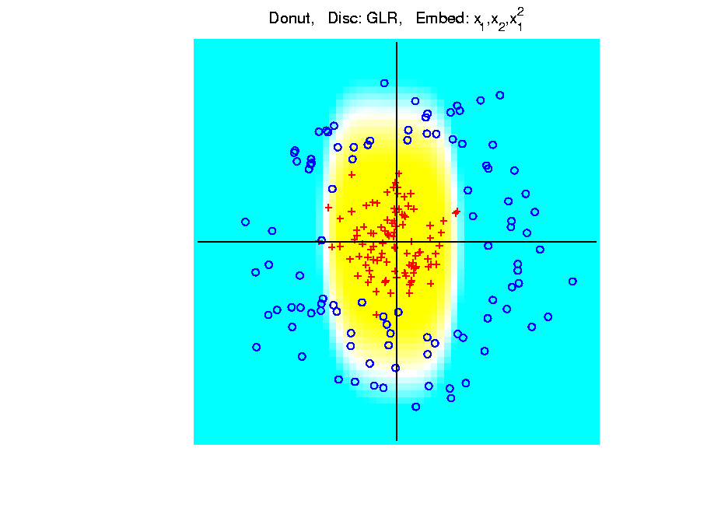
Kernel Embedding
Polynomial Embedding, Toy Example 3:
Donut
GLR
Notes:
PEod1Raw.ps

Slide 52
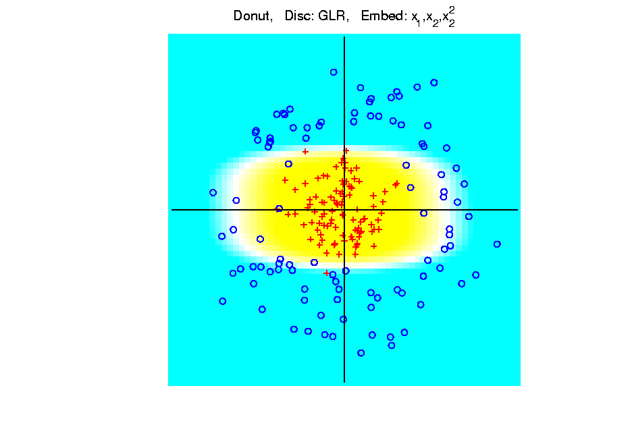
Kernel Embedding
Polynomial Embedding, Toy Example 3:
Donut
GLR
Notes:
PEod1Raw.ps

Slide 53
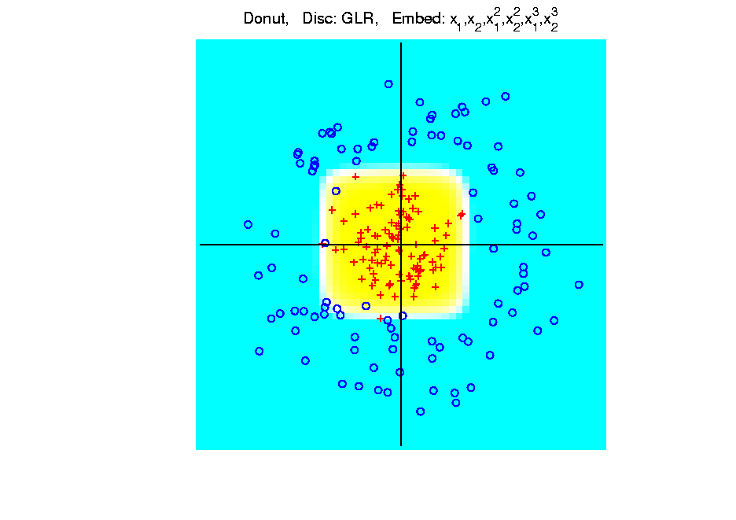
Kernel Embedding
Polynomial Embedding, Toy Example 3:
Donut
GLR
Overfitting
Gives Square
Shape?
Notes:
PEod1Raw.ps

Slide 54
Kernel Embedding
Drawbacks to polynomial embedding:
Too many extra terms create spurious structure
i.e. have “overfitting”
Too much flexibility
HDLSS problems typically get worse

Slide 55
Kernel Embedding
Important Variation: “Kernel Machines”
Idea: replace polynomials by
other nonlinear functions
e.g. 1: sigmoid functions from neural nets
e.g. 2: radial basis functions
Gaussian kernels
Related to “kernel density estimation”
(study more later)

Slide 56
Kernel Embedding
Radial Basis Functions:
Note: there are several ways to embed:
Naïve Embedding (equally spaced grid)
Explicit Embedding (evaluate at data)
Implicit Embedding (inner prod. based)
(everybody currently does the latter)

Slide 57
Kernel Embedding
Naïve Embedding, Radial basis functions:
At some “grid points” ${\underline{g}}_{1}⋯,{\underline{g}}_{k}$,
For a “bandwidth” (i.e. standard dev’n) $σ$,
Consider ($d$ dim’al) functions:
$$φ_{σ}\left(\underline{x}−{\underline{g}}_{1}\right),⋯,φ_{σ}\left(\underline{x}−{\underline{g}}_{k}\right)$$
$N_{d}\left(0,σ^{2}I\right)$ Probability Density

Slide 58
Kernel Embedding
Naïve Embedding, Radial basis functions:
At some “grid points” ${\underline{g}}_{1}⋯,{\underline{g}}_{k}$,
For a “bandwidth” (i.e. standard dev’n) $σ$,
Consider ($d$ dim’al) functions:
$$φ_{σ}\left(\underline{x}−{\underline{g}}_{1}\right),⋯,φ_{σ}\left(\underline{x}−{\underline{g}}_{k}\right)$$
Replace data matrix with:
$$\left(\begin{matrix}φ_{σ}\left({\underline{X}}_{1}−{\underline{g}}_{1}\right) & ⋯ & φ_{σ}\left({\underline{X}}_{n}−{\underline{g}}_{1}\right) \\ ⋮ & ⋱ & ⋮ \\ φ_{σ}\left({\underline{X}}_{1}−{\underline{g}}_{k}\right) & ⋯ & φ_{σ}\left({\underline{X}}_{n}−{\underline{g}}_{k}\right)\end{matrix}\right)$$

Slide 59
Kernel Embedding
Naïve Embedding, Radial basis functions:
For discrimination: work in radial basis space, With new data vector ${\underline{X}}_{0}$,
represented by: $\left(\begin{matrix}φ_{σ}\left({\underline{X}}_{0}−{\underline{g}}_{1}\right) \\ ⋮ \\ φ_{σ}\left({\underline{X}}_{0}−{\underline{g}}_{k}\right)\end{matrix}\right)$

Slide 60
Kernel Embedding
Naïve Embedd’g, Toy E.g. 1: Parallel Clouds
Good
at data
Poor
outside

Slide 61
Kernel Embedding
Naïve Embedd’g, Toy E.g. 2: Split X
OK at
data
Strange
outside

Slide 62
Kernel Embedding
Naïve Embedd’g, Toy E.g. 3: Donut
Mostly
good
Slight
mistake
for one
kernel

Slide 63
Kernel Embedding
Naïve Embedding, Radial basis functions:
Toy Example, Main lessons:
Generally good in regions with data,
Unpredictable where data are sparse

Slide 64
Kernel Embedding
Toy Example 4: Checkerboard
Very
Challenging!
Linear
Method?
Polynomial
Embedding?
Notes:
PEod1Raw.ps

Slide 65
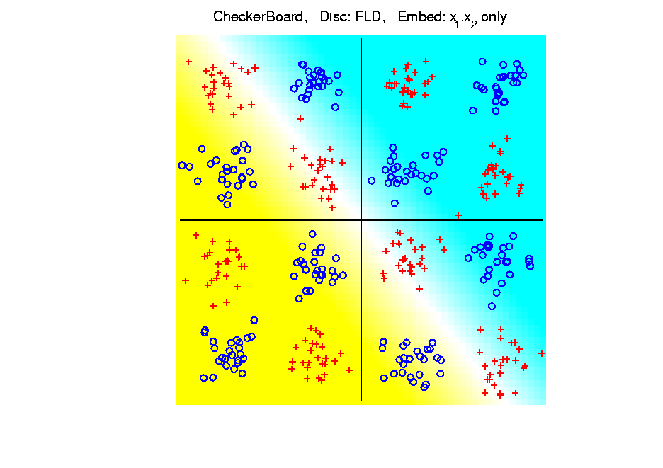
Kernel Embedding
Toy Example 4: Checkerboard
Very
Challenging!
FLD
Linear Is
Hopeless
Notes:
PEod1Raw.ps

Slide 66
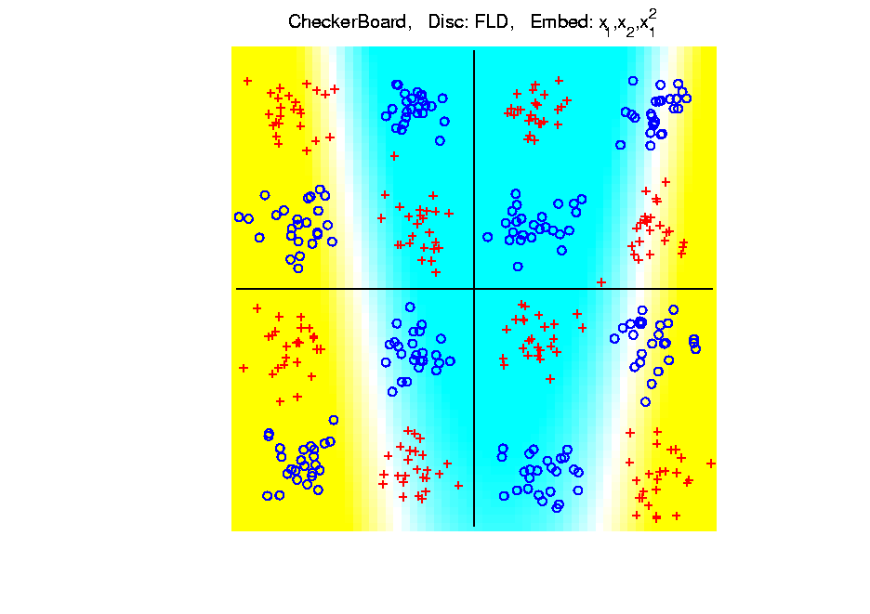
Kernel Embedding
Toy Example 4: Checkerboard
Very
Challenging!
FLD
Notes:
PEod1Raw.ps

Slide 67
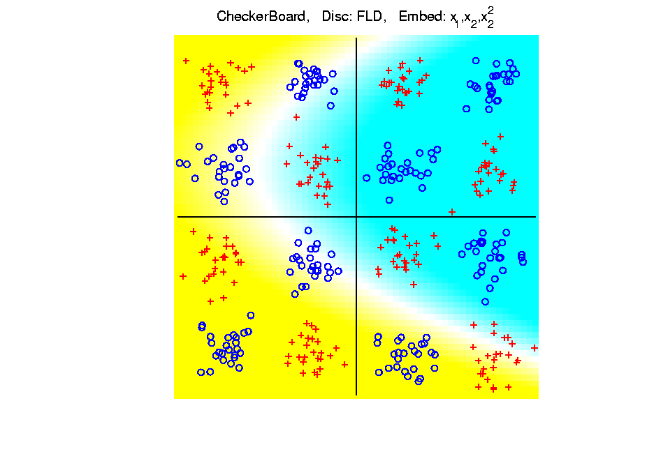
Kernel Embedding
Toy Example 4: Checkerboard
Very
Challenging!
FLD
Notes:
PEod1Raw.ps

Slide 68
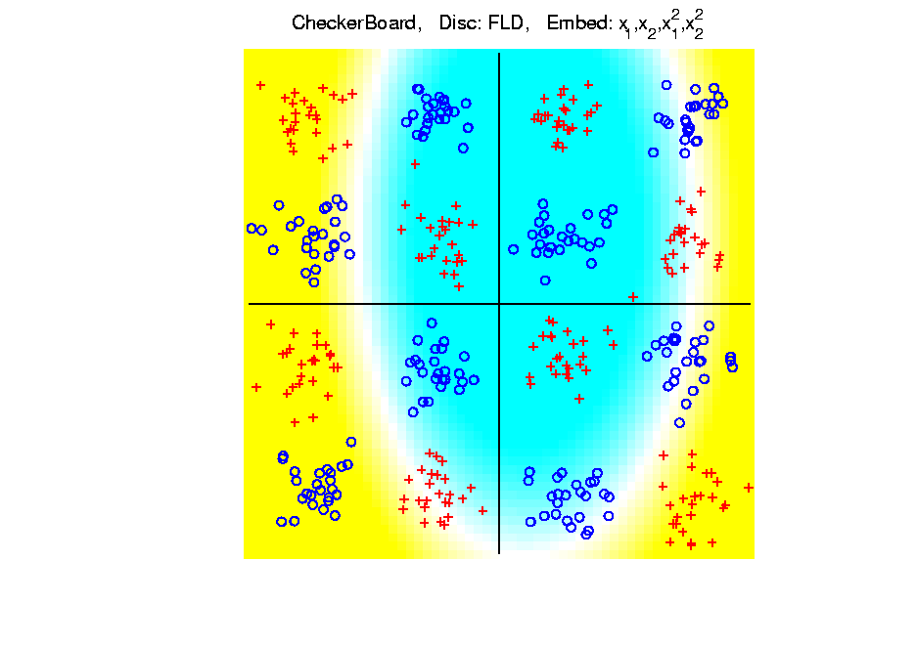
Kernel Embedding
Toy Example 4: Checkerboard
Very
Challenging!
FLD
Notes:
PEod1Raw.ps

Slide 69
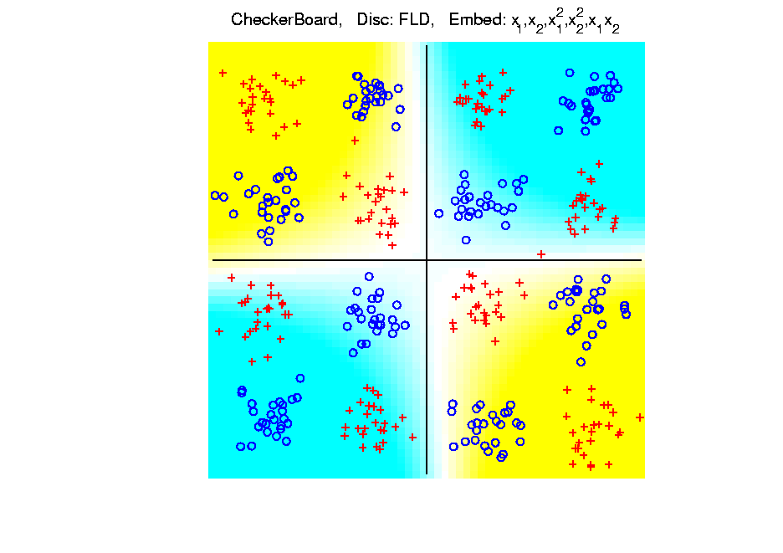
Kernel Embedding
Toy Example 4: Checkerboard
Very
Challenging!
FLD
Notes:
PEod1Raw.ps

Slide 70
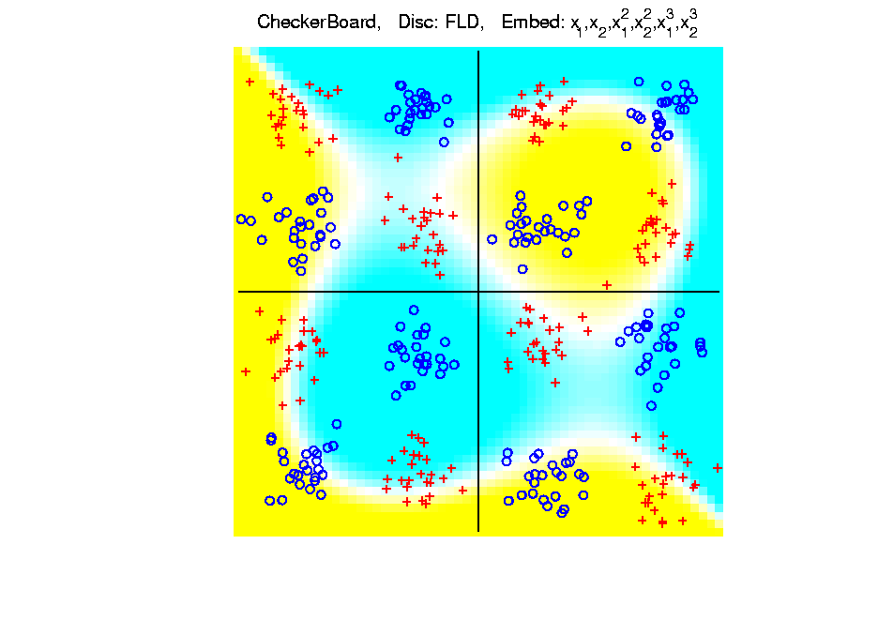
Kernel Embedding
Toy Example 4: Checkerboard
Very
Challenging!
FLD
Embedding
Gets Better
But Still
Not Great
Notes:
PEod1Raw.ps

Slide 71
Kernel Embedding
Toy Example 4: Checkerboard
Very
Challenging!
Polynomials
Don’t Have
Needed
Flexiblity
Notes:
PEod1Raw.ps

Slide 72
Kernel Embedding
Toy Example 4: Checkerboard
Radial
Basis
Embedding
+ FLD
Is
Excellent!
Notes:
PEod1Raw.ps

Slide 73
Kernel Embedding
Drawbacks to naïve embedding:
Equally spaced grid too big in high $d$
Not computationally tractable $\left(g^{d}\right)$
Approach:
Evaluate only at data points
Not on full grid
But where data live

Slide 74
Kernel Embedding
Other types of embedding:
Explicit
Implicit
Will be studied soon, after
introduction to Support Vector Machines…

Slide 75
Kernel Embedding
$∃$ generalizations of this idea to other types of analysis
& some clever computational ideas.
E.g. “Kernel based, nonlinear Principal Components Analysis”
Ref: Schölkopf et al (1998)

Slide 76
Kernel Embedding
Important Variation:
“Generalized Principal Components Analysis”
Ref: Vidal et al (2016)

Slide 77
Support Vector Machines
Motivation:
Find a linear method that “works well”
for embedded data
Note: Embedded data are
very non-Gaussian
Classical Statistics: “Use Prob. Dist’n”
Looks Hopeless

Slide 78
Support Vector Machines
Motivation:
Find a linear method that “works well”
for embedded data
Note: Embedded data are
very non-Gaussian
Suggests value of
really new approach

Slide 79
Support Vector Machines
Classical References:
Vapnik (1982)
Boser, Guyon & Vapnik (1992)
Vapnik (1995)

Slide 80
Support Vector Machines
Recommended tutorial:
Burges (1998)
Early Monographs:
Cristianini & Shawe-Taylor (2000)
Schölkopf & Smola (2002)
More Recent Monographs:
Hastie et al (2005)
Bishop (2006)

Slide 81
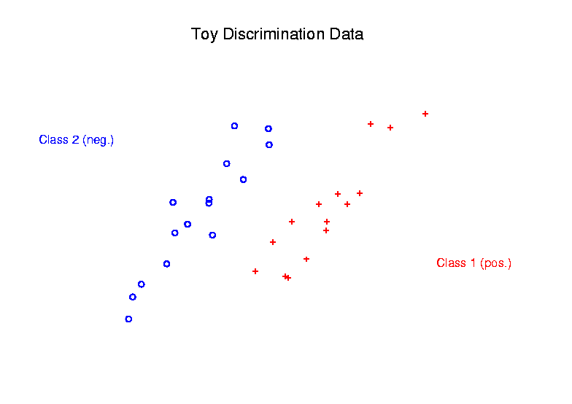
Support Vector Machines
Graphical View, using Toy Example:

Slide 82
Support Vector Machines
Graphical View, using Toy Example:
Find separating plane
To maximize distances from data to plane

Slide 83
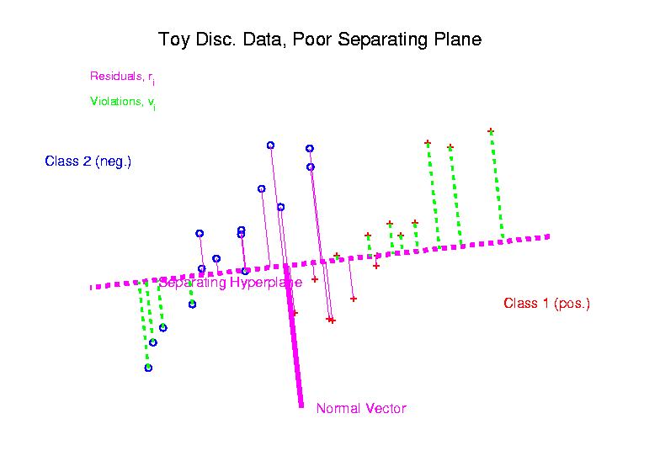
Support Vector Machines
Graphical View, using Toy Example:

Slide 84
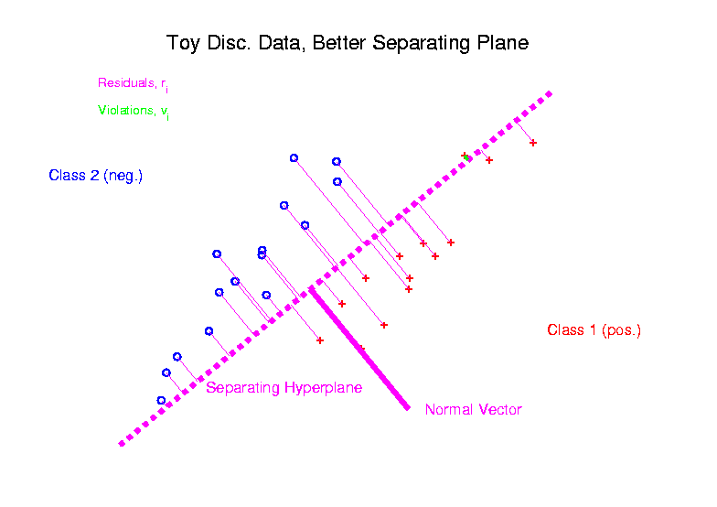
Support Vector Machines
Graphical View, using Toy Example:

Slide 85
Support Vector Machines
Graphical View, using Toy Example:
Find separating plane
To maximize distances from data to plane
In particular smallest distance

Slide 86
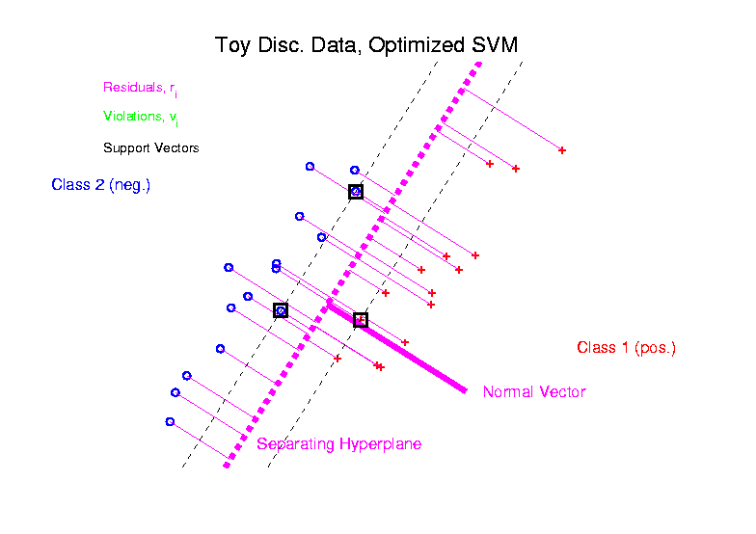
Support Vector Machines
Graphical View, using Toy Example:

Slide 87
Support Vector Machines
Graphical View, using Toy Example:
Find separating plane
To maximize distances from data to plane
In particular smallest distance
Data points closest are called
support vectors
Gap between is called margin
Caution: For some “margin” is different

Slide 88
SVMs, Optimization Viewpoint
Formulate Optimization problem, based on:
Data (feature) vectors $x_{1},⋯,x_{n}$
Class Labels $y_{i}=±1$
Normal Vector $w$
Location (determines intercept) $b$
Residuals (right side) $r_{i}=y_{i}\left({x_{i}}^{t}w+b\right)$
Residuals (wrong side) $ξ_{i}=−r_{i}$
Solve (convex problem) by quadratic programming

Slide 89
SVMs, Optimization Viewpoint
Lagrange Multipliers primal formulation (separable case):
Minimize:
$L_{P}\left(w,b,α\right)=\frac{1}{2}{\left\|w\right\|}^{2}−\sum_{i=1}^{n}{α_{i}}\left(y_{i}\left(x_{i}∙w+b\right)−1\right)$
Where $α_{1},⋯,α_{n}$ are Lagrange multipliers
Notation: “dot product” = inner product
Elsewhere: $u∙v= \left\langle u,v\right\rangle =u^{t}v$

Slide 90
SVMs, Optimization Viewpoint
Lagrange Multipliers primal formulation (separable case):
Minimize:
$L_{P}\left(w,b,α\right)=\frac{1}{2}{\left\|w\right\|}^{2}−\sum_{i=1}^{n}{α_{i}}\left(y_{i}\left(x_{i}∙w+b\right)−1\right)$
Where $α_{1},⋯,α_{n}$ are Lagrange multipliers
Dual Lagrangian version:
Maximize: $L_{D}=\sum_{i}{α_{i}}−\frac{1}{2}\sum_{i,j}{α_{i}α_{j}y_{i}}y_{j}x_{i}∙x_{j}$
Get classification function:
$f\left(x\right)=\sum_{i=1}^{n}{α_{i}y_{i}x∙x_{i}+b}$

Slide 91
SVMs, Optimization Viewpoint
Get classification function:
$$f\left(x\right)=\sum_{i=1}^{n}{α_{i}y_{i}x∙x_{i}+b}$$
Choose Class:
+1, when $f\left(x\right)>0$
-1, when $f\left(x\right)<0$
Note: linear function of $x$
i.e. have found separating hyperplane

Slide 92
SVMs, Computation
Major Computational Point:
Classifier only depends on data through inner products!
$$f\left(x\right)=\sum_{i=1}^{n}{α_{i}y_{i}x∙x_{i}+b}$$

Slide 93
SVMs, Computation
Major Computational Point:
Classifier only depends on data through inner products!
Thus enough to only store inner products
Creates big savings in optimization
Especially for HDLSS data
But also creates variations in kernel embedding (interpretation?!?)
This is almost always done in practice

Slide 94
SVMs, Comput’n & Embedding
For an “Embedding Map”, $Φ\left(x\right)$
e.g.
Explicit Embedding:
Maximize:
$$L_{D}=\sum_{i}{α_{i}}−\frac{1}{2}\sum_{i,j}{α_{i}α_{j}y_{i}}y_{j}Φ\left(x_{i}\right)∙Φ\left(x_{j}\right)$$
Get classification function:
$$f\left(x\right)=\sum_{i=1}^{n}{α_{i}y_{i}Φ\left(x\right)∙Φ\left(x_{i}\right)+b}$$
Straightforward application of embedding
But loses inner product advantage
$$Φ\left(x\right)=\left(\begin{matrix}x \\ x^{2}\end{matrix}\right)$$

Slide 95
SVMs, Comput’n & Embedding
Implicit Embedding:
Maximize:
$$L_{D}=\sum_{i}{α_{i}}−\frac{1}{2}\sum_{i,j}{α_{i}α_{j}y_{i}}y_{j}Φ\left(x_{i}∙x_{j}\right)$$

Slide 96
SVMs, Comput’n & Embedding
Implicit Embedding:
Maximize:
$$L_{D}=\sum_{i}{α_{i}}−\frac{1}{2}\sum_{i,j}{α_{i}α_{j}y_{i}}y_{j}Φ\left(x_{i}∙x_{j}\right)$$
Note Difference from Explicit Embedding:
$$L_{D}=\sum_{i}{α_{i}}−\frac{1}{2}\sum_{i,j}{α_{i}α_{j}y_{i}}y_{j}Φ\left(x_{i}\right)∙Φ\left(x_{j}\right)$$

Slide 97
SVMs, Comput’n & Embedding
Implicit Embedding:
Maximize:
$$L_{D}=\sum_{i}{α_{i}}−\frac{1}{2}\sum_{i,j}{α_{i}α_{j}y_{i}}y_{j}Φ\left(x_{i}∙x_{j}\right)$$
Get classification function:
$$f\left(x\right)=\sum_{i=1}^{n}{α_{i}y_{i}Φ\left(x∙x_{i}\right)+b}$$
Still defined only via inner products
Retains optimization advantage
Thus used very commonly
Comparison to explicit embedding?
Which is “better”???

Slide 98
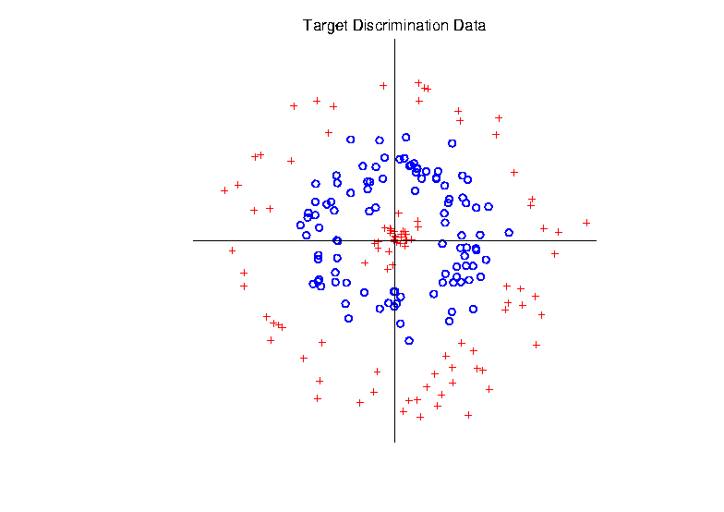
Support Vector Machines
Target Toy Data set:

Slide 99
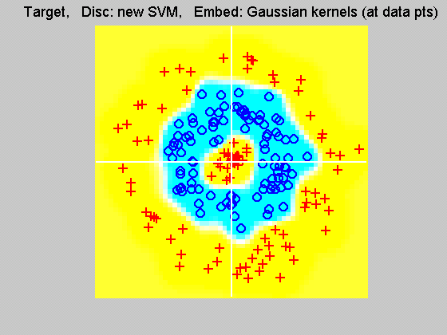
Support Vector Machines
Explicit Embedding, window σ = 0.1:
Gaussian
Kernel,
i.e.
Radial
Basis
Function

Slide 100
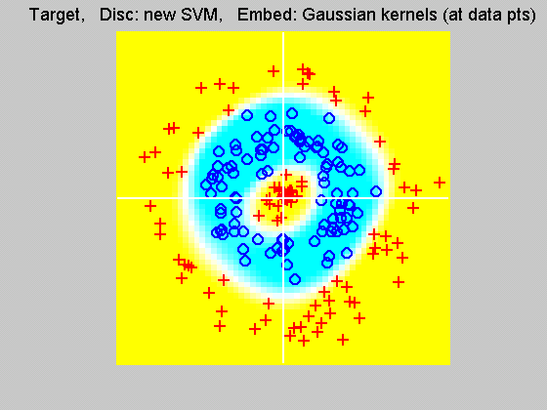
Support Vector Machines
Explicit Embedding, window σ = 1:
Pretty Big
Change
(Factor
of 10)

Slide 101
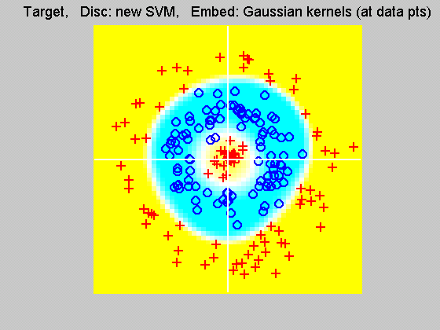
Support Vector Machines
Explicit Embedding, window σ = 10:
Not Quite
As Good
???

Slide 102
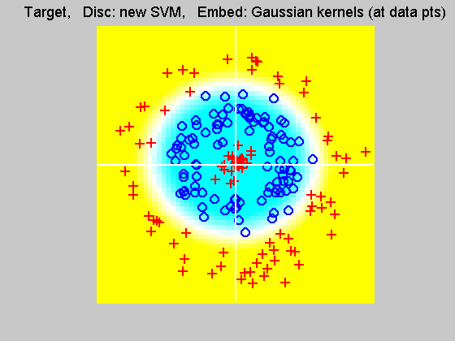
Support Vector Machines
Explicit Embedding, window σ = 100:
Note: Lost Center
(Over- Smoothed)

Slide 103
Support Vector Machines
Notes on Explicit Embedding:
Too small → Poor generalizability
Too big → miss important regions
Classical lessons from kernel smoothing
Surprisingly large “reasonable region”
I.e. parameter less critical (sometimes?)
Will study Later

Slide 104
Support Vector Machines
Interesting Alternative Viewpoint:
Study Projections
In Kernel Space
(Never done in Machine Learning World)

Slide 105
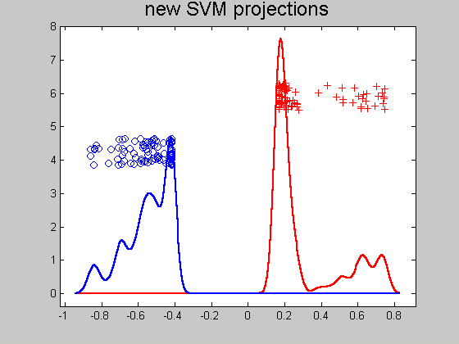
Support Vector Machines
Kernel space projection, window σ = 0.1:
Note:
Data
Piling
At
Margin
Will become
an issue soon

Slide 106
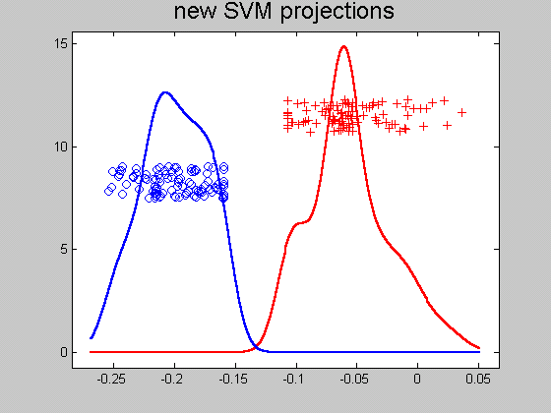
Support Vector Machines
Kernel space projection, window σ = 1:
Excellent
Separation
(but less
than σ = 0.1)

Slide 107
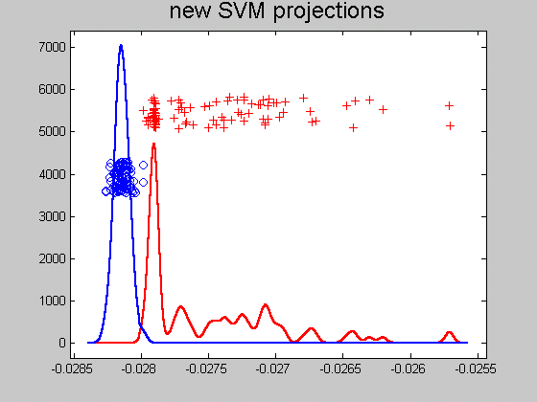
Support Vector Machines
Kernel space projection, window σ = 10:
Still Good
(But Some
Overlap)

Slide 108
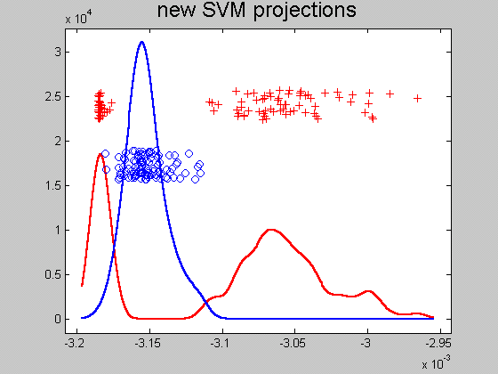
Support Vector Machines
Kernel space projection, window σ = 100:
Some Reds
On Wrong
Side
(Missed
Center)

Slide 109
Support Vector Machines
Notes on Kernel space projection:
Too small $σ$ →
Great separation
But recall, poor generalizability
Too big $σ$ → no longer separable
As above:
Classical lessons from kernel smoothing
Surprisingly large “reasonable region”
I.e. parameter less critical (sometimes?)

Slide 110
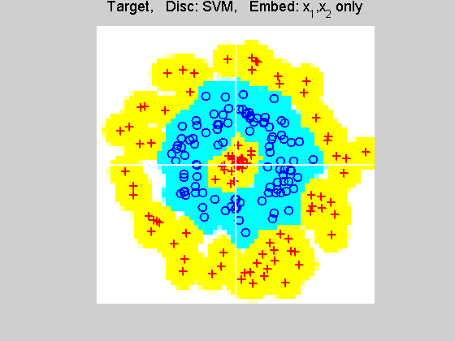
Support Vector Machines
Implicit Embedding, window σ = 0.1:

Slide 111
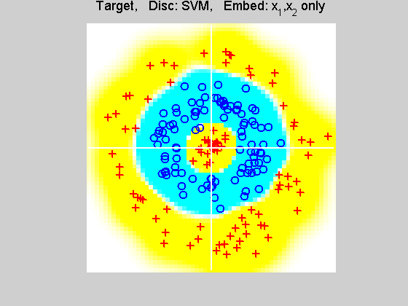
Support Vector Machines
Implicit Embedding, window σ = 0.5:

Slide 112
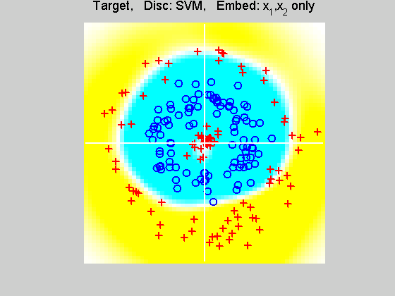
Support Vector Machines
Implicit Embedding, window σ = 1:

Slide 113
Support Vector Machines
Implicit Embedding, window σ = 10:

Slide 114
Support Vector Machines
Notes on Implicit Embedding:
Similar Large vs. Small lessons
Range of “reasonable results”
Seems to be smaller (different range)
Caution about “relative scales”
For $Φ\left(x\right)$ $↔$ $Φ\left(x^{t}x\right)$
Rescale by $σ ↔ σ^{2}$, i.e. $10 ↔ 100$
Much different “edge” behavior

Slide 115
SVMs & Robustness
Usually not severely affected by outliers,
But a possible weakness:
Can have very influential points
Toy E.g., only 2 points drive SVM

Slide 116
SVMs & Robustness
Can have very influential points

Slide 117
SVMs & Robustness
Usually not severely affected by outliers,
But a possible weakness:
Can have very influential points
Toy E.g., only 2 points drive SVM
Notes:
Huge range of chosen hyperplanes
But all are “pretty good discriminators”
Only happens when whole range is OK???
Good or bad?

Slide 118
SVMs & Robustness
Effect of violators:

Slide 119
SVMs, Tuning Parameter
Recall Regularization Parameter C:
Controls penalty for violation
I.e. lying on wrong side of plane
Appears in slack variables
Affects performance of SVM
Toy Example:
d = 50, Spherical Gaussian data

Slide 120
SVMs, Tuning Parameter
Toy Example: d = 50, Sph’l Gaussian data

Slide 121
SVMs, Tuning Parameter
Toy Example:
d = 50, Spherical Gaussian data
X=Axis: Opt. Dir’n Other: SVM Dir’n
Small C:
Where is the margin?
Small angle to optimal (generalizable)
Large C:
More data piling
Larger angle (less generalizable)
Bigger gap (but maybe not better???)
Between: Very small range

Slide 122
SVMs, Tuning Parameter
Toy Example: d = 50, Sph’l Gaussian data
Put MD on horizontal axis

Slide 123
SVMs, Tuning Parameter
Toy Example:
d = 50, Spherical Gaussian data
Careful look at small C:
Put MD on horizontal axis
Shows SVM and MD same for C small
Separates better for large C
But at cost of data piling (less generalizable)
Mathematics behind this:
Carmichael & Marron (2017)

Slide 124
SVMs, Tuning Parameter
Toy Example:
d = 50, Spherical Gaussian data
Strange Behavior in Both Views:
Stable Over Range of Small $C$
Big Changes Over Narrow Range of $C$
Stable Over Range of Large $C$
Mathematics behind this:
Carmichael & Marron (2017)

Slide 125
Support Vector Machines
Important Extension:
Multi-Class SVMs
Hsu & Lin (2002)
Lee, Lin, & Wahba (2002)
Defined for “implicit” version
“Direction Based” variation???

Slide 126
Distance Weighted Discrim’n
Improvement of SVM for HDLSS Data
Toy e.g.
$d=50$
indep. $N\left(0,1\right)$
$μ_{1}=±2$
$n_{+}=n_{−}=20$
(similar to
earlier movie)

Slide 127
Distance Weighted Discrim’n
Toy e.g.: Maximal Data Piling Direction
- Perfect
Separation
- Gross
Overfitting
- Large Angle
- Poor
Gen’ability
MDP

Slide 128
Distance Weighted Discrim’n
Toy e.g.: Support Vector Machine Direction
- Bigger Gap
- Smaller Angle
- Better
Gen’ability
- Feels support
vectors too
strongly???
- Ugly subpops?
- Improvement?

Slide 129
Distance Weighted Discrim’n
Toy e.g.: Distance Weighted Discrimination
- Addresses
these issues
- Smaller Angle
- Better
Gen’ability
- Nice subpops
- Replaces
min dist. by
avg. dist.

Slide 130
Distance Weighted Discrim’n
Based on Optimization Problem:
For “Residuals”:

Slide 131
Distance Weighted Discrim’n
Based on Optimization Problem:
Uses “poles” to push plane away from data

Slide 132
Distance Weighted Discrim’n
Based on Optimization Problem:
More precisely:
Work in appropriate penalty for violations
Optimization Method:
Second Order Cone Programming
“Still convex” gen’n of quad’c program’g
Allows fast greedy solution
Can use available fast software
(SDP3, Michael Todd, et al)

Slide 133
Distance Weighted Discrim’n
References for more on DWD:
Main paper:
Marron, Todd and Ahn (2007)
Links to more papers:
Ahn (2007)
R Implementation of DWD:
CRAN (2011)
SDPT3 Software:
Toh et al (1999)
Sparse DWD: Wang & Zou (2016)
Notes:
133

Slide 134
Distance Weighted Discrim’n
2-d Visualization:
Pushes Plane
Away From
Data
All Points
Have Some
Influence
(not just support vectors)

Slide 135
Support Vector Machines
Graphical View, using Toy Example:

Slide 136
Support Vector Machines
Graphical View, using Toy Example:

Slide 137
Distance Weighted Discrim’n
Graphical View, using Toy Example:

Slide 138
DWD in Face Recognition
Face Images as Data
Benito et al (2017)
Male – Female Difference?
Discrimination Rule?
Represented as long vector of pixel gray levels
Registration is critical

Slide 139
DWD in Face Recognition, (cont.)
Registered Data
Shifts and scale
Manually chosen
To align eyes and mouth
Still large variation
See males vs. females???

Slide 140
DWD in Face Recognition , (cont.)
DWD Direction
Good separation
Images “make sense”
Garbage at ends?
(extrapolation effects?)

Slide 141
DWD in Face Recognition , (cont.)
Unregistered Version
Much blurrier
Since features don’t properly line up
Nonlinear Variation
But DWD still works
Can see M-F differ’ce?

