Slide 1
Participant Presentations
(10 Minute Talks)

Slide 2
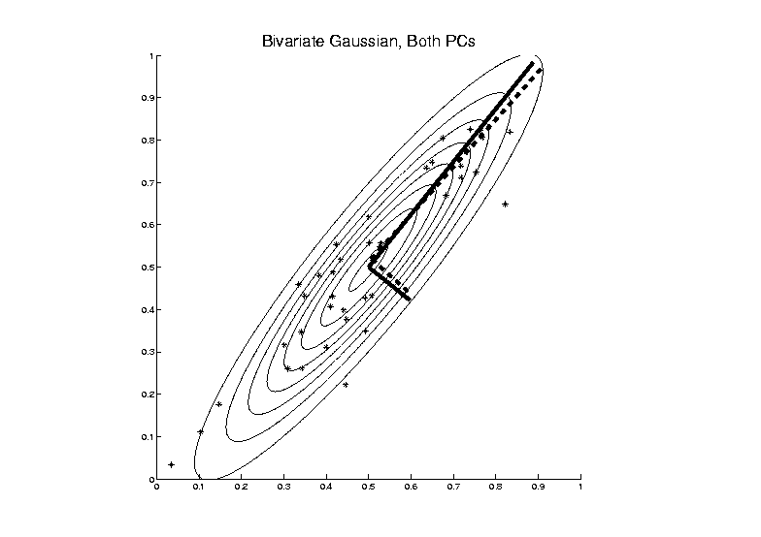
Big Picture View of PCA
Alternate Viewpoint: Gaussian Likelihood
Maximum Likelihood Estimate

Slide 3
Big Picture View of PCA
Alternate Viewpoint: Gaussian Likelihood
When data are multivariate Gaussian
PCA finds major axes of ellipt’al contours
of Probability Density
Maximum Likelihood Estimate
Mistaken idea:
PCA only useful for Gaussian data

Slide 4
Big Picture View of PCA
Simple check for Gaussian distribution:
Standardized parallel coordinate plot
Subtract coordinate wise median
(robust version of mean)
(not good as “point cloud center”,
but now only looking at coordinates)
Normalize by MAD / MAD(N(0,1))
(put on same scale as “standard deviation”)
See if data stays in range –3 to +3

Slide 5
Big Picture View of PCA
Raw Cornea Data:
Data – Median
(Data – Median)
-------------------
MAD

Slide 6
Big Picture View of PCA
Check for Gaussian dist’n:
Stand’zed Parallel Coord. Plot
E.g. Cornea data
(recall image view of data)
Several data points > 20 “s.d.s” from the center
Distribution clearly not Gaussian
Strong kurtosis (“heavy tailed”)
But PCA still gave strong insights

Slide 7
GWAS Data Analysis
PCA View
Clear Ethnic
Groups
And Several
Outliers!
Eliminate With
Spherical PCA?

Slide 8
GWAS Data Analysis
Spherical
PCA
Looks Same?!?
What is
going on?
Will Explain
Later

Slide 9
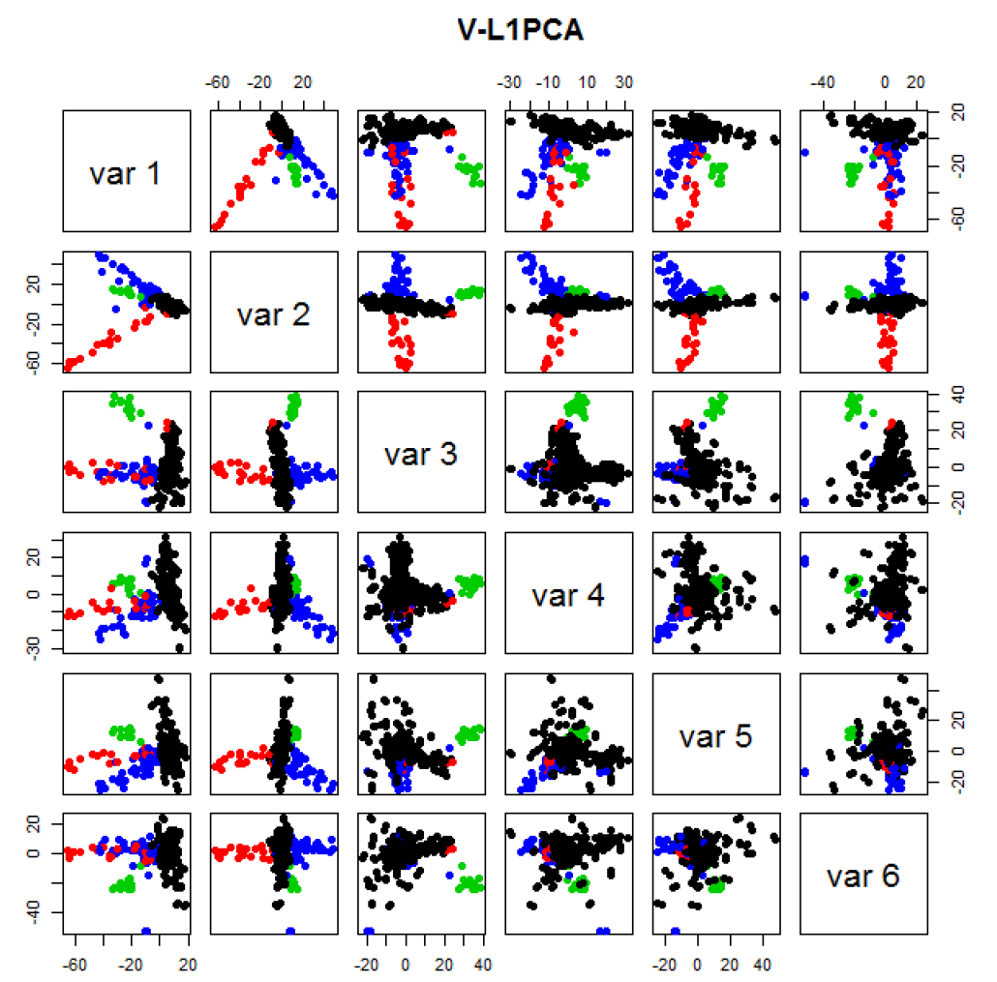
GWAS Data
VL1 PCA
Best Focus
On Ethnic
Groups
Seems To
Find Unlabelled
Clusters

Slide 10
Return to Big Picture
Main statistical goals of OODA:
Understanding population structure
Low dim’al Projections, PCA …
Classification (i. e. Discrimination)
Understanding 2+ populations
Time Series of Data Objects
Chemical Spectra, Mortality Data
“Vertical Integration” of Data Types

Slide 11
Classification - Discrimination
Background: Two Class (Binary) version:
Using “training data” from
Class +1 and Class -1
Develop a “rule” for
assigning new data to a Class
Canonical Example: Disease Diagnosis
New Patients are “Healthy” or “Ill”
Determine based on measurements

Slide 12
Classification - Discrimination
Important Distinction:
Classification vs. Clustering
Useful terminology:
Classification: supervised learning
Clustering: unsupervised learning

Slide 13
Classification Basics
For Simple Toy Example:
Project
On MD
& split
at center
Notes:
HDLSStmbMdif.ps

Slide 14
Fisher Linear Discrimination
Other common terminology (for FLD):
Linear Discriminant Analysis (LDA)
Original Paper: Fisher (1936)

Slide 15
Fisher Linear Discrimination
Thus discrimination rule is:
Classify ${\underline{X}}^{0}$ to Class +1 when:
$$\left\langle {\underline{X}}^{0}, {\underline{n}}_{FLD}\right\rangle ≥\left\langle {\underline{μ}}_{FLD}, {\underline{n}}_{FLD}\right\rangle$$
where:
$${\underline{n}}_{FLD}={\left({\hat{Σ}}^{w}\right)}^{−1/2}{\underline{n}}_{TFLD}={\left({\hat{Σ}}^{w}\right)}^{−1}\left({\overline{\underline{X}}}^{+}−{\overline{\underline{X}}}^{−}\right)$$
$${\underline{μ}}_{FLD}={\left({\hat{Σ}}^{w}\right)}^{1/2}{\underline{μ}}_{TFLD}=\left(\frac{1}{2}{\overline{\underline{X}}}^{+}+\frac{1}{2}{\overline{\underline{X}}}^{−}\right)$$
i.e.
${{\underline{X}}^{0}}^{t}{\left({\hat{Σ}}^{w}\right)}^{−1}\left({\overline{\underline{X}}}^{+}−{\overline{\underline{X}}}^{−}\right)≥$
$≥{\frac{1}{2}\left({\overline{\underline{X}}}^{+}+{\overline{\underline{X}}}^{−}\right)}^{t}{\left({\hat{Σ}}^{w}\right)}^{−1}\left({\overline{\underline{X}}}^{+}−{\overline{\underline{X}}}^{−}\right)$

Slide 16
Fisher Linear Discrimination
So (in orig’l space) have separ’ting hyperplane with:
Normal vector: ${\underline{n}}_{FLD}$
Intercept: ${\underline{μ}}_{FLD}$
Notes:
HDLSSod1egFLD.ps

Slide 17
Classical Discrimination
FLD Likelihood View (cont.)
Replacing ${\underline{μ}}^{+}$, ${\underline{μ}}^{−}$ and $Σ^{w}$
by maximum likelihood estimates:
${\overline{\underline{X}}}^{+}$, ${\overline{\underline{X}}}^{+}$ and ${\hat{Σ}}^{w}$
Gives the likelihood ratio discrimination rule:
Choose Class +1, when
$${{\underline{x}}^{0}}^{t}{Σ^{w}}^{−1}\left({\overline{\underline{X}}}^{+}−{\overline{\underline{X}}}^{−}\right)≥\frac{1}{2}{\left({\overline{\underline{X}}}^{+}+{\overline{\underline{X}}}^{−}\right)}^{t}{Σ^{w}}^{−1}\left({\overline{\underline{X}}}^{+}−{\overline{\underline{X}}}^{−}\right)$$
Same as above, so: FLD can be viewed as
Likelihood Ratio Rule

Slide 18
Classical Discrimination
FLD Generalization I
Gaussian Likelihood Ratio Discrimination
(a. k. a. “nonlinear discriminant analysis”)
Idea: Assume
class distributions are $N\left({\underline{μ}}^{⨀},Σ^{⨀}\right)$
Different covariances!
Likelihood Ratio rule is straightf’d num’l calc.
(thus can easily implement, and do discrim’n)

Slide 19
Classical Discrimination
FLD for Donut – Poor, no plane can work
Notes:
PEdonFLDe1.ps

Slide 20
Classical Discrimination
GLR for Donut – Works well (good quadratic)
(Even
though
data not
Gaussian)
Notes:
PEdonGLRe1.ps

Slide 21
Classical Discrimination
Summary of FLD vs. GLR:
Tilted Point Clouds Data
FLD good
GLR good
Donut Data
FLD bad
GLR good
X Data
FLD bad
GLR OK, not great
Classical Conclusion: GLR generally better
(will see a different answer for HDLSS data)

Slide 22
Classical Discrimination
FLD Generalization II (Gen. I was GLR)
Different prior probabilities
Main idea:
Give different weights to 2 classes
I.e. assume not a priori equally likely
Development is “straightforward”
Modified likelihood
Change intercept in FLD
Won’t explore further here

Slide 23
Classical Discrimination
FLD Generalization II (Gen. I was GLR)
Different prior probabilities
Main idea:
Give different weights to 2 classes
I.e. assume not a priori equally likely
Canonical Example: Rare Disease Testing
(Often Train on Mostly Rare Cases)

Slide 24
Classical Discrimination
FLD Generalization III
Principal Discriminant Analysis
Idea: FLD-like approach to > 2 classes
Assumption: Class covariance matrices are the same (similar)
(but not Gaussian, same situation as for FLD)
Main idea:
Quantify “location of classes” by their means
$${\underline{μ}}^{(1)},{\underline{μ}}^{(2)},⋯,{\underline{μ}}^{(k)}$$

Slide 25
Classical Discrimination
Principal Discriminant Analysis (cont.)
Simple way to find “interesting directions” among the means:
PCA on set of means
(Think Analog of Mean Difference)

Slide 26
Classical Discrimination
Principal Discriminant Analysis (cont.)
Simple way to find “interesting directions” among the means:
PCA on set of means
i.e. Eigen-analysis of “between class covariance matrix” ${\hat{Σ}}^{B}=MM^{t}$
Where
$$M=\frac{1}{\sqrt{k}}\left(μ^{(1)}−\overline{μ} ⋯μ^{(1)}−\overline{μ}\right)$$
Aside: can show: overall $n\hat{Σ}=k{\hat{Σ}}^{B}+n{\hat{Σ}}^{w}$
Mean of Means

Slide 27
Classical Discrimination
Principal Discriminant Analysis (cont.)
But PCA only works like Mean Difference,
Expect can improve by
taking covariance into account.
(Recall Improvement of FLD over MD)

Slide 28
Classical Discrimination
Principal Discriminant Analysis (cont.)
But PCA only works like Mean Difference,
Expect can improve by
taking covariance into account.
Blind application of above ideas suggests eigen-analysis of: ${Σ^{w}}^{−1}Σ^{B}$

Slide 29
Classical Discrimination
Principal Discriminant Analysis (cont.)
There are:
smarter ways to compute
(“generalized eigenvalue”)
other representations
(this solves optimization prob’s)
Special case: 2 classes,
reduces to standard FLD
Good reference for more: Section 3.8 of:
Duda, Hart & Stork (2001)

Slide 30
Classical Discrimination
Summary of Classical Ideas:
Among “Simple Methods”
MD and FLD sometimes similar
Sometimes FLD better
So FLD is preferred
Among Complicated Methods
GLR is best
So always use that?
Caution:
Story changes for HDLSS settings

Slide 31
HDLSS Discrimination
Main HDLSS issues:
Sample Size, $n$ < Dimension, $d$
Singular covariance matrix
So can’t use matrix inverse
I.e. can’t standardize (sphere) the data
(requires root inverse covariance)
Can’t do classical multivariate analysis

Slide 32
HDLSS Discrimination
Main HDLSS issues:
Can’t do classical multivariate analysis
Key Idea: Standardize
Subtract Sample Mean
Sphere the Data (i.e. Multiply by ${\hat{Σ}}^{−1/2}$)
And use $N(0,I)$ dist’n for statistical inference

Slide 33
HDLSS Discrimination
An approach to non-invertible covariances:
Replace by generalized inverses
Sometimes called pseudo inverses
Note: there are several
Here use Moore Penrose inverse
As used by Matlab (pinv.m)
Often provides useful results
(but not always)

Slide 34
HDLSS Discrimination
Application of Generalized Inverse to FLD:
Direction (Normal) Vector:
$${\underline{n}}_{FLD}={\left({\hat{Σ}}^{w}\right)}^{−}\left({\underline{\overline{X}}}^{+}−{\underline{\overline{X}}}^{−}\right)$$
Intercept:
$$μ_{FLD}=\left(\frac{1}{2}{\underline{\overline{X}}}^{+}+\frac{1}{2}{\underline{\overline{X}}}^{−}\right)$$

Slide 35
HDLSS Discrimination
Application of Generalized Inverse to FLD:
Direction (Normal) Vector:
$${\underline{n}}_{FLD}={\left({\hat{Σ}}^{w}\right)}^{−}\left({\underline{\overline{X}}}^{+}−{\underline{\overline{X}}}^{−}\right)$$
Intercept:
$$μ_{FLD}=\left(\frac{1}{2}{\underline{\overline{X}}}^{+}+\frac{1}{2}{\underline{\overline{X}}}^{−}\right)$$
Have replaced ${\left({\hat{Σ}}^{w}\right)}^{−1}$ by ${\left({\hat{Σ}}^{w}\right)}^{−}$

Slide 36
HDLSS Discrimination
Toy Example: Increasing Dimension
$n_{+}=n_{−}=20$ data vectors:
Entry 1:
Class +1: $N\left(+2.2,1\right)$ Class –1: $N\left(−2.2,1\right)$
Other Entries: $N\left(0,1\right)$
All Entries Independent
Look through dimensions, $d=1, 2, ⋯, 1000$

Slide 37
HDLSS Discrimination
Increasing Dimension Example
Project on
Optimal
Direction
Project on
FLD Direction
Project on
Both

Slide 38
HDLSS Discrimination
Add a 2nd Dimension ($N\left(0,1\right)$ noise)
Same Projections on
Optimal Direction
Axes Here
Are Same As
Directions Here
Now See 2
Dimensions

Slide 39
HDLSS Discrimination
Add a 3rd Dimension ($N\left(0,1\right)$ noise)
Project on
2-d subspace
generated
by optimal
dir’n & by
FLD dir’n

Slide 40
HDLSS Discrimination
Movie Through Increasing Dimensions

Slide 41
HDLSS Discrimination
FLD in Increasing Dimensions:
Low dimensions (d = 2-9):
Visually good separation
Small angle between FLD and Optimal
Good generalizability
Medium Dimensions (d = 10-26):
Visual separation too good?!?
Larger angle between FLD and Optimal
Worse generalizability
Feel effect of sampling noise

Slide 42
HDLSS Discrimination
FLD in Increasing Dimensions:
High Dimensions (d=27-37):
Much worse angle
Very poor generalizability
But very small within class variation
Poor separation between classes
Large separation / variation ratio

Slide 43
HDLSS Discrimination
FLD in Increasing Dimensions:
At HDLSS Boundary (d=38):
38 = degrees of freedom
(need to estimate 2 class means)
Within class variation = 0 ?!?
Data pile up, on just two points
Perfect separation / variation ratio?
But only feels microscopic noise aspects
So likely not generalizable
Angle to optimal very large

Slide 44
HDLSS Discrimination
FLD in Increasing Dimensions:
Just beyond HDLSS boundary (d=39-70):
Improves with higher dimension?!?
Angle gets better
Improving generalizability?
More noise helps classification?!?

Slide 45
HDLSS Discrimination
FLD in Increasing Dimensions:
Far beyond HDLSS boun’ry (d=70-1000):
Quality degrades
Projections look terrible
(populations overlap)
And Generalizability falls apart, as well
Asymptotics worked out by Bickel & Levina (2004)
Problem is estimation of $d×d$ covariance matrix

Slide 46
HDLSS Discrimination
Simple Solution:
Mean Difference (Centroid) Method
Recall not classically recommended
Usually no better than FLD
Sometimes worse
But avoids estimation of covariance
Means are very stable
Expect less HDLSS problem

