Slide 1
Participant Presentations
See Course Web Site (10 Minute Talks)

Slide 2
Cornea Data
Main Point: OODA Beyond FDA
Recall Interplay:
Object Space ←→ Descriptor Space

Slide 3
PCA of Cornea Data
PC2 Movie:

Slide 4
Outliers in PCA
Two Differing Goals for Outliers:
Avoid Major Influence on Analysis
Find Interesting Data Points
FDA Version: Mean & Shape Outliers
Dai & Genton (2016, 2017)

Slide 5
Outliers in PCA
Standard Statistical Approaches to Dealing with Influential Outliers:
Outlier Deletion:
Kick out “bad data”
Robust Statistical methods:
Work with full data set,
but downweight “bad data”
Reduce influence, instead of “deleting”
(Think Median)

Slide 6
Robust PCA
What is multivariate median?
There are several!
(“median” generalizes in different ways)
Coordinate-wise median
Often worst
Not rotation invariant
(2-d data uniform on “L”)
Can lie on convex hull of data
(same example)
Thus (usually) poor notion of “center”

Slide 7
Robust PCA
M-estimate (cont.):
“Slide sphere
around until
mean (of
projected data)
is at center”

Slide 8
Robust PCA
Robust PCA 3:
Spherical
PCA
Locantore et al (1999)

Slide 9
Robust PCA
Rescale
Coords
Spherical PCA
Unscale
Coords

Slide 10
Robust PCA
Elliptical PCA for cornea data:
Original PC2, Elliptical PC2

Slide 11
Robust PCA
Current state of the art:
Spherical & Elliptical PCA are a kludge
Put together by Robustness Amateurs
To solve this HDLSS problem
Good News: Robustness Pros have taken up this game:
Maronna, et al (2006), Sec. 6.10.2

Slide 12
Robust PCA
Disclaimer on robust analy’s of Cornea Data:
Critical parameter is “radius of analysis”,
$R_{0}=4mm$: Shown above, Elliptical PCA very effective
$R_{0}=4.2mm$: Stronger edge effects, Elliptical PCA less useful
$R_{0}=3.5mm$: Edge effects weaker, don’t need robust PCA

Slide 13
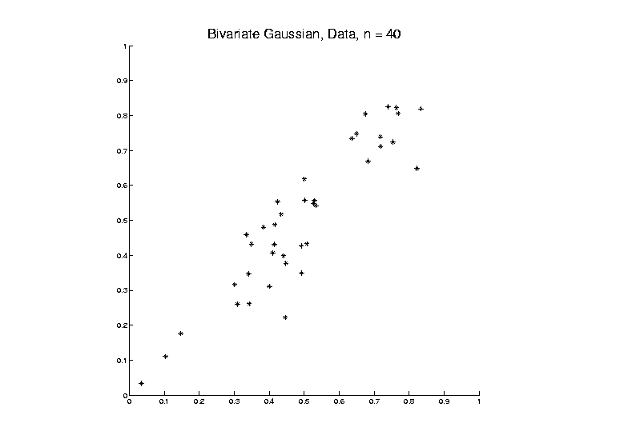
Big Picture View of PCA
Above View:
PCA finds optimal directions in point cloud

Slide 14
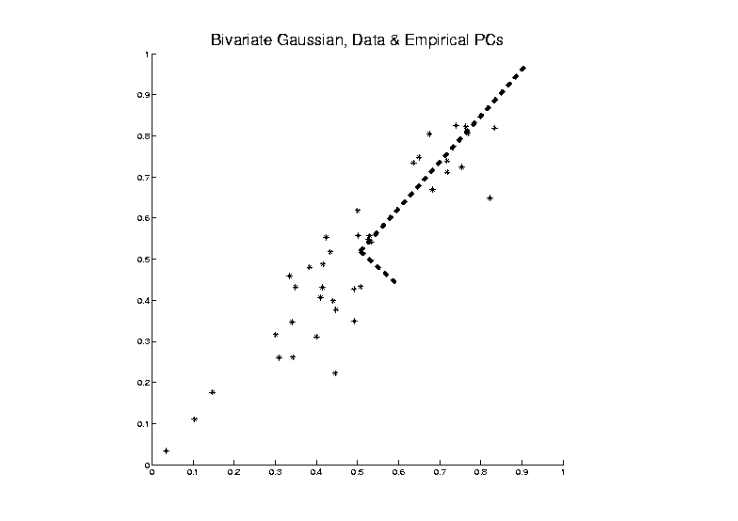
Big Picture View of PCA
Above View:
PCA finds optimal directions in point cloud

Slide 15
Big Picture View of PCA
Above View:
PCA finds optimal directions in point cloud
Maximize projected variation
Minimize residual variation
(same by Pythagorean Theorem)
Notes:
Get useful insights about data
Can compute for any point cloud
But there are other views.

Slide 16
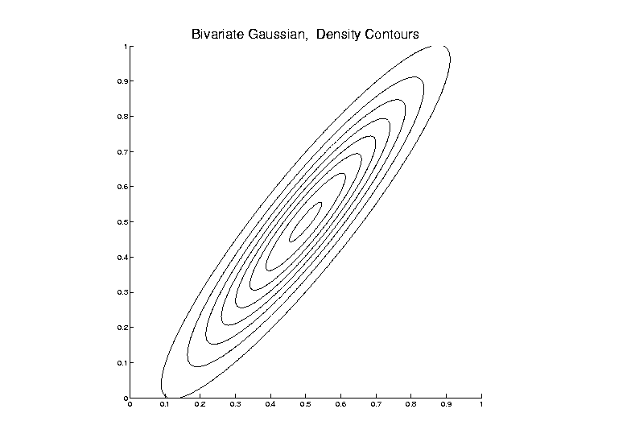
Big Picture View of PCA
Alternate Viewpoint: Gaussian Likelihood

Slide 17
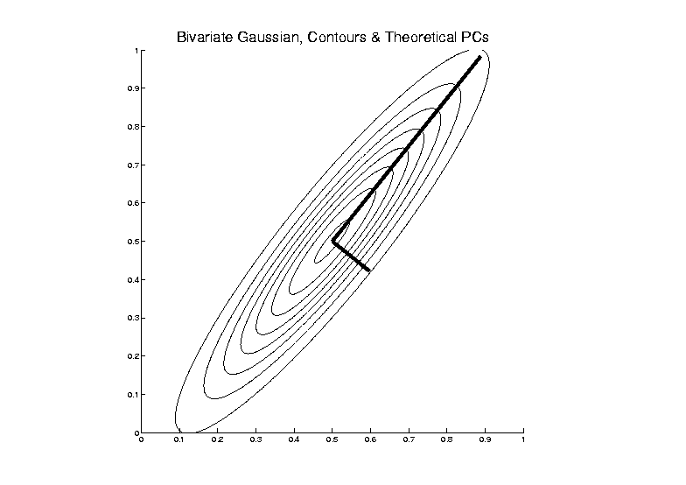
Big Picture View of PCA
Alternate Viewpoint: Gaussian Likelihood

Slide 18
Big Picture View of PCA
Alternate Viewpoint: Gaussian Likelihood
When data are multivariate Gaussian
PCA finds major axes of ellipt’al contours
of Probability Density
Maximum Likelihood Estimate

Slide 19
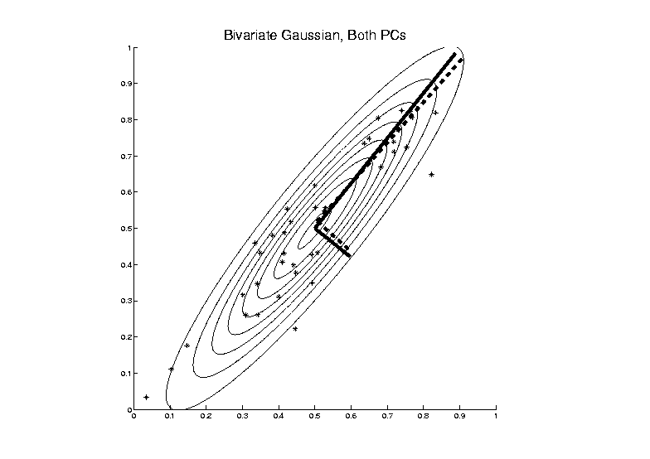
Big Picture View of PCA
Alternate Viewpoint: Gaussian Likelihood
Maximum Likelihood Estimate

Slide 20
Big Picture View of PCA
Alternate Viewpoint: Gaussian Likelihood
When data are multivariate Gaussian
PCA finds major axes of ellipt’al contours
of Probability Density
Maximum Likelihood Estimate
Mistaken idea:
PCA only useful for Gaussian data

Slide 21
Big Picture View of PCA
Simple check for Gaussian distribution:
Standardized parallel coordinate plot
Subtract coordinate wise median
(robust version of mean)
(not good as “point cloud center”,
but now only looking at coordinates)
Normalize by MAD / MAD(N(0,1))
(put on same scale as “standard deviation”)

Slide 22
Big Picture View of PCA
Computation of $MAD(N(0,1))$:
For $Z\sim N\left(0,1\right)$,
$$MAD\left(Z\right)=median\left|Z−median(Z)\right|$$
$$=median\left|Z\right|$$
$$=Φ^{−1}\left(0.75\right)$$
$$≈0.675$$
Standard Normal Cumulative Distribution

Slide 23
Big Picture View of PCA
Thanks to: Matt Bognar, http://homepage.stat.uiowa.edu/~mbognar/applets/normal.html

Slide 24
Big Picture View of PCA
Simple check for Gaussian distribution:
Standardized parallel coordinate plot
Subtract coordinate wise median
(robust version of mean)
(not good as “point cloud center”,
but now only looking at coordinates)
Normalize by MAD / MAD(N(0,1))
(put on same scale as “standard deviation”)
See if data stays in range –3 to +3

Slide 25
Big Picture View of PCA
E.g.
Cornea Data:
Standardized
Parallel
Coordinate
Plot
Shown before

Slide 26
Big Picture View of PCA
Raw Cornea Data:
Data – Median
(Data – Median)
-------------------
MAD

Slide 27
Big Picture View of PCA
Check for Gaussian dist’n:
Stand’zed Parallel Coord. Plot
E.g. Cornea data
(recall image view of data)
Several data points > 20 “s.d.s” from the center
Distribution clearly not Gaussian
Strong kurtosis (“heavy tailed”)
But PCA still gave strong insights

Slide 28
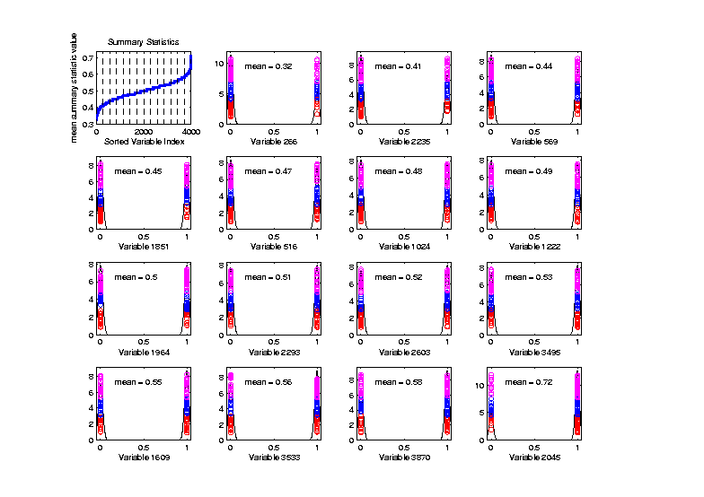
Big Picture View of PCA
Mistaken idea:
PCA only useful for Gaussian data
Toy Example:
Each Marginal
Binary
Clearly NOT
Gaussian
n = 100, d = 4000

Slide 29
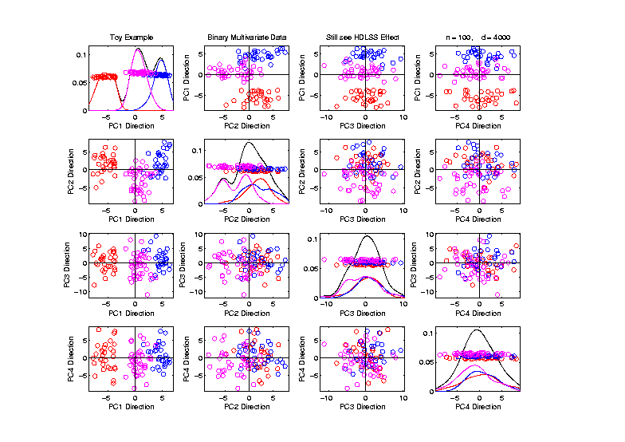
Big Picture View of PCA
Mistaken idea:
PCA only useful for Gaussian data
But PCA
Reveals
Trimodal
Structure

Slide 30
GWAS Data Analysis
Genome Wide Association Study (GWAS)
Data Objects: Vectors of Genetic Variants, at known chromosome locations
(Called SNPs)
Discrete (takes on 2 or 3 values)
Dimension $d$ as large as ~5 million
(can be reduced, e.g. $d\sim 20000)$

Slide 31
GWAS Data Analysis
Genome Wide Association Study (GWAS)
Cystic Fibrosis Study: Wright et al (2011)
Interesting Feature:
Some Subjects are Close Relatives
(e.g. ~half SNPs are same)

Slide 32
GWAS Data Analysis
PCA View
Clear Ethnic
Groups

Slide 33
GWAS Data Analysis
PCA View
Clear Ethnic
Groups
And Several
Outliers!
Eliminate With
Spherical PCA?

Slide 34
GWAS Data Analysis
Spherical
PCA
Looks Same?!?
What is
going on?
Will Explain
Later

Slide 35
GWAS Data Analysis
Alternate Approach:
L1 PCA
Idea replace $L^{2}$ norm, ${\left\|\underline{v}\right\|}_{2}=\sqrt{\sum_{j=1}^{d}{{v_{j}}^{2}}}$
By $L^{1}$ norm: ${\left\|\underline{v}\right\|}_{1}=\sum_{j=1}^{d}{\left|v_{j}\right|}$
More robust, since no square

Slide 36
L1 Statistics
E.g. Simple Linear Regression
Replace
Best L2 Fit

Slide 37
L1 Statistics
E.g. Simple Linear Regression
Replace
Best L2 Fit
With
Best L1 Fit

Slide 38
L1 Statistics
E.g. Simple Linear Regression
Best L1 Fit
Advantages:
Robust Against Outliers
Good “Sparsity” Properties

Slide 39
L1 PCA
Calculation:
Clever “backwards” algorithm
Brooks, Dulá, Boone (2013)

Slide 40
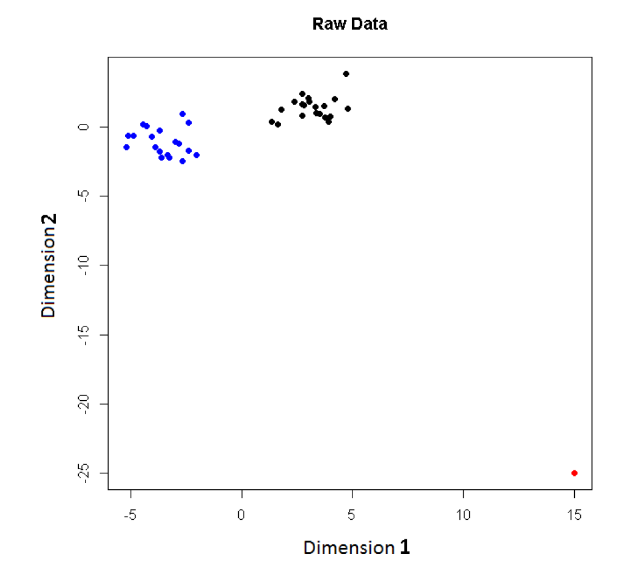
L1 PCA
Challenge:
L1 Projections
Hard to
Interpret
2-d Toy
Example
Note
Outlier

Slide 41
L1 PCA
Challenge:
L1 Projections
Hard to
Interpret
Parallel
Coordinate
View

Slide 42
L1 PCA
Conventional
L2 PCA
Outlier Pulls
Off PC1
Direction

Slide 43
L1 PCA
L1 PCA
Much Better
PC1 Direction

Slide 44
L1 PCA
L1 PCA
Much Better
PC1 Direction
But Very Strange
Projections
(i.e. Little
Data Insight)

Slide 45
L1 PCA
L1 PCA
Reason:
SVD Rotation
Before L1
Computation
Note: L1 Methods
Not Rotation Invariant

Slide 46
L1 PCA
Challenge: L1 Projections Hard to Interpret
(i.e. Little Data Insight)
Solution:
Compute PC Directions Using L1
Compute Projections (Scores) Using L2
Called “Visual L1 PCA” (VL1PCA)
Zhou & Marron (2016)

Slide 47
L1 PCA
VL1 PCA
Excellent PC
Directions
Interpretable
Scores

Slide 48
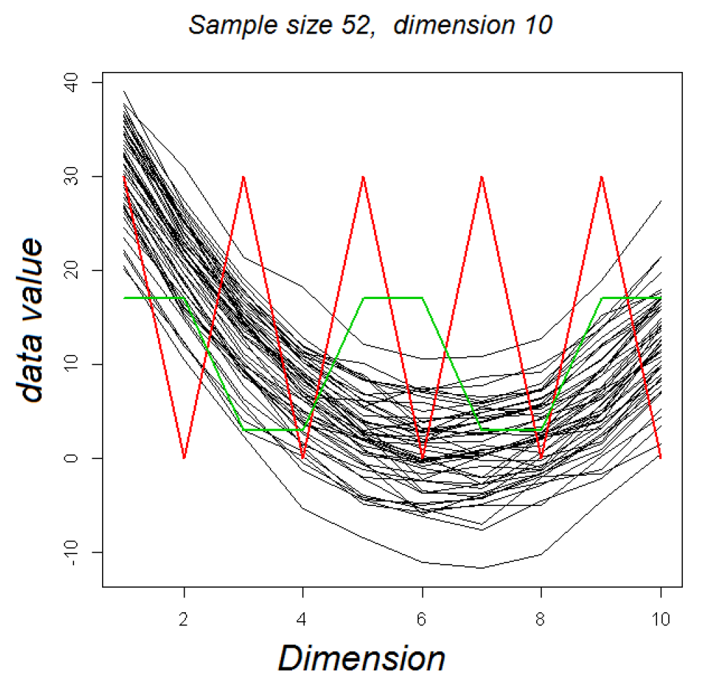
VL1 PCA
10-d Toy Example:
Parabolas
From Before
With Two
Outliers

Slide 49
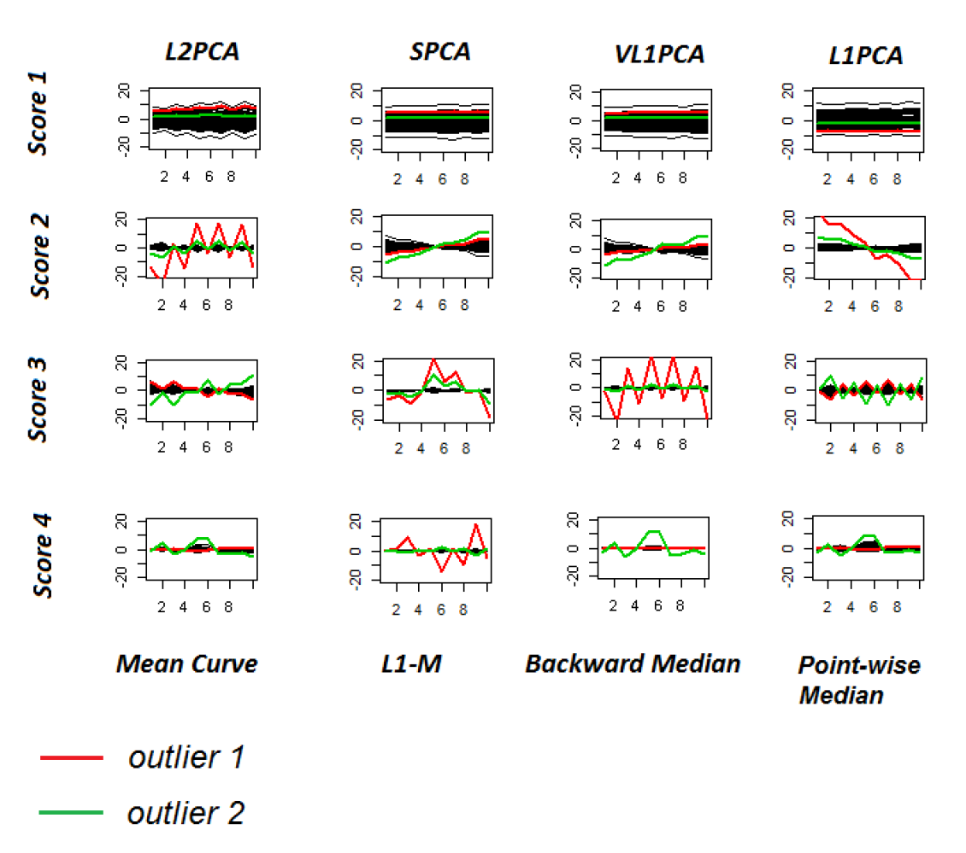
VL1 PCA
10-d Toy Example:
L2PCA
Strongly
Impacted
(In All
Components)

Slide 50
VL1 PCA
10-d Toy Example:
SCPA &
VL1PCA
Nicely
Robust
(Vl1PCA
Slightly
Better)

Slide 51
VL1 PCA
10-d Toy Example:
L1PCA
Hard To
Interpret

Slide 52
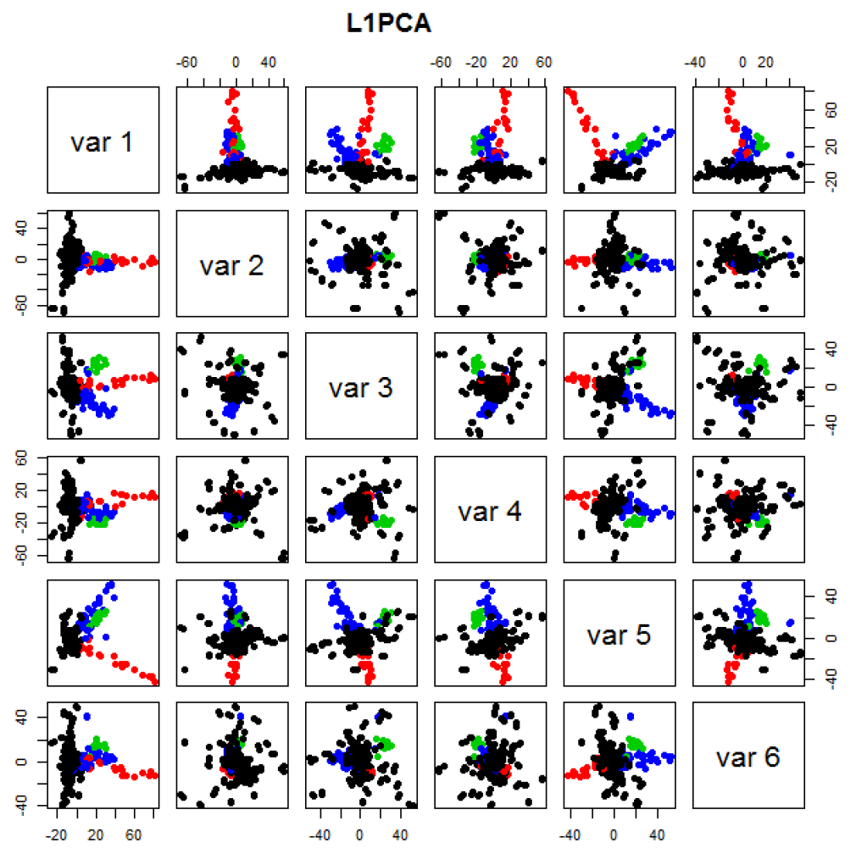
GWAS Data
L1 PCA
No Longer
Feels Outliers
But Still
Highlights
Individuals

Slide 53
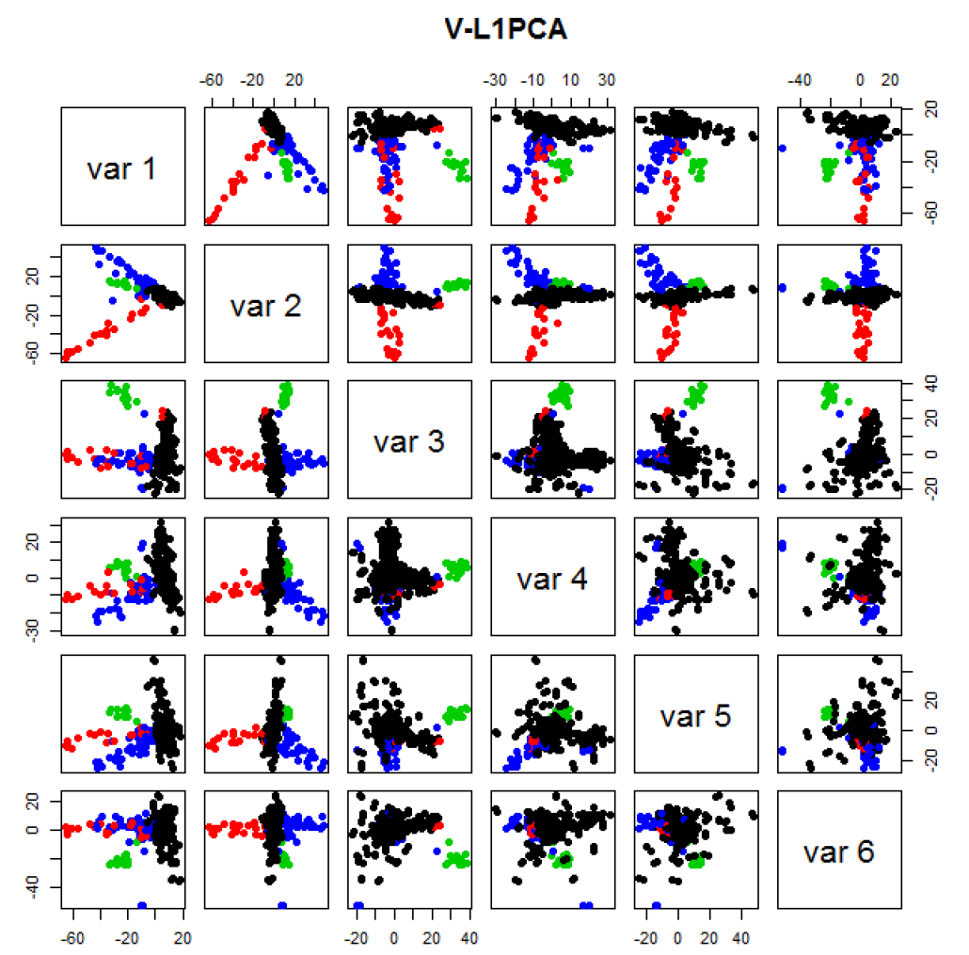
GWAS Data
VL1 PCA
Best Focus
On Ethnic
Groups

Slide 54
GWAS Data
VL1 PCA
Best Focus
On Ethnic
Groups
Seems To
Find Unlabelled
Clusters

Slide 55
Return to Big Picture
Main statistical goals of OODA:
Understanding population structure
Low dim’al Projections, PCA …
Classification (i. e. Discrimination)
Understanding 2+ populations
Time Series of Data Objects
Chemical Spectra, Mortality Data
“Vertical Integration” of Data Types

Slide 56
Classification - Discrimination
Background: Two Class (Binary) version:
Using “training data” from
Class +1 and Class -1
Develop a “rule” for
assigning new data to a Class
Canonical Example: Disease Diagnosis
New Patients are “Healthy” or “Ill”
Determine based on measurements

Slide 57
Classification - Discrimination
Important Distinction:
Classification vs. Clustering
Classification:
Class labels are known,
Goal: understand differences
Clustering:
Goal: Find class labels (to be similar)
Both are about clumps of similar data,
but much different goals

Slide 58
Classification - Discrimination
Important Distinction:
Classification vs. Clustering
Useful terminology:
Classification: supervised learning
Clustering: unsupervised learning

Slide 59
Classification - Discrimination
Terminology:
For statisticians, these are synonyms

Slide 60
Classification - Discrimination
Terminology:
For statisticians, these are synonyms
For biologists, classification means:
Constructing taxonomies
And sorting organisms into them
(maybe this is why discrimination
was used, until politically incorrect…)

Slide 61
Classification (i.e. discrimination)
There are a number of:
Approaches
Philosophies
Schools of Thought
Too often cast as:
Statistics vs. EE - CS

Slide 62
Classification (i.e. discrimination)
EE – CS variations:
Pattern Recognition
Artificial Intelligence
Neural Networks (Deep Learning)
Data Mining
Machine Learning

Slide 63
Classification (i.e. discrimination)
Differing Viewpoints:
Statistics
Model Classes with Probability Distribut’ns
Use to study class diff’s & find rules
EE – CS
Data are just Sets of Numbers
Optimize Separation Rules
Current thought: combine these

Slide 64
Classification (i.e. discrimination)
Important Overview Reference:
Duda, Hart and Stork (2001)
Too much about neural nets???
Pizer disagrees…
Update of Duda & Hart (1973)

Slide 65
Classification (i.e. discrimination)
For a more classical statistical view:
McLachlan (2004).
Gaussian Likelihood theory, etc.
Not well tuned to HDLSS data
Notes:
65

Slide 66
Classification Basics
Personal Viewpoint: Point Clouds
(In
Descriptor
Space)
Notes:
HDLSStmbRaw.ps

Slide 67
Classification Basics
Simple and Natural Approach:
Mean Difference
a.k.a.
Centroid Method
Find “skewer through two meatballs”

Slide 68
Classification Basics
For Simple Toy Example:
Project
On MD
& split
at center
Notes:
HDLSStmbMdif.ps

Slide 69
Classification Basics
Why not use PCA?
Reasonable
Result?
Doesn’t use
class labels…
Good?
Bad?
Notes:
HDLSStmbPCA.ps

Slide 70
Classification Basics
Harder Example (slanted clouds):
Notes:
HDLSSod1Raw.ps

Slide 71
Classification Basics
PCA for slanted clouds:
PC1 terrible
PC2 better?
Still misses
right dir’n
Doesn’t use
Class Labels
Notes:
HDLSSod1PCA.ps

Slide 72
Classification Basics
Mean Difference for slanted clouds:
A little
better?
Still misses
right dir’n
Want to
account for
covariance
Notes:
HDLSSod1Mdif.ps

Slide 73
Classification Basics
Mean Difference & Covariance,
Simplest Approach:
Rescale (standardize) coordinate axes
i. e. replace (full) data matrix:
$$X=\left(\begin{matrix}x_{11} & ⋯ & x_{1n} \\ ⋮ & ⋱ & ⋮ \\ x_{d1} & ⋯ & x_{dn}\end{matrix}\right) → \left(\begin{matrix}\frac{1}{s_{1}} & ⋯ & 0 \\ ⋮ & ⋱ & ⋮ \\ 0 & ⋯ & \frac{1}{s_{d}}\end{matrix}\right)X=\left(\begin{matrix}\frac{x_{11}}{s_{1}} & ⋯ & \frac{x_{1n}}{s_{1}} \\ ⋮ & ⋱ & ⋮ \\ \frac{x_{d1}}{s_{d}} & ⋯ & \frac{x_{dn}}{s_{d}}\end{matrix}\right)$$
Then do Mean Difference
Called “Naïve Bayes Approach”

Slide 74
Classification Basics
Naïve Bayes Reference:
Domingos & Pazzani (1997)
Most sensible contexts:
Non-comparable data
E.g. different units

Slide 75
Classification Basics
Problem with Naïve Bayes:
Only adjusts
Variances
Not Covariances
Doesn’t solve
this problem
Notes:
HDLSSod1Raw.ps

Slide 76
Classification Basics
Better Solution: Fisher Linear Discrimination
Gets the
right dir’n
How does
it work?
Notes:
HDLSSod1FLD.ps

Slide 77
Fisher Linear Discrimination
Other common terminology (for FLD):
Linear Discriminant Analysis (LDA)
Original Paper: Fisher (1936)

Slide 78
Fisher Linear Discrimination
Careful development:
Useful notation (data vectors of length $d$):
Class +1: Class -1:
${\underline{X}}_{1}^{+},⋯,{\underline{X}}_{n_{+}}^{+}$ ${\underline{X}}_{1}^{−},⋯,{\underline{X}}_{n_{−}}^{−}$
Centerpoints:
${\overline{\underline{X}}}^{+}=\frac{1}{n_{+}}\sum_{i=1}^{n_{+}}{{\underline{X}}_{i}^{+}}$ and ${\overline{\underline{X}}}^{−}=\frac{1}{n_{−}}\sum_{i=1}^{n_{−}}{{\underline{X}}_{i}^{−}}$

Slide 79
Fisher Linear Discrimination
Covariances, ${\hat{Σ}}^{⨀}={\tilde{X}}^{⨀}{{\tilde{X}}^{⨀}}^{t}$ for $⨀$ = +,-
(outer products)
Based on centered, normalized data matrices:
$${\tilde{X}}^{⨀}=\frac{1}{\sqrt{n_{⨀}}}\left({\underline{X}}_{1}^{⨀}−{\overline{\underline{X}}}^{⨀{}},⋯,{\underline{X}}_{n_{⨀}}^{⨀}−{\overline{\underline{X}}}^{⨀{}}\right)$$
Note: use “MLE” version of estimated
covariance matrices, for simpler notation

Slide 80
Fisher Linear Discrimination
Good estimate of (common) within class cov?
Pooled (weighted average) within class cov:
$${\hat{Σ}}^{w}=\frac{n_{+}{\hat{Σ}}^{+}+n_{−}{\hat{Σ}}^{−}}{n_{+}+n_{−}}=\tilde{\tilde{X}}{\tilde{\tilde{X}}}^{t}$$
Outer Product of combined full data matrix:
$\tilde{\tilde{X}}$=$\frac{1}{\sqrt{n}}\left(\sqrt{n_{+}}{\tilde{X}}^{+} \sqrt{n_{−}}{\tilde{X}}^{−}\right)$
Note: Different Means

Slide 81
Fisher Linear Discrimination
Note: ${\hat{Σ}}^{w}$ is similar to $\hat{Σ}$ from before
I.e. covariance matrix ignoring class labels
Important Difference:
Class by Class Centering
Will be important later
Notes:
HDLSSod1Raw.ps

Slide 82
Fisher Linear Discrimination
Simple way to find “correct cov. adjustment”:
Individually transform subpopulations so
“spherical” about their means
For $⨀$ = +,- define ${\underline{Z}}_{i}^{⨀}={\left({\hat{Σ}}^{w}\right)}^{−1/2}{\underline{X}}_{i}^{⨀}$
Notes:
HDLSSod1egFLD.ps

Slide 83
Fisher Linear Discrimination
For $⨀$ = +,- define ${\underline{Z}}_{i}^{⨀}={\left({\hat{Σ}}^{w}\right)}^{−1/2}{\underline{X}}_{i}^{⨀}$
Note: This spheres the data, in the sense that
$$ZZ^{t}={\hat{Σ}}^{{−1}/2}X{\left({\hat{Σ}}^{{−1}/2}X\right)}^{t}=$$
$$={\hat{Σ}}^{{−1}/2}XX^{t}{\hat{Σ}}^{{−1}/2}=I$$
Notes:
HDLSSod1egFLD.ps

Slide 84
Fisher Linear Discrimination
Then:
In Transformed Space,
Best separating hyperplane
is
Perpendicular bisector of
line between means
Notes:
HDLSSod1egFLD.ps

Slide 85
Fisher Linear Discrimination
In Transformed Space,
Separating Hyperplane has:
Transformed Normal Vector:
${\underline{n}}_{TFLD}={\left({\hat{Σ}}^{w}\right)}^{−1/2}{\overline{\underline{X}}}^{+}−{\left({\hat{Σ}}^{w}\right)}^{−1/2}{\overline{\underline{X}}}^{−}$
$={\left({\hat{Σ}}^{w}\right)}^{−1/2}\left({\overline{\underline{X}}}^{+}−{\overline{\underline{X}}}^{−}\right)$
Notes:
HDLSSod1egFLD.ps

Slide 86
Fisher Linear Discrimination
In Transformed Space,
Separating Hyperplane has:
Transformed Normal Vector:
${\underline{n}}_{TFLD}={\left({\hat{Σ}}^{w}\right)}^{−1/2}{\overline{\underline{X}}}^{+}−{\left({\hat{Σ}}^{w}\right)}^{−1/2}{\overline{\underline{X}}}^{−}$
$={\left({\hat{Σ}}^{w}\right)}^{−1/2}\left({\overline{\underline{X}}}^{+}−{\overline{\underline{X}}}^{−}\right)$
Transformed Intercept:
${\underline{μ}}_{TFLD}={\frac{1}{2}\left({\hat{Σ}}^{w}\right)}^{−1/2}{\overline{\underline{X}}}^{+}+\frac{1}{2}{\left({\hat{Σ}}^{w}\right)}^{−1/2}{\overline{\underline{X}}}^{−}$
$={\left({\hat{Σ}}^{w}\right)}^{−1/2}\left(\frac{1}{2}{\overline{\underline{X}}}^{+}+\frac{1}{2}{\overline{\underline{X}}}^{−}\right)$
Notes:
HDLSSod1egFLD.ps

Slide 87
Fisher Linear Discrimination
In Transformed Space,
Separating Hyperplane has:
Transformed Normal Vector:
${\underline{n}}_{TFLD}={\left({\hat{Σ}}^{w}\right)}^{−1/2}{\overline{\underline{X}}}^{+}−{\left({\hat{Σ}}^{w}\right)}^{−1/2}{\overline{\underline{X}}}^{−}$
$={\left({\hat{Σ}}^{w}\right)}^{−1/2}\left({\overline{\underline{X}}}^{+}−{\overline{\underline{X}}}^{−}\right)$
Transformed Intercept:
${\underline{μ}}_{TFLD}={\frac{1}{2}\left({\hat{Σ}}^{w}\right)}^{−1/2}{\overline{\underline{X}}}^{+}+\frac{1}{2}{\left({\hat{Σ}}^{w}\right)}^{−1/2}{\overline{\underline{X}}}^{−}$
$={\left({\hat{Σ}}^{w}\right)}^{−1/2}\left(\frac{1}{2}{\overline{\underline{X}}}^{+}+\frac{1}{2}{\overline{\underline{X}}}^{−}\right)$
Separating Hyperplane Has Eqn.
$\left\{\underline{z}:\left\langle \underline{z},{\underline{n}}_{TFLD}\right\rangle =\left\langle {\underline{μ}}_{TFLD},{\underline{n}}_{TFLD}\right\rangle \right\}$
Notes:
HDLSSod1egFLD.ps

Slide 88
Fisher Linear Discrimination
Thus discrimination rule is:
Given a new data vector ${\underline{X}}^{0}$,
Choose Class +1 when:
$$\left\langle {\left({\hat{Σ}}^{w}\right)}^{−1/2}{\underline{X}}^{0},{\underline{n}}_{TFLD}\right\rangle ≥\left\langle {\underline{μ}}_{TFLD},{\underline{n}}_{TFLD}\right\rangle$$
Using Boundary: $\left\{\underline{z}:\left\langle \underline{z},{\underline{n}}_{TFLD}\right\rangle =\left\langle {\underline{μ}}_{TFLD},{\underline{n}}_{TFLD}\right\rangle \right\}$

Slide 89
Fisher Linear Discrimination
Thus discrimination rule is:
Given a new data vector ${\underline{X}}^{0}$,
Choose Class +1 when:
$$\left\langle {\left({\hat{Σ}}^{w}\right)}^{−1/2}{\underline{X}}^{0},{\underline{n}}_{TFLD}\right\rangle ≥\left\langle {\underline{μ}}_{TFLD},{\underline{n}}_{TFLD}\right\rangle$$
i.e. (transforming back to original space)
$$\left\langle {\underline{X}}^{0},{\left({\hat{Σ}}^{w}\right)}^{−1/2}{\underline{n}}_{TFLD}\right\rangle ≥\left\langle {\left({\hat{Σ}}^{w}\right)}^{1/2}{\underline{μ}}_{TFLD},{\left({\hat{Σ}}^{w}\right)}^{−1/2}{\underline{n}}_{TFLD}\right\rangle$$
$$\left\langle {\underline{X}}^{0}, {\underline{n}}_{FLD}\right\rangle ≥\left\langle {\underline{μ}}_{FLD}, {\underline{n}}_{FLD}\right\rangle$$
where:
$${\underline{n}}_{FLD}={\left({\hat{Σ}}^{w}\right)}^{−1/2}{\underline{n}}_{TFLD}={\left({\hat{Σ}}^{w}\right)}^{−1}\left({\overline{\underline{X}}}^{+}−{\overline{\underline{X}}}^{−}\right)$$
$${\underline{μ}}_{FLD}={\left({\hat{Σ}}^{w}\right)}^{1/2}{\underline{μ}}_{TFLD}=\left(\frac{1}{2}{\overline{\underline{X}}}^{+}+\frac{1}{2}{\overline{\underline{X}}}^{−}\right)$$

Slide 90
Fisher Linear Discrimination
Thus discrimination rule is:
Classify ${\underline{X}}^{0}$ to Class +1 when:
$$\left\langle {\underline{X}}^{0}, {\underline{n}}_{FLD}\right\rangle ≥\left\langle {\underline{μ}}_{FLD}, {\underline{n}}_{FLD}\right\rangle$$
where:
$${\underline{n}}_{FLD}={\left({\hat{Σ}}^{w}\right)}^{−1/2}{\underline{n}}_{TFLD}={\left({\hat{Σ}}^{w}\right)}^{−1}\left({\overline{\underline{X}}}^{+}−{\overline{\underline{X}}}^{−}\right)$$
$${\underline{μ}}_{FLD}={\left({\hat{Σ}}^{w}\right)}^{1/2}{\underline{μ}}_{TFLD}=\left(\frac{1}{2}{\overline{\underline{X}}}^{+}+\frac{1}{2}{\overline{\underline{X}}}^{−}\right)$$
i.e.
${{\underline{X}}^{0}}^{t}{\left({\hat{Σ}}^{w}\right)}^{−1}\left({\overline{\underline{X}}}^{+}−{\overline{\underline{X}}}^{−}\right)≥$
$≥{\frac{1}{2}\left({\overline{\underline{X}}}^{+}+{\overline{\underline{X}}}^{−}\right)}^{t}{\left({\hat{Σ}}^{w}\right)}^{−1}\left({\overline{\underline{X}}}^{+}−{\overline{\underline{X}}}^{−}\right)$

Slide 91
Fisher Linear Discrimination
So (in orig’l space) have separ’ting hyperplane with:
Normal vector: ${\underline{n}}_{FLD}$
Intercept: ${\underline{μ}}_{FLD}$
Notes:
HDLSSod1egFLD.ps

Slide 92
Fisher Linear Discrimination
Relationship to Mahalanobis distance
Idea: For $X_{1},X_{2}\sim N\left(μ,Σ\right)$, a natural distance
measure is: $d_{M}={\left[{\left(X_{1}−X_{2}\right)}^{t}Σ^{−1}\left(X_{1}−X_{2}\right)\right]}^{1/2}$
$$d_{1}=d_{2}$$

Slide 93
Fisher Linear Discrimination
Relationship to Mahalanobis distance
Idea: For $X_{1},X_{2}\sim N\left(μ,Σ\right)$, a natural distance
measure is: $d_{M}={\left[{\left(X_{1}−X_{2}\right)}^{t}Σ^{−1}\left(X_{1}−X_{2}\right)\right]}^{1/2}$
“unit free”, i.e. “standardized”
essentially mod out covariance structure
Euclidean dist. applied to $Σ^{−1/2}X_{1}$ & $Σ^{−1/2}X_{2}$
Same as key transformation for FLD
I.e. FLD is
mean difference in Mahalanobis space

Slide 94
Classical Discrimination
Above derivation of FLD was:
Nonstandard
Not in any textbooks(?)
Nonparametric (don’t need Gaussian data)
I.e. Used no probability distributions
More Machine Learning than Statistics
(but careful about HDLSS case)

Slide 95
Classical Discrimination
FLD Likelihood View
Assume:
Class distributions are multivariate
$N\left({\underline{μ}}^{⨀},Σ\right)$ for $⨀$ = +,-
strong distributional assumption
+ common covariance

Slide 96
Classical Discrimination
FLD Likelihood View (cont.)
At a location ${\underline{x}}^{0}$, the likelihood ratio, for
choosing between Class +1 and Class -1, is:
$$LR\left({\underline{x}}^{0},{\underline{μ}}^{+},{\underline{μ}}^{−},Σ^{w}\right)={φ_{Σ^{w}}\left({\underline{x}}^{0}−{\underline{μ}}^{+}\right)}/{φ_{Σ^{w}}\left({\underline{x}}^{0}−{\underline{μ}}^{−}\right)}$$
where $φ_{Σ^{w}}$ is the Gaussian density
with covariance $Σ^{w}$

Slide 97
Classical Discrimination
FLD Likelihood View (cont.)
Simplifying, using the Gaussian density:
$$φ_{Σ^{w}}\left(x\right)=\frac{1}{{\left(2π\right)}^{d/2}\left|Σ^{w}\right|}e^{{−\left(x^{t}{Σ^{w}}^{−1}x\right)}/2}$$
Gives (critically using common covariances):
$LR\left({\underline{x}}^{0},{\underline{μ}}^{+},{\underline{μ}}^{−},Σ^{w}\right)$=
$$=e^{{−\left[{\left({\underline{x}}^{0}−{\underline{μ}}^{+}\right)}^{t}{Σ^{w}}^{−1}\left({\underline{x}}^{0}−{\underline{μ}}^{+}\right)−{\left({\underline{x}}^{0}−{\underline{μ}}^{−}\right)}^{t}{Σ^{w}}^{−1}\left({\underline{x}}^{0}−{\underline{μ}}^{−}\right)\right]}/2}$$
$−2\log{LR\left({\underline{x}}^{0},{\underline{μ}}^{+},{\underline{μ}}^{−},Σ^{w}\right)}=$
$$=\left[{\left({\underline{x}}^{0}−{\underline{μ}}^{+}\right)}^{t}{Σ^{w}}^{−1}\left({\underline{x}}^{0}−{\underline{μ}}^{+}\right)−{\left({\underline{x}}^{0}−{\underline{μ}}^{−}\right)}^{t}{Σ^{w}}^{−1}\left({\underline{x}}^{0}−{\underline{μ}}^{−}\right)\right]$$

Slide 98
Classical Discrimination
FLD Likelihood View (cont.)
But: ${\left({\underline{x}}^{0}−{\underline{μ}}^{⨀}\right)}^{t}{Σ^{w}}^{−1}\left({\underline{x}}^{0}−{\underline{μ}}^{⨀}\right)=$
$$={{\underline{x}}^{0}}^{t}{Σ^{w}}^{−1}{\underline{x}}^{0}−2{{\underline{x}}^{0}}^{t}{Σ^{w}}^{−1}{\underline{μ}}^{⨀}+{{\underline{μ}}^{⨀}}^{t}{Σ^{w}}^{−1}{\underline{μ}}^{⨀}$$
for $⨀{}=−1, +1$

Slide 99
Classical Discrimination
FLD Likelihood View (cont.)
But: ${\left({\underline{x}}^{0}−{\underline{μ}}^{⨀}\right)}^{t}{Σ^{w}}^{−1}\left({\underline{x}}^{0}−{\underline{μ}}^{⨀}\right)=$
$$={{\underline{x}}^{0}}^{t}{Σ^{w}}^{−1}{\underline{x}}^{0}−2{{\underline{x}}^{0}}^{t}{Σ^{w}}^{−1}{\underline{μ}}^{⨀}+{{\underline{μ}}^{⨀}}^{t}{Σ^{w}}^{−1}{\underline{μ}}^{⨀}$$
so: $−2LR\left({\underline{x}}^{0},{\underline{μ}}^{+},{\underline{μ}}^{−},Σ^{w}\right)=$
$$=−2{{\underline{x}}^{0}}^{t}{Σ^{w}}^{−1}\left({\underline{μ}}^{+}−{\underline{μ}}^{−}\right)+{\left({\underline{μ}}^{+}+{\underline{μ}}^{−}\right)}^{t}{Σ^{w}}^{−1}\left({\underline{μ}}^{+}−{\underline{μ}}^{−}\right)$$
Note: same terms subtract off

Slide 100
Classical Discrimination
FLD Likelihood View (cont.)
But: ${\left({\underline{x}}^{0}−{\underline{μ}}^{⨀}\right)}^{t}{Σ^{w}}^{−1}\left({\underline{x}}^{0}−{\underline{μ}}^{⨀}\right)=$
$$={{\underline{x}}^{0}}^{t}{Σ^{w}}^{−1}{\underline{x}}^{0}−2{{\underline{x}}^{0}}^{t}{Σ^{w}}^{−1}{\underline{μ}}^{⨀}+{{\underline{μ}}^{⨀}}^{t}{Σ^{w}}^{−1}{\underline{μ}}^{⨀}$$
so: $−2LR\left({\underline{x}}^{0},{\underline{μ}}^{+},{\underline{μ}}^{−},Σ^{w}\right)=$
$$=−2{{\underline{x}}^{0}}^{t}{Σ^{w}}^{−1}\left({\underline{μ}}^{+}−{\underline{μ}}^{−}\right)+{\left({\underline{μ}}^{+}+{\underline{μ}}^{−}\right)}^{t}{Σ^{w}}^{−1}\left({\underline{μ}}^{+}−{\underline{μ}}^{−}\right)$$
Note: cross terms have ± cancellation

Slide 101
Classical Discrimination
FLD Likelihood View (cont.)
But: ${\left({\underline{x}}^{0}−{\underline{μ}}^{⨀}\right)}^{t}{Σ^{w}}^{−1}\left({\underline{x}}^{0}−{\underline{μ}}^{⨀}\right)=$
$$={{\underline{x}}^{0}}^{t}{Σ^{w}}^{−1}{\underline{x}}^{0}−2{{\underline{x}}^{0}}^{t}{Σ^{w}}^{−1}{\underline{μ}}^{⨀}+{{\underline{μ}}^{⨀}}^{t}{Σ^{w}}^{−1}{\underline{μ}}^{⨀}$$
so: $−2LR\left({\underline{x}}^{0},{\underline{μ}}^{+},{\underline{μ}}^{−},Σ^{w}\right)=$
$$=−2{{\underline{x}}^{0}}^{t}{Σ^{w}}^{−1}\left({\underline{μ}}^{+}−{\underline{μ}}^{−}\right)+{\left({\underline{μ}}^{+}+{\underline{μ}}^{−}\right)}^{t}{Σ^{w}}^{−1}\left({\underline{μ}}^{+}−{\underline{μ}}^{−}\right)$$
Thus $LR\left({\underline{x}}^{0},{\underline{μ}}^{+},{\underline{μ}}^{−},Σ^{w}\right)≥1$ when
$$−2LR\left({\underline{x}}^{0},{\underline{μ}}^{+},{\underline{μ}}^{−},Σ^{w}\right)≤0$$
i.e. ${{\underline{x}}^{0}}^{t}{Σ^{w}}^{−1}\left({\underline{μ}}^{+}−{\underline{μ}}^{−}\right)≥\frac{1}{2}{\left({\underline{μ}}^{+}+{\underline{μ}}^{−}\right)}^{t}{Σ^{w}}^{−1}\left({\underline{μ}}^{+}−{\underline{μ}}^{−}\right)$

Slide 102
Classical Discrimination
FLD Likelihood View (cont.)
Replacing ${\underline{μ}}^{+}$, ${\underline{μ}}^{−}$ and $Σ^{w}$
by maximum likelihood estimates:
${\overline{\underline{X}}}^{+}$, ${\overline{\underline{X}}}^{+}$ and ${\hat{Σ}}^{w}$
Gives the likelihood ratio discrimination rule:
Choose Class +1, when
$${{\underline{x}}^{0}}^{t}{Σ^{w}}^{−1}\left({\overline{\underline{X}}}^{+}−{\overline{\underline{X}}}^{−}\right)≥\frac{1}{2}{\left({\overline{\underline{X}}}^{+}+{\overline{\underline{X}}}^{−}\right)}^{t}{Σ^{w}}^{−1}\left({\overline{\underline{X}}}^{+}−{\overline{\underline{X}}}^{−}\right)$$
Same as above, so: FLD can be viewed as
Likelihood Ratio Rule

Slide 103
Classical Discrimination
FLD Generalization I
Gaussian Likelihood Ratio Discrimination
(a. k. a. “nonlinear discriminant analysis”)
Idea: Assume
class distributions are $N\left({\underline{μ}}^{⨀},Σ^{⨀}\right)$
Different covariances!
Likelihood Ratio rule is straightf’d num’l calc.
(thus can easily implement, and do discrim’n)

Slide 104
Classical Discrimination
Gaussian Likelihood Ratio Discrim’n (cont.)
No longer have separ’g hyperplane repr’n
(instead regions determined by quadratics)
(fairly complicated case-wise calculations)
Graphical display: for grid of test points,
color as:
Yellow if assigned to Class +1
Cyan if assigned to Class -1
(intensity is strength of assignment)

Slide 105
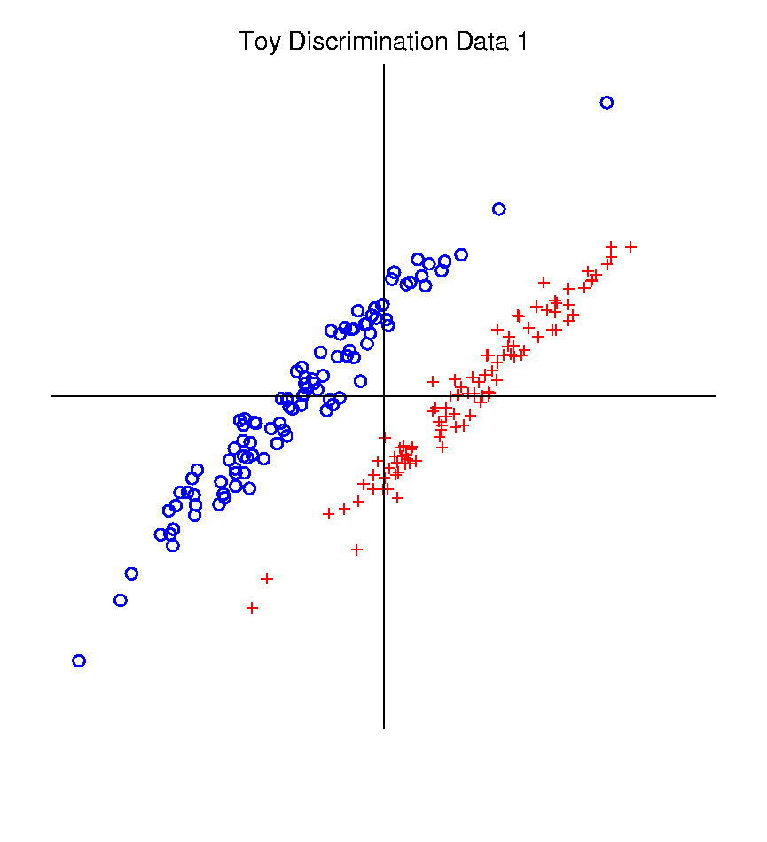
Classical Discrimination
Graphical Display of Classifiers
Use Yellow for Grid
Points Assigned
to Plus Class
Use Cyan for Grid
Points Assigned
to Minus Class
Notes:
PEod1FLDe1.ps

Slide 106
Classical Discrimination
FLD for Tilted Point Clouds – Works well
Notes:
PEod1FLDe1.ps

Slide 107
Classical Discrimination
GLR for Tilted Point Clouds – Works well
Notes:
PEod1GLRe1.ps

Slide 108
Classical Discrimination
FLD for Donut – Poor, no plane can work
Notes:
PEdonFLDe1.ps

Slide 109
Classical Discrimination
GLR for Donut – Works well (good quadratic)
(Even
though
data not
Gaussian)
Notes:
PEdonGLRe1.ps

Slide 110
Classical Discrimination
FLD for X – Poor, no plane can work
Notes:
PExd3FLDe1.ps

Slide 111
Classical Discrimination
GLR for X – Better, but not great
Notes:
PExd3GLRe1.ps

Slide 112
Classical Discrimination
Summary of FLD vs. GLR:
Tilted Point Clouds Data
FLD good
GLR good
Donut Data
FLD bad
GLR good
X Data
FLD bad
GLR OK, not great
Classical Conclusion: GLR generally better
(will see a different answer for HDLSS data)

