Slide 1
Participant Presentations
See Course Web Site (10 Minute Talks)

Slide 2
Object Oriented Data Analysis
Three Major Parts of OODA Applications:
I. Object Definition
“What are the Data Objects?”
Exploratory Analysis
“What Is Data Structure / Drivers?”
III. Confirmatory Analysis / Validation
Is it Really There (vs. Noise Artifact)?

Slide 3
PCA vs. SVD
2-d Toy Example
Direction of “Maximal Variation”???
PC1 Solution (Mean Centered) Very Good!

Slide 4
PCA vs. SVD
2-d Toy Example
Direction of “Maximal Variation”???
SV1 Solution (Origin Centered) Poor Rep’n

Slide 5
PCA Data Represent’n (Cont.)
Can Focus on Individual Data Vectors:
$${\underline{X}}_{i}=\underline{\overline{X}}+\sum_{j=1}^{d}{{\underline{v}}_{j}}c_{ij}$$
(Part of Above Full Matrix Rep’n)
Terminology: $c_{ij}$ are Called “PCs”
and are also Called Scores

Slide 6
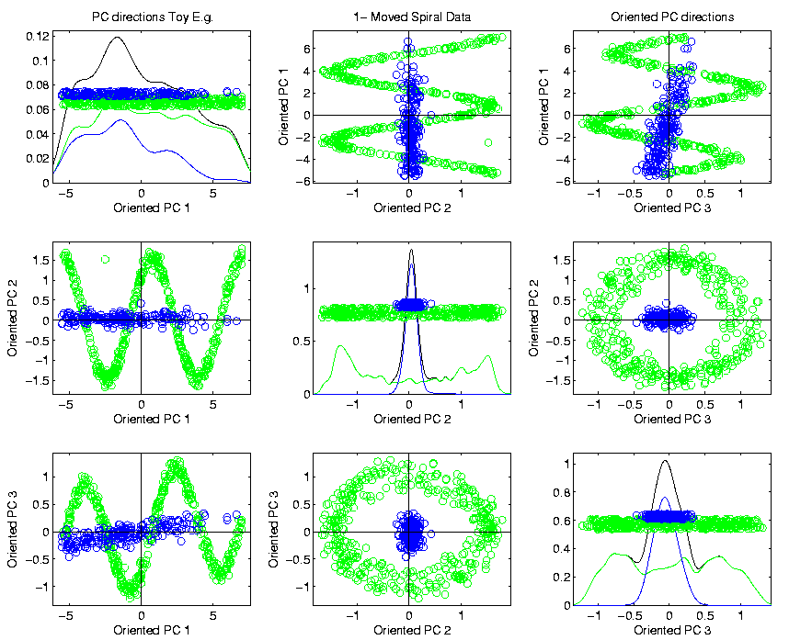
PCA & Graphical Displays
Toy Example (1 point moved)
Important
Point:
Constant
Axes

Slide 7
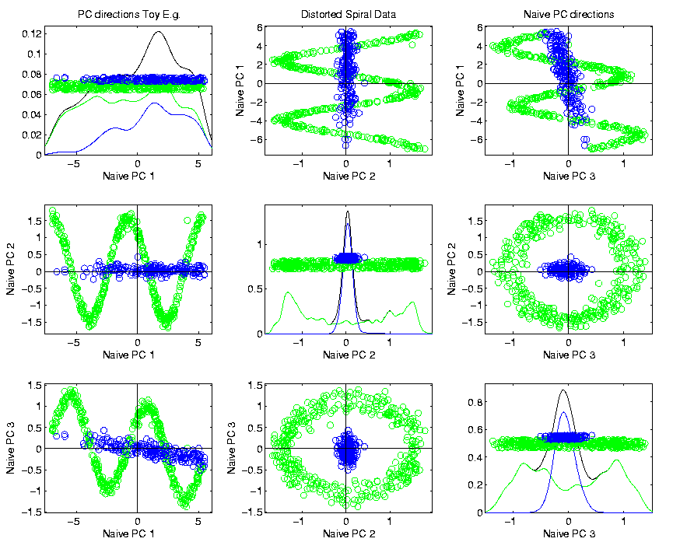
PCA & Graphical Displays
Original Data (arbitrary PC flip)

Slide 8
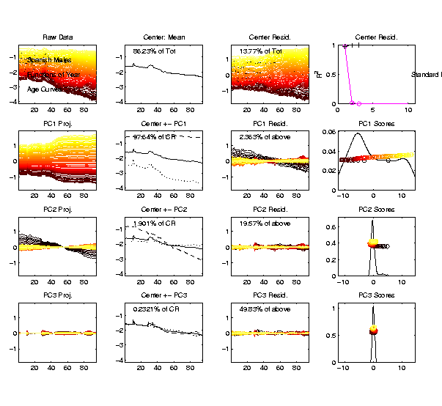
Demography Data
Dual PCA
Notes:
8

Slide 9
Alternate PCA Computation
Appears to be cool symmetry:
Primal ←→ Dual
Loadings ←→ Scores
←→
But, care is needed with the means
and $\sqrt{n−1}$ normalization …

Slide 10
Cornea Data
Main Point: OODA Beyond FDA
Recall Interplay:
Object Space ←→ Descriptor Space

Slide 11
Cornea Data
Cornea Data:
Raw Data
Decompose
Into
Modes of
Variation?

Slide 12
Cornea Data
Data Representation - Zernike Basis
Descriptor Space is Vector Space of Zernike Coefficients
So Perform PCA There

Slide 13
PCA of Cornea Data
PC1 Movie:

Slide 14
PCA of Cornea Data
PC1 Summary:
Mean (1st image): mild vert’l astigmatism
known pop’n structure called “with the rule”
Main dir’n: “more curved” & “less curved”
Corresponds to first optometric measure
(89% of variat’n, in Mean Resid. SS sense)
Also: “stronger astig’m” & “no astig’m”
Found corr’n between astig’m and curv’re
Scores (cyan): Apparent Gaussian dist’n

Slide 15
PCA of Cornea Data
PC2 Movie:

Slide 16
PCA of Cornea Data
PC2 Movie:
Mean: same as above
Common centerpoint of point cloud
Are studying “directions from mean”
Images along direction vector:
Looks terrible???
Why?

Slide 17
PCA of Cornea Data
PC2 Movie:
Reason made clear in Scores Plot (cyan):
Single outlying data object drives PC dir’n
A known problem with PCA
Recall finds direction with “max variation”
In sense of variance
Easily dominated by single large observat’n

Slide 18
PCA of Cornea Data
Toy Example: Single Outlier Driving PCA

Slide 19
PCA of Cornea Data
PC2 Affected by Outlier:
How bad is this problem?
View 1: Statistician: Arrggghh!!!!
Outliers are very dangerous
Can give arbitrary and meaningless dir’ns

Slide 20
PCA of Cornea Data
PC2 Affected by Outlier:
How bad is this problem?
View 2: Ophthalmologist: No Problem
Driven by “edge effects” (see raw data)
Artifact of “light reflection” data gathering
(“eyelid blocking”, and drying effects)
Routinely “visually ignore” those anyway
Found interesting (& well known) dir’n:
steeper superior vs steeper inferior

Slide 21
Cornea Data
Cornea Data:
Raw Data
Which one
is the outlier?
Will say more
later …

Slide 22
PCA of Cornea Data
PC3 Movie

Slide 23
PCA of Cornea Data
PC3 Movie (ophthalmologist’s view):
Edge Effect Outlier is present
But focusing on “central region” shows changing dir’n of astig’m (3% of MR SS)
“with the rule” (vertical) vs. “against the rule” (horizontal)
most astigmatism is “with the rule”
most of rest is “against the rule”
(known folklore)

Slide 24
PCA of Cornea Data
PC4 movie

Slide 25
PCA of Cornea Data
Continue with ophthalmologists view…
PC4 movie version:
Other direction of astigmatism???
Location (i.e. “registration”) effect???
Harder to interpret …
OK, since only 1.7% of MR SS
Substantially less than for PC2 & PC3

Slide 26
PCA of Cornea Data
Ophthalmologists View (cont.)
Overall Impressions / Conclusions:
Useful decomposition of population variation
Useful insight into population structure

Slide 27
PCA of Cornea Data
Now return to Statistician’s View:
How can we handle these outliers?
Even though not fatal here, can be for other examples…
Simple Toy
Example
(in 2d):

Slide 28
Outliers in PCA
Deeper Toy Example:

Slide 29
Outliers in PCA
Deeper Toy Example:
Why is green curve an outlier?
Never leaves range of other data
But Euclidean distance to others very large
relative to other distances
Also major difference in terms of shape
And even smoothness
Important lesson:
$∃$ many directions in $ℝ^{d}$

Slide 30
Outliers in PCA
Much like
earlier
Parabolas
Example
But with
1 “outlier”
thrown in

Slide 31
Outliers in PCA
PCA for
Deeper
Toy E.g.
Data:

Slide 32
Outliers in PCA
Deeper Toy Example:
At first glance, mean and PC1 look similar to no outlier version
PC2 clearly driven completely by outlier
PC2 scores plot (on right) gives clear outlier diagnostic
Outlier does not appear in other directions
Previous PC2, now appears as PC3
Total Power (upper right plot) now “spread farther”

Slide 33
Outliers in PCA
Closer Look at Deeper Toy Example:
Mean “influenced” a little, by the outlier
Appearance of “corners” at every other coordinate
PC1 substantially “influenced” by the outlier
Clear “wiggles”

Slide 34
Outliers in PCA
What can (should?) be done about outliers?
Context 1: Outliers are important aspects of the population
They need to be highlighted in the analysis
Although could separate into subpopulations
Context 2: Outliers are “bad data”, of no interest
recording errors? Other mistakes?
Then should avoid distorted view of PCA

Slide 35
Outliers in PCA
Two Differing Goals for Outliers:
Avoid Major Influence on Analysis
Find Interesting Data Points
(e.g. In-liers)
Wilkinson (2017)

Slide 36
Outliers in PCA
Two Differing Goals for Outliers:
Avoid Major Influence on Analysis
Find Interesting Data Points
FDA Version: Mean & Shape Outliers
Dai & Genton (2016, 2017)

Slide 37
Outliers in PCA
Standard Statistical Approaches to Dealing with Influential Outliers:
Outlier Deletion:
Kick out “bad data”
Robust Statistical methods:
Work with full data set,
but downweight “bad data”
Reduce influence, instead of “deleting”
(Think Median)

Slide 38
Outliers in PCA
Example Cornea Data:
Can find PC2 outlier (by looking through data (careful!))

Slide 39
Outliers in PCA
Example
Cornea Data
Which One Is
The Outlier?

Slide 40
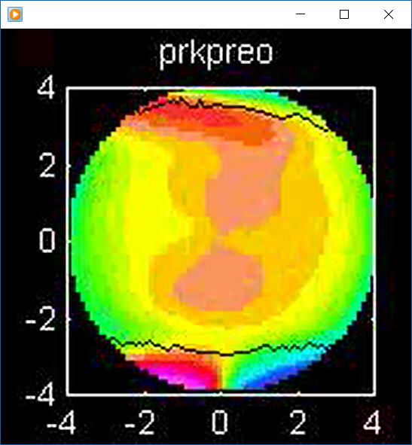
Outliers in PCA
Example
Cornea Data
Which One Is
The Outlier?
Not This

Slide 41
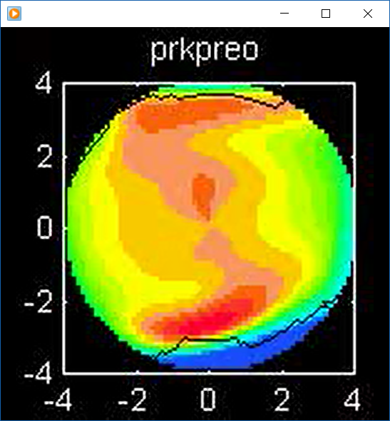
Outliers in PCA
Example
Cornea Data
Which One Is
The Outlier?
Another Wild One

Slide 42
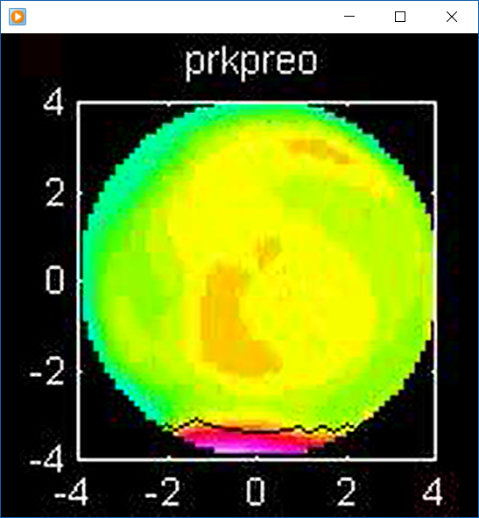
Outliers in PCA
Example
Cornea Data
Which One Is
The Outlier?
Might Think This

Slide 43
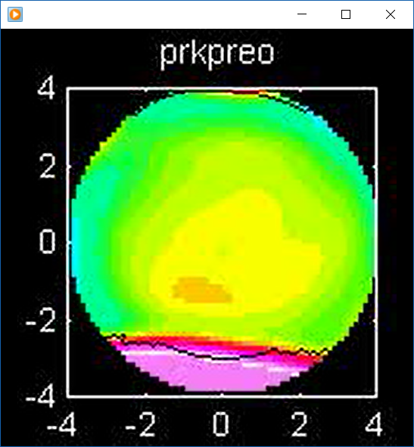
Outliers in PCA
Example
Cornea Data
Which One Is
The Outlier?
But In Fact Is This

Slide 44
Outliers in PCA
Example Cornea Data:
Can find PC2 outlier (by looking through data (careful!))
Problem: after removal, another point dominates PC2
Could delete that, but then another appears
After 4th step have eliminated 10% of data ($n=43$)

Slide 45
Outliers in PCA
Motivates alternate approach:
Robust Statistical Methods
Recall main idea:
Downweight (instead of delete) outliers
$∃$ a large literature. Good intro’s
(from different viewpoints) are:
Huber (2011)
Hampel, et al (2011)
Staudte & Sheather (2011)

Slide 46
Outliers in PCA
Simple robustness concept: breakdown point
how much of data “moved to ”
will “destroy estimate”?
Usual mean has breakdown 0
Median has breakdown ½ (best possible)
Conclude:
Median much more robust than mean
Median uses all data
Median gets good breakdown from
“equal vote”

Slide 47
Outliers in PCA
Mean has
breakdown 0
Single
Outlier
Pulls Mean
Outside
range
of data

Slide 48
Outliers in PCA
Controversy:
Is median’s “equal vote” scheme good or bad?
Huber:
Outliers contain some information,
So should only control “influence”
(e.g. median)
Hampel, et. al.:
Outliers contain no useful information
Should be assigned weight 0
(not done by median)
Using “proper robust method”
(not simply deleted)

Slide 49
Outliers in PCA
Robustness Controversy (cont.):
Both are “right” (depending on context)
Source of major (unfortunately bitter) debate!
Application to Cornea data:
Huber’s model more sensible
Already know $∃$ some useful info in each data point
Thus “median type” methods are sensible

Slide 50
Robust PCA
What is multivariate median?
There are several!
(“median” generalizes in different ways)
Coordinate-wise median
Often worst
Not rotation invariant
(2-d data uniform on “L”)
Can lie on convex hull of data
(same example)
Thus poor notion of “center”

Slide 51
Robust PCA
Coordinate-wise median
Not rotation invariant
Thus poor notion of “center”

Slide 52
Robust PCA
Coordinate-wise median
Can lie on convex hull of data
Thus poor notion of “center”

Slide 53
Robust PCA
What is multivariate median (cont.)?
ii. Simplicial depth (a. k. a. “data depth”):
Liu (1990)
“Paint Thickness” of $d+1$ dim “simplices” with corners at data
Nice idea
Good invariance properties
Slow to compute

Slide 54
Robust PCA
What is multivariate median (cont.)?
iii. Huber’s $L^{p}$ M-estimate:
Given data $X_{1},⋯,X_{n}∈ℝ^{d}$,
Estimate “center of population” by
$$\hat{θ}={argmin}_{θ}\sum_{i=1}^{n}{{\left\|X_{i}−θ\right\|}_{2}^{p}}$$
Where ${\left\|∙\right\|}_{2}$ is the usual Euclidean norm
Here: use only $p=1$
(minimal impact by outliers)

Slide 55
Robust PCA
Huber’s $L^{p}$ M-estimate (cont):
Estimate “center of population” by
$$\hat{θ}={argmin}_{θ}\sum_{i=1}^{n}{{\left\|X_{i}−θ\right\|}_{2}^{p}}$$
Case $p=2$:
Can show $\hat{θ}=\overline{X}$ (sample mean)
(also called “Fréchet Mean”, …)
Again Here: use only $p=1$
(minimal impact by outliers)

Slide 56
Robust PCA
$L^{1}$ M-estimate (cont.):
A view of minimizer: Study solution of
$$\underline{0}=\left(\begin{matrix}⋮ \\ \frac{∂}{∂θ_{j}}\sum_{i=1}^{n}{{\left\|X_{i}−θ\right\|}_{2}} \\ ⋮\end{matrix}\right)=$$
$$=\sum_{i=1}^{n}{\frac{X_{i}−θ}{{\left\|X_{i}−θ\right\|}_{2}}}$$

Slide 57
Robust PCA
$L^{1}$ M-estimate (cont.):
A view of minimizer: Study solution of
$$\underline{0}=\sum_{i=1}^{n}{\frac{X_{i}−θ}{{\left\|X_{i}−θ\right\|}_{2}}}$$
A useful viewpoint is based on:
$P_{Sph(θ,1)}$ = “Proj’n of data onto sphere
centered at $θ$ with radius $1$”
And representation: $P_{Sph(θ,1)}X_{i}=θ+\frac{X_{i}−θ}{{\left\|X_{i}−θ\right\|}_{2}}$

Slide 58
Robust PCA
$L^{1}$ M-estimate (cont.):
Thus the solution of
$$0=\sum_{i=1}^{n}{\frac{X_{i}−θ}{{\left\|X_{i}−θ\right\|}_{2}}}=\sum_{i=1}^{n}{\left(P_{Sph(θ,1)}X_{i}−θ\right)}$$
is the solution of:
$$0=avg\left\{P_{Sph(θ,1)}X_{i}−θ:i=1,⋯,n\right\}$$
So $\hat{θ}$ is location where projected data are centered at $\hat{θ}$
“Slide sphere around until mean (of projected data) is at center”

Slide 59
Robust PCA
$L^{1}$ M-estimate (cont.):
Data are
+ signs

Slide 60
Robust PCA
M-estimate (cont.):
Data are
+ signs
Sample Mean, $\overline{X}$
outside “hot dog”
of data

Slide 61
Robust PCA
M-estimate (cont.):
Candidate
Sphere Center, $θ$

Slide 62
Robust PCA
M-estimate (cont.):
Candidate
Sphere Center, $θ$
Projections
Of Data

Slide 63
Robust PCA
M-estimate (cont.):
Candidate
Sphere Center, $θ$
Projections
Of Data
Mean of
Projections

Slide 64
Robust PCA
M-estimate (cont.):
“Slide sphere
around until
mean (of
projected data)
is at center”

Slide 65
Robust PCA
M-estimate (cont.):
Additional literature:
Called “geometric median” (long before Huber) by: Haldane (1948)
Shown unique for $d>1$ by: Milasevic and Ducharme (1987)
Useful iterative algorithm: Gower (1974)
(see also Sec. 3.2 of Huber (2011)).
Cornea Data experience:
works well for $d=66$

Slide 66
Robust PCA
M-estimate for Cornea Data:
Sample Mean M-estimate
Definite improvement
But outliers still have some influence
Improvement? (will suggest one soon)

Slide 67
Robust PCA
Now have robust measure of “center”,
how about
“spread”?
I.e. how
can we
do robust
PCA?

Slide 68
Robust PCA
Now have robust measure of “center”,
how about
“spread”?
Parabs e.g.
from above
With an
“outlier” (???)
Added in

Slide 69
Robust PCA
Now have robust measure of “center”,
how about
“spread”?
Small Impact on Mean

Slide 70
Robust PCA
Now have robust measure of “center”,
how about
“spread”?
Small Impact on Mean
More on PC1 Dir’n

Slide 71
Robust PCA
Now have robust measure of “center”,
how about
“spread”?
Small Impact on Mean
More on PC1 Dir’n
Dominates Residuals
Thus PC2 Dir’n
& PC2 scores

Slide 72
Robust PCA
Now have robust measure of “center”,
how about
“spread”?
Small Impact on Mean
More on PC1 Dir’n
Dominates Residuals
Thus PC2 Dir’n
& PC2 scores
Tilt now in PC3
Viualization is very
Useful diagnostic

Slide 73
Robust PCA
Now have robust measure of “center”,
how about
“spread”?
How
can we
do robust
PCA?

Slide 74
Robust PCA
Approaches to Robust PCA:
Robust Estimation of Covariance Matrix
Projection Pursuit
Spherical PCA

Slide 75
Robust PCA
Robust PCA 1: Robust Estimation of Covariance Matrix
A. Component-wise Robust Covariances:
Major problem:
Hard to get non-negative definiteness
Minimum Volume Ellipsoid:
Rousseeuw & Leroy (2005)
Requires $n>d$ (in available software)
Needed for simple definition of affine invariant

Slide 76
Important Aside
Major difference between FDA (OODA)
& Classical Multivariate Analysis
High Dimension, Low Sample Size Data
(sample size $n$ < dimension $d$)
Classical Multivariate Analysis:
start with “sphering data” (multiply by ${\hat{Σ}}^{−1/2}$)
but ${\hat{Σ}}^{−1/2}$ doesn’t exist for HDLSS data

Slide 77
Important Aside
Classical Approach to HDLSS data: “Don’t have enough data for analysis, get more”
Unworkable (and getting worse) for many modern settings:
Medical Imaging (e.g. Cornea Data)
Gene Expression & Other Cancer Data
Neuroscience Data

Slide 78
Robust PCA
Robust PCA 2: Projection Pursuit
Idea: focus on
“finding direction of greatest variability”
Reference: Li and Chen (1985)
Problems:
Robust estimates of “spread” are nonlinear
Results in many local optima

Slide 79
Robust PCA
Robust PCA 2: Projection Pursuit (cont.)
Problems:
Results in many local optima
Makes search problem very challenging
Especially in very high dimensions
Most examples have $d=4,5$
Guoying Li:
“I’ve heard of $d=20$,
but 60 seems too big”

Slide 80
Robust PCA
Robust PCA 3:
Spherical
PCA
Locantore et al (1999)

Slide 81
Robust PCA
Robust PCA 3: Spherical PCA
Idea: use “projection to sphere” idea from M-estimation
In particular project data to centered sphere
“Hot Dog” of data becomes “Ice Caps”
Easily found by PCA (on proj’d data)
Outliers pulled in to reduce influence
Radius of sphere unimportant
Notes:
81

Slide 82
Robust PCA
Robust PCA 3: Spherical PCA
Independent Derivation & Alternate Name:
PCA of Spatial Signs
(think: multivariate extension of “sign test”)
Idea: test $H_{0}:μ=0$ using #(+) & #(-)
Notes:
82

Slide 83
Robust PCA
Robust PCA 3: Spherical PCA
Independent Derivation & Alternate Name:
PCA of Spatial Signs
1st Paper:
Möttönen & Oja (1995)
Complete Description:
Oja (2010)
Notes:
83

Slide 84
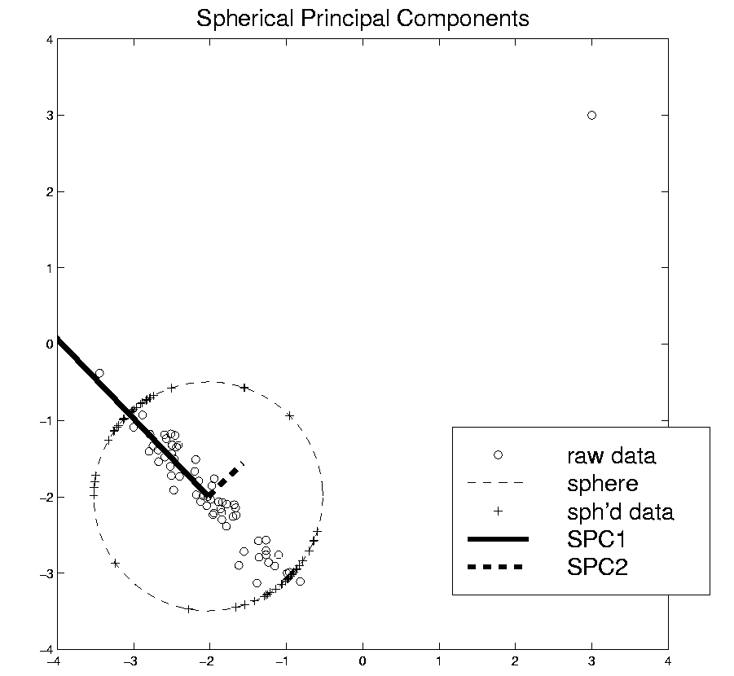
Robust PCA
Spatial Signs
Interesting Variation:
Spatial Ranks
Idea: Keep
Track of “Depth”
Via Ranks of Radii
Notes:
84

Slide 85
Robust PCA
Spherical PCA for Toy Example:
Curve Data
With an
Outlier
First recall
Conventional
PCA
Notes:
85

Slide 86
Robust PCA
Spherical PCA for Toy Example:
Now do
Spherical
PCA
Better result?
Notes:
86

Slide 87
Robust PCA
Spherical PCA for Toy Data:
Mean looks “smoother”
PC1 nearly “flat” (unaffected by outlier)
PC2 is nearly “tilt” (again unaffected by outlier)
PC3 finally strongly driven by outlier
OK, since all other directions “about equal in variation”
Scree Plot, no longer ordered
(outlier drives SS, but not directions)
Notes:
87

Slide 88
Robust PCA
Spherical PCA for Toy Example:
Check out
Later
Components
Notes:
88

Slide 89
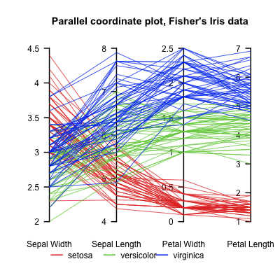
Aside On Visualization
Recall Multivariate Data Visualization Tool:
Parallel Coordinates
E.g. Fisher Iris Data
$d=4$
Named Variables
(thanks to Wikipedia)
Notes:
89

Slide 90
Aside On Visualization
Recall Multivariate Data Visualization Tool:
Parallel Coordinates
E.g. Fisher Iris Data
$d=4$
Named Variables
Curves are Data Objects
(4-vectors)
Inselberg (1985, 2009)
Notes:
90

Slide 91
Robust PCA
Useful View: Parallel Coordinates Plot
X-axis:
Zernike
Coefficient
Number
Y-axis:
Coefficient
Notes:
91

Slide 92
Robust PCA
Cornea Data, Parallel Coordinates Plot:
Top Plot: Zernike
Coefficients
Notes:
92

Slide 93
Robust PCA
Cornea Data, Parallel Coordinates Plot:
Top Plot: Zernike
Coefficients
All n = 43 Very
Similar
.
Notes:
93

Slide 94
Robust PCA
Cornea Data, Parallel Coordinates Plot:
Top Plot: Zernike
Coefficients
All n = 43 Very
Similar
Most Action in few
Low Freq. Coeffs.
Notes:
94

Slide 95
Robust PCA
Cornea Data, Parallel Coordinates Plot
Middle Plot: (Zernike Coefficients – median)
Most Variation in lowest frequencies
E.g. as in Fourier compression of smooth signals
Projecting on sphere will destroy this
By magnifying high frequency behavior
Bottom Plot: discussed later
Notes:
95

Slide 96
Robust PCA
Spherical PCA Problem :
Magnification of High Freq. Coeff’s
Solution : Elliptical Analysis
Main idea: project data onto suitable ellipse, not sphere
Which ellipse? (in general, this is problem that PCA solves!)
Simplification: Consider ellipses parallel to coordinate axes
Notes:
96

Slide 97
Robust PCA
Spherical PCA Problem :
Magnification of High Freq. Coeff’s
Solution : Elliptical Analysis
Background (Univariate):
MAD = Median Absolute Deviation
MAD = $median\left|X_{i}−median\left(X_{i}\right)\right|$
Simple, High Breakdown, Outlier Resistant, Measure of “Scale”
Notes:
97

Slide 98
Robust PCA
Rescale
Coords
Spherical PCA
Unscale
Coords

Slide 99
Robust PCA
Elliptical Analysis (cont.):
Simple Implementation,
via coordinate axis rescaling
Divide each axis by MAD
Project Data to sphere (in transformed space)
Return to original space (mul’ply by orig’l MAD) for analysis
Do PCA on Projections

Slide 100
Robust PCA
Elliptical Estimate of “center”:
Do M-estimation in transformed space
(then transform back)
Results for cornea data:
Sample Mean Spherical Center Elliptical Center
Elliptical clearly best
Nearly no edge effect

Slide 101
Robust PCA
Elliptical PCA for cornea data:
Original PC1, Elliptical PC1

Slide 102
Robust PCA
Elliptical PCA for cornea data:
Original PC1, Elliptical PC1
Still finds overall curvature & correlated astigmatism
Minor edge effects almost completely gone

Slide 103
Robust PCA
Elliptical PCA for cornea data:
Original PC2, Elliptical PC2

Slide 104
Robust PCA
Elliptical PCA for cornea data:
Original PC1, Elliptical PC1
Still finds overall curvature & correlated astigmatism
Minor edge effects almost completely gone
Original PC2, Elliptical PC2
Huge edge effects dramatically reduced
Still finds steeper superior vs. inferior

Slide 105
Robust PCA
Elliptical PCA for cornea data:
Original PC3, Elliptical PC3

Slide 106
Robust PCA
Elliptical PCA for Cornea Data (cont.):
Original PC3, Elliptical PC3
-Edge effects greatly diminished
But some of against the rule astigmatism also lost
Price paid for robustness

Slide 107
Robust PCA
Elliptical PCA for cornea data:
Original PC4, Elliptical PC4

Slide 108
Robust PCA
Elliptical PCA for Cornea Data (cont.):
Original PC3, Elliptical PC3
-Edge effects greatly diminished
But some of against the rule astigmatism also lost
Price paid for robustness
Original PC4, Elliptical PC4
Now looks more like variation on astigmatism???

