Slide 1
Participant Presentations
See Course Web Site (10 Minute Talks)

Slide 2
Object Oriented Data Analysis
Three Major Parts of OODA Applications:
I. Object Definition
“What are the Data Objects?”
Exploratory Analysis
“What Is Data Structure / Drivers?”
III. Confirmatory Analysis / Validation
Is it Really There (vs. Noise Artifact)?

Slide 3
Course Background I
Linear Algebra
Please Check Familiarity
No? Read Up in Linear Algebra Text
Or Wikipedia?

Slide 4
Review of Linear Algebra (Cont.)
SVD Full Representation:
=
Intuition: For $X$ as Linear Operator:
Represent as:
Isometry (~Rotation)
Coordinate Rescaling
Isometry (~Rotation)

Slide 5
Review of Linear Algebra (Cont.)
SVD Reduced Representation:
=

Slide 6
Review of Linear Algebra (Cont.)
SVD Compact Representation:
=
For Reduced Rank Approximation Can Further Reduce
Key to Dimension Reduction

Slide 7
Review of Multivar. Prob. (Cont.)
Outer Product Representation:
,
Where:

Slide 8
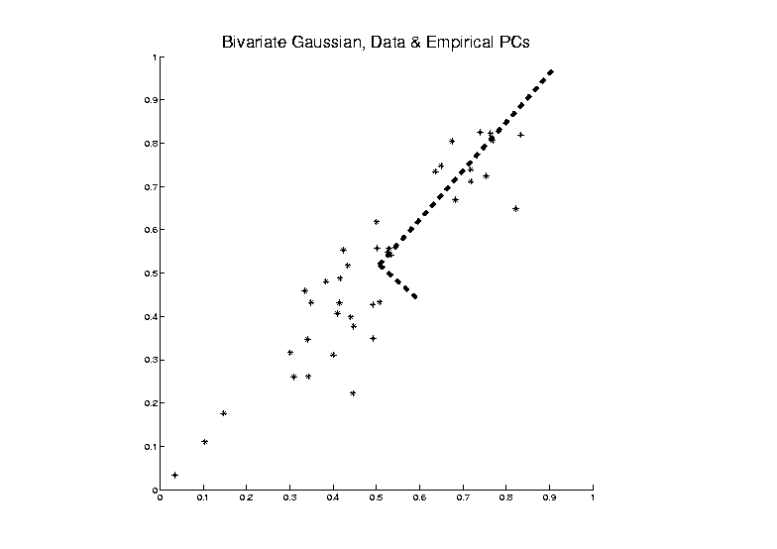
PCA as an Optimization Problem
Find Direction of Greatest Variability:

Slide 9
PCA as Optimization (Cont.)
Variability in the Direction :
i.e. (Proportional to) a
Quadratic Form in the Covariance Matrix
Simple Solution Comes from the Eigenvalue Representation of :

Slide 10
PCA as Optimization (Cont.)
Now since is an Orthonormal Basis Matrix,
and
So the Rotation Gives a Decomposition of the Energy of in the Eigen-directions of
And is Max’d (Over ), by Putting maximal Energy in the “Largest Direction”, i.e. taking ,
Where “Eigenvalues are Ordered”,

Slide 11
PCA as Optimization (Cont.)
Notes:
Projecting onto Subspace $⊥$ to $\underline{v_{1}}$,
Gives $\underline{v_{2}}$ as Next Direction
Continue Through $\underline{v_{3}},⋯,\underline{v_{d}}$

Slide 12
Connect Math to Graphics
2-d Toy Example
From Much Earlier Class Meeting
2-d Curves as Data In Object Space
Simple, Visualizable Descriptor Space

Slide 13
PCA Redistribution of Energy
Now for Scree Plots (Upper Right of FDA Anal.)
Carefully Look At:
Intuition
Relation to Eigenanalysis
Numerical Calculation

Slide 14
PCA Redist’n of Energy (Cont.)
ANOVA Mean Decomposition:
Total Variation =
= Mean Variation + Mean Residual Variation
$\sum_{i=1}^{n}{{\left\|X_{i}\right\|}^{2}}$= $\sum_{i=1}^{n}{{\left\|\overline{X}\right\|}^{2}}+\sum_{i=1}^{n}{{\left\|X_{i}−\overline{X}\right\|}^{2}}$
Mathematics: Pythagorean Theorem
Intuition Quantified via Sums of Squares
(Squares More Intuitive Than Absolutes)

Slide 15
PCA Redist’n of Energy (Cont.)
Eigenvalues Provide Atoms of SS Decompos’n
Useful Plots are:
Power Spectrum: vs.
log Power Spectrum: vs.
Cumulative Power Spectrum: vs.
Note PCA Gives SS’s for Free (As Eigenval’s),
But Watch Factors of
Notes:
15

Slide 16
PCA Redist’n of Energy (Cont.)
Note, have already considered some of these Useful Plots:
Power Spectrum (as %s)
Cumulative Power Spectrum (%)
Common Terminology:
Power Spectrum is Called
“Scree Plot”
Kruskal (1964) Cattell (1966)
(all but name “scree”) (1st Appearance of name???)
Notes:
16

Slide 17
PCA vs. SVD
Sometimes “SVD Analysis of Data”
= Uncentered PCA

Slide 18
PCA vs. SVD
Sometimes “SVD Analysis of Data”
= Uncentered PCA
Consequence: Skip this step

Slide 19
PCA vs. SVD
Sometimes “SVD Analysis of Data”
= Uncentered PCA
Useful view point: For Data Matrix $X$
Ignore scaled, centered $\tilde{X}=\frac{1}{\sqrt{n−1}}\left(X−\overline{X}\right)$
Instead do eigen-analysis of $XX^{t}$
(in contrast to $\hat{Σ}=\tilde{X}{\tilde{X}}^{t}$)

Slide 20
PCA vs. SVD
Sometimes “SVD Analysis of Data”
= Uncentered PCA
Eigen-analysis of $XX^{t}$
Intuition:
Find Directions of Maximal Variation
From the Origin

Slide 21
PCA vs. SVD
Sometimes “SVD Analysis of Data”
= Uncentered PCA
Investigate with Similar Toy Example

Slide 22
PCA vs. SVD
2-d Toy Example
Direction of “Maximal Variation”???

Slide 23
PCA vs. SVD
2-d Toy Example
Direction of “Maximal Variation”???
PC1 Solution (Mean Centered) Very Good!

Slide 24
PCA vs. SVD
2-d Toy Example
Direction of “Maximal Variation”???
SV1 Solution (Origin Centered) Poor Rep’n

Slide 25
PCA vs. SVD
2-d Toy Example
Look in Orthogonal Direction:
PC2 Solution (Mean Centered) Very Good!

Slide 26
PCA vs. SVD
2-d Toy Example
Look in Orthogonal Direction:
SV2 Solution (Origin Centered) Off Map!

Slide 27
PCA vs. SVD
2-d Toy Example
SV2 Solution Larger Scale View:
Not Representative of Data

Slide 28
PCA vs. SVD
Sometimes “SVD Analysis of Data”
= Uncentered PCA
Investigate with Similar Toy Example:
Conclusions:
PCA Generally Better
Unless “Origin Is Important”
Deeper Look: Zhang et al (2007)

Slide 29
Different Views of PCA
Solves several optimization problems:
Direction to maximize SS of 1-d proj’d data
Notes:
29

Slide 30
Different Views of PCA
2-d Toy Example
Max SS of Projected Data
Notes:
30

Slide 31
Different Views of PCA
Solves several optimization problems:
Direction to maximize SS of 1-d proj’d data
Direction to minimize SS of residuals
Notes:
31

Slide 32
Different Views of PCA
2-d Toy Example
Max SS of Projected Data
Min SS of Residuals
Notes:
32

Slide 33
Different Views of PCA
Solves several optimization problems:
Direction to maximize SS of 1-d proj’d data
Direction to minimize SS of residuals
(same, by Pythagorean Theorem)
“Best fit line” to data in “orthogonal sense”
(vs. regression of Y on X = vertical sense
& regression of X on Y = horizontal sense)
Notes:
33

Slide 34
Different Views of PCA
2-d Toy Example
Max SS of Projected Data
Min SS of Residuals
Best Fit Line
Notes:
34

Slide 35
Different Views of PCA
Toy Example Comparison of Fit Lines:
PC1
Regression of Y on X
Regression of X on Y
Notes:
35

Slide 36
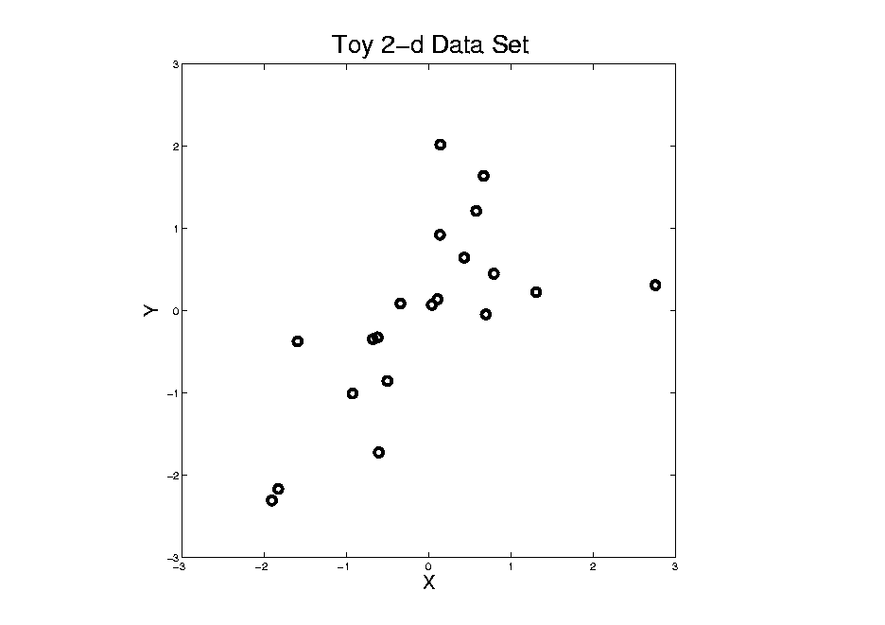
Different Views of PCA
Normal
Data
ρ = 0.3
Notes:
36

Slide 37
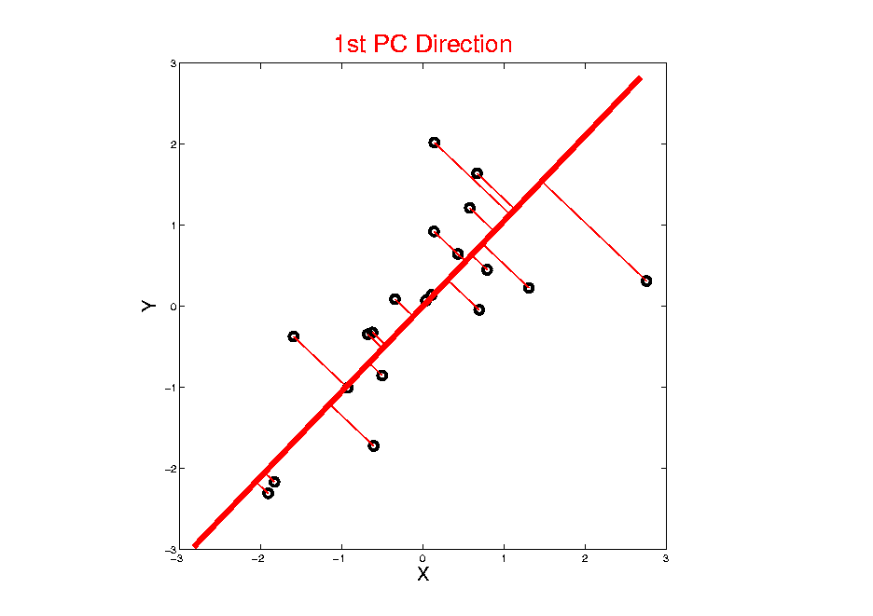
Different Views of PCA
Projected
Residuals
Notes:
37

Slide 38
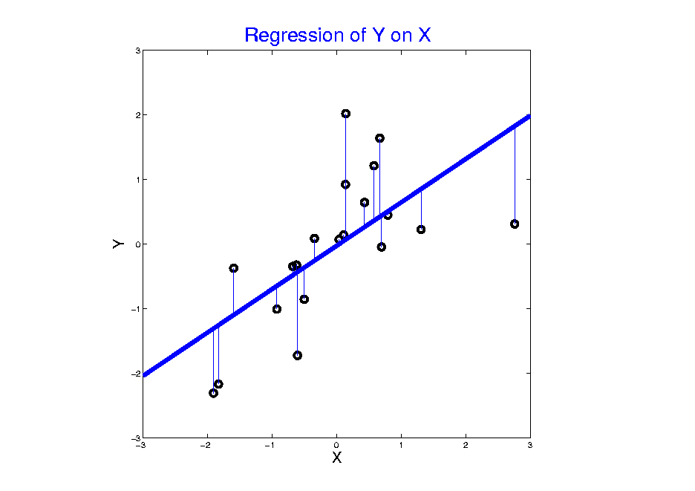
Different Views of PCA
Vertical
Residuals
(X predicts Y)
Notes:
38

Slide 39
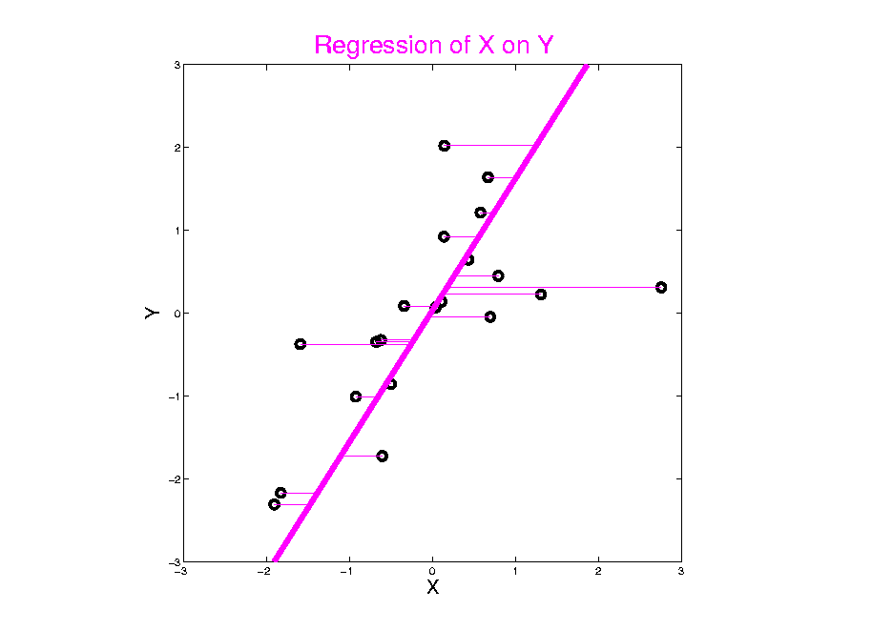
Different Views of PCA
Horizontal
Residuals
(Y predicts X)
Notes:
39

Slide 40
Different Views of PCA
Projected
Residuals
(Balanced
Treatment)
Notes:
40

Slide 41
Different Views of PCA
Toy Example Comparison of Fit Lines:
PC1
Regression of Y on X
Regression of X on Y
Note: Big Difference Prediction Matters
Notes:
41

Slide 42
Different Views of PCA
Solves several optimization problems:
Direction to maximize SS of 1-d proj’d data
Direction to minimize SS of residuals
(same, by Pythagorean Theorem)
“Best fit line” to data in “orthogonal sense”
(vs. regression of Y on X = vertical sense
& regression of X on Y = horizontal sense)
Use one that makes sense…
Notes:
42

Slide 43
PCA Data Representation
Idea: Expand Data Matrix
in Terms of Inner Prod’ts & Eigenvectors
Recall Notation:
$$\tilde{X}=\frac{1}{\sqrt{n−1}}{\left({\underline{X}}_{1}−\underline{\overline{X}},⋯,{\underline{X}}_{n}−\underline{\overline{X}}\right)}_{d×n}$$
(Mean Centered Data)

Slide 44
PCA Data Representation
Idea: Expand Data Matrix
in Terms of Inner Prod’ts & Eigenvectors
Recall Notation:
$$\tilde{X}=\frac{1}{\sqrt{n−1}}{\left({\underline{X}}_{1}−\underline{\overline{X}},⋯,{\underline{X}}_{n}−\underline{\overline{X}}\right)}_{d×n}$$
Spectral Representation (centered data):
$${\tilde{X}}_{d×n}=\sum_{j=1}^{d}{{\underline{v}}_{j}}\left({{\underline{v}}_{j}}^{t}\tilde{X}\right)$$

Slide 45
PCA Data Represent’n (Cont.)
Now Using:
$$X=\underline{\overline{X}}+\sqrt{n−1}\tilde{X}$$
Spectral Representation (Raw Data):
$$X_{d×n}=\underline{\overline{X}}+\sum_{j=1}^{d}{{\underline{v}}_{j}\sqrt{n−1}\left({{\underline{v}}_{j}}^{t}\tilde{X}\right)}=\underline{\overline{X}}+\sum_{j=1}^{d}{{\underline{v}}_{j}{\underline{c}}_{j}}$$
Where:
Entries of ${\underline{v}}_{j}$ $\left(d×1\right)$ are Loadings
Entries of ${\underline{c}}_{j}$ $\left(1×n\right)$ are Scores

Slide 46
PCA Data Represent’n (Cont.)
Can Focus on Individual Data Vectors:
$${\underline{X}}_{i}=\underline{\overline{X}}+\sum_{j=1}^{d}{{\underline{v}}_{j}}c_{ij}$$
(Part of Above Full Matrix Rep’n)
Terminology: $c_{ij}$ are Called “PCs”
and are also Called Scores

Slide 47
PCA Data Represent’n (Cont.)
More Terminology:
Scores, $c_{ij}$ are Coefficients in Spectral Representation:
$${\underline{X}}_{i}=\underline{\overline{X}}+\sum_{j=1}^{d}{{\underline{v}}_{j}}c_{ij}$$
Loadings are Entries $v_{ij}$ of Eigenvectors: ${\underline{v}}_{j}=\left(\begin{matrix}v_{1j} \\ ⋮ \\ v_{dj}\end{matrix}\right)$

Slide 48
PCA Data Represent’n (Cont.)
Note: PCA Scatterplot Matrix Views
Provide a Rotation of Data,
Where Axes Are Directions of Max. Variation
By Plotting $c_{1j},⋯,c_{nj}$ on axis $j$

Slide 49
PCA Data Represent’n (Cont.)
E.g. Recall Raw Data,
Slightly
Mean
Shifted
Gaussian
Data

Slide 50
PCA Data Represent’n (Cont.)
PCA Rotation: Scatterplot Matrix View
$c_{11},⋯,c_{n1}$
$c_{12},⋯,c_{n2}$

Slide 51
PCA Data Represent’n (Cont.)
PCA Rotates to Directions of Max. Variation

Slide 52
PCA Data Represent’n (Cont.)
PCA Rotates to Directions of Max. Variation
Will Use
This
Later

Slide 53
PCA Data Represent’n (Cont.)
Reduced Rank Representation:
$${\underline{X}}_{i}=\underline{\overline{X}}+\sum_{j=1}^{k}{{\underline{v}}_{j}c_{ij}}$$
Reconstruct Using Only $k (≪d)$ Terms
(Assuming Decreasing Eigenvalues)

Slide 54
PCA Data Represent’n (Cont.)
Reduced Rank Representation:
$${\underline{X}}_{i}=\underline{\overline{X}}+\sum_{j=1}^{k}{{{\underline{v}}_{j}c}_{ij}}$$
Reconstruct Using Only $k (≪d)$ Terms
(Assuming Decreasing Eigenvalues)
Gives: Rank $k$ Approximation of Data
Key to PCA Dimension Reduction
And PCA for Data Compression (~ .jpeg)

Slide 55
PCA Data Represent’n (Cont.)
Choice of in Reduced Rank Represent’n:
Generally Very Slippery Problem
Not Recommended:
Arbitrary Choice
E.g. % Variation Explained 90%? 95%?

Slide 56
PCA Data Represent’n (Cont.)
Choice of in Reduced Rank Represent’n:
Generally Very Slippery Problem
SCREE Plot (Kruskal 1964):
Find Knee in Power Spectrum

Slide 57
PCA Data Represent’n (Cont.)
SCREE Plot Drawbacks:
What is a Knee?
What if There are Several?
Knees Depend on Scaling (Power? log?)
Personal Suggestions:
Find Auxiliary Cutoffs (Inter-Rater Variation)
Use the Full Range

Slide 58
PCA Simulation
Idea: given
Mean Vector
Eigenvectors
Eigenvalues
Simulate data from Corresponding Normal Distribution

Slide 59
PCA Simulation
Idea: given
Mean Vector
Eigenvectors
Eigenvalues
Simulate data from Corresponding Normal Distribution
Approach: Invert PCA Data Represent’n
where

Slide 60
PCA & Graphical Displays
Small caution on PC directions & plotting:
PCA directions (may) have sign flip
Mathematically no difference
Numerically caused artifact of round off
Can have large graphical impact

Slide 61
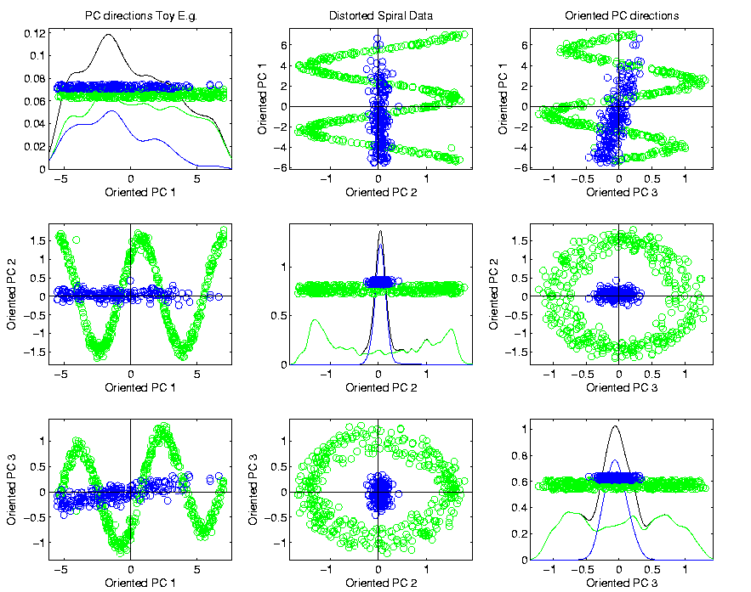
PCA & Graphical Displays
Toy Example (2 colored “clusters” in data)

Slide 62
PCA & Graphical Displays
Toy Example (1 point moved)

Slide 63
PCA & Graphical Displays
Toy Example (1 point moved)
Important
Point:
Constant
Axes

Slide 64
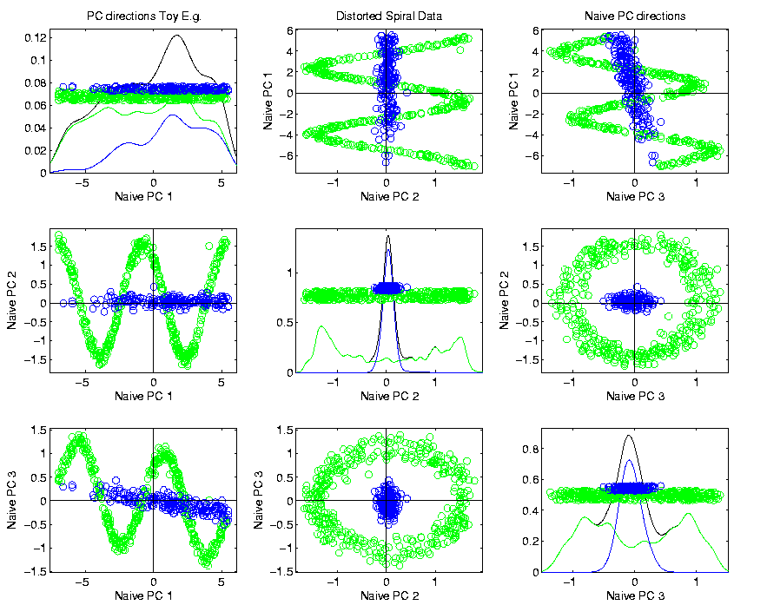
PCA & Graphical Displays
Original Data (arbitrary PC flip)

Slide 65
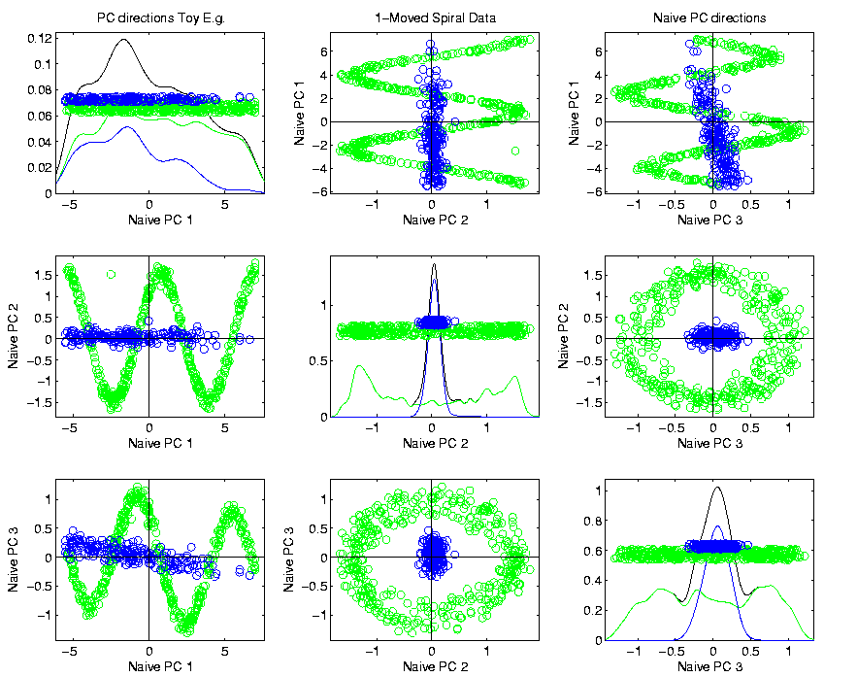
PCA & Graphical Displays
Point Moved Data (arbitrary PC flip)
Much
Harder
To See
Moving
Point

Slide 66
PCA & Graphical Displays
How to “fix directions”?
One Option:
Use ± 1 flip that gives:
$$\max_{i=1,⋯,n}{Proj\left(X_{i}\right)}>\left|\min_{i=1,⋯,n}{Proj\left(X_{i}\right)}\right|$$
(assumes 0 centered)

Slide 67
PCA & Graphical Displays
How to “fix directions”?
Personal Current Favorite:
Use ± 1 flip that makes the projection vector
$\underline{v}=\left(\begin{matrix}v_{1} \\ ⋮ \\ v_{d}\end{matrix}\right)$ “point most towards” $\left(\begin{matrix}1 \\ ⋮ \\ 1\end{matrix}\right)$
i.e. makes $\sum_{j=1}^{d}{v_{j}}>0$

Slide 68
Alternate PCA Computation
Issue: for HDLSS data (recall $d>n$)
$\hat{Σ}$ May be Quite Large, $d×d$
Thus Slow to Work with, and to Compute
What About a Shortcut?
Approach: Singular Value Decomposition
(of (centered, scaled) Data Matrix $\tilde{X}$)

Slide 69
Review of Linear Algebra (Cont.)
Recall SVD Full Representation:
=
Graphics Display Assumes $d>n$

Slide 70
Review of Linear Algebra (Cont.)
Recall SVD Reduced Representation:
=

Slide 71
Review of Linear Algebra (Cont.)
Recall SVD Compact Representation:
=
where $r=$rank($X$)

Slide 72
Alternate PCA Computation
Singular Value Decomposition, $\tilde{X}=USV^{t}$
Computational Advantage (for Rank $r$):
Use Compact Form, only need to find
$U_{d×r},$ $S_{r×r}$, ${V^{t}}_{r×n}$
e-vec’s s-val’s scores
Other Components not Useful
So can be much faster for $d≫n$

Slide 73
Alternate PCA Computation
Another Variation: Dual PCA
Recall Data Matrix Views:
$X={\left[\begin{matrix}X_{11} & ⋯ & X_{1n} \\ ⋮ & ⋱ & ⋮ \\ X_{d1} & ⋯ & X_{dn}\end{matrix}\right]}_{d×n}$
Recall: Matlab
& This Course
Columns as Data Objects

Slide 74
Alternate PCA Computation
Another Variation: Dual PCA
Recall Data Matrix Views:
$X={\left[\begin{matrix}X_{11} & ⋯ & X_{1n} \\ ⋮ & ⋱ & ⋮ \\ X_{d1} & ⋯ & X_{dn}\end{matrix}\right]}_{d×n}$
Columns as Data Objects
Rows as Data Objects
Recall: R & SAS

Slide 75
Alternate PCA Computation
Another Variation: Dual PCA
Recall Data Matrix Views:
$X={\left[\begin{matrix}X_{11} & ⋯ & X_{1n} \\ ⋮ & ⋱ & ⋮ \\ X_{d1} & ⋯ & X_{dn}\end{matrix}\right]}_{d×n}$
Idea: Keep Both in Mind
Columns as Data Objects
Rows as Data Objects

Slide 76
Alternate PCA Computation
Dual PCA Computation:
Same as above, but replace $X$ with $X^{t}$
So can almost replace $\hat{Σ}=\tilde{X}{\tilde{X}}^{t}$
with ${\hat{Σ}}_{D}={\tilde{X}}^{t}\tilde{X}$
Then use SVD, $\tilde{X}=USV^{t}$, to get:
$${\hat{Σ}}_{D}={\tilde{X}}^{t}\tilde{X}={\left(USV^{t}\right)}^{t}\left(USV^{t}\right)=$$
$$=VSU^{t}USV^{t}=VS^{2}V^{t}$$
Note: Same Eigenvalues

Slide 77
Alternate PCA Computation
Appears to be cool symmetry:
Primal ←→ Dual
Loadings ←→ Scores
←→
But, care is needed with the means
and $\sqrt{n−1}$ normalization …

Slide 78
Alternate PCA Computation
Terminology:
The Dual Covariance Matrix
$${\hat{Σ}}_{D}={\tilde{X}}^{t}\tilde{X}$$
Is Sometimes Called the
Gram Matrix

Slide 79
Functional Data Analysis
Recall from Early Class Meeting:
Spanish Mortality Data

Slide 80
Functional Data Analysis
Interesting Data Set:
Mortality Data
For Spanish Males (thus can relate to history)
Each curve is a single year
x coordinate is age
Note: Choice made of Data Object
(could also study age as curves,
x coordinate = time)

Slide 81
Functional Data Analysis
Important Issue:
What are the Data Objects?
Curves (years) : Mortality vs. Age
Curves (Ages) : Mortality vs. Year
Note: Rows vs. Columns of Data Matrix

Slide 82
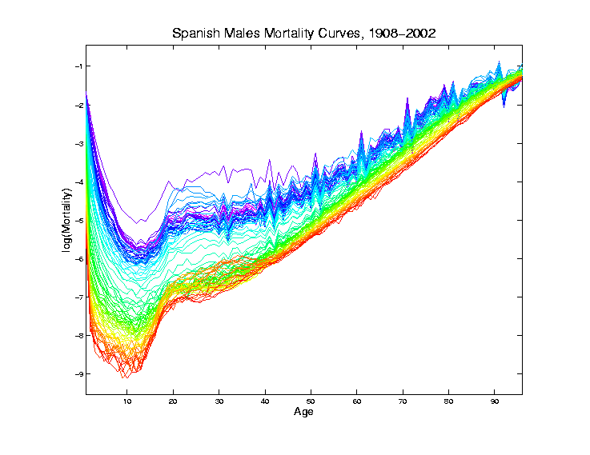
Mortality Time Series
Recall
Improved
Coloring:
Rainbow
Representing
Year:
Magenta
= 1908
Red = 2002

Slide 83
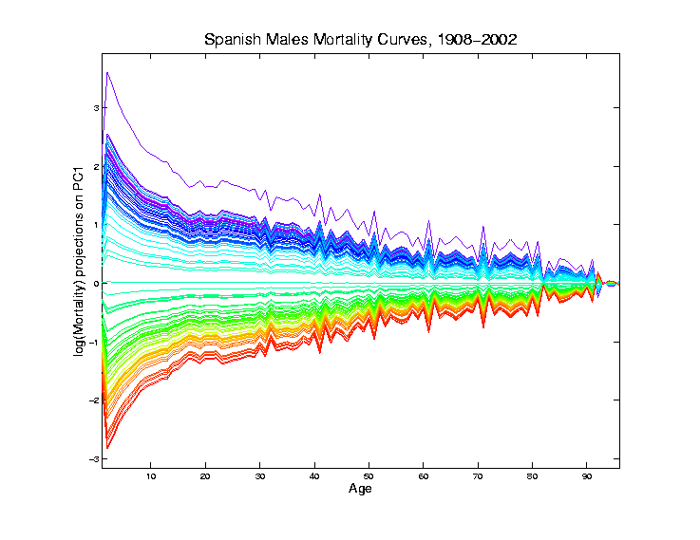
Mortality Time Series
Object Space View of Projections
Onto PC1
Direction
Main Mode
Of Variation:
Constant
Across Ages

Slide 84
Mortality Time Series
Shows Major
Improvement
Over Time
(medical technology,
etc.)
And Change
In Age
Rounding Blips

Slide 85
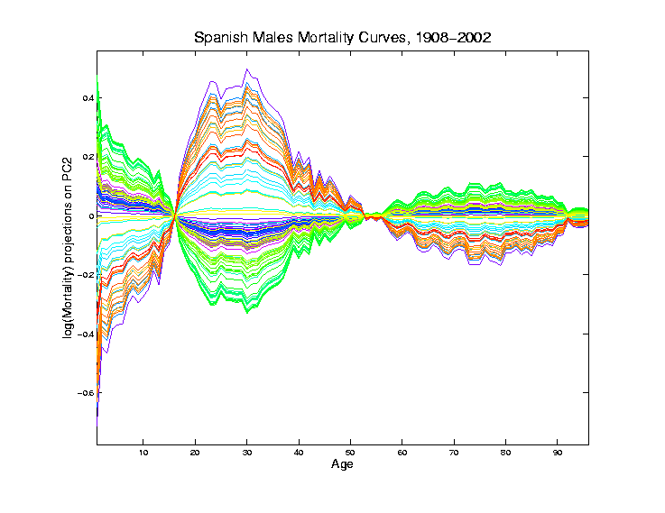
Mortality Time Series
Object Space View of Projections
Onto PC2
Direction
2nd Mode
Of Variation:
Difference
Between
20-45 & Rest

Slide 86
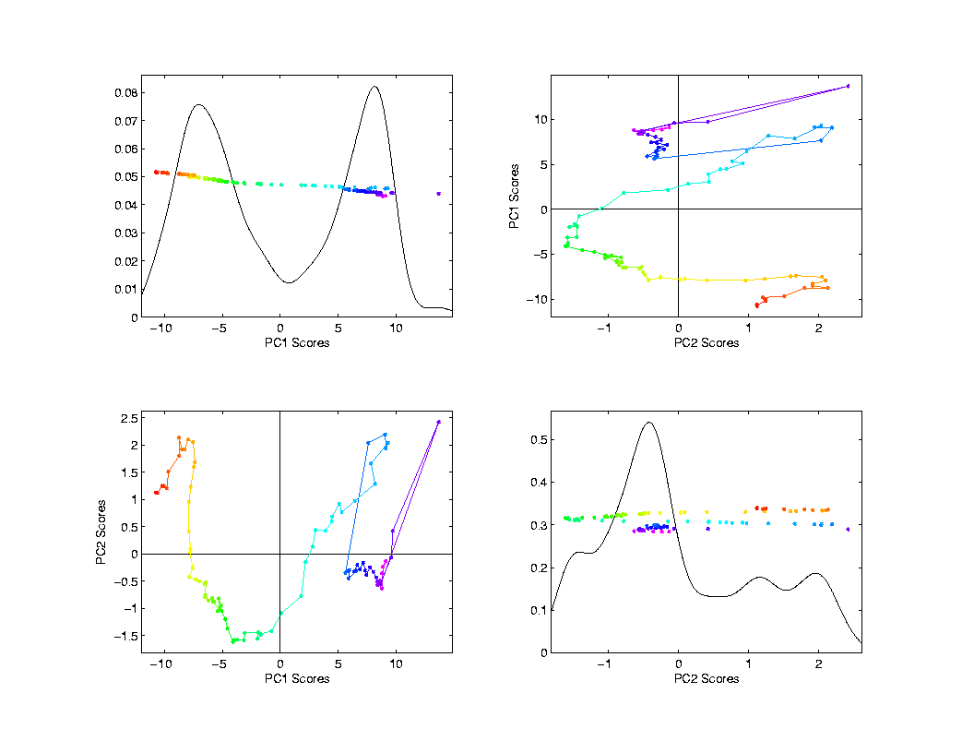
Mortality Time Series
Scores Plot
Feature
(Point Cloud)
Space View
Connecting
Lines
Highlight
Time Order
Good View of
Historical
Effects

Slide 87
Demography Data
Dual PCA
Idea: Rows and Columns trade places
Terminology: from optimization
Insights come from studying “primal” & “dual” problems
Machine Learning Terminology:
Gram Matrix PCA

Slide 88
Primal / Dual PCA
Consider
“Data Matrix”
Notes:
88

Slide 89
Primal / Dual PCA
Consider
“Data Matrix”
Primal Analysis:
Columns are data vectors
Notes:
89

Slide 90
Primal / Dual PCA
Consider
“Data Matrix”
Dual Analysis:
Rows are data vectors
Notes:
90

Slide 91
Demography Data
Recall Primal - Raw Data
Rainbow
Color Scheme
Allowed Good
Interpretation
Notes:
91

Slide 92
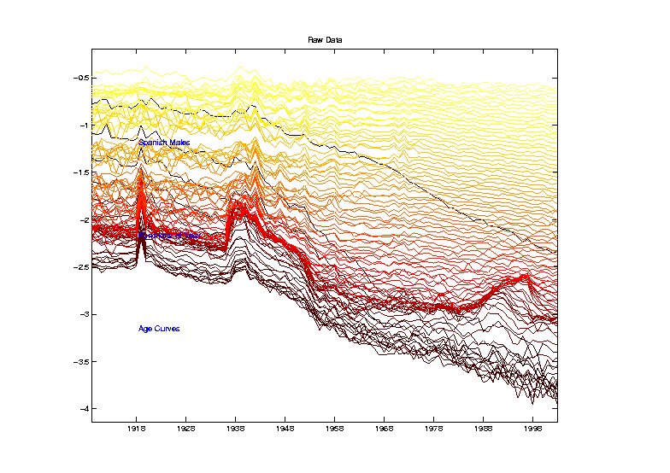
Demography Data
Dual PCA - Raw Data
Hot Metal
Color Scheme
To Help Keep
Primal & Dual
Separate
Notes:
92

Slide 93
Demography Data
Color Code
(Ages)
Notes:
93

Slide 94
Demography Data
Dual PCA - Raw Data
Note: Flu
Pandemic
Notes:
94

Slide 95
Demography Data
Dual PCA - Raw Data
Note: Flu
Pandemic
& Spanish
Civil War
Notes:
95

Slide 96
Demography Data
Dual PCA - Raw Data
Curves
Indexed
By Ages
1-95
Notes:
96

Slide 97
Demography Data
Dual PCA - Raw Data
1st Year of
Life Is
Dangerous
Notes:
97

Slide 98
Demography Data
Dual PCA - Raw Data
1st Year of
Life Is
Dangerous
Later
Childhood
Years Much
Improved
Notes:
98

Slide 99
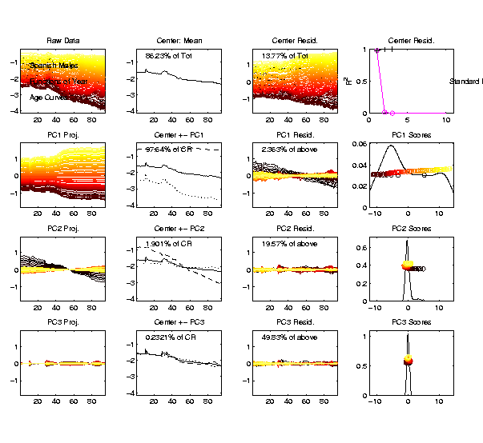
Demography Data
Dual PCA
Notes:
99

Slide 100
Demography Data
Dual PCA
Years
1908-2002
on
Horizontal
Axes
Notes:
100

Slide 101
Demography Data
Dual PCA
Note: Hard
To See /
Interpret
Smaller
Effects
(Lost in
Scaling)
Notes:
101

Slide 102
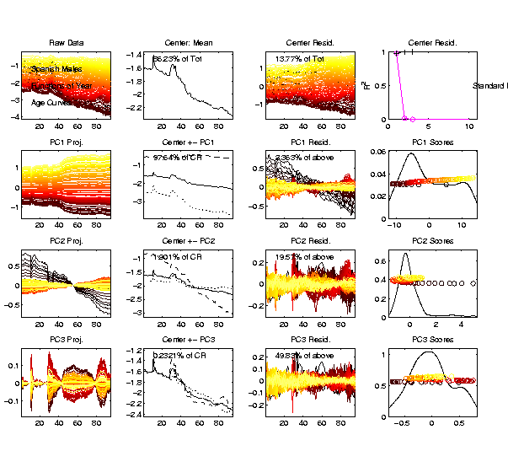
Demography Data
Dual PCA
Choose
Axis Limits
To Maximize
Visible
Variation
Notes:
102

Slide 103
Demography Data
Dual PCA
Mean Shows
Some History
Flu
Pandemic
Civil War
Notes:
103

Slide 104
Demography Data
Dual PCA
PC1 Shows
Mortality
Increases
With Age
Notes:
104

Slide 105
Demography Data
Dual PCA
PC2 Shows
Improvements
Strongest
For Young
Notes:
105

Slide 106
Demography Data
Dual PCA
This Shows
Improvements
For All
Notes:
106

Slide 107
Demography Data
Dual PCA
PC3 Shows
Automobile
Effects
Contrast of
20-45 & Rest
Notes:
107

Slide 108
Alternate PCA Computation
Appears to be cool symmetry:
Primal ←→ Dual
Loadings ←→ Scores
←→
But, care is needed with the means
and $\sqrt{n−1}$ normalization …

Slide 109
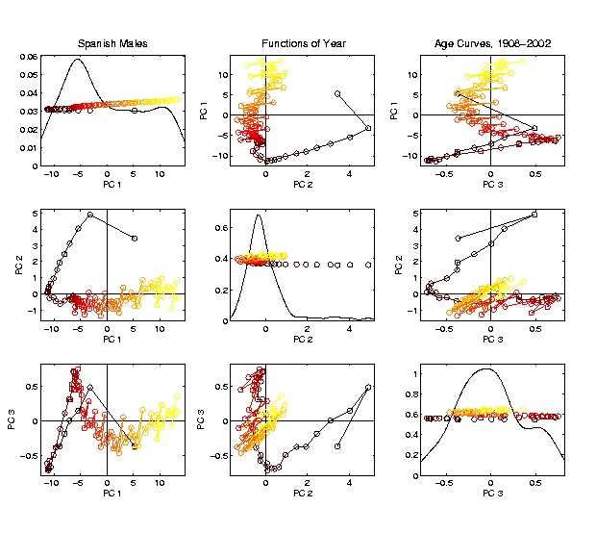
Demography Data
Dual PCA
Scores
Linear Connections
Highlight
Age Ordering
Notes:
109

Slide 110
Demography Data
Dual PCA
Scores
Note PC2
& PC1
Together
Show
Mortality
vs. Age
Notes:
110

Slide 111
Demography Data
Dual PCA
Scores
PC2
Captures
“Age
Rounding”
Notes:
111

Slide 112
Demography Data
Important Observation:
Effects in Primal Scores (Loadings)
$↕ ↕$
Appear in Dual Loadings (Scores)
(Would Be Exactly True, Except for Centering)
(Auto Effects in PC2 & PC3
Shows This is Serious)
Notes:
112

Slide 113
Primal / Dual PCA
Which is “Better”?
Same Info,
Displayed
Differently
Here: Prefer Primal,
As Indicated by Graphics Quality
Notes:
113

Slide 114
Primal / Dual PCA
Which is “Better”?
In General:
Either Can Be Best
Try Both and Choose
Or Use “Natural Choice” of
Data Object
Notes:
114

Slide 115
Primal / Dual PCA
Important Early Version:
BiPlot Display
Overlay Primal & Dual PCAs
Not Easy to Interpret
Gabriel, K. R. (1971)
Notes:
115

Slide 116
Cornea Data
Early Example: OODA Beyond FDA
Recall Interplay:
Object Space ←→ Descriptor Space

Slide 117
Cornea Data
Cornea: Outer surface of the eye
Driver of Vision: Curvature of Cornea
Data Objects: Images on the unit disk
Radial Curvature as “Heat Map”
Special Thanks to K. L. Cohen, N. Tripoli,
UNC Ophthalmology

Slide 118
Cornea Data
Cornea Data:
Raw Data
Decompose
Into
Modes of
Variation?

Slide 119
Cornea Data
Reference: Locantore, et al (1999)
Visualization (generally true for images):
More challenging than for curves
(since can’t overlay)
Instead view sequence of images
Harder to see “population structure”
(than for curves)
So PCA type decomposition of variation is more important

Slide 120
Cornea Data
Nature of images
(on the unit disk, not usual rectangle)
Color is “curvature”
Along radii of circle
(direction with most effect on vision)
Hotter (red, yellow) for “more curvature”
Cooler (blue, green) for “less curvature”
Descriptor vector is coefficients of Zernike expansion
Zernike basis: ~ Fourier basis, on disk
Conveniently represented in polar coord’s

Slide 121
Cornea Data
Data Representation - Zernike Basis
Pixels as features is large and wasteful
Natural to find more efficient represent’n
Polar Coordinate Tensor Product of:
Fourier basis (angular)
Special Jacobi (radial, to avoid singularities)
See:
Schwiegerling, Greivenkamp & Miller (1995)
Born & Wolf (1980)

Slide 122
Cornea Data
Data Representation - Zernike Basis
Choice of Basis Dimension:
Based on Collaborator’s Expertise
Large Enough for Important Features
Not Too Large to Eliminate Noise

Slide 123
Cornea Data
Data Representation - Zernike Basis
Descriptor Space is Vector Space of Zernike Coefficients
So Perform PCA There
Then Visualize in Image (Object) Space

Slide 124
PCA of Cornea Data
Recall: PCA can find (often insightful)
direction of greatest variability
Main problem: display of result (no overlays for images)
Solution: show movie of “marching along the direction vector”

Slide 125
PCA of Cornea Data
PC1 Movie:

Slide 126
PCA of Cornea Data
PC1 Summary:
Mean (1st image): mild vert’l astigmatism
known pop’n structure called “with the rule”
Main dir’n: “more curved” & “less curved”
Corresponds to first optometric measure
(89% of variat’n, in Mean Resid. SS sense)
Also: “stronger astig’m” & “no astig’m”
Found corr’n between astig’m and curv’re
Scores (cyan): Apparent Gaussian dist’n

Slide 127
PCA of Cornea Data
PC2 Movie:

Slide 128
PCA of Cornea Data
PC2 Movie:
Mean: same as above
Common centerpoint of point cloud
Are studying “directions from mean”
Images along direction vector:
Looks terrible???
Why?

Slide 129
PCA of Cornea Data
PC2 Movie:
Reason made clear in Scores Plot (cyan):
Single outlying data object drives PC dir’n
A known problem with PCA
Recall finds direction with “max variation”
In sense of variance
Easily dominated by single large observat’n

Slide 130
PCA of Cornea Data
Toy Example: Single Outlier Driving PCA

Slide 131
PCA of Cornea Data
PC2 Affected by Outlier:
How bad is this problem?
View 1: Statistician: Arrggghh!!!!
Outliers are very dangerous
Can give arbitrary and meaningless dir’ns

Slide 132
PCA of Cornea Data
PC2 Affected by Outlier:
How bad is this problem?
View 2: Ophthalmologist: No Problem
Driven by “edge effects” (see raw data)
Artifact of “light reflection” data gathering
(“eyelid blocking”, and drying effects)
Routinely “visually ignore” those anyway
Found interesting (& well known) dir’n:
steeper superior vs steeper inferior

Slide 133
Cornea Data
Cornea Data:
Raw Data
Which one
is the outlier?
Will say more
later …

Slide 134
PCA of Cornea Data
PC3 Movie

Slide 135
PCA of Cornea Data
PC3 Movie (ophthalmologist’s view):
Edge Effect Outlier is present
But focusing on “central region” shows changing dir’n of astig’m (3% of MR SS)
“with the rule” (vertical) vs. “against the rule” (horizontal)
most astigmatism is “with the rule”
most of rest is “against the rule”
(known folklore)

Slide 136
PCA of Cornea Data
PC4 movie

Slide 137
PCA of Cornea Data
Continue with ophthalmologists view…
PC4 movie version:
Other direction of astigmatism???
Location (i.e. “registration”) effect???
Harder to interpret …
OK, since only 1.7% of MR SS
Substantially less than for PC2 & PC3

Slide 138
PCA of Cornea Data
Ophthalmologists View (cont.)
Overall Impressions / Conclusions:
Useful decomposition of population variation
Useful insight into population structure

Slide 139
PCA of Cornea Data
Now return to Statistician’s View:
How can we handle these outliers?
Even though not fatal here, can be for other examples…
Simple Toy
Example
(in 2d):

Slide 140
Outliers in PCA
Deeper Toy Example:

Slide 141
Outliers in PCA
Deeper Toy Example:
Why is green curve an outlier?
Never leaves range of other data
But Euclidean distance to others very large
relative to other distances
Also major difference in terms of shape
And even smoothness
Important lesson:
$∃$ many directions in $ℝ^{d}$

Slide 142
Outliers in PCA
Much like
earlier
Parabolas
Example
But with
1 “outlier”
thrown in

Slide 143
Outliers in PCA
PCA for
Deeper
Toy E.g.
Data:

Slide 144
Outliers in PCA
Deeper Toy Example:
At first glance, mean and PC1 look similar to no outlier version
PC2 clearly driven completely by outlier
PC2 scores plot (on right) gives clear outlier diagnostic
Outlier does not appear in other directions
Previous PC2, now appears as PC3
Total Power (upper right plot) now “spread farther”

Slide 145
Outliers in PCA
Closer Look at Deeper Toy Example:
Mean “influenced” a little, by the outlier
Appearance of “corners” at every other coordinate
PC1 substantially “influenced” by the outlier
Clear “wiggles”

Slide 146
Outliers in PCA
What can (should?) be done about outliers?
Context 1: Outliers are important aspects of the population
They need to be highlighted in the analysis
Although could separate into subpopulations
Context 2: Outliers are “bad data”, of no interest
recording errors? Other mistakes?
Then should avoid distorted view of PCA

Slide 147
Outliers in PCA
Two Differing Goals for Outliers:
Avoid Major Influence on Analysis
Find Interesting Data Points
(e.g. In-liers)
Wilkinson (2017)

Slide 148
Outliers in PCA
Standard Statistical Approaches to Dealing with Influential Outliers:
Outlier Deletion:
Kick out “bad data”
Robust Statistical methods:
Work with full data set,
but downweight “bad data”
Reduce influence, instead of “deleting”
(Think Median)

Slide 149
Outliers in PCA
Example Cornea Data:
Can find PC2 outlier (by looking through data (careful!))
Problem: after removal, another point dominates PC2
Could delete that, but then another appears
After 4th step have eliminated 10% of data ($n=43$)

Slide 150
Outliers in PCA
Example
Cornea
Data

Slide 151
Outliers in PCA
Motivates alternate approach:
Robust Statistical Methods
Recall main idea:
Downweight (instead of delete) outliers
$∃$ a large literature. Good intro’s
(from different viewpoints) are:
Huber (2011)
Hampel, et al (2011)
Staudte & Sheather (2011)

Slide 152
Outliers in PCA
Simple robustness concept: breakdown point
how much of data “moved to ”
will “destroy estimate”?
Usual mean has breakdown 0
Median has breakdown ½ (best possible)
Conclude:
Median much more robust than mean
Median uses all data
Median gets good breakdown from
“equal vote”

Slide 153
Outliers in PCA
Mean has
breakdown 0
Single
Outlier
Pulls Mean
Outside
range
of data

Slide 154
Outliers in PCA
Controversy:
Is median’s “equal vote” scheme good or bad?
Huber:
Outliers contain some information,
So should only control “influence”
(e.g. median)
Hampel, et. al.:
Outliers contain no useful information
Should be assigned weight 0
(not done by median)
Using “proper robust method”
(not simply deleted)

Slide 155
Outliers in PCA
Robustness Controversy (cont.):
Both are “right” (depending on context)
Source of major (unfortunately bitter) debate!
Application to Cornea data:
Huber’s model more sensible
Already know $∃$ some useful info in each data point
Thus “median type” methods are sensible

Slide 156
Robust PCA
What is multivariate median?
There are several!
(“median” generalizes in different ways)
Coordinate-wise median
Often worst
Not rotation invariant
(2-d data uniform on “L”)
Can lie on convex hull of data
(same example)
Thus poor notion of “center”

Slide 157
Robust PCA
Coordinate-wise median
Not rotation invariant
Thus poor notion of “center”

Slide 158
Robust PCA
Coordinate-wise median
Can lie on convex hull of data
Thus poor notion of “center”

Slide 159
Robust PCA
What is multivariate median (cont.)?
ii. Simplicial depth (a. k. a. “data depth”):
Liu (1990)
“Paint Thickness” of $d+1$ dim “simplices” with corners at data
Nice idea
Good invariance properties
Slow to compute

Slide 160
Robust PCA
What is multivariate median (cont.)?
iii. Huber’s $L^{p}$ M-estimate:
Given data $X_{1},⋯,X_{n}∈ℝ^{d}$,
Estimate “center of population” by
$$\hat{θ}={argmin}_{θ}\sum_{i=1}^{n}{{\left\|X_{i}−θ\right\|}_{2}^{p}}$$
Where ${\left\|∙\right\|}_{2}$ is the usual Euclidean norm
Here: use only $p=1$
(minimal impact by outliers)

Slide 161
Robust PCA
Huber’s $L^{p}$ M-estimate (cont):
Estimate “center of population” by
$$\hat{θ}={argmin}_{θ}\sum_{i=1}^{n}{{\left\|X_{i}−θ\right\|}_{2}^{p}}$$
Case $p=2$:
Can show $\hat{θ}=\overline{X}$ (sample mean)
(also called “Fréchet Mean”, …)
Again Here: use only $p=1$
(minimal impact by outliers)

Slide 162
Robust PCA
$L^{1}$ M-estimate (cont.):
A view of minimizer: solution of
$$0=\frac{∂}{∂θ}\sum_{i=1}^{n}{{\left\|X_{i}−θ\right\|}_{2}}=\sum_{i=1}^{n}{\frac{X_{i}−θ}{{\left\|X_{i}−θ\right\|}_{2}}}$$
A useful viewpoint is based on:
$P_{Sph(θ,1)}$ = “Proj’n of data onto sphere
centered at $θ$ with radius $1$”
And representation: $P_{Sph(θ,1)}X_{i}=θ+\frac{X_{i}−θ}{{\left\|X_{i}−θ\right\|}_{2}}$

Slide 163
Robust PCA
$L^{1}$ M-estimate (cont.):
Thus the solution of
$$0=\sum_{i=1}^{n}{\frac{X_{i}−θ}{{\left\|X_{i}−θ\right\|}_{2}}}=\sum_{i=1}^{n}{\left(P_{Sph(θ,1)}X_{i}−θ\right)}$$
is the solution of:
$$0=avg\left\{P_{Sph(θ,1)}X_{i}−θ:i=1,⋯,n\right\}$$
So $\hat{θ}$ is location where projected data are centered
“Slide sphere around until mean (of projected data) is at center”

Slide 164
Robust PCA
$L^{1}$ M-estimate (cont.):
Data are
+ signs

Slide 165
Robust PCA
M-estimate (cont.):
Data are
+ signs
Sample Mean, $\overline{X}$
outside “hot dog”
of data

Slide 166
Robust PCA
M-estimate (cont.):
Candidate
Sphere Center, $θ$

Slide 167
Robust PCA
M-estimate (cont.):
Candidate
Sphere Center, $θ$
Projections
Of Data

Slide 168
Robust PCA
M-estimate (cont.):
Candidate
Sphere Center, $θ$
Projections
Of Data
Mean of
Projections

Slide 169
Robust PCA
M-estimate (cont.):
“Slide sphere
around until
mean (of
projected data)
is at center”

Slide 170
Robust PCA
M-estimate (cont.):
Additional literature:
Called “geometric median” (long before Huber) by: Haldane (1948)
Shown unique for $d>1$ by: Milasevic and Ducharme (1987)
Useful iterative algorithm: Gower (1974)
(see also Sec. 3.2 of Huber (2011)).
Cornea Data experience:
works well for $d=66$

Slide 171
Robust PCA
M-estimate for Cornea Data:
Sample Mean M-estimate
Definite improvement
But outliers still have some influence
Improvement? (will suggest one soon)

Slide 172
Robust PCA
Now have robust measure of “center”,
how about
“spread”?
I.e. how
can we
do robust
PCA?

Slide 173
Robust PCA
Now have robust measure of “center”,
how about
“spread”?
Parabs e.g.
from above
With an
“outlier” (???)
Added in

Slide 174
Robust PCA
Now have robust measure of “center”,
how about
“spread”?
Small Impact on Mean

Slide 175
Robust PCA
Now have robust measure of “center”,
how about
“spread”?
Small Impact on Mean
More on PC1 Dir’n

Slide 176
Robust PCA
Now have robust measure of “center”,
how about
“spread”?
Small Impact on Mean
More on PC1 Dir’n
Dominates Residuals
Thus PC2 Dir’n
& PC2 scores

Slide 177
Robust PCA
Now have robust measure of “center”,
how about
“spread”?
Small Impact on Mean
More on PC1 Dir’n
Dominates Residuals
Thus PC2 Dir’n
& PC2 scores
Tilt now in PC3
Viualization is very
Useful diagnostic

Slide 178
Robust PCA
Now have robust measure of “center”,
how about
“spread”?
How
can we
do robust
PCA?

