Slide 1
Participant Presentations
Please Sign Up:
Name
Email (Onyen is fine, or …)
Are You ENRolled?
Tentative Title (???? Is OK)
When:
Next Week, Early, Oct., Nov., Late

Slide 2
Transformations
Useful Method for Data Analysts
Apply to Marginal Distributions
(i.e. to Individual Variables)
Idea: Put Data on Right Scale
Common Example:
Data Orders of Magnitude Different
Log₁₀ Puts Data on More Analyzable Scale

Slide 3
Transformations
Famous Family:
Box – Cox Transformations
Box & Cox (1964)
Given a parameter $λ∈ℝ$,
$$x ↦ \frac{x^{λ}−1}{λ}$$

Slide 4
Transformations
Another useful family:
Shifted Log Transformations
Given a parameter $δ∈ℝ$,
$$x ↦ \log\left(x+δ\right)$$
(Will use more below)

Slide 5
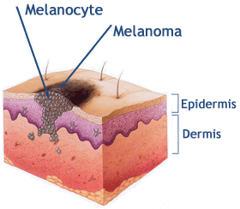
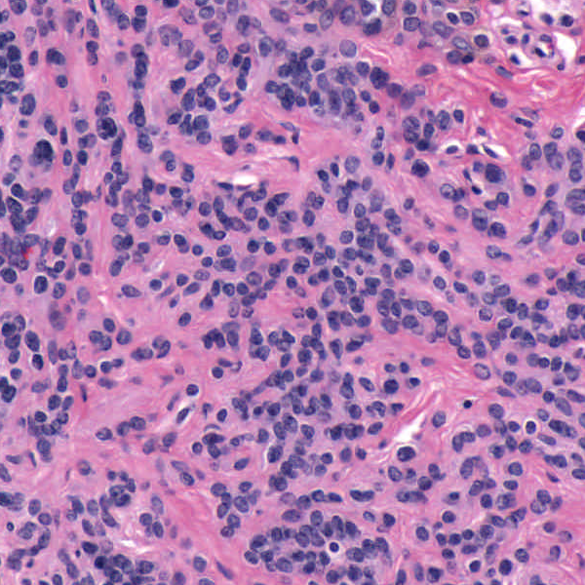
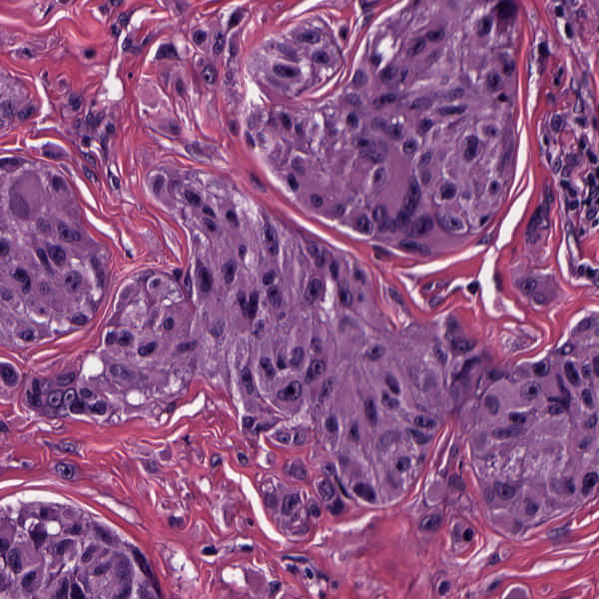
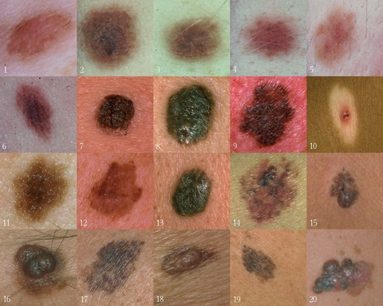
Background
Goal
Image Analysis of Histology Slides
Image: www.melanoma.ca
Benign
Melanoma
1 in 75 North Americans will develop a
malignant melanoma in their lifetime.
Initial goal: Automatically segment nuclei.
Challenge: Dense packing of nuclei.
Ultimately: Cancer grading and patient survival.
Image: melanoma.blogsome.com

Slide 6
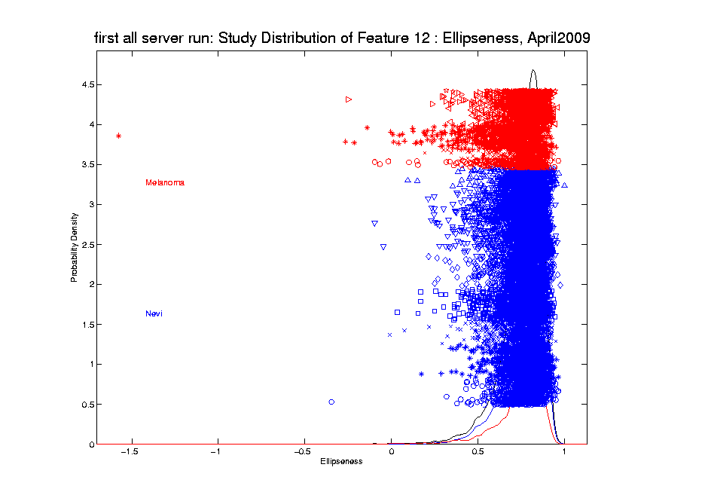
Transformations
Different Direction (Negative) of Skewness

Slide 7
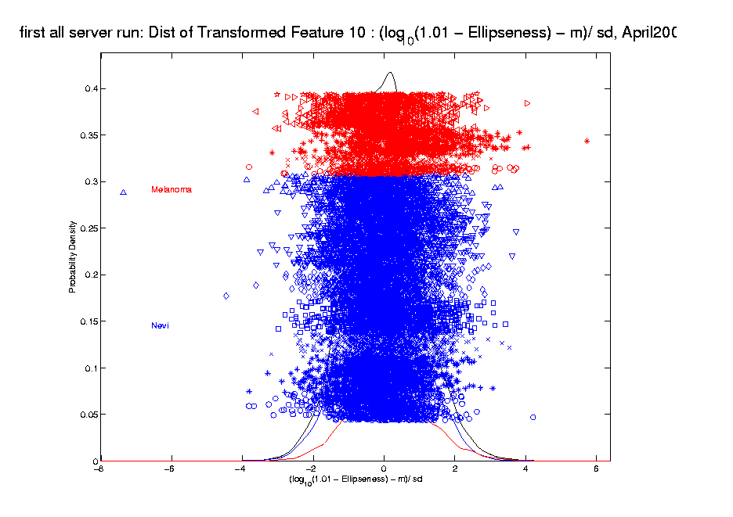
Transformations
Use Log Difference Transformation

Slide 8
Automatic Transformations
Approach: Shifted log transform
Challenges Addressed:
Tune the shift parameter for each variable
$\log\left(∙+δ\right)$: Independent of data magnitude
Handle both positive and negative skewness
Address influential data points
Notes:
For a high dimensional data set, automation is important!
The parameterizations of the shift parameter strongly depend on knowledge of the data e.g. data range, data distribution, so user intervention is usually required. However, modern high-output data sets usually have a very large number of variables, i.e. features, so there is a strong need to automate the selection of shift parameter
What is the challenge here?
First challenge comes from tuning the shift parameter value
variables may range from different magnitude
It depends on the data magnitude (to make valid log function)
You have different optimal shift parameter value for different variables given a target
How to handle positive and negative skewness at same time
2. Address outliers which are also quite different from variable to variable

Slide 9
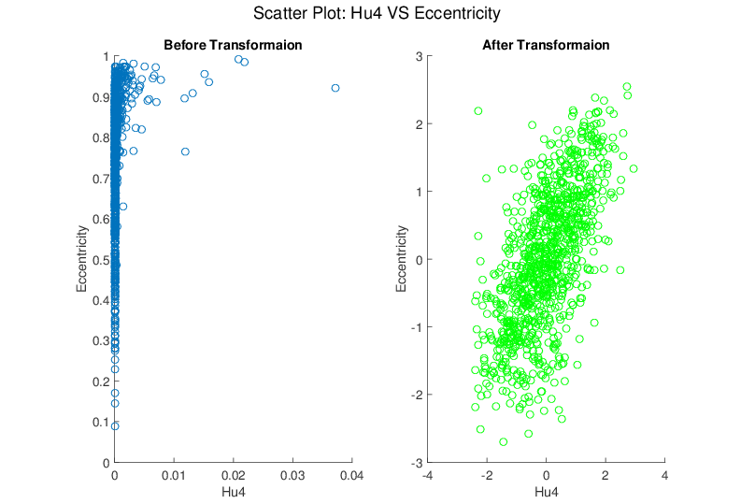
Melanoma Data
Much Nicer Distributions
Notes:
Besides, although the transformation targets at marginal dist
We see improvement of bivariate normality in many real data sets for example here.

Slide 10
Yeast Cell Cycle Data
Another Example Showing
Interesting Directions Beyond PCA
Exploratory Data Analysis

Slide 11
Yeast Cell Cycle Data, FDA View
Periodic
genes?
Naïve
approach:
Simple PCA

Slide 12
Yeast Cell Cycles, Freq. 2 Proj.
PCA on
Freq. 2
Periodic
Component
Of Data
Choice of Data Object

Slide 13
Frequency 2 Analysis
Colors are

Slide 14
Detailed Look at PCA
Three Important (& Interesting) Viewpoints:
Mathematics
Numerics
Statistics
Goal: Study Interrelationships

Slide 15
Course Background I
Linear Algebra
Please Check Familiarity
No? Read Up in Linear Algebra Text
Or Wikipedia?

Slide 16
Course Background I
Linear Algebra Key Concepts
Vector
Scalar
Vector Space (Subspace)
Basis
Dimension
Unit Vector Basis in $ℝ^{d}$
Linear Combo as Matrix Multiplication
$$\left\{\left(\begin{matrix}\begin{matrix}1 \\ 0\end{matrix} \\ \begin{matrix}⋮ \\ 0\end{matrix}\end{matrix}\right),⋯,\left(\begin{matrix}\begin{matrix}0 \\ ⋮\end{matrix} \\ \begin{matrix}0 \\ 1\end{matrix}\end{matrix}\right)\right\}$$

Slide 17
Course Background I
Linear Algebra Key Concepts
Matrix Trace
Vector Norm = Length
Distance in $ℝ^{d}$ = Euclidean Metric
Inner (Dot, Scalar) Product
Vector Angles
Orthogonality (Perpendicularity)
Orthonormal Basis

Slide 18
Course Background I
Linear Algebra Key Concepts
Spectral Representation
Pythagorean Theorem
ANOVA Decomposition (Sums of Squares)
Parseval Identity / Inequality
Projection (Vector onto a Subspace)
Projection Operator / Matrix
(Real) Unitary Matrices

Slide 19
Course Background I
Linear Algebra Key Concepts
Now look more carefully at:
Singular Value Decomposition
Eigenanalysis
Generalized Inverse

Slide 20
Review of Linear Algebra
Singular Value Decomposition (SVD):
For a Matrix $X_{d×n}$
Find a Diagonal Matrix $S_{d×n}$,
with Entries $s_{1},⋯,s_{min\left(d,n\right)},0,⋯,0$
called Singular Values
And Unitary (Isometry) Matrices $U_{d×d}$, $V_{n×n}$
(recall $U^{t}U=I$, $V^{t}V=I$)
So That $X=USV^{t}$

Slide 21
Review of Linear Algebra (Cont.)
SVD Full Representation:
=
Graphics Display Assumes

Slide 22
Review of Linear Algebra (Cont.)
SVD Full Representation:
=
Full Rank Basis Matrix
(Orthonormal)

Slide 23
Review of Linear Algebra (Cont.)
SVD Full Representation:
=
Intuition: For $X$ as Linear Operator:
Represent as:
Isometry (~Rotation)
Coordinate Rescaling
Isometry (~Rotation)

Slide 24
Review of Linear Algebra (Cont.)
SVD Full Representation:
=
Full Rank Basis Matrix
All 0s off diagonal (& in bottom)

Slide 25
Review of Linear Algebra (Cont.)
SVD Reduced Representation:
=
These Columns Get 0ed Out

Slide 26
Review of Linear Algebra (Cont.)
SVD Reduced Representation:
=

Slide 27
Review of Linear Algebra (Cont.)
SVD Reduced Representation:
=
Also, Some of These $s_{j}$ May be 0

Slide 28
Review of Linear Algebra (Cont.)
SVD Compact Representation:
=

Slide 29
Review of Linear Algebra (Cont.)
SVD Compact Representation:
=
These Get 0ed Out

Slide 30
Review of Linear Algebra (Cont.)
SVD Compact Representation:
=
Note $r$ is the rank of $X$

Slide 31
Review of Linear Algebra (Cont.)
SVD Compact Representation:
=
For Reduced Rank Approximation Can Further Reduce
Key to Dimension Reduction

Slide 32
Review of Linear Algebra (Cont.)
Eigenvalue Decomposition:
For a (Symmetric) Square Matrix $X_{d×d}$
Find a Diagonal Matrix $D=\left(\begin{matrix}λ_{1} & ⋯ & 0 \\ ⋮ & ⋱ & ⋮ \\ 0 & ⋯ & λ_{d}\end{matrix}\right)$
And an Orthonormal (Unitary) Matrix $B_{d×d}$
(i.e. $B^{t}∙B=B∙B^{t}=I_{d×d}$)
So that: $X∙B=B∙D$, i.e. $X=B∙D∙B^{t}$

Slide 33
Review of Linear Algebra (Cont.)
Eigenvalue Decomposition (cont.):
Relation to Singular Value Decomposition
(looks similar?):
Eigenvalue Decomposition “Looks Harder”
Since Needs $B=U=V$
Price is Eigenvalue Decomp’n is Generally Complex (uses $i=\sqrt{−1}$)
Except for $X$ Square and Symmetric
Then Eigenvalue Decomp. is Real Valued
Thus is the Sing’r Value Decomp. with:
$U=V=B$

Slide 34
Review of Linear Algebra (Cont.)
Better View of Relationship:
Singular Value Dec. $⟺$ Eigenvalue Dec.
(better than on previous page)

Slide 35
Review of Linear Algebra (Cont.)
Better View of Relationship:
Singular Value Dec. $⟺$ Eigenvalue Dec.
Start with $d×n$ data matrix: $X$
Note SVD: $X=U∙S∙V^{t}$
Create square, symmetric matrix: $X∙X^{t}$
Terminology: “Outer Product”
In Contrast to: “Inner Product” $x^{t}∙x$

Slide 36
Review of Linear Algebra (Cont.)
Better View of Relationship:
Singular Value Dec. $⟺$ Eigenvalue Dec.
Start with $d×n$ data matrix: $X$
Note SVD: $X=U∙S∙V^{t}$
Create square, symmetric matrix: $X∙X^{t}$
Note that: $XX^{t}=\left(USV^{t}\right)\left(VSU^{t}\right)=US^{2}U^{t}$
Gives Eigenanalysis, $B=U$ & $D=S^{2}$

Slide 37
Review of Linear Algebra (Cont.)
Computation of Singular Value and Eigenvalue Decompositions:
Details too complex to spend time here
A primitive of good software packages
Set of Eigenvalues $\left\{λ_{1},⋯,λ_{d}\right\}$ is Unique
(Often Ordered as $λ_{1}≥λ_{2}≥⋯≥λ_{d}$)

Slide 38
Review of Linear Algebra (Cont.)
Direction
Vectors
In PCA
Computation of Singular Value and Eigenvalue Decompositions:
Details too complex to spend time here
A primitive of good software packages
Set of Eigenvalues $\left\{λ_{1},⋯,λ_{d}\right\}$ is Unique
Col’s of $B=\left(\underline{v_{1}},⋯,\underline{v_{d}}\right)$ are “Eigenvectors”
Eigenvectors are “$λ$-Stretched” by $X$ as a
Linear Transform: $X∙\underline{v_{i}}=λ_{i}∙\underline{v_{i}}$
Sums of Squares
Of Projection Coeffs

Slide 39
Review of Linear Algebra (Cont.)
Eigenvalue Decomp. Solves Matrix Problems:
Inversion: $X^{−1}=B∙\left(\begin{matrix}{λ_{1}}^{−1} & ⋯ & 0 \\ ⋮ & ⋱ & ⋮ \\ 0 & ⋯ & {λ_{d}}^{−1}\end{matrix}\right)∙B^{t}$

Slide 40
Review of Linear Algebra (Cont.)
Eigenvalue Decomp. Solves Matrix Problems:
Sq. Root: $X^{\frac{1}{2}}=B∙\left(\begin{matrix}{λ_{1}}^{\frac{1}{2}} & ⋯ & 0 \\ ⋮ & ⋱ & ⋮ \\ 0 & ⋯ & {λ_{d}}^{\frac{1}{2}}\end{matrix}\right)∙B^{t}$
$$⟺$$

Slide 41
Review of Linear Algebra (Cont.)
Eigenvalue Decomp. Solves Matrix Problems:
$X$ is Positive (Nonn’ve, i.e. Semi) Definite $⟺$
$⟺$ all $λ_{i}>\left(≥\right) 0$
$$⟺$$

Slide 42
Recall Linear Algebra (Cont.)
Moore-Penrose Generalized Inverse:
For

Slide 43
Recall Linear Algebra (Cont.)
Easy to see this satisfies the definition of
Generalized (Pseudo) Inverse
symmetric
symmetric

Slide 44
Recall Linear Algebra (Cont.)
Moore-Penrose Generalized Inverse:
Idea: Matrix Inverse on Non-Null Space
of the Corresponding Linear Transformation
Reduces to Ordinary Inverse, in Full Rank case,
i.e. for $r=d$, so could just Always Use This
Tricky aspect:
“$>0$ vs. $=0$” & Floating Point Arithmetic

Slide 45
Recall Linear Algebra (Cont.)
Moore-Penrose Generalized Inverse:
Folklore: most multivariate formulas involving matrix inversion “still work” when Generalized Inverse is used instead
E.g. Least Squares Projection Formula:
$$X{\left(X^{t}X\right)}^{−1}X^{t}$$

Slide 46
Course Background II
MultiVariate Probability
Again Please Check Familiarity
No? Read Up in Probability Text
Or Wikipedia?

Slide 47
Course Background II
MultiVariate Probability
Data Matrix (Course Convention)
$$X=\left(\begin{matrix}X_{11} & ⋯ & X_{1n} \\ ⋮ & ⋱ & ⋮ \\ X_{d1} & ⋯ & X_{dn}\end{matrix}\right)$$
Columns as Data Objects (e.g. Matlab)
Not Rows (e.g. SAS, R)

Slide 48
Review of Multivariate Probability
Given a Random Vector,

Slide 49
Review of Multivariate Probability
Given a Random Vector,
A Center of the Distribution is the Mean Vector,

Slide 50
Review of Multivariate Probability
Given a Random Vector,
A Center of the Distribution is the Mean Vector,
Note: Component-Wise Calc’n (Euclidean)

Slide 51
Review of Multivariate Probability
Given a Random Vector,
A Measure of Spread is the Covariance Matrix:

Slide 52
Review of Multivar. Prob. (Cont.)
Covariance Matrix:
Noneg’ve Definite (Since all varia’s are ≥ 0)
(i.e. var of any linear combo)

Slide 53
Review of Multivar. Prob. (Cont.)
Covariance Matrix:
Noneg’ve Definite (Since all varia’s are ≥ 0)
Provides “Elliptical Summary of Distribution”
(e.g. Contours of Gaussian Density)

Slide 54
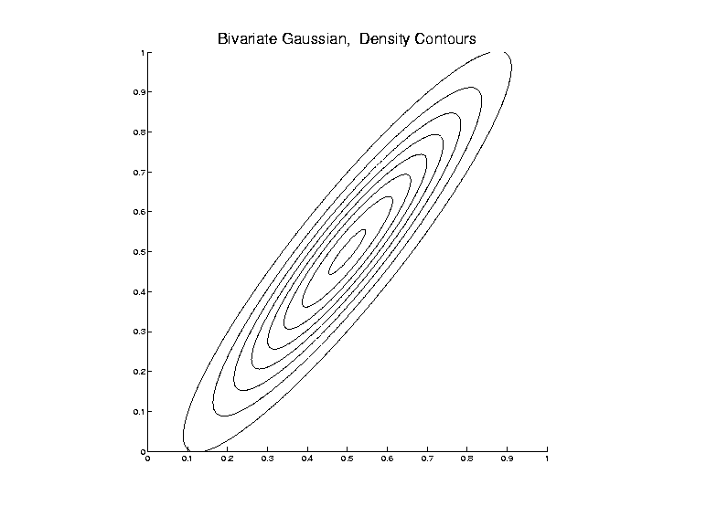
Review of Multivar. Prob. (Cont.)
Covariance Matrix:
Noneg’ve Definite (Since all varia’s are ≥ 0)
Provides “Elliptical Summary of Distribution”
(e.g. Contours of Gaussian Density)

Slide 55
Review of Multivar. Prob. (Cont.)
Covariance Matrix:
Noneg’ve Definite (Since all varia’s are ≥ 0)
Provides “Elliptical Summary of Distribution”
Calculated via “Outer Product”:

Slide 56
Review of Multivar. Prob. (Cont.)
Aside on Terminology,
Inner Product:
${\underline{x}}^{t}\underline{y}$

Slide 57
Review of Multivar. Prob. (Cont.)
Aside on Terminology,
Inner Product:
${\underline{x}}^{t}\underline{y}$
=
(scalar)

Slide 58
Review of Multivar. Prob. (Cont.)
Aside on Terminology,
Inner Product: Outer Product:
${\underline{x}}^{t}\underline{y}$ $\underline{x}{\underline{y}}^{t}$
=
(scalar)

Slide 59
Review of Multivar. Prob. (Cont.)
Aside on Terminology,
Inner Product: Outer Product:
${\underline{x}}^{t}\underline{y}$ $\underline{x}{\underline{y}}^{t}$
= =
(scalar) (matrix)

Slide 60
Review of Multivar. Prob. (Cont.)
Empirical Versions:
Given a Random Sample

Slide 61
Review of Multivar. Prob. (Cont.)
Empirical Versions:
Given a Random Sample ,
Estimate the Theoretical Mean

Slide 62
Review of Multivar. Prob. (Cont.)
Empirical Versions:
Given a Random Sample ,
Estimate the Theoretical Mean ,
with the Sample Mean:

Slide 63
Review of Multivar. Prob. (Cont.)
Empirical Versions:
Given a Random Sample ,
Estimate the Theoretical Mean ,
with the Sample Mean:
Notation: “hat” for estimate

Slide 64
Review of Multivar. Prob. (Cont.)
Empirical Versions (cont.)
And Estimate the “Theoretical Cov.”

Slide 65
Review of Multivar. Prob. (Cont.)
Empirical Versions (cont.)
And Estimate the “Theoretical Cov.” ,
with the “Sample Cov.”:

Slide 66
Review of Multivar. Prob. (Cont.)
Empirical Versions (cont.)
And Estimate the “Theoretical Cov.” ,
with the “Sample Cov.”:
Normalizations:
Gives Unbiasedness
Gives MLE in Gaussian Case

Slide 67
Review of Multivar. Prob. (Cont.)
Outer Product Representation:

Slide 68
Review of Multivar. Prob. (Cont.)
Outer Product Representation:

Slide 69
Review of Multivar. Prob. (Cont.)
Outer Product Representation:
,
Where:

Slide 70
Review of Multivar. Prob. (Cont.)
Outer Product Representation:
$\tilde{X}{\tilde{X}}^{t}=$ $=$
$d$
$n$

Slide 71
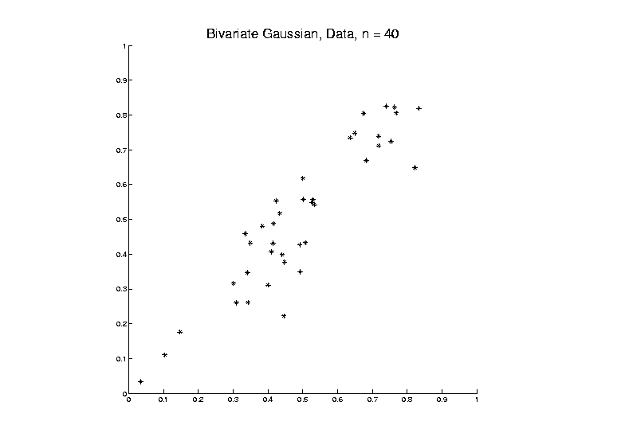
PCA as an Optimization Problem
Find Direction of Greatest Variability:

Slide 72
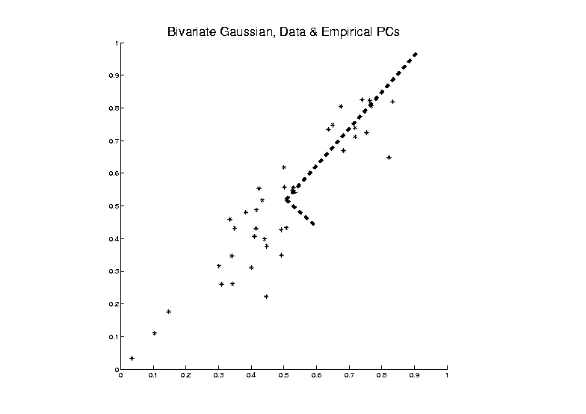
PCA as an Optimization Problem
Find Direction of Greatest Variability:

Slide 73
PCA as an Optimization Problem
Find Direction of Greatest Variability:
Raw Data

Slide 74
PCA as an Optimization Problem
Find Direction of Greatest Variability:
Mean
Residuals
(Shift to
Origin)

Slide 75
PCA as an Optimization Problem
Find Direction of Greatest Variability:
Mean
Residuals
(Shift to
Origin)

Slide 76
PCA as an Optimization Problem
Find Direction of Greatest Variability:
Centered
Data

Slide 77
PCA as an Optimization Problem
Find Direction of Greatest Variability:
Centered
Data
Projections

Slide 78
PCA as an Optimization Problem
Find Direction of Greatest Variability:
Centered
Data
Projections
Direction
Vector

Slide 79
PCA as Optimization (Cont.)
Find Direction of Greatest Variability:
Given a Direction Vector, (i.e. )
(Variable, Over Which Will Optimize)

Slide 80
PCA as Optimization (Cont.)
Find Direction of Greatest Variability:
Given a Direction Vector, (i.e. )
Idea: Think of
Optimizing Projected
Variance Over
Candidate
Direction
Vectors $\underline{u}$

Slide 81
PCA as Optimization (Cont.)
Find Direction of Greatest Variability:
Given a Direction Vector, (i.e. )
Projection of in the Direction :
Projection Coefficients, i.e. Scores

Slide 82
PCA as Optimization (Cont.)
Find Direction of Greatest Variability:
Given a Direction Vector, (i.e. )
Projection of in the Direction :
Variability in the Direction :

Slide 83
PCA as Optimization (Cont.)
Find Direction of Greatest Variability:
Given a Direction Vector, (i.e. )
Projection of in the Direction :
Variability in the Direction :
Parseval identity

Slide 84
PCA as Optimization (Cont.)
Find Direction of Greatest Variability:
Given a Direction Vector, (i.e. )
Projection of in the Direction :
Variability in the Direction :
Heading Towards
Covariance Matrix

Slide 85
PCA as Optimization (Cont.)
Variability in the Direction :

Slide 86
PCA as Optimization (Cont.)
Variability in the Direction :
i.e. (Proportional to) a
Quadratic Form in the Covariance Matrix

Slide 87
PCA as Optimization (Cont.)
Variability in the Direction :
i.e. (Proportional to) a
Quadratic Form in the Covariance Matrix
Simple Solution Comes from the Eigenvalue Representation of :

Slide 88
PCA as Optimization (Cont.)
Variability in the Direction :
i.e. (Proportional to) a
Quadratic Form in the Covariance Matrix
Simple Solution Comes from the Eigenvalue Representation of :
Where is Orthonormal, &

Slide 89
PCA as Optimization (Cont.)
Variability in the Direction :

Slide 90
PCA as Optimization (Cont.)
Variability in the Direction :
But

Slide 91
PCA as Optimization (Cont.)
Variability in the Direction :
But = “ Transform of ”

Slide 92
PCA as Optimization (Cont.)
Variability in the Direction :
But = “ Transform of ”
= “ Rotated into Coordinates”,

Slide 93
PCA as Optimization (Cont.)
Variability in the Direction :
But = “ Transform of ”
= “ Rotated into Coordinates”,
and the Diagonalized Quadratic Form Becomes

Slide 94
PCA as Optimization (Cont.)
Now since is an Orthonormal Basis Matrix,
and

Slide 95
PCA as Optimization (Cont.)
Now since is an Orthonormal Basis Matrix,
and
So the Rotation Gives a Decomposition of the Energy of in the Eigen-directions of

Slide 96
PCA as Optimization (Cont.)
Now since is an Orthonormal Basis Matrix,
and
So the Rotation Gives a Decomposition of the Energy of in the Eigen-directions of
And is Max’d (Over ), by Putting maximal Energy in the “Largest Direction”, i.e. taking ,
Where “Eigenvalues are Ordered”,

Slide 97
PCA as Optimization (Cont.)
Notes:
Projecting onto Subspace $⊥$ to $\underline{v_{1}}$,
Gives $\underline{v_{2}}$ as Next Direction
Continue Through $\underline{v_{3}},⋯,\underline{v_{d}}$

Slide 98
Iterated PCA Visualization

Slide 99
PCA as Optimization (Cont.)
Notes:
Replace $\hat{Σ}$ by $Σ$ to get Theoretical PCA
Estimated by the Empirical Version
Solution is Unique when $λ_{1}>λ_{2}>⋯>λ_{d}$
Else have Sol’ns in Subsp. Gen’d by $\underline{v}$s

Slide 100
PCA as Optimization (Cont.)
Recall Toy
Example

Slide 101
PCA as Optimization (Cont.)
Recall Toy
Example
Empirical (Sample)
EigenVectors

Slide 102
PCA as Optimization (Cont.)
Recall Toy
Example
Theoretical
Distribution

Slide 103
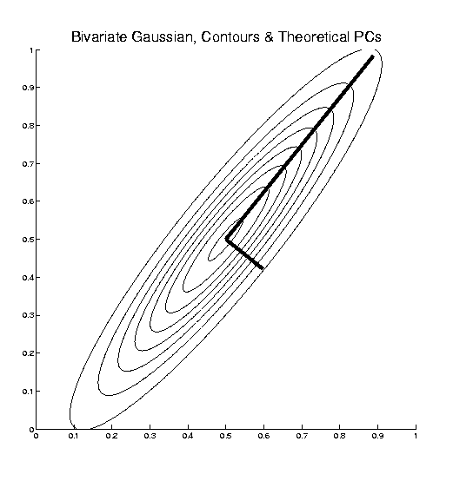
PCA as Optimization (Cont.)
Recall Toy
Example
Theoretical
Distribution
& Eigenvectors

Slide 104
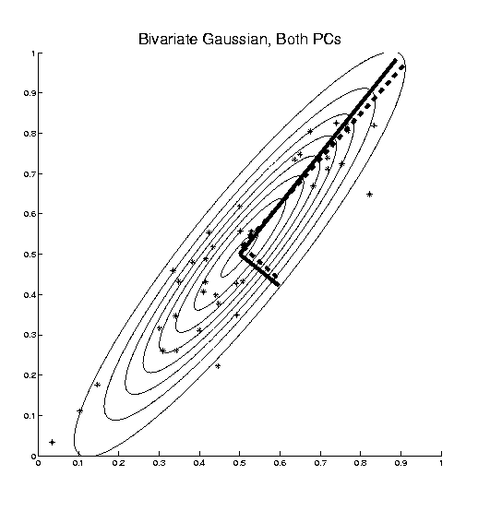
PCA as Optimization (Cont.)
Recall Toy
Example
Empirical (Sample)
EigenVectors
Theoretical
Distribution
& Eigenvectors
Different!

Slide 105
Connect Math to Graphics
2-d Toy Example
From Much Earlier Class Meeting
2-d Curves as Data In Object Space
Simple, Visualizable Descriptor Space

Slide 106
Connect Math to Graphics
2-d Toy Example
Data Points
(Curves)
are columns of $2×25$ matrix, $X$

Slide 107
Connect Math to Graphics (Cont.)
2-d Toy Example
Sample Mean, $\overline{X}$

Slide 108
Connect Math to Graphics (Cont.)
2-d Toy Example
Residuals from Mean = Data - Mean

Slide 109
Connect Math to Graphics (Cont.)
2-d Toy Example
Recentered Data = Mean Residuals, shifted to 0
= (recentering of $X$) $\tilde{X}$

Slide 110
Connect Math to Graphics (Cont.)
2-d Toy Example
PC1 Direction follows $v_{1}$ = Eigvec (w/ biggest $λ=λ_{1}$)

Slide 111
Connect Math to Graphics (Cont.)
2-d Toy Example
PC1 Projections
Best 1-d Approximations of Data

Slide 112
Connect Math to Graphics (Cont.)
2-d Toy Example
PC1 Residuals

Slide 113
Connect Math to Graphics (Cont.)
2-d Toy Example
PC2 Direction follows $v_{2}$ = Eigvec (w/ 2nd $λ=λ_{2}$)

Slide 114
Connect Math to Graphics (Cont.)
2-d Toy Example
PC2 Projections (= PC1 Resid’s)
2nd Best 1-d Approximations of Data

Slide 115
Connect Math to Graphics (Cont.)
2-d Toy Example
PC2 Residuals = PC1 Projections

Slide 116
Connect Math to Graphics (Cont.)
Note for this 2-d Example:
PC1 Residuals = PC2 Projections
PC2 Residuals = PC1 Projections
(i.e. colors common across these pics)

Slide 117
PCA Redistribution of Energy
Now for Scree Plots (Upper Right of FDA Anal.)
Carefully Look At:
Intuition
Relation to Eigenanalysis
Numerical Calculation

Slide 118
PCA Redistribution of Energy
Convenient Summary of Amount of Structure:
Total Sum of Squares $\sum_{i=1}^{n}{{\left\|X_{i}\right\|}^{2}}$
Physical Interpetation:
Total Energy in Data
(Signal Processing Literature)

Slide 119
PCA Redistribution of Energy
Convenient Summary of Amount of Structure:
Total Sum of Squares $\sum_{i=1}^{n}{{\left\|X_{i}\right\|}^{2}}$
Physical Interpetation:
Total Energy in Data
Insight comes from decomposition
Statistical Terminology:
ANalysis Of VAriance (ANOVA)

Slide 120
PCA Redist’n of Energy (Cont.)
ANOVA Mean Decomposition:
Total Variation =
$\sum_{i=1}^{n}{{\left\|X_{i}\right\|}^{2}}$= $\sum_{i=1}^{n}{{\left\|\overline{X}\right\|}^{2}}$

Slide 121
PCA Redist’n of Energy (Cont.)
ANOVA Mean Decomposition:
Total Variation =
= Mean Variation + Mean Residual Variation
$\sum_{i=1}^{n}{{\left\|X_{i}\right\|}^{2}}$= $\sum_{i=1}^{n}{{\left\|\overline{X}\right\|}^{2}}+\sum_{i=1}^{n}{{\left\|X_{i}−\overline{X}\right\|}^{2}}$
Mathematics: Pythagorean Theorem
Intuition Quantified via Sums of Squares
(Squares More Intuitive Than Absolutes)

Slide 122
Connect Math to Graphics (Cont.)
2-d Toy Example

Slide 123
Connect Math to Graphics (Cont.)
2-d Toy Example
Total Sum of Squares $=\sum_{i=1}^{n}{{\left\|X_{i}\right\|}^{2}}$

Slide 124
Connect Math to Graphics (Cont.)
2-d Toy Example
Total Sum of Squares $=\sum_{i=1}^{n}{{\left\|X_{i}\right\|}^{2}}=861$

Slide 125
Connect Math to Graphics (Cont.)
2-d Toy Example
Total Sum of Squares $=\sum_{i=1}^{n}{{\left\|X_{i}\right\|}^{2}}=861$
Quantifies Overall Variation (from 0)

Slide 126
Connect Math to Graphics (Cont.)
2-d Toy Example
Mean Sum of Squares $=\sum_{i=1}^{n}{{\left\|\overline{X}\right\|}^{2}}$

Slide 127
Connect Math to Graphics (Cont.)
2-d Toy Example
Mean Sum of Squares $=\sum_{i=1}^{n}{{\left\|\overline{X}\right\|}^{2}}=606$
$=92\%$ of Total Sum

Slide 128
Connect Math to Graphics (Cont.)
2-d Toy Example
Mean Sum of Squares $=\sum_{i=1}^{n}{{\left\|\overline{X}\right\|}^{2}}=606$
$=92\%$ of Total Sum
Quantifies Variation Due to Mean (from 0)

Slide 129
Connect Math to Graphics (Cont.)
2-d Toy Example
Mean Resid Sum of Sq’s $=\sum_{i=1}^{n}{{\left\|X_{i}−\overline{X}\right\|}^{2}}$

Slide 130
Connect Math to Graphics (Cont.)
2-d Toy Example
Mean Resid Sum of Sq’s $=\sum_{i=1}^{n}{{\left\|X_{i}−\overline{X}\right\|}^{2}}=55$
$=8\%$ of Total Sum
Quantifies Variation About Mean

Slide 131
PCA Redist’n of Energy (Cont.)
Have already studied this decomposition (recall curve e.g.)
Notes:
131

Slide 132
PCA Redist’n of Energy (Cont.)
Have already studied this decomposition (recall curve e.g.)
Variation (SS) due to Mean (% of total)
Notes:
132

Slide 133
PCA Redist’n of Energy (Cont.)
Have already studied this decomposition (recall curve e.g.)
Variation (SS) due to Mean (% of total)
Variation (SS) of Mean Residuals (% of total)
Notes:
133

Slide 134
PCA Redist’n of Energy (Cont.)
Now Decompose SS About the Mean
Called the Squared Frobenius Norm of
the Matrix
Notes:
134

Slide 135
PCA Redist’n of Energy (Cont.)
Now Decompose SS About the Mean
where:
Note Inner Products this time
Notes:
135

Slide 136
PCA Redist’n of Energy (Cont.)
Now Decompose SS About the Mean
where:
Recall: Can Commute Matrices Inside Trace
Notes:
136

Slide 137
PCA Redist’n of Energy (Cont.)
Now Decompose SS About the Mean
where:
Recall: Cov Matrix is Outer Product
Notes:
137

Slide 138
PCA Redist’n of Energy (Cont.)
Now Decompose SS About the Mean
where:
i.e. Energy is Expressed in Trace of Cov Matrix
Notes:
138

Slide 139
PCA Redist’n of Energy (Cont.)
(Using Eigenvalue Decomp. Of Cov Matrix)
Notes:
139

Slide 140
PCA Redist’n of Energy (Cont.)
(Commute Matrices Within Trace)
Notes:
140

Slide 141
PCA Redist’n of Energy (Cont.)
(Since Basis Matrix is Orthonormal)
Notes:
141

Slide 142
PCA Redist’n of Energy (Cont.)
Eigenvalues Provide Atoms of SS Decompos’n
Notes:
142

Slide 143
Connect Math to Graphics (Cont.)
2-d Toy Example
PC1 Sum of Squares $=51$
$=93\%$ of Mean Res. Sum

Slide 144
Connect Math to Graphics (Cont.)
2-d Toy Example
PC1 Sum of Squares $=51$
$=93\%$ of Mean Res. Sum
Quantifies PC1 Component of Variation

Slide 145
Connect Math to Graphics (Cont.)
2-d Toy Example
PC2 Residual SS $=$3.8
$=7\%$ of Mean Residual Sum

Slide 146
Connect Math to Graphics (Cont.)
2-d Toy Example
PC2 Sum of Squares $=3.8$
$=7\%$ of Mean Res. Sum

Slide 147
Connect Math to Graphics (Cont.)
2-d Toy Example
PC2 Sum of Squares $=3.8$
$=7\%$ of Mean Res. Sum
Quantifies PC2 Component of Variation

Slide 148
Connect Math to Graphics (Cont.)
2-d Toy Example
PC2 Residual SS $=51$
$=93\%$ of Mean Residual Sum

Slide 149
PCA Redist’n of Energy (Cont.)
Eigenvalues Provide Atoms of SS Decompos’n
Notes:
149

Slide 150
PCA Redist’n of Energy (Cont.)
Eigenvalues Provide Atoms of SS Decompos’n
Useful Plots are:
Power Spectrum: vs.
Notes:
150

Slide 151
PCA Redist’n of Energy (Cont.)
Eigenvalues Provide Atoms of SS Decompos’n
Useful Plots are:
Power Spectrum: vs.
log Power Spectrum: vs.
(Very Useful When Are Orders of Mag. Apart)
Notes:
151

Slide 152
PCA Redist’n of Energy (Cont.)
Eigenvalues Provide Atoms of SS Decompos’n
Useful Plots are:
Power Spectrum: vs.
log Power Spectrum: vs.
Cumulative Power Spectrum: vs.
Notes:
152

Slide 153
PCA Redist’n of Energy (Cont.)
Eigenvalues Provide Atoms of SS Decompos’n
Useful Plots are:
Power Spectrum: vs.
log Power Spectrum: vs.
Cumulative Power Spectrum: vs.
Note PCA Gives SS’s for Free (As Eigenval’s),
But Watch Factors of
Notes:
153

Slide 154
PCA Redist’n of Energy (Cont.)
Note, have already considered some of these Useful Plots:
Notes:
154

Slide 155
PCA Redist’n of Energy (Cont.)
Note, have already considered some of these Useful Plots:
Power Spectrum (as %s)
Notes:
155

Slide 156
PCA Redist’n of Energy (Cont.)
Note, have already considered some of these Useful Plots:
Power Spectrum (as %s)
Cumulative Power Spectrum (%)
Notes:
156

Slide 157
PCA Redist’n of Energy (Cont.)
Note, have already considered some of these Useful Plots:
Power Spectrum (as %s)
Cumulative Power Spectrum (%)
Common Terminology:
Power Spectrum is Called
“Scree Plot”
Kruskal (1964) Cattell (1966)
(all but name “scree”) (1st Appearance of name???)
Notes:
157

Slide 158
PCA Redist’n of Energy (Cont.)
Etimology of term Scree:
Geological Feature
Pile Up of Rock
Fragments
(from Wikipedia)
Notes:
158

