Slide 1
Participant Presentations
Please Sign Up:
Name
Email (Onyen is fine, or …)
Are You ENRolled?
Tentative Title (???? Is OK)
When:
Next Week, Early, Oct., Nov., Late

Slide 2
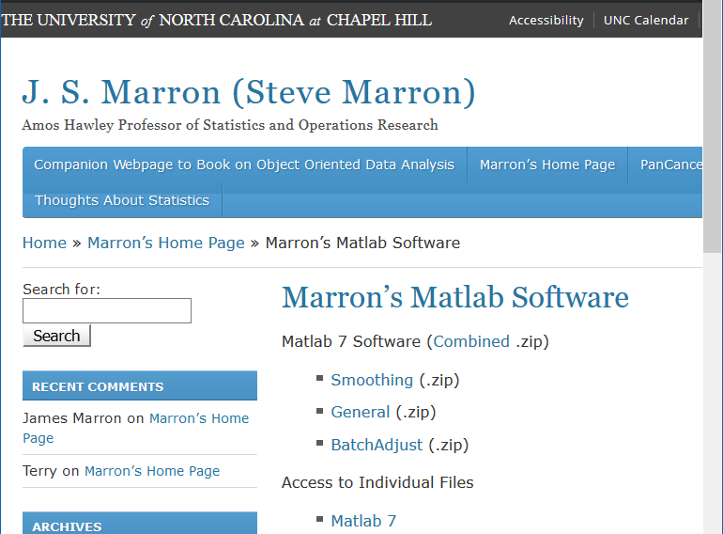
Matlab Software
Download .zip File, & Expand to 4 Directories

Slide 3
Object Oriented Data Analysis
Three Major Parts of OODA Applications:
I. Object Definition
“What are the Data Objects?”
Exploratory Analysis
“What Is Data Structure / Drivers?”
III. Confirmatory Analysis / Validation
Is it Really There (vs. Noise Artifact)?

Slide 4
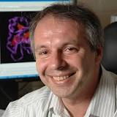
Marg. Dist. Plot Data Example
Drug Discovery Data
$n = 262$, Chemical Compounds
$d = 2489$, Chemical “Descriptors”
Discrete Response:
0 – blue 0, 1 – red +
(Thanks to Alex Tropsha Lab)

Slide 5
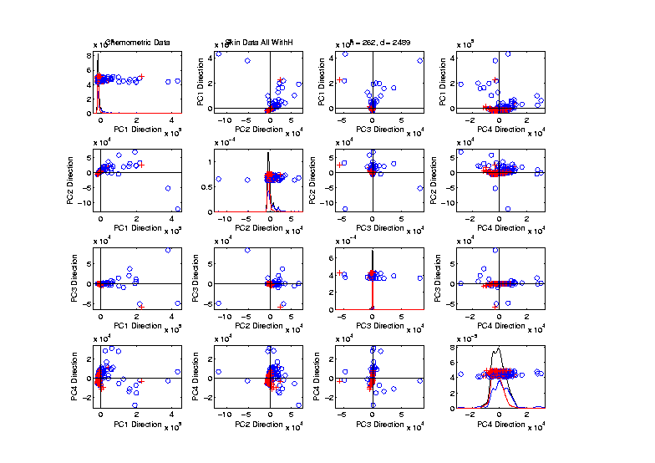
Marg. Dist. Plot Data Example
Drug Discovery – PCA Scatterplot
Dominated
By Few
Large
Compounds
Not Good
Blue - Red
Separation

Slide 6
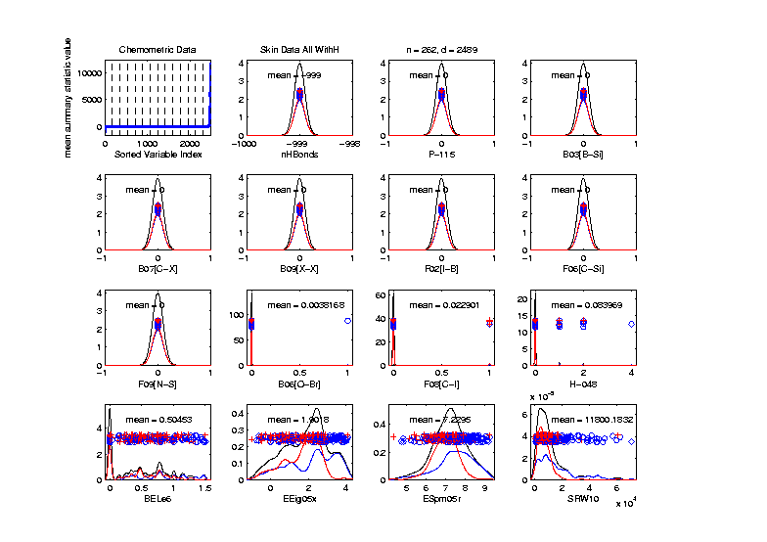
Marg. Dist. Plot Data Example
Drug Discovery – Sort on Means
Suspicious
Value ???

Slide 7
Marg. Dist. Plot Data Example
Explicit Screening Found:
$d = 364$ Binary Variables
Consider Those Only
Do PCA
Try Variable Screening

Slide 8
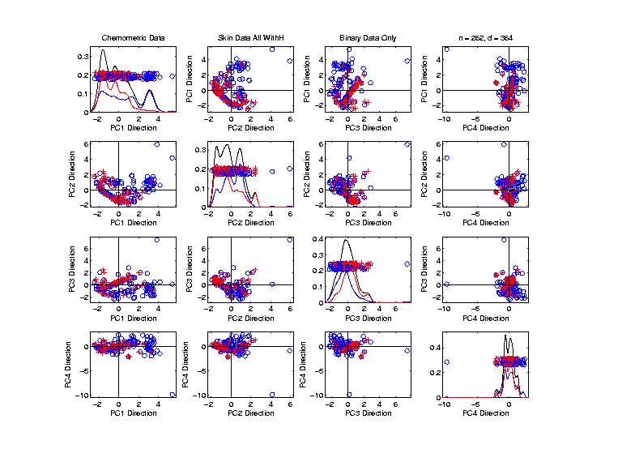
Recall Drug Discovery Data
PCA on Binary Variables
Deep
Question:
Is
Red vs. Blue
Separation
Better?

Slide 9
Marg. Dist. Plot Data Example
Explicit Screening Found:
$d = 800$Non-Binary Variables
Now Focus on Those Only
Standardize Variables
(Subtract Mean, Divide By SD)

Slide 10
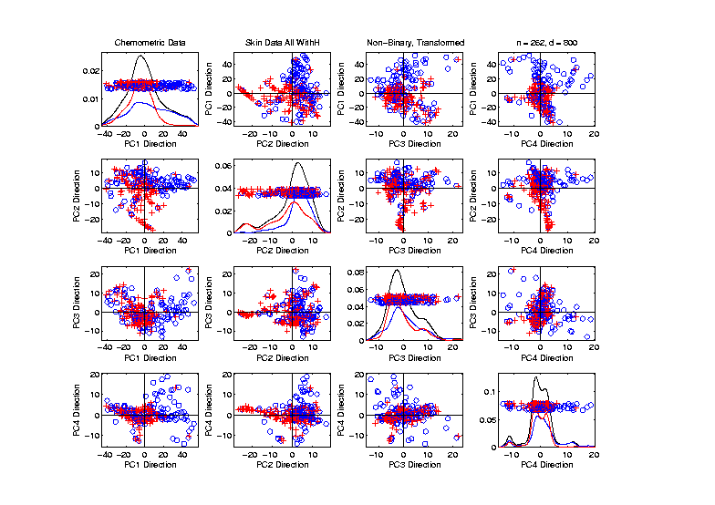
Recall Drug Discovery Data
PCA on Standardized Non-Binary Variables
Same Deep
Question:
Is
Red vs. Blue
Separation
Better?

Slide 11
Recall Drug Discovery Data
Question:
When Is Red vs. Blue Separation Better?
Visual Approach:
Train DWD to Separate
Project, and View How Separated
Useful View, Add Orthogonal PC Directions

Slide 12
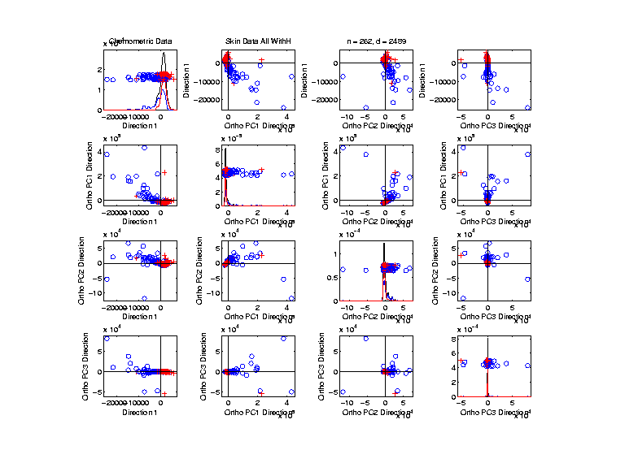
Recall Drug Discovery Data
Raw Data – DWD & Ortho PCs Scatterplot
Some
Blue - Red
Separation
But Dominated
By Few Large
Compounds

Slide 13
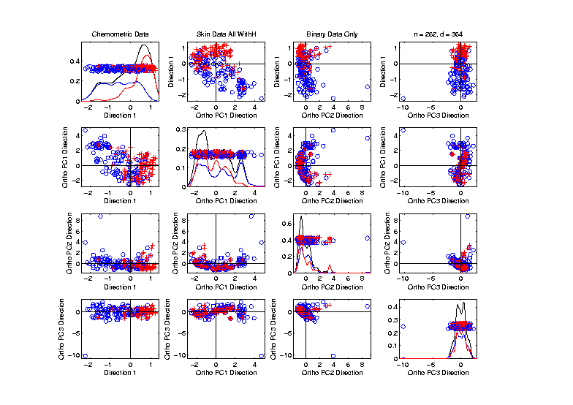
Recall Drug Discovery Data
Binary Data – DWD & Ortho PCs Scatterplot
Better
Blue - Red
Separation
And Better
Visualization

Slide 14
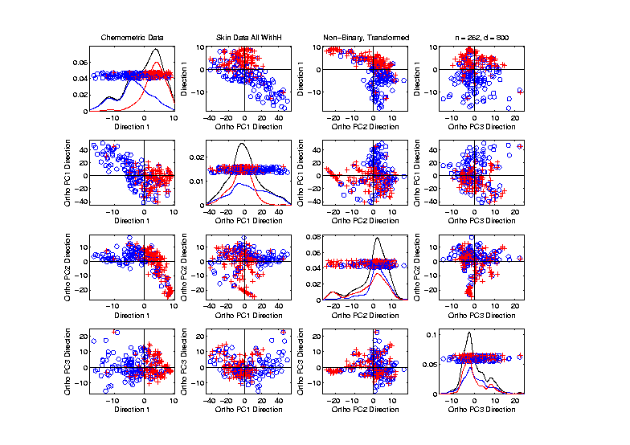
Recall Drug Discovery Data
Standard’d Non-Binary Data – DWD & OPCA
Better
Blue - Red
Separation
???
Very Useful
Visualization

Slide 15
Caution
Important Lesson:
DWD Separation Can Be Deceptive
Since DWD is Really Good at Separation
Important Concept:
Statistical Inference is Essential
III. Confirmatory Analysis

Slide 16
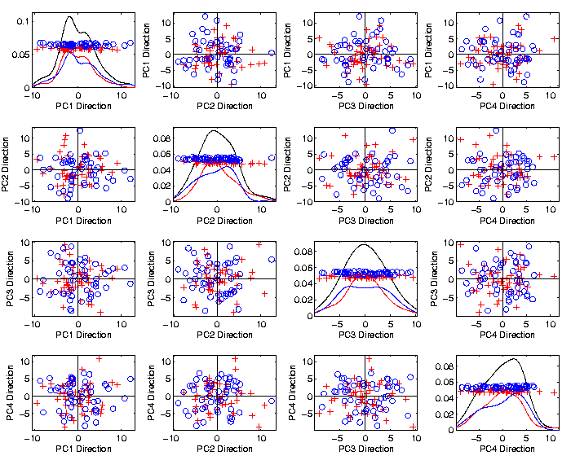
Caution
Toy 2-Class
Example
See
Structure?
Careful,
Only PC1-4

Slide 17
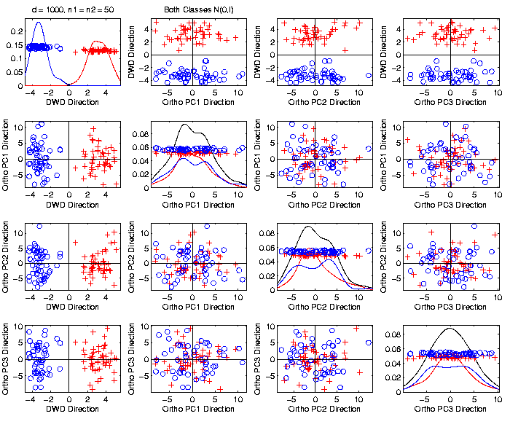
Caution
Toy 2-Class
Example
Separation
Is Natural
Sampling
Variation
(Will Study in Detail Later)

Slide 18
DiProPerm Hypothesis Test
Suggested Approach:
Find a DIrection
(separating classes)
PROject the data
(reduces to 1 dim)
PERMute
(class labels, to assess significance,
with recomputed direction)

Slide 19
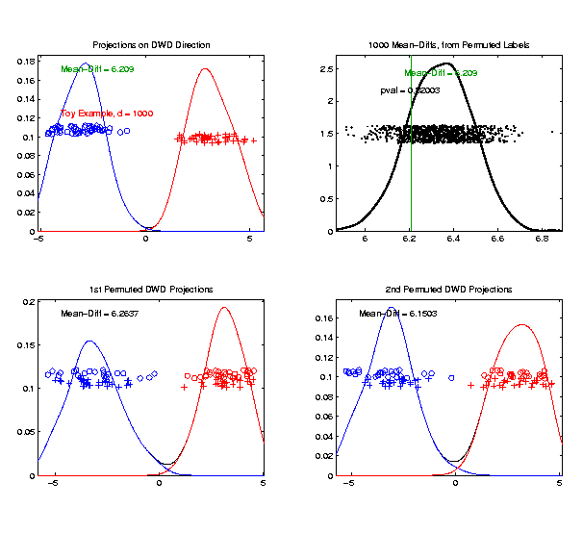
DiProPerm Hypothesis Test
Toy 2-Class Example
Generate Null
Distribution
Compare With
Original Value
Not Significant

Slide 20
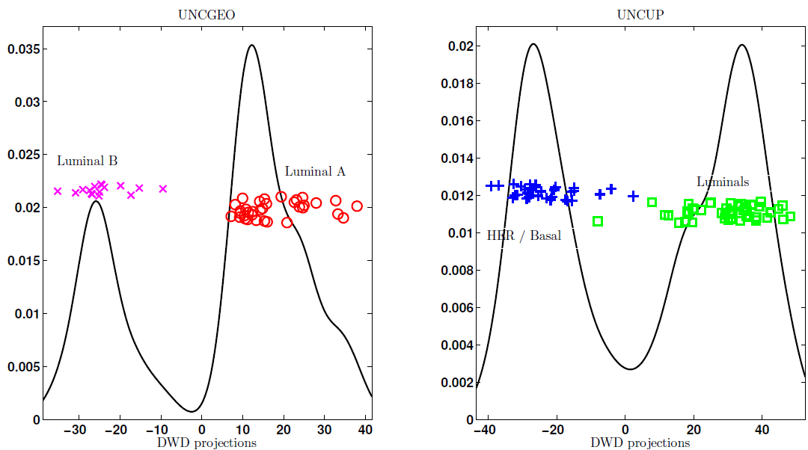
DiProPerm Hypothesis Test
Two
Examples
Which Is
“More
Distinct”?
Visually Better Separation?
Thanks to Katie Hoadley

Slide 21
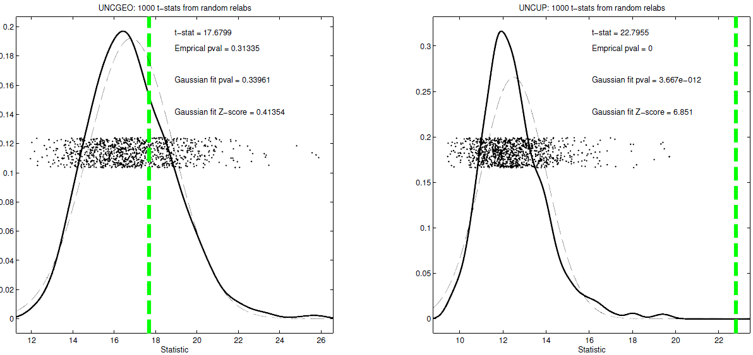
DiProPerm Hypothesis Test
Two
Examples
Which Is
“More
Distinct”?
Stronger Statistical Significance!
(Reason: Differing Sample Sizes)

Slide 22
DiProPerm Hypothesis Test
Value of DiProPerm:
Visual Impression is Easily Misleading
(Onto HDLSS Projections,
Recall $N\left(0,I\right)$ Example)
Really Need to Assess Significance
DiProPerm used routinely
(even for variable selection)

Slide 23
DiProPerm Hypothesis Test
Choice of Direction:
Distance Weighted Discrimination (DWD)
Support Vector Machine (SVM)
Mean Difference
Maximal Data Piling
Introduced
Later

Slide 24
DiProPerm Hypothesis Test
Choice of 1-d Summary Statistic:
2-sample t-stat
Mean difference
Median difference
Area Under ROC Curve
Surprising
Comparison
Coming Later

Slide 25
Recall Matlab Software
Posted Software for OODA

Slide 26
DiProPerm Hypothesis Test
Matlab Software:
DiProPermSM.m
In BatchAdjust Directory

Slide 27
Recall Drug Discovery Data
Raw Data – DWD & Ortho PCs Scatterplot
Some
Blue - Red
Separation
But Dominated
By Few Large
Compounds

Slide 28
Recall Drug Discovery Data
Binary Data – DWD & Ortho PCs Scatterplot
Better
Blue - Red
Separation
And
Visualization

Slide 29
Recall Drug Discovery Data
Standard’d Non-Binary Data – DWD & OPCA
Better
Blue - Red
Separation
???
Very Useful
Visualization

Slide 30
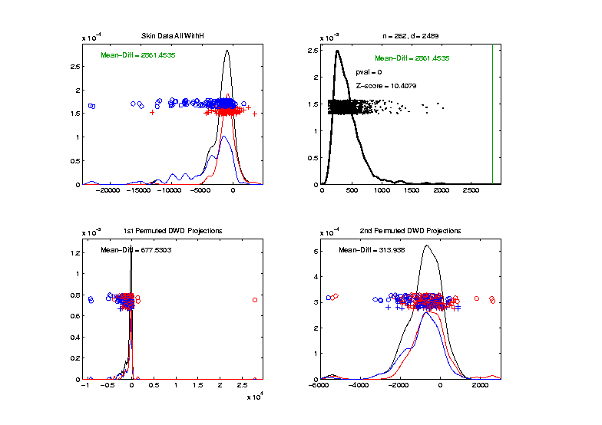
Recall Drug Discovery Data
DiProPerm test of Blue vs. Red
Full Raw Data
Z = 10.4
Reasonable
Difference
Note Strange
Permutations

Slide 31
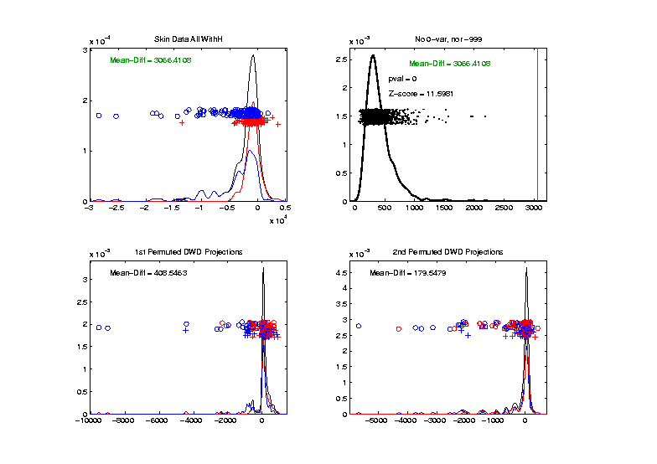
Recall Drug Discovery Data
DiProPerm test of Blue vs. Red
Delete var = 0 & -999 Variables
Z = 11.6
Slightly
Stronger
No Visual Diff.
Yet DiProPerm
Finds Some

Slide 32
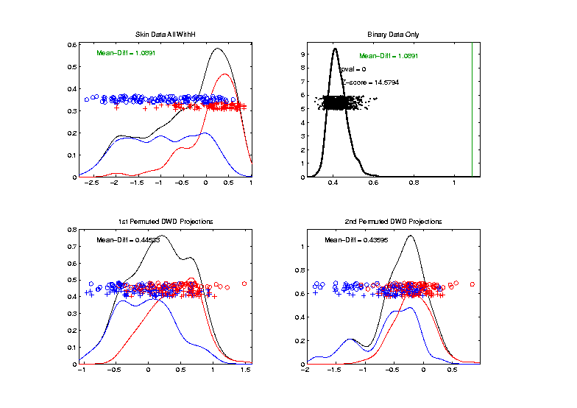
Recall Drug Discovery Data
DiProPerm test of Blue vs. Red
Binary Variables Only
Z = 14.6
More Than
Raw Data
Much Nicer
Permutations

Slide 33
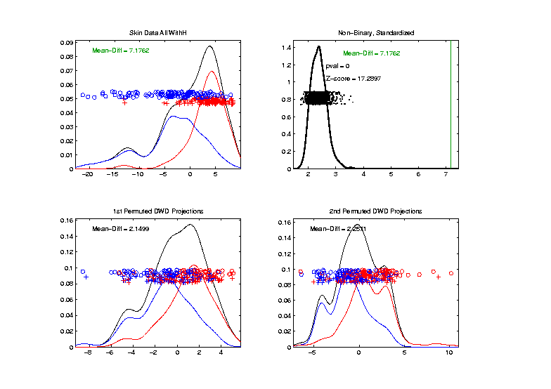
Recall Drug Discovery Data
DiProPerm test of Blue vs. Red
Non-Binary – Standardized
Z = 17.3
Stronger
Reflects
More Info
In Data

Slide 34
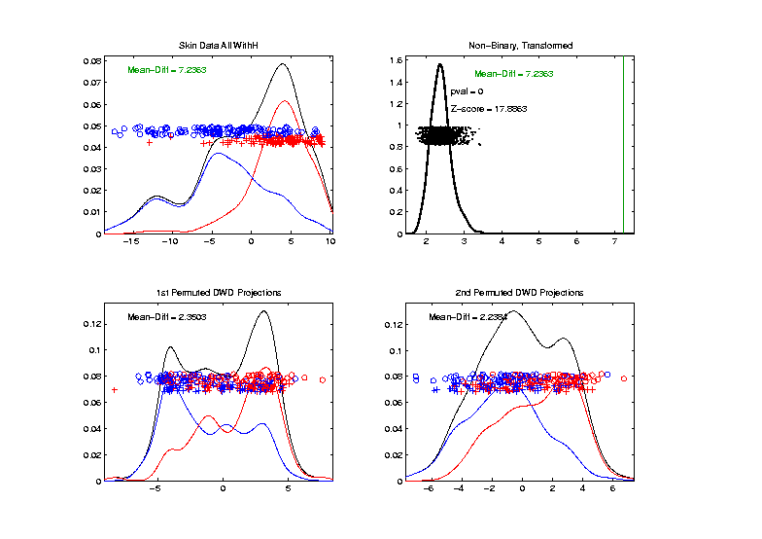
Recall Drug Discovery Data
Introduced
Very Soon
DiProPerm test of Blue vs. Red
Non-Binary – Shifted Log Transforms
Z = 17.9
Slightly
Stronger

Slide 35
Transformations
Useful Method for Data Analysts
Apply to Marginal Distributions
(i.e. to Individual Variables)
Idea: Put Data on Right Scale
Common Example:
Data Orders of Magnitude Different
Log₁₀ Puts Data on More Analyzable Scale

Slide 36
Transformations
Famous Family:
Box – Cox Transformations
Box & Cox (1964)
Given a parameter $λ∈ℝ$,
$$x ↦ \frac{x^{λ}−1}{λ}$$

Slide 37
Transformations
Box – Cox Transformations
Why this strange form? Instead of just
$$x ↦x^{λ}$$
Reason: Nicer Behavior as $λ→0$,
$$\lim_{λ→0}{\frac{x^{λ}−1}{λ}}=\ln{x}$$

Slide 38
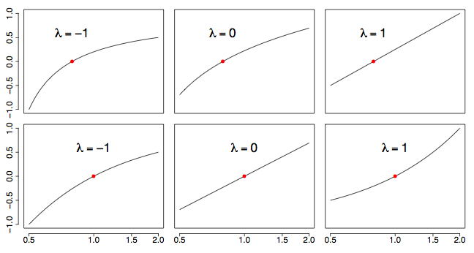
Transformations
Box – Cox Transformations
(vs. $x$)
(vs. $\ln{x}$)
(graphics from http://onlinestatbook.com/2/transformations/box-cox.html)

Slide 39
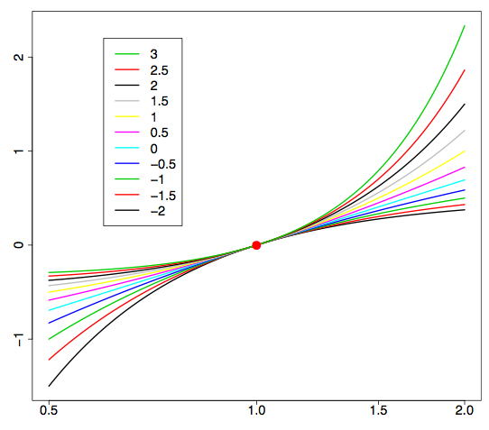
Transformations
Box – Cox Transformations (vs. $\ln{x}$)
(graphics from http://onlinestatbook.com/2/transformations/box-cox.html)

Slide 40
Transformations
Another useful family:
Shifted Log Transformations
Given a parameter $δ∈ℝ$,
$$x ↦ \log\left(x+δ\right)$$
(Will use more below)

Slide 41
Transformations
Example: Melanoma Data Analysis
Miedema, et al (2012)

Slide 42
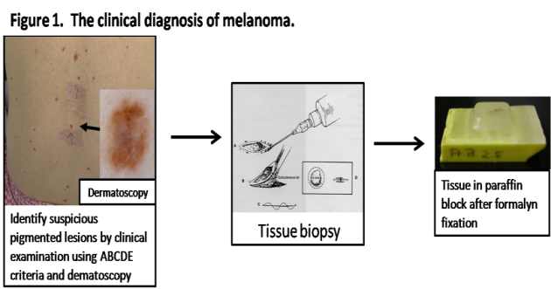
Introduction
Background
Clinical diagnosis

Slide 43
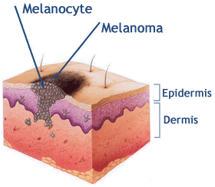
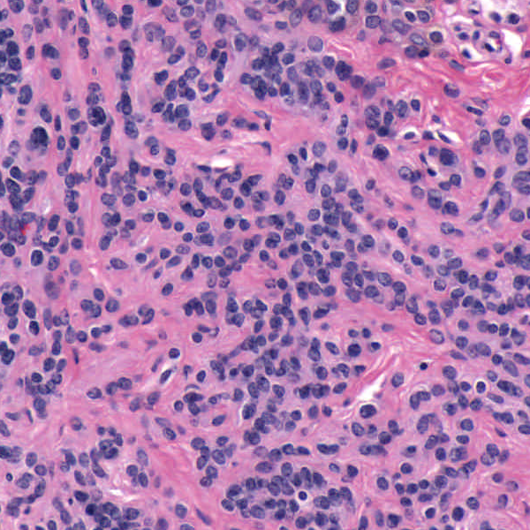
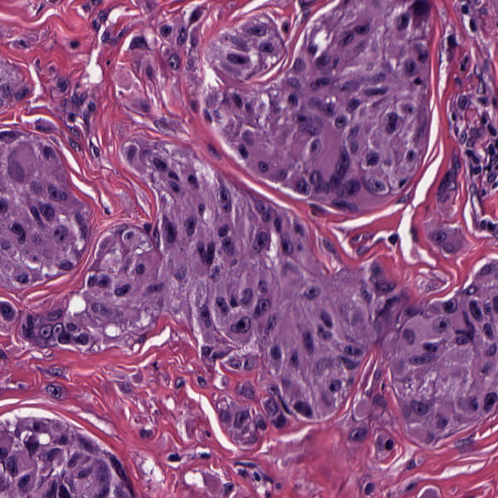
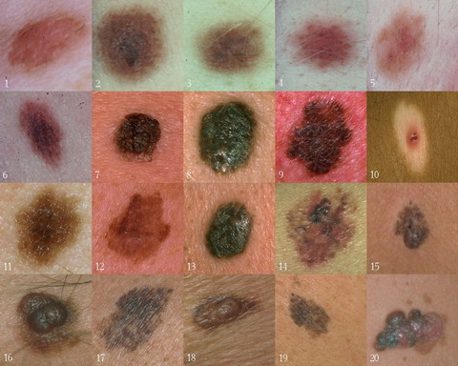
Background
Goal
Image Analysis of Histology Slides
Image: www.melanoma.ca
Benign
Melanoma
1 in 75 North Americans will develop a
malignant melanoma in their lifetime.
Initial goal: Automatically segment nuclei.
Challenge: Dense packing of nuclei.
Ultimately: Cancer grading and patient survival.
Image: melanoma.blogsome.com

Slide 44
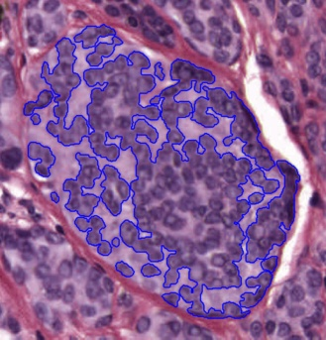
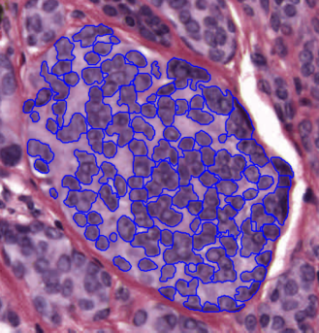
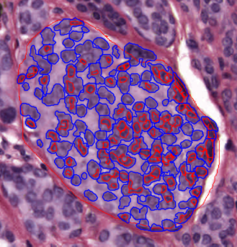
Segmentation
Cell Nuclei from Histology
Cutting Cell Clusters
Without subdivision
With subdivision
Our segmentation
Commercial seg.
Not perfect, but improved over standard algorithm (rq. validation).

Slide 45
Feature Extraction
Features from Cell Nuclei
Feature Extraction
Extract various features based on color and morphology
Example “high-level” concepts:
Stain intensity
Nuclear area
Density of nuclei
Regularity of nuclear shape

Slide 46
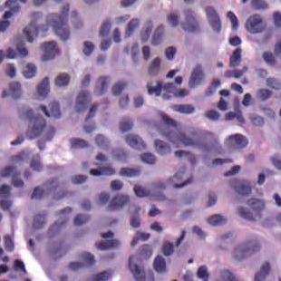
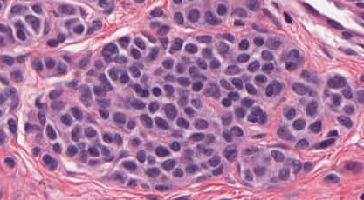
Feature Extraction
Features from Cell Nuclei
Original Image
Conventional Nevus
Superficial Spreading Melanoma

Slide 47
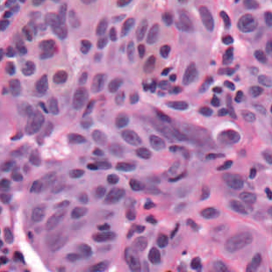
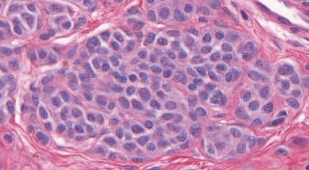
Feature Extraction
Features from Cell Nuclei
Restained Image
Conventional Nevus
Superficial Spreading Melanoma

Slide 48
Feature Extraction
Features from Cell Nuclei
Masked Region
Conventional Nevus
Conventional Nevus
Superficial Spreading Melanoma
Superficial Spreading Melanoma
Masks generated by pathologist

Slide 49
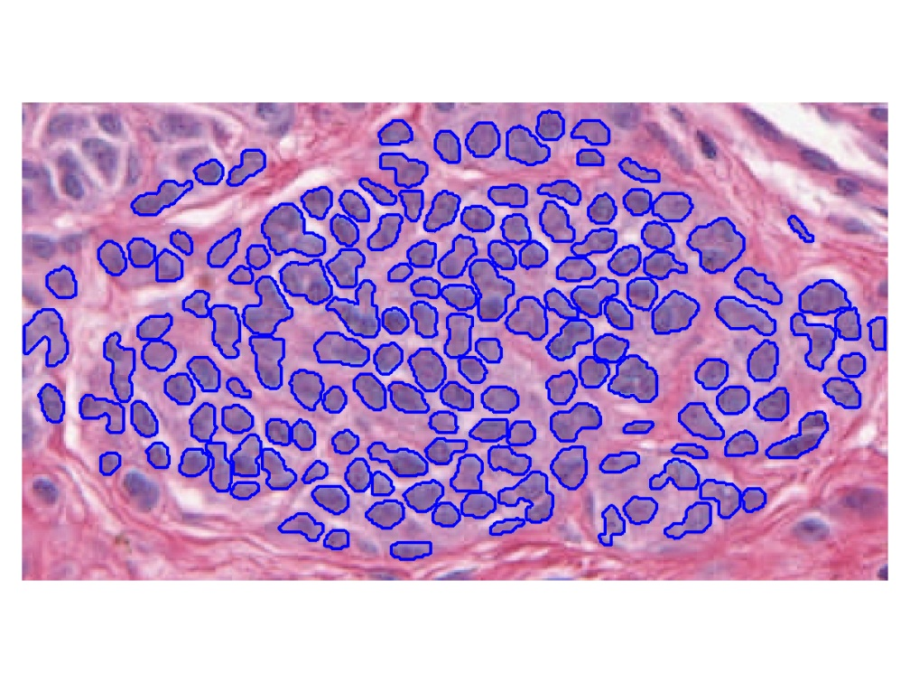
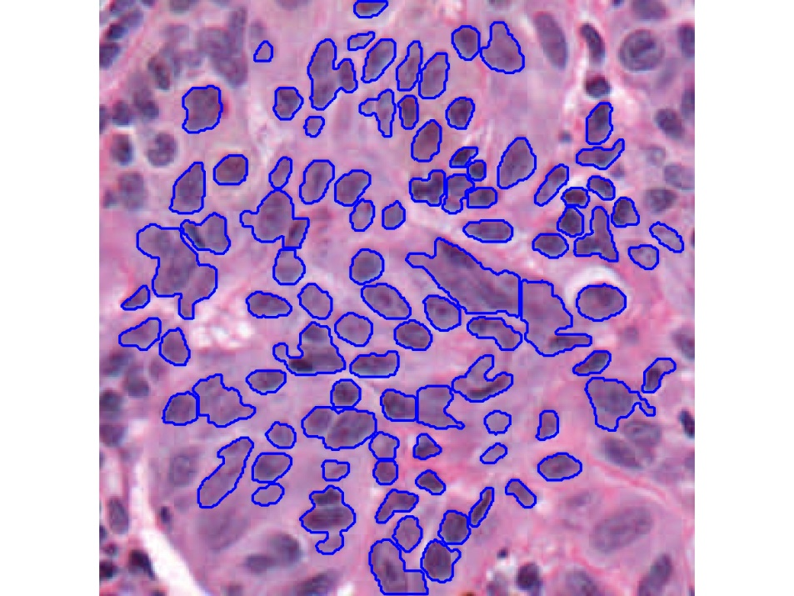
Feature Extraction
Features from Cell Nuclei
Segmented Nuclei
Conventional Nevus
Superficial Spreading Melanoma

Slide 50
Feature Extraction
Features from Cell Nuclei
Labeled Nuclei
Conventional Nevus
Superficial Spreading Melanoma

Slide 51
Feature Extraction
Features from Cell Nuclei
Nuclear Regions
Conventional Nevus
Superficial Spreading Melanoma
Generated by growing nuclei out from boundary
Used for various color and density features:
Region Stain 2, Region Area Ratio, etc.

Slide 52
Feature Extraction
Features from Cell Nuclei
Delaunay Triangulation
Conventional Nevus
Superficial Spreading Melanoma
Triangulation of nuclear centers
Used for various density features:
Mean Delaunay, Max. Delaunay, etc.

Slide 53
Transformations
Statistical Challenge:
Some Features Spread Over Several Orders of Magnitude
Few Big Values Can Dominate Analysis

Slide 54
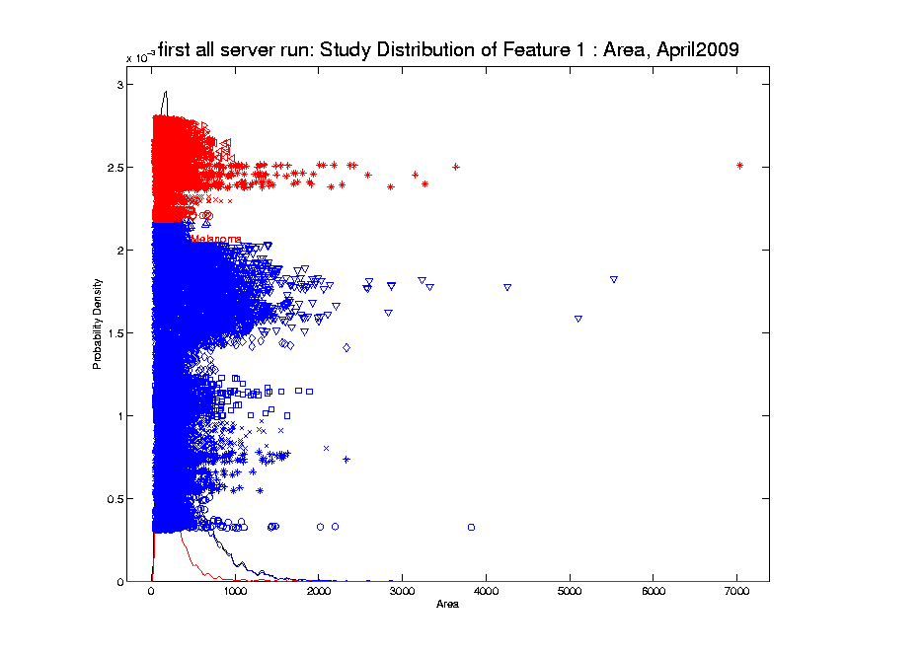
Transformations
Few Large Values Can Dominate Analysis

Slide 55
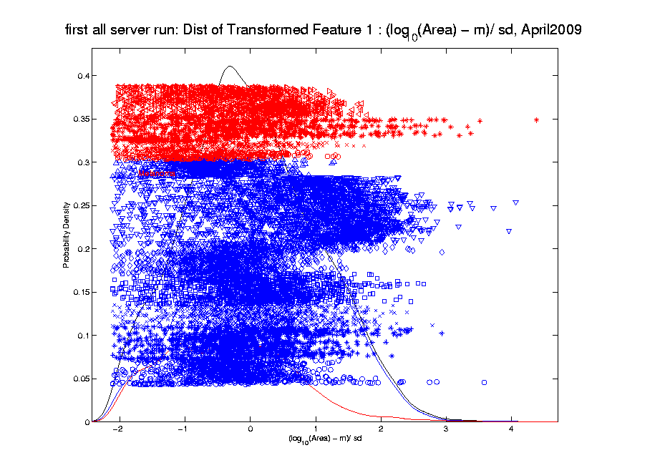
Transformations
Log Scale Gives All More Appropriate Weight
Note:
Orders
Of
Magnitude
Log₁₀ most
Interpretable

Slide 56
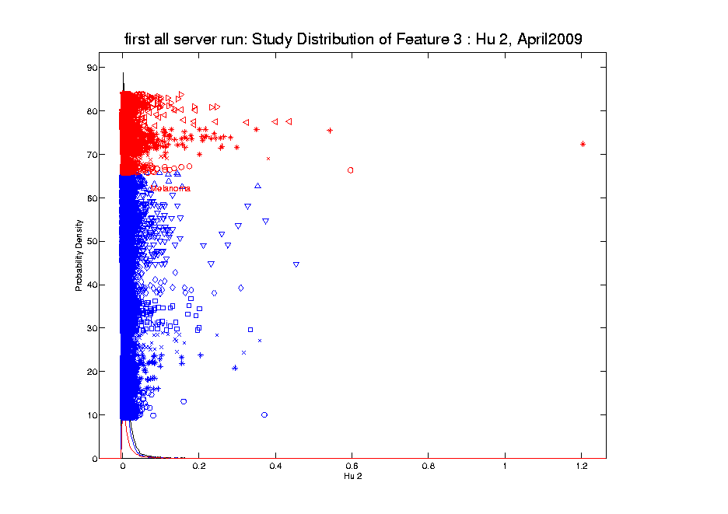
Transformations
Another Feature with Large Values
Problem
For This
Feature:
0 Values
(no log)

Slide 57
Transformations
Another Feature with Large Values
Approach:
Shifted
Log:
$$log\left(∙+δ\right)$$
Need to
Tune

Slide 58
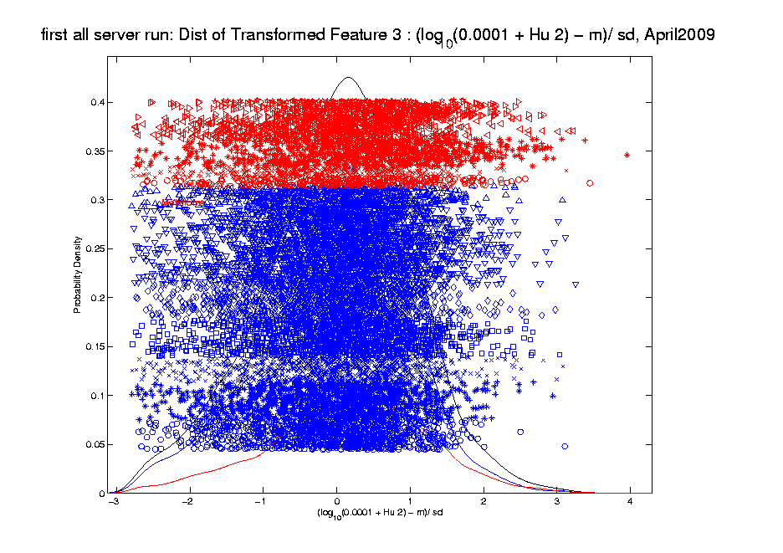
Transformations
Much Nicer Distribution

Slide 59
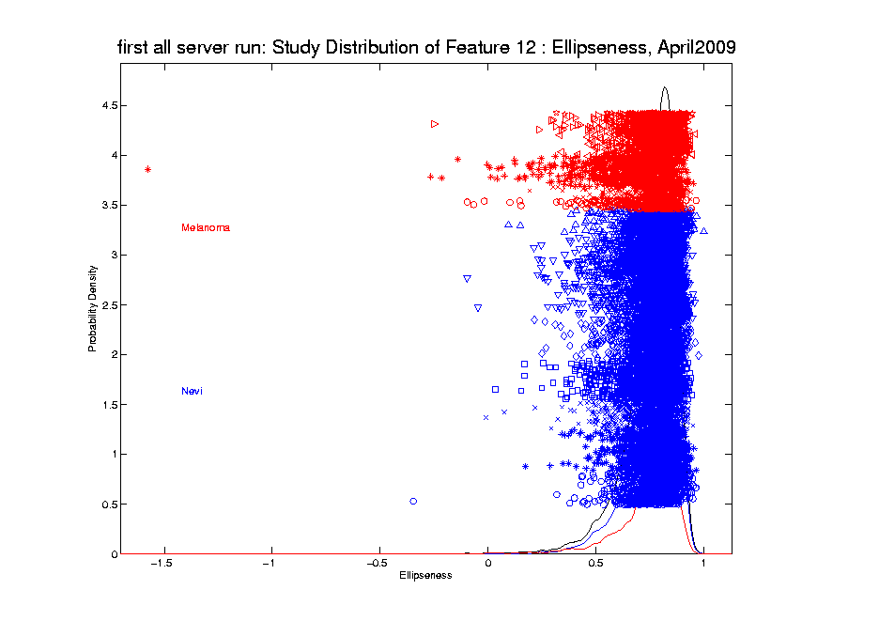
Transformations
Different Direction (Negative) of Skewness

Slide 60
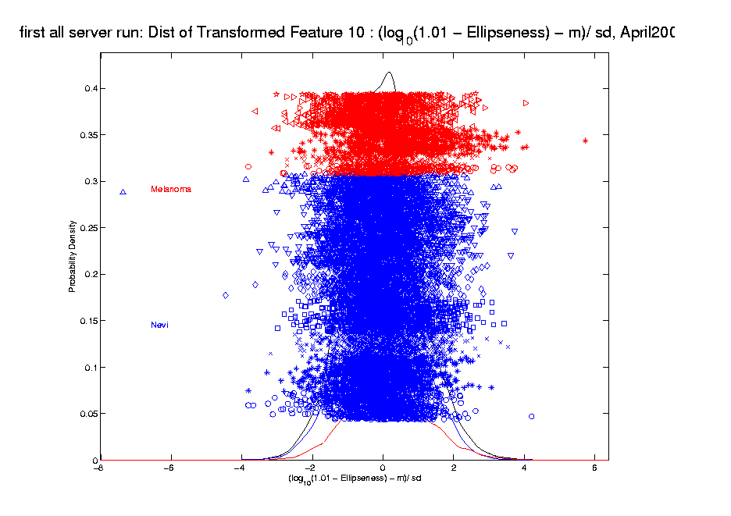
Transformations
Use Log Difference Transformation

Slide 61
Transformations
Major Challenge:
Hard to Visually Choose
Transformation of Many Variables
Motivates Automatic Transformation
Approach: Feng et al (2016)
Notes:
For a high dimensional data set, automation is important!
The parameterizations of the shift parameter strongly depend on knowledge of the data e.g. data range, data distribution, so user intervention is usually required. However, modern high-output data sets usually have a very large number of variables, i.e. features, so there is a strong need to automate the selection of shift parameter
What is the challenge here?
First challenge comes from tuning the shift parameter value
variables may range from different magnitude
It depends on the data magnitude (to make valid log function)
You have different optimal shift parameter value for different variables given a target
How to handle positive and negative skewness at same time
2. Address outliers which are also quite different from variable to variable

Slide 62
Automatic Transformations
Approach: Shifted log transform
Challenges Addressed:
Tune the shift parameter for each variable
$\log\left(∙+δ\right)$: Independent of data magnitude
Handle both positive and negative skewness
Address influential data points
Notes:
For a high dimensional data set, automation is important!
The parameterizations of the shift parameter strongly depend on knowledge of the data e.g. data range, data distribution, so user intervention is usually required. However, modern high-output data sets usually have a very large number of variables, i.e. features, so there is a strong need to automate the selection of shift parameter
What is the challenge here?
First challenge comes from tuning the shift parameter value
variables may range from different magnitude
It depends on the data magnitude (to make valid log function)
You have different optimal shift parameter value for different variables given a target
How to handle positive and negative skewness at same time
2. Address outliers which are also quite different from variable to variable

Slide 63
Automatic Transformations
Outline
A new parameterized transformation function
Appropriate reparametrization of $\log\left(∙+δ\right)$
Standardization and Winsorization
Selection of $δ$
Notes:
Based on these challenges we propose an automatic transformation scheme
The new scheme consists of three parts
1. A new parametrized family of transformation functions
This re-parametrization facilitate the automation by making the selection of shift tuning parameter independent of data magnitude.
Beside, it put transformation function for handling both positive and negative skewness in the same family
2. A robust way for standardization and also an option for winsorizing the influential points (winsorization means that given a vector of data values and a threshold, when the absolute data values are larger than the threshold, you will pull these values back to the threshold)
3. The parameter value selection
How to use an algorithm for optimal value

Slide 64
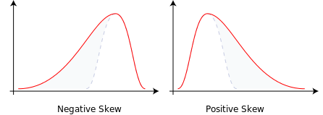
Automatic Transformations
Form of Transformation Function
Based on 1-d data set: $x_{1}, ⋯,x_{n}$
For positive skewness want: $\log\left(x_{i}\right)$
For negative skewness want: $−\log\left(−x_{i}\right)$
But Need Valid Inputs!
i.e. $\log{x}$ needs $x>0$
Notes:
We start with the new re-parametrized function and we will start from the very basic
Deal both positive and negative skewness + maintain the order of data values
Given a feature vector in the data set, we need to first calculate its skewness
Based on the sign of the skewness we will have different log transformation (applying convex transformation function will increase the skewness and concave will decrease)
For negative one, we add negative sign to keep the same order of the data values

Slide 65
Automatic Transformations
Transformation Function
Modified log transforms
Positive skewness
$log⁡(x_{i}−min\left(x_{1}, ⋯,x_{n}\right)+η$)
Negative skewness
$−log⁡(\max\left(x_{1}, ⋯,x_{n}\right)− x_{i}+η$)
$η>0$ depends on the data magnitude
Notes:
One big concern is that logarithm functions require positive inputs
Therefore it is important to modify the functions for both positive and negative cases to be valid for any element value.
Substract the minimal value and add a positive shift parameter
use max value to minus each data value and add with a positive shift parameter

Slide 66
Automatic Transformations
Transformation function
Parameterize $η=\left|\frac{1}{β}\right|R$, $R=\max\left(x_{1}, ⋯,x_{n}\right)−min\left(x_{1}, ⋯,x_{n}\right)$
Positive skewness
$log⁡(x_{i}−min\left(x_{1}, ⋯,x_{n}\right)+\left|\frac{1}{β}\right|R$)
Negative skewness
$−log⁡(\max\left(x_{1}, ⋯,x_{n}\right)− x_{i}+\left|\frac{1}{β}\right|R$)
$β∈\left(−∞,+∞\right)$,
symmetric about 0
Notes:
Thus, we further parametrize the parameter eta in terms of the multiples of the range
of the feature vectors
This makes the selection of parameter values beta independent of the data magnitude
The beta ranges from negative inf to positive inf
Now we note that the functions for pos and negative are both symmetric around zero
Thus we can take advantage of it and combine them into one family of functions.

Slide 67
Automatic Transformations
$$φ_{β}\left(x_{i}\right)=\left\{\begin{aligned}log⁡(x_{i}−min\left(x_{1}, ⋯,x_{n}\right)+\frac{1}{β}R\text{)}, β>0 \\ −log⁡(\max\left(x_{1}, ⋯,x_{n}\right)− x_{i}−\frac{1}{β}R\text{)}\text{, }β<0\end{aligned}\right.$$
Family of transformation functions
Comments
Single family for both positive and negative skewness
Parameter value selection is independent of data magnitude
As $β→0$: transformation + standardization $→$
$→$ standardization only
Notes:
Finally incorporating all the elements we have discussed the new parameterized family of transformation functions
For beta is positive, transformation for positive skewness
For beta is negative, transformation for negative skewness
And the parameter value selection is independent of data magnitude

Slide 68
Automatic Transformations
Standardization
Subtract median (robust center)
Divide by $\sqrt{π/2}$ of the MAD (robust scale)
(Mean Absolute Deviation from the median)
Winsorization
Threshold based on extreme value theory
(see paper for details)
Notes:
After the shift log transformation, we need to deal with potential influential values by winsorization,
Before that we need a robust standardization ( and I will talk about it later)
To make standardization robust, we will use some robust statistics that is subtracting the median and divide based on the mean absolute deviation from median (not MAD which might be 0)

Slide 69
Automatic Transformations
Select parameter value $β$
Evaluation: Anderson – Darling test statistics
Often Useful Weighting of Tails
Powerful for Important Departures from Normality
Anderson – Darling (1952), Discussion / Comparison: Stephens (1974)
Algorithm: grid search
Search a value minimizing AD test statistics
Can be computed in parallel
Notes:
Here we a process for transformation which is controlled by the parameter beta
The last step is to deicide the optimal value of beta
To do that, we first need a criteria
A-D test stat is used which measures the distance between the empirical distribution function (EDF) of the transformed data and the cumulative distribution function (CDF) of the standard normal.
It give appropriate weight to the tails using a weighted L2 metric. It is more powerful for detecting
Given the evaluation, we adopt the grid search algorithm for minimizing the A-D test stat.
One major reason for using it is due to the simplicity of computing the stat and complexity of optimizing it. Besides, grid search is useful if the number of parameter to optimize is not large. Another advantage is that the computation of A-D test stat is independent with each other and thus is easy to be computed in parallel.

Slide 70
Melanoma Data
Much Nicer Distributions
Notes:
We applied our automatic transformation on the same melanoma data

Slide 71
Melanoma Data
Q-Q plot Views (will study in detail later)
(before, after, ${45}^{°}$ line)
Notes:
Use QQ Plot to compare normality

Slide 72
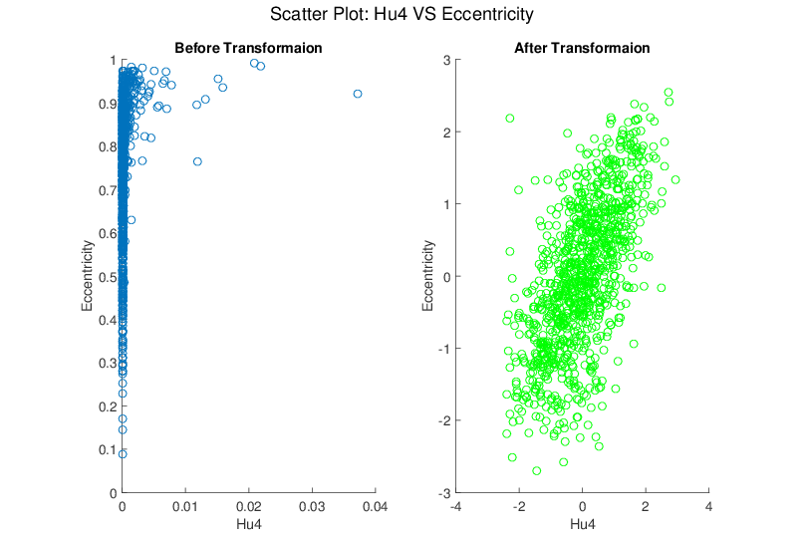
Melanoma Data
Much Nicer Distributions
Notes:
Besides, although the transformation targets at marginal dist
We see improvement of bivariate normality in many real data sets for example here.

Slide 73
Limitations
Not Useful for:
Binary Variables
Symmetric but highly kurtotic distribution
Notes:
No benefit for binary variables.
not useful in modifying a symmetric, but highly kurtotic distribution.

Slide 74
Recall Matlab Software
Posted Software for OODA

Slide 75
Automatic Shifted Log Trans.
Matlab Software:
AutoTransQF.m
In General Directory

Slide 76
Yeast Cell Cycle Data
Another Example Showing
Interesting Directions Beyond PCA
Exploratory Data Analysis

Slide 77
Yeast Cell Cycle Data
“Gene Expression” – Microarray data
Data (after major preprocessing): Expression “level” of:
thousands of genes (d ~ 1,000s)
but only dozens of “cases” (n ~ 10s)
Interesting statistical issue:
High Dimension Low Sample Size data
(HDLSS)

Slide 78
Yeast Cell Cycle Data
Data from:
Spellman, et al (1998)
Analysis here is from:
Zhao, Marron & Wells (2004)

Slide 79
Yeast Cell Cycle Data
Lab experiment:
Chemically “synchronize cell cycles”, of yeast cells
Do cDNA micro-arrays over time
Used 18 time points, over “about 2 cell cycles”
Studied 4,489 genes (whole genome)
Time series view of data:
have 4,489 time series of length 18
Functional Data View:
have 18 “curves”, of dimension 4,489
What are
the data
objects?

Slide 80
Yeast Cell Cycle Data, FDA View
Central question:
Which genes are “periodic” over 2 cell cycles?

Slide 81
Yeast Cell Cycle Data, FDA View
Periodic
genes?
Naïve
approach:
Simple PCA

Slide 82
Yeast Cell Cycle Data, FDA View
Central question: which genes are “periodic” over 2 cell cycles?
Naïve approach: Simple PCA
No apparent (2 cycle) periodic structure?
Eigenvalues suggest “variation” spread in many directions (upper left “Scree” plot)
PCA finds “directions of maximal variation”
Often, but not always, same as “interesting directions”
Here need better approach to study periodicities

Slide 83
Yeast Cell Cycle Data, FDA View
Approach
Project on Period 2 Components Only
Calculate via Fourier Representation
To understand, study Fourier Basis
Powerful Fact: linear combos of $sin$ and $cos$ capture “phase”, since:
$$\cos\left(x−φ\right)=\cos{φ}\cos{x}+\sin{φ}\sin{x}$$
$=c_{1}\cos{x}+c_{2}\sin{x}$

Slide 84
Sin-Cos Phase Shifts are Linear
Powerful Fact: linear combos of sin and cos capture “phase”, since:
$$\cos\left(x−φ\right)=\cos{φ}\cos{x}+\sin{φ}\sin{x}$$
$=c_{1}\cos{x}+c_{2}\sin{x}$
Consequence:
Random Phase Shifts Captured in Just 2 PCs

Slide 85
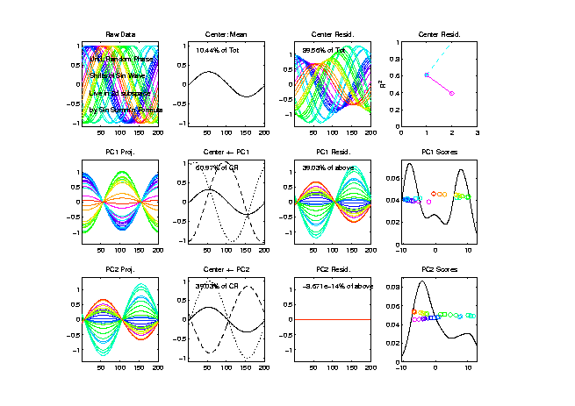
Sin-Cos Phase Shifts are Linear
n = 30
curves
Over
Random
Phases
$φ$

Slide 86
Sin-Cos Phase Shifts are Linear
n = 30
curves
Random Phase Shifts Captured in Just 2 PCs

Slide 87
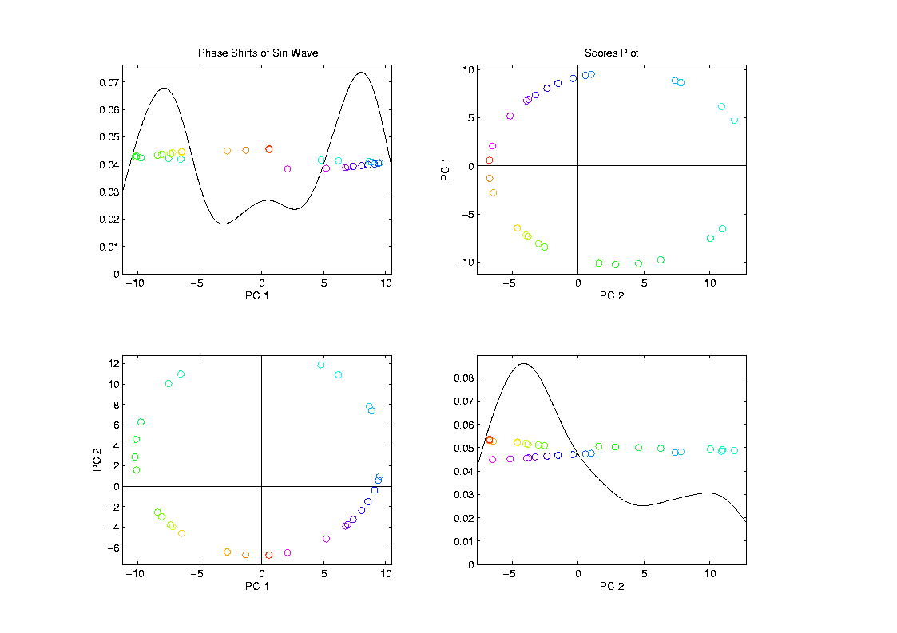
Sin-Cos Phase Shifts are Linear
Coefficents
(Scores)
Show
Circular
Pattern
Since plot of
$\sin{φ}$ vs.$\cos{φ}$,
from summation
formula $\cos{φ}\cos{x}+\sin{φ}\sin{x}$

Slide 88
Fourier Basis

Slide 89
Fourier Basis
Fourier Basis Facts:
Two Versions
Discrete (For Vectors in $ℝ^{d}$)
Continuous (For Curves in $L^{2}$)
Approximately Same (by Riemann Summation)
Thus use same graphics for each
Orthonormal Basis
Exactly true for both versions

Slide 90
Fourier Basis
Fourier Basis Facts:
Complete Basis (spans whole space)
Exactly True for both versions
Basis Elements are “Directions”
Will think about as above
Good References:
Brillinger (2001)
Bloomfield (2004)
(To Fourier Analysis of Time Series)

Slide 91
Fourier Basis

Slide 92
Yeast Cell Cycle Data, FDA View
Approach
Project on Period 2 Components Only
Calculate via Fourier Representation
Project onto Subspace of Even Frequencies
Keeps only 2-period part of data
(i.e. same over both cycles)
(note: subspace dimension = $d/2$)
Then do PCA on projected data

Slide 93
Fourier Basis

Slide 94
Yeast Cell Cycles, Freq. 2 Proj.
PCA on
Freq. 2
Periodic
Component
Of Data
Choice of Data Object

Slide 95
Yeast Cell Cycles, Freq. 2 Proj.
PCA on periodic component of data
Hard to see periodicities in raw data
But very clear in PC1 (~sin) and PC2 (~cos)
PC1 and PC2 explain 65% of variation (see residuals)
Recall linear combos of sin and cos capture “phase”, since:
$$\cos\left(x−φ\right)=\cos{φ}\cos{x}+\sin{φ}\sin{x}$$
$=c_{1}\cos{x}+c_{2}\sin{x}$

Slide 96
Frequency 2 Analysis
Most important features of data appear only at frequency 2,
Hence project data onto 2-dim space of sin and cos (freq. 2)
Useful view: scatterplot
Similar to PCA proj’ns, except “directions” are now chosen, not “var max’ing”

Slide 97
Frequency 2 Analysis
Colors are

Slide 98
Frequency 2 Analysis
Project data onto 2-dim space of sin and cos (freq. 2)
Useful view: scatterplot
Angle (in polar coordinates) shows phase
Colors: Spellman’s cell cycle phase classification
Black was labeled “not periodic”
Within class phases approx’ly same, but notable differences
Later will try to improve “phase classification”

Slide 99
Detailed Look at PCA
Now Study “Folklore” More Carefully
BackGround
History
(as noted on 8/22/17)
Early Use: Pearson (1901)
Name “PCA”: Hotelling (1935)

Slide 100
Detailed Look at PCA
Now Study “Folklore” More Carefully
BackGround
History
Underpinnings
(Mathematical & Computational)
Good Overall Reference: Jolliffe (2002)

Slide 101
PCA: Rediscovery – Renaming
Statistics:
Principal Component Analysis (PCA)
Social Sciences:
Factor Analysis (PCA is a subset)
Probability / Electrical Eng:
Karhunen – Loeve expansion
Applied Mathematics:
Proper Orthogonal Decomposition (POD)
Geo-Sciences:
Empirical Orthogonal Functions (EOF)

Slide 102
An Interesting Historical Note
The 1st (?) application of PCA to Functional Data Analysis:
Rao (1958)
1st Paper with “Curves as Data Objects” viewpoint

Slide 103
Detailed Look at PCA
Three Important (& Interesting) Viewpoints:
Mathematics
Numerics
Statistics
Goal: Study Interrelationships

Slide 104
Detailed Look at PCA
Three Important (& Interesting) Viewpoints:
Mathematics
Numerics
Statistics
1st: Review Linear Alg. and Multivar. Prob.

Slide 105
Course Background I
Linear Algebra
Please Check Familiarity
No? Read Up in Linear Algebra Text
Or Wikipedia?

Slide 106
Course Background I
Linear Algebra Key Concepts
Vector
Scalar
Vector Space (Subspace)
Basis
Dimension
Unit Vector Basis in $ℝ^{d}$
Linear Combo as Matrix Multiplication
$$\left\{\left(\begin{matrix}\begin{matrix}1 \\ 0\end{matrix} \\ \begin{matrix}⋮ \\ 0\end{matrix}\end{matrix}\right),⋯,\left(\begin{matrix}\begin{matrix}0 \\ ⋮\end{matrix} \\ \begin{matrix}0 \\ 1\end{matrix}\end{matrix}\right)\right\}$$

Slide 107
Course Background I
Linear Algebra Key Concepts
Matrix Trace
Vector Norm = Length
Distance in $ℝ^{d}$ = Euclidean Metric
Inner (Dot, Scalar) Product
Vector Angles
Orthogonality (Perpendicularity)
Orthonormal Basis

