Slide 1
AJIVE Data Structure
AJIVE Organizational Model:
Multiple Matrices
(Data Types, i.e. “Blocks”)
With common
Columns as Data Objects

Slide 2
HDLSS Asymptotics
Recall Various “Mysteries” about
High Dimension Low Sample Size Data
Natural Separation of $N_{1000}\left(0,I\right)$ Data
GWAS Failure of Spherical PCA
Strange behavior in HDLSS Classificat’n
Next Investigate Mathematics Of These
Notes:
2

Slide 3
0 Covariance is not independence
Parallel Conclusion:
Joint distribution of $X_{1},⋯,X_{d}$:
Has $cov\left(X,Y\right)=0$
Yet strong dependence of $X$ and $Y$
Shows covariance matrix $\sim I ⇏$
$⇏$ Independence
Only Have “$⇒$” for Gaussian Distributions

Slide 4
HDLSS Geometric Representation
Conditions for Geo. Rep’n & PCA Consist.:
John Kent example:
$$\underline{X}\sim 0.5N_{d}\left(\underline{0},I_{d}\right)+0.5N_{d}\left(\underline{0},{100∗I}_{d}\right)$$
Can only say: $\left\|\underline{X}\right\|=O_{p}\left(d^{1/2}\right)$ $\left(=\left\{\begin{matrix}d^{1/2} & w.p.\frac{1}{2} \\ 10d^{1/2} & w.p.\frac{1}{2}\end{matrix}\right. \right)$
not deterministic
Conclude: For Geo. Rep’n need Additional Condition
Reasonable Approach: Mixing Conditions

Slide 5
Mixing Conditions
Mixing Condition Used Here:
Rho – Mixing
For Random Variables ${\left\{Z_{j}\right\}}_{−∞}^{+∞}$, Define
$$ρ\left(m\right)=\sup_{j,f,g}\left|corr(f,g)\right|,$$
Where $f∈ℑ_{−∞}^{j}$, $g∈ℑ_{m+j}^{+∞}$
Assume: $\lim_{m→∞}{ρ\left(m\right)=0}$
Idea: Uncorrelated at Far Lags

Slide 6
HDLSS Geometric Representation
Conditions for Geo. Rep’n:
Hall, Marron and Neeman (2005):
Assume Entries of Data Vectors
Are $ρ$-mixing

Slide 7
HDLSS Geometric Representation
Conditions for Geo. Rep’n:
Condition from Jung & Marron (2009):
where
Define:
Assume: Ǝ a permutation,
So that is ρ-mixing

Slide 8
HDLSS Math. Stat. of PCA
Consistency (big enough spike):
For $α>1$,
$$Angle\left(u_{1},{\hat{u}}_{1}\right)→0$$
Strong Inconsistency (spike not big enough):
For $α<1$,
$$Angle\left(u_{1},{\hat{u}}_{1}\right)→{90}^{°}$$

Slide 9
HDLSS Math. Stat. of PCA
PC Scores (i.e. projections)
Not Consistent
So how can PCA find Useful Signals in Data?
Key is “Proportional Errors” $\frac{{\hat{s}}_{i,j}}{s_{i,j}}→R_{j}≠1$
Axes have Inconsistent Scales,
But Relationships are Still Useful

Slide 10
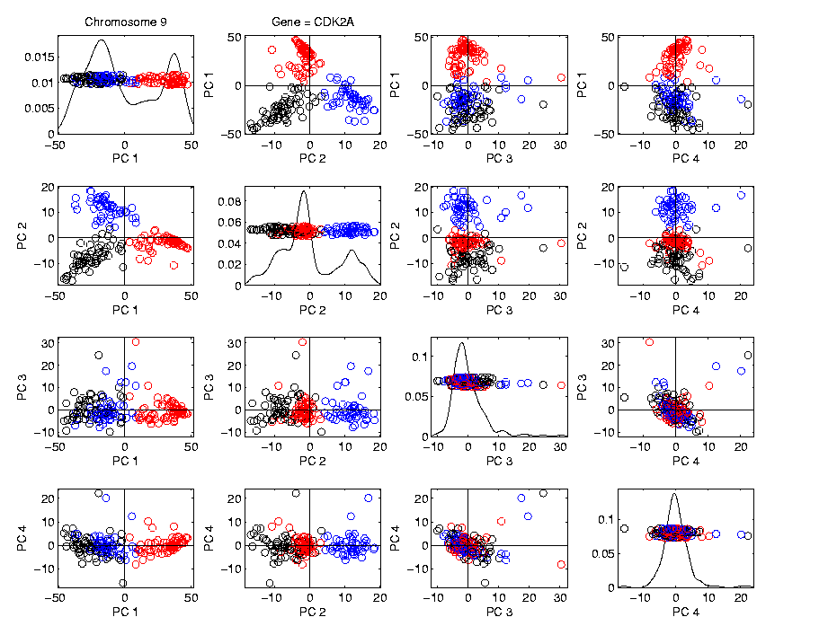
HDLSS Math. Stat. of PCA
Numbers
On Axes
Are Wrong
But
Relationships
Are Right

Slide 11
HDLSS Analysis of DiProPerm
Wei et al (2015)
Mathematically Driven Recommendation:
Use Mean Difference Summary to Focus on:
$H_{0}: μ_{1}=μ_{2}$ vs. $H_{0}: μ_{1}≠μ_{2}$

Slide 12
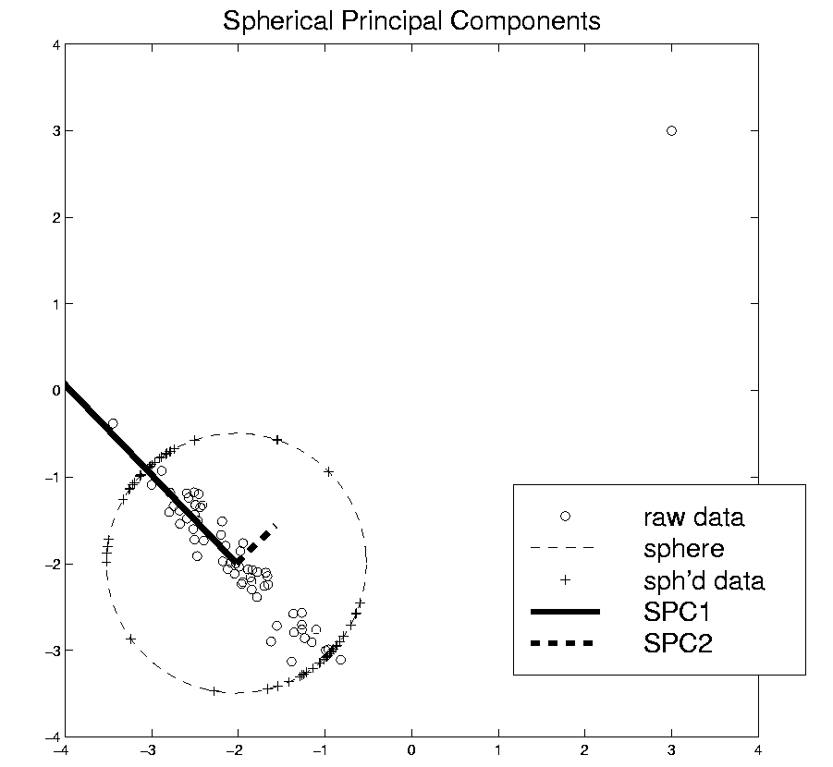
HDLSS Robust PCA
Recall Robust PCA via Spherical Projection

Slide 13
GWAS Data Analysis
PCA View
Clear Ethnic
Groups
And Several
Outliers!
Eliminate With
Spherical PCA?

Slide 14
GWAS Data Analysis
Spherical
PCA
Looks Same?!?
What is
going on?
Will Explain
Later

Slide 15
HDLSS Asymptotics in Classification
Explanation:
HDLSS geometric representation
Recall in limit as $d→∞$ with $n$ fixed,
Data lie near surface of $\sqrt{d}$-sphere
Data tend to be ~orthogonal
Family members are half the same
Thus relatively small angle $\left(\sim {60}^{°}\right)$
Enough for families to dominate PCs
Spherical PC doesn’t change anything!

Slide 16
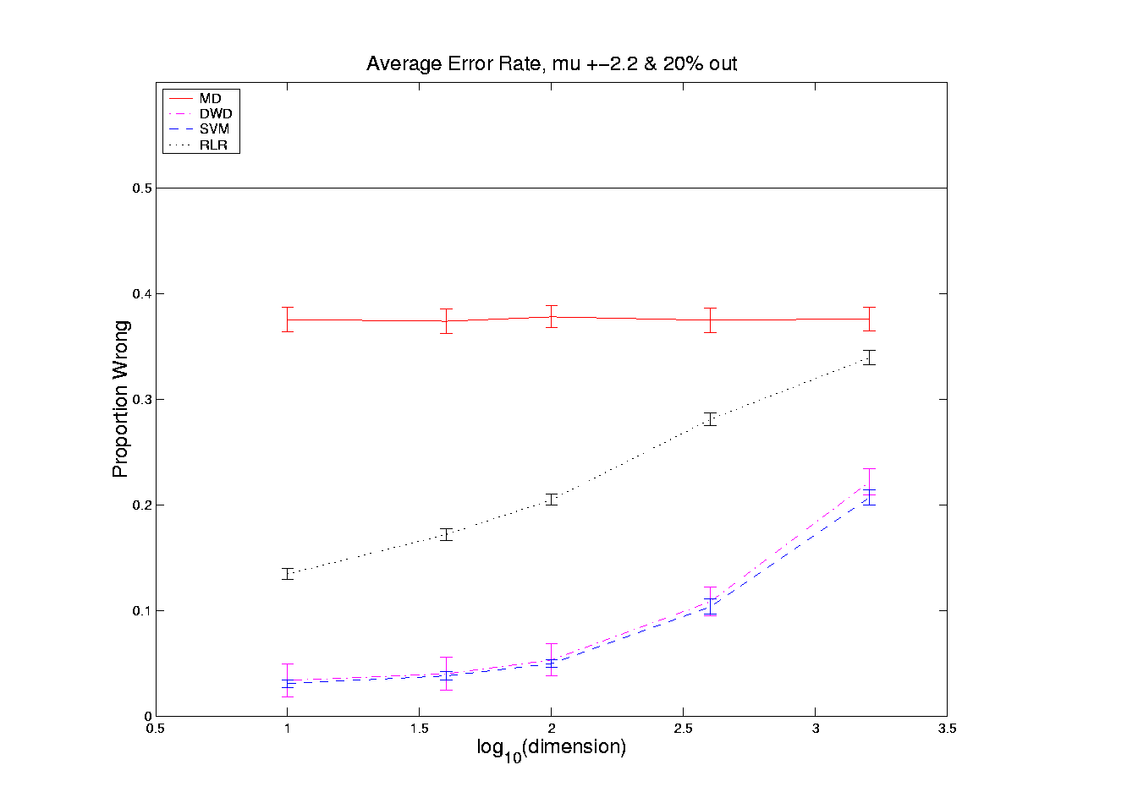
HDLSS Asymptotics in Classification
Recall in Simulations,
Methods Came Together, for High $d$

Slide 17
HDLSS Asymptotics in Classification
Explanation of Observed (Simulation) Behavior:
“everything similar for very high d ”
2 popn’s are 2 simplices (i.e. regular n-hedrons)
All are same distance from the other class
i.e. everything is a support vector
i.e. all sensible directions show “data piling”
so “sensible methods are all nearly the same”

Slide 18
HDLSS Asymptotics
Personal Observations:
HDLSS world is…
Surprising (many times!)
[Think I’ve got it, and then …]
Mathematically Beautiful (?)
Practically Relevant

Slide 19
The Future of HDLSS Asymptotics
“Contiguity” in Hypo Testing?
Rates of Convergence?
Improvements of DWD?
(e.g. other functions of distance than inverse)
Many Others?
It is still early days …
(Will do more later in course)

Slide 20
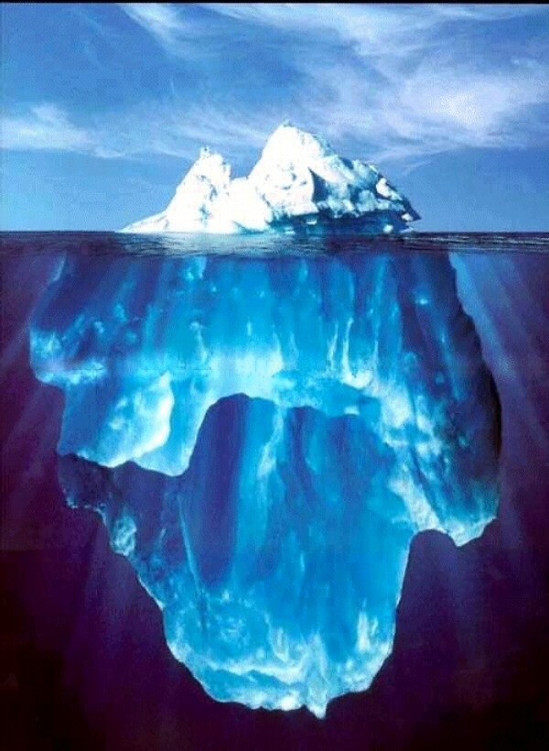
State of HDLSS Research?
Development
Of Methods
Mathematical
Assessment
…
(thanks to:
defiant.corban.edu/gtipton/net-fun/iceberg.html)

Slide 21
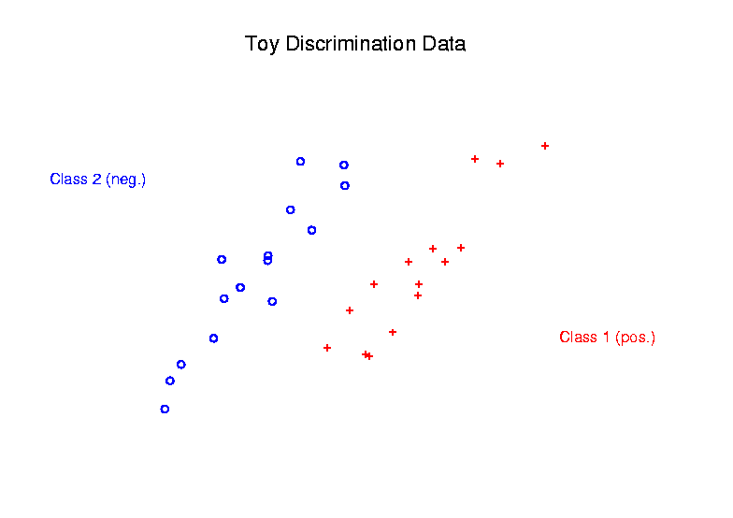
Radial DWD
Main Idea:
Linear Classifiers Good When Each Class Lives in a Distinct Region
Notes:
21

Slide 22
Radial DWD
Main Idea:
Linear Classifiers Good When Each Class Lives in a Distinct Region
Hard When All Members Of One Class Are Outliers in a Random Direction
Notes:
22

Slide 23
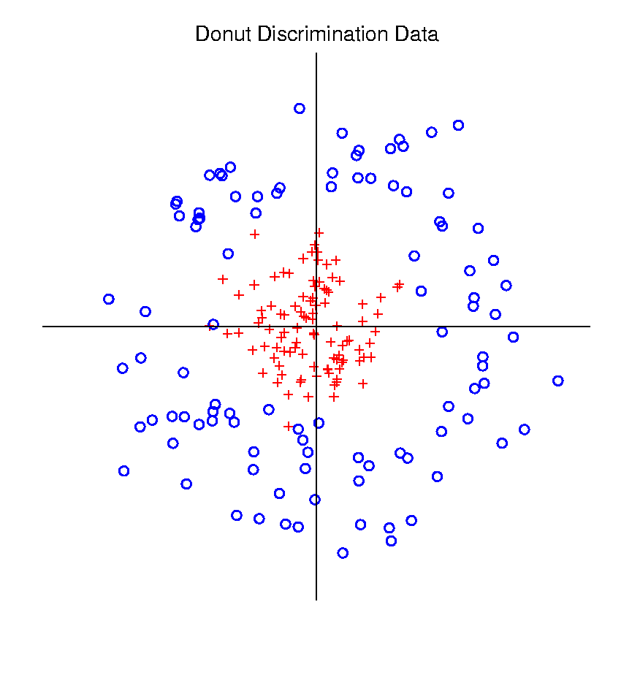
Radial DWD
Hard When All Members Of One Class Are Outliers in a Random Direction
Think HDLSS
Version of
Notes:
23

Slide 24
Radial DWD
Hard When All Members Of One Class Are Outliers in a Random Direction
E.g. Normal Cases
& Randomly Degraded
Notes:
24

Slide 25
Radial DWD
Reference:
Xiong, Dittmer & Marron (2016)
Notes:
25

Slide 26
Radial DWD
Motivating Example: Virus Hunting
Based on DNA
DNA in Sample is Amplified & Cut Up
Matched to Known Virus Genome
Data Objects: Counts $\underline{x}=\left(\begin{matrix}x_{1} \\ ⋮ \\ x_{d}\end{matrix}\right)$
Notes:
26

Slide 27
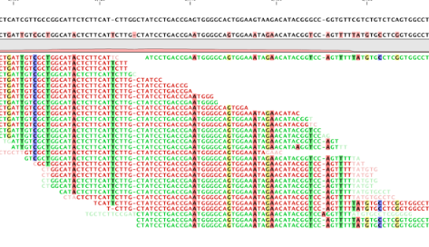
Virus Hunting
“Reads” Matched to Virus Genome & Counted to give $x_{1},⋯,x_{d}$
Notes:
27

Slide 28
Virus Hunting
Challenge 1:
Highly Variable DNA Amplification
Solution:
Standardize by Dividing by Total
Notes:
28

Slide 29
Virus Hunting
Standardize by Dividing by Total
Consequence:
Data Objects lie on Unit Simplex
$$\left\{\underline{x}=\left(\begin{matrix}x_{1} \\ ⋮ \\ x_{d}\end{matrix}\right):x_{1},⋯x_{d}≥0,\sum_{j=1}^{d}{x_{j}}=1\right\}$$
Notes:
29

Slide 30
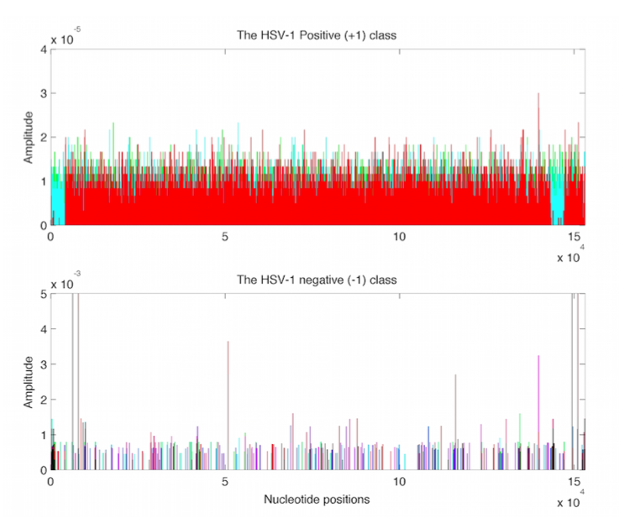
Virus Hunting
Look at
Data:
Mostly
Non-0
Near Simplex Center
Almost
All 0
Near Simplex Corners
Notes:
30

Slide 31
Virus Hunting
Look at
Data:
Note:
Heights
Orders of
Magnitude
-5 << -3
Different
Notes:
31

Slide 32
Virus Hunting
Note: HDLSS situation: $d\sim 10,000s n\sim 100s$
Have usual asymptotics?
Recall:
$\left\|{\underline{x}}_{i}\right\| \sim \sqrt{d}$
$\left\|{\underline{x}}_{i}−{\underline{x}}_{j}\right\| \sim \sqrt{2d}$
Notes:
32

Slide 33
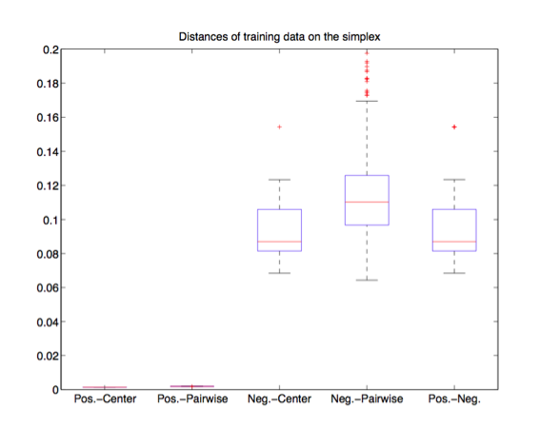
Virus Hunting
Check
HDLSS
Dist’s
Notes:
33

Slide 34
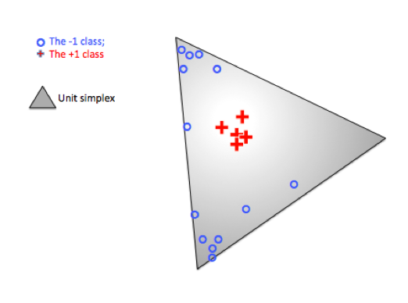
Radial DWD
Thought
Model:
+ Class
Near Center
- Class At
Random
Corners
Note: $∃$ Many ($d$) Corners
Notes:
34

Slide 35
Radial DWD
Consider Training Data
+ Class in Center
- Class Really in
Multiple Corners
Notes:
35

Slide 36
Radial DWD
Consider Training Data
Classify Using
Separating Plane
Notes:
36

Slide 37
Radial DWD
Consider Training Data
But What About
Test Point In A
Different Corner
???
Notes:
37

Slide 38
Radial DWD
Approach:
Replace Separating Plane
With Separating Sphere
Find Parameters
Via DWD-like
Optimization
Enables Finding Corners
With No Training Data
Notes:
38

Slide 39
Virus Hunting
Real Data Result:
Train +
Train –
Test +
Related
Test -
Notes:
39

Slide 40
Virus Hunting
Compare With Other Classifiers
Includes Above Radial DWD
Notes:
40

Slide 41
Virus Hunting
Compare With Other Classifiers
Linear Methods All Poor
Notes:
41

Slide 42
Virus Hunting
Compare With Other Classifiers
Even Kernel SVM Fails!!!
Reason:
Test Data
Lies In
Corners
With No
Training
Data
Notes:
42

Slide 43
Radial DWD
Verify With Simulation Study
Note: Very Similar Behavior!
Notes:
43

Slide 44
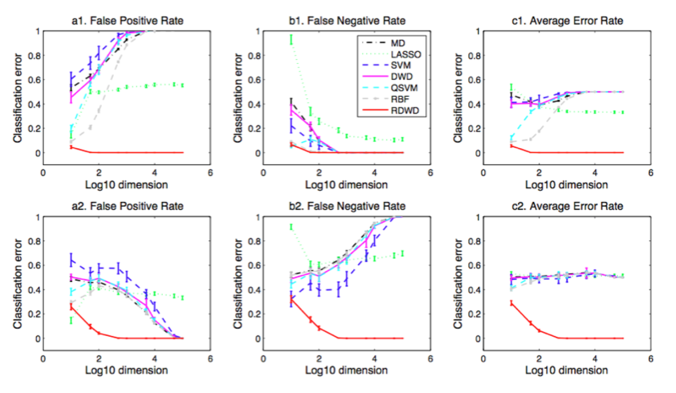
Radial DWD
Verify With Simulation Study
Stunning Test Classificat’n Rates as $d$ grows!
Notes:
44

Slide 45
Melanoma Data
Study Differences Between
(Malignant) Melanoma & (Benign) Nevi
Use Image Features From 9/5/17
(Recall from Transformation Discussion)
Paper: Miedema et al (2012)

Slide 46
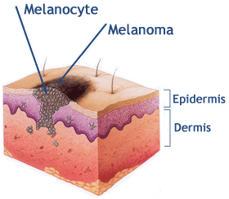
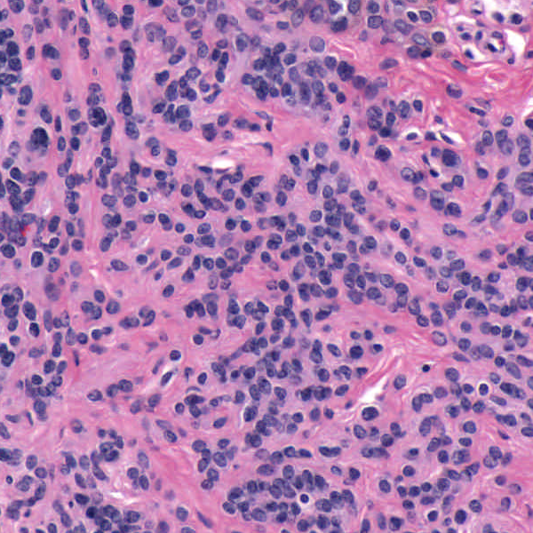
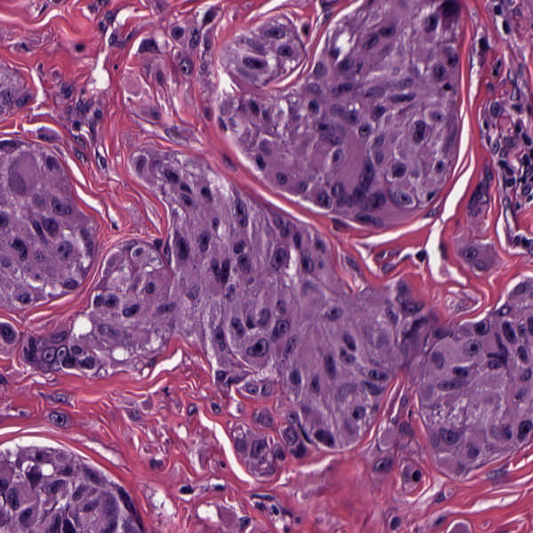
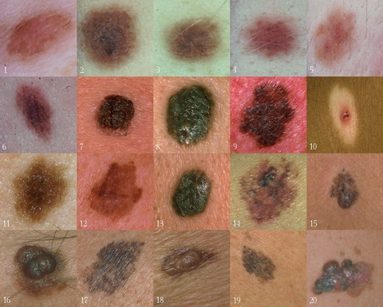
Background
Goal
Image Analysis of Histology Slides
Image: www.melanoma.ca
Benign
Melanoma
1 in 75 North Americans will develop a
malignant melanoma in their lifetime.
Initial goal: Automatically segment nuclei.
Challenge: Dense packing of nuclei.
Ultimately: Cancer grading and patient survival.
Image: melanoma.blogsome.com

Slide 47
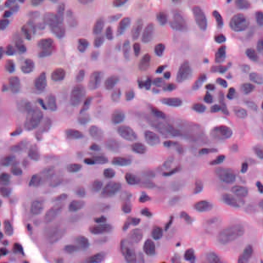
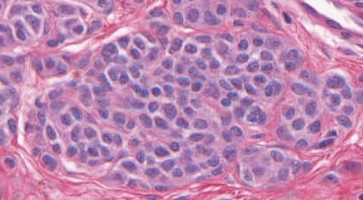
Feature Extraction
Features from Cell Nuclei
Delaunay Triangulation
Conventional Nevus
Superficial Spreading Melanoma
Triangulation of nuclear centers
Used for various density features:
Mean Delaunay, Max. Delaunay, etc.

Slide 48
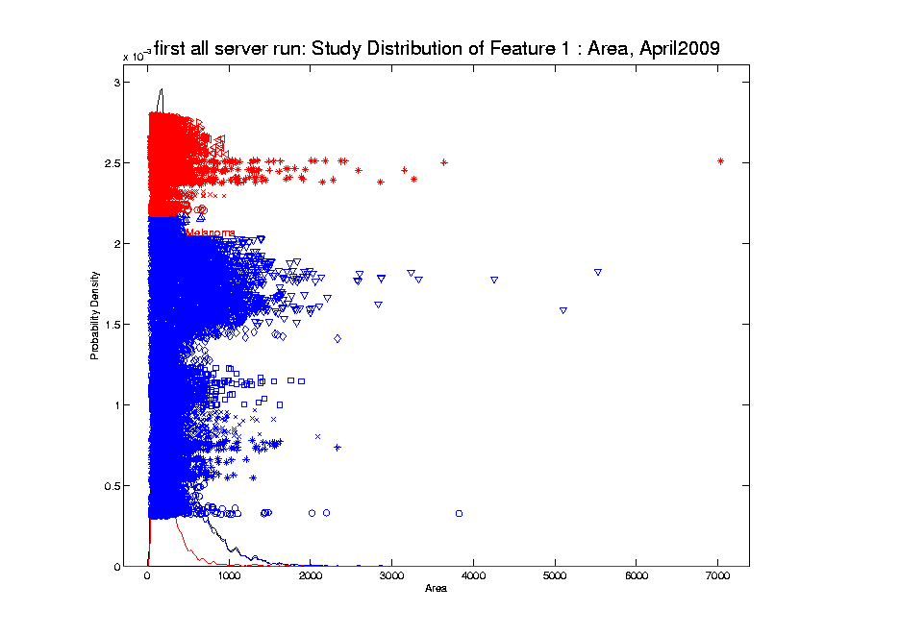
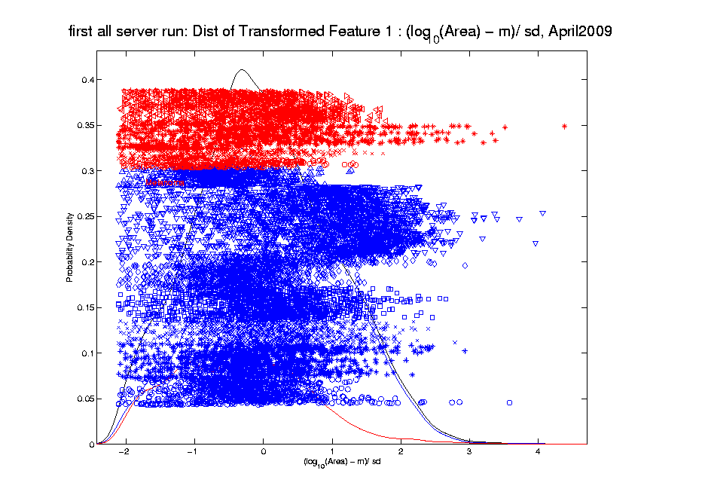
Melanoma Data
Recall From 9/5/17:
Studied
Transformation
Of This
Data

Slide 49
Melanoma Data
Study Differences Between
(Malignant) Melanoma & (Benign) Nevi
Explore with PCA View

Slide 50
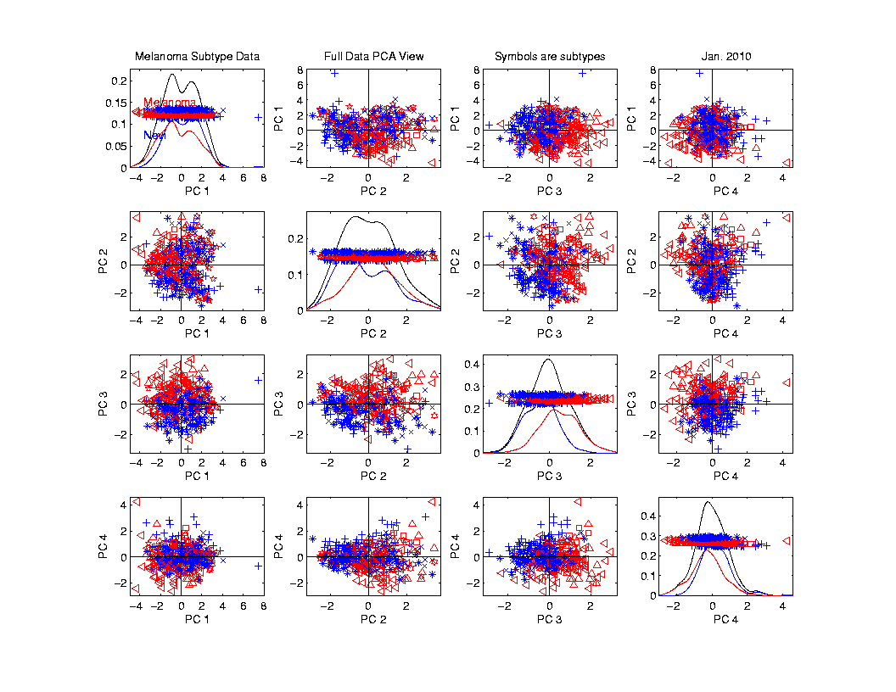
Melanoma Data
PCA
View

Slide 51
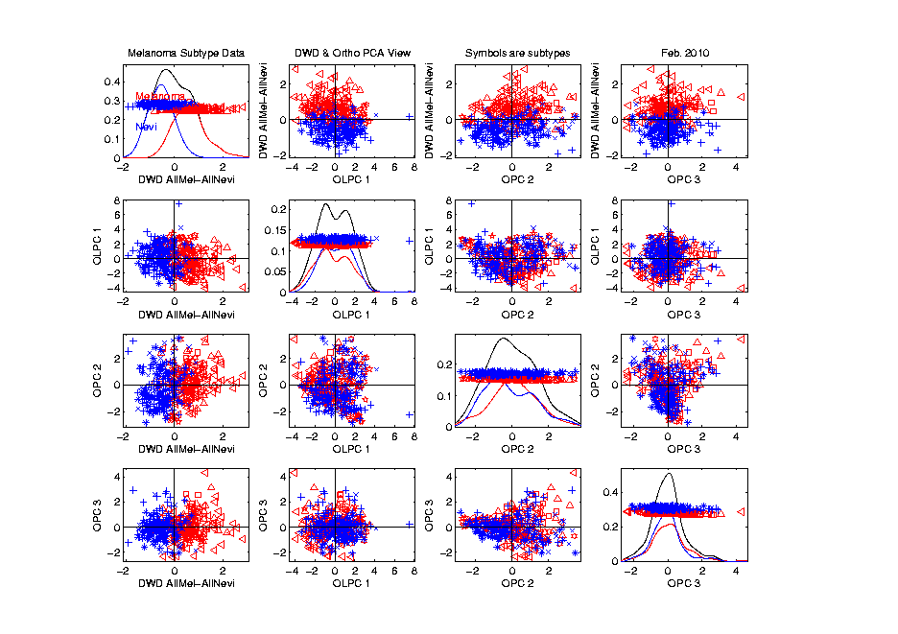
Melanoma Data
Rotate
To DWD
Direction
“Good”
Separation
???

Slide 52
Melanoma Data
Rotate
To DWD
Direction
Orthogonal
PCs
Avoid
Strange
Projections

Slide 53
Melanoma Data
Return
To
PCA
View
And
Focus
On
Subtypes

Slide 54
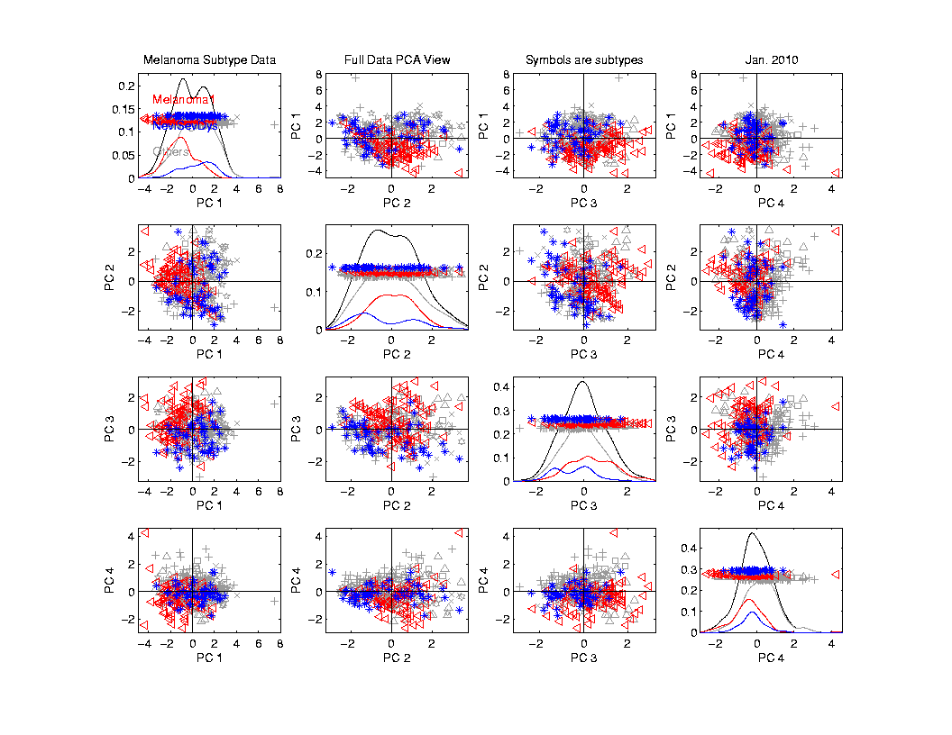
Melanoma Data
Focus
On
Subtypes:
Melanoma 1
Sev. Dys.
Nevi
Gray Out
Others

Slide 55
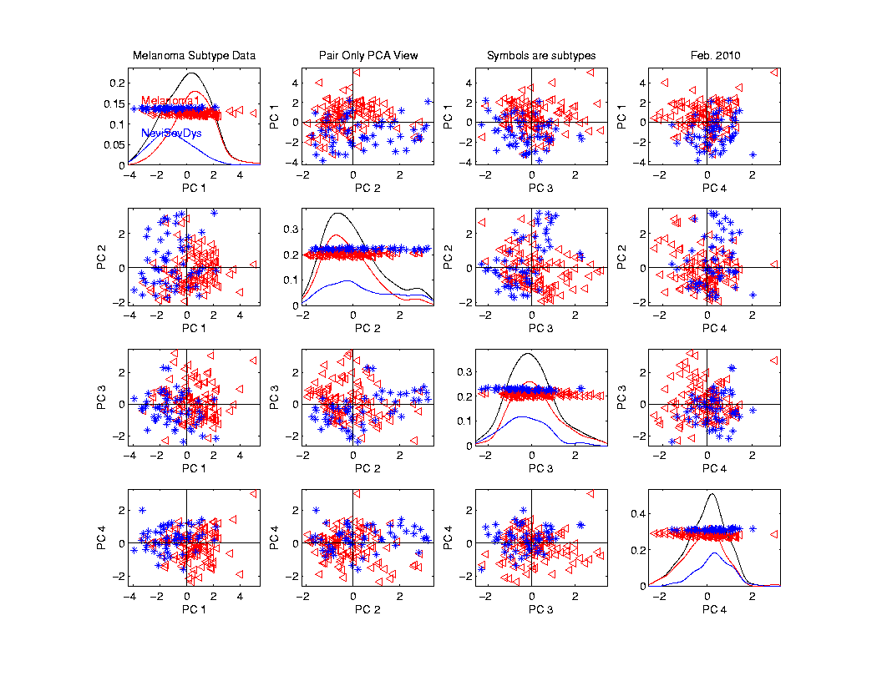
Melanoma Data
Rotate
To
Pairwise
Only
PCA
Separation
From PC1
And PC4

Slide 56
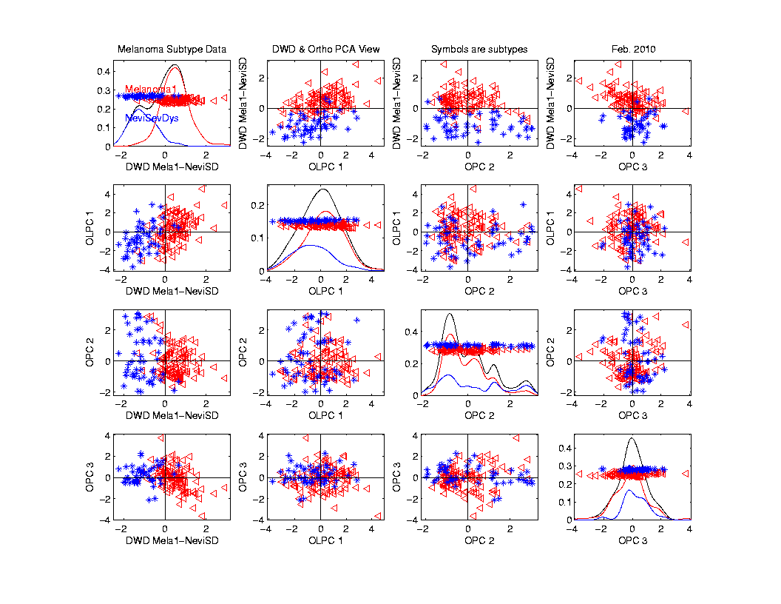
Melanoma Data
Rotate
To DWD
& Ortho PCs
Better
Separation
Than Full
Data???

Slide 57
Melanoma Data
Full Data
DWD
Direction
“Good”
Separation
???

Slide 58
Melanoma Data
Challenge:
Measure “Goodness of Separation”
Could use DiProPerm Hypothesis Test
Alternate Approach from Signal Detection:
Receiver Operator Characteristic
(ROC) Curve

Slide 59
ROC Curve
Challenge:
Measure “Goodness of Separation”
Approach from Signal Detection:
Receiver Operator Characteristic
(ROC) Curve
Developed in WWII, History in
Green and Swets (1966)

Slide 60
ROC Curve
Challenge:
Measure “Goodness of Separation”
Approach from Signal Detection:
Receiver Operator Characteristic
(ROC) Curve
Good Modern Treatment:
DeLong, DeLong & Clarke-Pearson (1988)

Slide 61
ROC Curve
Challenge:
Measure “Goodness of Separation”
Idea: For Range of Cutoffs
Plot:
Prop’n +1’s Smaller than Cutoff
Vs.
Prop’n -1s Smaller than Cutoff

Slide 62
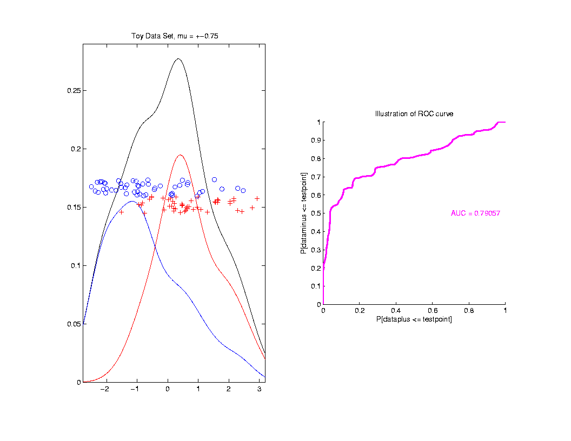
ROC Curve
Aim:
Quantify
“Overlap”
Approach
Consider
Series
Of Cutoffs

Slide 63
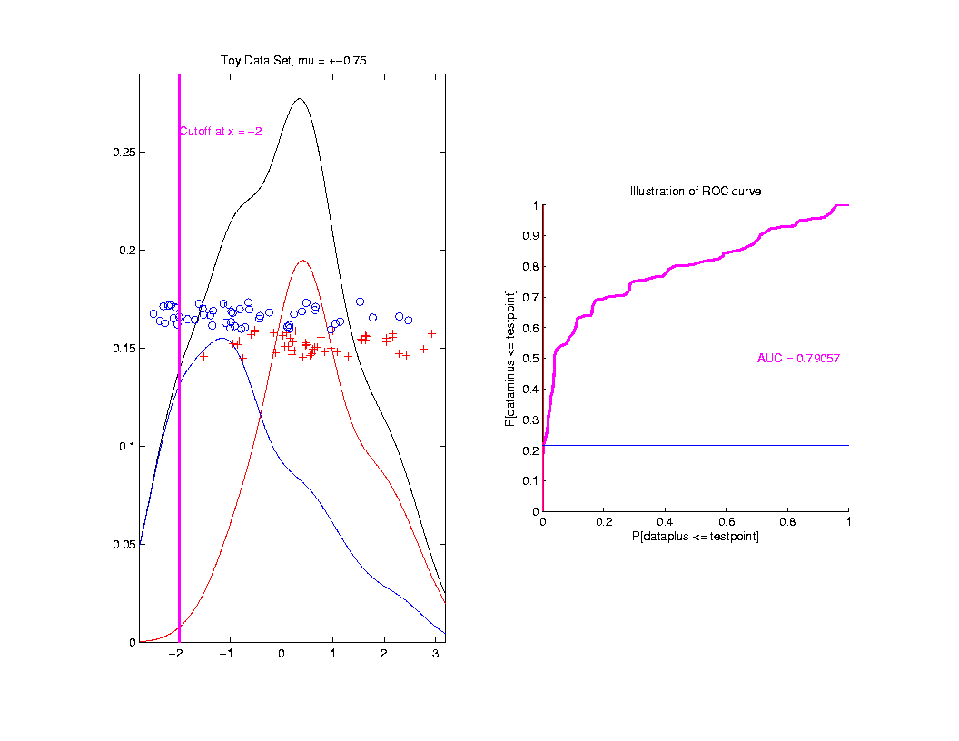
ROC Curve
Approach
Consider
Series
Of Cutoffs

Slide 64
ROC Curve
X-coord
Is Prop’n
Of Reds
Smaller

Slide 65
ROC Curve
X-coord
Is Prop’n
Of Reds
Smaller
Y-coord
Is Prop’n
Of Blues
Smaller

Slide 66
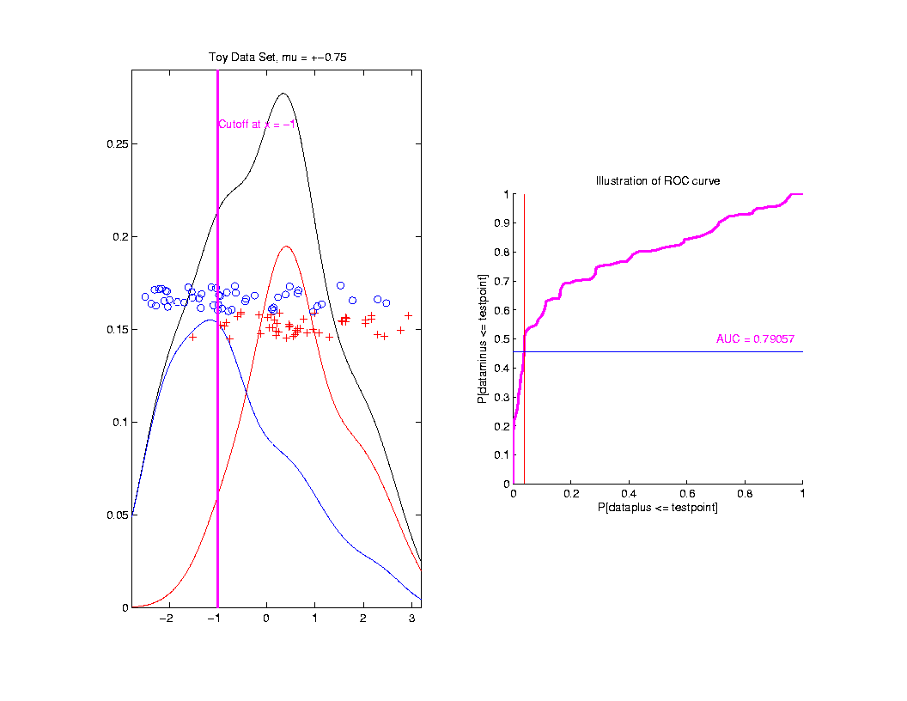
ROC Curve
Slide
Cutoff
To
Trace
Out
Curve

Slide 67
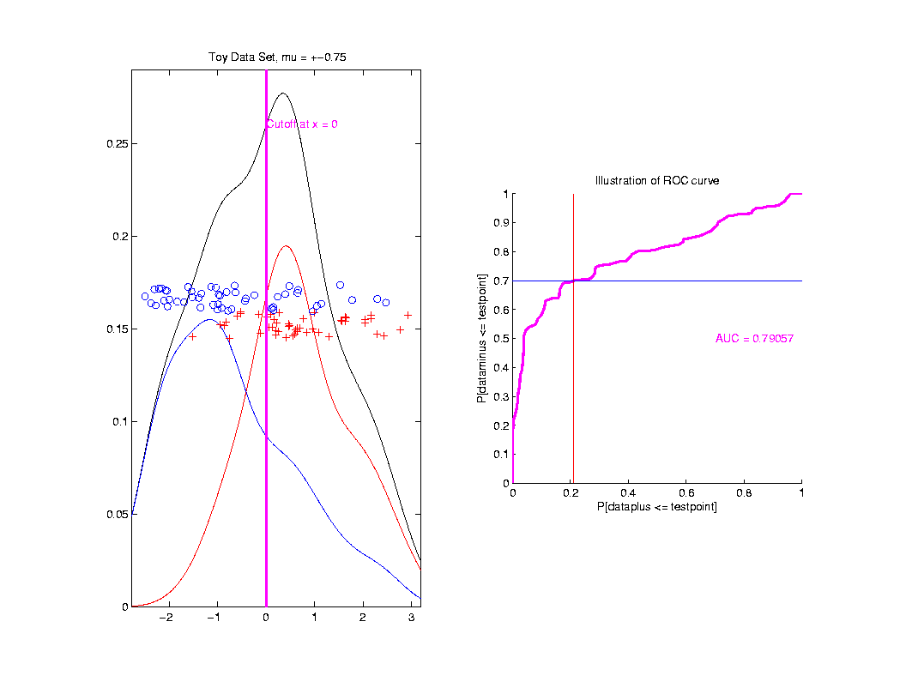
ROC Curve
Slide
Cutoff
To
Trace
Out
Curve

Slide 68
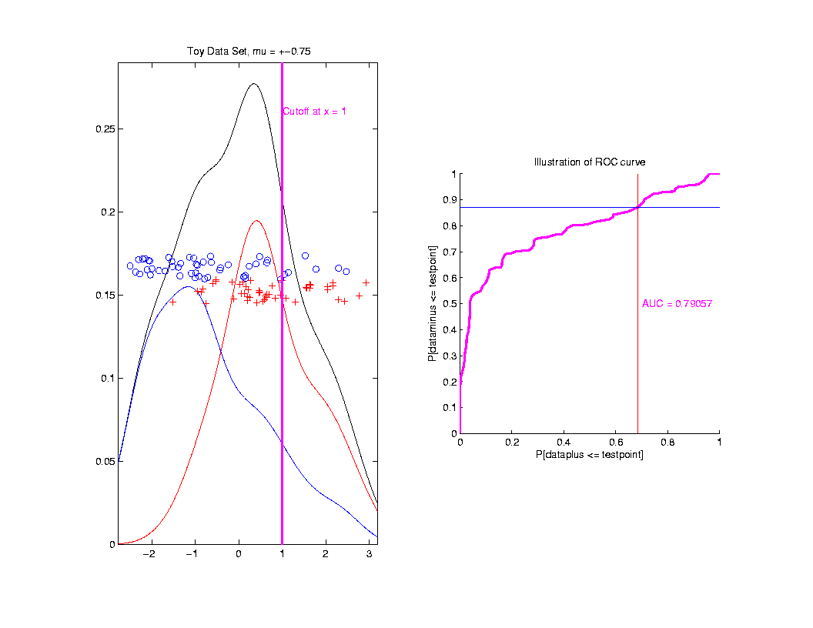
ROC Curve
Slide
Cutoff
To
Trace
Out
Curve

Slide 69
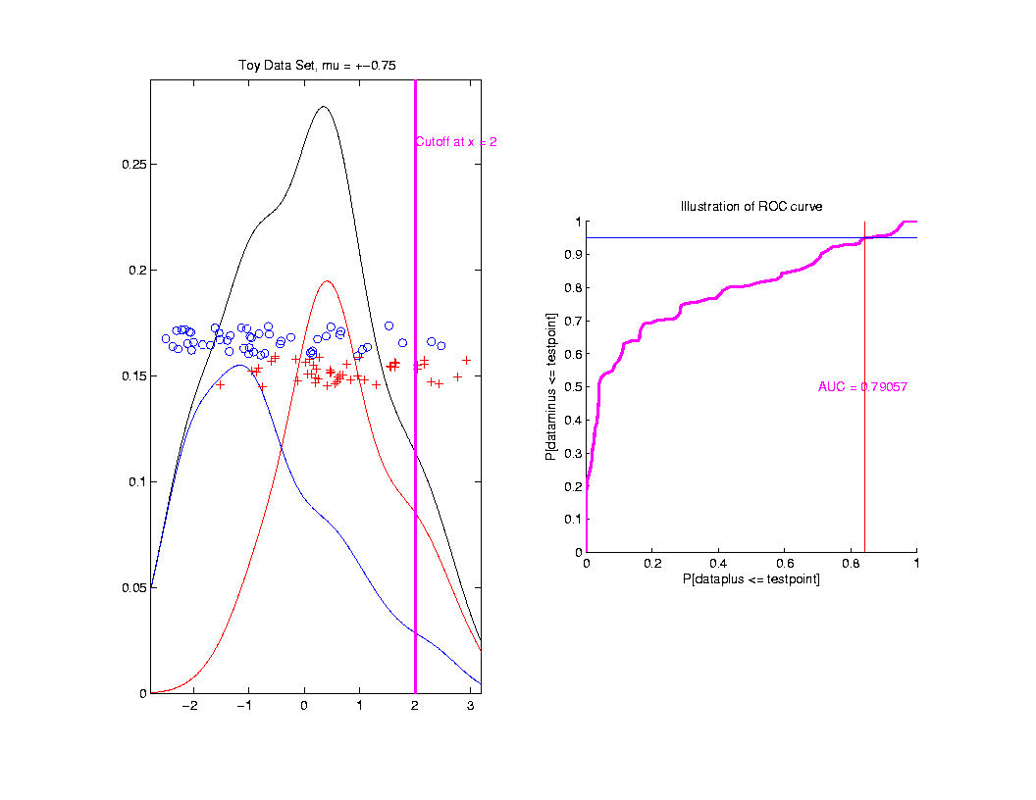
ROC Curve
Slide
Cutoff
To
Trace
Out
Curve

Slide 70
ROC Curve
Better
Separation
Is “More
To Upper
Left”

Slide 71
ROC Curve
Summarize
& Compare
Using
Area
Under
Curve
(AUC)

Slide 72
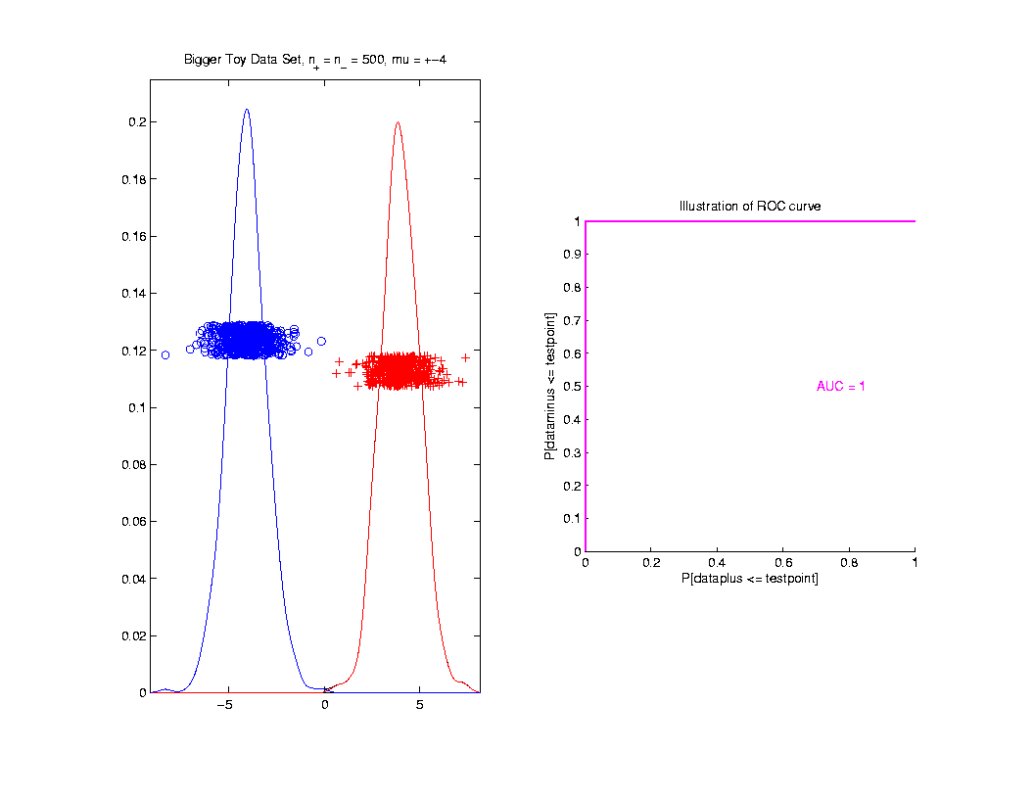
ROC Curve
Toy
Example
Perfect
Separation

Slide 73
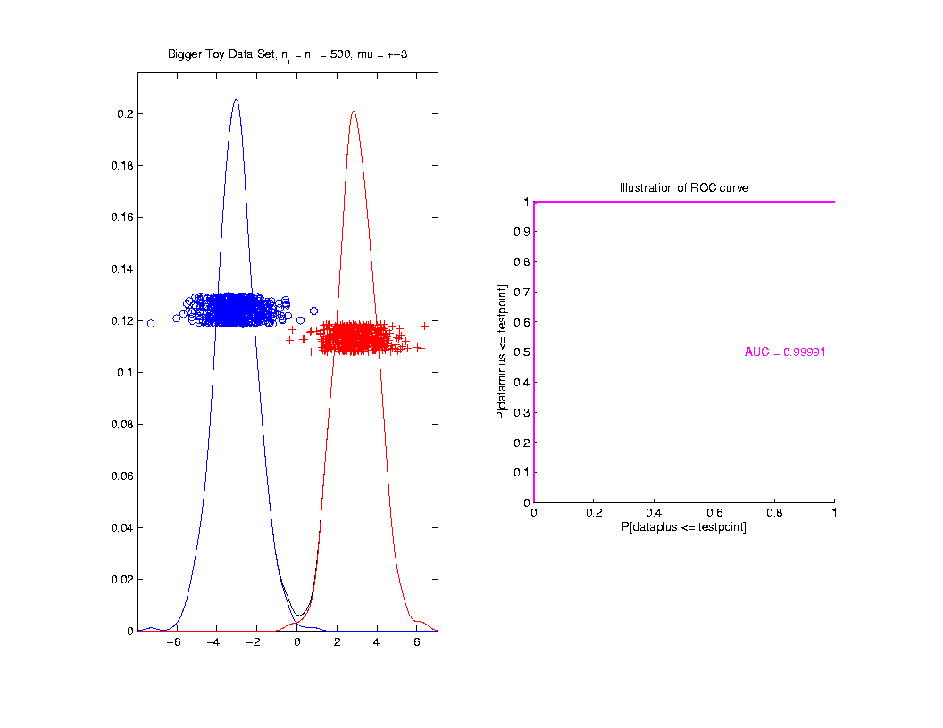
ROC Curve
Toy
Example
Very
Slight
Overlap

Slide 74
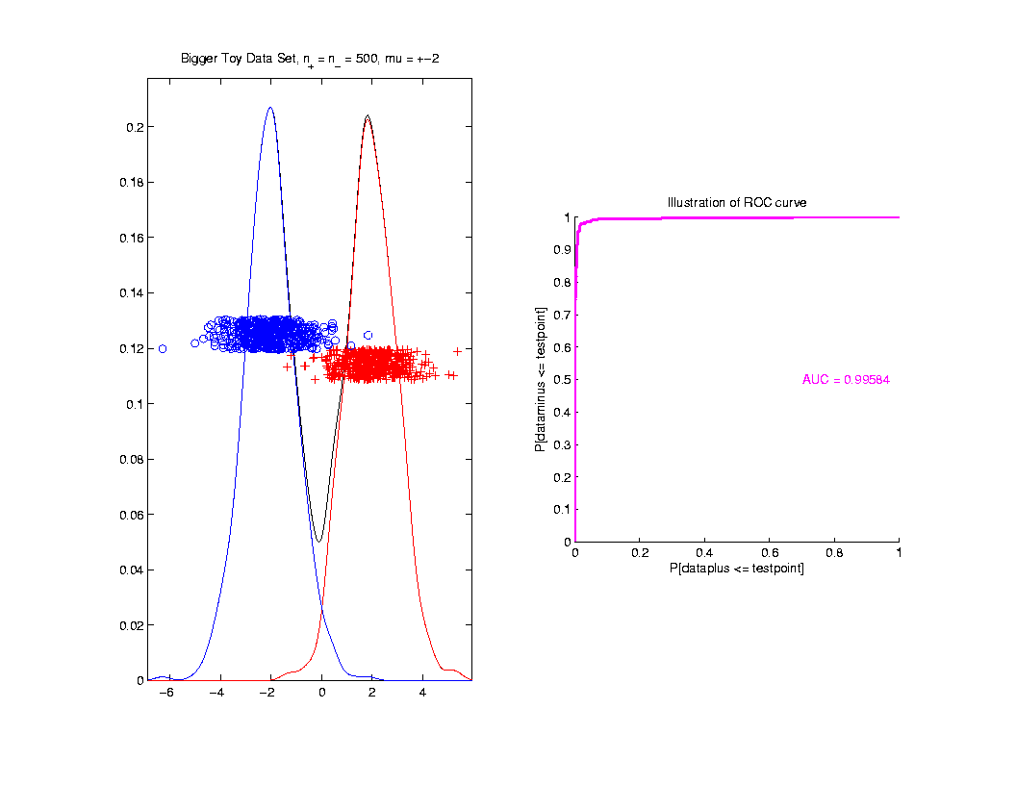
ROC Curve
Toy
Example
Little
More
Overlap

Slide 75
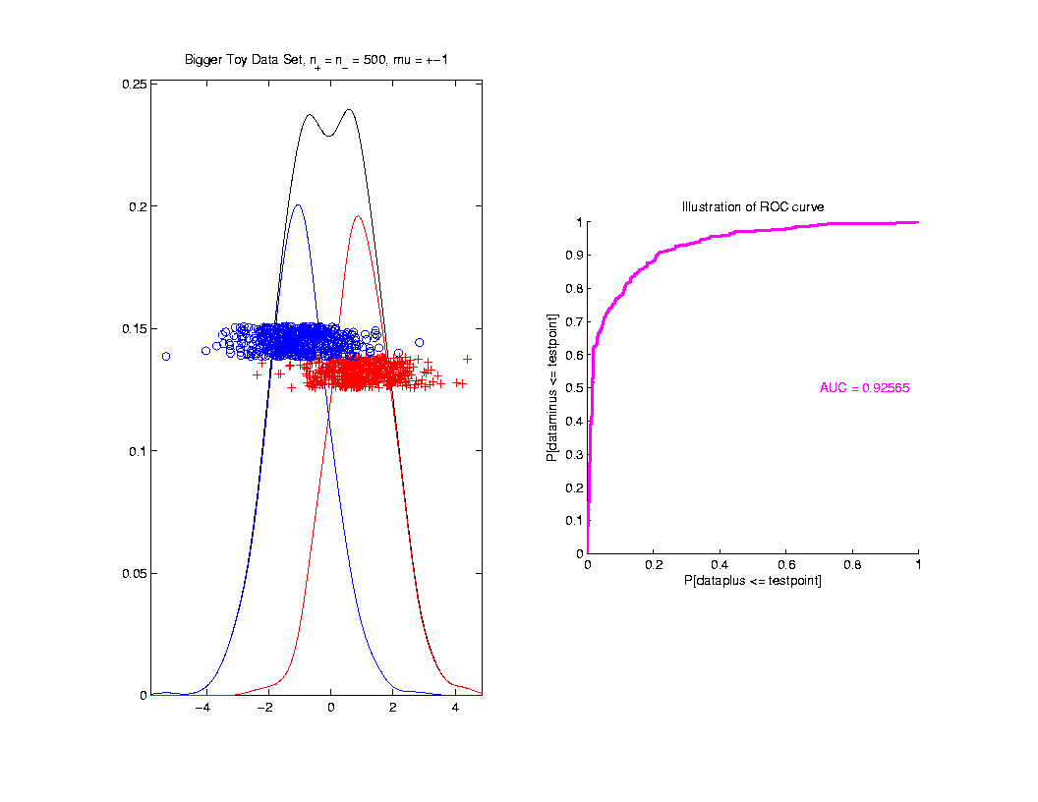
ROC Curve
Toy
Example
More
Overlap

Slide 76
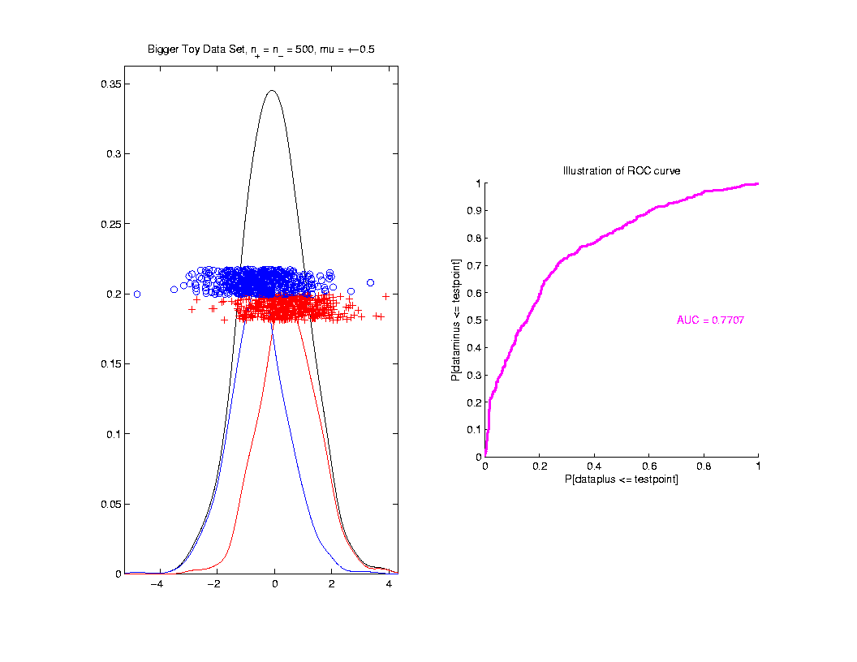
ROC Curve
Toy
Example
Much
More
Overlap

Slide 77
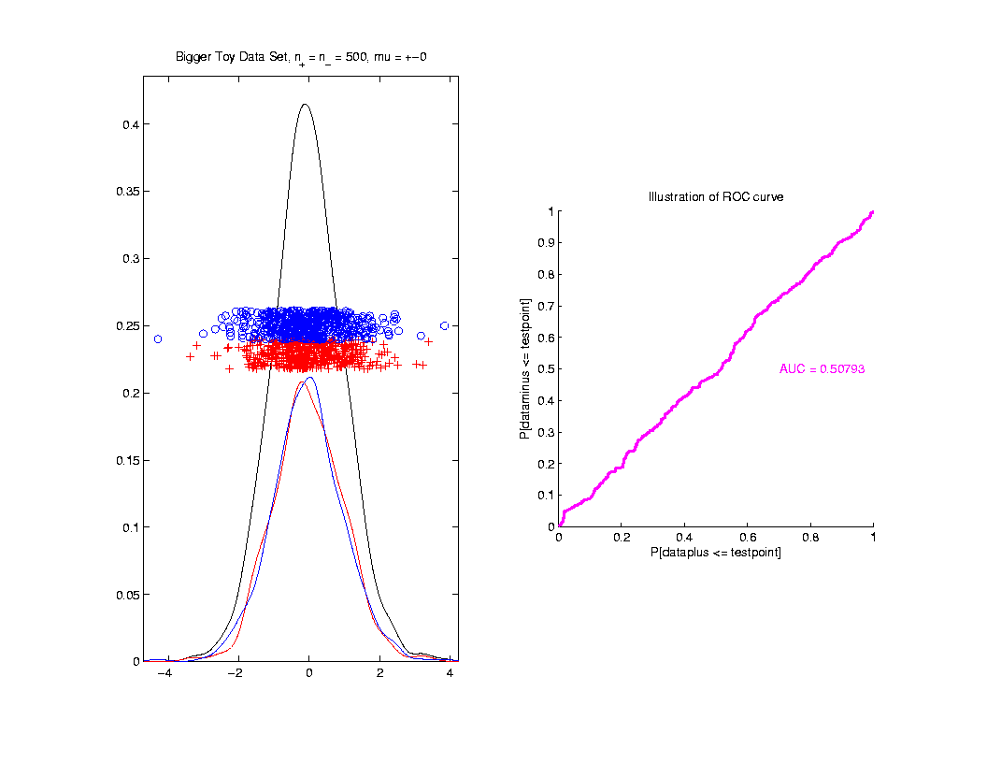
ROC Curve
Toy
Example
Complete
Overlap

Slide 78
ROC Curve
Toy
Example
Complete
Overlap
AUC ≈ 0.5 Reflects “Coin Tossing”

Slide 79
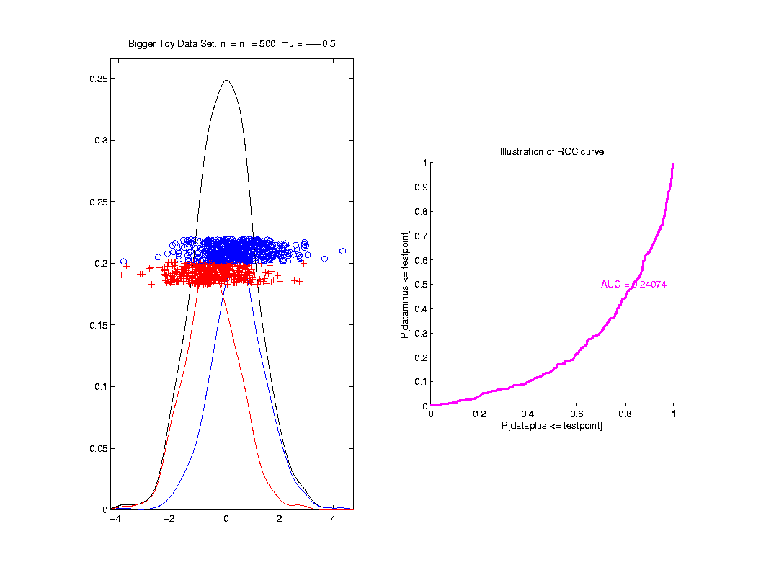
ROC Curve
Toy
Example
Can
Reflect
“Worse
Than Coin
Tossing”

Slide 80
ROC Curve
Interpretation of AUC:
Very Context Dependent
Radiology:
“> 70% has Predictive Usefulness”
Varies Field by Field
Bigger is Better

Slide 81
Melanoma Data
Recall Question:
Which Gives Better Separation of
Melanoma vs. Nevi?
DWD on All Melanoma vs. All Nevi
DWD on Melanoma 1 vs. Sev. Dys. Nevi

Slide 82
Melanoma Data
Subclass
DWD
Direction

Slide 83
Melanoma Data
Full Data
DWD
Direction

Slide 84
Melanoma Data
Recall Question:
Which Gives Better Separation of
Melanoma vs. Nevi
DWD on All Melanoma vs. All Nevi
DWD on Melanoma 1 vs. Sev. Dys. Nevi

Slide 85
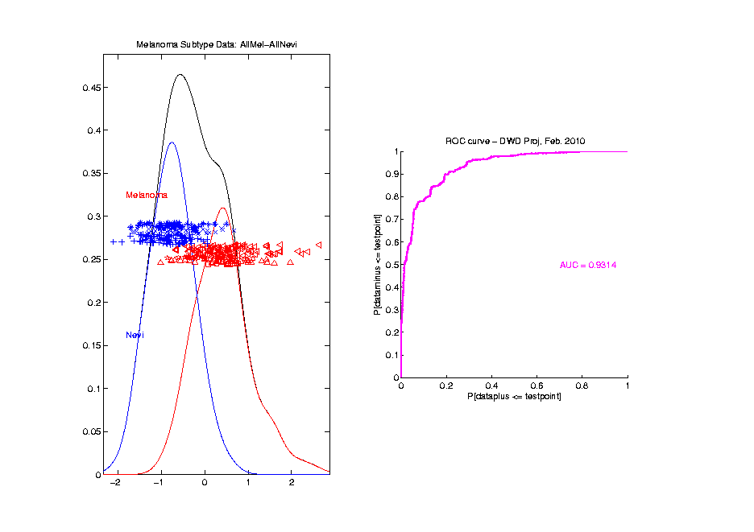
Melanoma Data
Full Data
ROC
Analysis
AUC = 0.93

Slide 86
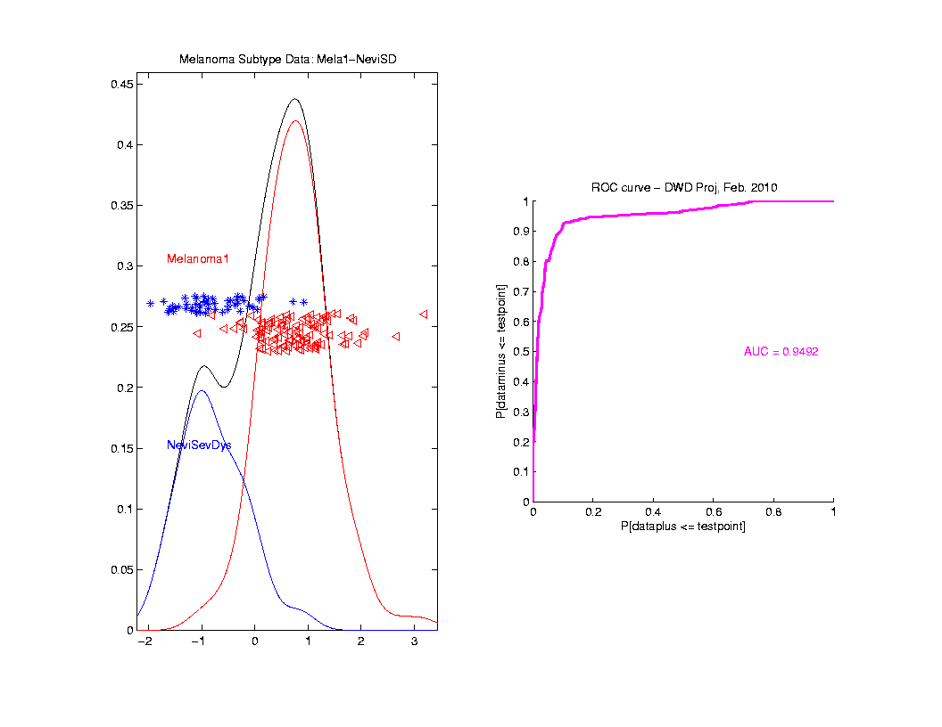
Melanoma Data
SubClass
ROC
Analysis
AUC = 0.95
Better,
Makes
Intuitive
Sense

Slide 87
Clusters in data
Common Statistical Task:
Find Clusters in Data
Interesting sub-populations?
Important structure in data?
How to do this?
PCA & visualization is very simple approach
There is a large literature of other methods
(will study more later)

Slide 88
PCA to find clusters
Toy Example (2 clusters)

Slide 89
PCA to find clusters
Toy Example (2 clusters)
Dominant direction finds very distinct clusters
Skewer through meatballs (in point cloud space)
Shows up clearly in scores plot
An important use of scores plot is finding such structure

Slide 90
PCA to find clusters
Recall Toy Example with more clusters:

Slide 91
PCA to find clusters
Best revealed by 2d scatterplots (4 clusters):

Slide 92
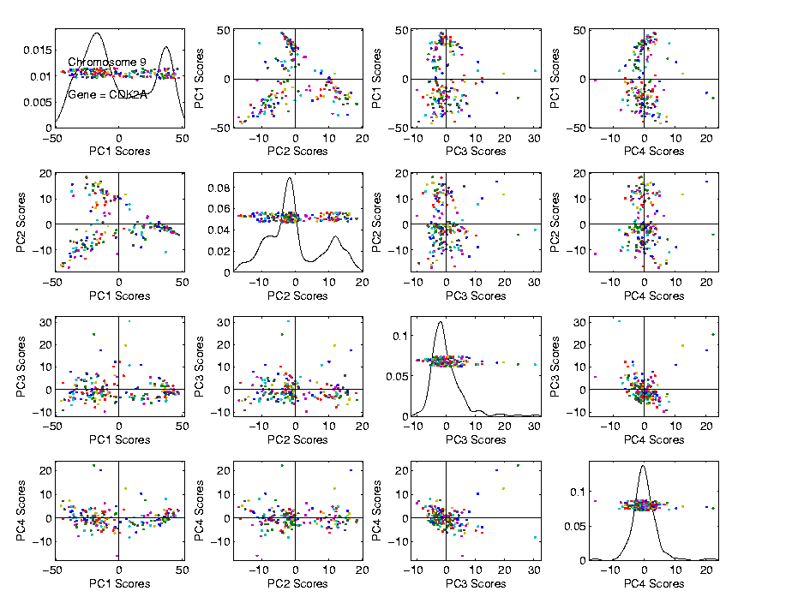
PCA to find clusters
Recall Data Discovery in RNAseq Data (8/24/17)

Slide 93
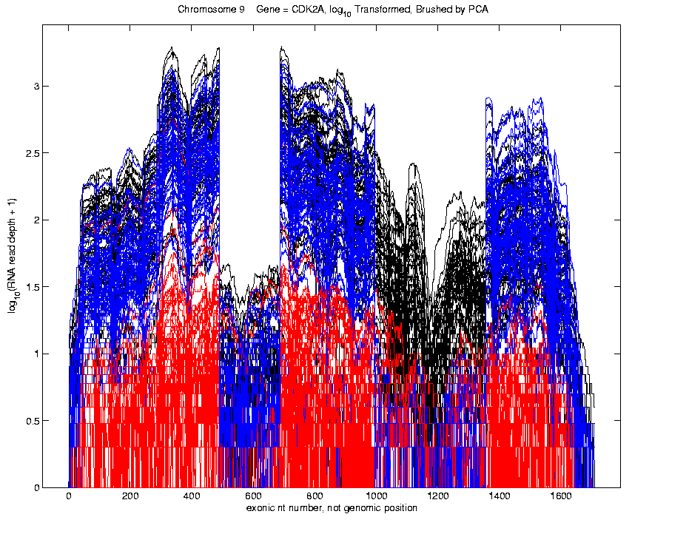
PCA to find clusters
Recall Data Discovery in RNAseq Data (8/24/17)
Used
Brushing
To Visualize
Clusters

Slide 94
PCA to find clusters
Caution: there are limitations…
Revealed by NCI60 data
Recall Microarray data
With 8 known different cancer types
Could separate out clusters
Using specialized DWD directions
But mostly not found using PCA
Recall only finds dirn’s of max variation
Does not use class label information

Slide 95
PCA to find clusters
Specific DWD directions, for NCI60 Data:
Good
Separation
Of Cancer
Types

Slide 96
PCA to find clusters
PCA directions, for NCI60 Data:
PC2:
Melanoma
PC1-3
Leukemia

Slide 97
PCA to find clusters
Off Diagonal PC1-4 & 5-8, NCI60 Data:
PC1 & 5
Renal
Leukemia
(separated)
PC2:
Melanoma

Slide 98
PCA to find clusters
Main Lesson:
PCA is limited at finding clusters
Revealed by NCI60 data
Recall Microarray data
With 8 known different cancer types
PCA does not find all 8 clusters
Recall only finds dirn’s of max variation
Does not use class label information

Slide 99
PCA to find clusters
A deeper example:
Mass Flux Data
Data from Enrica Bellone,
National Center for Atmospheric Research
Mass Flux for quantifying cloud types
How does mass change when moving into a cloud

Slide 100
PCA to find clusters
PCA of Mass Flux Data:

Slide 101
PCA to find clusters
Summary of PCA of Mass Flux Data:
Mean:
Captures General Mountain Shape
PC1:
Generally overall height of peak
shows up nicely in mean +- plot (2nd col)
3 apparent clusters in scores plot
Are those “really there”?
If so, could lead to interesting discovery
If not, could waste effort in investigation

Slide 102
PCA to find clusters
Summary of PCA of Mass Flux Data:
PC2:
Location of peak
again mean +- plot very useful here
PC3:
Width adjustment
again see most clearly in mean +- plot
Maybe non-linear modes of variation???

Slide 103
Participant Presentations
Zhenlin Xu - Imaging
Dylan Glotzer - Extreme Ship Motions
Aditya Balaram - Single Pass PCA

