Slide 1
STOR 881 Object Oriented Data Analysis
Angle-Based Joint and Individual Variation Explained
Meilei Jiang
Dept. of Statistics and Operations Research
University of North Carolina
October 15, 2017

Slide 2

Acronym
Angle-Based Joint and Individual Variation Explained
$$↓$$
AJIVE

Slide 3







History
Generation 1 – JIVE: Eric Lock, Katherine Hoadley, J. S. Marron, Andrew Nobel.
Joint and Individual Variation Explained (JIVE) for integrated analysis of multiple data types.
Annals of Applied Statistics. 2013.
Generation 2 – AJIVE: Qing Feng, Jan Hannig, Meilei Jiang, J. S. Marron.
Angle-Based Joint and Individual Variation Explained.
arXiv:1704.02060, 2017.

Slide 4
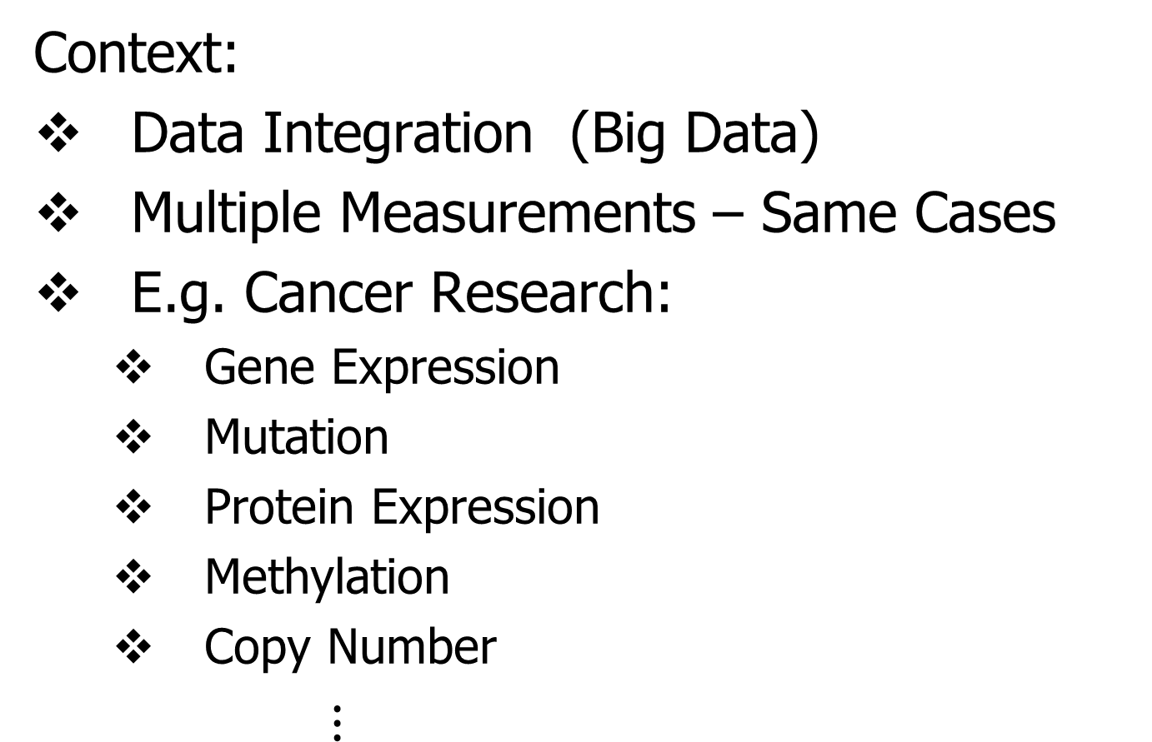
AJIVE Overview
Context:
Data Integration (Big Data)
Multiple Measurements – Same Cases
E.g. Cancer Research:
  Gene Expression
  Mutation
  Protein Expression
  Methylation
  Copy Number
$⋮$

Slide 5
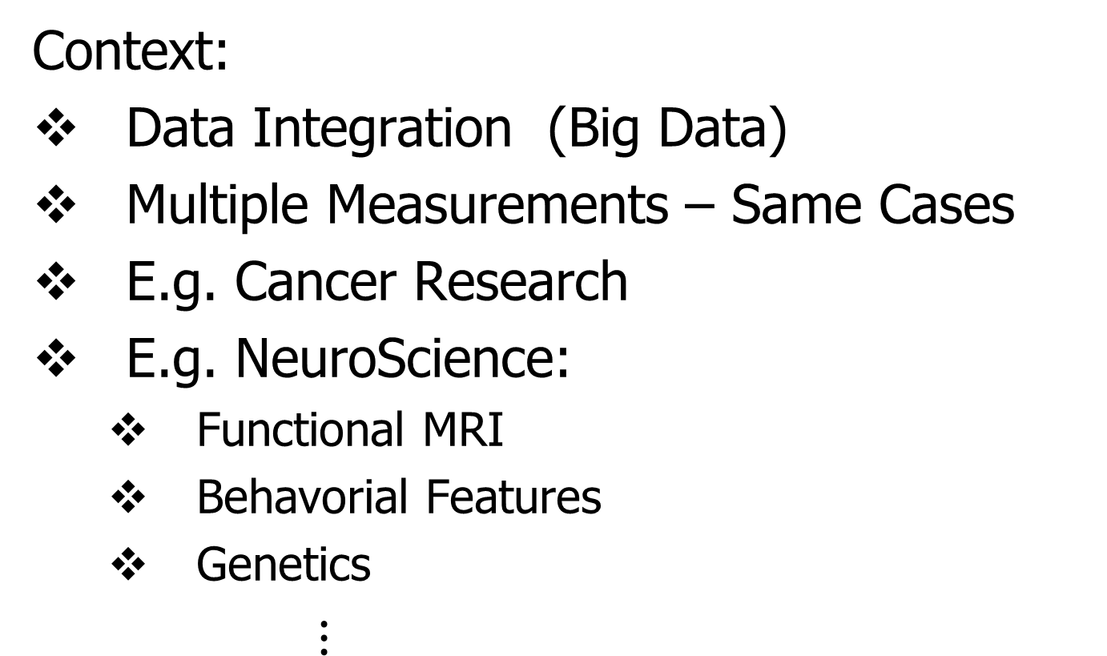
AJIVE Overview
Context:
Data Integration (Big Data)
Multiple Measurements – Same Cases
E.g. Cancer Research
E.g. NeuroScience:
  Functional MRI
  Behavorial Features
  Genetics
$⋮$

Slide 6
AJIVE Data Structure
Organizational Model
for Single Data Set:
Matrix
Convention in this talk:
“Columns as Data Objects”
(Atoms of the Statistical Analysis,
i.e. Experimental Units, or Data Vectors)

Slide 7
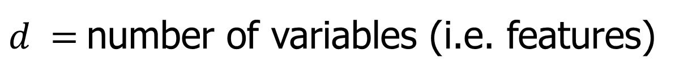


AJIVE Data Structure
Organizational Model
for Single Data Set:
Matrix
Convention in this talk:
“Columns as Data Objects”
$$d$$
$$n$$
$d =$number of variables (i.e. features)
$n =$number of cases (i.e. subjects or samples)

Slide 8
AJIVE Data Structure
Organizational Model
for Single Data Set: ←
Matrix
Convention in this talk:
Data Are “Mean Centered”
i.e. Mean Vector is 0

Slide 9
AJIVE Data Structure
Organizational Model
for Single Data Set:
Matrix
Convention in this talk:
Data Are “Mean Centered”
i.e. Mean Vector is 0
i.e. Mean of Entries in Each Row is 0

Slide 10
AJIVE Data Structure
AJIVE Organizational Model:
Multiple Matrices
(Data Types, i.e. “Blocks”)
With common
Columns as Data Objects

Slide 11
AJIVE Data Structure
AJIVE Organizational Model:
Multiple Matrices
(Data Types, i.e. “Blocks”)
With common
Columns as Data Objects
1st consider only 2 blocks

Slide 12
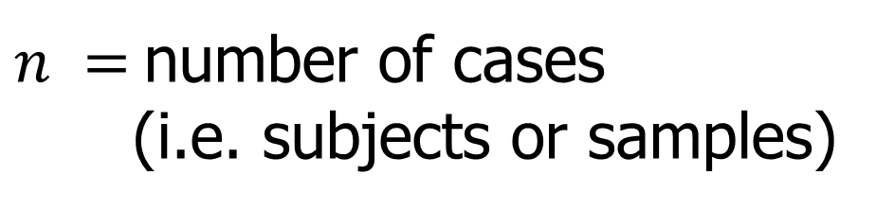
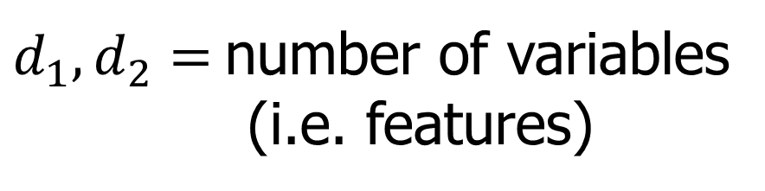



AJIVE Data Structure
AJIVE Organizational Model:
Multiple Matrices:
$d_{1},d_{2}=$number of variables
(i.e. features)
$$d_{1}$$
$$n$$
$n =$number of cases
(i.e. subjects or samples)
$$d_{2}$$
$$n$$

Slide 13
AJIVE Analytic Goals
Explore & Quantify Variation
In spirit of PCA
(Principal Component Analysis)

Slide 14

Example of PCA Data Exploration
Context: Single Data Set
Fun Example:
Spanish Male Mortality
Age
(5-95)
Thanks to: Andrés M. Alonso
U. Carlos III, Madrid

Slide 15
Example of PCA Data Exploration
Context: Single Data Set
Fun Example:
Spanish Male Mortality
Data Objects:
Mortality(age) = log(# of age died / # age)

Slide 16
Example of PCA Data Exploration
Context: Single Data Set
Fun Example:
Spanish Male Mortality
Data Objects:
Mortality(age) = log(# of age died / # age)
Over years (1908 - 2002)

Slide 17
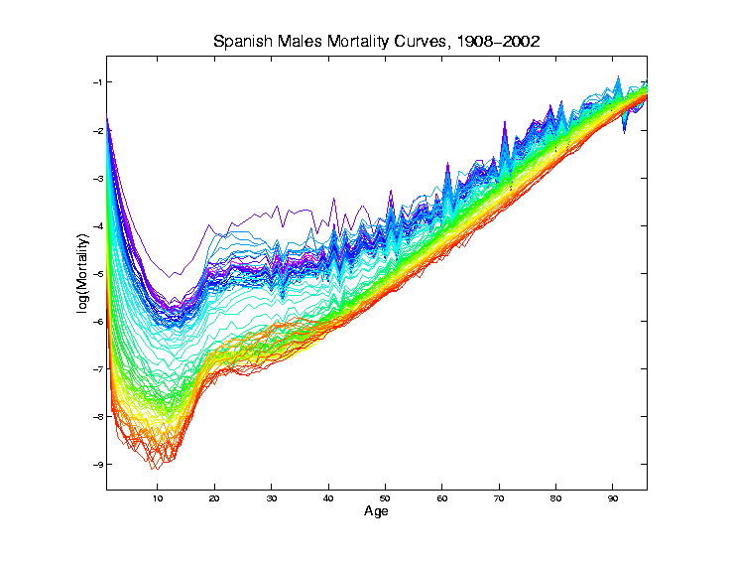
PCA Exploration of Spanish Mortality
Rainbow
Representing
Year:
Magenta
= 1908
Red = 2002

Slide 18
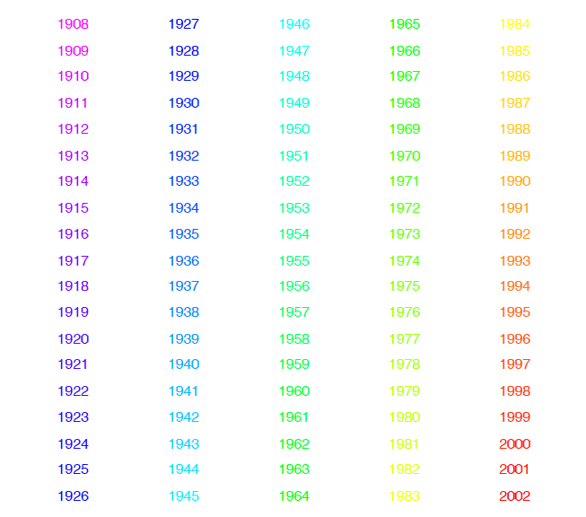
PCA Exploration of Spanish Mortality
Color Code
(Years)

Slide 19
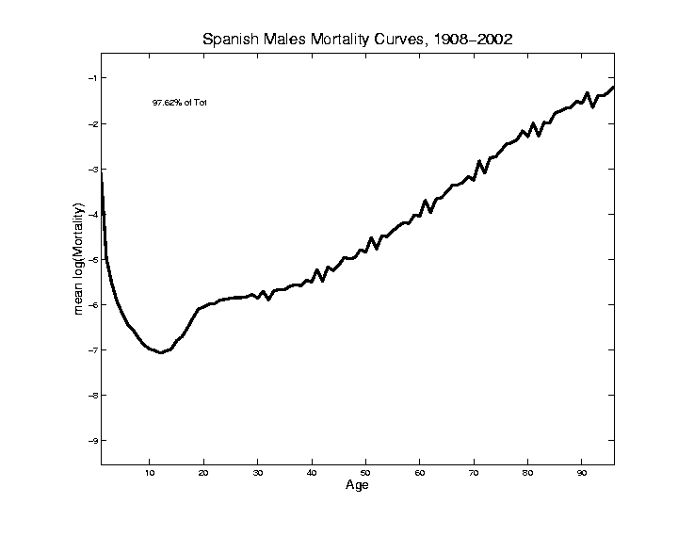
PCA Exploration of Spanish Mortality
Find
Population Center
(Mean
Vector)

Slide 20
PCA Exploration of Spanish Mortality
Blips Appear
At Decades
Since Ages
Not Precise
(in Spain)
Reported as
“about 50”,
Etc.

Slide 21
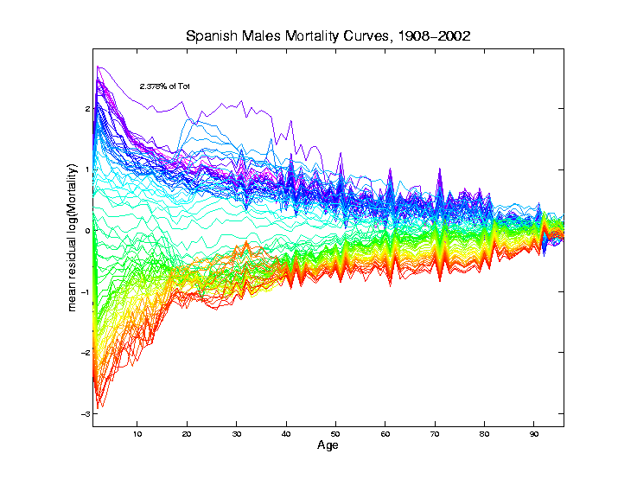
PCA Exploration of Spanish Mortality
Mean
Residual
View of
Shifting Data
To Origin

Slide 22
PCA Exploration of Spanish Mortality
Shows:
Main Age
Effects in
Mean, Not
Variation
About Mean

Slide 23
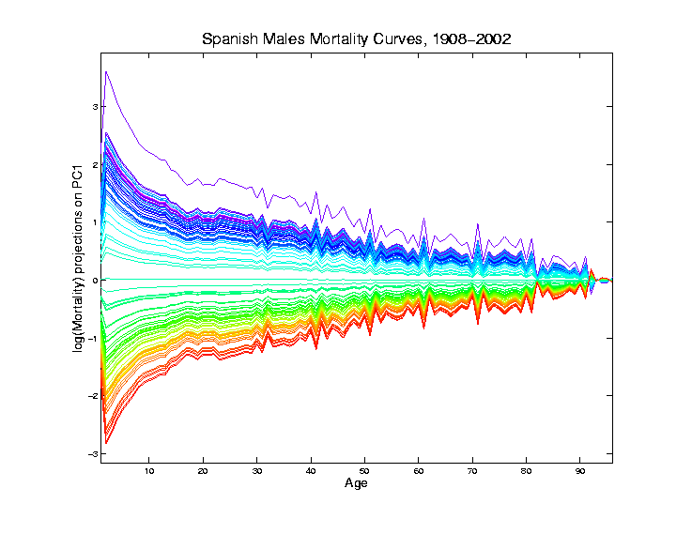
PCA Exploration of Spanish Mortality
Projections
Onto PC1
Direction
Main Mode
Of Variation:
Constant
Across Ages
Loadings Plot

Slide 24
PCA Exploration of Spanish Mortality
Shows Major
Improvement
Over Time
(medical technology,
etc.)

Slide 25
PCA Exploration of Spanish Mortality
Shows Major
Improvement
Over Time
(medical technology,
etc.)
And Change
In Age
Rounding Blips

Slide 26
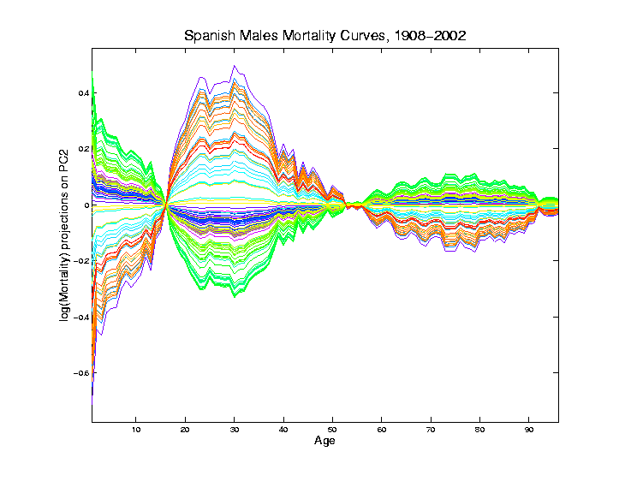
PCA Exploration of Spanish Mortality
Projections
Onto PC2
Direction
Loadings Plot

Slide 27
PCA Exploration of Spanish Mortality
Projections
Onto PC2
Direction
2nd Mode
Of Variation:
Difference
Between
20-45 & Rest

Slide 28
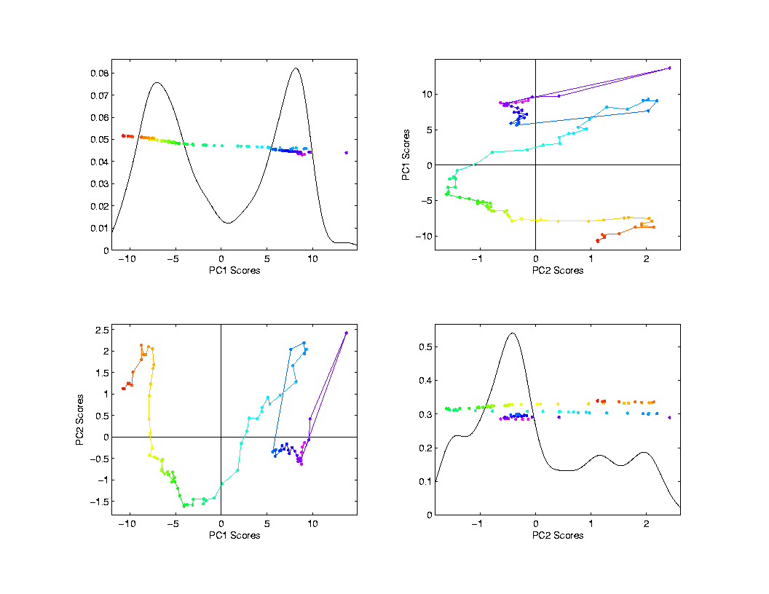
PCA Exploration of Spanish Mortality
Scatterplot
Matrix View
Scores Plot
Connecting
Lines
Highlight
Time Order

Slide 29
PCA Exploration of Spanish Mortality
Scatterplot
Matrix View
Scores Plot
Common 1st Graphic in Exploratory
Analysis
Reveals Relationships Between Data Objects

Slide 30
PCA Exploration of Spanish Mortality
Common 2nd Graphic in Exploratory
Analysis
Shows
Driver
Of PC
Direction
Via Vector
Entries
Loadings Plot

Slide 31
AJIVE Analytic Goals
Explore & Quantify Variation
In spirit of PCA
(Principal Component Analysis)
For 2+ Data Blocks

Slide 32
AJIVE Analytic Goals
Explore & Quantify Variation
Through Joint Variation
(Focus on: Interactions)

Slide 33
AJIVE Analytic Goals
Explore & Quantify Variation
Through Joint Variation
(Focus on: Interactions)
And Individual Variation
(Highlight: Unique Aspects)

Slide 34
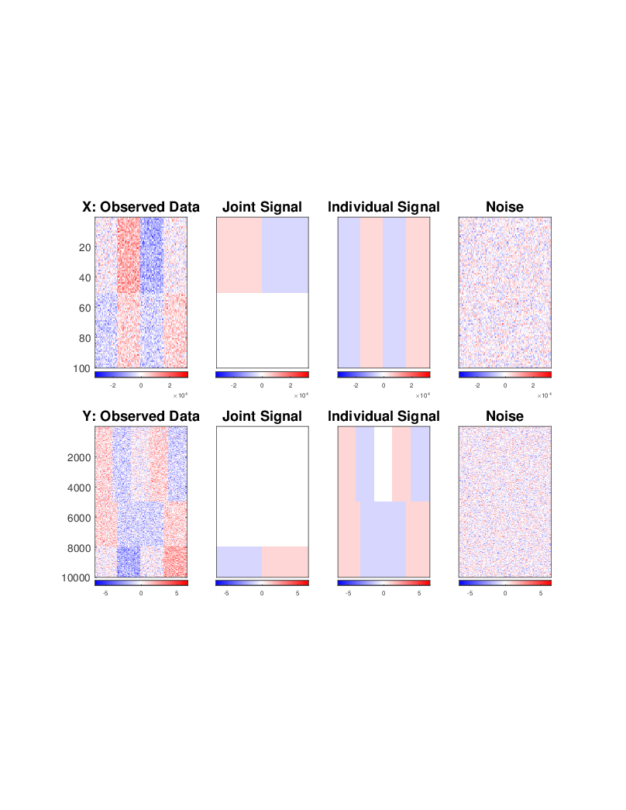
AJIVE Toy Example
“Heat Map” View
Based on Color Bar
Red for > 0
White for = 0
Blue for < 0
Intensity shows magnitude

Slide 35
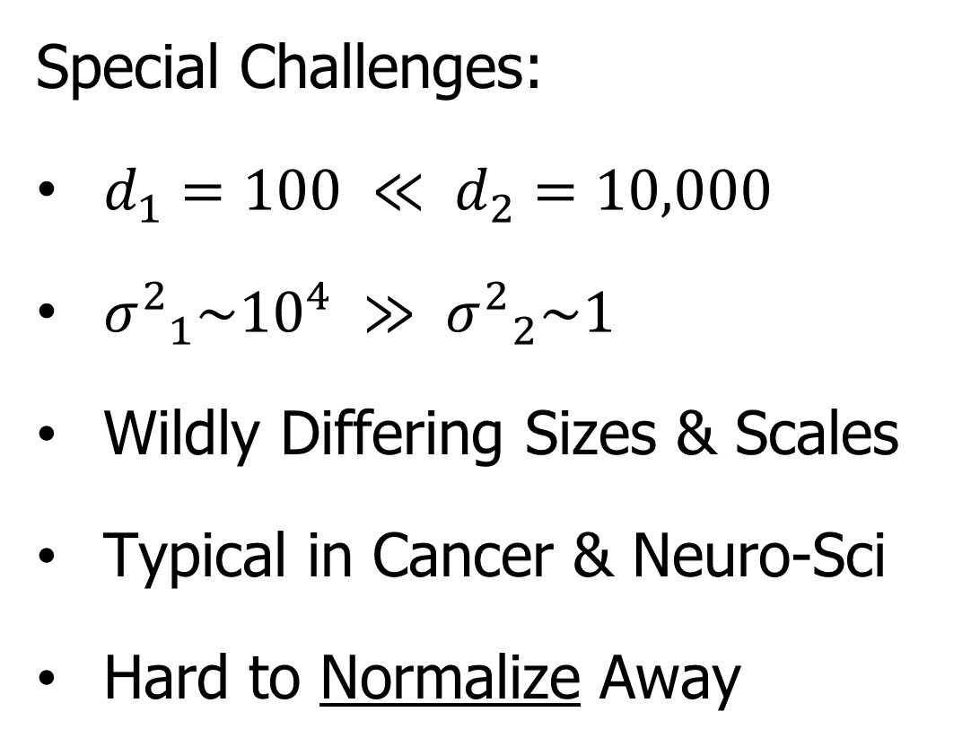
AJIVE Toy Example
Special Challenges:
$d_{1}=100 ≪ d_{2}=10,000$
${σ^{2}}_{1}\sim {10}^{4} ≫ {σ^{2}}_{2}\sim 1$
Wildly Differing Sizes & Scales
Typical in Cancer & Neuro-Sci
Hard to Normalize Away

Slide 36
AJIVE Toy Example
Underlying Components
(Additive
Signals +
+ Noise)

Slide 37
AJIVE Toy Example
Underlying Components:
Joint – Rank 1
Same
“Subject
Signal”
(linear combo)

Slide 38
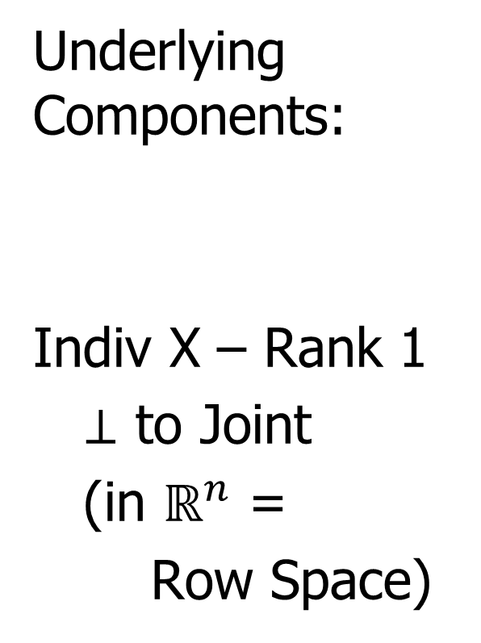
AJIVE Toy Example
Underlying Components:
Indiv X – Rank 1
$⊥$ to Joint
(in $ℝ^{n}$ =
Row Space)

Slide 39
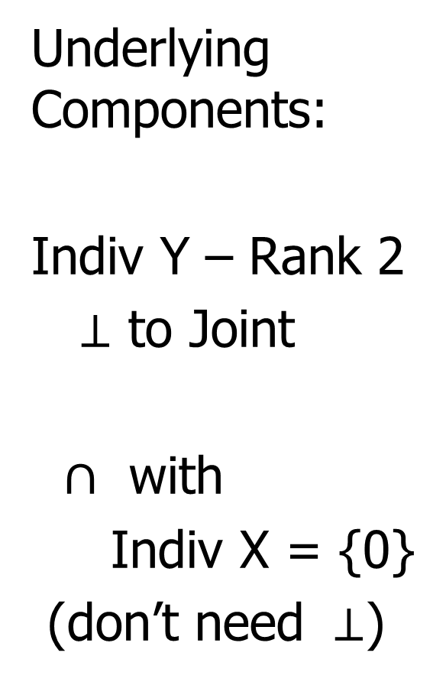
AJIVE Toy Example
Underlying Components:
Indiv Y – Rank 2
$⊥$ to Joint
$∩$ with
Indiv X = {0}
(don’t need $⊥$)

Slide 40
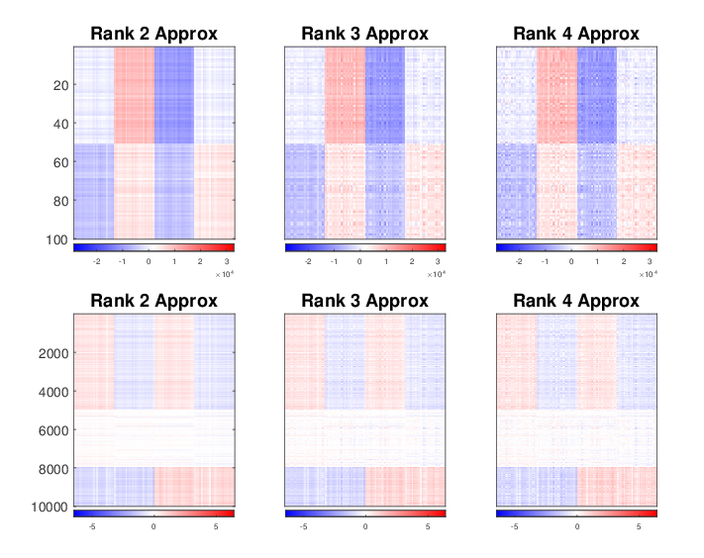

AJIVE Toy Example
Concatenate & SVD:
Only (Joint $∪$ X – Indiv), Lose Sep. & Y – Indiv

Slide 41
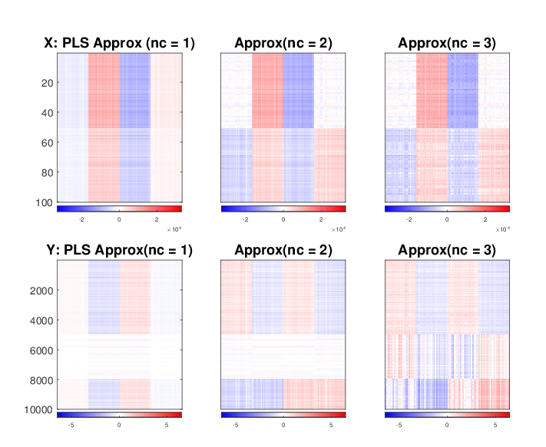
AJIVE Toy Example
Partial Least Squares:
Decent Rank 2 Approx., but no Indiv. Comp.

Slide 42
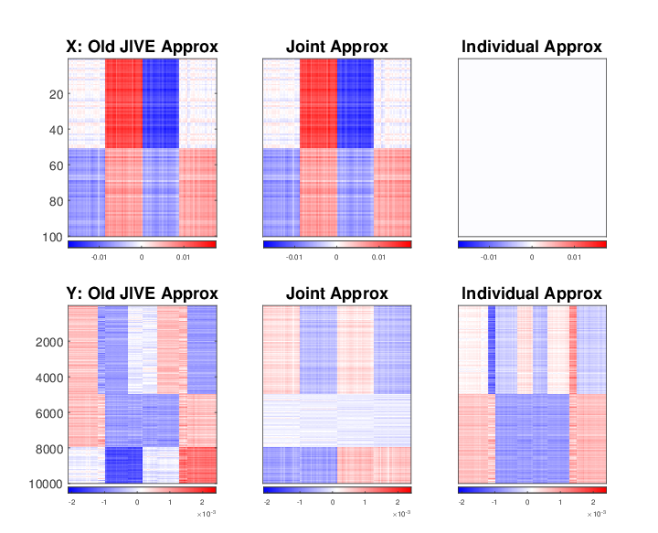
AJIVE Toy Example
Early JIVE (Lock et al, 2013):
Good 2-d Approx. – Missed Joint-Ind Decomp.

Slide 43
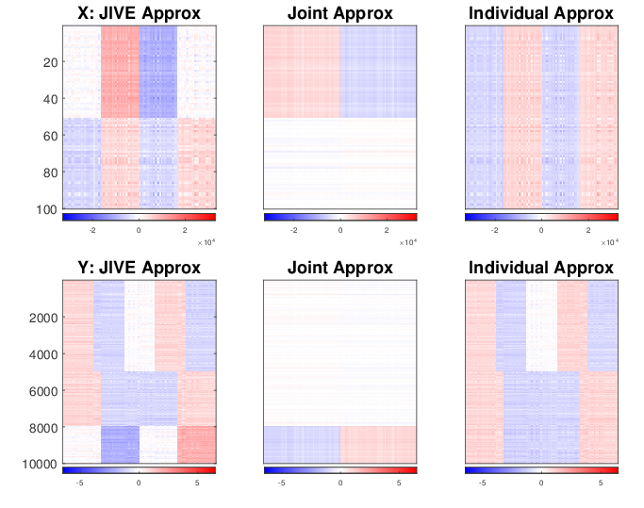
AJIVE Toy Example
AJIVE(Feng et al, 2017):
Excellent Decomposition

Slide 44
AJIVE Algorithm
Overview:
Step 1: Signal Space Initial Extraction
Step 2: Score Space Segmentation
Step 3: Final Decomposition

Slide 45
AJIVE Algorithm
Step 1

Slide 46
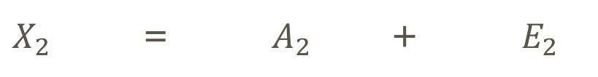

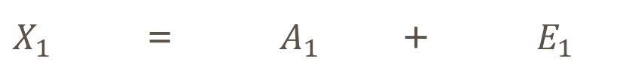


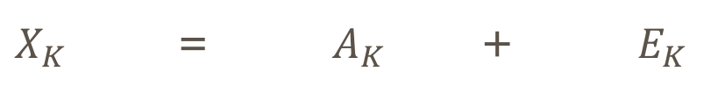
AJIVE Algorithm
Step 1: Signal Space Initial Extraction
$X_{1}$ = $A_{1}$ + $E_{1}$
$X_{2}$ = $A_{2}$ + $E_{2}$
Residuals
$$⋮$$
$$⋮$$
$$⋮$$
$X_{K}$ = $A_{K}$ + $E_{K}$

Slide 47
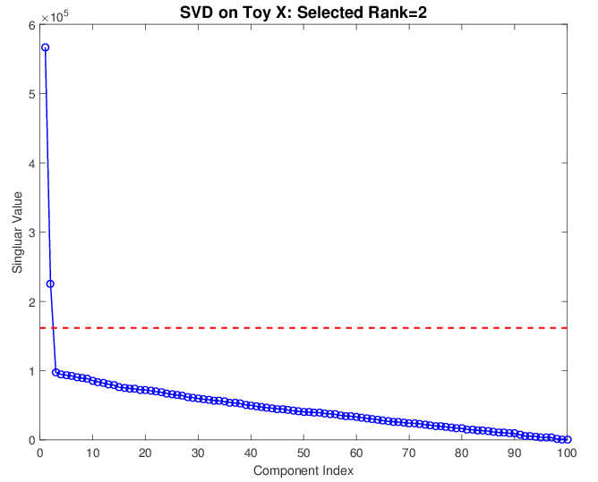
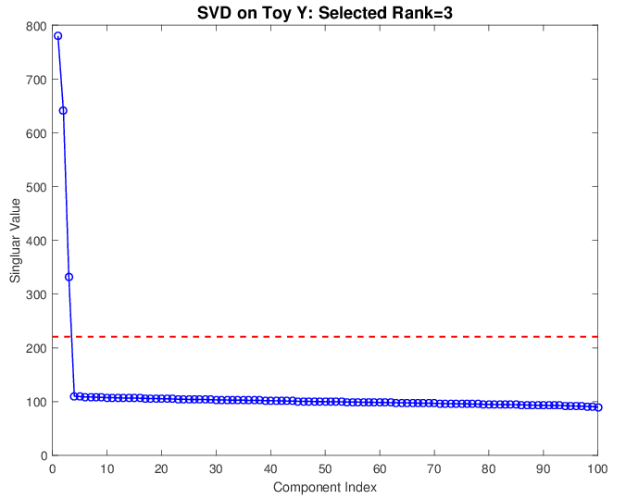
AJIVE Algorithm
Step 1: Signal Space Initial Extraction
Toy Example:
Scree Plot Rank Selection
X SVD rank = 2
Y SVD rank = 3

Slide 48
AJIVE Algorithm
Step 2:
Overview

Slide 49
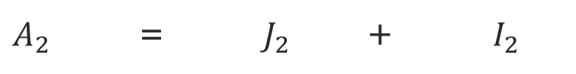
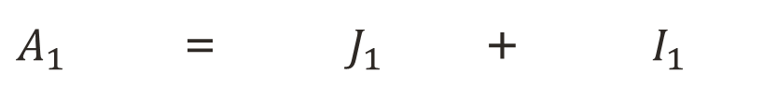
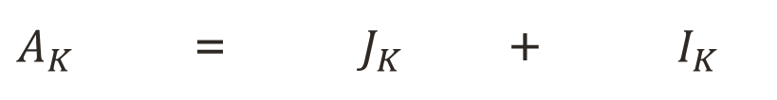
AJIVE Algorithm
Step 2: Score Space Segmentation
$A_{1}$ = $J_{1}$ + $I_{1}$
$A_{2}$ = $J_{2}$ + $I_{2}$
$$⋮$$
$$⋮$$
$$⋮$$
$A_{K}$ = $J_{K}$ + $I_{K}$
(Further Decomposition)

Slide 50




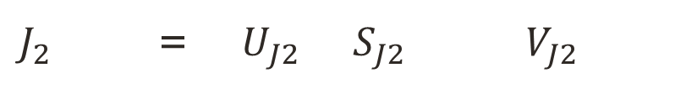
AJIVE Algorithm
Step 2: Score Space Segmentation – Notion of Joint
$J_{1}$ = $U_{J1}$ $S_{J1}$ $V_{J1}$
$J_{2}$ = $U_{J2}$ $S_{J2}$ $V_{J2}$
Subspaces in $ℝ^{n}$
$$⋮$$
$$⋮$$
$J_{K}$ = $U_{JK}$ $S_{JK}$ $V_{JK}$
Where Row($V_{J1}$) = Row($V_{J2}$) = $⋯$ = Row($V_{JK}$), Row($V_{Jk}$) $⊂$ Row($A_{k}$)

Slide 51


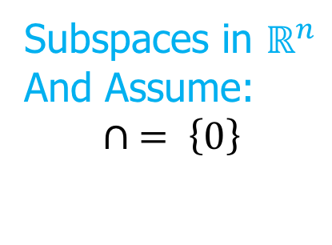


AJIVE Algorithm
Step 2: Score Space Segmentation – Notion of Individual
$I_{1}$ = $U_{I1}$ $S_{I1}$ $V_{I1}$
Subspaces in $ℝ^{n}$
And Assume:
$$∩ = \left\{0\right\}$$
$I_{2}$ = $U_{I2}$ $S_{I2}$ $V_{I2}$
$$⋮$$
$$⋮$$
$I_{K}$ = $U_{IK}$ $S_{IK}$ $V_{IK}$
Where Row($V_{Ik}$) $⊥$ Row($V_{Jk}$), $k=1, ⋯, K$

Slide 52
AJIVE Algorithm
Step 2a:
Principal Angle Analysis

Slide 53
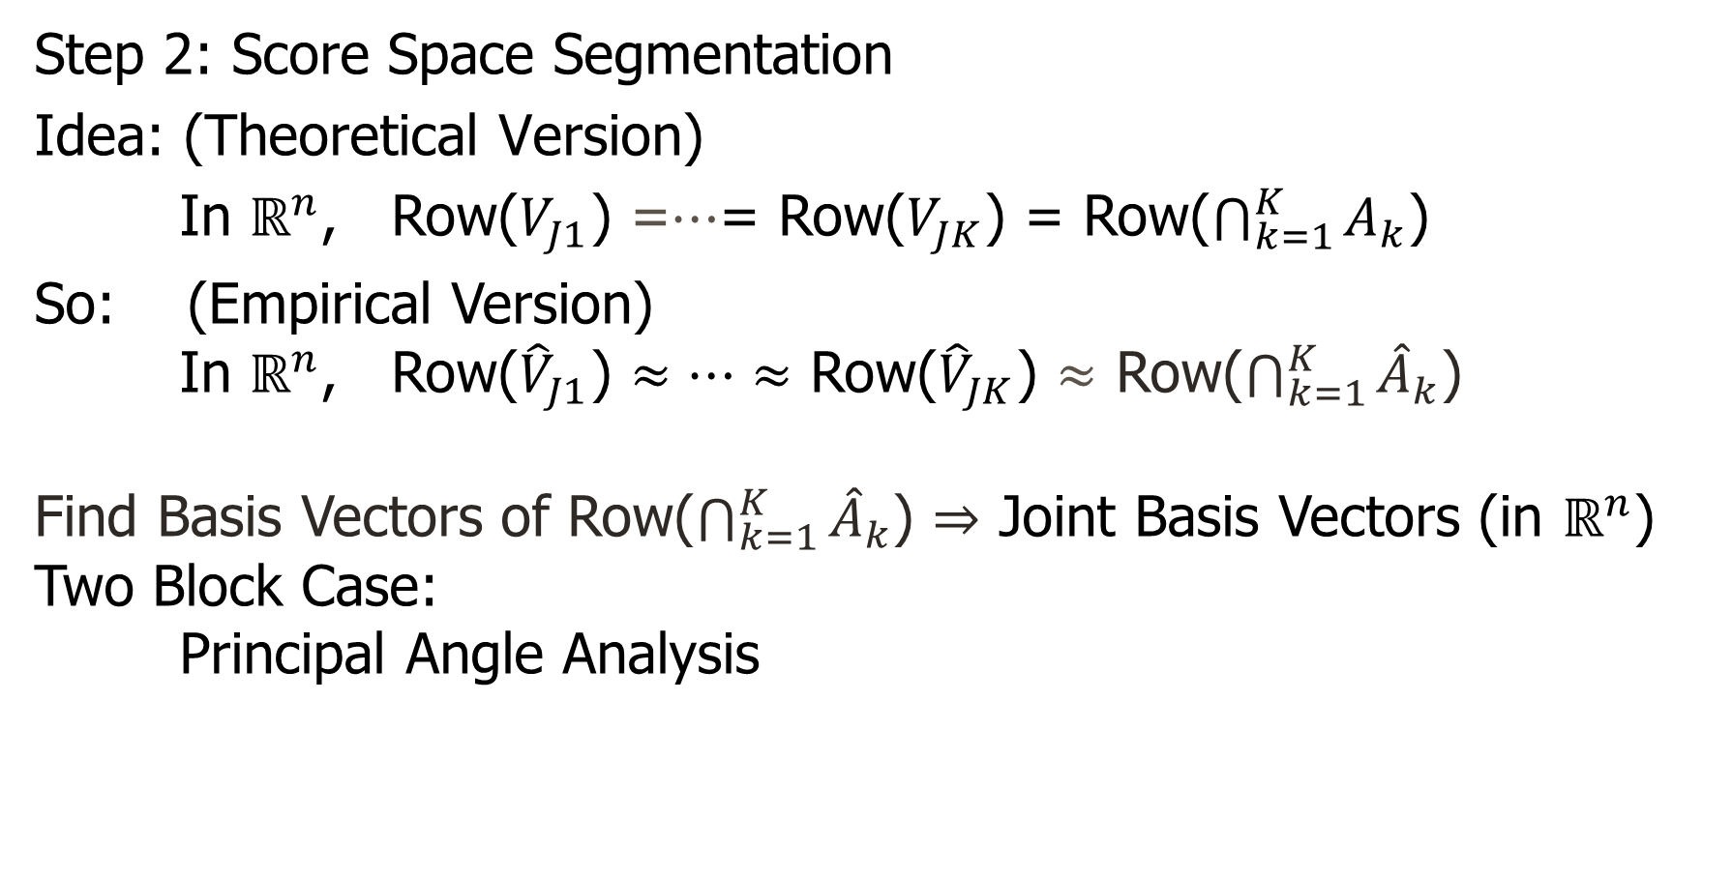
AJIVE Algorithm
Step 2: Score Space Segmentation
Idea: (Theoretical Version)
In $ℝ^{n}$, Row($V_{J1}$) =$…$= Row($V_{JK}$) = Row($\bigcap_{k=1}^{K}{A_{k}}$)
So: (Empirical Version)
In $ℝ^{n}$, Row(${\hat{V}}_{J1}$) $≈…≈$ Row(${\hat{V}}_{JK}$) $≈$ Row($\bigcap_{k=1}^{K}{{\hat{A}}_{k}}$)
Find Basis Vectors of Row($\bigcap_{k=1}^{K}{{\hat{A}}_{k}}$) $⇒$ Joint Basis Vectors (in $ℝ^{n}$)
Two Block Case:
Principal Angle Analysis

Slide 54





AJIVE Algorithm
Step 2: Score Space Segmentation
Principal Angles
Angle between subspaces: $∠\left(V_{1}, V_{2}\right)$
$$θ_{j}=\min_{\begin{aligned}v_{j,k}∈V_{k} \\ v_{j,k}⊥{\hat{v}}_{i,k}, \\ i=1, ⋯,j−1;k=1,2\end{aligned}}\operatorname{acos}{\frac{\left\langle v_{j,1}, v_{j,2}\right\rangle }{\left\|v_{j,1}\right\|\left\|v_{j,2}\right\|}}$$
$0^{°}≤θ_{1}≤θ_{2}≤…≤θ_{l}≤{90}^{°},l=\min{(\dim\left(V_{1}\right),\dim{(V_{2})})}$
$\sin{θ_{1}}$ is a pseudo-metric among subspaces
$\dim\left(V_{1}∩V_{2}\right)=r\overset{⇔}{}θ_{1}=…=θ_{r}=0<θ_{r+1}$
$$V_{2}$$
$$V_{1}$$
$$θ_{2}$$
$$θ_{1}=0$$

Slide 55

AJIVE Algorithm
Step 2: Score Space Segmentation
Principal Angle Analysis
Finds pairs of basis vectors,
with minimal angles, $v_{j,1},v_{j,2}$
Final $j$th Joint Basis Vector (in $ℝ^{n}$):
Average of $v_{j,1}≈v_{j,2}$
$\frac{v_{j,1}+v_{j,2}}{\left\|v_{j,1}+v_{j,2}\right\|}$
$$V_{2}$$
$$V_{1}$$
$$θ_{2}$$
$$θ_{1}=0$$

Slide 56









AJIVE Algorithm
Step 2: Score Space Segmentation
Principal Angle Analysis – SVD
$$V_{A1}$$
$$S_{M}$$
$$V_{M}^{T}$$
$$M$$
$$=$$
$$=$$
$$U_{M}$$
$$V_{A2}$$
Principal Vectors
Principal Angles:
$$θ_{i}=\operatorname{acos}\left(σ_{M,i}^{2}−1\right)≈0$$
$σ_{M,i}≈\sqrt{2}$
Joint Space Basis Vectors:
Common Normalized Scores

Slide 57



AJIVE Algorithm
Step 2: Score Space Segmentation
Multi-block Case – Generalization of Principal Angle Analysis
$$V_{A1}$$
$$S_{M}$$
$$V_{M}^{T}$$
$$V_{A2}$$
Singular values:
$$σ_{M,i}≈\sqrt{K}$$
$$M$$
$$=$$
$$=$$
$$U_{M}$$
$$…$$
$$…$$
$$V_{AK}$$
Joint Space Basis Vectors:
Common Normalized Scores

Slide 58
AJIVE Algorithm
Step 2b:
Segmentation of Joint Space Basis

Slide 59
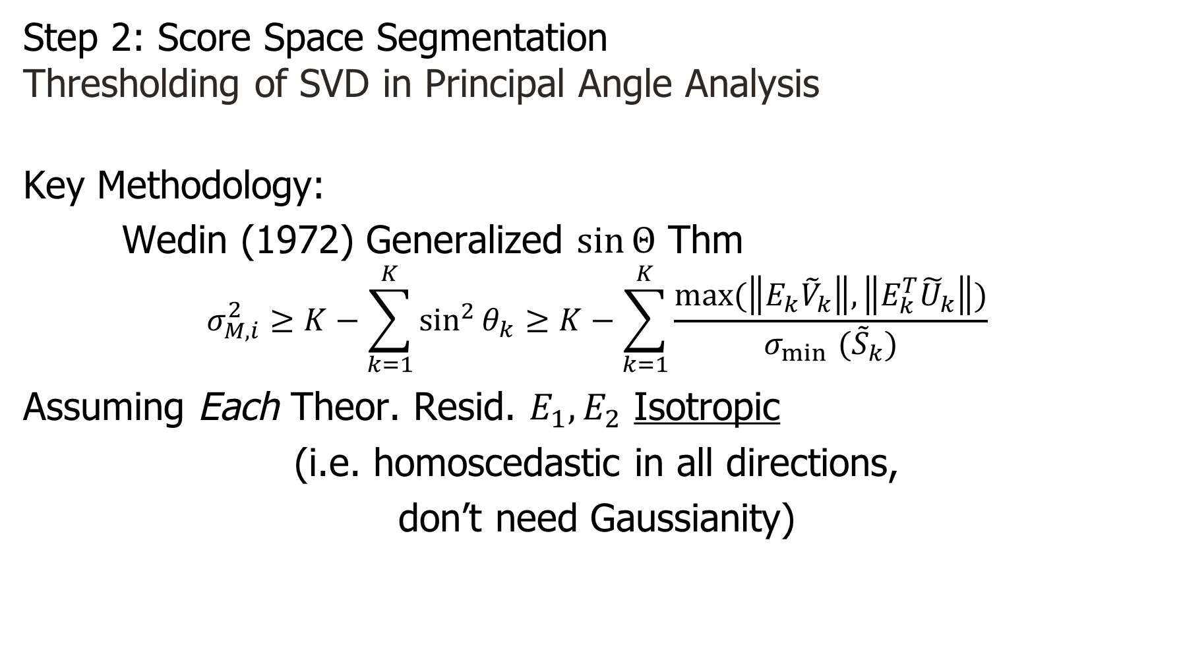
AJIVE Algorithm
Step 2: Score Space Segmentation
Thresholding of SVD in Principal Angle Analysis
Key Methodology:
Wedin (1972) Generalized $\sin{Θ}$ Thm
$$σ_{M,i}^{2}≥K−\sum_{k=1}^{K}{\sin^{2}{θ_{k}}}≥K−\sum_{k=1}^{K}{\frac{\max{(\left\|E_{k}{\tilde{V}}_{k}\right\|,\left\|E_{k}^{T}{\tilde{U}}_{k}\right\|)}}{σ_{\min{ }}({\tilde{S}}_{k})}}$$
Assuming Each Theor. Resid. $E_{1}, E_{2}$ Isotropic
(i.e. homoscedastic in all directions,
don’t need Gaussianity)

Slide 60
AJIVE Algorithm
Step 2: Score Space Segmentation
Thresholding of SVD in Toy Example

Slide 61
AJIVE Algorithm
Step 3

Slide 62
AJIVE Algorithm
Step 3: Final Decomposition
Challenge: After Finding Joint Space,
Some Blocks Might Have Comp. Var. < Thresh.
(e.g. “Semi-Joint” in Multi-Block)
Then Move Comp. to Indiv. or Error

Slide 63
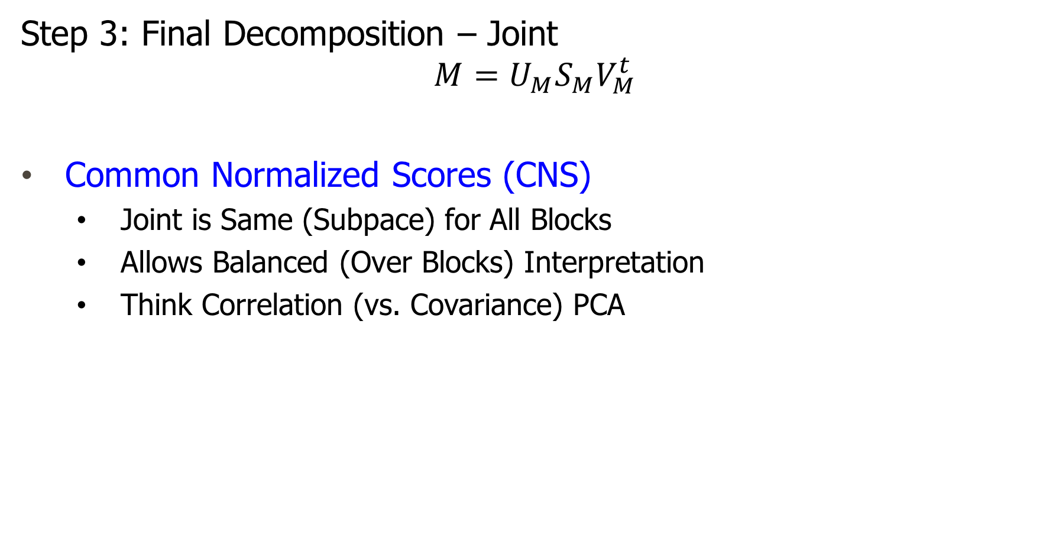
AJIVE Algorithm
Step 3: Final Decomposition – Joint
$$M=U_{M}S_{M}V_{M}^{t}$$
Common Normalized Scores (CNS)
  Joint is Same (Subpace) for All Blocks
  Allows Balanced (Over Blocks) Interpretation
  Think Correlation (vs. Covariance) PCA

Slide 64
AJIVE Algorithm
CNS

Slide 65
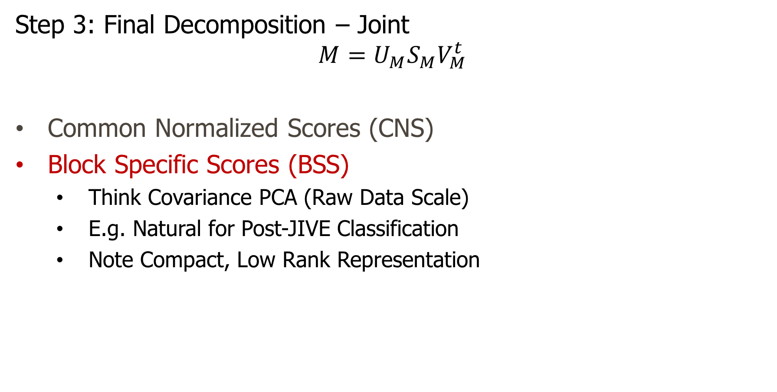
AJIVE Algorithm
Step 3: Final Decomposition – Joint
$$M=U_{M}S_{M}V_{M}^{t}$$
Common Normalized Scores (CNS)
Block Specific Scores (BSS)
  Think Covariance PCA (Raw Data Scale)
  E.g. Natural for Post-JIVE Classification
  Note Compact, Low Rank Representation

Slide 66
AJIVE Algorithm
BSS

Slide 67
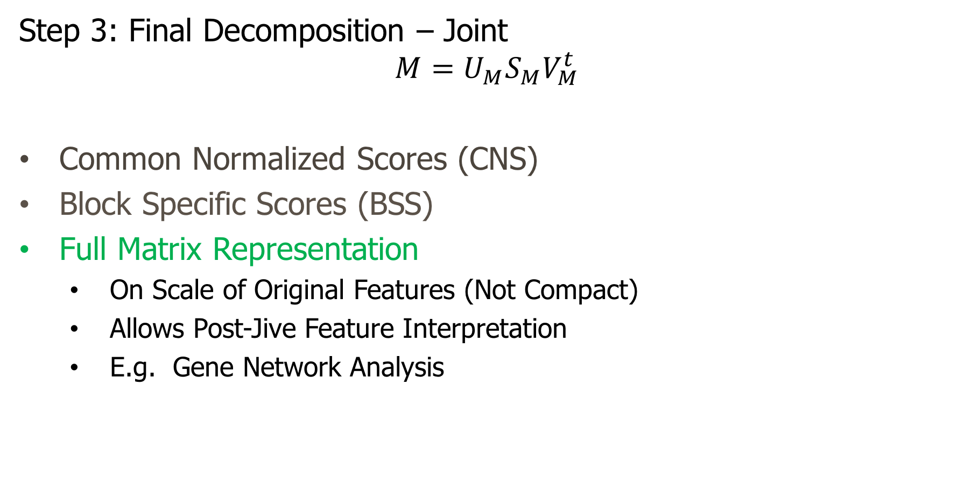
AJIVE Algorithm
Step 3: Final Decomposition – Joint
$$M=U_{M}S_{M}V_{M}^{t}$$
Common Normalized Scores (CNS)
Block Specific Scores (BSS)
Full Matrix Representation
  On Scale of Original Features (Not Compact)
  Allows Post-Jive Feature Interpretation
  E.g. Gene Network Analysis

Slide 68
AJIVE Algorithm
Full Matrix

Slide 69

AJIVE Algorithm
Step 3: Final Decomposition
For Individual Components:
“Basis Subtract”, in $ℝ^{n}$, $V_{Ik}=V_{Ak}⊖V_{Jk}$
“Reproject” to find $S_{Ik}$, $U_{Ik}$

Slide 70
AJIVE Algorithm

Slide 71
AJIVE Applications
Application 1:
Spanish Mortality Data
Males vs Females
Application 2:
Cancer Genetics
Gene Expression vs Copy Number vs Protein Expression vs Mutation
Application 3:
Functional Magnetic Resonance Imaging
Behavior vs Brain Connectivity

Slide 72
Revisit Spanish Mortality Data
Recall PCA Example & Analysis Above:

Slide 73
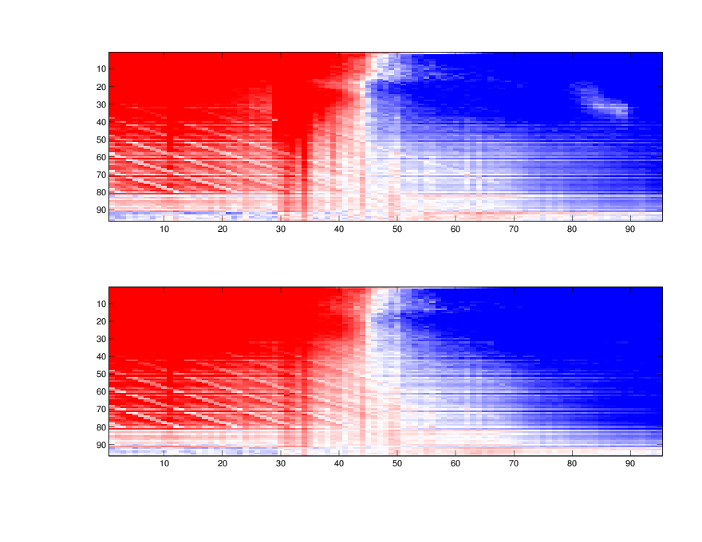
Revisit Spanish Mortality Data
Data Blocks:
+
-
Spanish Males
Age as features
(0 – 95)
Years as Subjects (1908 - 2002)
Spanish Females
Age as features

Slide 74
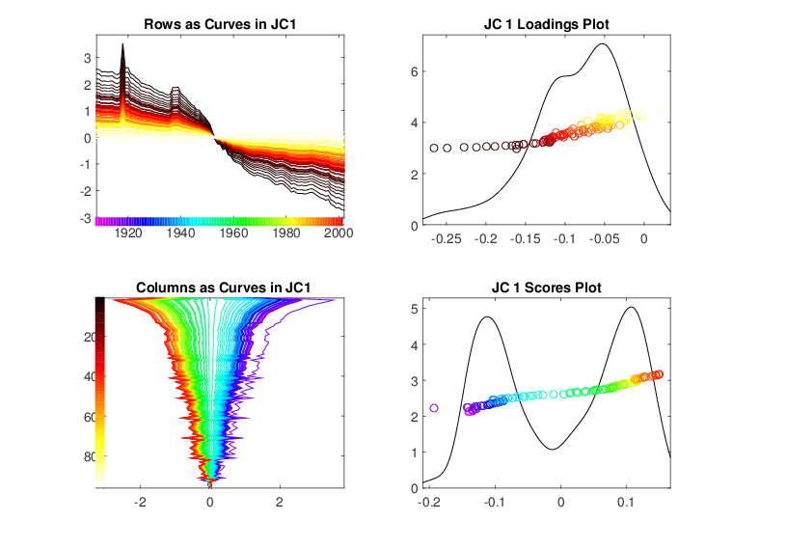
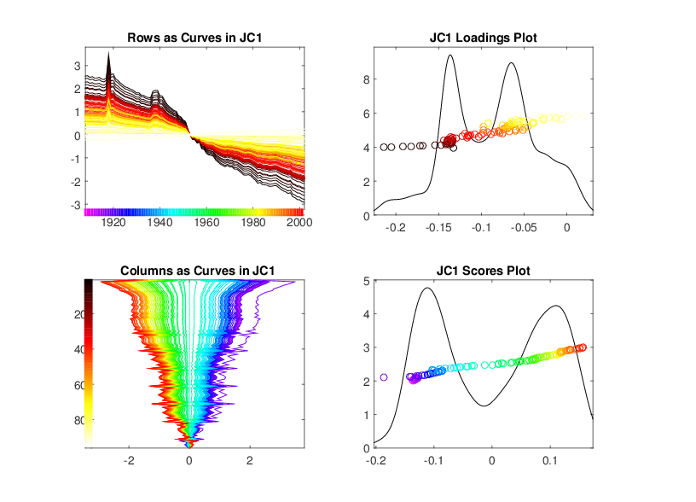
AJIVE Analysis – Spanish Mortality Data
First Joint Component
Male
Female

Slide 75
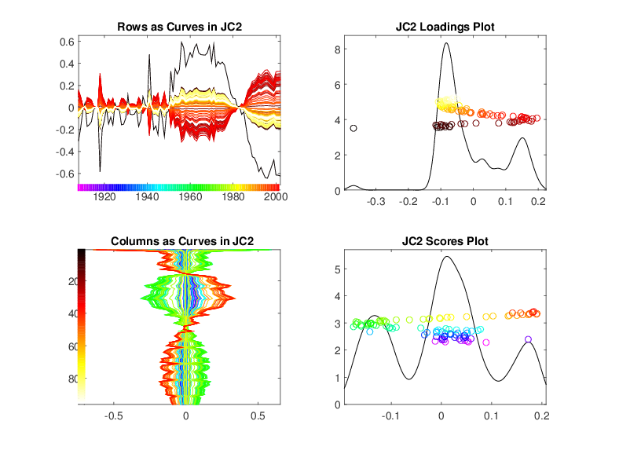
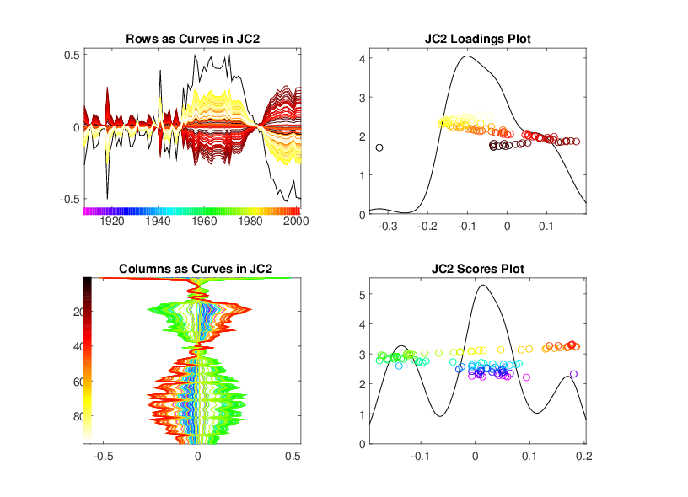
AJIVE Analysis – Spanish Mortality Data
Second Joint Component
Male
Female

Slide 76
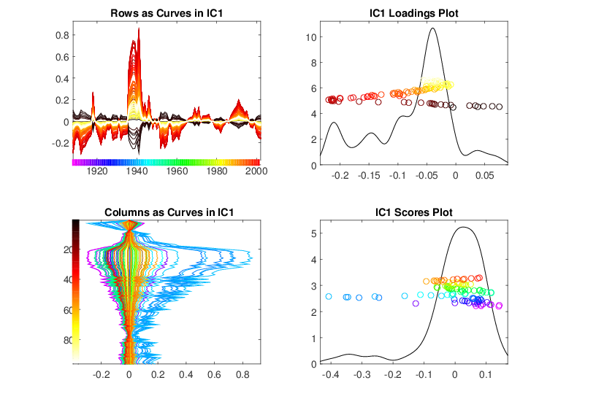
AJIVE Analysis – Spanish Mortality Data
Individual Component – Male

Slide 77
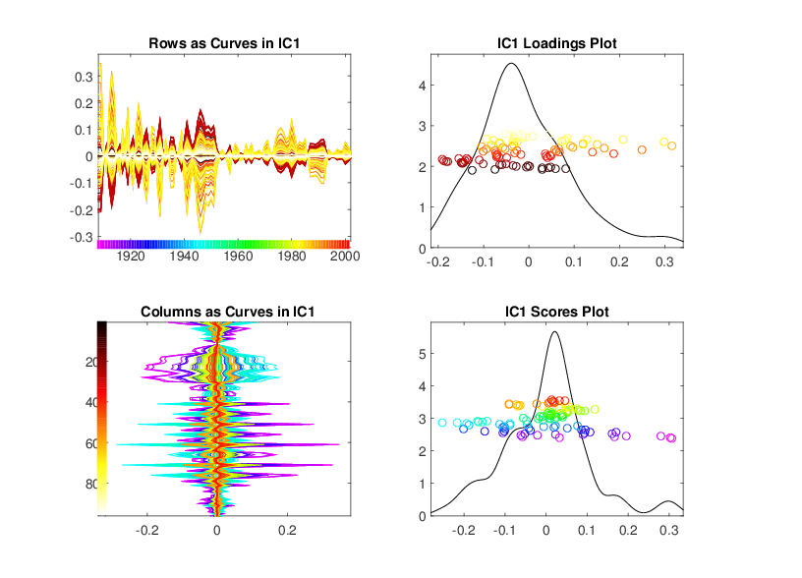
AJIVE Analysis – Spanish Mortality Data
Individual Component – Female

Slide 78
AJIVE Research in Progress
Improved 1st Thresholds (Design a Test?)
Sub-Joint Blocks (e.g. Pairs)

Slide 79
AJIVE Research in Progress
Improved 1st Thresholds (Design a Test?)
Sub-Joint Blocks (e.g. Pairs)
≈ + + + +

Slide 80
AJIVE Research in Progress
Improved 1st Thresholds (Design a Test?)
Sub-Joint Blocks (e.g. Pairs)
Statistical Inference
Joint Block as Nuisance → Batch Effects
Supervised JIVE (Vert’l and/or Horiz’l)

Slide 81
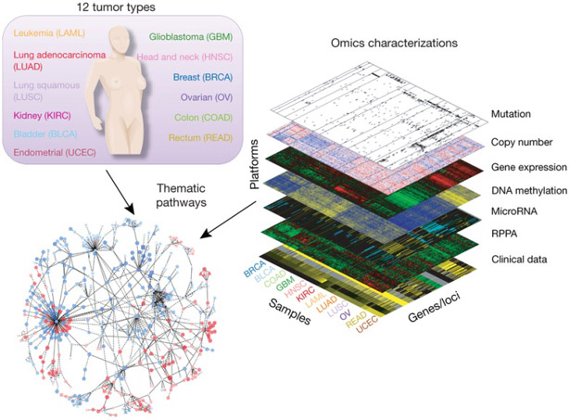
Major Application: Cancer Genetics
Data Source:
The Cancer
Genome Atlas
Subset Here:
Breast Cancer
Figure : The Cancer Genome Atlas Research Network, Weinstein, J.N., Collisson, E.A., Mills, G.B., Shaw, K.M., Ozenberger, B.A., Ellrott, K., Shmulevich, I., Sander, C., and Stuart, J.M. (2013)
The Cancer Genome Atlas Pan-Cancer analysis project.

Slide 82

Major Application: Cancer Genetics
TCGA Breast Cancer Data:
Data Blocks ($∩$s & Carefully Cleaned)
  mRNA (GE): 16615×616
  Copy Number (CN): 24174×616
  Rev. Phase Protein Array (RPPA): 187×616
  Gene mutation (Mutation): 18256×616
Tumor Subtypes
  Basal-like: ⊲
  HER2-like: ∗
  Luminal A: +
  Luminal B: ×

Slide 83

TCGA Breast Cancer Data
Separate PCA on Gene Expression (GE)
Clear
Subtype
Effects
(Not
Surprising)

Slide 84
TCGA Breast Cancer Data
Separate PCA on Gene Expression (GE)
PC1 Flags
Basals
PC2 Flags
LumAs

Slide 85

TCGA Breast Cancer Data
Separate PCA on Copy Number (CN)
Other
Effects
+Subtypes

Slide 86

AJIVE Analysis – TCGA Breast Cancer Data
Gene Expression (GE) 1st SVD Threshold
Suggested Ranks： 11 / 16

Slide 87

AJIVE Analysis – TCGA Breast Cancer Data
Copy Number (CN) 1st SVD Threshold
Suggested Ranks： 6 / 12

Slide 88

AJIVE Analysis – TCGA Breast Cancer Data
Proteins (RPPA) 1st SVD Threshold
Suggested Ranks： 8 / 15

Slide 89

AJIVE Analysis – TCGA Breast Cancer Data
Mutations (Mut) 1st SVD Threshold
Suggested Ranks： 12 / 16

Slide 90

AJIVE Analysis – TCGA Breast Cancer Data
4-way Joint Threshold
2nd Comp.
~ Thresh.

Slide 91
AJIVE Analysis – TCGA Breast Cancer Data
4-way Joint Threshold
After Step 3:
Only 1 Remaining Joint Component
(2nd Strong in all but Mut.)
(Fits w/ Biologist’s Impression of Mut. Data)

Slide 92

AJIVE Analysis – TCGA Breast Cancer Data
4-way Joint Scores (CNS)
Flags LumAs
Effect Driven
By All 4
Factors
Together
Interesting Point: Mutation Plays Role Here

Slide 93
AJIVE Analysis – TCGA Breast Cancer Data
Next Issue: 3-way JIVE for GE-CN-RPPA
Approach: Use 3 Indiv. Blocks from above,
GE, CN, RPPA as inputs
Perform JIVE, Study Joint PC1

Slide 94

AJIVE Analysis – TCGA Breast Cancer Data
Joint JIVE PC1 for GE-CN-RPPA (CNS)
Great Separation
of Basals
Some Separation
of Her2s
LumAs & LumBs
Combined
All More Distinct
Than Raw Data
Differences Separate from Mutation

Slide 95
AJIVE Analysis – TCGA Breast Cancer Data
Now Focus on Pair-Wise Comparisons:
AJIVE on GE – CN only
Hypothesis Test of Basals vs. Others
(DiProPerm Z-scores Allow Quantitation)

Slide 96

AJIVE Analysis – TCGA Breast Cancer Data
AJIVE on GE – CN, Test of Basals vs. Others
(SEPARATE!)
CN - PCA
View
Group
Coloring

Slide 97

AJIVE Analysis – TCGA Breast Cancer Data
AJIVE on GE – CN, Test of Basals vs. Others
Better
Separation
From DWD
& Ortho PC
Directions
How Separated???

Slide 98

AJIVE Analysis – TCGA Breast Cancer Data
AJIVE on GE – CN, Test of Basals vs. Others
DiProPerm Hypothesis Test
Stat. Sig. ~ Z-score

Slide 99
AJIVE Analysis – TCGA Breast Cancer Data
AJIVE on GE – CN, Test of Basals vs. Others
Summarize Z-scores
Separate PCA:
GE >> CN
(Not
Surprising)

Slide 100
AJIVE Analysis – TCGA Breast Cancer Data
AJIVE on GE – CN, Test of Basals vs. Others
Summarize Z-scores
Joint AJIVE
>> Separate
AJIVE Data
Combo Helps!

Slide 101
AJIVE Analysis – TCGA Breast Cancer Data
AJIVE on GE – CN, Test of Basals vs. Others
Summarize Z-scores
GE has info
Not in CN
But not CN

Slide 102
AJIVE Analysis – TCGA Breast Cancer Data
To be Continued …
(Both Inter of Above, & Other Case
& Scores Plots)

Slide 103



Functional Magnetic Resonance Imaging
2015 SAMSI Program
On Neuroscience
Qunqun Yu Benjamin Risk

Slide 104
Functional Magnetic Resonance Imaging
Approach:
Measure “Brain Activity”
Over Both Location & Time
Via Blood Flow
Data Objects???

Slide 105

Functional Magnetic Resonance Imaging
Data
Objects?
3d- Movie?
Time Series
At Voxels?
Thanks to fmri.ucsd.edu

Slide 106


Functional Magnetic Resonance Imaging
Study Data From:

Slide 107

Functional Magnetic Resonance Imaging
Data Objects: $n=491$
X: Behavioral Features
$$d=139$$
Y: 3-d Voxel Summaries of Task
(Condense Time Series to Single #s)
$$d=91282$$
(Registered Voxels Along Cerebral Cortex)

Slide 108
Functional Magnetic Resonance Imaging
Separate
PC1 of
Behavior
Features
Important
Groups
View Entries of Eigenvectors

Slide 109


Functional Magnetic Resonance Imaging
View Entries of Eigenvectors
Separate PC1 of Image Loadings
All Up
& Down
Together
Also Some
Hot Spots?

Slide 110

Functional Magnetic Resonance Imaging
Separate PC2 of Image Loadings
Interesting
Structure
???
And Same
Hot Spots?

Slide 111

Functional Magnetic Resonance Imaging
Previous Mapping of Regions of Interest
Hot Spots
Are
Working
Memory
Related

Slide 112

Functional Magnetic Resonance Imaging
Joint PC1 of Image Loadings
Using
Behavior
Combines
Hot Spots
From
Separate
PC1 & 2

Slide 113

Functional Magnetic Resonance Imaging
Overall
Comparison
Sep. Beh. PC1
Assoc. w. Image
Joint Im. PC1
Concentrates
Relevant Parts
Of Sep.
PC1 & PC2

Slide 114
Functional Magnetic Resonance Imaging
Overall
Comparison
Overall Heat
Var’n not
Assoc. w/
Behavior
New 2nd Mode
Of Joint Var’n
Behavior
~ Sep. PC2

