Slide 1
Participant Presentations
Please Sign Up:
Name
Email (Onyen is fine, or …)
Are You ENRolled?
Tentative Title (???? Is OK)
When:
Next Week, Early, Oct., Nov., Late

Slide 2
Limitation of PCA
Strongly Feels Scaling of Each Variable
Consequence:
May want to standardize each variable
(i.e. subtract $\overline{X}$, divide by $s$)
Also called Whitening
Equivalent Approach:
Base PCA on Correlation Matrix
Called Correlation PCA

Slide 3
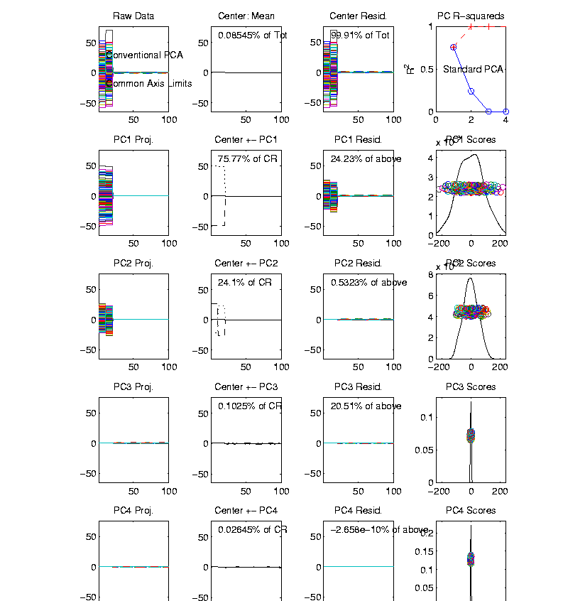
Correlation PCA
Toy Example Contrasting Cov. vs. Corr.
1st Comp:
Nearly Flat
2nd Comp:
Contrast
3rd & 4th:
Look Very
Small Since
Common Axes

Slide 4
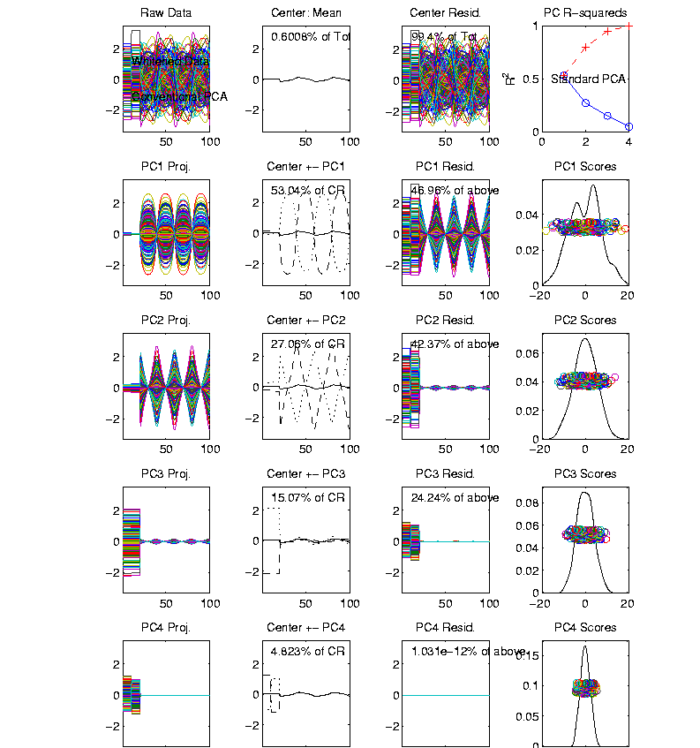
Correlation PCA
Toy Example Contrasting Cov. vs. Corr.
Correlation
“Whitened”
Version
All Much
Different
Which Is
“Right” ???

Slide 5
NCI 60: Can we find classes Using PCA view?
Notes:
5

Slide 6
NCI 60: Views using DWD Dir’ns (focus on biology)
Notes:
6

Slide 7
Big Picture Data Visualization
For a Matrix of Data:
$${\left(\begin{matrix}x_{11} & ⋯ & x_{1n} \\ ⋮ & ⋱ & ⋮ \\ x_{d1} & ⋯ & x_{dn}\end{matrix}\right)}_{d×n}$$
Three Useful (& Important) Visualizations
Curve Objects
Relationships Between Objects
Marginal Distributions (1-d each “variable”)

Slide 8
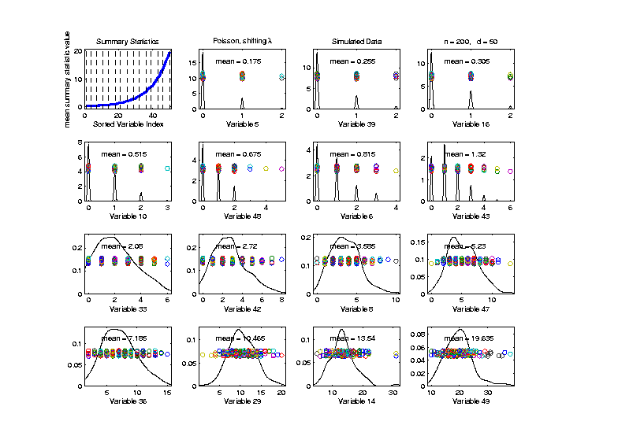
Marginal Distribution Plots
Toy Example: $n=200$, $d=50$,
i.i.d. Poisson, with parameters $λ=0.2,⋯,20$
Sort Variables
On Sample
Mean
Wide Range
Of Poissons

Slide 9
Marg. Dist. Plot Data Example
Drug Discovery Data
$n = 262$, Chemical Compounds
$d = 2489$, Chemical “Descriptors”
Discrete Response:
0 – blue 0, 1 – red +
(Thanks to Alex Tropsha Lab)

Slide 10
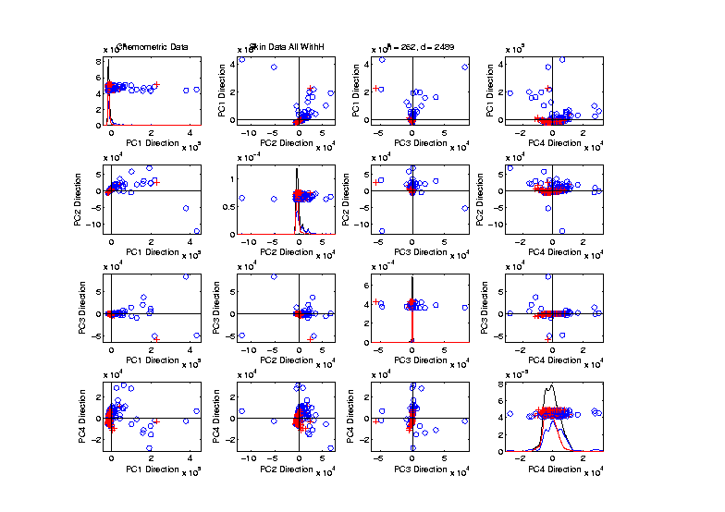
Marg. Dist. Plot Data Example
Drug Discovery – PCA Scatterplot
Dominated
By Few
Large
Compounds
Not Good
Blue - Red
Separation

Slide 11
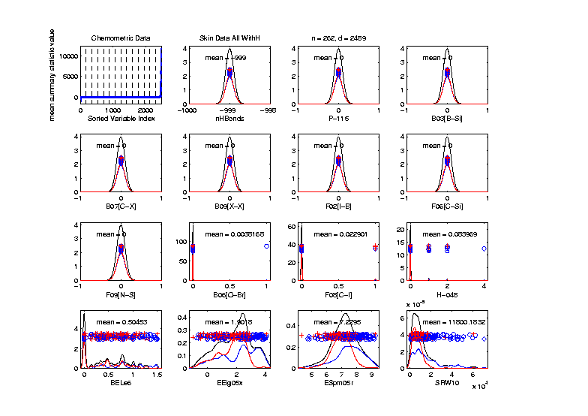
Marg. Dist. Plot Data Example
Drug Discovery – Sort on Means
Suspicious
Value ???

Slide 12
Marg. Dist. Plot Data Example
Drug Discovery – Sort on Means
Note:
Descriptor
Names

Slide 13
Marg. Dist. Plot Data Example
Drug Discovery – Sort on Means
Investigate Weird -999 Values
Note: Sometimes Such Values Are Used To Code Missing Values
(And Nobody Remembers to Say So)
(Not Too Bad Until Big Values Added In)

Slide 14
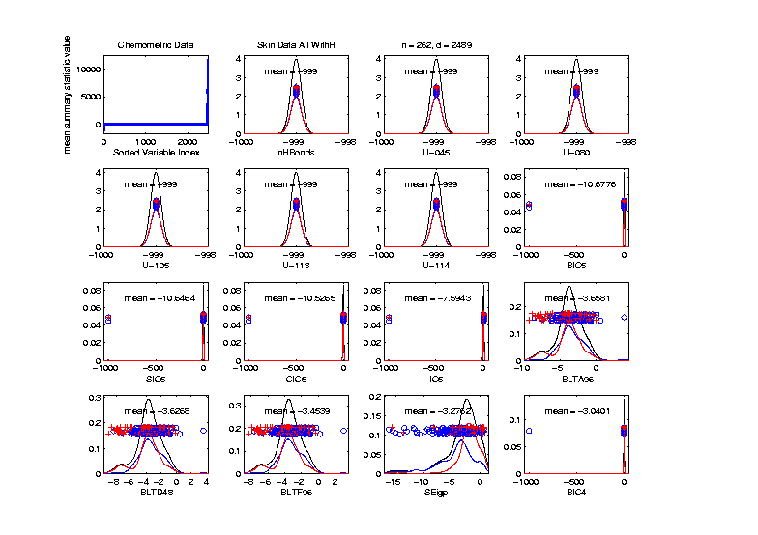
Marg. Dist. Plot Data Example
Drug Discovery – Sort on Means
Investigate Weird -999 Values, Via Mean
Look at
Smallest
Mean Values
(All Dashed
Bars On Left)

Slide 15
Marg. Dist. Plot Data Example
Drug Discovery – Sort on Means
Investigate Weird -999 Values, Via Mean,
Smallest
6 Variables
Are All -999

Slide 16
Marg. Dist. Plot Data Example
Drug Discovery – Sort on Means
Investigate Weird -999 Values, Via Mean,
Smallest
6 Variables
Are All -999
Other Have
Some -999

Slide 17
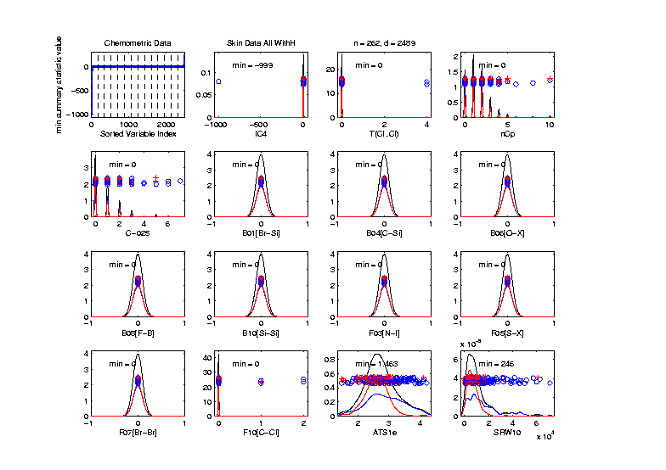
Marg. Dist. Plot Data Example
Drug Discovery
Focus on -999 Values, Using Minimum,
Equally
Spaced
Not Too
Many Such
Variables

Slide 18
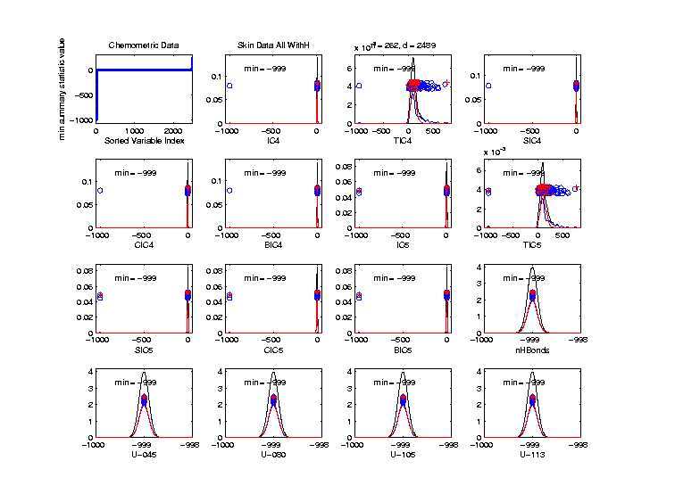
Marg. Dist. Plot Data Example
Drug Discovery
Focus More on -999 Values, Using Minimum,
Smallest 15
(Again All
Dashed
Bars On
Left)

Slide 19
Marg. Dist. Plot Data Example
Drug Discovery
Explicit Screening Found:
Out of $d = 2489$ Variables
$1315$ Had 0 Variance
$16$ Had some –999
So Deleted All Of The Above
Remaining Data Set Had $d = 1164$

Slide 20
Marg. Dist. Plot Data Example
Drug Discovery - Full Data PCA from Above
(Include
To Show
Contrast)

Slide 21
Marg. Dist. Plot Data Example
Drug Discovery - PCA After Variable Deletion
Looks Very
Similar!

Slide 22
Marg. Dist. Plot Data Example
Drug Discovery - PCA After Variable Deletion
Makes Sense
For 0-Var
Variables

Slide 23
Marg. Dist. Plot Data Example
Drug Discovery - PCA After Variable Deletion
-999s Have
No Impact
Since Others
Much Bigger!

Slide 24
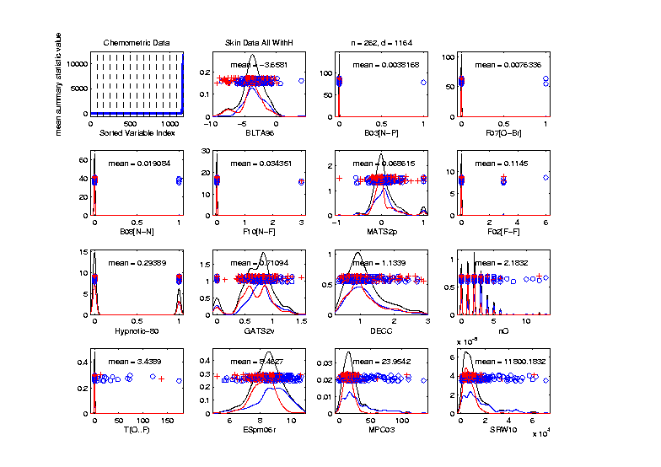
Marg. Dist. Plot Data Example
Drug Discovery - After Variable Deletion
Sort Marginals On Means, Equally Spaced
Still Have
Massive
Variation
In Types

Slide 25
Marg. Dist. Plot Data Example
Drug Discovery - After Variable Deletion
Sort Marginals On Means, Equally Spaced
Still Have
Very Few
That Are
Very Big

Slide 26
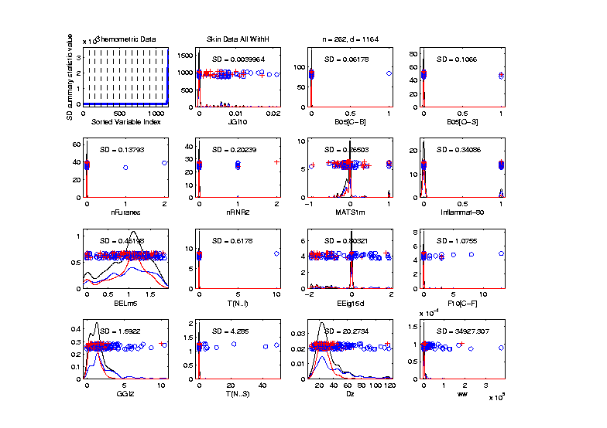
Marg. Dist. Plot Data Example
Drug Discovery - Sort Marginals On SDs,
Equally Spaced To Study Variation
Very Wide
Range
Standardization
May Be Useful

Slide 27
Marg. Dist. Plot Data Example
Drug Discovery - Sort Marginals On SDs,
Equally Spaced To Study Variation
Now See
Some
Very Small
How Many?

Slide 28
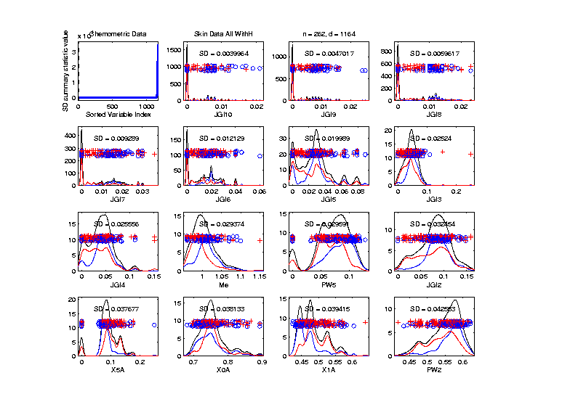
Marg. Dist. Plot Data Example
Drug Discovery - Sort Marginals On SDs,
Smallest
Several
Very Small
Variables
Some Very
Skewed???

Slide 29
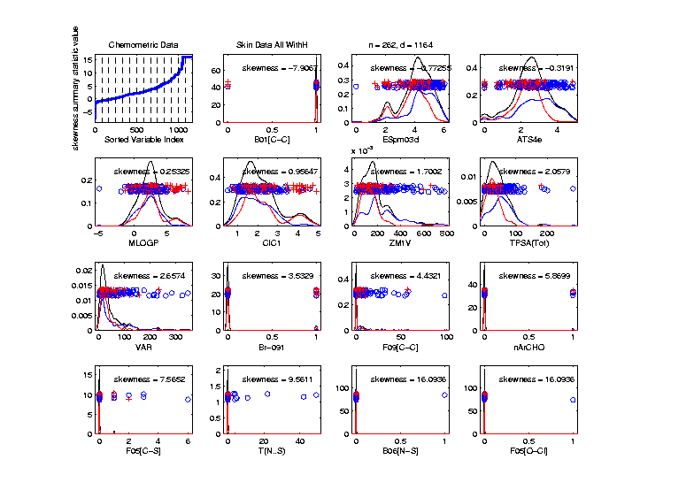
Marg. Dist. Plot Data Example
Drug Discovery - Sort On Skewness
Wide Range
(Consider
Transform-
ation)
0-1s Very
Prominent

Slide 30
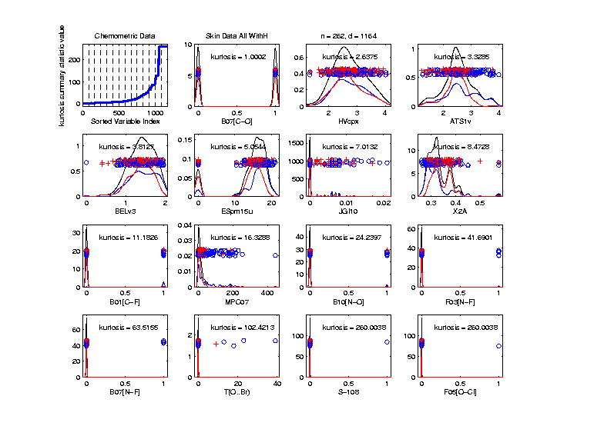
Marg. Dist. Plot Data Example
Drug Discovery - Sort On Kurtosis
Again Very
Wide Range
Again 0-1s
Are Major
Players
So Focus on 0-1 Variables

Slide 31
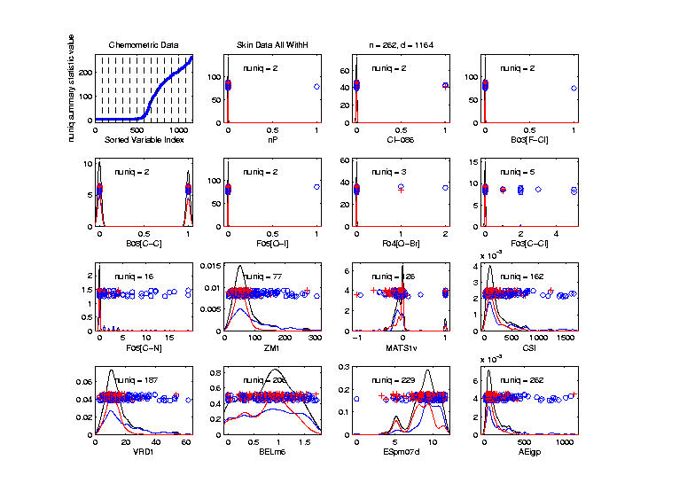
Marg. Dist. Plot Data Example
Drug Discovery - Sort On Number Unique
Shows
Many
Binary

Slide 32
Marg. Dist. Plot Data Example
Drug Discovery - Sort On Number Unique
Shows
Many
Binary
Few Truly
Continuous

Slide 33
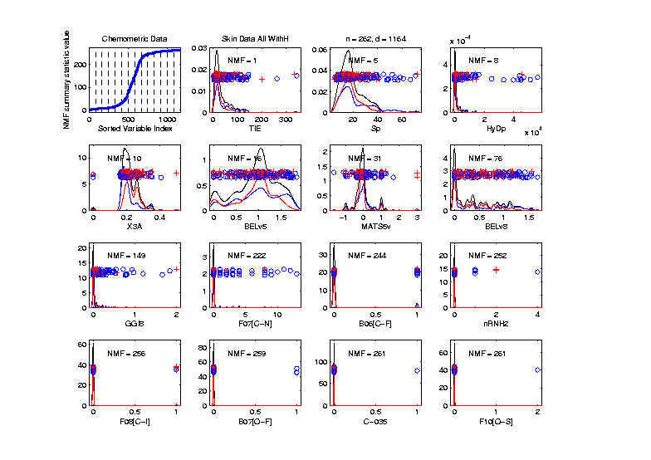
Marg. Dist. Plot Data Example
Drug Discovery - Sort On Number of Most Frequent
Shows Many
Have a Very
Common
Value
(Often 0)

Slide 34
Marg. Dist. Plot Data Example
Explicit Screening Found:
$d = 364$ Binary Variables
Consider Those Only
Do PCA
Try Variable Screening

Slide 35
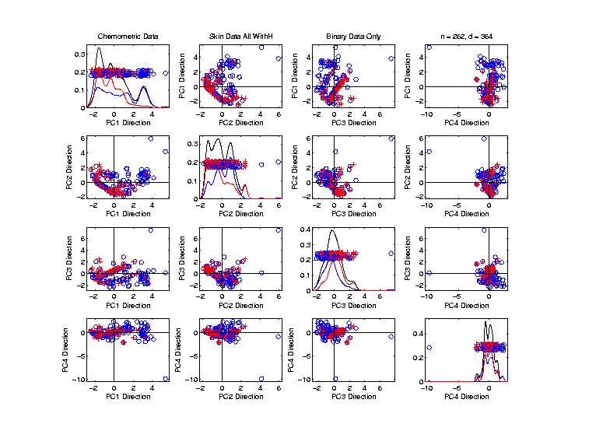
Marg. Dist. Plot Data Example
Drug Discovery - PCA on Binary Variables
Interesting
Structure?

Slide 36
Marg. Dist. Plot Data Example
Drug Discovery - PCA on Binary Variables
Interesting
Structure?
Clusters?

Slide 37
Marg. Dist. Plot Data Example
Drug Discovery - PCA on Binary Variables
Interesting
Structure?
Clusters?
Stronger
Red vs. Blue

Slide 38
Marg. Dist. Plot Data Example
Drug Discovery - PCA on Binary Variables
Interesting
Structure?
Can See
“Activity
Cliffs”
Maggiora (2006)

Slide 39
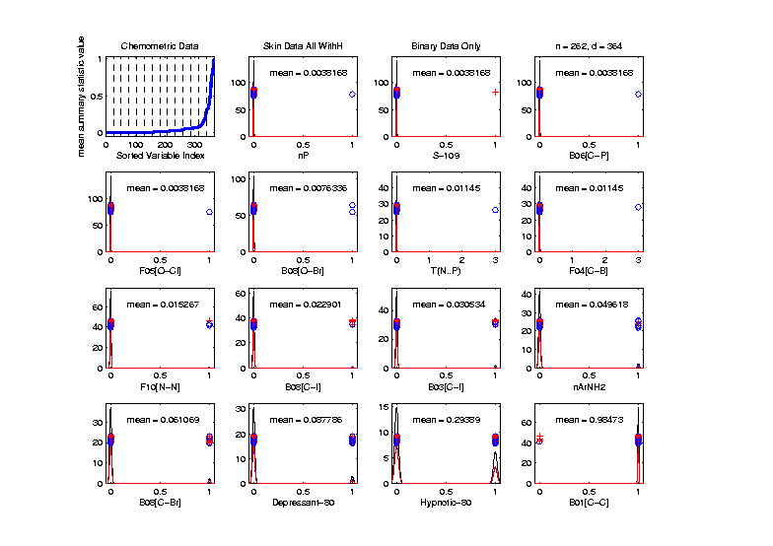
Marg. Dist. Plot Data Example
Drug Discovery - Binary Variables, Mean Sort
Shows
Many Are
Mostly 0s

Slide 40
Marg. Dist. Plot Data Example
Common Practice:
Delete Mostly 0 Variables (little information)
More Careful Look, Borysov et al (2016)
These Can Contain Useful Info
(Especially When So Many)

Slide 41
Marg. Dist. Plot Data Example
Explicit Screening Found:
$d = 800$Non-Binary Variables
Now Focus on Those Only
Standardize Variables
(Subtract Mean, Divide By SD)

Slide 42
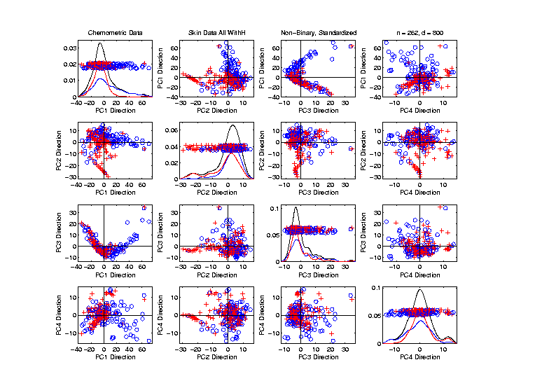
Marg. Dist. Plot Data Example
Drug Discovery - PCA on non-Binary Variables
Interesting
Structure?

Slide 43
Marg. Dist. Plot Data Example
Drug Discovery - PCA on non-Binary Variables
Interesting
Structure?
Suggests
Subtypes

Slide 44
Marg. Dist. Plot Data Example
Drug Discovery - PCA on non-Binary Variables
Interesting
Structure?
Suggests
Subtypes
Reds Only?

Slide 45
Marg. Dist. Plot Data Example
Drug Discovery - PCA on non-Binary Variables
Again
Suggestion
Of “Activity
Cliffs”
Maggiora (2006)

Slide 46
Matlab Software
Want to try similar analyses?
Matlab Available from UNC Site License
Download Software:
Google “Marron Matlab Software”

Slide 47
Matlab Software
Choose

Slide 48
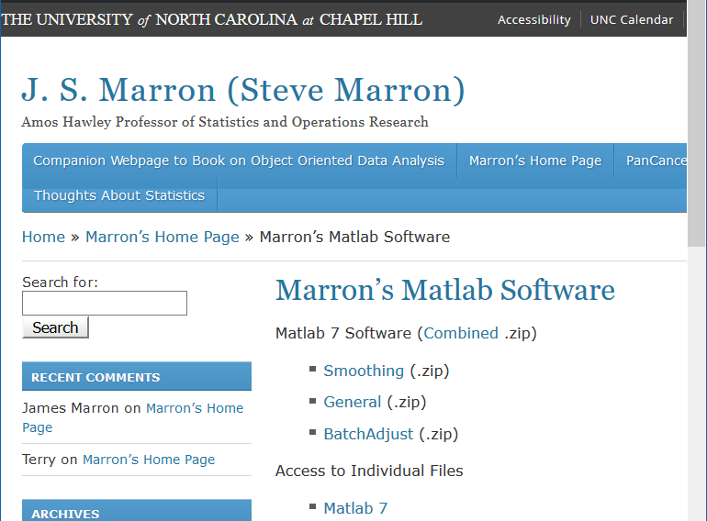
Matlab Software
Download .zip File, & Expand to 4 Directories

Slide 49
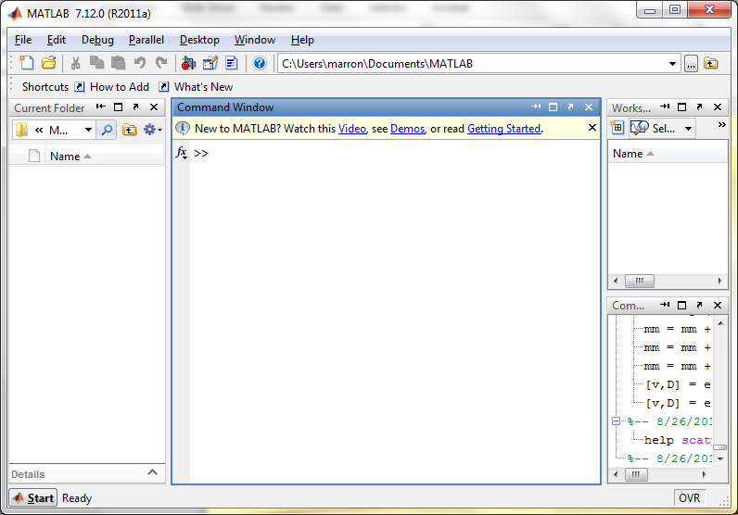
Matlab Software
Put these in Matlab Path

Slide 50
Matlab Software
Put these in Matlab Path

Slide 51
Matlab Basics
Matlab has Modalities:
Interpreted
(Type Commands & Run Individually)
Batch
(Run “Script Files” = Command Sets)

Slide 52
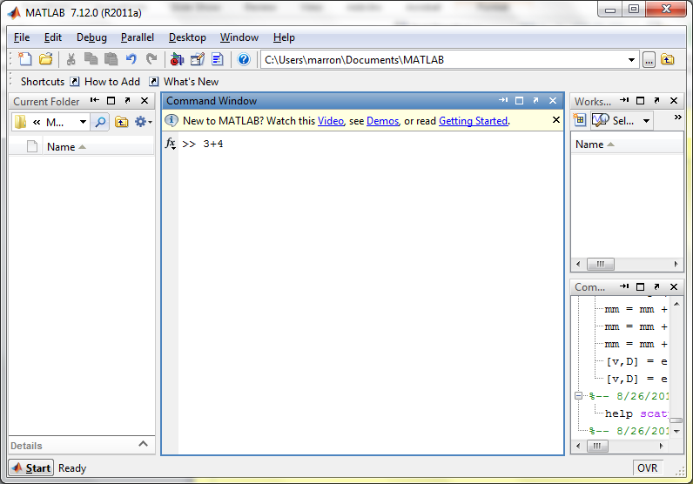
Matlab Basics
Matlab in Interpreted Mode:

Slide 53
Matlab Basics
Matlab in Interpreted Mode:

Slide 54
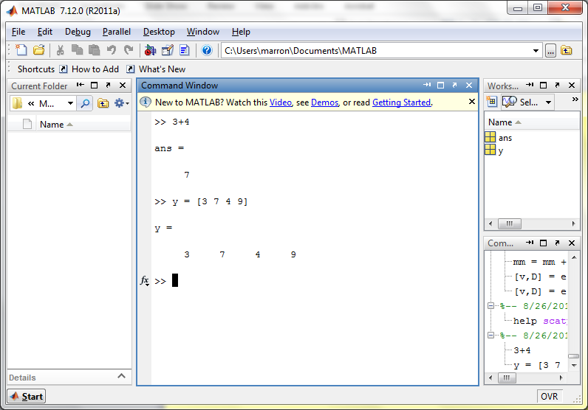
Matlab Basics
Matlab in Interpreted Mode:

Slide 55
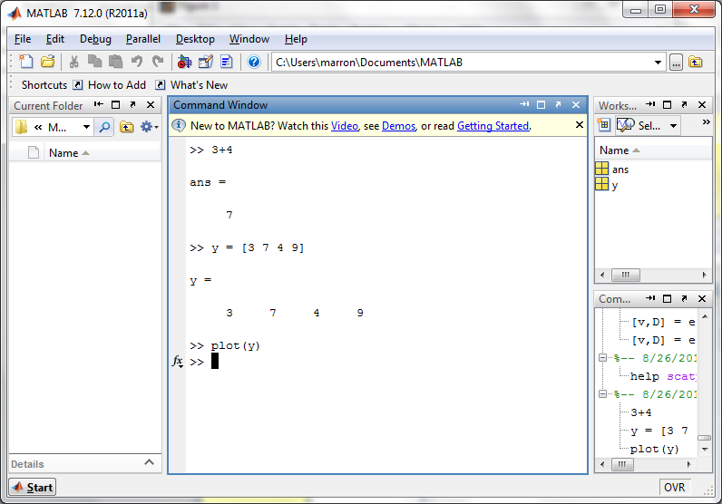
Matlab Basics
Matlab in Interpreted Mode:

Slide 56
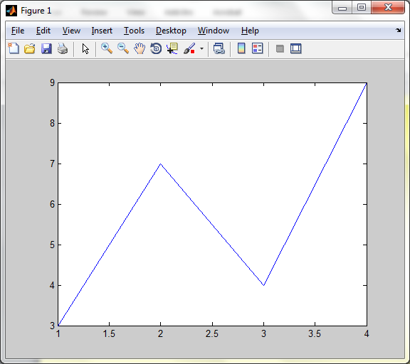
Matlab Basics
Matlab in Interpreted Mode:

Slide 57
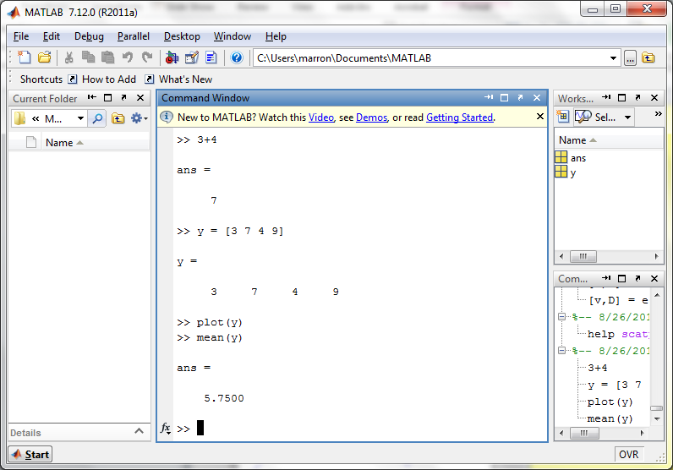
Matlab Basics
Matlab in Interpreted Mode:

Slide 58
Matlab Basics
Matlab in Interpreted Mode:
For description of a function:
>> help [function name]

Slide 59
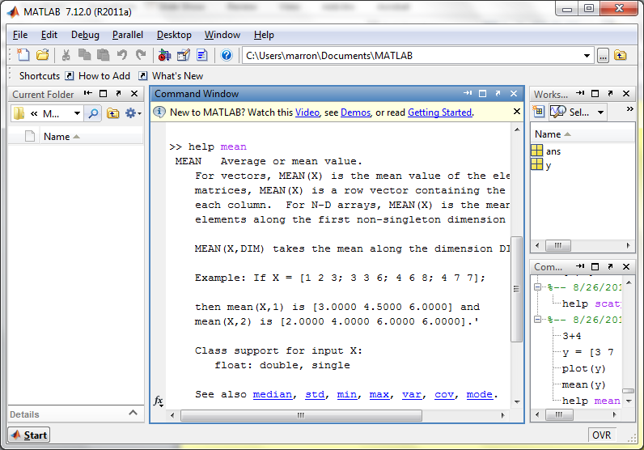
Matlab Basics
Matlab in Interpreted Mode:

Slide 60
Matlab Basics
Matlab in Interpreted Mode:
To Find Functions:
>> help [category name]
e.g.
>> help stats

Slide 61
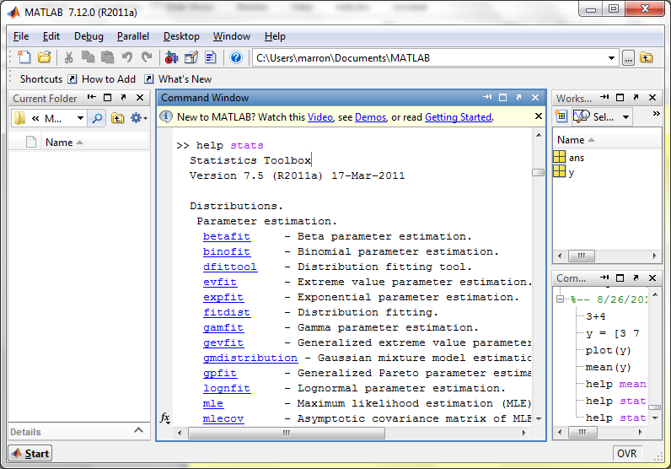
Matlab Basics
Matlab in Interpreted Mode:

Slide 62
Matlab Basics
Matlab has Modalities:
Interpreted (Type Commands)
Batch (Run “Script Files”)
For Serious Scientific Computing:
Always Run Scripts

Slide 63
Matlab Basics
Matlab Script File:
Just a List of Matlab Commands
Matlab Executes Them in Order
Why Bother (Why Not Just Type Commands)?
Reproducibility
(Can Find Mistakes & Use Again Much Later)

Slide 64
Matlab Script Files
An Example:
Recall “Brushing Analysis” of
RNAseq Lung Cancer Data

Slide 65
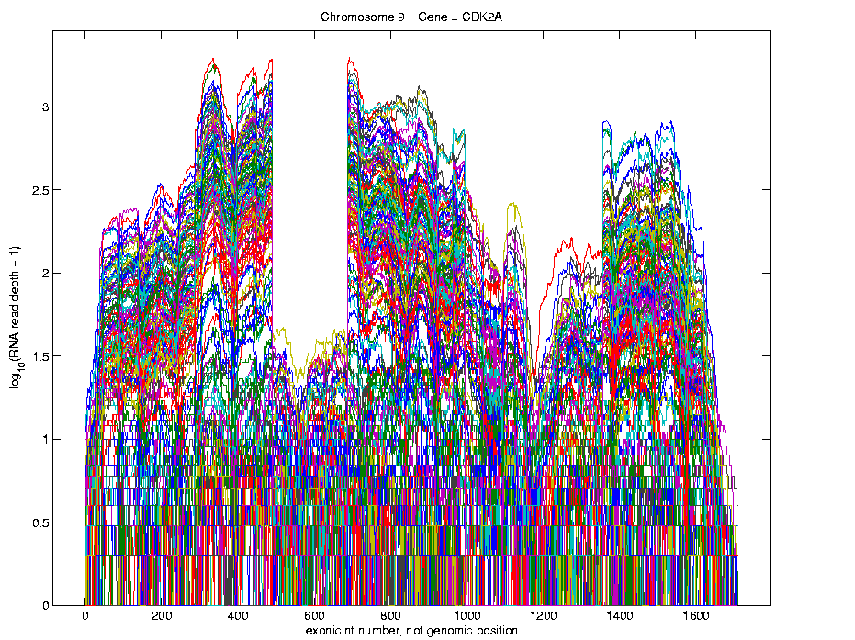
Functional Data Analysis
Simple
1st
View:
Curve
Overlay
(log
scale)

Slide 66
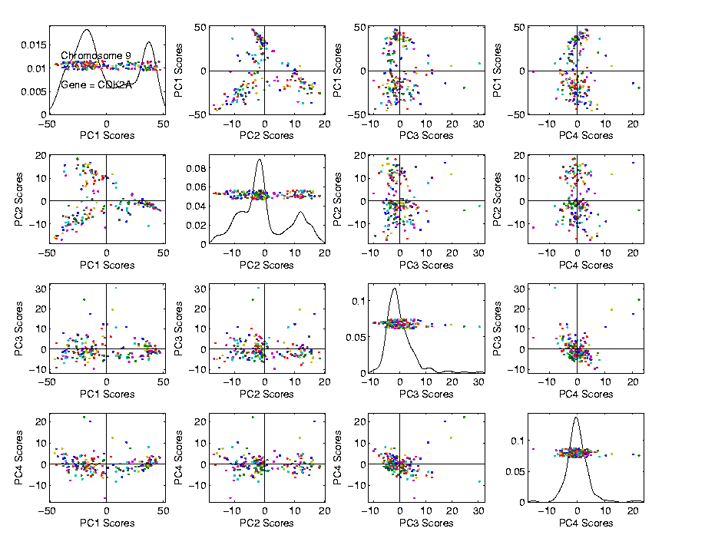
Functional Data Analysis
Often
Useful
Population
View:
PCA
Scores

Slide 67
Functional Data Analysis
Suggestion
Of
Clusters
???

Slide 68
Functional Data Analysis
Suggestion
Of
Clusters
Which
Are
These?

Slide 69
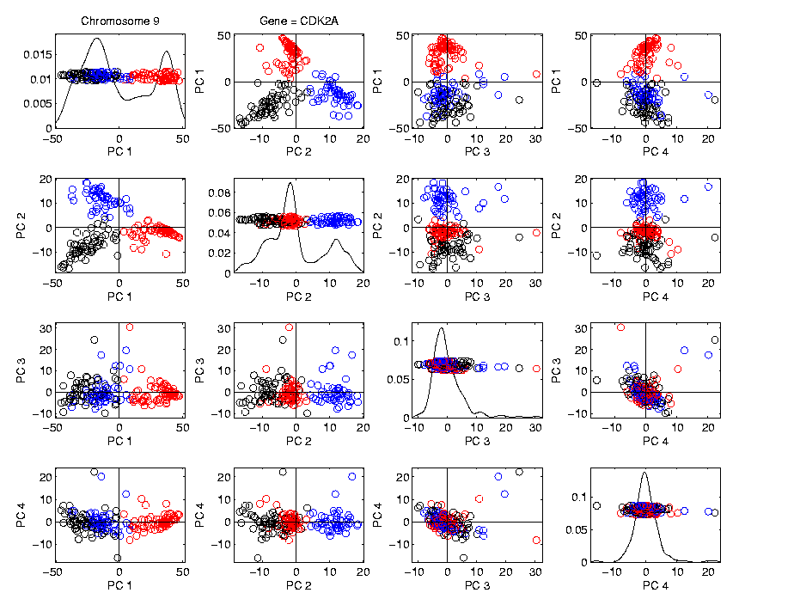
Functional Data Analysis
Manually
“Brush”
Clusters

Slide 70
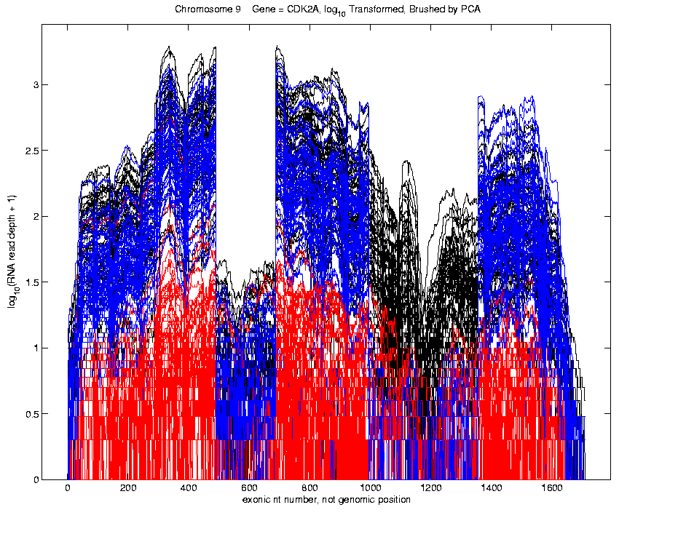
Functional Data Analysis
Manually
Brush
Clusters
Clear
Alternate
Splicing

Slide 71
Matlab Script Files
An Example:
Recall “Brushing Analysis” of
RNAseq Lung Cancer Data
Analysis In Script File:
LungCancer2011.m
On Course Web Page
Matlab Script File Suffix

Slide 72
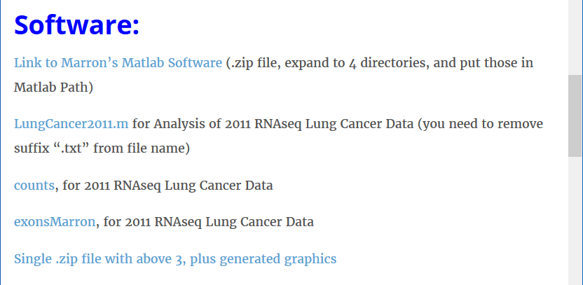
Matlab Script Files
An Example:
On Course Web Page
Careful to Remove “.txt”
After Download

Slide 73
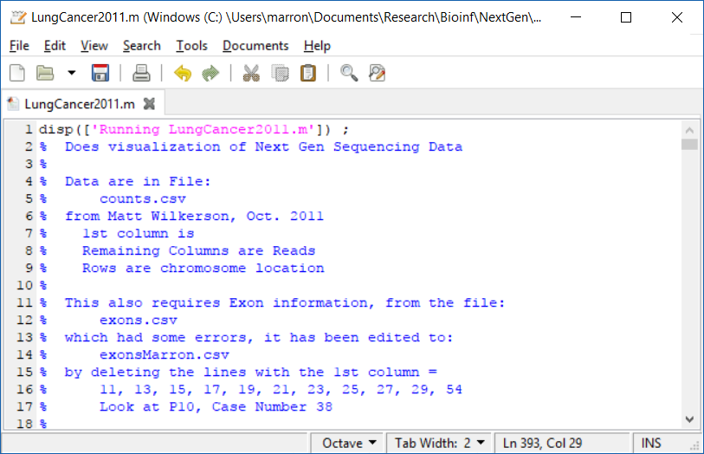
Matlab Script Files
String of Text

Slide 74
Matlab Script Files
Command to Display String to Screen

Slide 75
Matlab Script Files
Notes About Data (Maximizes Reproducibility)

Slide 76
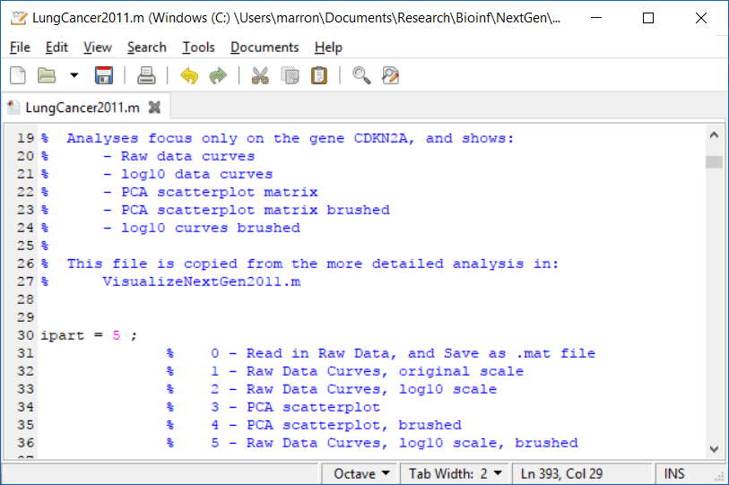
Matlab Script Files
Have Index for Each Part of Analysis

Slide 77
Matlab Script Files
So Keep Everything Done (Max’s Reprod’ity)

Slide 78
Matlab Script Files
Easy to Regenerate (& Change) Graphics

Slide 79
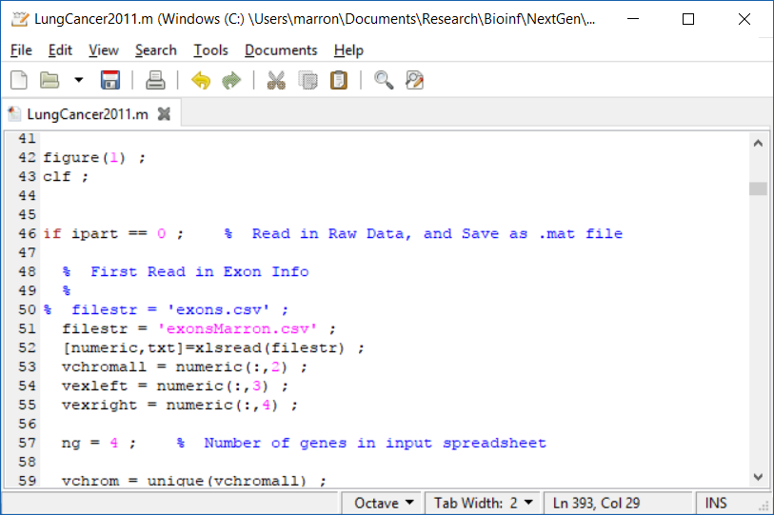
Matlab Script Files
Set Graphics to Default

Slide 80
Matlab Script Files
Put Different Program Parts in IF-Block

Slide 81
Matlab Script Files
Comment Out Currently Unused Commands

Slide 82
Matlab Script Files
Read Data from Excel File

Slide 83
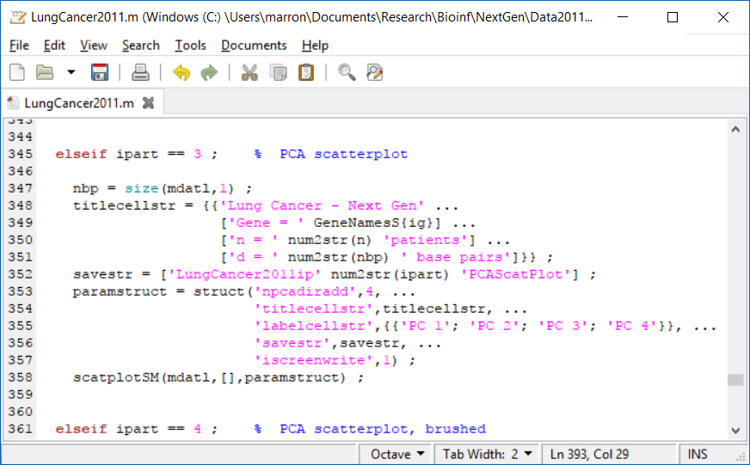
Matlab Script Files
For Scores Scatterplot (in “General” Directory)

Slide 84
Matlab Script Files
Input Data Matrix

Slide 85
Matlab Script Files
Structure, with Other Settings

Slide 86
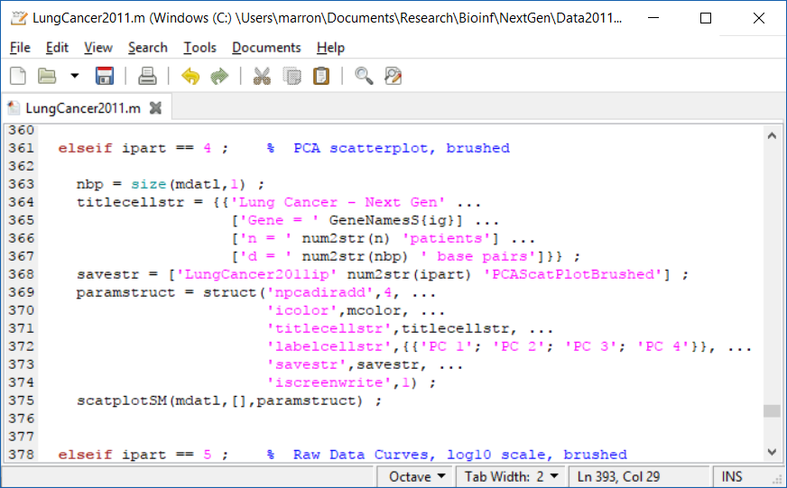
Matlab Script Files
To Make Brushed Colored Version

Slide 87
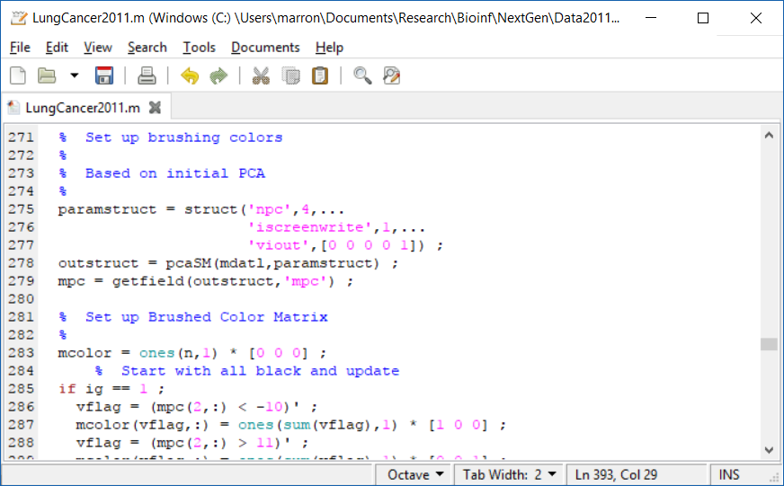
Matlab Script Files
Start with PCA (To Determine Colors)

Slide 88
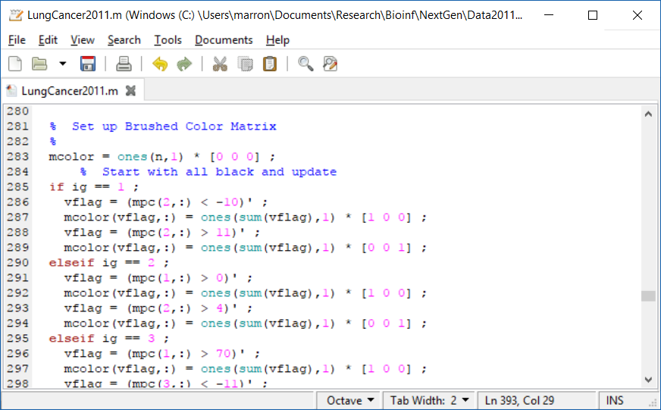
Matlab Script Files
Then Create Color Matrix

Slide 89
Matlab Script Files
Black Red Blue

Slide 90
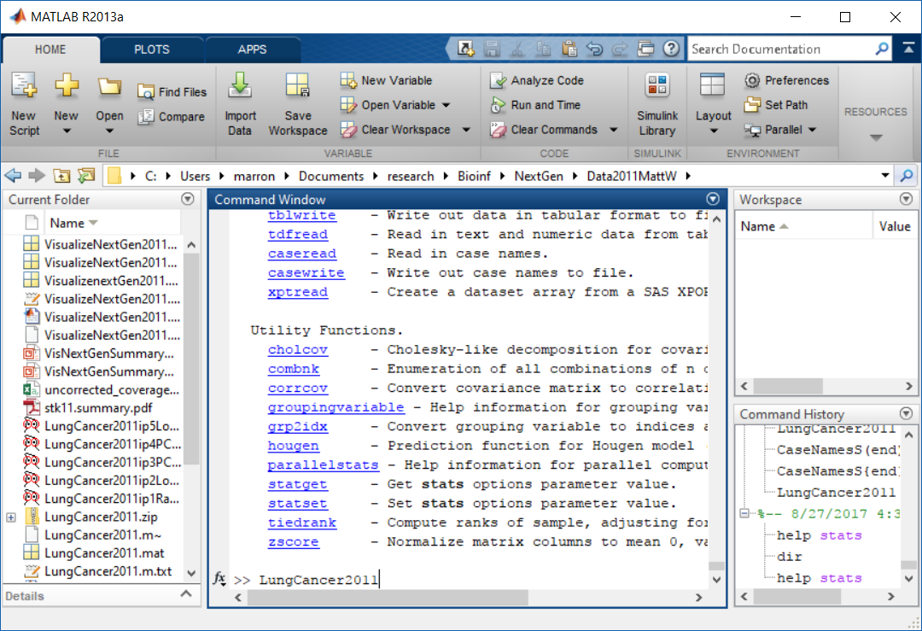
Matlab Script Files
Run Script Using Filename as a Command

Slide 91
Marginal Distribution Plots
Toy Example: $n=200$, $d=50$,
i.i.d. Poisson, with parameters $λ=0.2,⋯,20$
Sort
Variables
On
Sample
Mean

Slide 92
Marginal Distribution Plots
Matlab Software:
MargDistPlotSM.m
In General Directory

Slide 93
Object Oriented Data Analysis
Three Major Parts of OODA Applications:
I. Object Definition
“What are the Data Objects?”
Exploratory Analysis
“What Is Data Structure / Drivers?”
III. Confirmatory Analysis / Validation
Is it Really There (vs. Noise Artifact)?

Slide 94
Recall Drug Discovery Data
$n = 262$, Chemical Compounds
$d = 2489$, Chemical “Descriptors”
Discrete Response:
0 – blue 0, 1 – red +
Illustrated MargDistPlot.m
(Thanks to Alex Tropsha Lab)

Slide 95
Recall Drug Discovery Data
Raw Data – PCA Scatterplot
Dominated
By Few
Large
Compounds
Not Good
Blue - Red
Separation

Slide 96
Recall Drug Discovery Data
MargDistPlot.m – Sorted on Means
Revealed
Many
Interesting
Features
Led To
Data
Modifcation

Slide 97
Recall Drug Discovery Data
PCA on Binary Variables
Interesting
Structure?
Clusters?
Stronger
Red vs. Blue

Slide 98
Recall Drug Discovery Data
PCA on Binary Variables
Deep
Question:
Is
Red vs. Blue
Separation
Better?

Slide 99
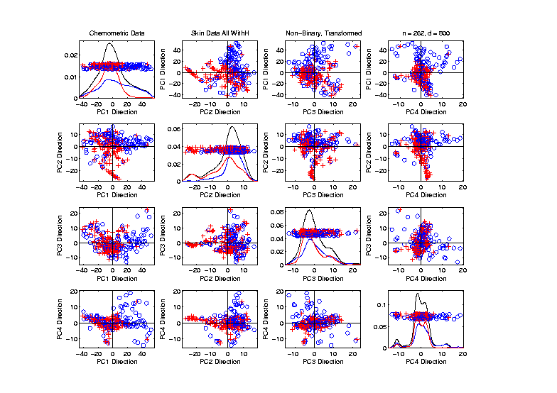
Recall Drug Discovery Data
PCA on Standardized Non-Binary Variables
Interesting
Structure?
Clusters?
Stronger
Red vs. Blue

Slide 100
Recall Drug Discovery Data
PCA on Standardized Non-Binary Variables
Same Deep
Question:
Is
Red vs. Blue
Separation
Better?

Slide 101
Recall Drug Discovery Data
Question:
When Is Red vs. Blue Separation Better?
Visual Approach:
Train DWD to Separate
Project, and View How Separated
Useful View, Add Orthogonal PC Directions

Slide 102
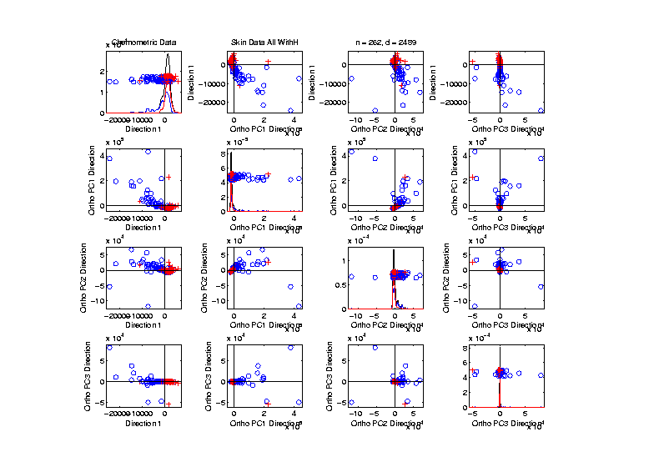
Recall Drug Discovery Data
Raw Data – DWD & Ortho PCs Scatterplot
Some
Blue - Red
Separation
But Dominated
By Few Large
Compounds

Slide 103
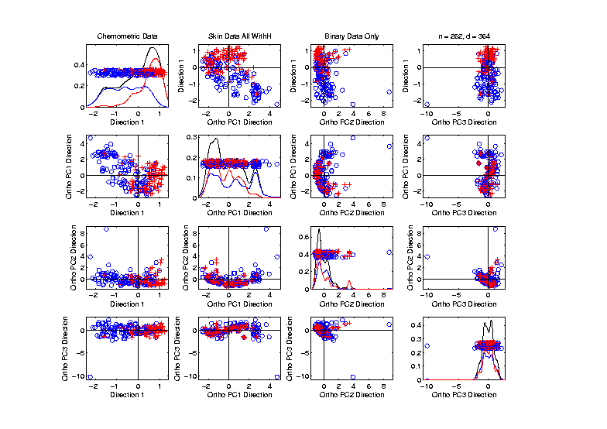
Recall Drug Discovery Data
Binary Data – DWD & Ortho PCs Scatterplot
Better
Blue - Red
Separation
And Better
Visualization

Slide 104
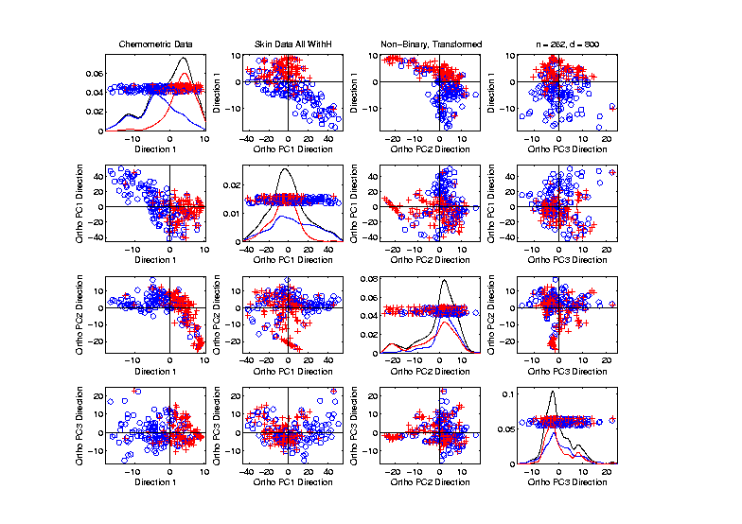
Recall Drug Discovery Data
Standard’d Non-Binary Data – DWD & OPCA
Better
Blue - Red
Separation
???
Very Useful
Visualization

Slide 105
Caution
DWD Separation Can Be Deceptive
Since DWD is Really Good at Separation
Important Concept:
Statistical Inference is Essential

Slide 106
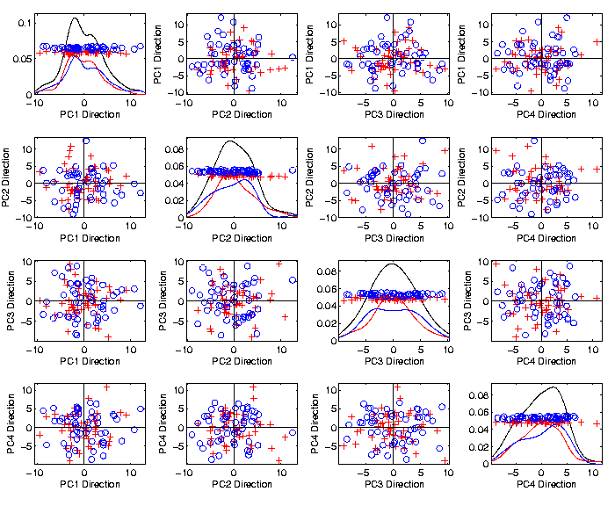
Caution
Toy 2-Class
Example
See
Structure?
Careful,
Only PC1-4

Slide 107
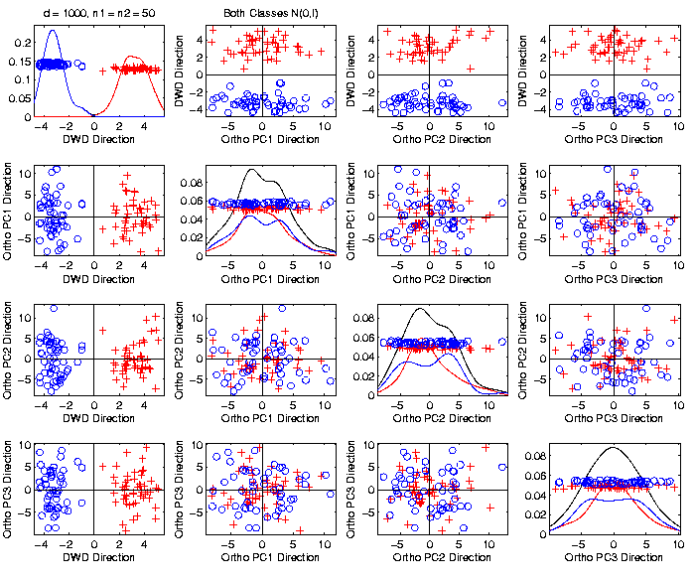
Caution
Toy 2-Class
Example
DWD &
Ortho PCA
Finds Big
Separation

Slide 108
Caution
Toy 2-Class
Example
Not in 1ST
4 PCs
Since
Smaller Scale

Slide 109
Caution
Toy 2-Class
Example
Actually
Both
Classes
Are $N\left(0,I\right)$
$$d=1000$$

Slide 110
Caution
Toy 2-Class
Example
Separation
Is Natural
Sampling
Variation
(Will Study in Detail Later)

Slide 111
Caution
Main Lesson Again:
DWD Separation Can Be Deceptive
Since DWD is Really Good at Separation
Important Concept:
Statistical Inference is Essential
III. Confirmatory Analysis

Slide 112
DiProPerm Hypothesis Test
Context: 2 – sample means
H₀: μ₊₁ = μ₋₁ vs. H₁: μ₊₁ ≠ μ₋₁
(in High Dimensions)
$∃$ A Large Literature. Some Highlights:
Bai & Sarandasa (2006)
Chen & Qin (2010)
Srivastava et al (2013)
Cai et al (2014)

Slide 113
DiProPerm Hypothesis Test
Context: 2 – sample means
H₀: μ₊₁ = μ₋₁ vs. H₁: μ₊₁ ≠ μ₋₁
(in High Dimensions)
Approach taken here:
Wei et al (2013)
Focus on Visualization via Projection
(Thus Test Related to Exploration)

Slide 114
DiProPerm Hypothesis Test
Context: 2 – sample means
H₀: μ₊₁ = μ₋₁ vs. H₁: μ₊₁ ≠ μ₋₁
Challenges:
Distributional Assumptions
Parameter Estimation
HDLSS space is slippery

Slide 115
DiProPerm Hypothesis Test
Context: 2 – sample means
H₀: μ₊₁ = μ₋₁ vs. H₁: μ₊₁ ≠ μ₋₁
Challenges:
Distributional Assumptions
Parameter Estimation
Suggested Approach:
Permutation test
(A flavor of classical “non-parametrics”)

Slide 116
DiProPerm Hypothesis Test
Suggested Approach:
Find a DIrection
(separating classes)
PROject the data
(reduces to 1 dim)
PERMute
(class labels, to assess significance,
with recomputed direction)

Slide 117
DiProPerm Hypothesis Test
Toy 2-Class Example
Separated DWD
Projections
(Again $N\left(0,I\right)$, $d=1000$)

Slide 118
DiProPerm Hypothesis Test
Toy 2-Class Example
Separated DWD
Projections
Measure Separation of Classes Using:
Mean Difference = 6.209

Slide 119
DiProPerm Hypothesis Test
Toy 2-Class Example
Separated DWD
Projections
Measure Separation of Classes Using:
Mean Difference = 6.209
Record as Vertical Line

Slide 120
DiProPerm Hypothesis Test
Toy 2-Class Example
Separated DWD
Projections
Measure Separation of Classes Using:
Mean Difference = 6.209
Statistically Significant???

Slide 121
DiProPerm Hypothesis Test
Toy 2-Class Example
Permuted
Class Labels

Slide 122
DiProPerm Hypothesis Test
Toy 2-Class Example
Permuted
Class Labels
Recompute DWD
& Projections

Slide 123
DiProPerm Hypothesis Test
Toy 2-Class Example
Measure Class
Separation
Using Mean
Difference
= 6.26

Slide 124
DiProPerm Hypothesis Test
Toy 2-Class Example
Measure Class
Separation
Using Mean
Difference
= 6.26
Record as Dot

Slide 125
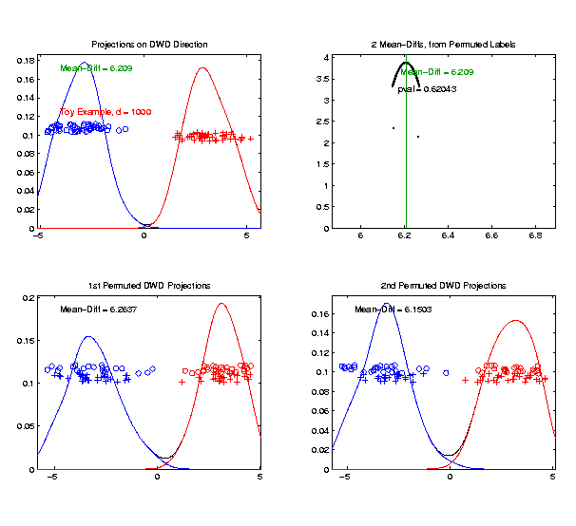
DiProPerm Hypothesis Test
Toy 2-Class Example
Generate 2nd
Permutation

Slide 126
DiProPerm Hypothesis Test
Toy 2-Class Example
Measure Class
Separation
Using Mean
Difference
= 6.15

Slide 127
DiProPerm Hypothesis Test
Toy 2-Class Example
Record as
Second Dot

Slide 128
DiProPerm Hypothesis Test
.
.
.
Repeat This 1,000 Times
To Generate Null Distribution

Slide 129
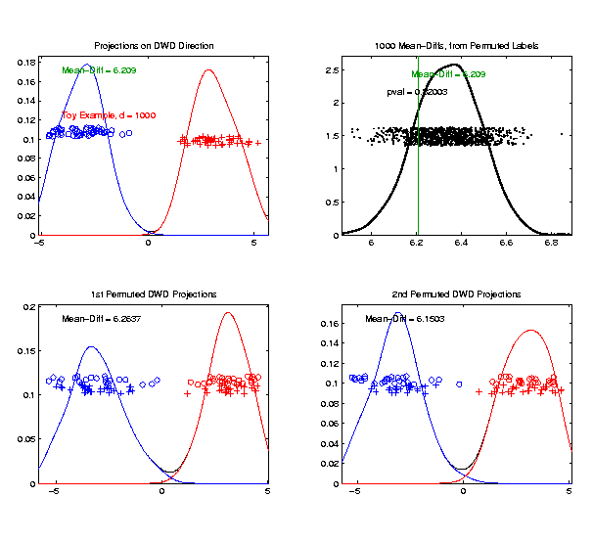
DiProPerm Hypothesis Test
Toy 2-Class Example
Generate Null
Distribution

Slide 130
DiProPerm Hypothesis Test
Toy 2-Class Example
Generate Null
Distribution
Compare With
Original Value

Slide 131
DiProPerm Hypothesis Test
Toy 2-Class Example
Generate Null
Distribution
Compare With
Original Value
Take Proportion
Larger as P-Value

Slide 132
DiProPerm Hypothesis Test
Toy 2-Class Example
Generate Null
Distribution
Compare With
Original Value
Not Significant

Slide 133
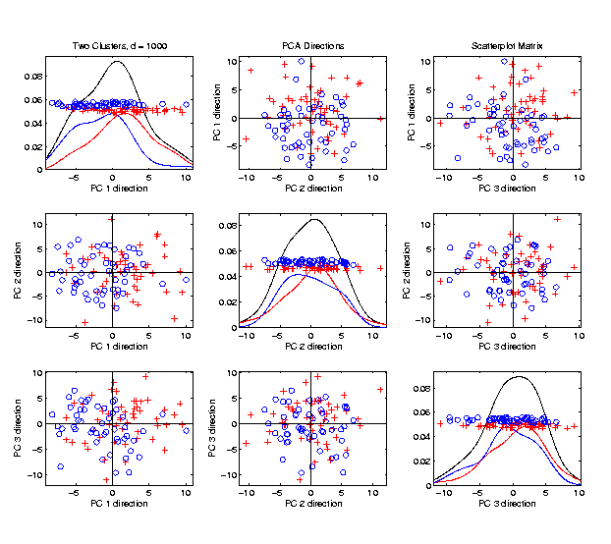
DiProPerm Hypothesis Test
$J$ = vector of 1s
Another Example
$N_{1000}\left(+0.05∗J,I\right)$
$N_{1000}\left(−0.05∗J,I\right)$
PCA View

Slide 134
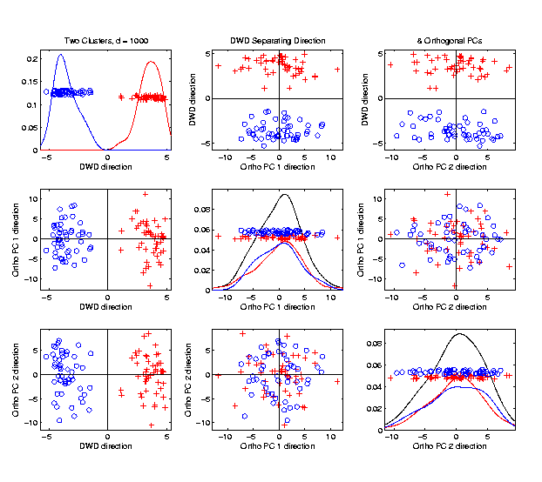
DiProPerm Hypothesis Test
Another Example
$N_{1000}\left(+0.05∗J,I\right)$
$N_{1000}\left(−0.05∗J,I\right)$
DWD View
(Similar
to $N\left(0,I\right)$?)

Slide 135
DiProPerm Hypothesis Test
Another Example
$N_{1000}\left(+0.05∗J,I\right)$
$N_{1000}\left(−0.05∗J,I\right)$
DiProPerm Now
Quite Significant

Slide 136
DiProPerm Hypothesis Test
Stronger Example
$N_{1000}\left(+0.2∗J,I\right)$
$N_{1000}\left(−0.2∗J,I\right)$
Even PCA
Shows Class
Difference

Slide 137
DiProPerm Hypothesis Test
Stronger Example
$N_{1000}\left(+0.2∗J,I\right)$
$N_{1000}\left(−0.2∗J,I\right)$
DiProPerm Very
Significant

Slide 138
DiProPerm Hypothesis Test
Stronger Example
$N_{1000}\left(+0.2∗J,I\right)$
$N_{1000}\left(−0.2∗J,I\right)$
DiProPerm Very
Significant
Z-Score Allows
Comparison
>> 5.4 above

Slide 139
DiProPerm Hypothesis Test
Real Data Example: Autism
Caudate Shape
(sub-cortical brain structure)
Shape summarized by 3-d locations of 1032 corresponding points
Autistic vs. Typically Developing
(Thanks to Josh Cates)

Slide 140
DiProPerm Hypothesis Test
Finds
Significant
Difference
Despite Weak
Visual
Impression

Slide 141
DiProPerm Hypothesis Test
Also Compare: Developmentally Delayed
No
Significant
Difference
But Stronger
Visual
Impression

Slide 142
DiProPerm Hypothesis Test
Two
Examples
Which Is
“More
Distinct”?
Visually Better Separation?
Thanks to Katie Hoadley

Slide 143
DiProPerm Hypothesis Test
Two
Examples
Which Is
“More
Distinct”?
Stronger Statistical Significance!
(Reason: Differing Sample Sizes)

