Slide 1
Statistics – O. R. 881 Object Oriented Data Analysis
Steve Marron
Dept. of Statistics and Operations Research
University of North Carolina

Slide 2
Administrative Info
Details on Course Web Page
https://stor881fall2017.web.unc.edu/
Will Post Daily Power Points
Also Keep Running List of References

Slide 3
Course Expectations
Grading Based on:
“Participant Presentations”
5 – 10 minute talks
By Enrolled Students
Hopefully Others

Slide 4
Participant Presentations
Please Prepare to Sign Up:
Name
Email (Onyen is fine, or …)
Are You ENRolled?
Tentative Title (???? Is OK)
When:
Next Week, Early, Oct., Nov., Late

Slide 5
Basics of OODA
Starting Point:
Data Object Selection
“What should be the data objects?”
Two Main Parts:
Data Object Determination
Data Object Representation
(e.g. Mortality Data)

Slide 6
Basics of OODA
Return to Organizational Structure:
Data Matrix
$$\left[\begin{matrix}x_{11} & ⋯ & x_{1n} \\ ⋮ & ⋱ & ⋮ \\ x_{d1} & ⋯ & x_{dn}\end{matrix}\right]$$
Convention Here:
Columns are Data Objects
Caution: Not Always Done!

Slide 7
Basics of OODA
Row vs. Column Choice by Areas:
Columns as Data Objects:
Linear Algebra (column vectors)
Bioinformatics (from Excel restrictions)
Rows as Data Objects:
Statistical Data Bases
Linear Models

Slide 8
Basics of OODA
Object Space ←→ Descriptor Space
Simple $d=2$ Toy Example:
Enables Visualization of BOTH Spaces

Slide 9
E.g. Curves As Data
Aside on Visualization:
$\left(\begin{matrix}x_{1} \\ ⋮ \\ x_{d}\end{matrix}\right)$
Called Parallel Coordinate View
by Inselberg (1985, 2005)

Slide 10
Functional Data Analysis, 10-d Toy EG 1
Terminology:
“Loadings Plots” “Scores Plots”
Notes:
EGCD1Parabs.ps

Slide 11
Functional Data Analysis, 50-d Toy EG 3
Notes:
EGCD1Clust4a.ps

Slide 12
Functional Data Analysis, 50-d Toy EG 3
Notes:
EGCD1Clust4aDP2d.ps

Slide 13
Object Oriented Data Analysis
Three Major Parts of OODA Applications:
I. Object Definition
“What are the Data Objects?”
Exploratory Analysis
“What Is Data Structure / Drivers?”
III. Confirmatory Analysis / Validation
Is it Really There (vs. Noise Artifact)?

Slide 14
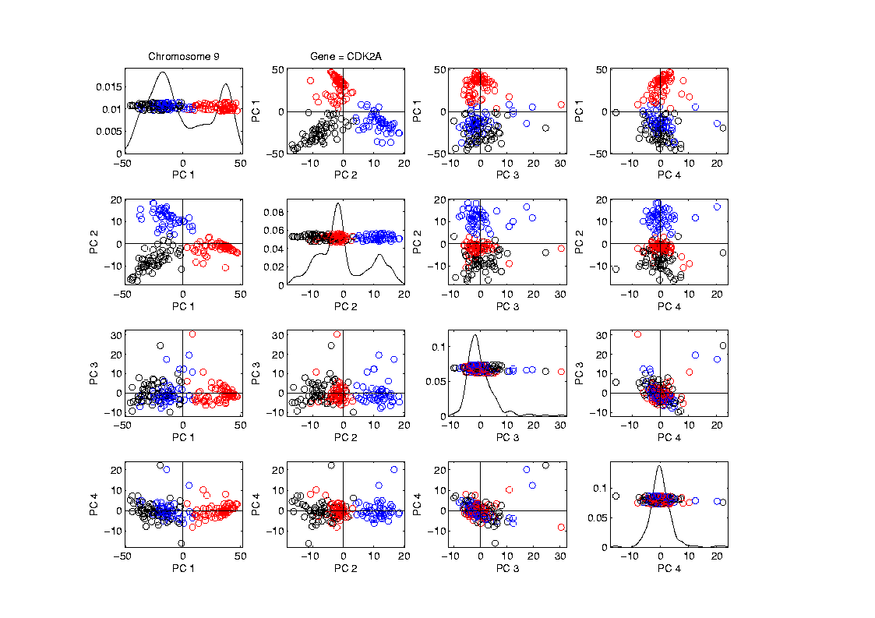
Functional Data Analysis
Visualization in Descriptor Space
Manually
“Brush”
Clusters
II. Exploratory
Analysis

Slide 15
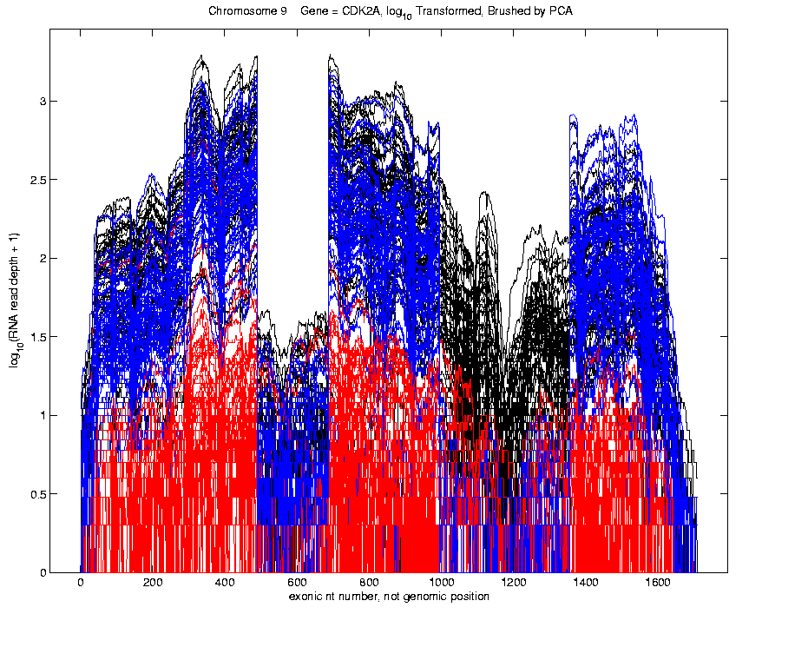
Functional Data Analysis
Visualization in Object Space
Manually
Brush
Clusters
Clear
Alternate
Splicing
II. Exploratory
Analysis

Slide 16
Limitation of PCA
Strongly Feels Scaling of Each Variable
Consequence:
May want to standardize each variable
(i.e. subtract $\overline{X}$, divide by $s$)
Also called Whitening
Equivalent Approach:
Base PCA on Correlation Matrix
Called Correlation PCA

Slide 17
Correlation PCA
A related (& better known?) variation of PCA:
Replace cov. matrix with correlation matrix
I.e. do eigen analysis of
Where

Slide 18
Correlation PCA
Why use correlation matrix?
Makes features “unit free”
e.g. Height, Weight, Age, $, …
Are “directions in point cloud” meaningful or useful?
Will unimportant directions dominate?

Slide 19
Correlation PCA
Personal Thoughts on Correlation PCA:
Can be very useful
(especially with noncommensurate units)
Not always, can hide important structure
Illustrate with example

Slide 20
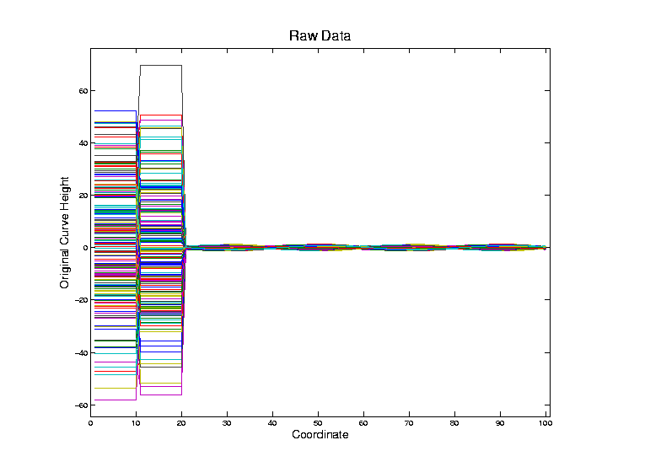
Correlation PCA
Toy Example Contrasting Cov. vs. Corr.

Slide 21
Correlation PCA
Toy Example Contrasting Cov. vs. Corr.
Big Var’n
Part

Slide 22
Correlation PCA
Toy Example Contrasting Cov. vs. Corr.
Big Var’n
Part
Small
Var’n
Part

Slide 23
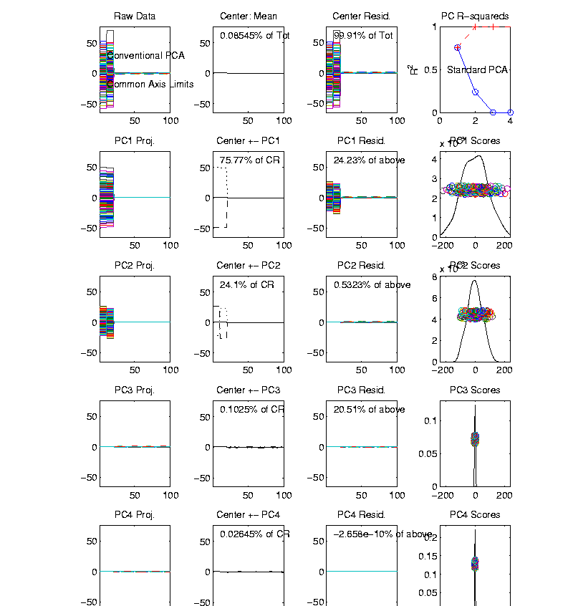
Correlation PCA
Toy Example Contrasting Cov vs. Corr.
1st Comp:
Nearly Flat

Slide 24
Correlation PCA
Toy Example Contrasting Cov. vs. Corr.
1st Comp:
Nearly Flat
2nd Comp:
Contrast

Slide 25
Correlation PCA
Toy Example Contrasting Cov. vs. Corr.
1st Comp:
Nearly Flat
2nd Comp:
Contrast
3rd & 4th:
Very Small

Slide 26
Correlation PCA
Toy Example Contrasting Cov. vs. Corr.
1st Comp:
Nearly Flat
2nd Comp:
Contrast
3rd & 4th:
Look Very
Small Since
Common Axes

Slide 27
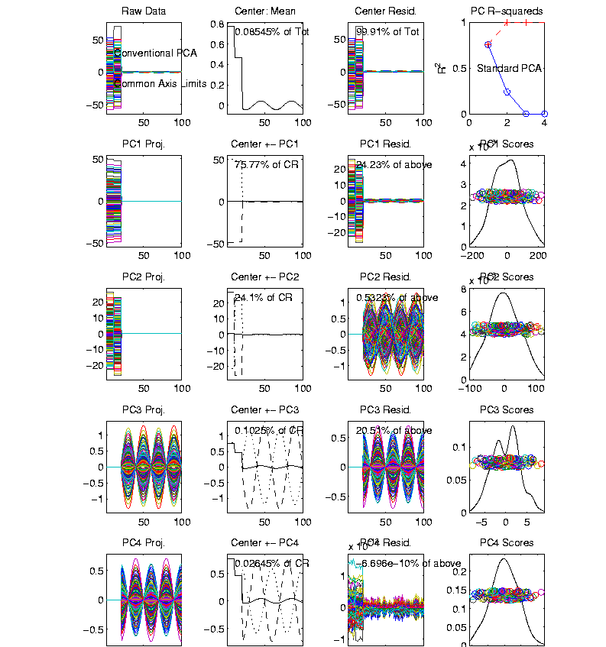
Correlation PCA
Toy Example Contrasting Cov vs. Corr.
Use Rescaled
Axes (Typical
Default)
Now Can
See Mean

Slide 28
Correlation PCA
Toy Example Contrasting Cov. vs. Corr.
Use Rescaled
Axes (Typical
Default)
All Comp’s
Visible
(sin & cos)

Slide 29
Correlation PCA
Toy Example Contrasting Cov. vs. Corr.
Use Rescaled
Axes (Typical
Default)
All Comp’s
Visible
Good or
Bad ???

Slide 30
Correlation PCA
Toy Example Contrasting Cov. vs. Corr.

Slide 31
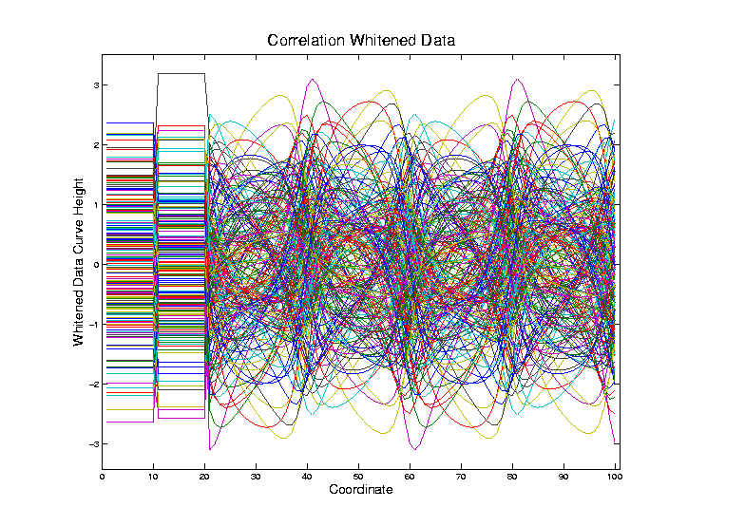
Correlation PCA
Toy Example Contrasting Cov. vs. Corr.
Correlation
“Whitened”
Version
Each Coord.
Rescaled
By Its S.D.

Slide 32
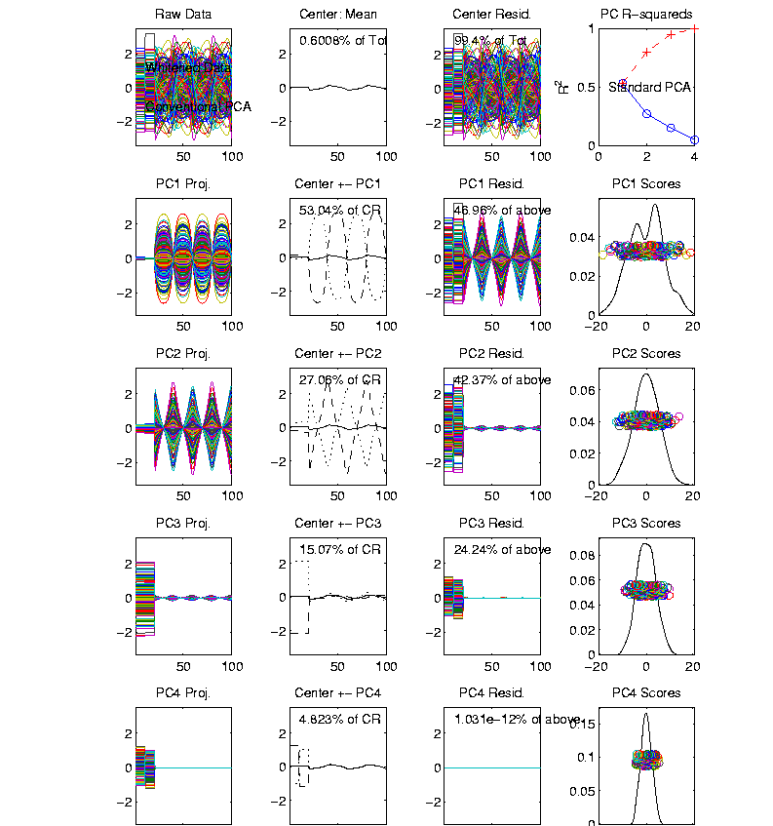
Correlation PCA
Toy Example Contrasting Cov vs. Corr.
Correlation
“Whitened”
Version
All Much
Different

Slide 33
Correlation PCA
Toy Example Contrasting Cov. vs. Corr.
Correlation
“Whitened”
Version
All Much
Different
Which Is
“Right” ???

Slide 34
Correlation PCA
Personal Thoughts on Correlation PCA:
Can be very useful
(especially with noncommensurate units)
Not always, can hide important structure
To make choice:
Decide whether whitening is useful
My personal use of correlat’n PCA is rare
Other people use it most of the time

Slide 35
Limitation of PCA
PCA can provide useful projection directions
But can’t “see everything”…
Reason:
PCA finds dir’ns of maximal variation
Which may obscure interesting structure

Slide 36
Limitation of PCA
Toy Example:
Apple – Banana – Pear
Obscured by “noisy dimensions”
1st 3 PC directions only show noise
Study some rotations, to find structure

Slide 37
Limitation of PCA, Toy E.g.

Slide 38
Limitation of PCA
Toy Example:
Rotation shows Apple – Banana – Pear
Example constructed as:
1st make these in 3-d
Add 3 dimensions of high s.d. noise
Carefully watch axis labels

Slide 39
Limitation of PCA
Main Point:
May be Important Data Structure
Not Visible in 1st Few PCs

Slide 40
Limitation of PCA, E.g.
Interesting Data Set: NCI-60
NCI = National Cancer Institute
60 Cell Lines (cancer treatment targets)
For Different Cancer Types
Measured “Gene Expression”
= “Gene Activity”
Several Thousand Genes (Simultaneously)
Data Objects = Vectors of Gene Exp’n
Lots of Preprocessing (study later)
Example from:
Liu et al (2009)

Slide 41
NCI 60 Data
Important Aspect: 8 Cancer Types
Renal Cancer
Non Small Cell Lung Cancer
Central Nervous System Cancer
Ovarian Cancer
Leukemia Cancer
Colon Cancer
Breast Cancer
Melanoma (Skin)
Notes:
41

Slide 42
PCA Visualization of NCI 60 Data
Can we find classes:
(Renal, CNS, Ovar, Leuk, Colon, Melan)
Using PC directions??
First try “unsupervised view”
I.e. switch off class colors
Then turn on colors, to identify clusters
I.e. look at “supervised view”
II. Exploratory
Analysis
Notes:
42

Slide 43
NCI 60: Can we find classes Using PCA view?
Notes:
43

Slide 44
NCI 60: Can we find classes Using PCA view?
Notes:
44

Slide 45
PCA Visualization of NCI 60 Data
Maybe need to look at more PCs?
Study array of such PCA projections:
Notes:
45

Slide 46
NCI 60: Can we find classes Using PCA 5-8?
Notes:
46

Slide 47
NCI 60: Can we find classes Using PCA 5-8?
Notes:
47

Slide 48
NCI 60: Can we find classes Using PCA 9-12?
Notes:
48

Slide 49
NCI 60: Can we find classes Using PCA 9-12?
Notes:
49

Slide 50
NCI 60: Can we find classes Using PCA 1-4 vs. 5-8?
Notes:
50

Slide 51
NCI 60: Can we find classes Using PCA 1-4 vs. 5-8?
Notes:
51

Slide 52
NCI 60: Can we find classes Using PCA 1-4 vs. 9-12?
Notes:
52

Slide 53
NCI 60: Can we find classes Using PCA 5-8 vs. 9-12?
Notes:
53

Slide 54
PCA Visualization of NCI 60 Data
Can we find classes using PC directions??
Found some, but not others
Nothing after 1st five - six PCs
Rest seem to have other drivers
Are There Better Directions?
PCA only “feels” maximal variation
Ignores Class Labels
How Can We Use Class Labels?
Notes:
54

Slide 55
Visualization of NCI 60 Data
How Can We Use Class Labels?
Approach:
Find Directions to “Best Separate” Classes
In Disjoint Pairs (thus 4 Directions)
Use DWD:
Distance Weighted Discrimination
Defined (& Motivated) Later
Project All Data on These 4 Directions
Notes:
55

Slide 56
NCI 60: Views using DWD Dir’ns (focus on biology)
Notes:
56

Slide 57
DWD Visualization of NCI 60 Data
Most cancer types clearly distinct
(Renal, CNS, Ovar, Leuk, Colon, Melan)
Using these carefully chosen directions
Others less clear cut
NSCLC (at least 3 subtypes)
Breast (4 published subtypes)

Slide 58
DWD Visualization
Recall PCA limitations
DWD uses class info
Hence can “better separate known classes”
Do this for pairs of classes
(DWD just on those, ignore others)
Carefully choose pairs in NCI 60 data
Note DWD Directions Not Orthogonal
(PCA orthogonality may be
too strong a constraint)

Slide 59
NCI 60: Views using DWD Dir’ns (focus on biology)

Slide 60
PCA Visualization of NCI 60 Data
Can we find classes using PC directions??
Found some, but not others
Not so distinct as in DWD view
Nothing after 1st five PCs
Rest seem to be noise driven
Orthogonality too strong a constraint???
Interesting dir’ns are nearly orthogonal
(will see why later)
Notes:
60

Slide 61
Big Picture Data Visualization
For a Matrix of Data:
$${\left(\begin{matrix}x_{11} & ⋯ & x_{1n} \\ ⋮ & ⋱ & ⋮ \\ x_{d1} & ⋯ & x_{dn}\end{matrix}\right)}_{d×n}$$

Slide 62
Big Picture Data Visualization
For a Matrix of Data:
$${\left(\begin{matrix}x_{11} & ⋯ & x_{1n} \\ ⋮ & ⋱ & ⋮ \\ x_{d1} & ⋯ & x_{dn}\end{matrix}\right)}_{d×n}$$
With Columns as Data Objects
(recall not everybody does this,
e.g. rows are data objects in R & SAS)

Slide 63
Big Picture Data Visualization
For a Matrix of Data:
$${\left(\begin{matrix}x_{11} & ⋯ & x_{1n} \\ ⋮ & ⋱ & ⋮ \\ x_{d1} & ⋯ & x_{dn}\end{matrix}\right)}_{d×n}$$
Three Useful (& Important) Visualizations
(Not Widely Understood)
(Most Analysts Don’t Look Enough at Data)

Slide 64
Big Picture Data Visualization
For a Matrix of Data:
$${\left(\begin{matrix}x_{11} & ⋯ & x_{1n} \\ ⋮ & ⋱ & ⋮ \\ x_{d1} & ⋯ & x_{dn}\end{matrix}\right)}_{d×n}$$
Three Useful (& Important) Visualizations
Curve Objects (e.g. PCA decomp)

Slide 65
Big Picture Data Visualization
For a Matrix of Data:
$${\left(\begin{matrix}x_{11} & ⋯ & x_{1n} \\ ⋮ & ⋱ & ⋮ \\ x_{d1} & ⋯ & x_{dn}\end{matrix}\right)}_{d×n}$$
Three Useful (& Important) Visualizations
Curve Objects
Relationships Between Objects
(e.g. scatterplot matrices)

Slide 66
Big Picture Data Visualization
For a Matrix of Data:
$${\left(\begin{matrix}x_{11} & ⋯ & x_{1n} \\ ⋮ & ⋱ & ⋮ \\ x_{d1} & ⋯ & x_{dn}\end{matrix}\right)}_{d×n}$$
Three Useful (& Important) Visualizations
Curve Objects
Relationships Between Objects
Marginal Distributions (1-d each “variable”)

Slide 67
Marginal Distribution Plots
Ideas:
For Each Variable
Study 1-d Distributions
Simultaneous Views:
Jitter Plots
Smooth Histograms (Kernel Density Est’s)

Slide 68
Marginal Distribution Plots
View:
4 x 4 Grid
Since Comfortable Number
Lose Detail for More
For $d>16$:
Choose Representative Subset
(Since often too many to look at all)

Slide 69
Marginal Distribution Plots
Representative Subset of Variables:
Sort Variables on a Data Summary
E.g Mean, S.D., Skewness, Median, …
Usually Take Nearly Equally Spaced Grid
Sometimes Specify Variables
E.g. All Largest (or Smallest) Summaries

Slide 70
Marginal Distribution Plots
Note Often Useful for:
Object Determination / Representation
Which Variables to Include?
How to Scale Variables?
Need to Transform (e.g. log) Variables?

Slide 71
Marginal Distribution Plots
Toy Example: $n=200$, $d=50$,
i.i.d. Poisson, with parameters $λ=0.2,⋯,20$
Logarithmically Spaced

Slide 72
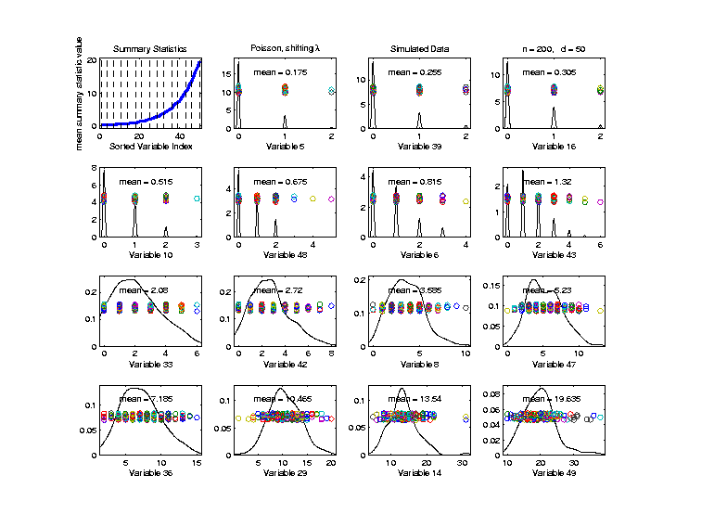
Marginal Distribution Plots
Toy Example: $n=200$, $d=50$,
i.i.d. Poisson, with parameters $λ=0.2,⋯,20$
Sort Variables
On Sample
Mean
Summary
Plot with
Equal
Spacing

Slide 73
Marginal Distribution Plots
Toy Example: $n=200$, $d=50$,
i.i.d. Poisson, with parameters $λ=0.2,⋯,20$
Sort Variables
On Sample
Mean
Dashed Lines
Correspond
To 1-d Distn’s

Slide 74
Marginal Distribution Plots
Toy Example: $n=200$, $d=50$,
i.i.d. Poisson, with parameters $λ=0.2,⋯,20$
Sort Variables
On Sample
Mean
Wide Range
Of Poissons

Slide 75
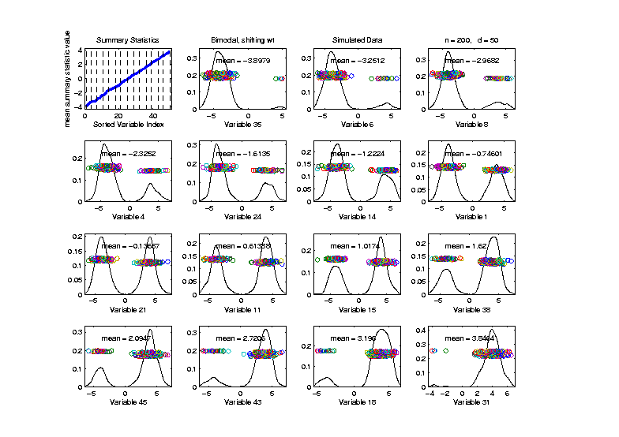
Marginal Distribution Plots
Toy Example: Normal Mean Mixture
$$ωN\left(4,1\right)+\left(1−ω\right)N\left(−4,1\right)$$
Sort on
Mean
Useful
Ordering

Slide 76
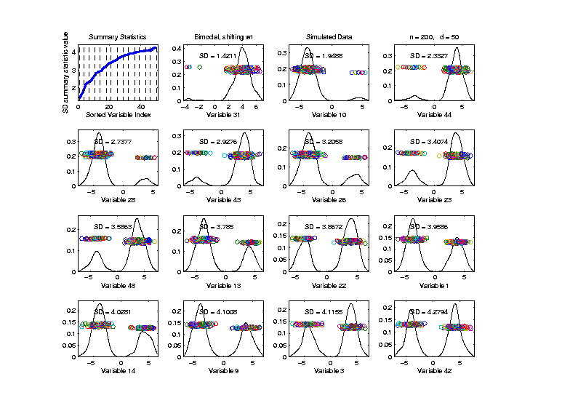
Marginal Distribution Plots
Toy Example: Normal Mean Mixture
$$ωN\left(4,1\right)+\left(1−ω\right)N\left(−4,1\right)$$
Sort on
Standard
Deviation
Less Useful
Ordering

Slide 77
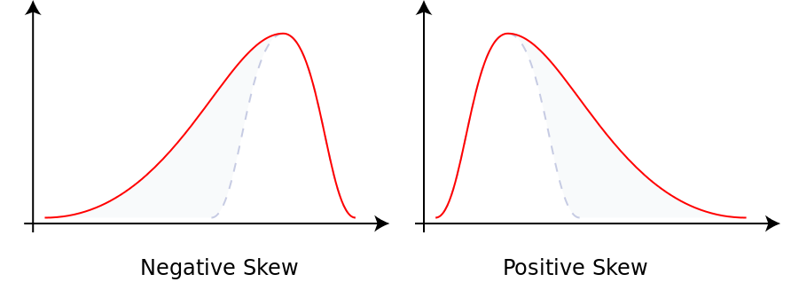
Marginal Distribution Plots
Additional Summaries: Skewness
Measure Asymmetry
Left Skewed Right Skewed
(Thanks to Wikipedia)

Slide 78
Marginal Distribution Plots
Additional Summaries: Skewness
Quantification: Based on “Moments”
$$E\left[{\left(\frac{X−μ}{σ}\right)}^{3}\right]=\frac{E\left[{\left(X−μ\right)}^{3}\right]}{{\left(E\left[{\left(X−μ\right)}^{2}\right]\right)}^{3/2}}$$
“Central 3rd Moment” (Also Rescaled)
Note: 0 at Gaussian

Slide 79
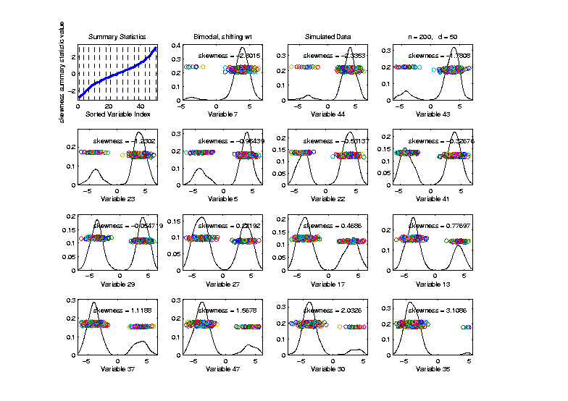
Marginal Distribution Plots
Toy Example: Normal Mean Mixture
$$ωN\left(4,1\right)+\left(1−ω\right)N\left(−4,1\right)$$
Sort on
Skewness
Useful
Ordering

Slide 80
Marginal Distribution Plots
Additional Summaries: Kurtosis
4-th Moment Summary
$$E\left[{\left(\frac{X−μ}{σ}\right)}^{4}\right]−3=\frac{E\left[{\left(X−μ\right)}^{4}\right]}{{\left(E\left[{\left(X−μ\right)}^{2}\right]\right)}^{2}}−3$$
Centered (and Scaled) 4th Moment

Slide 81
Marginal Distribution Plots
Additional Summaries: Kurtosis
4-th Moment Summary
$$E\left[{\left(\frac{X−μ}{σ}\right)}^{4}\right]−3=\frac{E\left[{\left(X−μ\right)}^{4}\right]}{{\left(E\left[{\left(X−μ\right)}^{2}\right]\right)}^{2}}−3$$
Makes 0 at Gaussian
Think of Departures From Gaussian
(not always done)

Slide 82
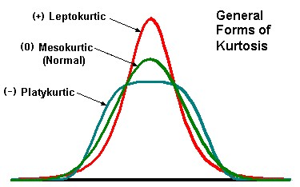
Marginal Distribution Plots
Additional Summaries: Kurtosis
4-th Moment Summary
Nice Graphic
(from mvpprograms.com)

Slide 83
Marginal Distribution Plots
Additional Summaries: Kurtosis
4-th Moment Summary
Positive Big at Peak
And Tails
(with controlled
variance)

Slide 84
Marginal Distribution Plots
Additional Summaries: Kurtosis
4-th Moment Summary
Negative Big in Flanks

Slide 85
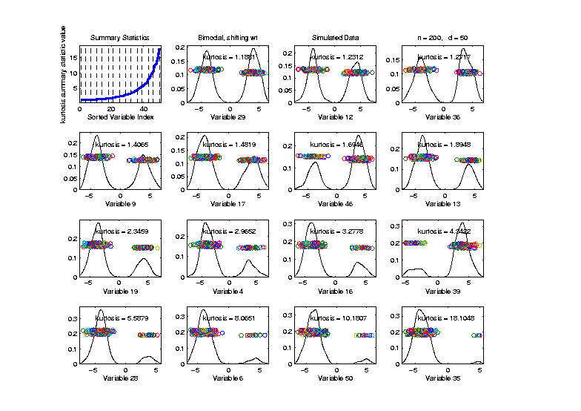
Marginal Distribution Plots
Toy Example: Normal Mean Mixture
$$ωN\left(4,1\right)+\left(1−ω\right)N\left(−4,1\right)$$
Sort on
Kurtosis
Less Useful
Ordering

Slide 86
Marginal Distribution Plots
Some Useful Summaries:
Mean, SD, Skewness, Kurtosis
# Unique, # Most Frequent, # 0s
Robust Measures
L-statistics
Entropy
Continuity Measure
$⋮$

Slide 87
Marg. Dist. Plot Data Example
Drug Discovery Data
$n = 262$, Chemical Compounds
$d = 2489$, Chemical “Descriptors”
Discrete Response:
0 – blue 0, 1 – red +
(Thanks to Alex Tropsha Lab)

Slide 88
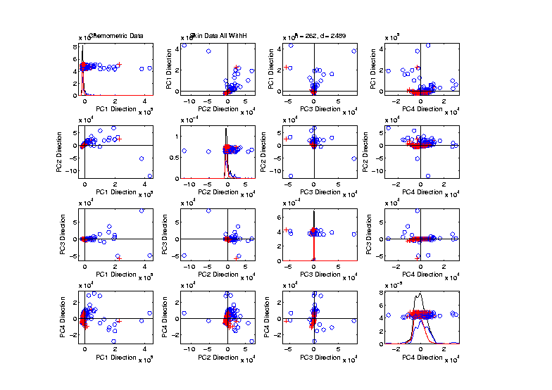
Marg. Dist. Plot Data Example
Drug Discovery – PCA Scatterplot
Dominated
By Few
Large
Compounds
Not Good
Blue - Red
Separation

Slide 89
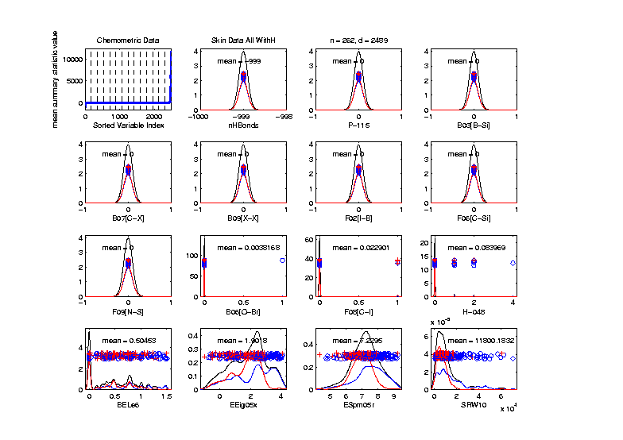
Marg. Dist. Plot Data Example
Drug Discovery – Sort on Means
Very Few
Are Crazy
Big
Will They
Dominate
PCA???

Slide 90
Marg. Dist. Plot Data Example
Drug Discovery – Sort on Means
Note: Many
With No
Variation???

Slide 91
Marg. Dist. Plot Data Example
Drug Discovery – Sort on Means
Suspicious
Value ???

Slide 92
Marg. Dist. Plot Data Example
Drug Discovery – Sort on Means
Note:
Sub-Densities
Highlight
Blue – Red
Differences

Slide 93
Marg. Dist. Plot Data Example
Drug Discovery – Sort on Means
Note:
Descriptor
Names

Slide 94
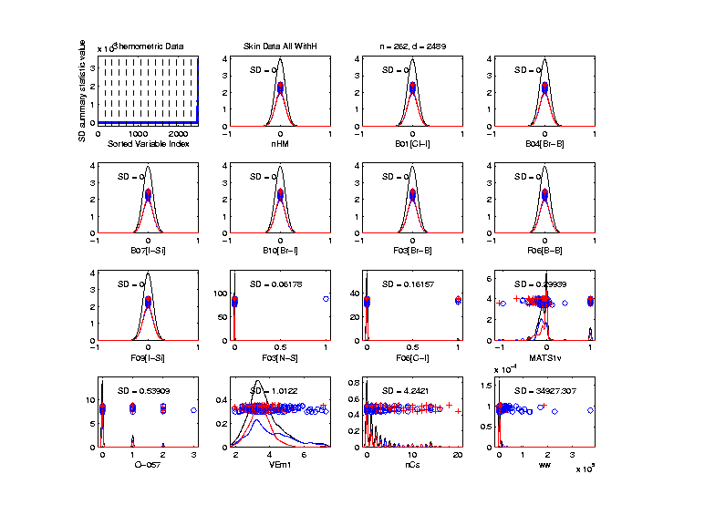
Marg. Dist. Plot Data Example
Drug Discovery – Sort on Standard Deviation
Very Large
Number of
0-Variation
Variables
(No Useful
Info…)

Slide 95
Marg. Dist. Plot Data Example
Drug Discovery – Sort on Means
Investigate Weird -999 Values
Note: Sometimes Such Values Are Used To Code Missing Values
(And Nobody Remembers to Say So)
(Not Too Bad Until Big Values Added In)

