Slide 1
Statistics – O. R. 881 Object Oriented Data Analysis
Steve Marron
Dept. of Statistics and Operations Research
University of North Carolina

Slide 2
Administrative Info
Details on Course Web Page
https://stor881fall2017.web.unc.edu/
Will Post Daily Power Points
Also Keep Running List of References

Slide 3
Course Expectations
Grading Based on:
“Participant Presentations”
5 – 10 minute talks
By Enrolled Students
Hopefully Others

Slide 4
Object Oriented Data Analysis
What is it?
A Sound-Bite Explanation:
What is the “atom of the statistical analysis”?
1st Course: Numbers
Multivariate Analysis Course : Vectors
Functional Data Analysis: Curves
More generally: Data Objects

Slide 5
Object Oriented Data Analysis
Data Object Types
Curves (Functional Data Analysis)
Spectra (Non-Negative!)
Images
Shapes
Trees
Movies (Functional MRI)
$⋮$

Slide 6
Object Oriented Data Analysis
Current Motivation:
In Complicated Data Analyses

Slide 7
Object Oriented Data Analysis
Current Motivation:
In Complicated Data Analyses
Big Data

Slide 8
Object Oriented Data Analysis
Current Motivation:
In Complicated Data Analyses
Big Data
Complex Data

Slide 9
A Taste of OODA Examples
Spanish Male Mortality Curves
Enhancement: Color by Year
1908
1931
1964
1987
2002

Slide 10
Visualization
How do we look at Euclidean data?
Higher Dimensions?
Workhorse Idea: Projections

Slide 11
Projection
General Definition (in a metric space):
Given a point $x$ and a set $S$, $S$
The Projection of $x$ onto $S$ is:
the closest point in $S$ to $x$
$x$

Slide 12
Illust’n of Multivar. View: Typical View
Note Linkage of Axes
Notes:
EgView1p39ScatPlot.ps

Slide 13
Illust’n of Multivar. View: Typical View
Note Linkage of Axes
Notes:
EgView1p39ScatPlot.ps

Slide 14
Illust’n of Multivar. View: Typical View
Note Linkage of Axes
Notes:
EgView1p39ScatPlot.ps

Slide 15
Illust’n of PCA View: Gene by Gene View
Note Colors Enhance
Impressions of Clusters
Notes:
EgView1p71GeneViewClustColor.ps

Slide 16
Illust’n of PCA View: PCA View
Clusters are “more distinct”
Since more “air space”
In between
Notes:
EgView1p72PCAViewClustColor.ps

Slide 17
Another Comparison: Gene by Gene View
Very Small Differences
Between Means
Notes:
EgView2p1dat1GeneView.ps

Slide 18
Another Comparison: PCA View
Notes:
EgView2p2dat1PCAView.ps

Slide 19
Basics of OODA
Starting Point:
Data Object Selection
Two Main Parts:
Data Object Determination
(e.g. Mortality Data,
which curves???)

Slide 20
Data Object Determination
E.g. Mortality Data,
Studied Mortality vs. Age (over years)
But could have
chosen: vs. Year
(over ages)
{tried both, this is
more interesting}

Slide 21
Basics of OODA
Starting Point:
Data Object Selection
Two Main Parts:
Data Object Determination
Data Object Representation
(e.g. Mortality Data)

Slide 22
Data Object Representation
E.g. Mortality Data,
Recall log scale more informative
(for this data set)

Slide 23
Basics of OODA
Usual Organizational Structure:
Data Matrix
$$\left[\begin{matrix}x_{11} & ⋯ & x_{1n} \\ ⋮ & ⋱ & ⋮ \\ x_{d1} & ⋯ & x_{dn}\end{matrix}\right]$$
Convention Here:
Columns are Data Objects
(Indexed by $j=1,⋯,n$)

Slide 24
Basics of OODA
Usual Organizational Structure:
Data Matrix
$$\left[\begin{matrix}x_{11} & ⋯ & x_{1n} \\ ⋮ & ⋱ & ⋮ \\ x_{d1} & ⋯ & x_{dn}\end{matrix}\right]$$
Terminology:
Numbers in Rows are called “Features”
(Indexed by $i=1,⋯,d$)

Slide 25
Basics of OODA
Common Synonyms:
 | Number | Synonyms
Cases | $$n$$ | Observations, Individuals, Sample Elements, Biological Samples
Features | $$d$$ | Variables, Descriptors

Slide 26
Basics of OODA
Return to Organizational Structure:
Data Matrix
$$\left[\begin{matrix}x_{11} & ⋯ & x_{1n} \\ ⋮ & ⋱ & ⋮ \\ x_{d1} & ⋯ & x_{dn}\end{matrix}\right]$$
Convention Here:
Columns are Data Objects
Caution: Not Always Done!

Slide 27
Basics of OODA
Row vs. Column Choice by Areas:
Columns as Data Objects:
Linear Algebra (column vectors)
Bioinformatics (from Excel restrictions)
Rows as Data Objects:
Statistical Data Bases
Linear Models

Slide 28
Basics of OODA
Row vs. Column Choice by Software:
Columns as Data Objects:
Matlab
Rows as Data Objects:
R
SAS & others

Slide 29
Basics of OODA
Useful Conceptual Framework:
Object Space ←→ Descriptor Space
(Where data
objects live)
(How they are
represented)

Slide 30
Basics of OODA
Object Space ←→ Descriptor Space
Curves $ℝ^{d}$
Images Manifolds
Shapes Graph Space
Trees
Movies

Slide 31
Basics of OODA
Object Space ←→ Descriptor Space
Simple $d=2$ Toy Example:
Enables Visualization of BOTH Spaces

Slide 32
Basics of OODA
Simple $d=2$ Toy Example:
Each Curve is a Point

Slide 33
Basics of OODA
Simple $d=2$ Toy Example:
Each Curve is a Point
Mean is shown as well (part of analysis)

Slide 34
Basics of OODA
Simple $d=2$ Toy Example:
Best Rank 1 Approximation (PC 1)
As Curves, and as Points

Slide 35
Basics of OODA
Simple $d=2$ Toy Example:
Computed as Projections onto
Eigen-direction centered at Mean

Slide 36
Basics of OODA
Simple $d=2$ Toy Example:
Interpretation:
1st Mode of Variation

Slide 37
Basics of OODA
Simple $d=2$ Toy Example:
Second Best Rank 1 Approximation (PC 2)
As Curves, and as Points

Slide 38
Basics of OODA
Simple $d=2$ Toy Example:
Computed as Projections onto
Eigen-direction centered at Mean

Slide 39
Basics of OODA
Simple $d=2$ Toy Example:
Interpretation:
2nd Mode of Variation

Slide 40
Basics of OODA
Decomposition into Modes of Variation

Slide 41
E.g. Curves As Data
Deeper example
10-d family of (digitized) curves
Object space: bundles of curves
Descriptor space = $ℝ^{10}$
(harder to visualize as point cloud,
but keep point cloud in mind)
PCA: reveals “population structure”

Slide 42
E.g. Curves As Data
Aside on Visualization:
$\left(\begin{matrix}x_{1} \\ ⋮ \\ x_{d}\end{matrix}\right)$
Called Parallel Coordinate View
by Inselberg (1985, 2005)

Slide 43
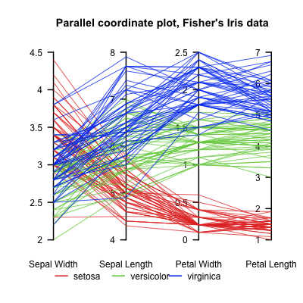
Parallel Coordinates
Proposed for Multivariate Data Visualization:
by Inselberg (1985, 2005)
E.g. Fisher Iris Data
d = 4
Named Variables
(thanks to Wikipedia)
Notes:
43

Slide 44
Parallel Coordinates
Proposed for Multivariate Data Visualization:
by Inselberg (1985, 2005)
E.g. Fisher Iris Data
d = 4
Named Variables
Curves are Data Objects
Vectors → Curves
Notes:
44

Slide 45
Functional Data Analysis, 10-d Toy EG 1
Terminology:
“Loadings Plots” “Scores Plots”
Notes:
EGCD1Parabs.ps

Slide 46
Functional Data Analysis, 10-d Toy EG 1
OODA Conceptual Framework
Object
Space
Views
Desc-
riptor
Space
Views
Notes:
EGCD1Parabs.ps

Slide 47
Functional Data Analysis, 10-d Toy EG 1
Notes:
EGCD1Parabs.ps

Slide 48
E.g. Curves As Data
PCA: reveals “population structure”
Mean → Parabolic Structure
PC1 → Vertical Shift
PC2 → Tilt
higher PCs → Gaussian (spherical)
Decomposition into modes of variation

Slide 49
E.g. Curves As Data
Two Cluster Example
10-d curves again

Slide 50
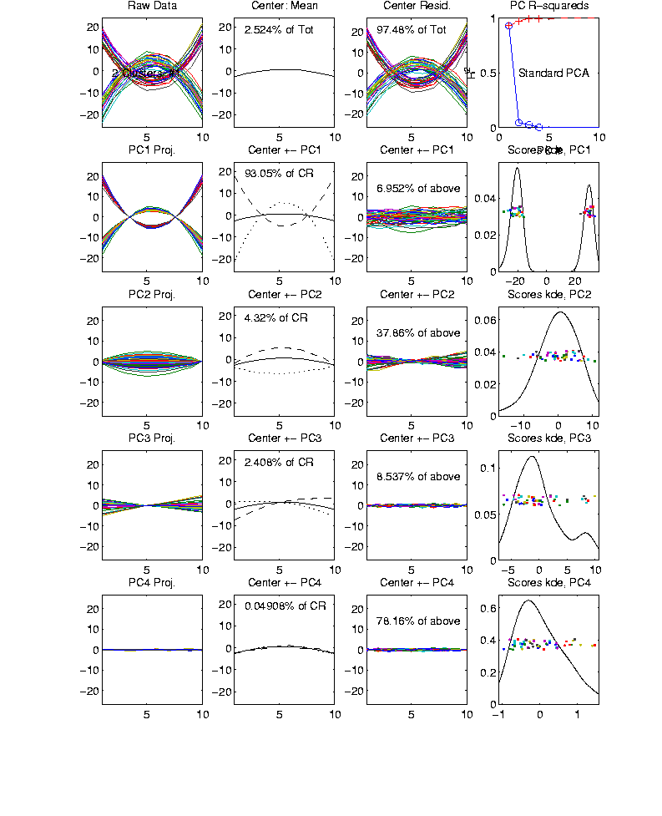
Functional Data Analysis, 10-d Toy EG 2
Notes:
EGCD1Clust2.ps

Slide 51
E.g. Curves As Data
Two Cluster Example
10-d curves again
Two big clusters
Revealed by 1-d projection plot (right side)
Note: Cluster Difference is not orthogonal
to Vertical Shift
PCA: reveals “population structure”

Slide 52
E.g. Curves As Data
More Complicated Example
50-d curves

Slide 53
Functional Data Analysis, 50-d Toy EG 3
Notes:
EGCD1Clust4a.ps

Slide 54
Functional Data Analysis, 50-d Toy EG 3
Notes:
EGCD1Clust4aDP2d.ps

Slide 55
E.g. Curves As Data
More Complicated Example
50-d curves
Pop’n structure hard to see in 1-d
2-d projections make structure clear
Joint Dist’ns More than Marginals
PCA: reveals “population structure”

Slide 56
Object Oriented Data Analysis
What is it?
A Sound-Bite Explanation:
What is the “atom of the statistical analysis”?
1st Course: Numbers
Multivariate Analysis Course : Vectors
Functional Data Analysis: Curves
More generally: Data Objects

Slide 57
Object Oriented Data Analysis
Three Major Parts of OODA Applications:
I. Object Definition
“What are the Data Objects?”
Exploratory Analysis
“What Is Data Structure / Drivers?”
III. Confirmatory Analysis / Validation
Is it Really There (vs. Noise Artifact)?

Slide 58
Object Oriented Data Analysis
I. Object Definition / Representation
“What are the Data Objects?”
Generally Not Widely Appreciated

Slide 59
Object Oriented Data Analysis
Exploratory Analysis
“What Is Data Structure / Drivers?”
Understood by Some in Statistics
Classical Reference: Tukey (1977)
Better Understood in Machine Learning

Slide 60
Object Oriented Data Analysis
III. Confirmatory Analysis / Validation
Is it Really There (vs. Noise Artifact)?
Primary Focus of Modern “Statistics”
E.g. STOR & Biostat PhD Curriculum
Less So In Machine Learning

Slide 61
Functional Data Analysis
Interesting Real Data Example
Genetics (Cancer Research)
RNAseq (Next Gener’n Sequen’g)
Deep look at “gene components”
Microarrays: Single number (per gene)
RNAseq: Thousands of measurements
I. Object Definition

Slide 62
Functional Data Analysis
Interesting Real Data Example
Genetics (Cancer Research)
RNAseq (Next Gener’n Sequen’g)
Deep look at “gene components”
Gene studied here: CDKN2A
Goal: Study Alternate Splicing
Sample Size, $n = 180$
Dimension, $d = \sim 1700$

Slide 63
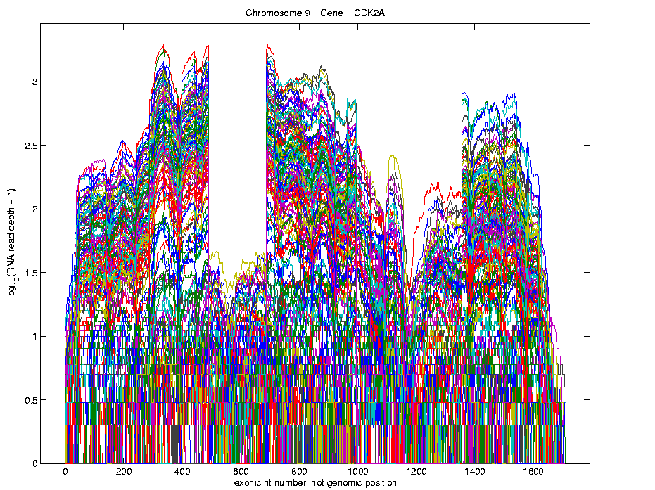
Functional Data Analysis
Simple
1st
View:
Curve
Overlay
(log
scale)
I. Object Representation

Slide 64
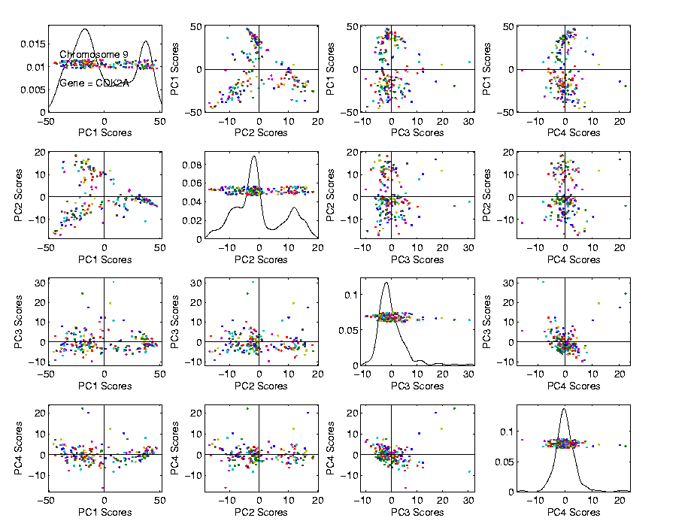
Functional Data Analysis
Visualization in Descriptor Space
Often
Useful
Population
View:
PCA
Scores

Slide 65
Functional Data Analysis
Suggestion
Of
Clusters
???

Slide 66
Functional Data Analysis
Suggestion
Of
Clusters
Which
Are
These?

Slide 67
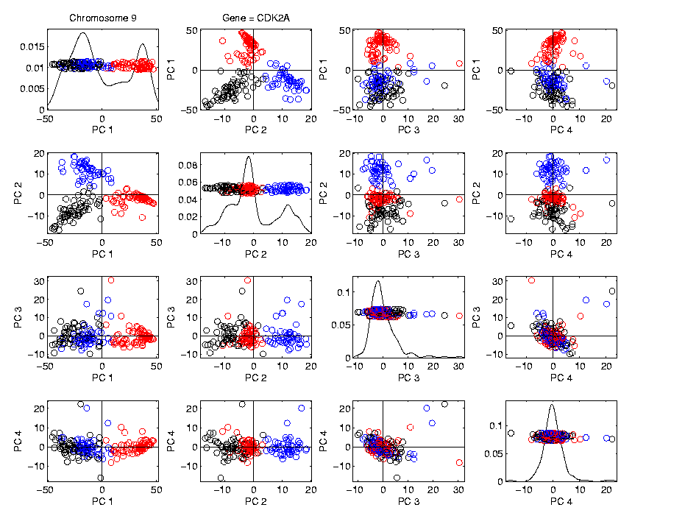
Functional Data Analysis
Visualization in Descriptor Space
Manually
“Brush”
Clusters
II. Exploratory
Analysis

Slide 68
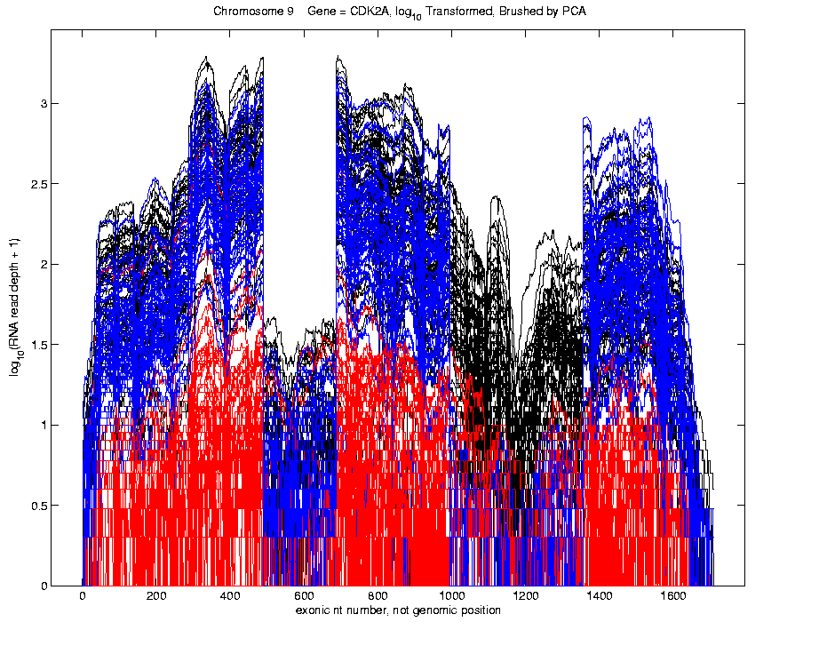
Functional Data Analysis
Visualization in Object Space
Manually
Brush
Clusters
Clear
Alternate
Splicing
II. Exploratory
Analysis

Slide 69
Functional Data Analysis
Important Points
PCA found Important Structure
In High Dimensional Data Analysis
d ~ 1700
(Will Come Back To This Point)

Slide 70
Functional Data Analysis
Consequences:
Led to Development of SigFuge
Whole Genome Scan Found Interesting Genes
Wet Lab Experiment Verified Discoveries
Published in Kimes, et al (2014)

Slide 71
Functional Data Analysis
Interesting Question:
When are clusters really there?
(will study later)
III. Confirmatory Analysis

Slide 72
Functional Data Analysis
Revisit Spanish Male Mortality Data Set:
Each curve is a single year
x coordinate is age
Mortality = # died / total # (for each age)
Study on log scale
Investigate change over years 1908 – 2002
From Marron & Alonso (2014)
Note: Choice made of Data Object
(could also study age as curves,
x coordinate = time)
Another Data Object Choice
(not about experimental units)
I. Object Definition & Representation

Slide 73
Functional Data Analysis
I. Object Definition
Important Issue:
What are the Data Objects?
Mortality vs. Age Curves (over years)
Mortality vs. Year Curves (over ages)
Note: Rows vs. Columns of Data Matrix

Slide 74
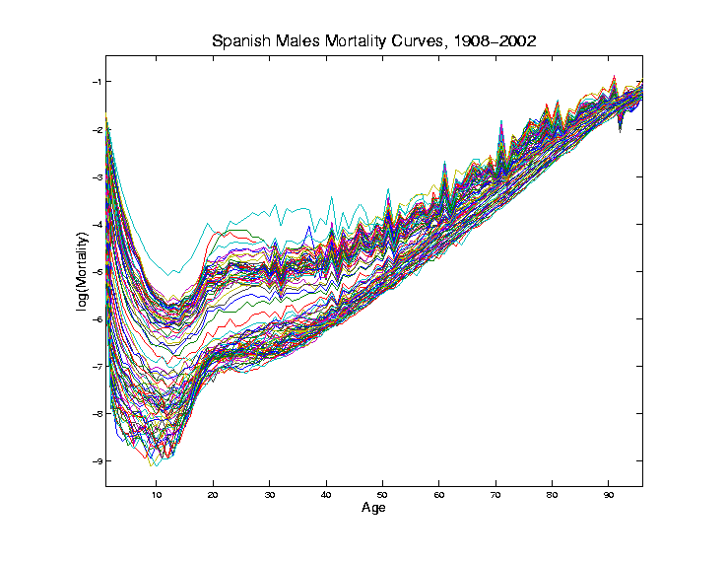
Mortality Time Series
Conventional
Coloring:
Rotate
Through
(7) Colors
Hard to
See Time
Structure
II. Exploratory
Analysis

Slide 75
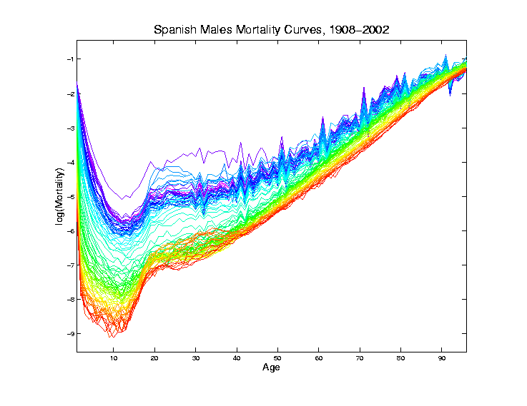
Mortality Time Series
Improved
Coloring:
Rainbow
Representing
Year:
Magenta
= 1908
Red = 2002

Slide 76
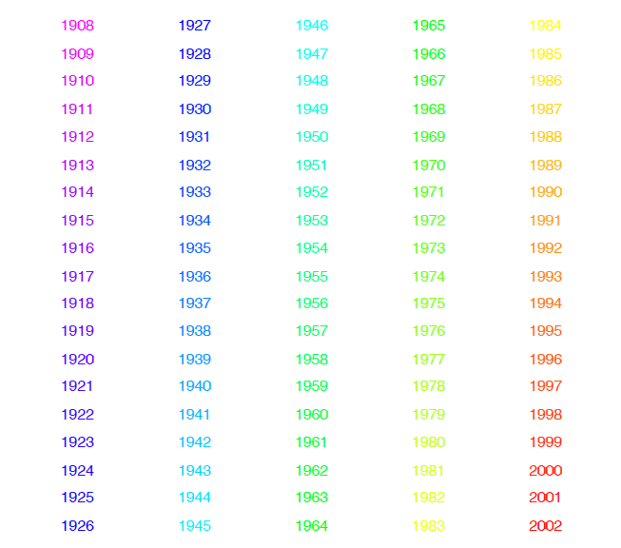
Mortality Time Series
Color Code
(Years)
Notes:
76

Slide 77
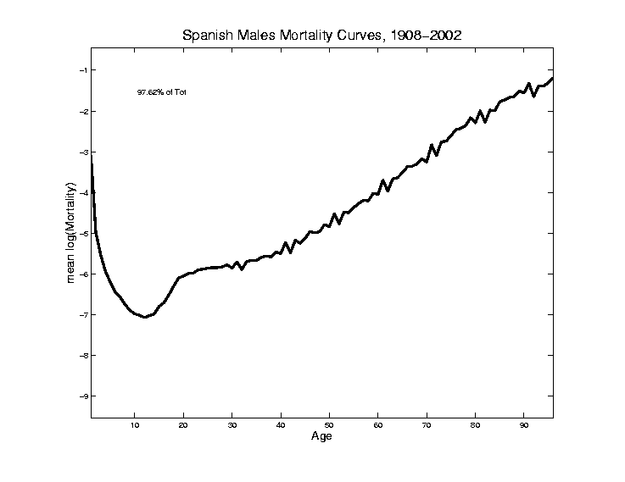
Mortality Time Series
Find
Population Center
(Mean Vector)
Compute in
Descriptor
Space
Show in
Object Space

Slide 78
Mortality Time Series
Blips Appear
At Decades
Since Ages
Not Precise
(in Spain)
Reported as
“about 50”,
Etc.

Slide 79
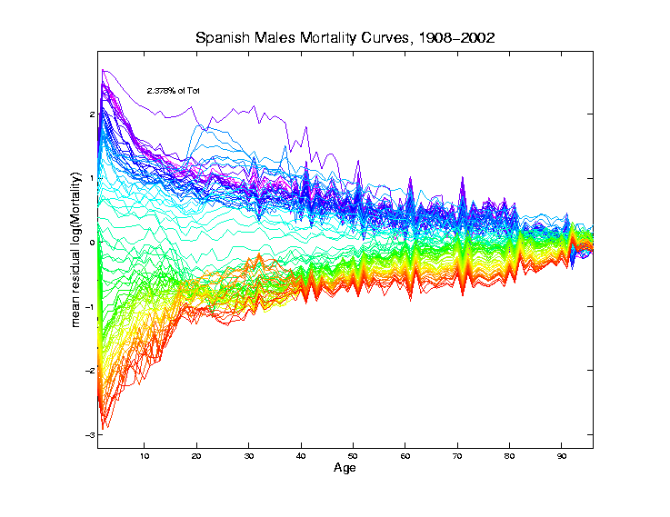
Mortality Time Series
Mean
Residual
Object
Space
View of
Shifting Data
To Origin in
Descriptor Space

Slide 80
Mortality Time Series
Shows:
Main Age
Effects in
Mean, Not
Variation
About Mean

Slide 81
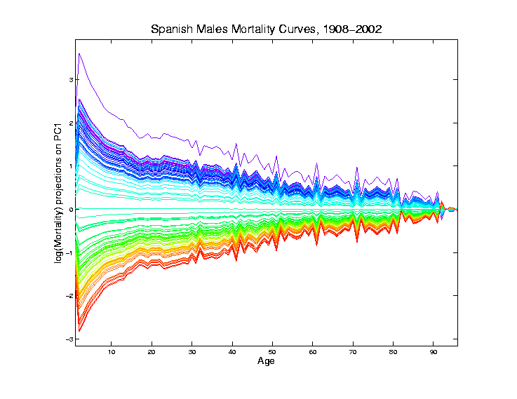
Mortality Time Series
Object Space View of Projections
Onto PC1
Direction
Main Mode
Of Variation:
Constant
Across Ages
Loadings Plot

Slide 82
Mortality Time Series
Shows Major
Improvement
Over Time
(medical technology,
etc.)
And Change
In Age
Rounding Blips

Slide 83
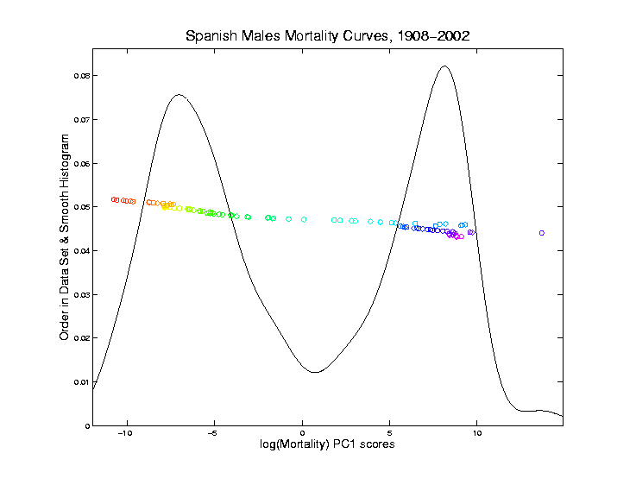
Mortality Time Series
Corresponding
PC 1 Scores
Again Shows
Overall
Improvement
High Mortality
Early

Slide 84
Mortality Time Series
Corresponding
PC 1 Scores
Again Shows
Overall
Improvement
High Mortality
Early
Lower Later
Transformation Fairly Rapid

Slide 85
Mortality Time Series
Outliers
1918 Global
Flu Pandemic
1936-1939
Spanish
Civil War

Slide 86
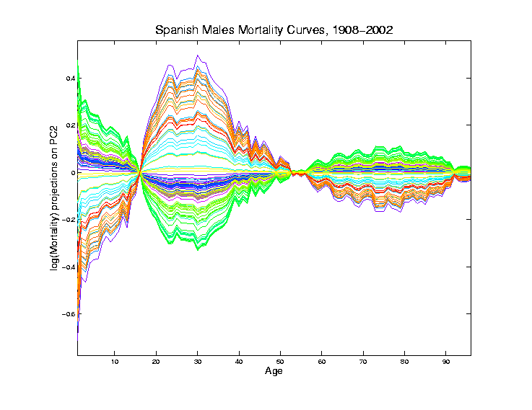
Mortality Time Series
Object Space View of Projections
Onto PC2
Direction
Loadings Plot

Slide 87
Mortality Time Series
Object Space View of Projections
Onto PC2
Direction
2nd Mode
Of Variation:
Difference
Between
20-45 & Rest

Slide 88
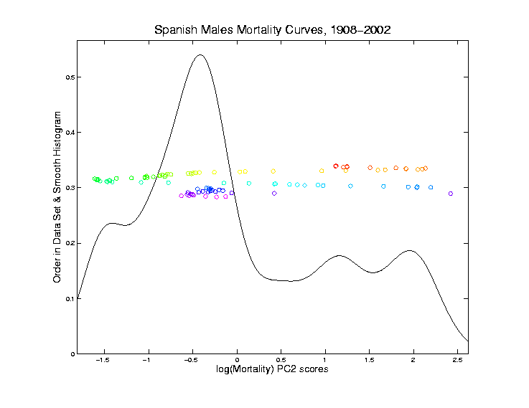
Mortality Time Series
Explain Using
PC 2 Scores
Early
Improvement

Slide 89
Mortality Time Series
Explain Using
PC 2 Scores
Early
Improvement
Pandemic
Hit Hardest

Slide 90
Mortality Time Series
Explain Using
PC 2 Scores
Then better

Slide 91
Mortality Time Series
Explain Using
PC 2 Scores
Then better
Spanish Civil War Hit
Hardest

Slide 92
Mortality Time Series
Explain Using
PC 2 Scores
Steady
Improvement
To mid-50s

Slide 93
Mortality Time Series
Explain Using
PC 2 Scores
Steady
Improvement
To mid-50s
Increasing
Automotive
Death Rate

Slide 94
Mortality Time Series
Explain Using
PC 2 Scores
Corner Finally
Turned by
Safer Cars
& Roads

Slide 95
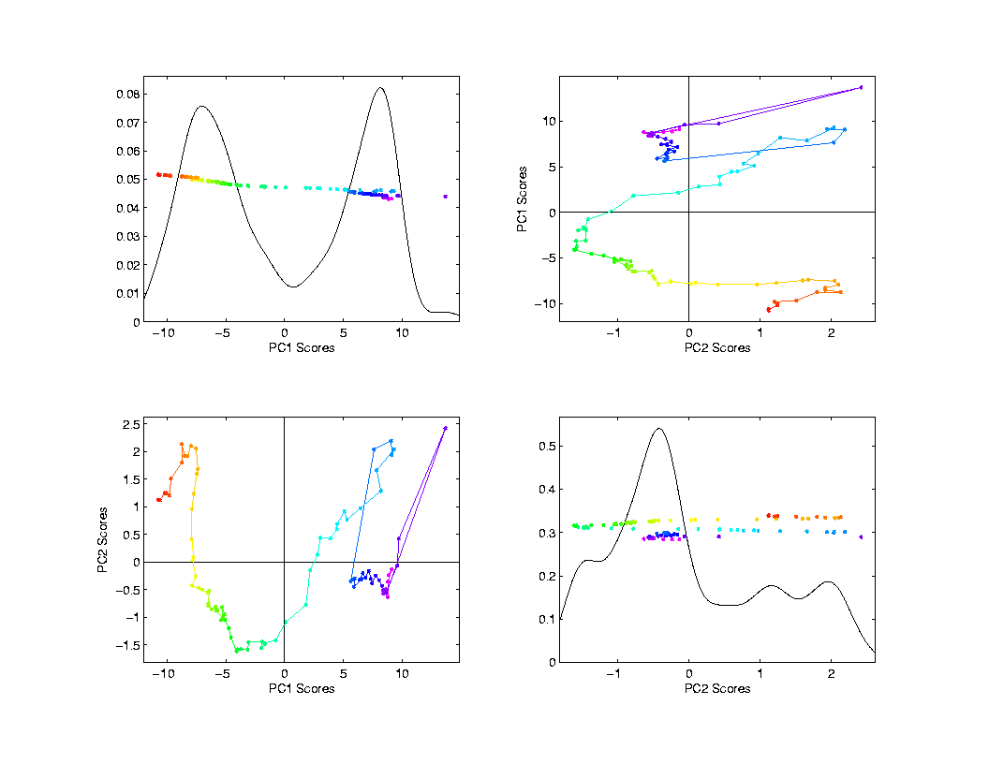
Mortality Time Series
Scores Plot
Descriptor
(Point Cloud)
Space View
Connecting
Lines
Highlight
Time Order
Good View of
Historical
Effects

Slide 96
Mortality Time Series
Try a Related Mortality Data Set:
Switzerland
(In Europe, but different history)

Slide 97
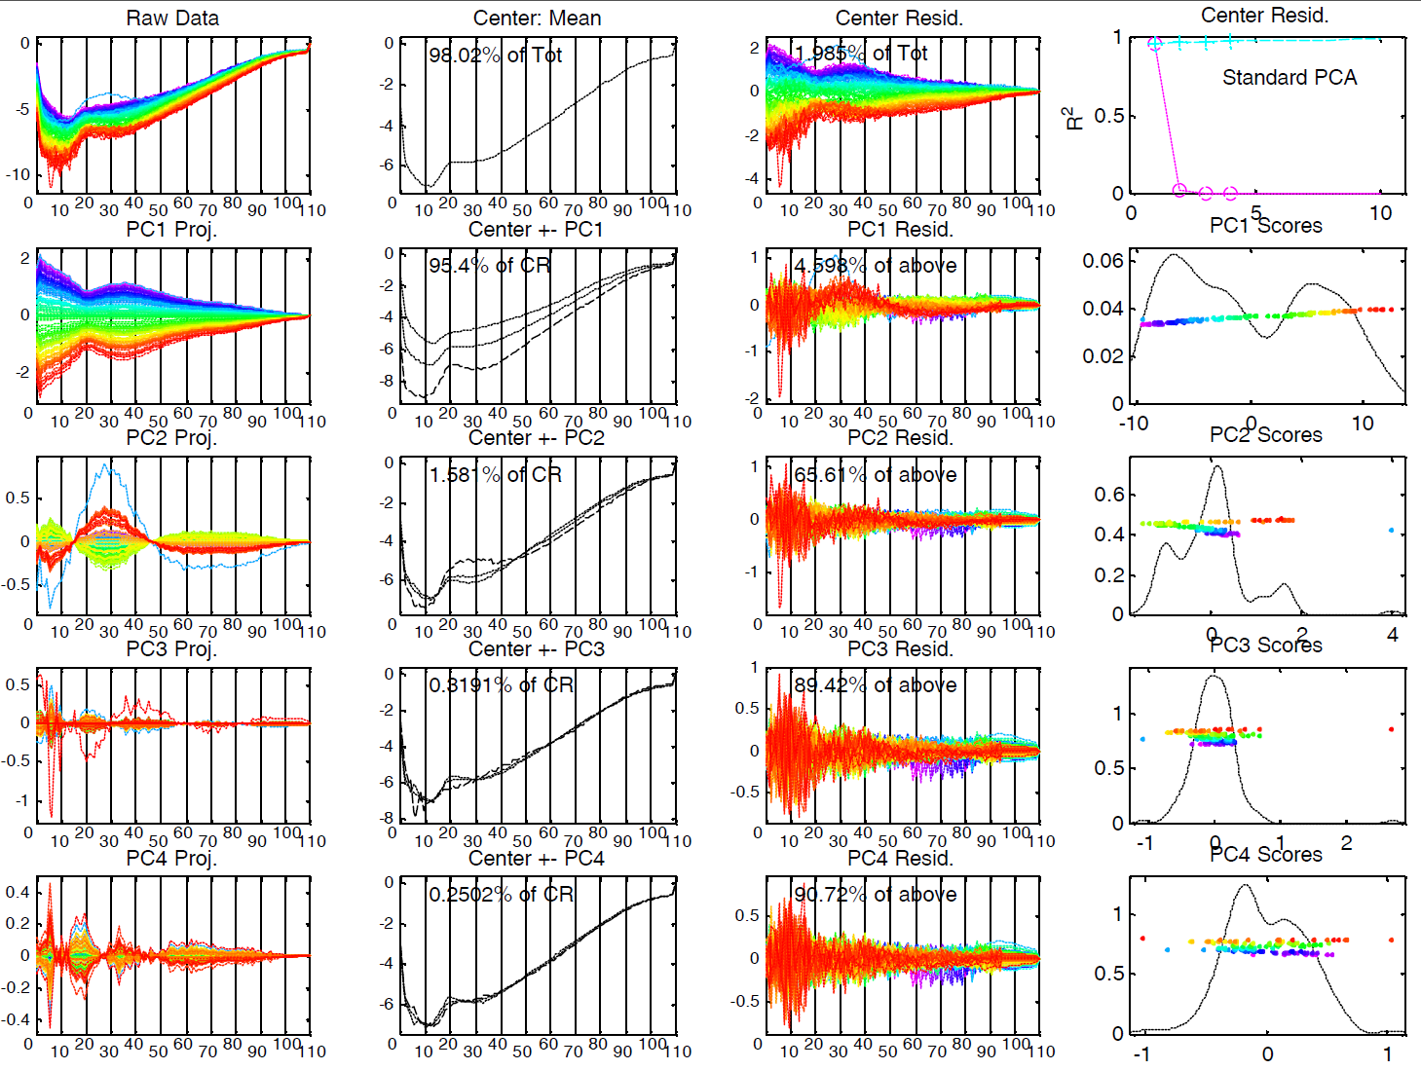
Mortality Time Series – Swiss Males

Slide 98
Mortality Time Series – Swiss Males
Some Points Similar to Spain:
PC1: Overall Improvement
Better for Young
PC2: About 20 – 45 vs. Others
Flu Pandemic
Automobile Effects
Some Quite Different:
No Age Rounding
No Civil War

Slide 99
Time Series of Data Objects
Mortality Data Illustrates an Important Point:
OODA is more than a “framework”
It Provides a Focal Point
Highlights Pivotal Choice:
What should be the Data Objects?

Slide 100
Limitation of PCA
Strongly Feels Scaling of Each Variable
Consequence:
May want to standardize each variable
(i.e. subtract $\overline{X}$, divide by $s$)
Also called Whitening
Equivalent Approach:
Base PCA on Covariance Matrix
Called Correlation PCA

Slide 101
Correlation PCA
A related (& better known?) variation of PCA:
Replace cov. matrix with correlation matrix
I.e. do eigen analysis of
Where

Slide 102
Correlation PCA
Why use correlation matrix?
Makes features “unit free”
e.g. Height, Weight, Age, $, …
Are “directions in point cloud” meaningful or useful?
Will unimportant directions dominate?

