Slide 1
Statistics – O. R. 881
Object Oriented Data Analysis
Steve Marron
Dept. of Statistics and Operations Research
University of North Carolina

Slide 2
Administrative Info
Details on Course Web Page
https://stor881fall2017.web.unc.edu/
Or:
  Google: “Marrons teaching material”
  Choose This Course

Slide 3
Administrative Info
Available on Web Page:
Will Post Daily Power Points
Also Keep Running List of References

Slide 4
Who are we?
Varying Levels of Expertise
  2nd Year Graduate Students
  …
  Faculty Level Researchers
Various Backgrounds
  Statistics / Biostat
  Computer Science – Imaging
  Bioinformatics
  Pharmacy
  Others…

Slide 5
Course Expectations
Grading Based on:
“Participant Presentations”
5 – 10 minute talks
By Enrolled Students
Hopefully Others

Slide 6
Class Meeting Style
When you don’t understand something
Many others probably join you
So please fire away with questions
Discussion usually enlightening for others
If needed, I’ll tell you to shut up
(essentially never happens)

Slide 7
Object Oriented Data Analysis
What is it?
A Sound-Bite Explanation:
What is the “atom of the statistical analysis”?
1st Course: Numbers
Multivariate Analysis Course : Vectors
Functional Data Analysis: Curves

Slide 8


Functional Data Analysis
Currently hot field in statistics, see:
Ramsay & Silverman (2005) {Book}
Ramsay & Silverman (2002) {Book}
Ramsay, J. O. (2005) {Website}

Slide 9
Object Oriented Data Analysis
What is it?
A Sound-Bite Explanation:
What is the “atom of the statistical analysis”?
1st Course: Numbers
Multivariate Analysis Course : Vectors
Functional Data Analysis: Curves
More generally: Data Objects

Slide 10
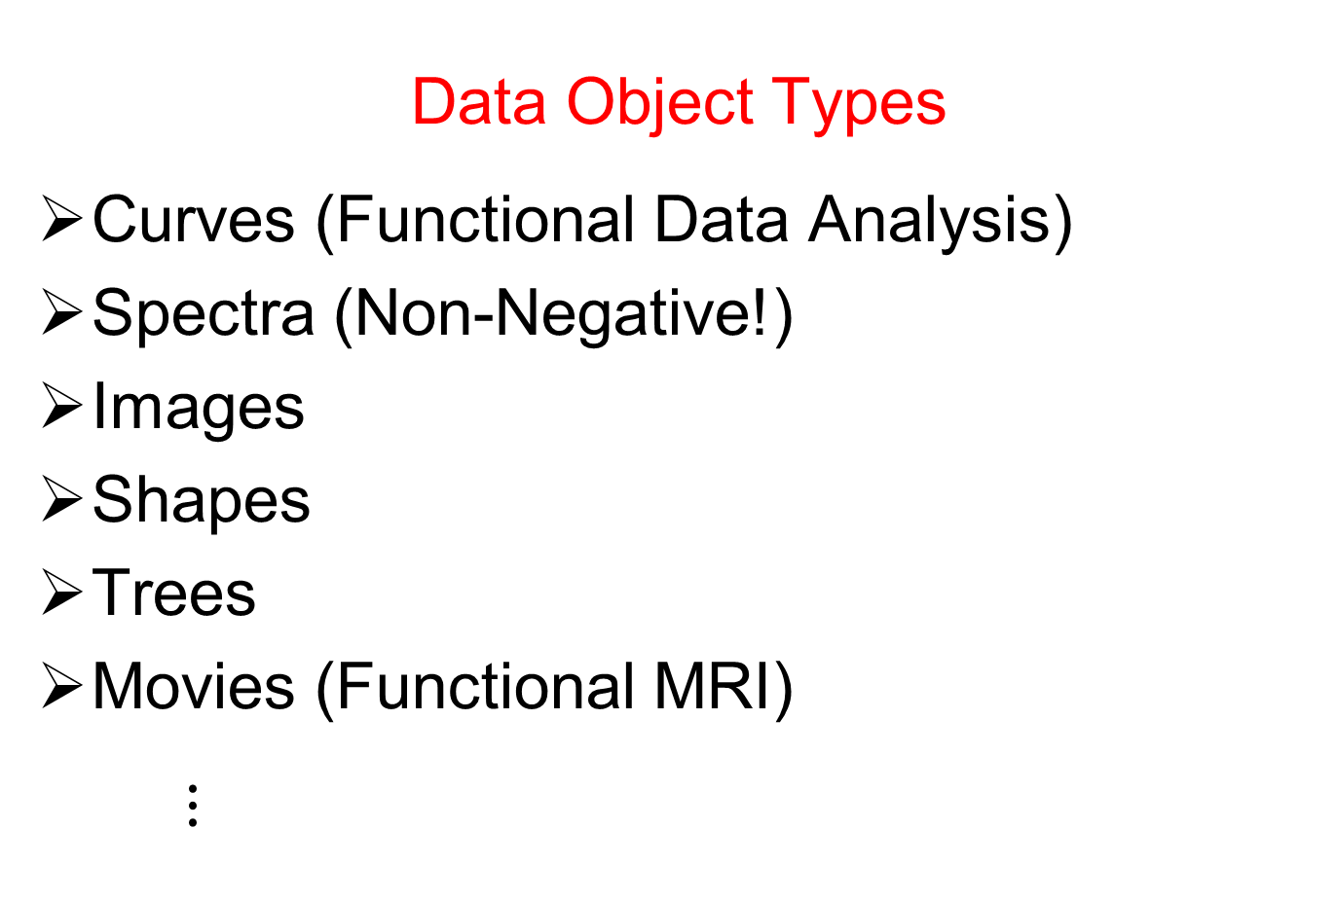
Object Oriented Data Analysis
Data Object Types
Curves (Functional Data Analysis)
Spectra (Non-Negative!)
Images
Shapes
Trees
Movies (Functional MRI)
$⋮$

Slide 11
Object Oriented Data Analysis
Nomenclature Clash?
Computer Science View:
Object Oriented Programming:
Programming that supports encapsulation, inheritance, and polymorphism
(from Google: define object oriented programming,
my favorite: www.innovatia.com/software/papers/com.htm)

Slide 12
Object Oriented Data Analysis
Some statistical history:
John Chambers Idea (1960s - ):
Object Oriented approach to statistical analysis
Developed as software package S
  Basis of S-plus (commerical product)
  And of R (free-ware, current favorite of Chambers)
Reference for more on this:
Venables, W. N. and Ripley, B. D. (2002) Modern Applied Statistics with S, Fourth Edition, Springer, N. Y., ISBN 0-387-95457-0.
Notes:
12

Slide 13
Object Oriented Data Analysis
Another take: J. O. Ramsay
http://www.psych.mcgill.ca/faculty/ramsay/ramsay.html
“Functional Data Objects”
(closer to C. S. meaning)
Personal Objection:
“Functional” in mathematics is:
“Function that operates on functions”

Slide 14
Object Oriented Data Analysis
Current Motivation:
In Complicated Data Analyses
Fundamental (Non-Obvious) Question Is:
“What Should We Take as Data Objects?”
Key to Focussing Needed Analyses

Slide 15
Object Oriented Data Analysis
Reviewer for Annals of Applied Statistics:
Why not just say:
“Experimental Units”?
Useful for some situations
But misses different representations
E.g. log transformations …

Slide 16


Object Oriented Data Analysis
Currently Published References:
Wang and Marron (2007)
Marron and Alonso (2014)

Slide 17

Object Oriented Data Analysis
Publication in Progress:
Object Oriented Data Analysis
Book with Ian Dryden
Latest Draft Available on
Course Web Page
Comments Welcome
(Email Preferred)

Slide 18
Object Oriented Data Analysis
What is Actually Done?
Major Statistical Tasks:
Understanding Population Structure
Classification (i. e. Discrimination)
Time Series of Data Objects
“Vertical Integration” of Datatypes

Slide 19
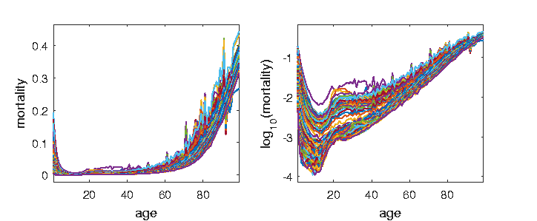
A Taste of OODA Examples
Spanish Male Mortality Curves
For Each Age = # Died / Total #
≈ Prob. Of Dying

Slide 20
A Taste of OODA Examples
Spanish Male Mortality Curves
Challenge: Very Small For Young
Solution: Log Scale (Object Choice)

Slide 21
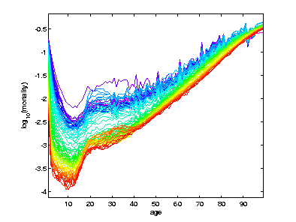
A Taste of OODA Examples
Spanish Male Mortality Curves
Enhancement: Color by Year
(Highlights
Time
Structure)

Slide 22
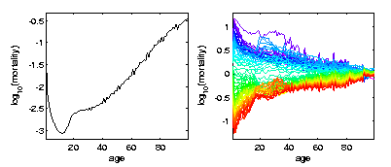
A Taste of OODA Examples
Spanish Male Mortality Curves
Mean (Contains Many Age Parts)
Residuals About Mean

Slide 23
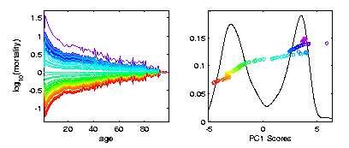
A Taste of OODA Examples
Spanish Male Mortality Curves
Rank 1 Approx “PC1”
Finds “Overall Improvement”

Slide 24
A Taste of OODA Examples
Spanish Male Mortality Curves
1918 Flu Pandemic
Spanish Civil War

Slide 25
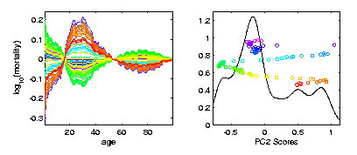
A Taste of OODA Examples
Spanish Male Mortality Curves
2nd Component “PC 2”
Contrast Between 20-45s and rest

Slide 26
A Taste of OODA Examples
Spanish Male Mortality Curves
Flu Pandemic, Civil War
Intro of Automobile, Improved Safety

Slide 27

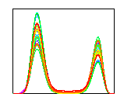


A Taste of OODA Examples
Phase and Amplitude Curves
Raw
Data
Ampl’de
Varia’n
Phase
Varia’n
Warps

Slide 28
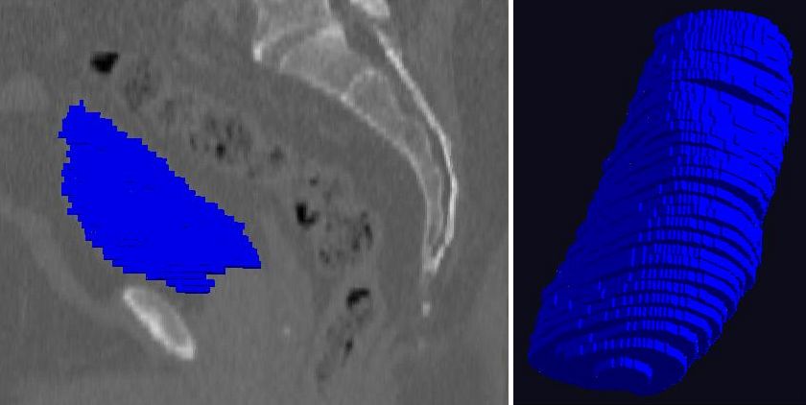
A Taste of OODA Examples
Shapes in Image Analysis (3-d)
Manual Segmentation (Male Bladder)

Slide 29
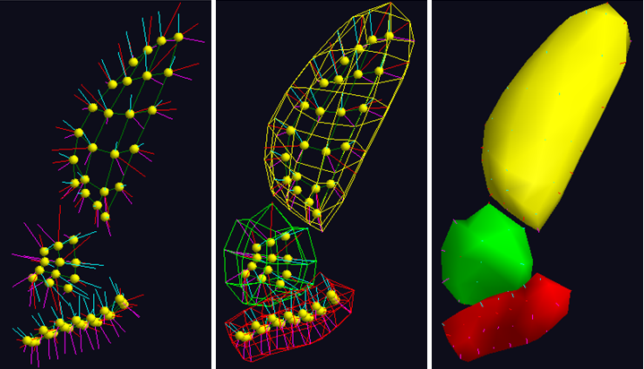
A Taste of OODA Examples
Shapes in Image Analysis (3-d)
Skeletal Shape Representation
Challenge: Data Objects Lie on Manifold

Slide 30
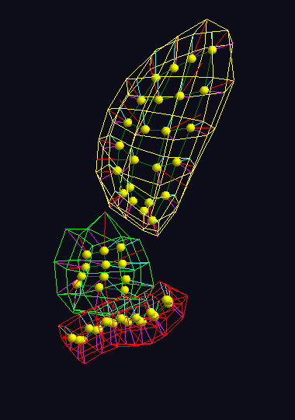
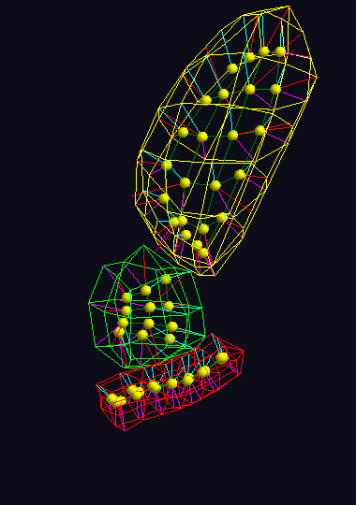
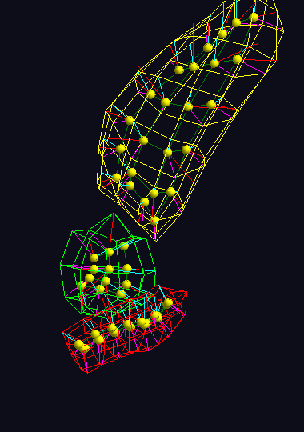



A Taste of OODA Examples
Shapes in Image Analysis (3-d)
Analysis of Variation (Princ. Geod. Anal.)
$$μ+2×{PC}_{1}$$
$$μ+2×{PC}_{1}$$
$$μ+2×{PC}_{1}$$

Slide 31
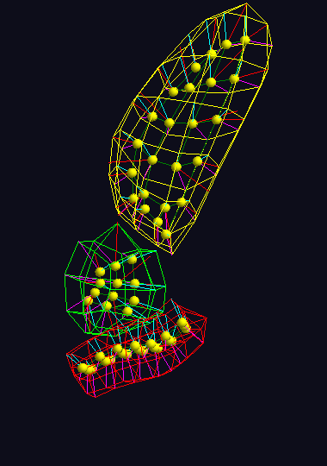

A Taste of OODA Examples
Shapes in Image Analysis (3-d)
Analysis of Variation (Princ. Geod. Anal.)
$$μ$$
$$μ$$
$$μ$$

Slide 32
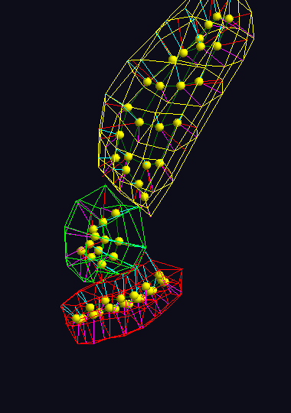
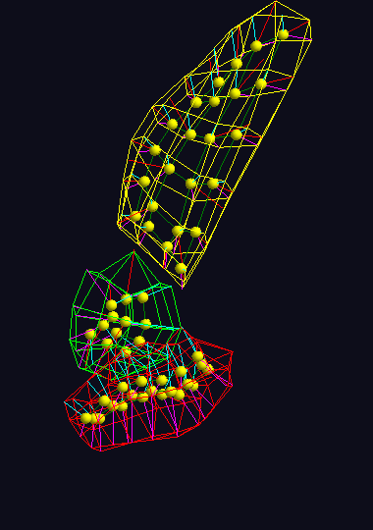
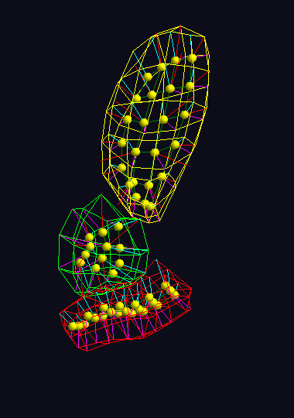



A Taste of OODA Examples
Shapes in Image Analysis (3-d)
Analysis of Variation (Princ. Geod. Anal.)
$$μ−2×{PC}_{1}$$
$$μ−2×{PC}_{1}$$
$$μ−2×{PC}_{1}$$

Slide 33
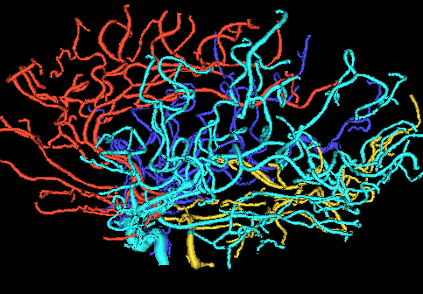
A Taste of OODA Examples
Tree Structured Data Objects
Brain Artery Data
Marron’s
Brain

Slide 34
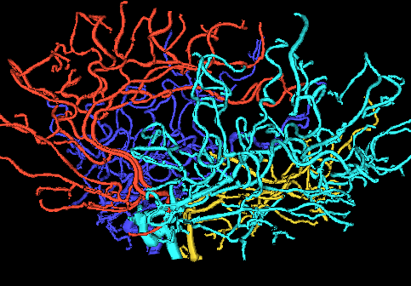
A Taste of OODA Examples
Tree Structured Data Objects
Brain Artery Data
Marron’s
Brain

Slide 35
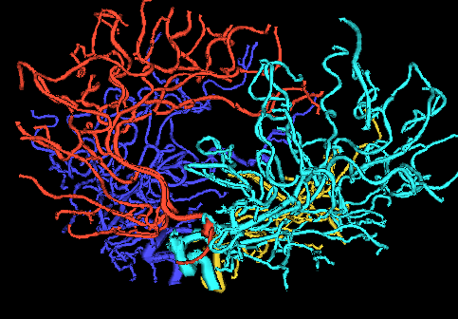
A Taste of OODA Examples
Tree Structured Data Objects
Brain Artery Data
Marron’s
Brain

Slide 36
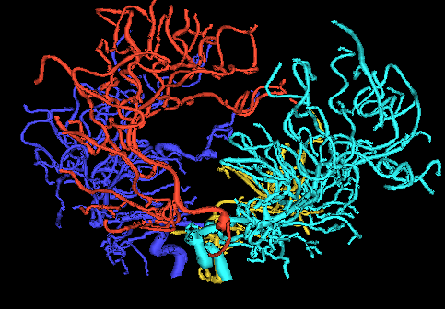
A Taste of OODA Examples
Tree Structured Data Objects
Brain Artery Data
Marron’s
Brain

Slide 37
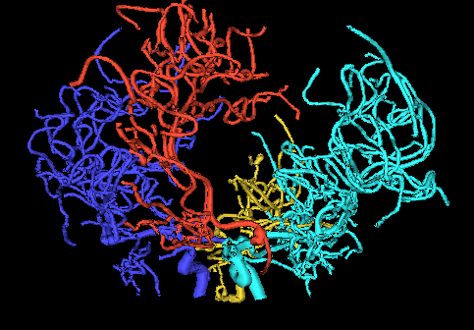
A Taste of OODA Examples
Tree Structured Data Objects
Brain Artery Data
Marron’s
Brain

Slide 38
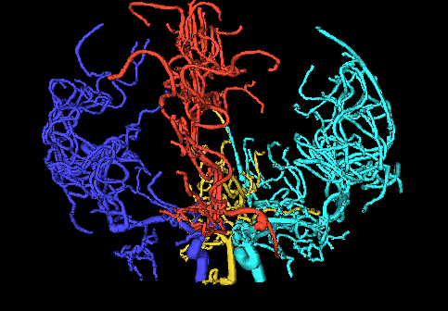
A Taste of OODA Examples
Tree Structured Data Objects
Brain Artery Data
Marron’s
Brain

Slide 39
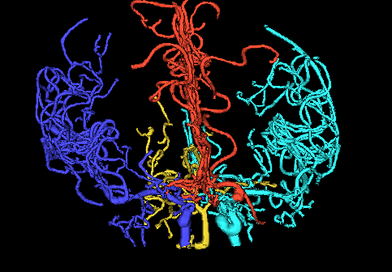
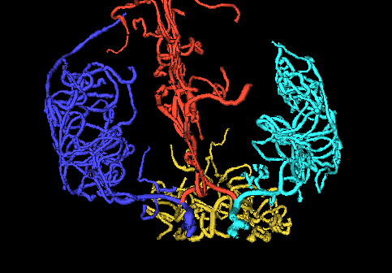
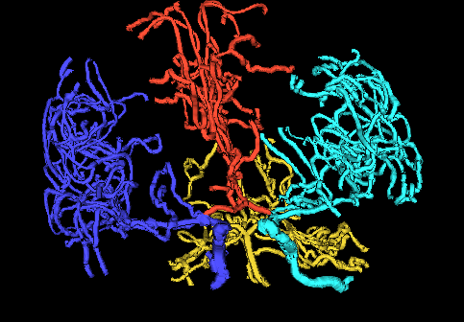
A Taste of OODA Examples
Tree Structured Data Objects
Brain Artery Data,
Analyze Sample of n=100
Average? Variation About Average???
,
, ... ,

Slide 40
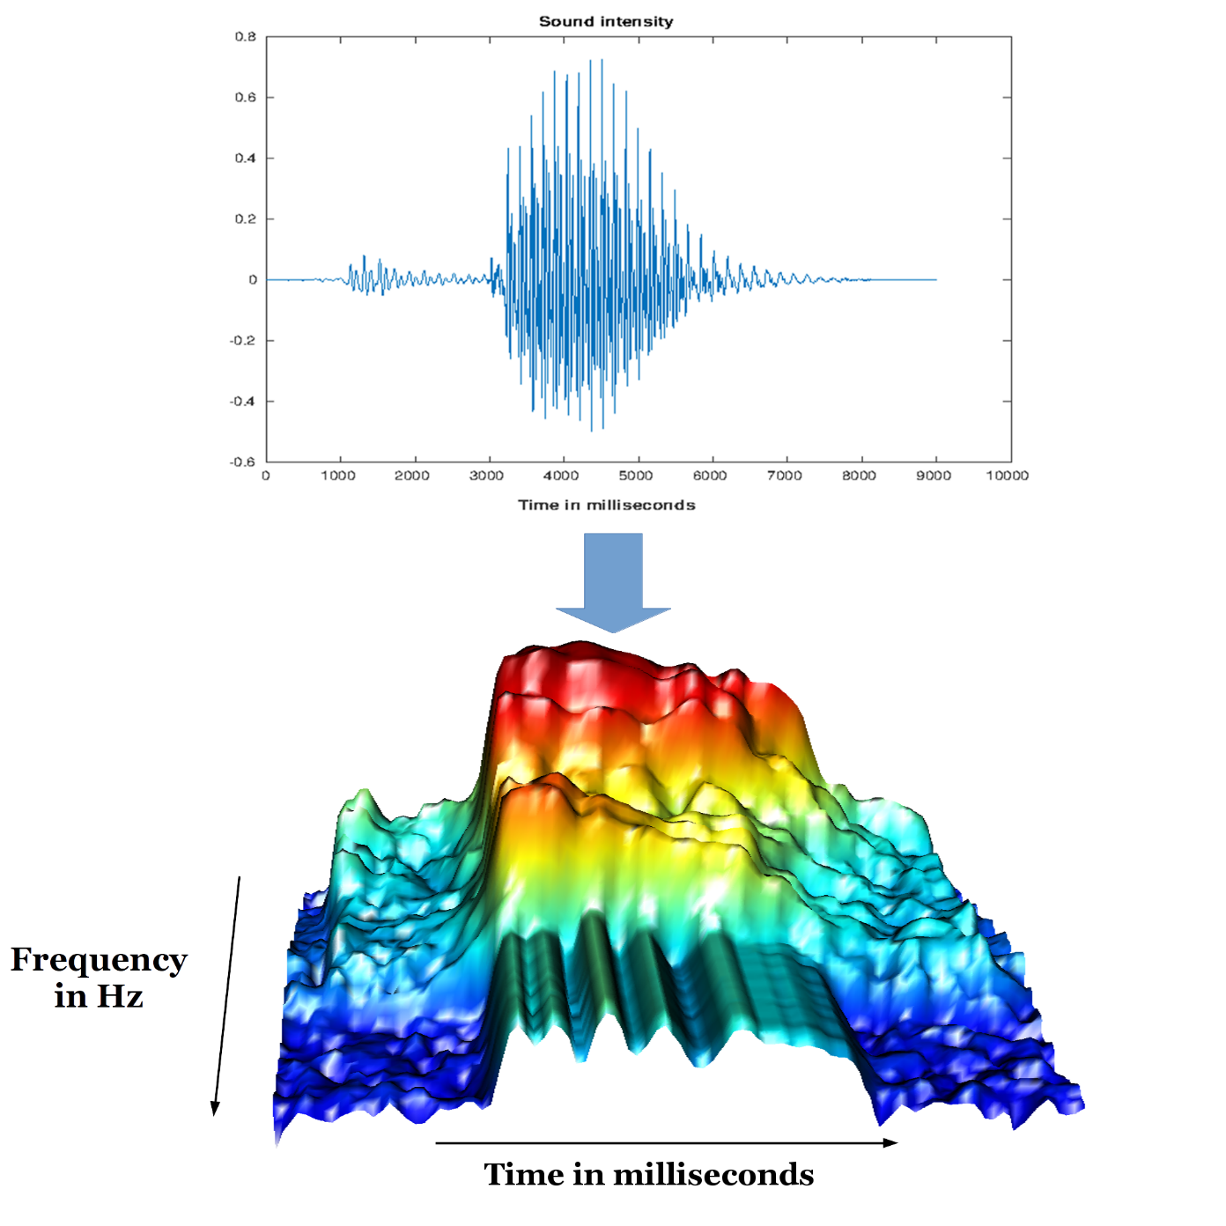
A Taste of OODA Examples
Sounds
as Data
Objects
Sonogram

Slide 41
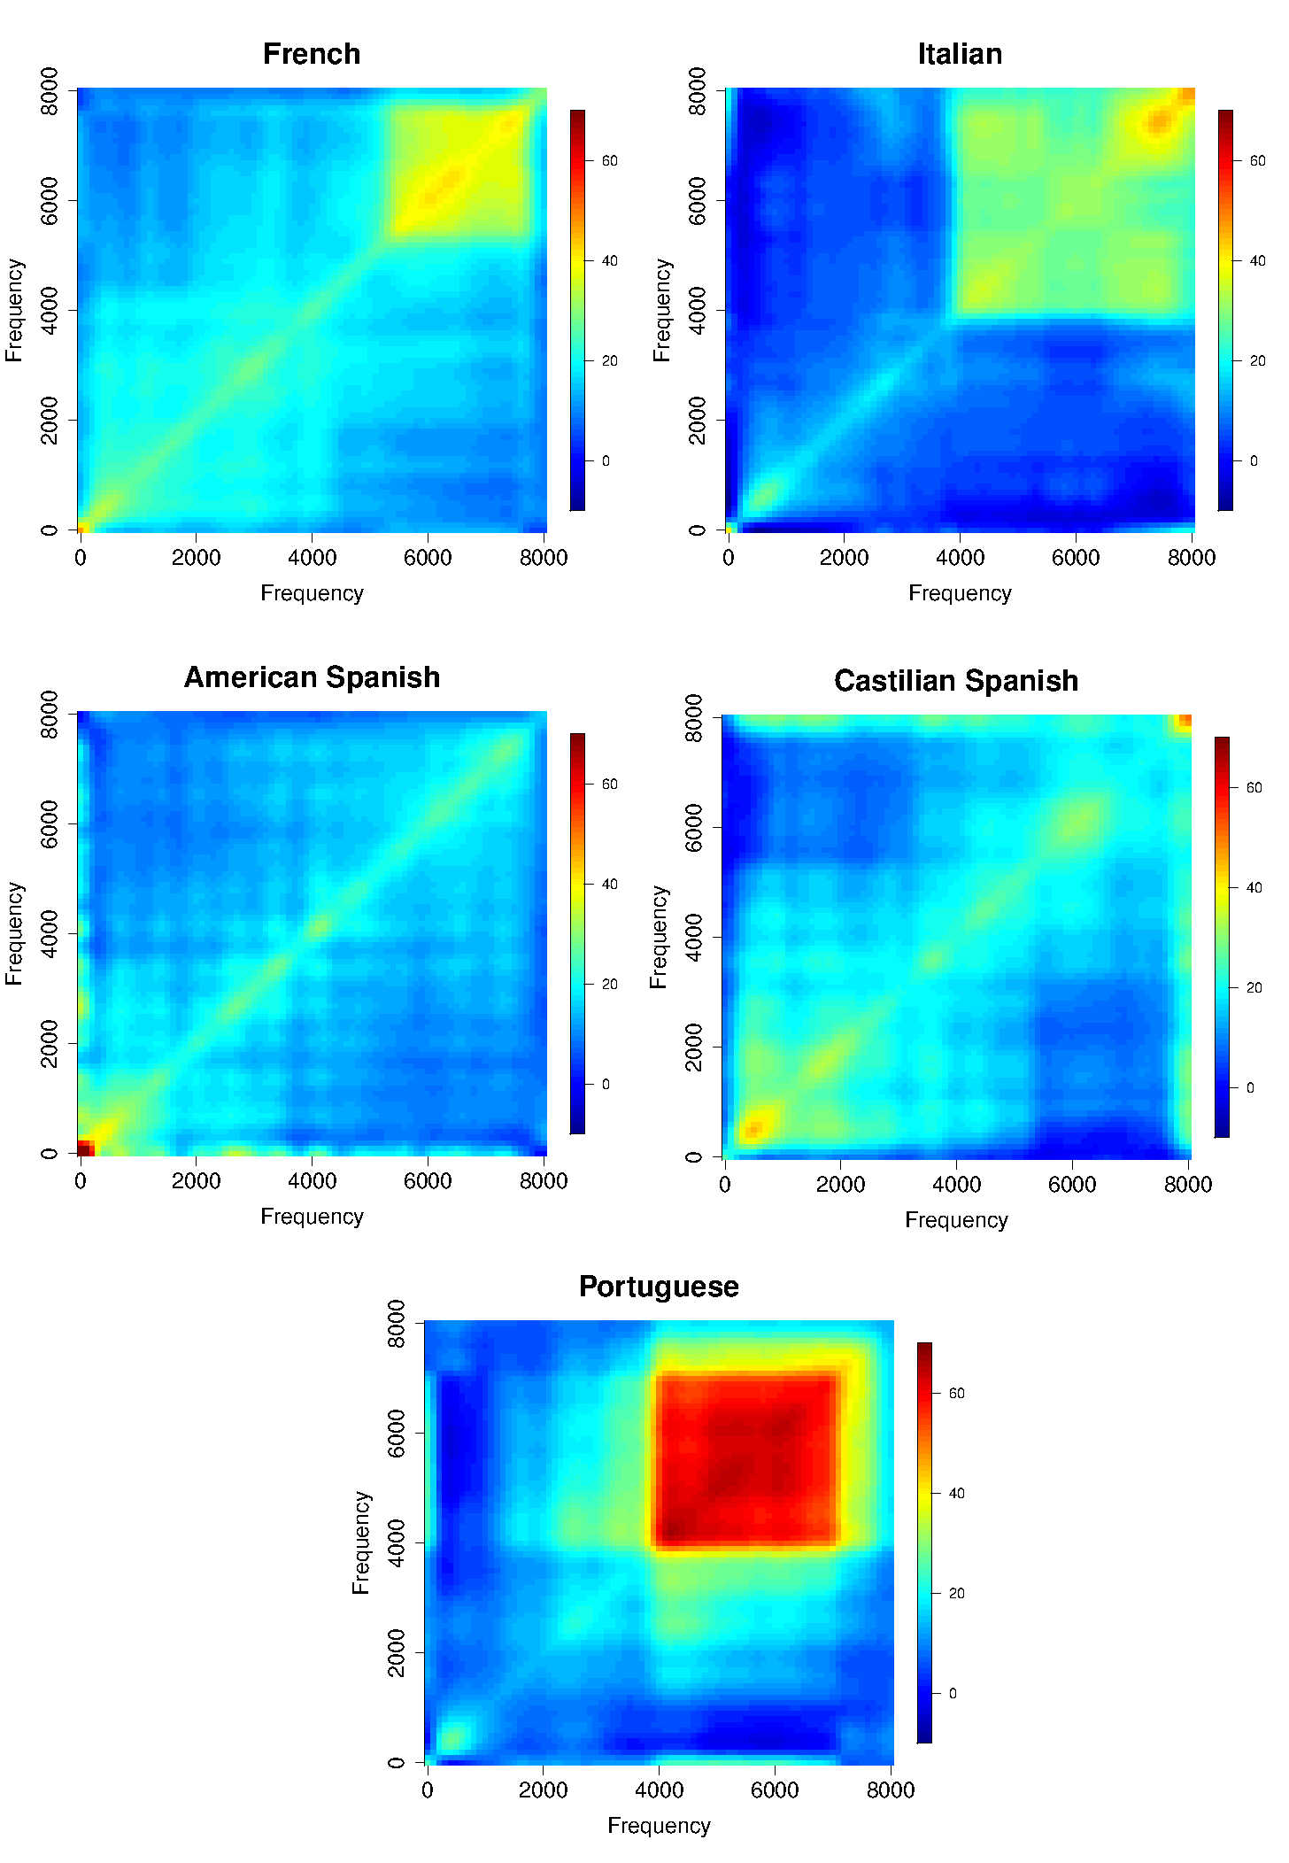
A Taste of OODA Examples
Sounds
as Data
Objects
Analysis
Of Dialects

Slide 42
A Taste of OODA Examples
Sounds
as Data
Objects
Analysis
Of Dialects

Slide 43

A Taste of OODA Examples
Faces as Data Objects
Raw Data

Slide 44
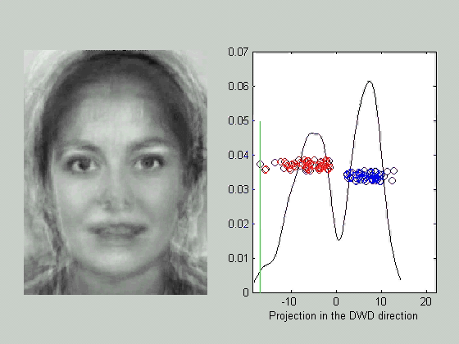
A Taste of OODA Examples
Faces as Data Objects
Classify
Males vs.
Females

Slide 45
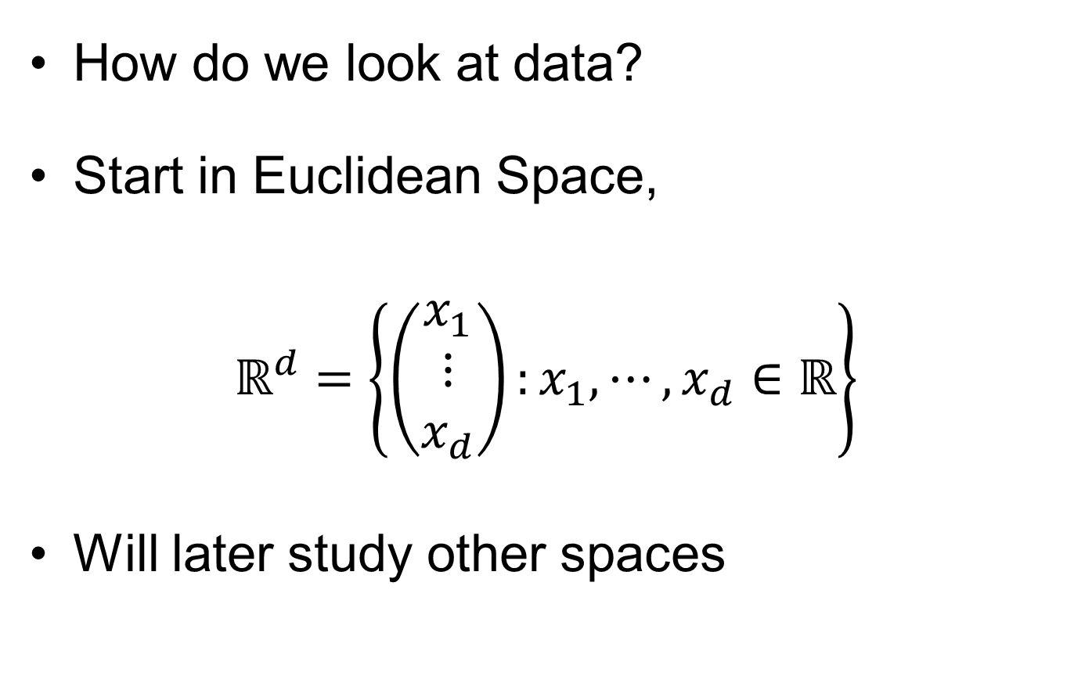
Visualization
How do we look at data?
Start in Euclidean Space,
$$ℝ^{d}=\left\{\left(\begin{matrix}x_{1} \\ ⋮ \\ x_{d}\end{matrix}\right):x_{1},⋯,x_{d}∈ℝ\right\}$$
Will later study other spaces

Slide 46
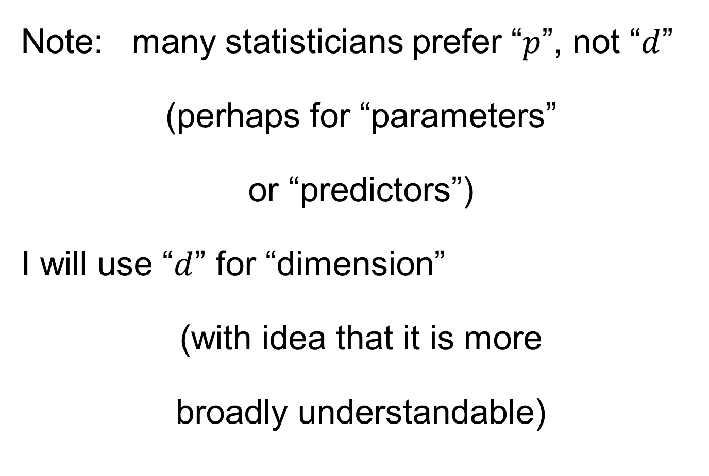
Notation
Note: many statisticians prefer “$p$”, not “$d$”
(perhaps for “parameters”
or “predictors”)
I will use “$d$” for “dimension”
(with idea that it is more
broadly understandable)

Slide 47
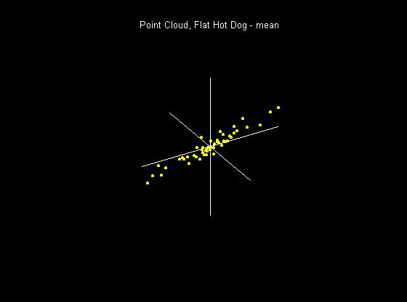
Visualization
How do we look at Euclidean data?
1-d: histograms, etc.
2-d: scatterplots
3-d: spinning point clouds

Slide 48
Visualization
How do we look at Euclidean data?
Higher Dimensions?
Workhorse Idea: Projections

Slide 49
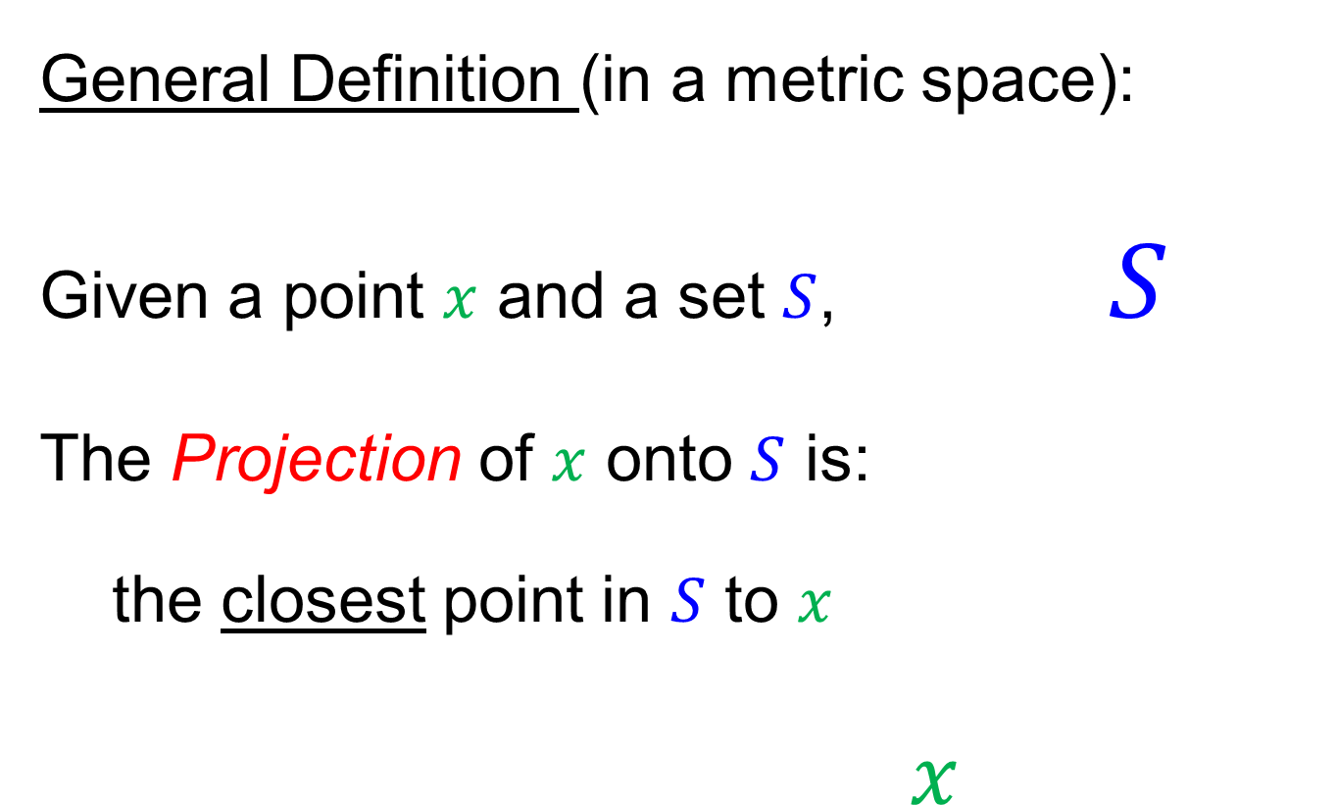
Projection
General Definition (in a metric space):
Given a point $x$ and a set $S$, $S$
The Projection of $x$ onto $S$ is:
the closest point in $S$ to $x$
$x$

Slide 50
Projection
Important Point
There are many “directions of interest” on which projection is useful
An important set of directions:
Principal Components

Slide 51
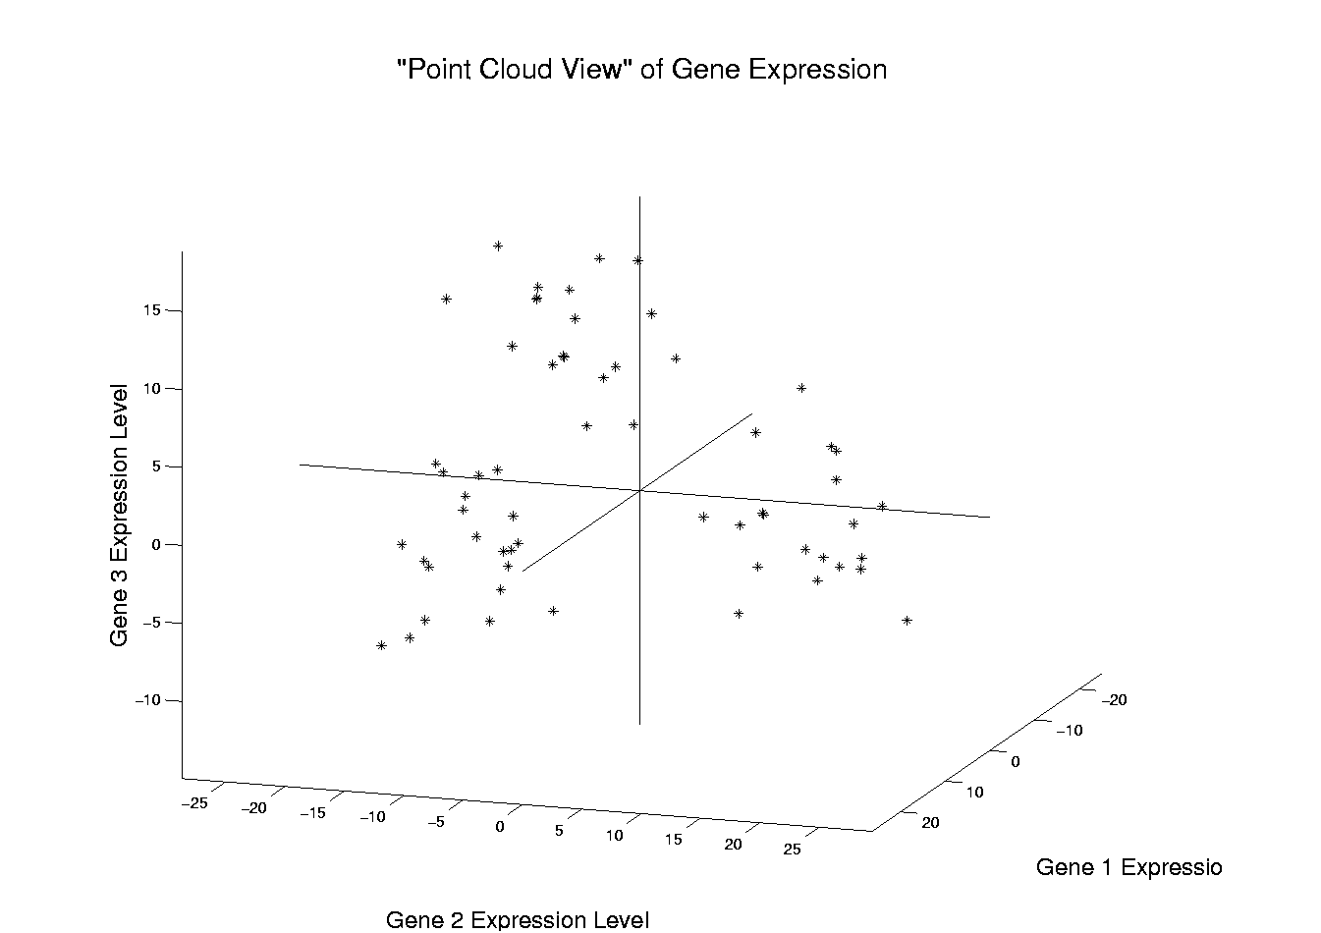
Illustration of Multivariate View: Raw Data
Notes:
EgView1p1RawData.ps

Slide 52
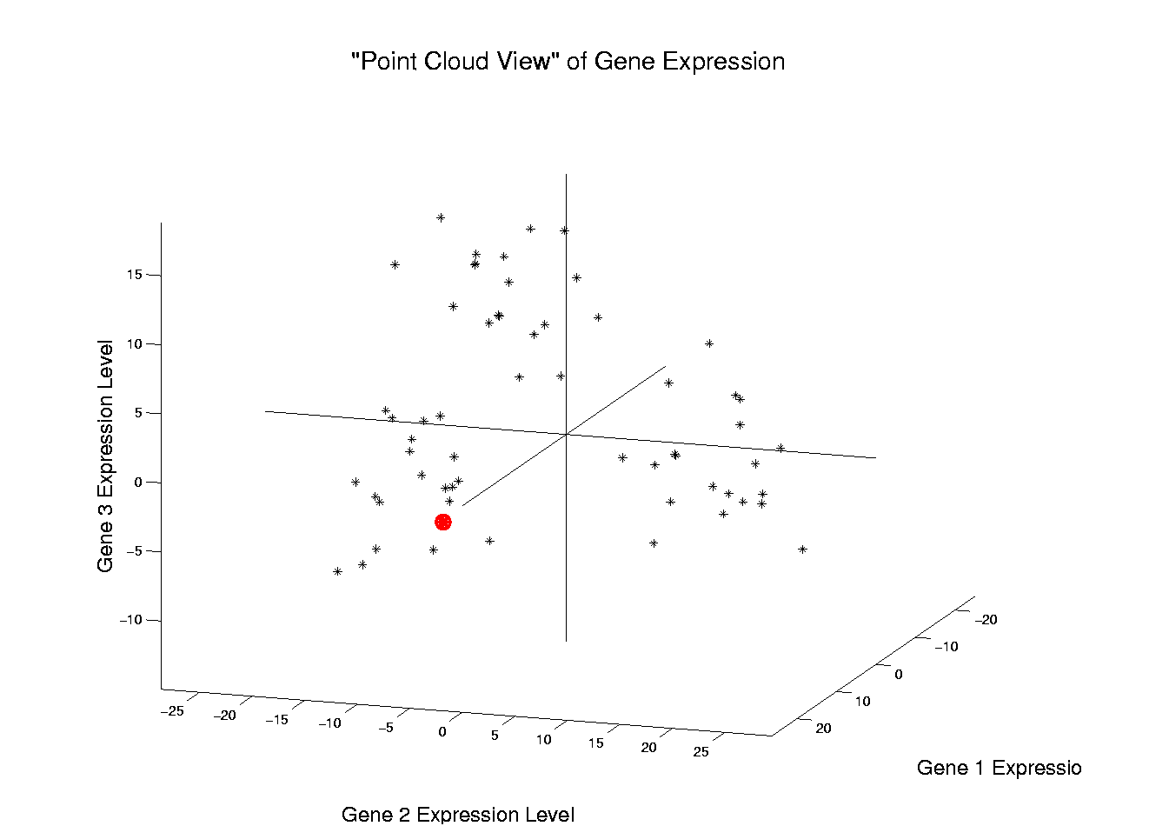
Illustration of Multivariate View: Highlight One
Notes:
EgView1p2RawDataHiLite1.ps

Slide 53
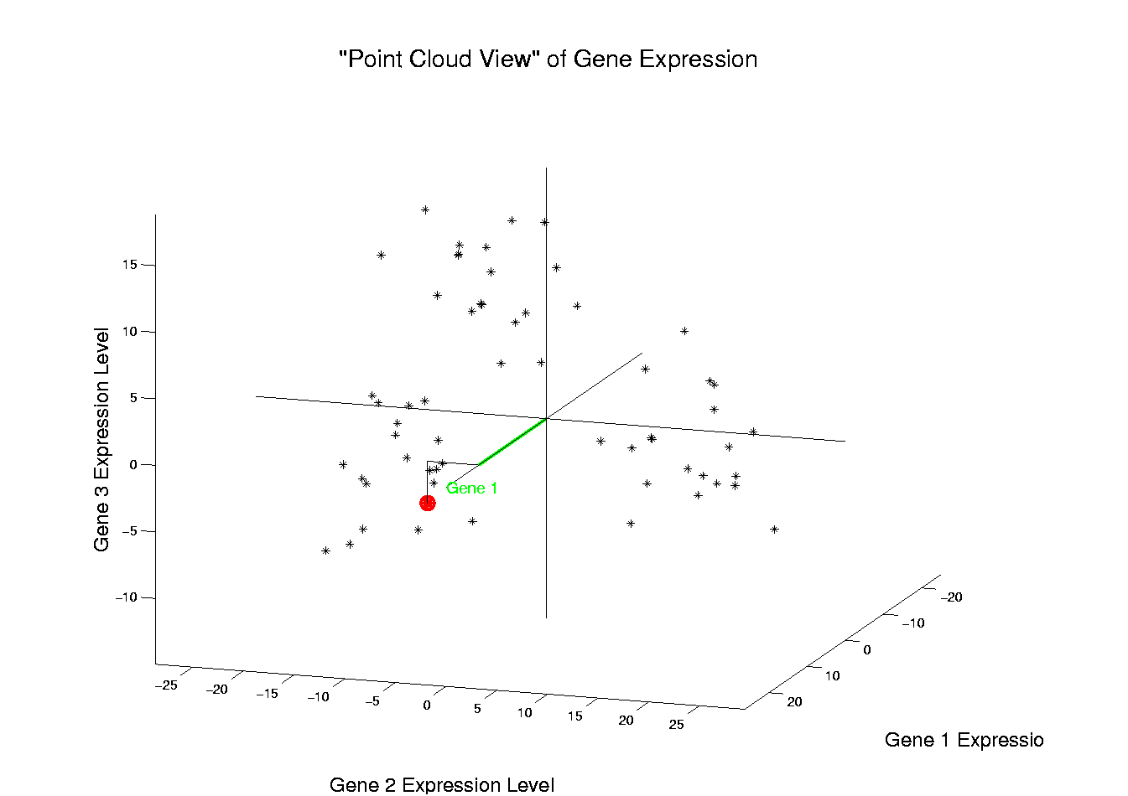
Illustration of Multivariate View: Gene 1 Express’n
Notes:
EgView1p3RawDataHL1CoordX.ps

Slide 54
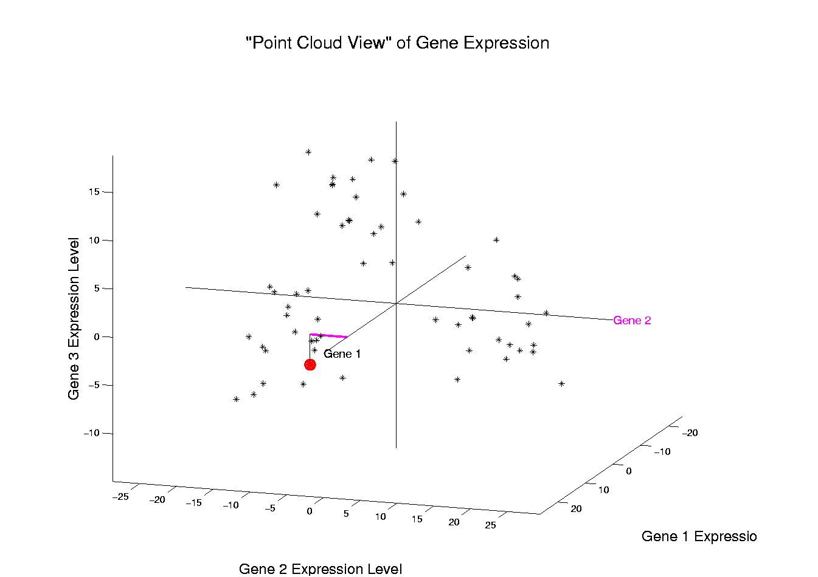
Illustration of Multivariate View: Gene 2 Express’n
Notes:
EgView1p3RawDataHL1CoordY.ps

Slide 55
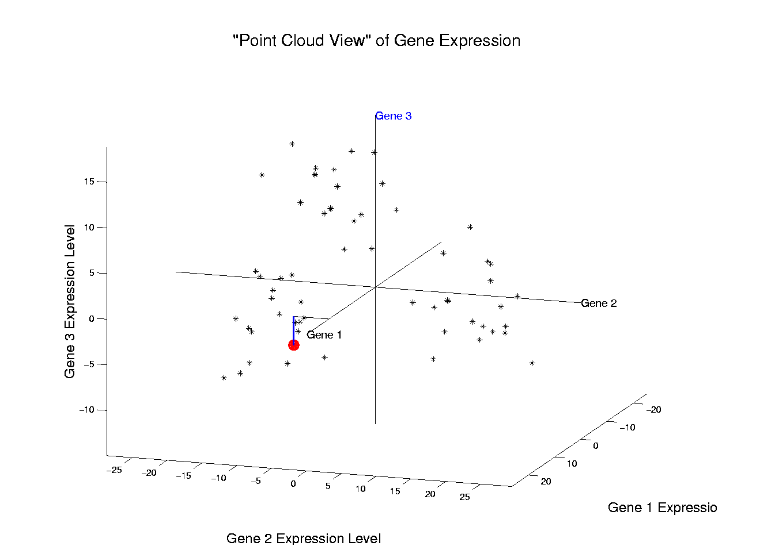
Illustration of Multivariate View: Gene 3 Express’n
Notes:
EgView1p3RawDataHL1CoordZ.ps

Slide 56
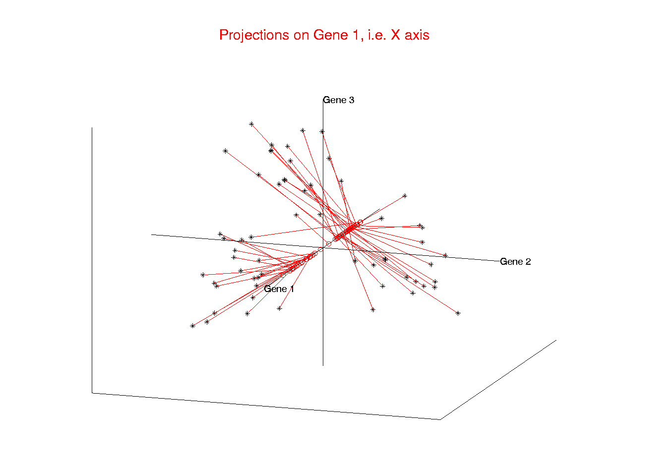
Illust’n of Multivar. View: 1-d Projection, X-axis
Notes:
EgView1p21proj3DX.ps

Slide 57
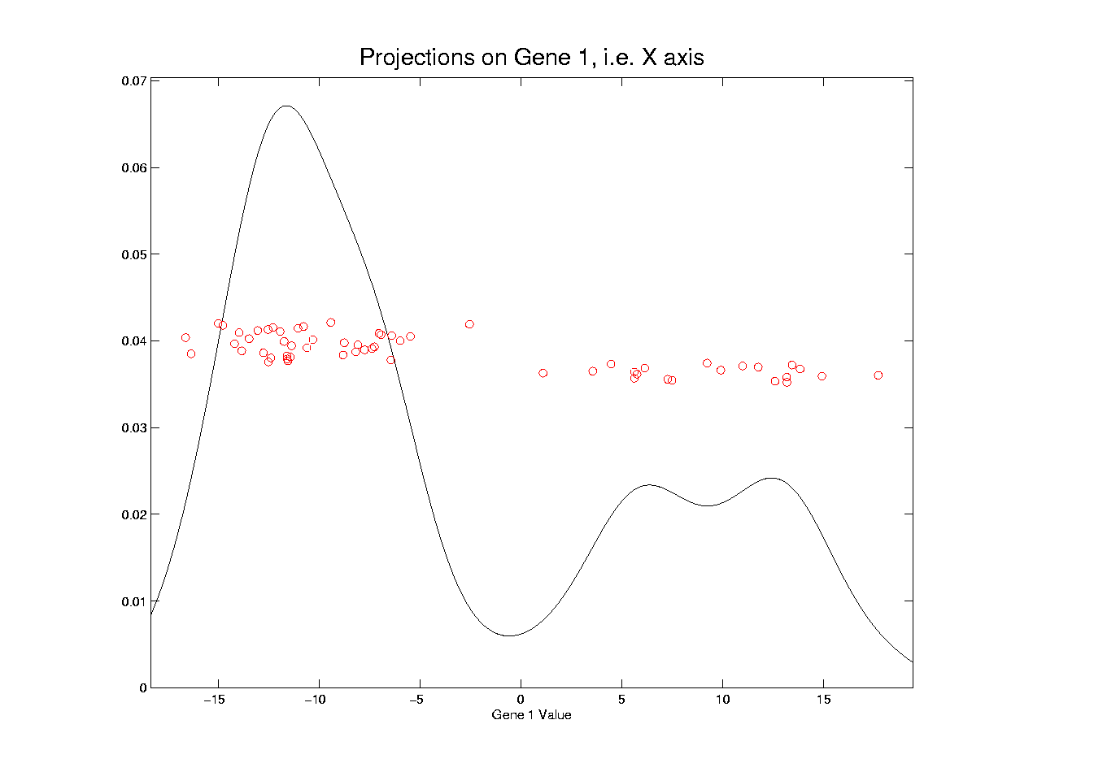
Illust’n of Multivar. View: X-Projection, 1-d view
Notes:
EgView1p31Proj1dX.ps

Slide 58
Illust’n of Multivar. View: X-Projection, 1-d view
X Coordinates
Are Projections
Notes:
EgView1p31Proj1dX.ps

Slide 59
Illust’n of Multivar. View: X-Projection, 1-d view
Y Coordinates Show
Order in Data Set
(or Random)
Notes:
EgView1p31Proj1dX.ps

Slide 60
Illust’n of Multivar. View: X-Projection, 1-d view
Smooth histogram =
Kernel Density Estimate
Will Study in Detail Later
Notes:
EgView1p31Proj1dX.ps

Slide 61
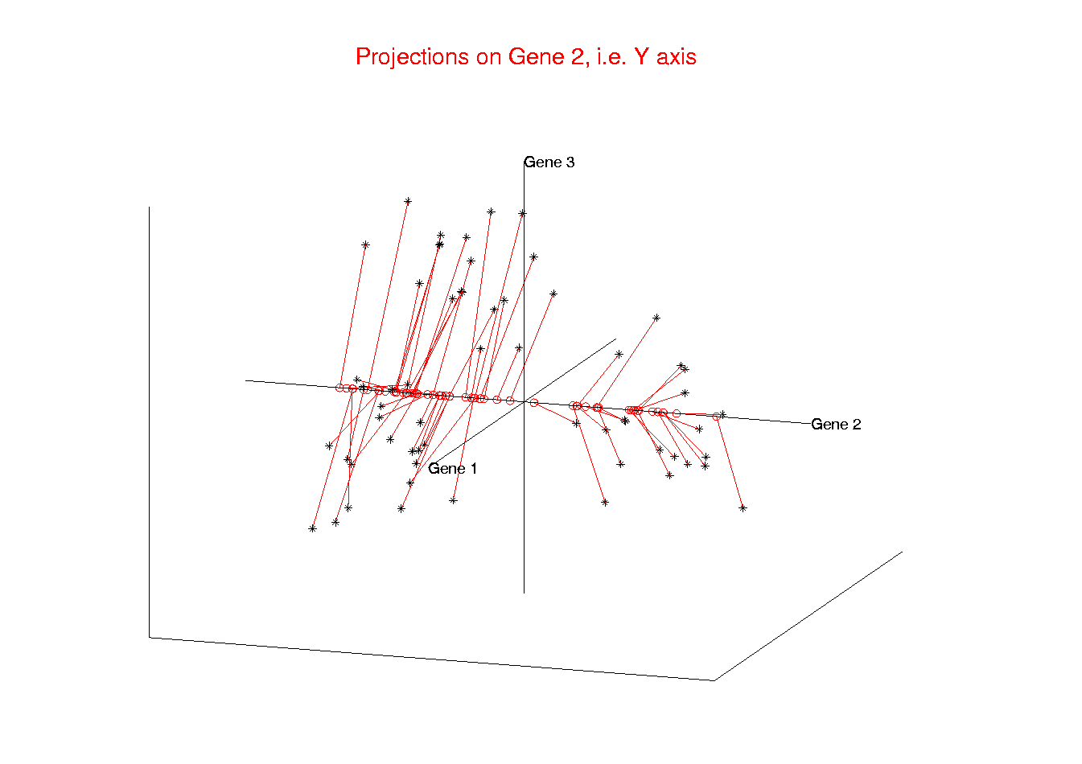
Illust’n of Multivar. View: 1-d Projection, Y-axis
Notes:
EgView1p22proj3DY.ps

Slide 62
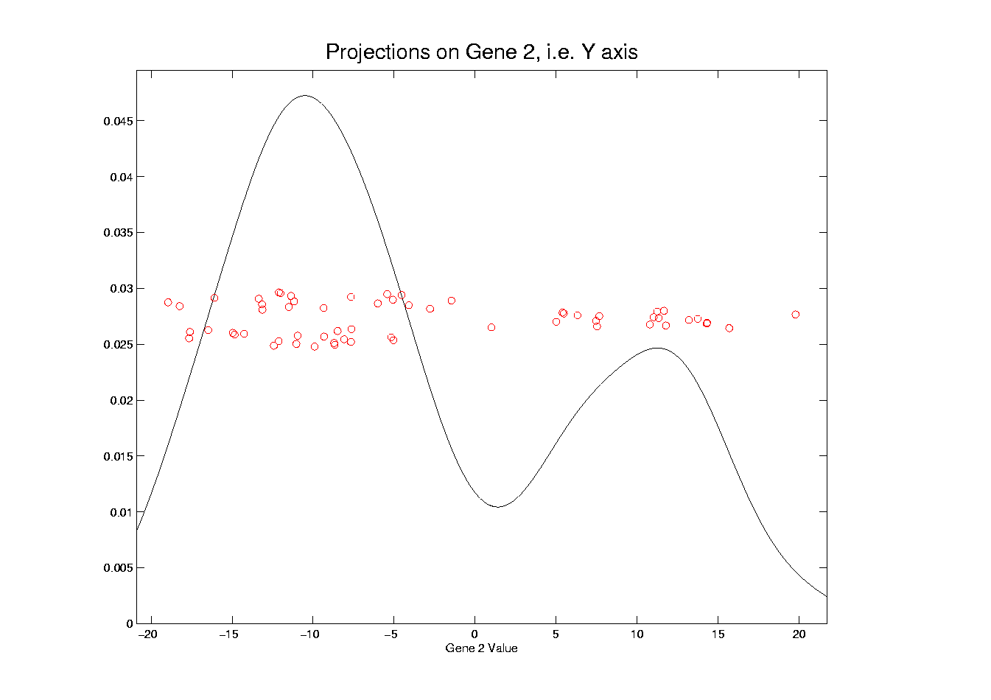
Illust’n of Multivar. View: Y-Projection, 1-d view
Notes:
EgView1p32Proj1dY.ps

Slide 63
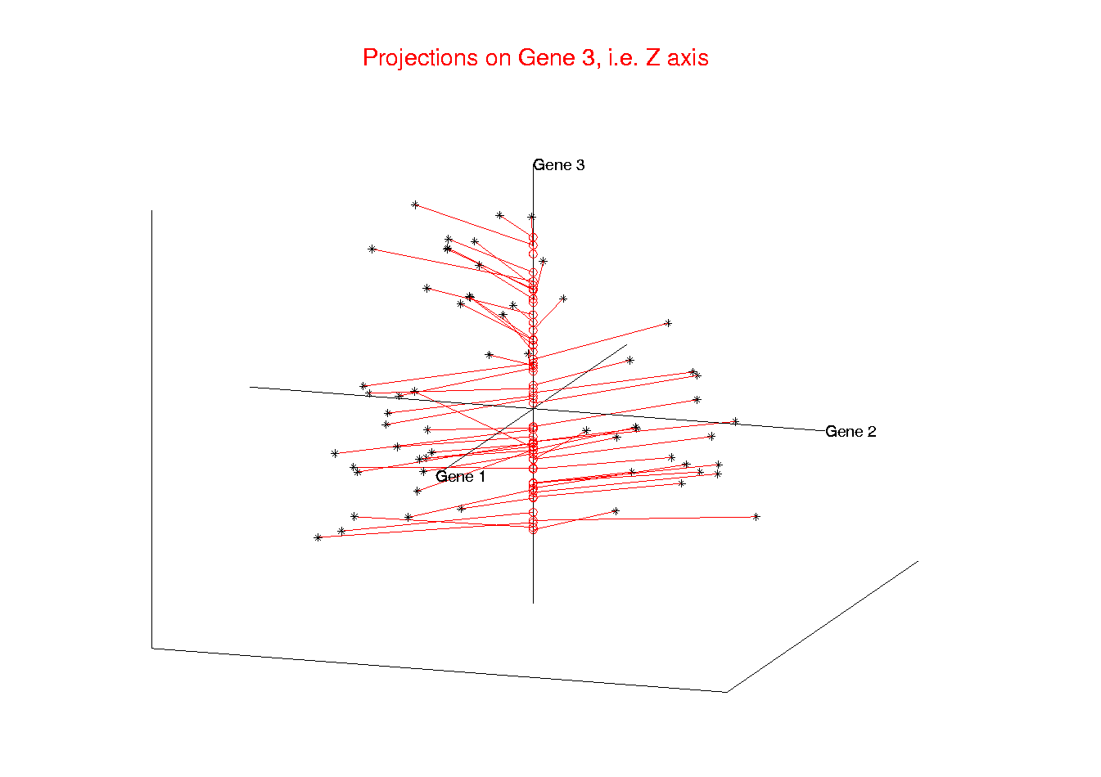
Illust’n of Multivar. View: 1-d Projection, Z-axis
Notes:
EgView1p23proj3DZ.ps

Slide 64
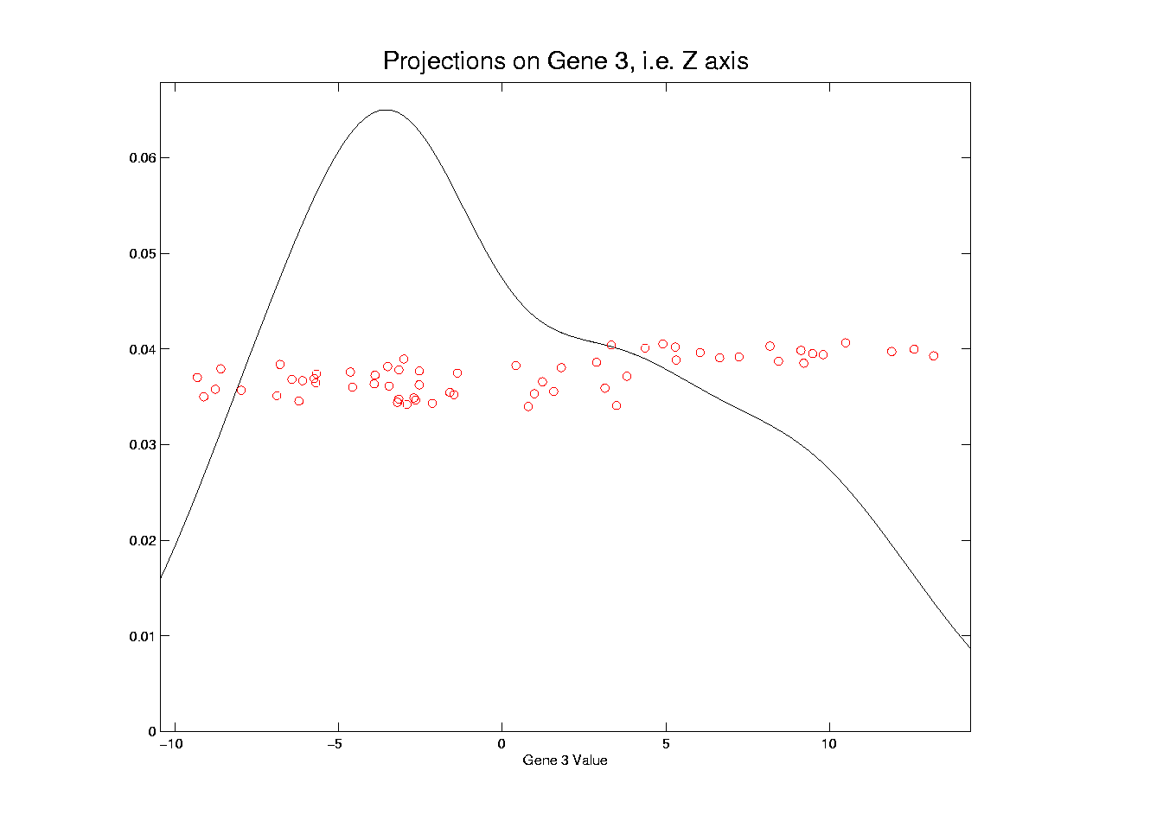
Illust’n of Multivar. View: Z-Projection, 1-d view
Notes:
EgView1p33Proj1dZ.ps

Slide 65
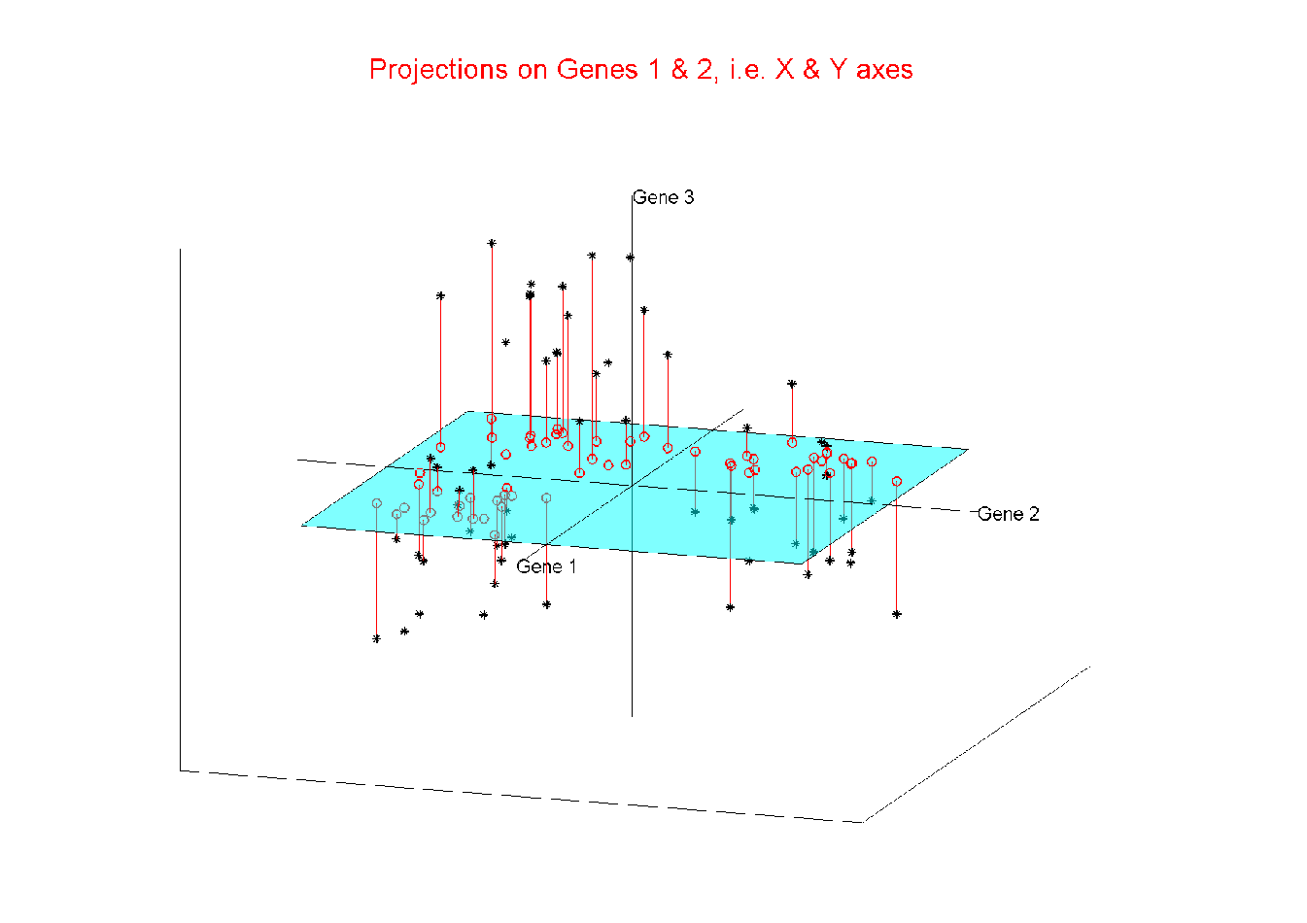
Illust’n of Multivar. View: 2-d Proj’n, XY-plane
Notes:
EgView1p24proj3DXY.ps

Slide 66
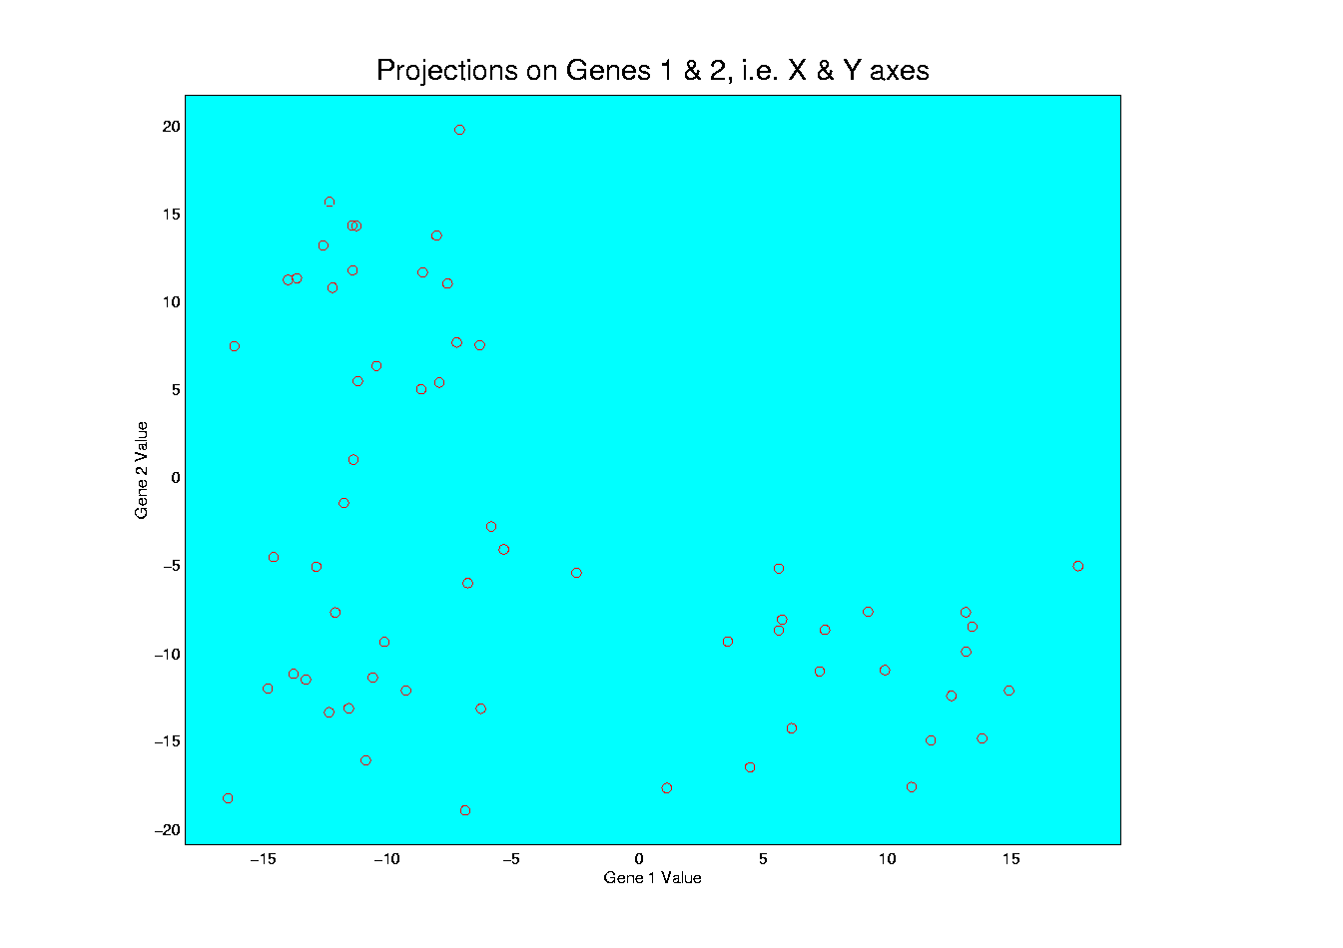
Illust’n of Multivar. View: XY-Proj’n, 2-d view
Notes:
EgView1p34proj2DXY.ps

Slide 67
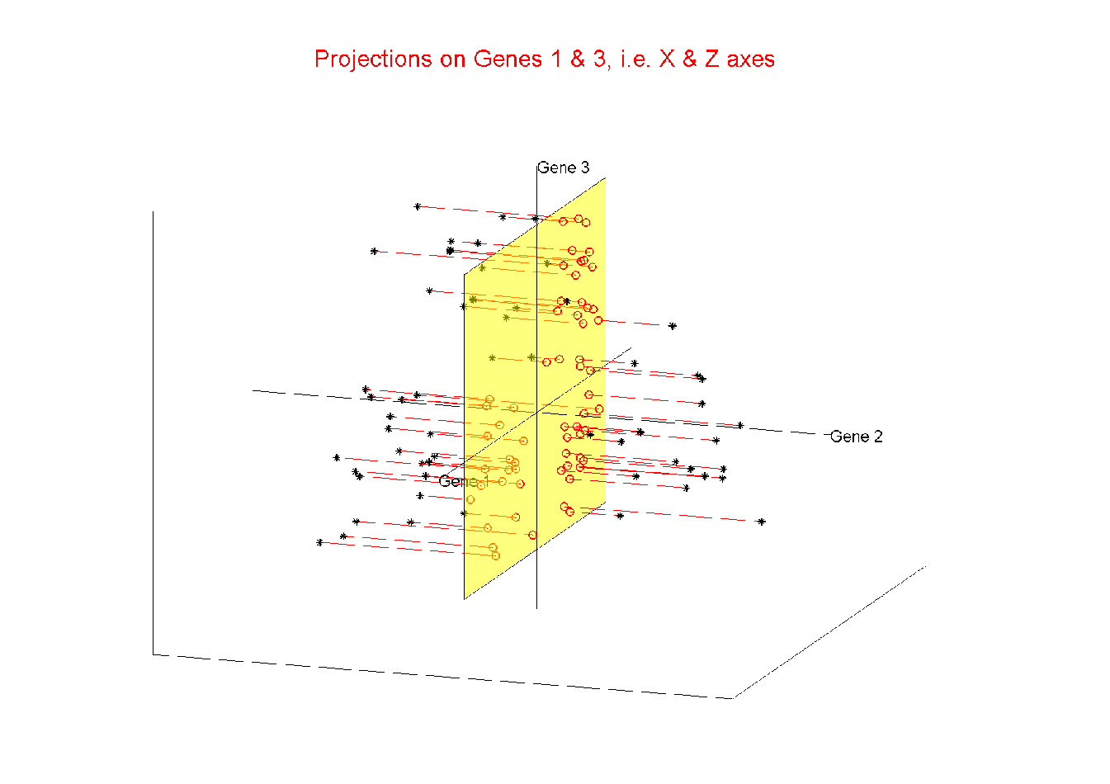
Illust’n of Multivar. View: 2-d Proj’n, XZ-plane
Notes:
EgView1p25proj3DXZ.ps

Slide 68
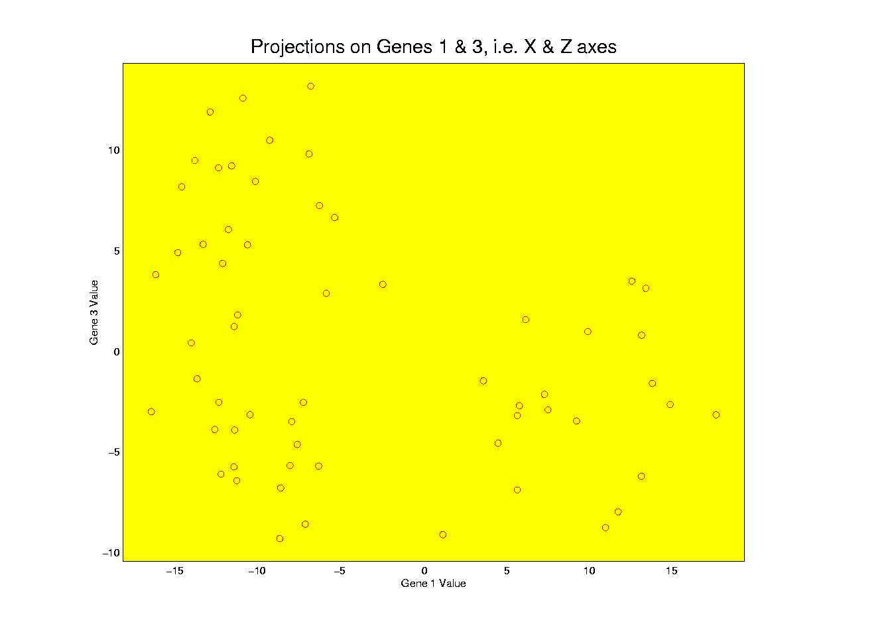
Illust’n of Multivar. View: XZ-Proj’n, 2-d view
Notes:
EgView1p35proj2DXZ.ps

Slide 69
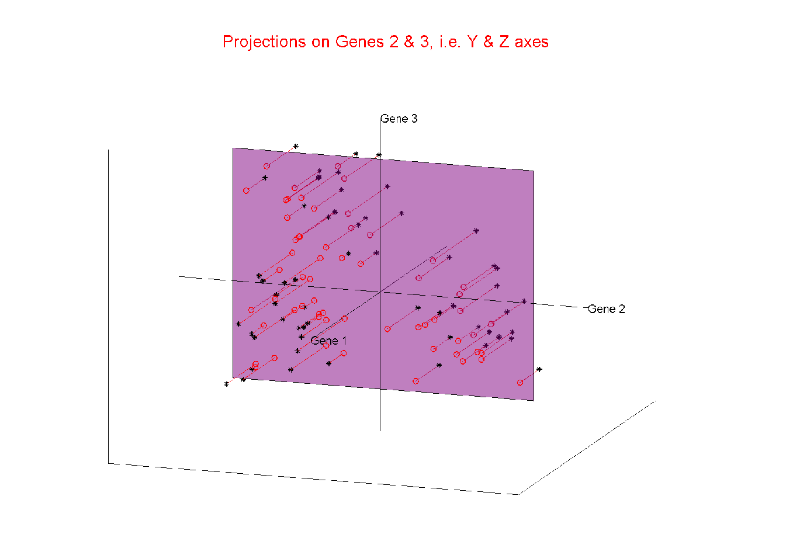
Illust’n of Multivar. View: 2-d Proj’n, YZ-plane
Notes:
EgView1p26proj3DYZ.ps

Slide 70
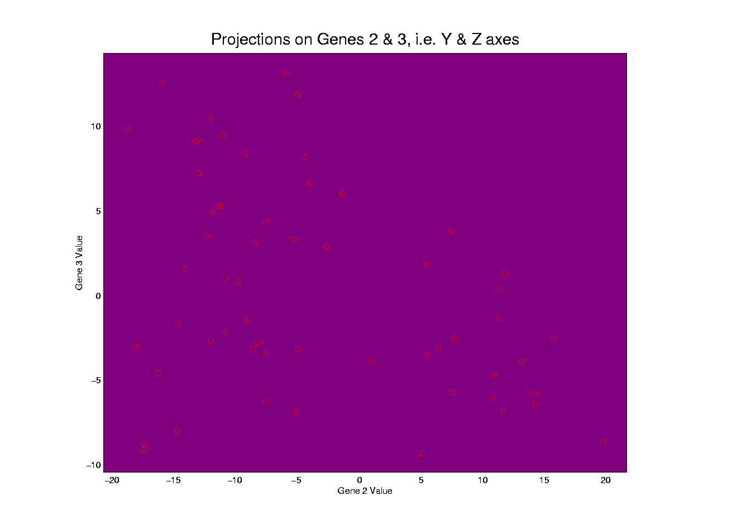
Illust’n of Multivar. View: YZ-Proj’n, 2-d view
Notes:
EgView1p36proj2DYZ.ps

Slide 71
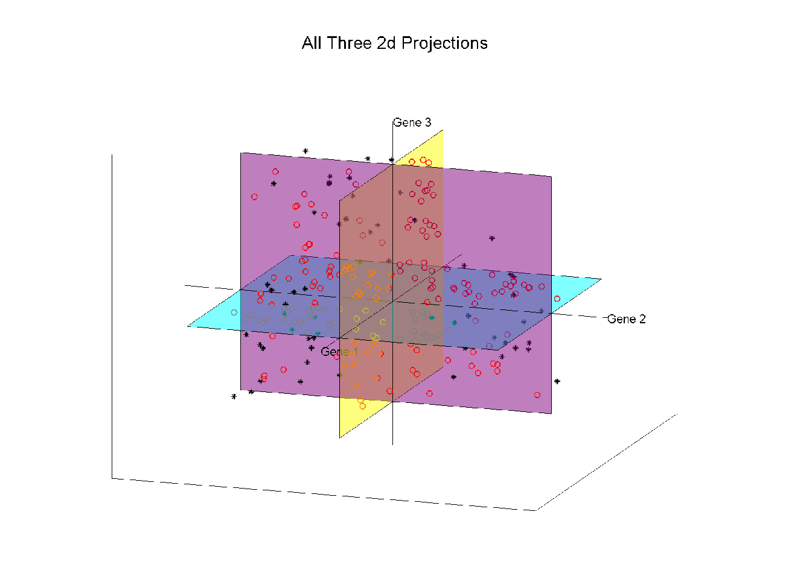
Illust’n of Multivar. View: all 3 planes
Think:
Front
Top
Side
Views
Notes:
EgView1p27proj3Dall.ps

Slide 72

Illust’n of Multivar. View: Diagonal 1-d proj’ns
Notes:
EgView1p37proj1Ddiag.ps

Slide 73

Illust’n of Multivar. View: Add off-diagonals
Notes:
EgView1p38proj1n2Dcolor.ps

Slide 74

Illust’n of Multivar. View: Typical View
Notes:
EgView1p39ScatPlot.ps

Slide 75
Illust’n of Multivar. View: Typical View
Note Linkage of Axes
Notes:
EgView1p39ScatPlot.ps

Slide 76
Illust’n of Multivar. View: Typical View
Note Linkage of Axes
Notes:
EgView1p39ScatPlot.ps

Slide 77
Illust’n of Multivar. View: Typical View
Note Linkage of Axes
Notes:
EgView1p39ScatPlot.ps

Slide 78
Illust’n of Multivar. View: Typical View
Note Correspondence
of Points
Notes:
EgView1p39ScatPlot.ps

Slide 79
Illust’n of Multivar. View: Typical View
Note Correspondence
of Points
Notes:
EgView1p39ScatPlot.ps

Slide 80
Projection
Important Point
There are many “directions of interest” on which projection is useful
An important set of directions:
Principal Components

Slide 81
Principal Components
Find Directions of:
“Maximal (projected) Variation”
Compute Sequentially
On Orthogonal Subspaces
Will take careful look at mathematics later

Slide 82
Principal Components
For simple,
3-d toy data,
recall raw
data view:
Notes:
82

Slide 83

Principal Components
PCA just
gives rotated
coordinate
system:
Notes:
83

Slide 84

Principal Components
Early References:
Pearson (1901)
Hotelling (1933)
Founder of UNC Statistics Dept.
Notes:
84

Slide 85
Illust’n of PCA View: Recall Raw Data
Notes:
EgView1p1RawData.ps

Slide 86
Illust’n of PCA View: Recall Gene by Gene Views
Notes:
EgView1p27proj3Dall.ps

Slide 87

Illust’n of PCA View: PC1 Projections
Notes:
EgView1p51proj3dPC1.ps

Slide 88
Illust’n of PCA View: PC1 Projections
Note Different Axis
Chosen to
Maximize Spread
Notes:
EgView1p51proj3dPC1.ps

Slide 89

Illust’n of PCA View: PC1 Projections, 1-d View
Notes:
EgView1p61Proj1dPC1.ps

Slide 90

Illust’n of PCA View: PC2 Projections
Notes:
EgView1p52proj3dPC2.ps

Slide 91

Illust’n of PCA View: PC2 Projections, 1-d View
Notes:
EgView1p62Proj1dPC2.ps

Slide 92

Illust’n of PCA View: PC3 Projections
Notes:
EgView1p53proj3dPC3.ps

Slide 93

Illust’n of PCA View: PC3 Projections, 1-d View
Notes:
EgView1p63Proj1dPC3.ps

Slide 94

Illust’n of PCA View: Projections on PC1,2 plane
Notes:
EgView1p54proj3dPC12.ps

Slide 95

Illust’n of PCA View: PC1 & 2 Proj’n Scatterplot
Notes:
EgView1p64proj2dPC12.ps

Slide 96

Illust’n of PCA View: Projections on PC1,3 plane
Notes:
EgView1p55proj3dPC13.ps

Slide 97

Illust’n of PCA View: PC1 & 3 Proj’n Scatterplot
Notes:
EgView1p65proj2dPC13.ps

Slide 98

Illust’n of PCA View: Projections on PC2,3 plane
Notes:
EgView1p56proj3dPC23.ps

Slide 99

Illust’n of PCA View: PC2 & 3 Proj’n Scatterplot
Notes:
EgView1p66proj2dPC23.ps

Slide 100

Illust’n of PCA View: All 3 PC Projections
Notes:
EgView1p57proj3dPCall.ps

Slide 101

Illust’n of PCA View: Matrix with 1-d proj’ns on diag.
Notes:
EgView1p67proj1dPCAdiag.ps

Slide 102

Illust’n of PCA: Add off-diagonals to matrix
Notes:
EgView1p68proj1n2dPCAcolor.ps

Slide 103

Illust’n of PCA View: Typical View
Notes:
EgView1p69PCAScatPlot.ps

Slide 104
Comparison of Views
Highlight 3 clusters
Gene by Gene View
  Clusters appear in all 3 scatterplots
  But never very separated
PCA View
  1st shows three distinct clusters
  Better separated than in gene view
  Clustering concentrated in 1st scatterplot
Effect is small, since only 3-d

Slide 105

Illust’n of PCA View: Gene by Gene View
Note Colors Enhance
Impressions of Clusters
Notes:
EgView1p71GeneViewClustColor.ps

Slide 106

Illust’n of PCA View: PCA View
Notes:
EgView1p72PCAViewClustColor.ps

Slide 107
Illust’n of PCA View: PCA View
Clusters are “more distinct”
Since more “air space”
In between
Notes:
EgView1p72PCAViewClustColor.ps

Slide 108
Another Comparison of Views
Much higher dimension, # genes = 4000
Gene by Gene View
Simulation:
50% N(0.1,1) (marginals)
50% N(-0.1,1) (marginals)

Slide 109

Another Comparison: Gene by Gene View
Notes:
EgView2p1dat1GeneView.ps

Slide 110
Another Comparison: Gene by Gene View
Very Small Differences
Between Means
Notes:
EgView2p1dat1GeneView.ps

Slide 111
Another Comparison of Views
Much higher dimension, # genes = 4000
Gene by Gene View
  Clusters very nearly the same
  Very slight difference in means

Slide 112

Another Comparison: PCA View
Notes:
EgView2p2dat1PCAView.ps

Slide 113
Another Comparison of Views
Much higher dimension, # genes = 4000
Gene by Gene View
  Clusters very nearly the same
  Very slight difference in means
PCA View
  Huge difference in 1st PC Direction
  Magnification of clustering
  Lesson: Alternate views can show much more
  (especially in high dimensions, i.e. for many genes)
  Shows PC view is very useful

Slide 114

Data Object Conceptualization
Object Space ←→ Descriptor Space
Curves $ℝ^{d}$
Images Manifolds
Shapes Tree Space
Trees
Movies

